Slide 1
Inferring Models of cis-Regulatory Modules using Information Theory
BMI/CS 776
www.biostat.wisc.edu/bmi776/
Spring 2018
Anthony Gitter
gitter@biostat.wisc.edu
These slides, excluding third-party material, are licensed under CC BY-NC 4.0 by Mark Craven, Colin Dewey, and Anthony Gitter

Slide 2
Overview
Biological question
  What is causing differential gene expression?
Goal
  Find regulatory motifs in the DNA sequence
Solution
  FIRE (Finding Informative Regulatory Elements)

Slide 3
Goals for Lecture
Key concepts:
Entropy
Mutual information (MI)
Motif logos
Using MI to identify cis-regulatory module elements

Slide 4
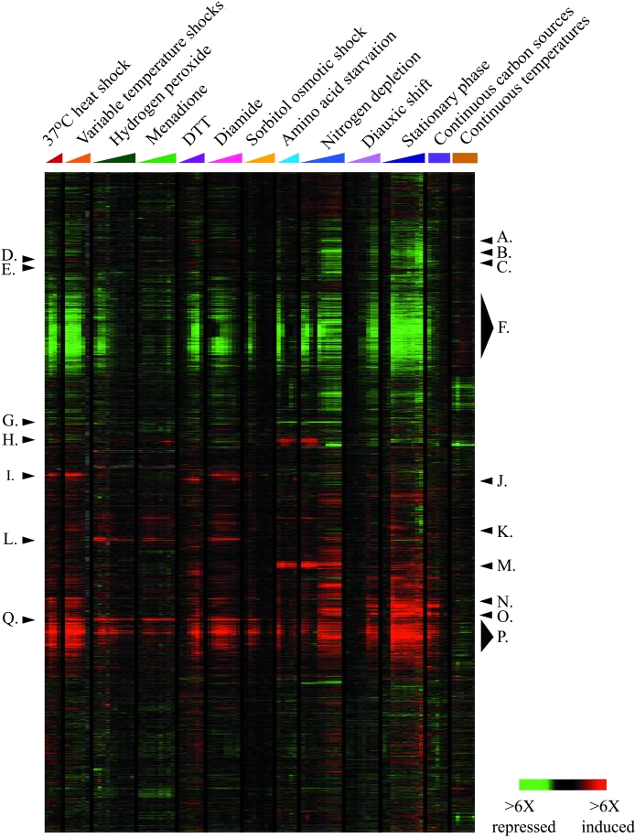
A Common Type of Question
What causes this set of yeast genes to be up-regulated in stress conditions?
Genes
Experiments / Conditions
Figure from Gasch et al., Mol. Biol. Cell, 2000

Slide 5
cis-Regulatory Modules (CRMs)
Co-expressed genes are often controlled by specific configurations of binding sites
RNAP
…accgcgctgaaaaaattttccgatgagtttagaagagtcaccaaaaaattttcatacagcctactggtgttctctgtgtgtgctaccactggctgtcatcatggttgta…
…caaaattattcaagaaaaaaagaaatgttacaatgaatgcaaaagatgggcgatgagataaaagcgagagataaaaatttttgagcttaaatgatctggcatgagcagt…
…gagctggaaaaaaaaaaaatttcaaaagaaaacgcgatgagcatactaatgctaaaaatttttgaggtataaagtaacgaattggggaaaggccatcaatatgaagtcg…
RNAP
RNAP

Slide 6


Information Theory Background
Problem
  Create a code to communicate information
Example
  Need to communicate the manufacturer of each bike

Slide 7
Information Theory Background
Four types of bikes
Possible code
Type
code
Trek
11
Specialized
10
Cervelo
01
Serotta
00
Expected number of bits we have to communicate: 2 bits/bike

Slide 8
Information Theory Background
Can we do better?
Yes, if the bike types aren’t equiprobable
Optimal code uses bits for event with probability
Type, probability
# bits
code
1
1
2
01
3
001
3
000

Slide 9
Information Theory Background
Type, probability
# bits
code
1
1
2
01
3
001
3
000
Expected number of bits we have to communicate: 1.75 bits/bike

Slide 10
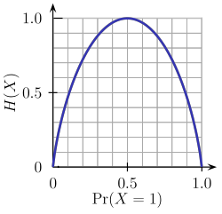
Entropy
Entropy is a measure of uncertainty associated with a random variable
Can be interpreted as the expected number of bits required to communicate the value of the variable
entropy function for
binary variable
Image from Wikipedia

Slide 11
How is entropy related to
DNA sequences?

Slide 12
Sequence Logos
Typically represent a binding site
Height of each character c is proportional to P(c)

Slide 13
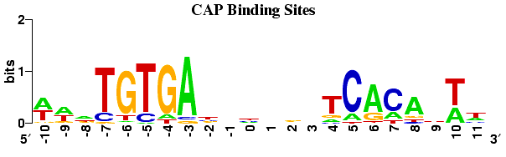
Sequence Logos
Height of logo at a given position determined by decrease in entropy (from maximum possible)
# of characters in alphabet
decrease in entropy

Slide 14
Mutual Information
Mutual information quantifies how much knowing the value of one variable tells about the value of another
entropy of M
conditioned on C
entropy of M

Slide 15
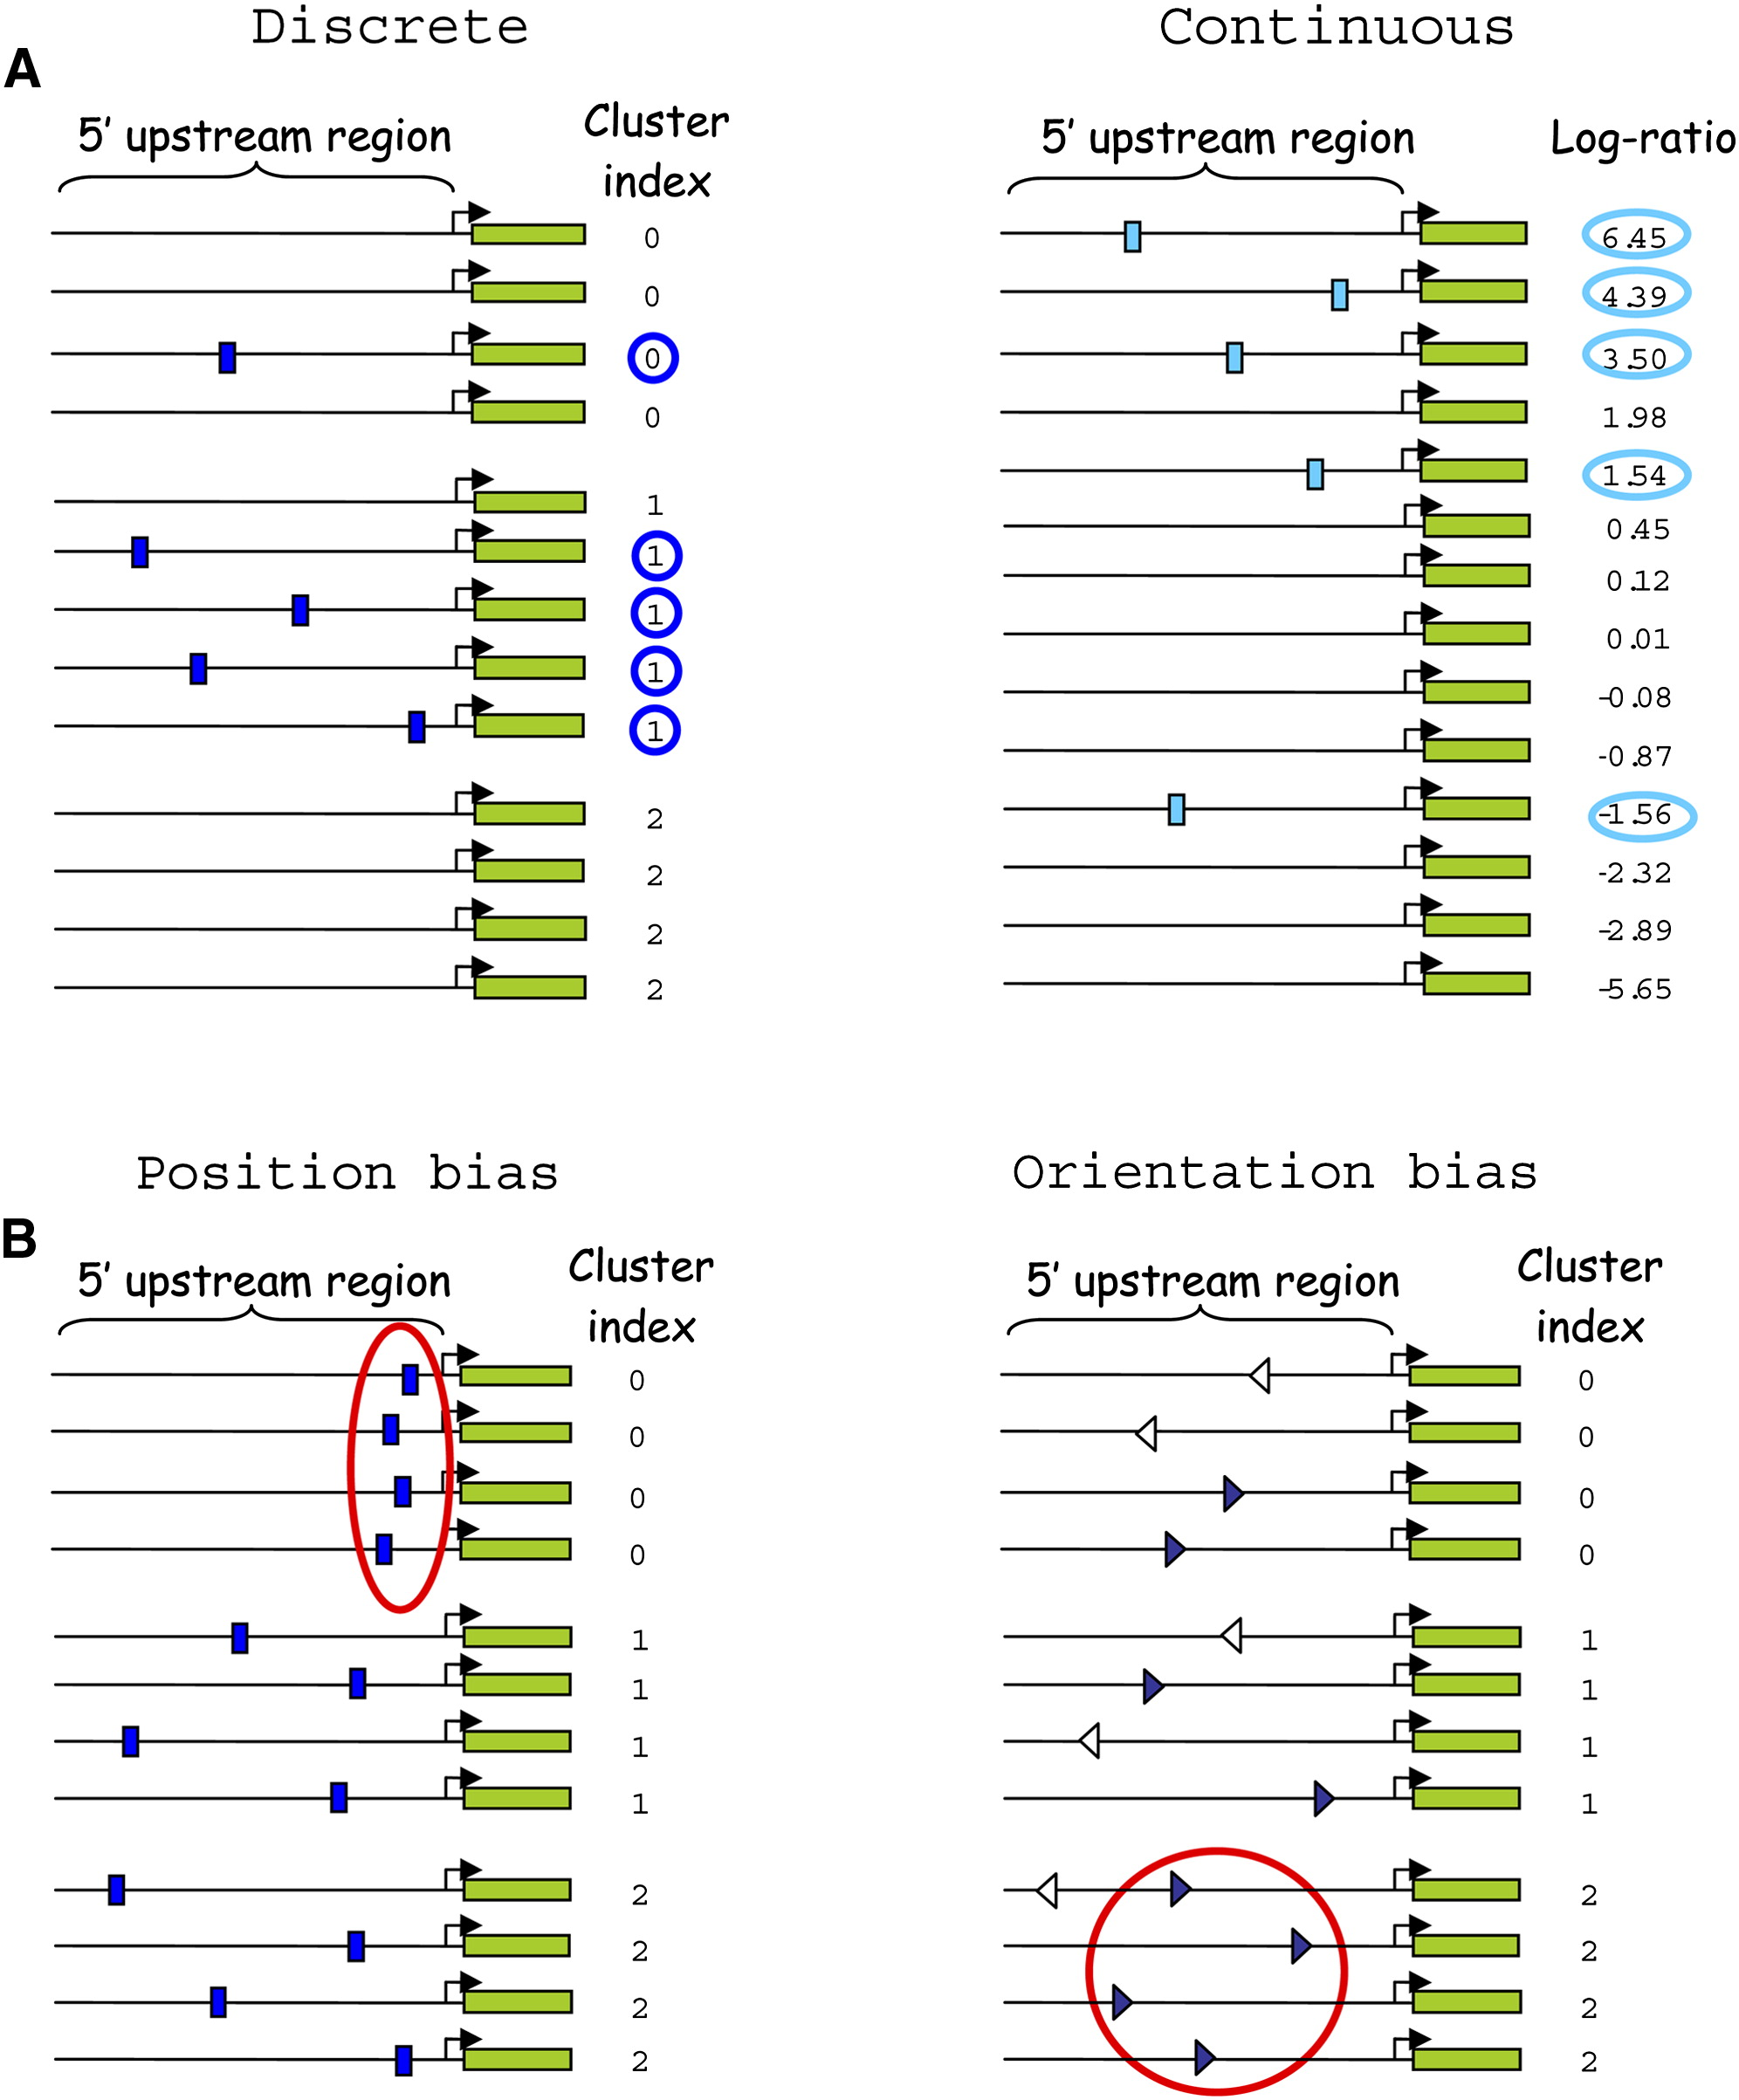
FIRE
Elemento et al., Molecular Cell 2007
Finding Informative Regulatory Elements (FIRE)
Given a set of sequences grouped into clusters
Find motifs, and relationships, that have high mutual information with the clusters
Applicable when sequences have continuous values instead of cluster labels

Slide 16
Mutual Information in FIRE
We can compute the mutual information between a motif and the clusters as follows
m=0, 1 represent absence/presence of motif
c ranges over the cluster labels

Slide 17
Finding Motifs in FIRE
Motifs are represented by regular expressions; initially each motif is represented by a strict k-mer (e.g. TCCGTAC)
Test all k-mers (k=7 by default) to see which have significant mutual information with the cluster label
Filter k-mers using a significance test to obtain motif seeds
Generalize each motif seed
Filter motifs using a significance test

Slide 18
Key Step in Generalizing a Motif in FIRE
Randomly pick a position in the motif
Generalize in all ways consistent with current value at position
Score each by computing mutual information
Retain the best generalization
A or G in this position
TCCGTAC
TCC[AG]TAC
TCC[GT]TAC
TCC[CG]TAC
TCC[ACG]TAC
TCC[CGT]TAC
TCC[AGT]TAC
TCC[ACGT]TAC

Slide 19
Generalizing a Motif in FIRE
given: k-mer, n
best ← null
repeat n times
motif ← k-mer
repeat
motif ← GeneralizePosition(motif) // shown on previous slide
until convergence (no improvement at any position)
if score(motif) > score(best)
best ← motif
return: best

Slide 20
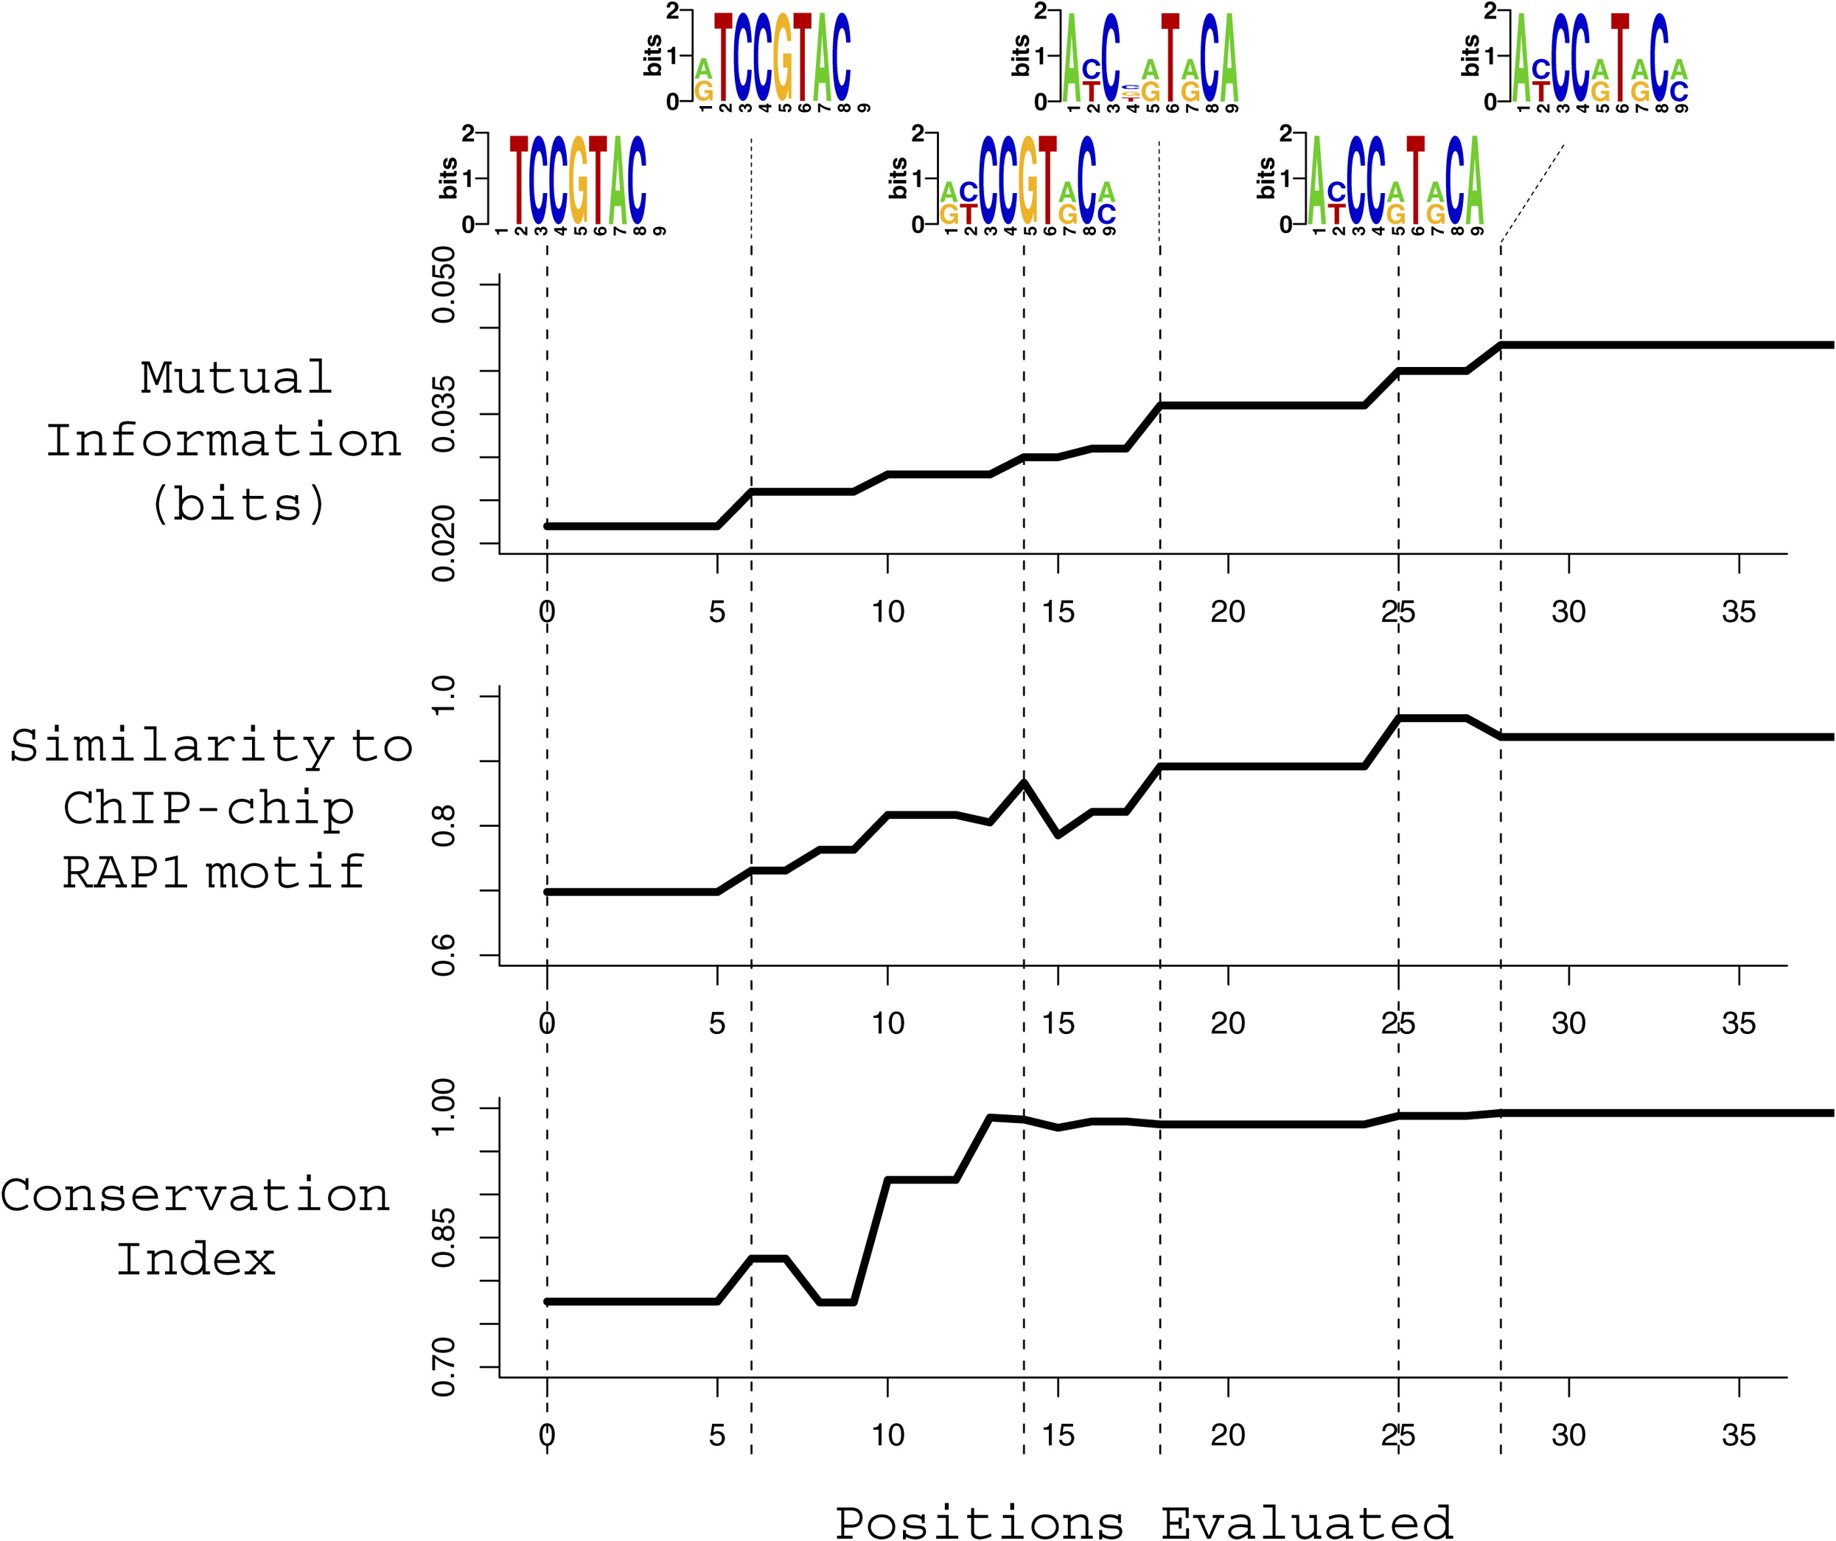
Generalizing a Motif in FIRE: Example
Figure from Elemento et al. Molecular Cell 2007

Slide 21
Avoiding Redundant Motifs
Different seeds could converge to similar motifs
Use mutual information to test whether new motif is unique and contributes new information
TCCGTAC
TCCCTAC
TCC[CG]TAC
TCC[CG]TAC
previous motif
new candidate motif
expression clusters

Slide 22
Characterizing Predicted Motifs in FIRE
Mutual information is also used to assess various properties of found motifs
  orientation bias
  position bias
  interaction with another motif

Slide 23
Using MI to Determine Orientation Bias
C indicates cluster
S=1 indicates motif present on transcribed strand
S=0 otherwise (not present or not on transcribed strand)
C S
0
0
1
1
Also compute MI where S=1 indicates motif present on complementary strand
0
1
0
1
1
1
1
1

Slide 24
Using MI to Determine Position Bias
P ranges over position bins
O=0, 1 indicates whether or not the motif is over-represented in a sequence’s cluster
P O
0
1
0
1
0
1
0
1
1
0
Only sequences containing the motif are considered for this calculation
0
0
2
0
0
0
2
0
0
0
1
0
0
0
P
2
1
0

Slide 25
Using MI to Determine Motif Interactions
M₁=0, 1 indicates whether or not a sequence has the motif and is in a cluster for which the motif is over-represented; similarly for M₂
M₁ M₂
0
0
0
0
0
0
0
0
0
1
1
0
1
1
1
1
1
1
0
1
0
0
0
1
0
0

Slide 26
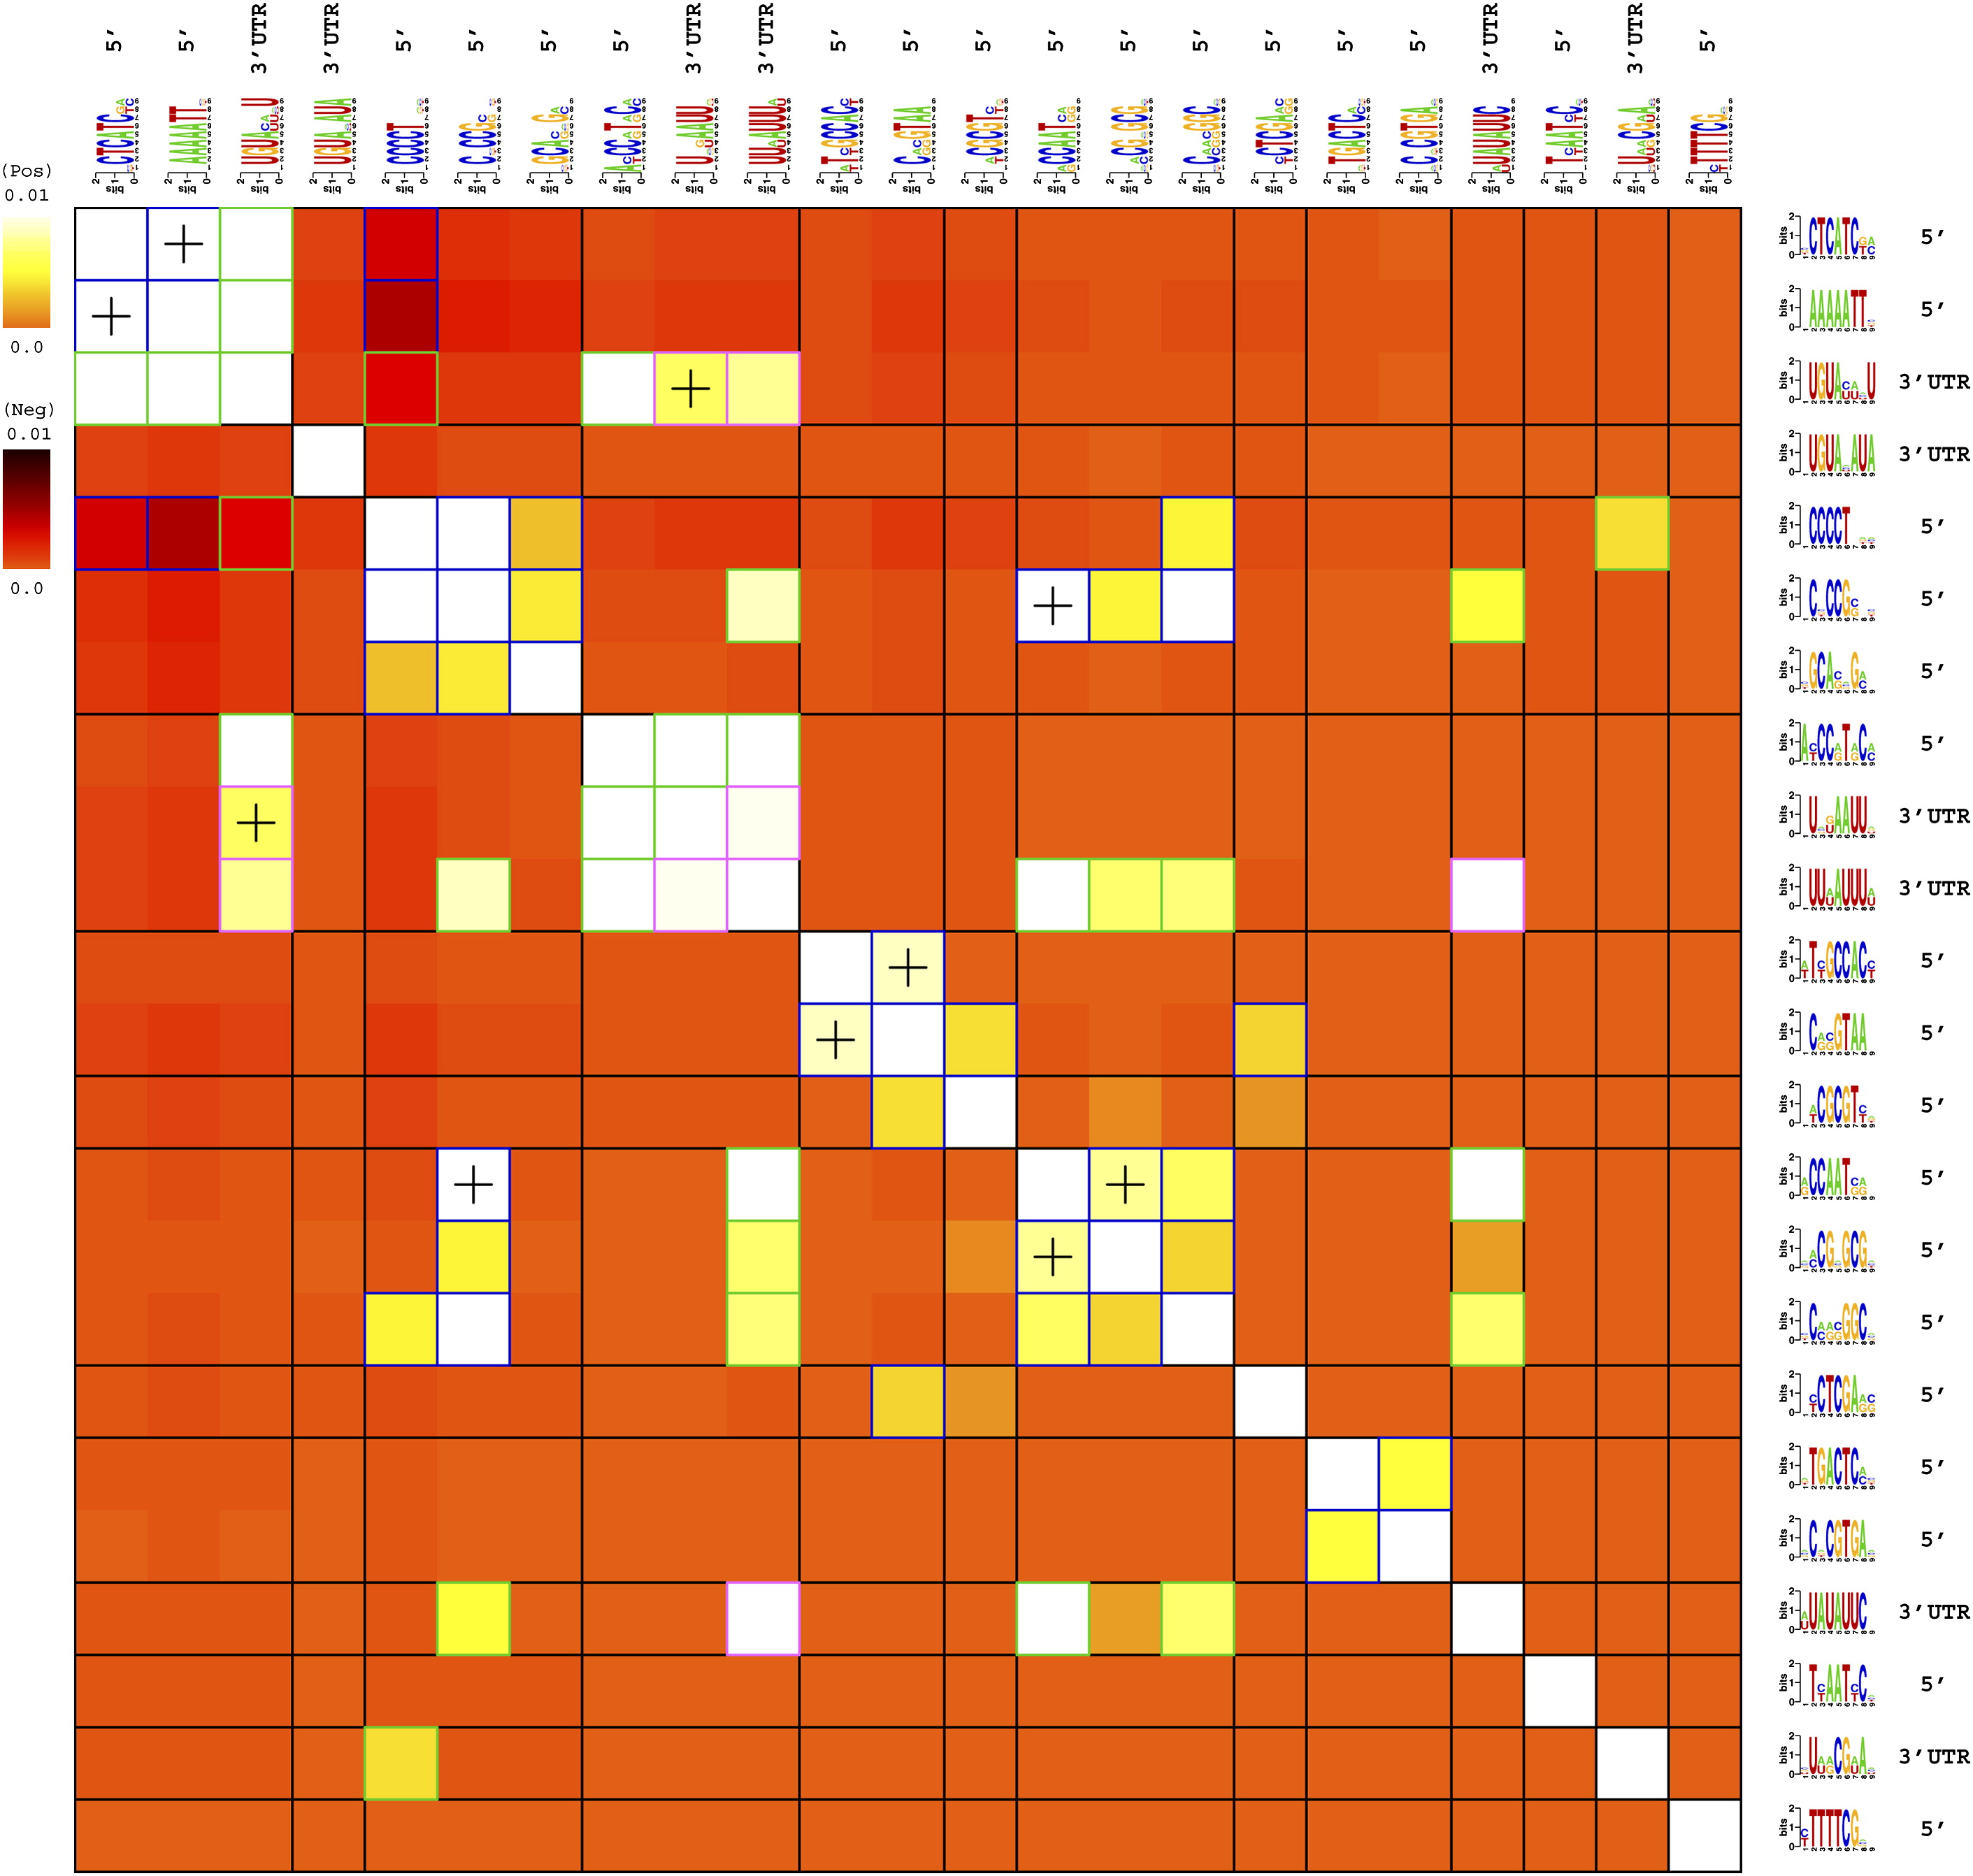
Using MI to Determine Motif Interactions
Yeast motif-motif interactions
White: positive association
Dark red: negative association
Blue box: DNA-DNA
Green box: DNA-RNA
Plus: spatial co-localization

Slide 27
Discussion of FIRE
FIRE
  mutual information used to identify motifs and relationships among them
  motif search is based on generalizing informative k-mers
Consider advantages and disadvantages of k-mers versus PWMs
In contrast to many motif-finding approaches, FIRE takes advantage of negative sequences
FIRE returns all informative motifs found

Slide 28
Mutual Information for Gene Networks
Mutual information and conditional mutual information can also be useful for reconstructing biological networks
Build gene-gene network where edges indicate high MI in genes’ expression levels
Algorithm for the Reconstruction of Accurate Cellular Networks (ARACNE)

Slide 29
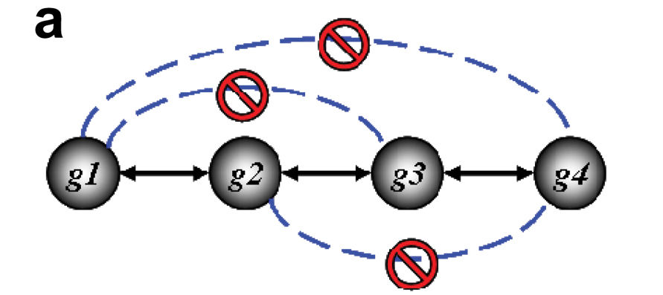
ARACNE
Gaussian kernel estimator to estimate mutual information
  No binning or histograms
Data processing inequality
  Prune indirect edges
Margolin et al. BMC Bioinformatics 2006

