Slide 1
Mass spectrometry-based proteomics
BMI/CS 776
www.biostat.wisc.edu/bmi776/
Spring 2018
Anthony Gitter
gitter@biostat.wisc.edu
These slides, excluding third-party material, are licensed under CC BY-NC 4.0 by Anthony Gitter, Mark Craven, and Colin Dewey

Slide 2
Goals for lecture
Key concepts
Benefits of mass spectrometry
Generating mass spectrometry data
Computational tasks
Matching spectra and peptides

Slide 3
Mass spectrometry uses
Mass spectrometry is like the protein analog of RNA-seq
  Quantify abundance or state of all (many) proteins
  No need to specify proteins to measure in advance
Other applications in biology
  Targeted proteomics
  Metabolomics
  Lipidomics

Slide 4
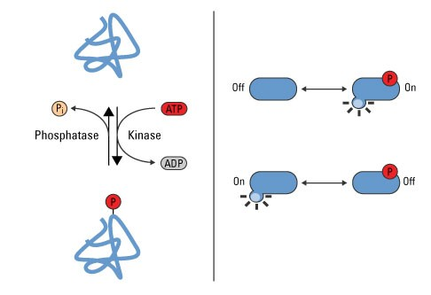
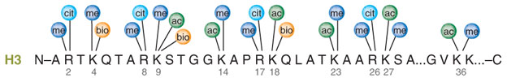
Advantages of proteomics
Proteins are functional units in a cell
  Protein abundance directly relevant to activity
Post-translational modifications
  Change protein state
Phosphorylation in signaling
Thermo Fisher Scientific
Histone modifications
Latham Nature Structural & Molecular Biology 2007; Katie Ris-Vicari

Slide 5
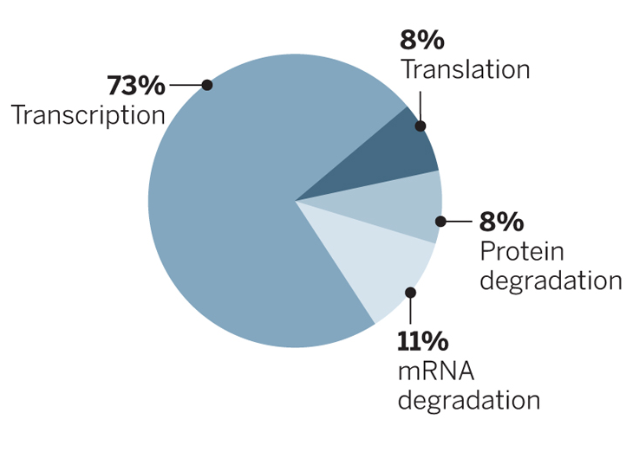
Estimating protein levels from gene expression
Correlation between gene expression and protein abundance has been debated
Gene expression tells us nothing about post-translational modifications
Contribution to protein levels
Li and Biggin Science 2015

Slide 6
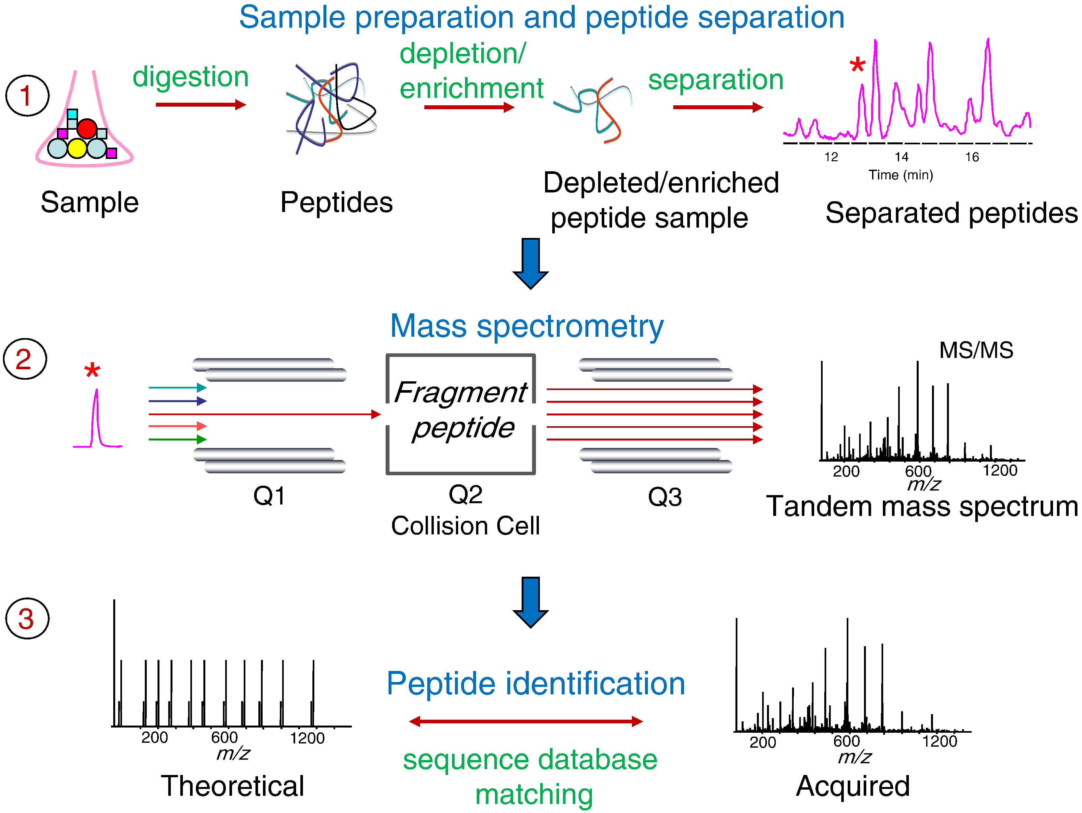
Mass spectrometry workflow
Total ion chromato-gram
Filter based on MS¹
MS²
Nesvizhskii Journal of Proteomics 2010

Slide 7
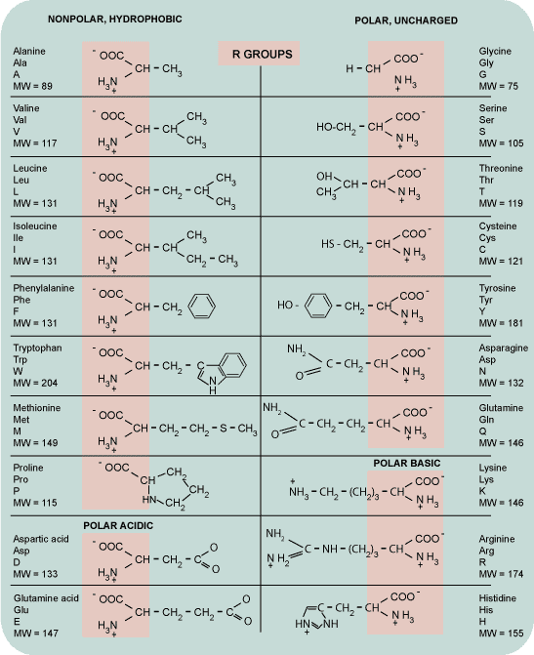
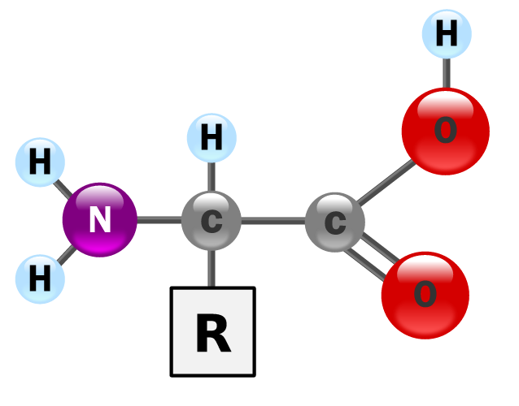
Amino Acids
20 amino acids
Building blocks of proteins
Known molecular weight
Common template
Amino-terminal
Carboxy-terminal
Wikipedia, Yassine Mrabet

Slide 8
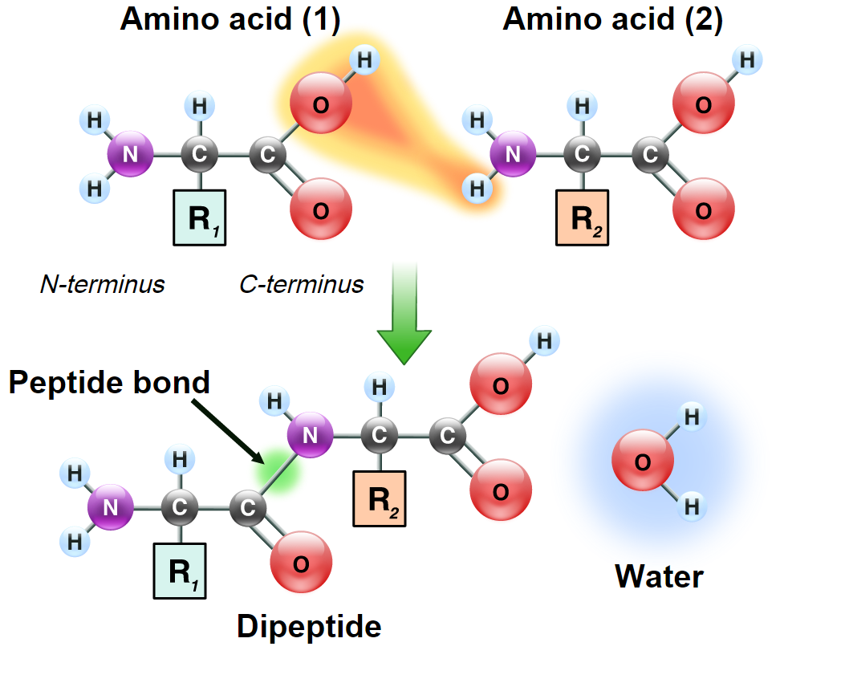
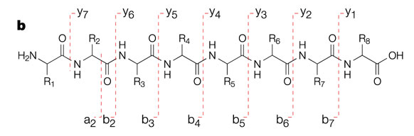
Peptide fragmentation
Peptide bond
Select similar peptides from MS¹
Fragment with high energy collisions
Break peptide bonds
Wikipedia, Yassine Mrabet
Charge on amino-terminal (b) or carboxy-terminal fragment (y)
Subscript = # R groups retained
Steen and Mann Nat Rev Mol Cell Biol 2004

Slide 9
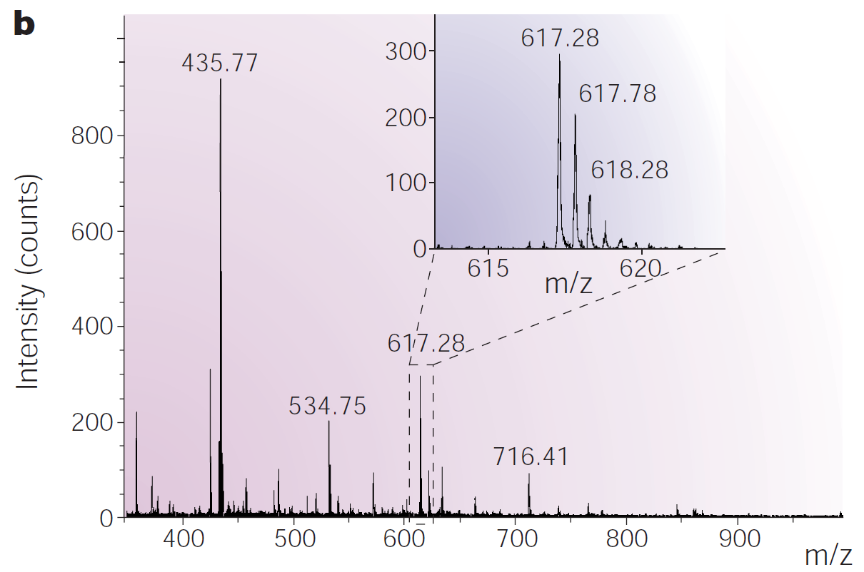
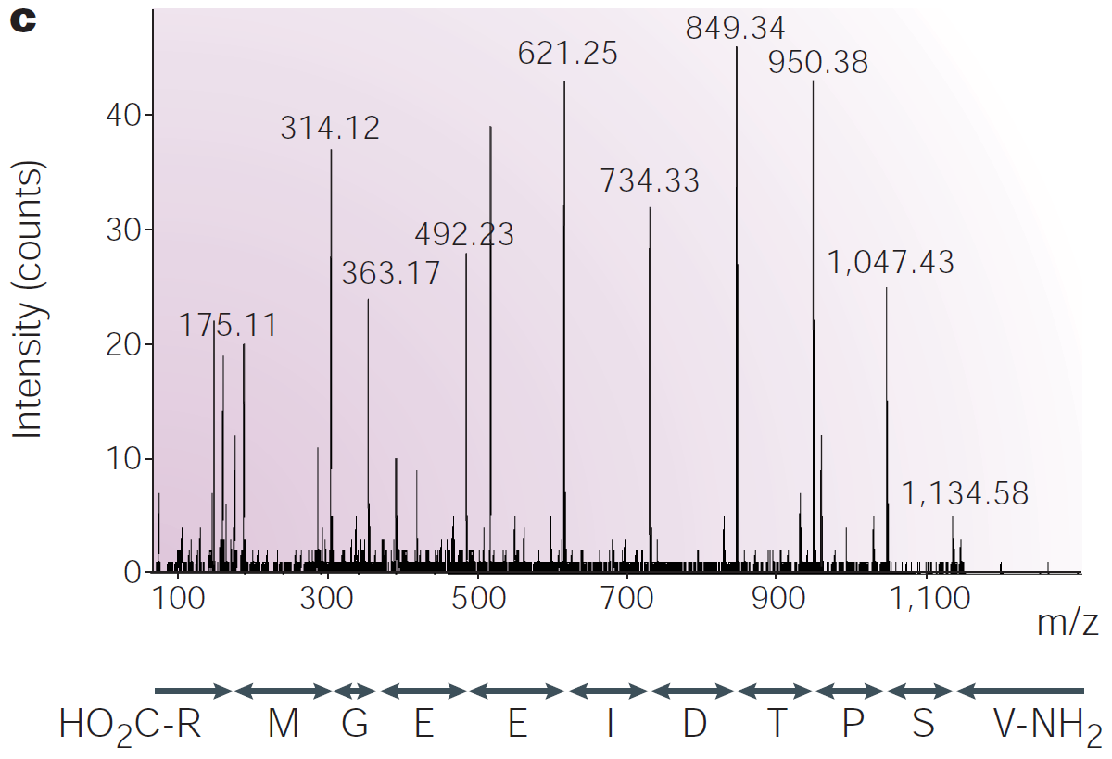
Mass spectra
MS¹
Fragment and analyze one precursor ion
MS²
Steen and Mann Nat Rev Mol Cell Biol 2004
Mass-to-charge ratio
Spectrum contains information about amino acid sequence, fragment at different bonds

Slide 10
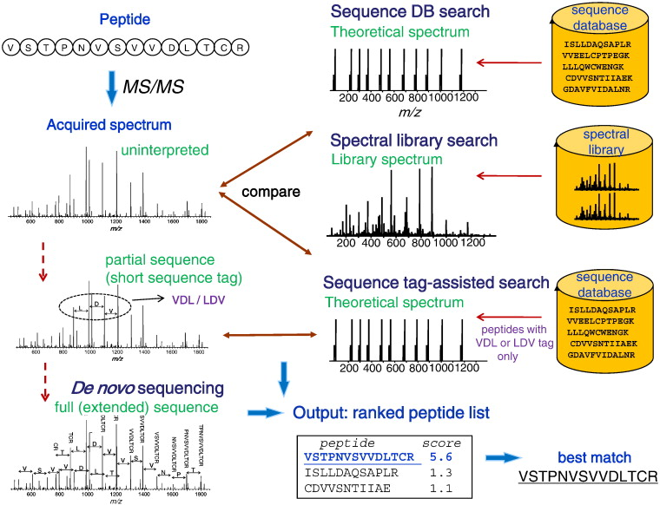
From spectra to peptides
Nesvizhskii Journal of Proteomics 2010

Slide 11
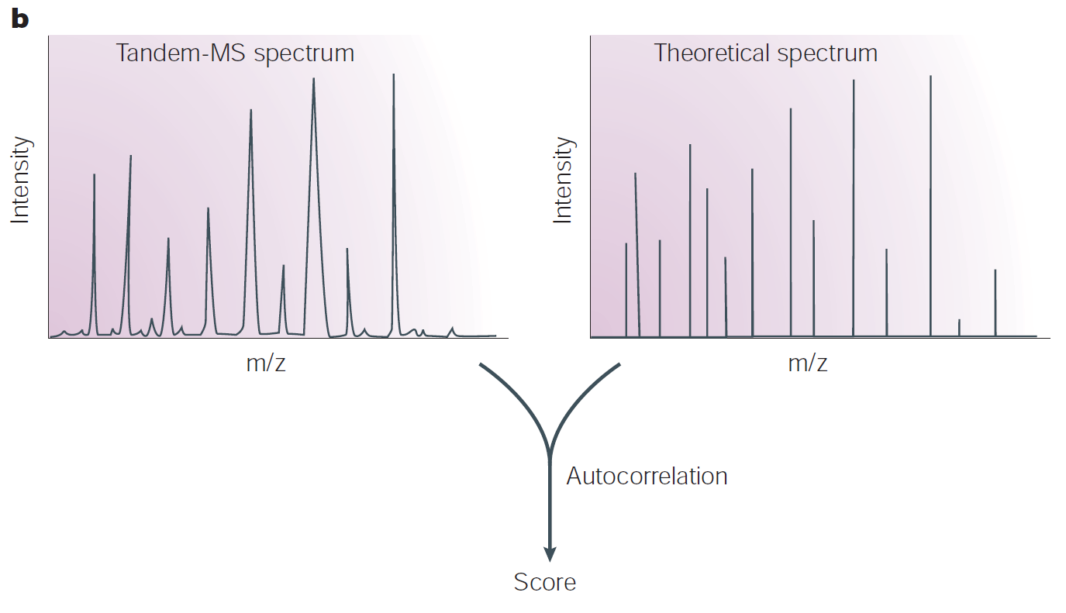
Sequence database search
Need to define a scoring function
Identify peptide-spectrum match (PSM)
Steen and Mann Nat Rev Mol Cell Biol 2004

Slide 12
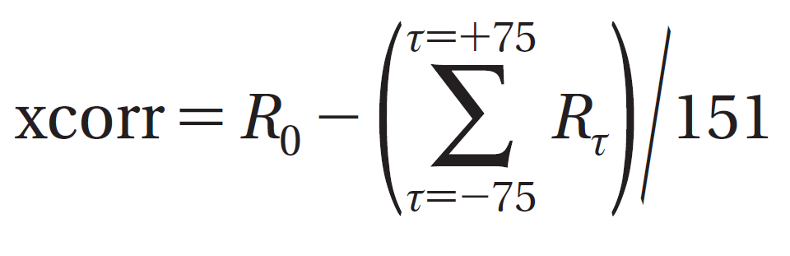
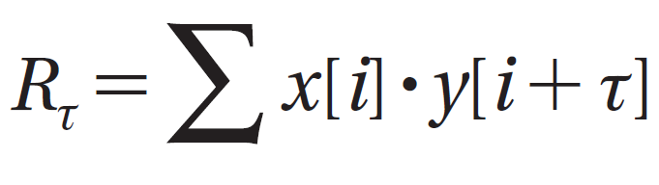
SEQUEST
Cross correlation (xcorr)
Similarity between theoretical spectrum (x) and acquired spectrum (y)
Correction for mean similarity at different offsets
Offsets
Actual similarity
Theoretical
Acquired
Eng, McCormack, Yates J Am Soc Mass Spectrom 1994

Slide 13
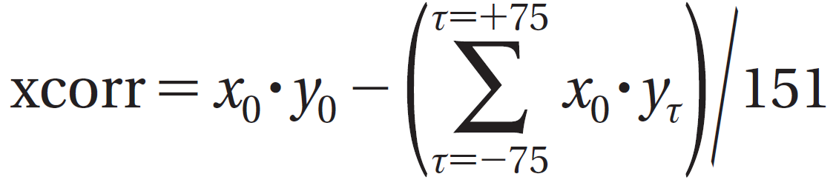
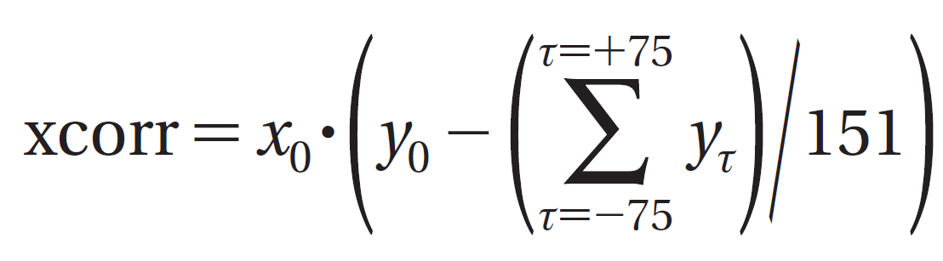
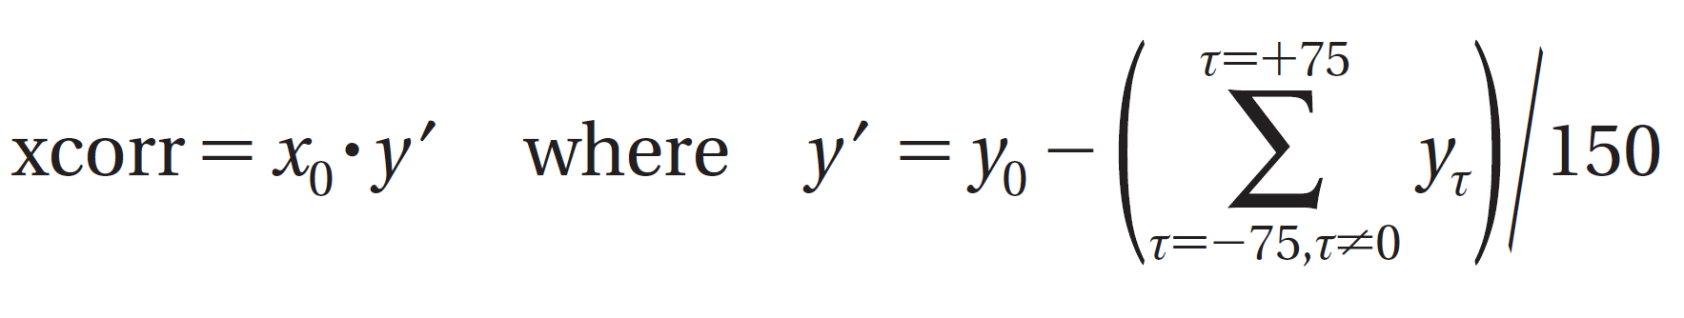
Fast SEQUEST
SEQUEST originally only applied to top 500 peptides based on coarse filtering score
Skip the 0 offset
Eng et al J Proteome Res 2008

Slide 14
PSM significance
E-value: expected number of null peptides with score ≥ observed score
Compute FDR from E-value distribution
Add decoy peptides to database
  Reversed peptide sequences
  Used to estimate false discoveries

Slide 15
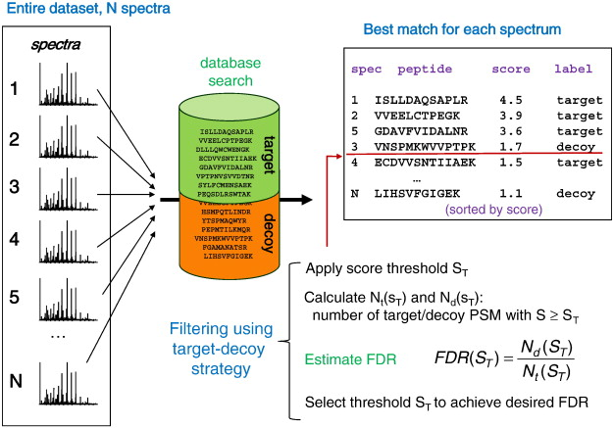
Target-decoy strategy
Nesvizhskii Journal of Proteomics 2010
target PSMs above score threshold = N_{t} (S_{T})
decoy PSMs above score threshold = N_{d} (S_{T})

Slide 16
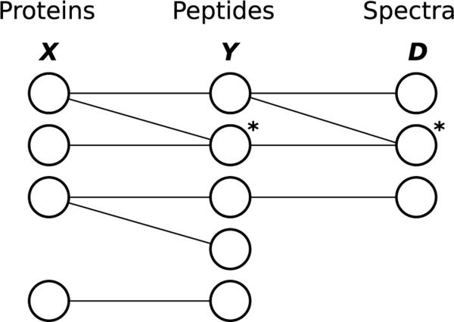
Identifying proteins
Even after identifying PSM, still need to identify protein of origin
Serang and Noble Stat Interface 2012

Slide 17
Mass spectrometry versus RNA-seq
RNA-seq
  Transcript → RNA fragment → paired-end read
Mass spectrometry
  Protein → peptides → ions → spectrum
Mapping spectra to proteins more ambiguous than mapping reads to transcripts
Spectra state space is enormous

Slide 18
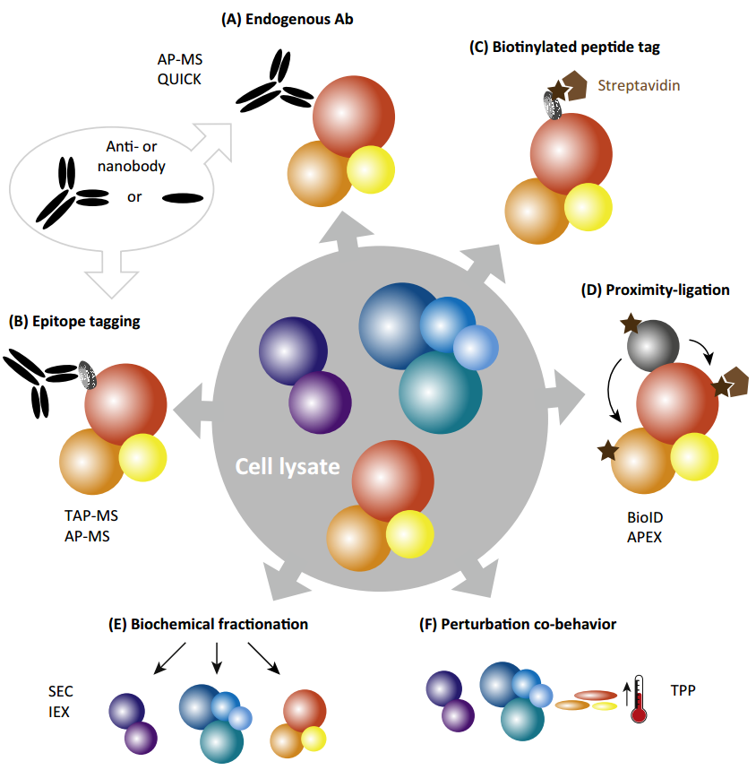
Protein-protein interactions
Affinity-purification mass spectrometry
Purify protein of interest, identify complex members
Smits and Vermeulen Trends in Biotechnology 2016

Slide 19
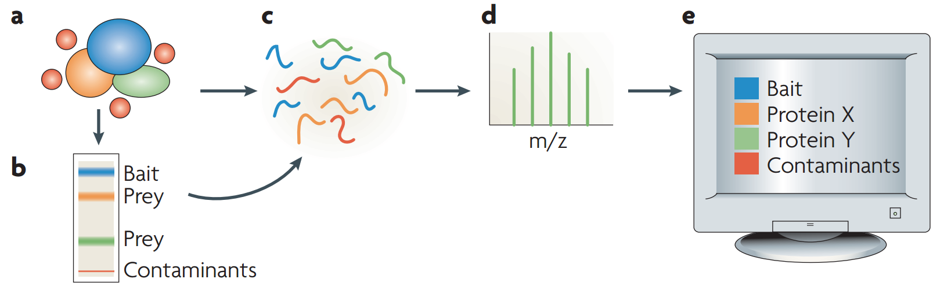
Protein-protein interactions
Mass spectrometry identifies proteins in the complex
Must control for contaminants
MS²
Gingras et al Nature Reviews Molecular Cell Biology 2007

Slide 20
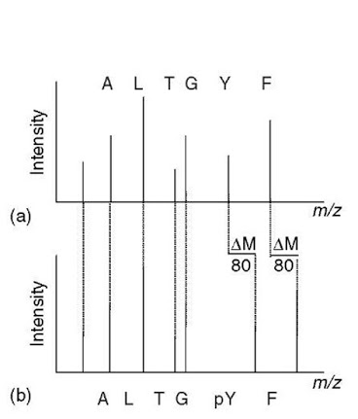
Post-translational modifications (PTMs)
Shift the peptide mass by a known quantity
what-when-how

Slide 21
Phosphoproteomics example
Gene | Modified Site | Peptide | Phosphorylation (Treatment / Control)
AGRN | S671 | AGPC[160.03]EQAEC[160.03]GS[167.00]GGSGSGEDGDC[160.03]EQELC[160.03]R | 4.54
ADAMTS10 | S74 | RGTGATAES[167.00]R | 0.30
CABYR | T16 | T[181.01]LLEGISR | 0.37
TTC7B | T152 | VIEQDET[181.01]R | 5.97
STAT3 | Y705 | K.n[305.21]YC[160.03]RPESQEHPEADPGSAAPY[243.03]LK[432.30].T | 4.50
Sychev et al PLoS Pathogens 2017

Slide 22
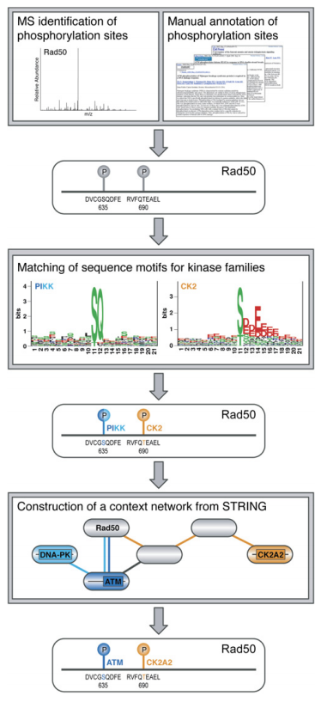
Phosphoproteomics interpretation
Predict kinases/phosphatases for phospho sites
Linding et al Cell 2007

Slide 23
Mass spectrometry replicates
Doesn’t identify all proteins in the sample
  Data dependent acquisition has low overlap across replicates
  Partly due to biological variation
  New protocols to overcome this
Phosphorylation PTMs are especially variable
  Grimsrud et al Cell Metabolism 2012
    5 biological replicates
    9,558 phosphoproteins identified
    5.6% in all replicates

Slide 24
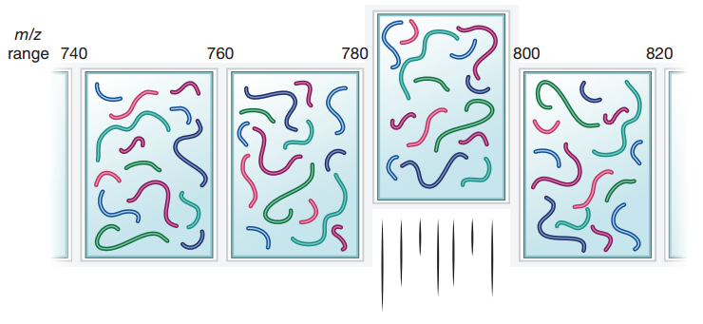
Data independent acquisition
Not dependent on most abundance signals in MS¹
Sliding m/z window
Doerr Nature Methods 2015

Slide 25
Mass spectrometry summary
Incredibly powerful for looking at biological processes beyond gene expression
  Protein abundance
  Post-translational modifications
  Metabolites
  Protein-protein interactions
Typically reports relative abundance
Labeling strategies for comparative analysis
  Compare relative abundance in multiple conditions
Missing data was a big problem, but improving
Fully probabilistic analysis pipelines are not the most popular tools
  Arguably greater diversity in software than RNA-seq

