Slide 1
Introduction to Epigenetics
BMI/CS 776
www.biostat.wisc.edu/bmi776/
Spring 2019
Colin Dewey
colin.dewey@wisc.edu
These slides, excluding third-party material, are licensed under CC BY-NC 4.0 by Anthony Gitter, Mark Craven, and Colin Dewey

Slide 2
Goals for lecture
Key concepts
Importance of epigenetic data for understanding transcriptional regulation
Use of epigenetic data for predicting transcription factor binding sites

Slide 3
Defining epigenetics
Formally: attributes that are “in addition to” genetic sequence or sequence modifications
Informally: experiments that reveal the context of DNA sequence
  DNA has multiple states and modifications
G A C T A G T G C G T T A C T
vs.
modification
inaccessible
A
G T G C G T T A C T
T
C
Histones
A
G

Slide 4
Importance of epigenetics
Better understand
DNA binding and transcriptional regulation
Differences between cell and tissue types
Development and other important processes
Non-coding genetic variants (next lecture)

Slide 5
PWMs are not enough
Genome-wide motif scanning is imprecise
Transcription factors (TFs) bind < 5% of their motif matches
Same motif matches in all cells and conditions

Slide 6
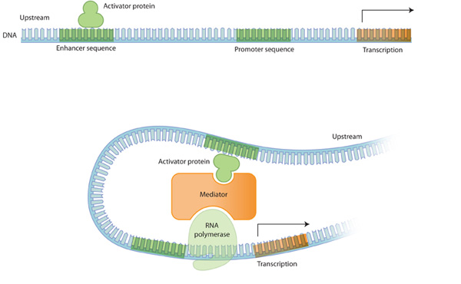
PWMs are not enough
DNA looping can bring distant binding sites close to transcription start sites
Which genes does an enhancer regulate?
Promoter: DNA binding site for TFs, close to gene
transcription start site
Enhancer: DNA binding site for TFs, can be far from affected gene
Nature Education 2010

Slide 7
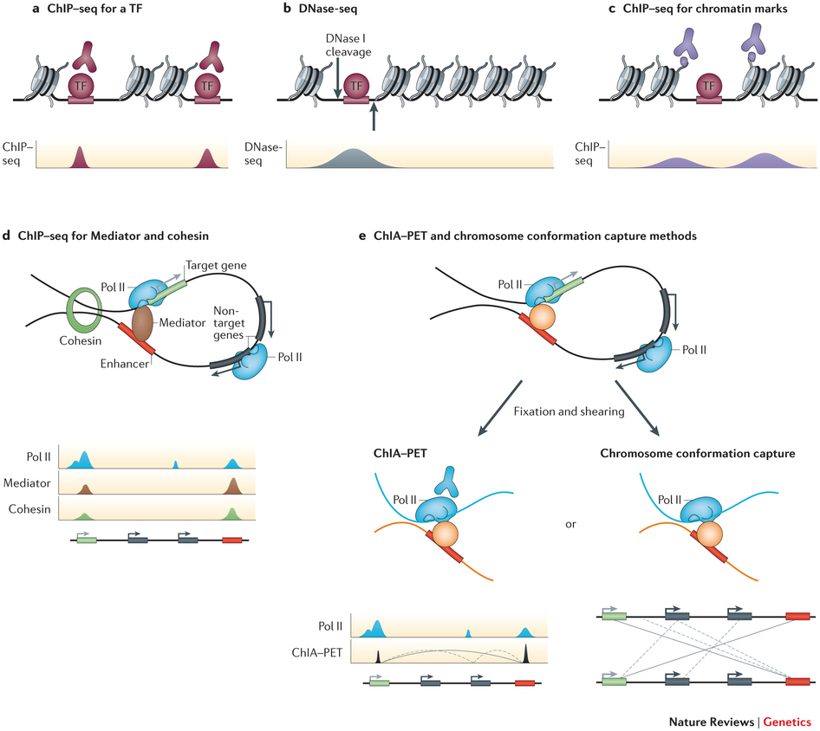
Mapping regulatory elements genome-wide
Can do much better than motif scanning with additional data
ChIP-seq measures binding sites for one TF at a time
Shlyueva Nature Reviews Genetics 2014
Epigenetic data suggests where some TF binds

Slide 8
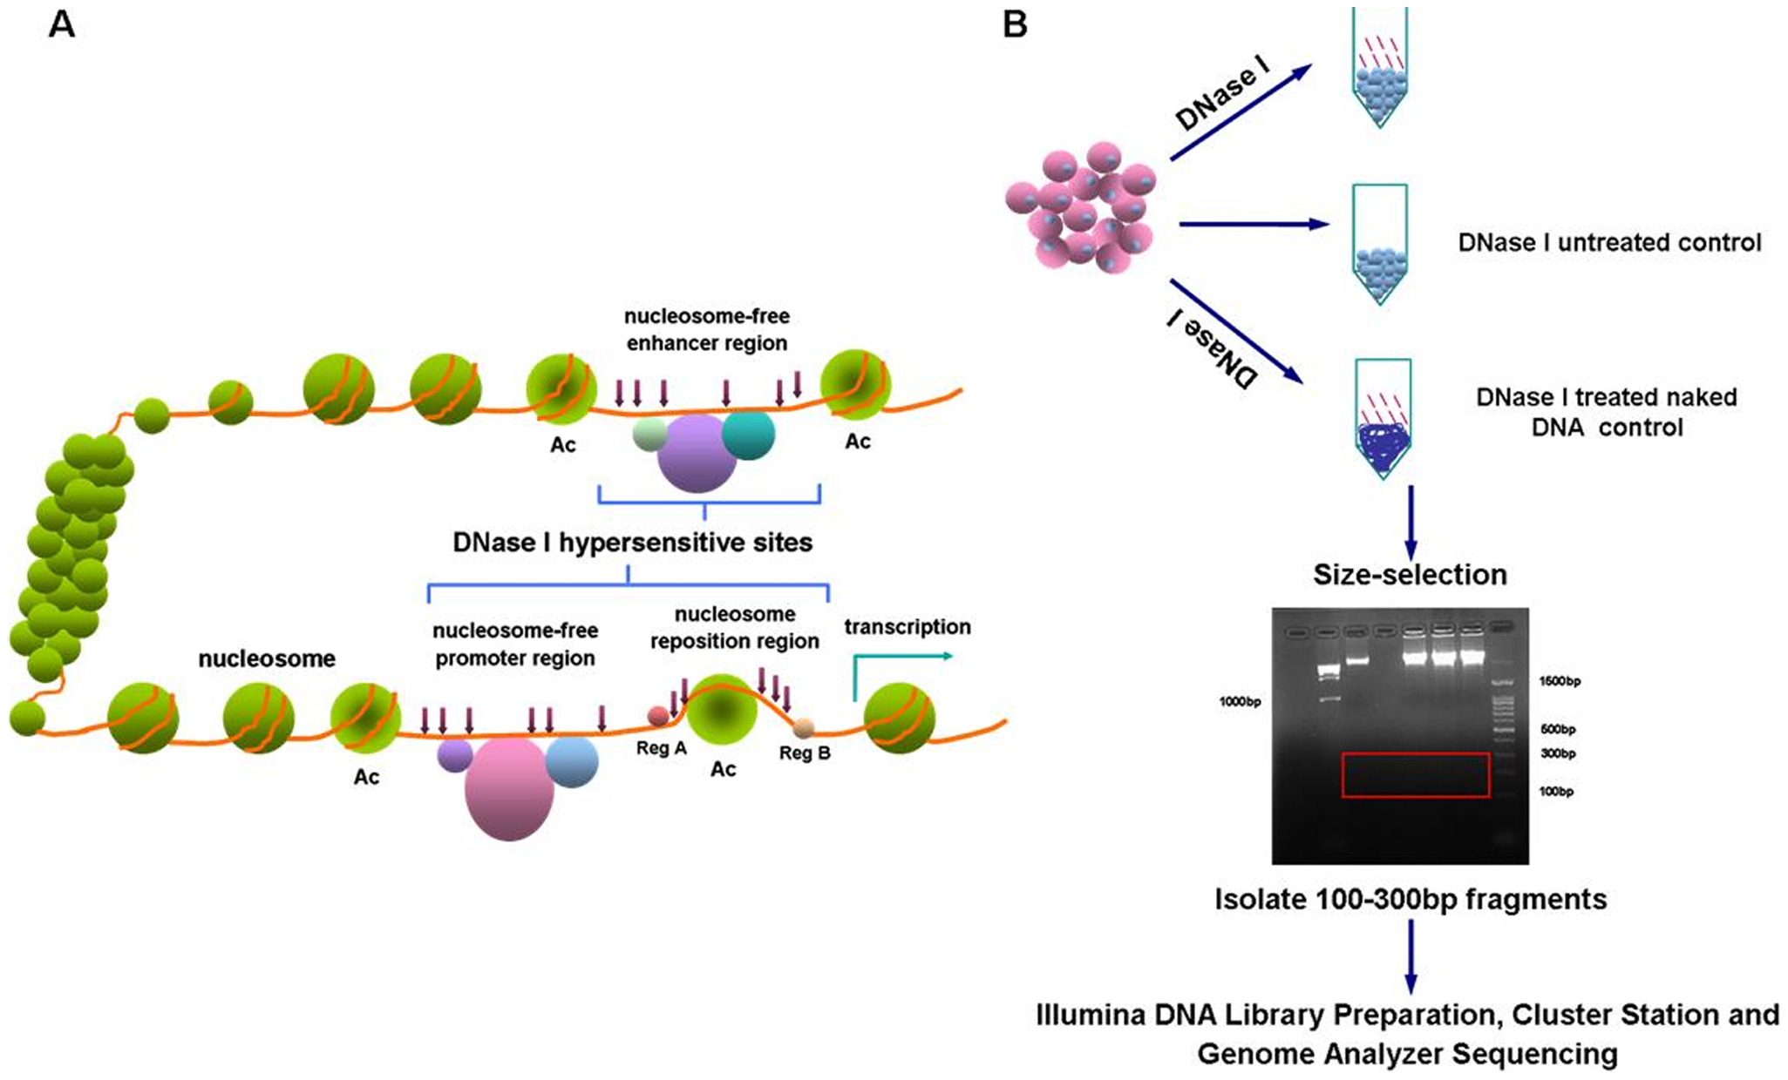
DNase I hypersensitivity
Regulatory proteins bind accessible DNA
DNase I enzyme cuts open chromatin regions that are not protected by nucleosomes
Nucleosome: DNA wrapped around histone proteins
Wang PLoS ONE 2012

Slide 9
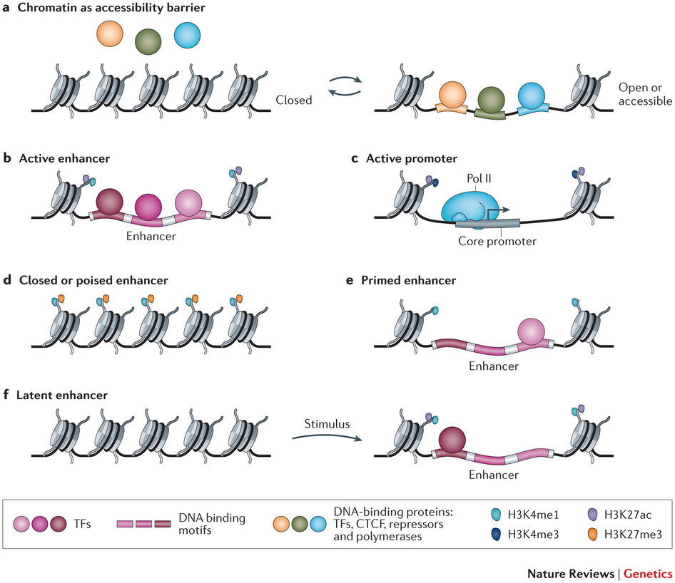
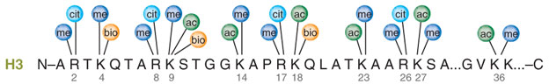
Histone modifications
Mark particular regulatory configurations
H3 (protein) K27 (amino acid) ac (modification)
Two copies of histone proteins H2A, H2B, H3, H4
Shlyueva Nature Reviews Genetics 2014
Latham Nature Structural & Molecular Biology 2007; Katie Ris-Vicari

Slide 10
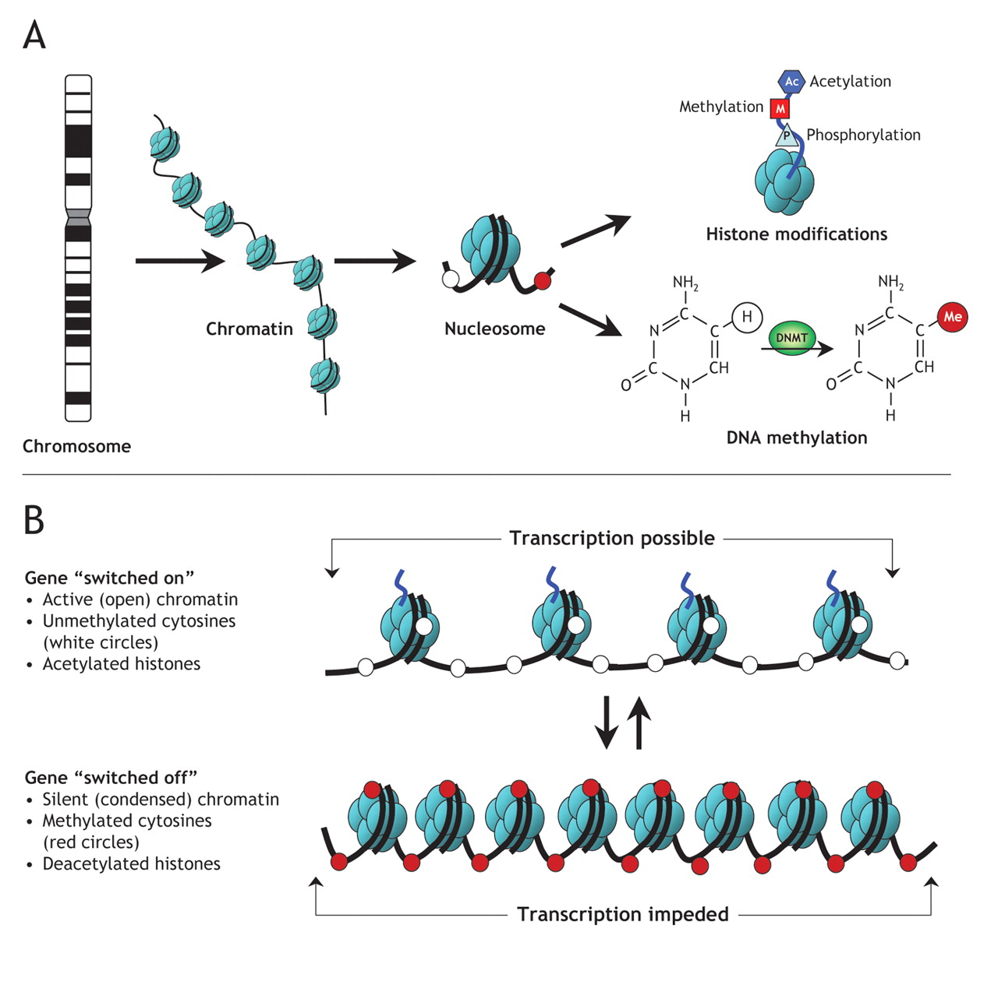
DNA methylation
Reversible DNA modification
Represses gene expression
OpenStax CNX

Slide 11
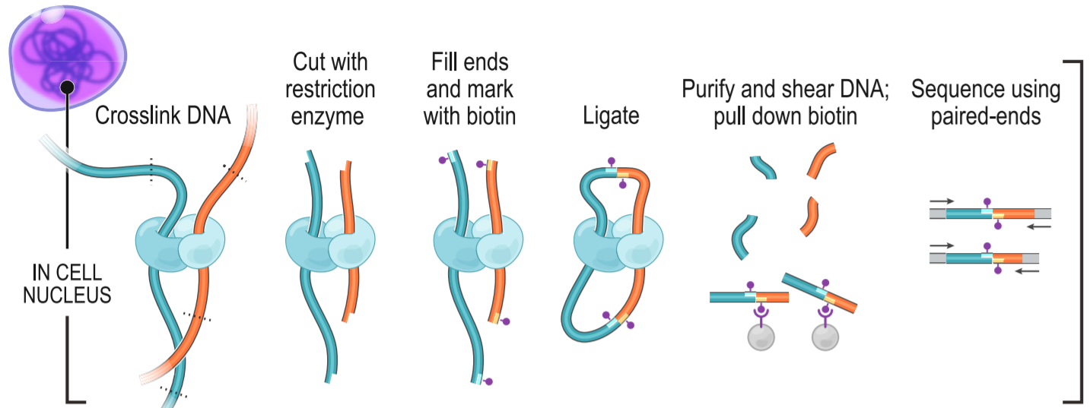
3d organization of chromatin
Algorithms to predict long range enhancer-promoter interactions
Or measure with chromosome conformation capture (3C, Hi-C, etc.)
Rao Cell 2014

Slide 12
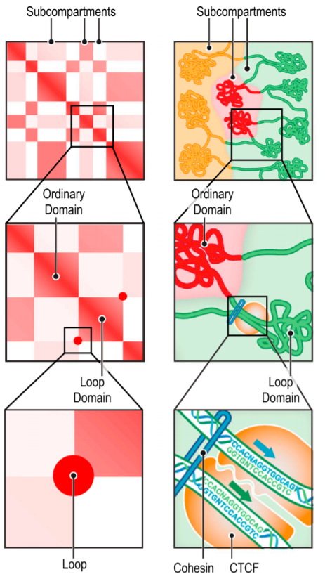
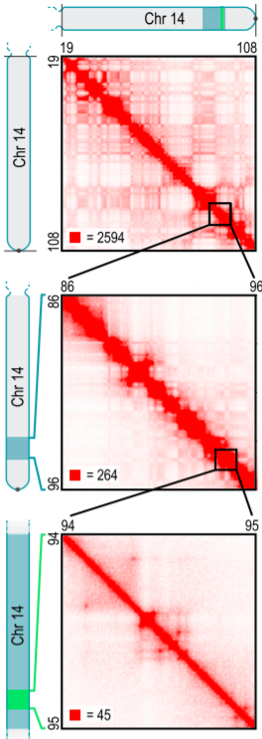
3d organization of chromatin
Hi-C produces 2d chromatin contact maps
Learn domains, enhancer-promoter interactions
500 kb
50 kb
5 kb
Rao Cell 2014

Slide 13
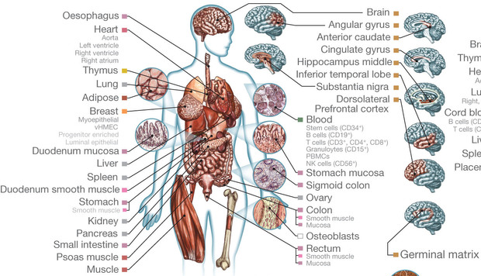
Large-scale epigenetic maps
Epigenomes are condition-specific
Roadmap Epigenomics Consortium and ENCODE surveyed over 100 types of cells and tissues
Roadmap Epigenomics Consortium Nature 2015

Slide 14
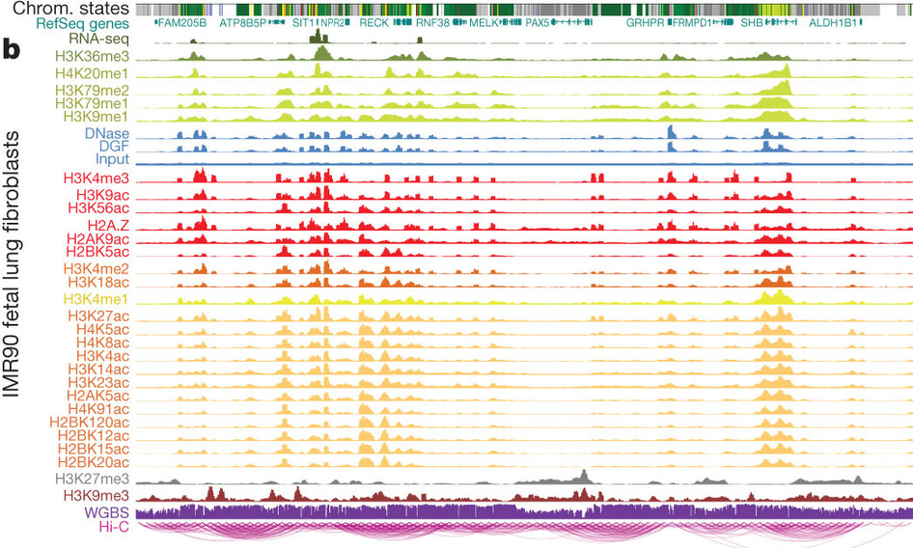
Genome annotation
Combinations of epigenetic signals can predict functional state
  ChromHMM: Hidden Markov model
  Segway: Dynamic Bayesian network
Roadmap Epigenomics Consortium Nature 2015

Slide 15
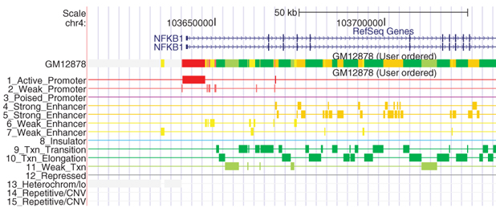
Genome annotation
States are more interpretable than raw data
Ernst and Kellis Nature Methods 2012

Slide 16
Predicting TF binding with DNase-Seq

Slide 17
DNase I hypersensitive sites
Arrows indicate DNase I cleavage sites
Obtain short reads that we map to the genome
Wang PLoS ONE 2012

Slide 18
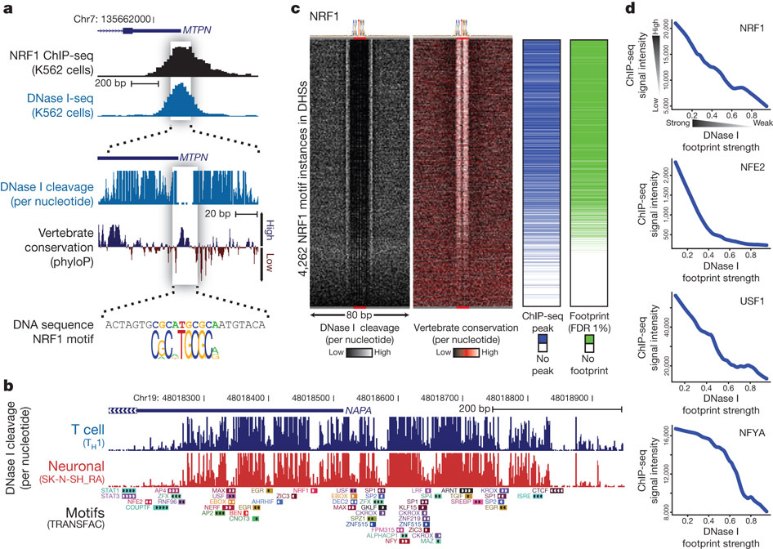
DNase I footprints
Distribution of mapped reads is informative of open chromatin and specific TF binding sites
ChIP-Seq peak
I
Read depth at each position
Nucleosome free “open” chromatin
Zoom in
TF binding prevents DNase cleavage leaving Dnase I “footprint”, only consider 5′ end
Neph Nature 2012

Slide 19
DNase I footprints to TF binding predictions
DNase footprints suggest that some TF binds that location
We want to know which TF binds that location
Two ideas:
  Search for DNase footprint patterns, then match TF motifs
  Search for motif matches in genome, then model proximal DNase-Seq reads
We’ll consider this approach

