Slide 1
Alignment of Long Sequences:
LAGAN
BMI/CS 776
www.biostat.wisc.edu/bmi776/
Spring 2019
Colin Dewey
colin.dewey@wisc.edu
These slides, excluding third-party material, are licensed under CC BY-NC 4.0 by Mark Craven, Colin Dewey, and Anthony Gitter

Slide 2
Goals for Lecture
Key concepts
using tries and threaded tries to find alignment seeds
using sparse dynamic programming (DP) to find a chain of local alignments
constrained dynamic programming to align between/around anchors

Slide 3
The LAGAN Method
Brudno et al., Genome Research, 2003
Given: genomes A and B
  anchors = find_anchors(A, B)
  step 3: finish global alignment with DP constrained by anchors
find_anchors(A, B)
step 1: find local alignments by matching, chaining k-mer seeds
step 2: anchors = highest-weight sequence of local alignments
for each pair of adjacent anchors a₁, a₂ in anchors
  if a₁, a₂ are more than d bases apart
  A’, B’ = sequences between a₁, a₂
  sub-anchors = find_anchors( A’, B’ )
  insert sub-anchors between a₁, a₂ in anchors
  return anchors

Slide 4
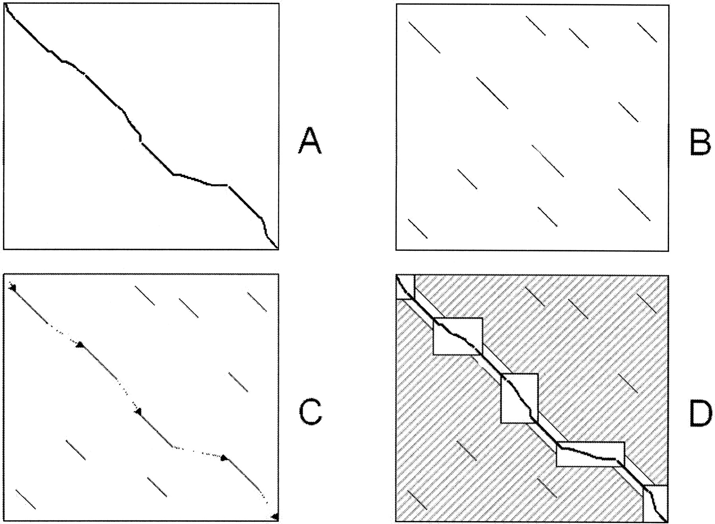
LAGAN: Three Main Steps
Brudno et al. Genome Research, 2003
General
Pattern matching to find seeds for global alignment
Find a good chain of anchors
Fill in with standard but constrained alignment
LAGAN
Threaded tries to obtain seeds
Sparse dynamic programming for chaining
Dynamic programming for gap filling

Slide 5
Step 1: Finding Seeds in LAGAN
Degenerate k-mers: matching k-long sequences with a small number of mismatches allowed
By default, LAGAN uses 10-mers and allows 1 mismatch
cacg cgcgctacat acct
acta cgcggtacat cgta

Slide 6
Finding Seeds in LAGAN
Example: a trie to represent all 3-mers of the sequence gaaccgacct
a
c
g
a
c
c
g
a
c
c
g
t
a
a
c
2
3, 7
4
8
5
1
6
One sequence is used to build the trie
The other sequence (the query) is “walked” through to find matching k-mers

Slide 7
Allowing Degenerate Matches
Suppose we’re allowing 1 base to mismatch in looking for matches to the 3-mer acc; need to explore green nodes
a
c
g
a
c
c
g
a
c
c
g
t
a
a
c
2
3, 7
4
8
5
1
6

Slide 8
LAGAN Uses Threaded Tries
In a threaded trie, each leaf for word w₁...w_{k} has a back pointer to the node for w₂...w_{k}
a
c
g
a
c
c
g
a
c
c
g
t
a
a
c
2
3, 7
4
8
5
1
6

Slide 9
Traversing a Threaded Trie
Consider traversing the trie to find 3-mer matches for the query sequence: accgt
a
c
g
a
c
c
g
a
c
c
g
t
a
a
c
2
3, 7
4
8
5
1
6
Usually requires following only two pointers to match against the next k-mer, instead of traversing tree from root for each

Slide 10
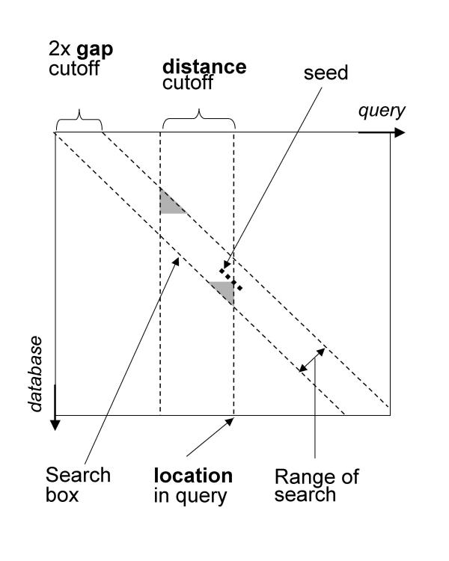
Step 1b: Chaining Seeds in LAGAN
can chain seeds s₁ and s₂ if
  the indices of s₁ > indices of s₂ (for both sequences)
  s₁ and s₂ are near each other
keep track of seeds in the “search box” as the query sequence is processed
Figure from: Brudno et al. BMC Bioinformatics, 2003

Slide 11
Step 2: Chaining in LAGAN
use sparse dynamic programming to chain local alignments

Slide 12
The Problem: Find a Chain of Local Alignments
(x,y) → (x’,y’)
requires
x < x’
y < y’
Each local alignment has a weight
FIND the chain with highest total weight

Slide 13
Sparse DP for rectangle chaining
1,…, N: rectangles
(h_{j}, l_{j}): y-coordinates of rectangle j
w(j): weight of rectangle j
V(j): optimal score of chain ending in j
L: list of triplets (l_{j}, V(j), j)
  L is sorted by l_{j}: smallest (North) to largest (South) value
  L is implemented as a balanced binary tree
h
l
y

Slide 14
Sparse DP for rectangle chaining
Main idea:
Sweep through x-coordinates
To the right of b, anything chainable to a is chainable to b
Therefore, if V(b) > V(a), rectangle a is “useless” for subsequent chaining
In L, keep rectangles j sorted with increasing l_{j}-coordinates ⇒
sorted with increasing V(j) score
V(b)
V(a)

Slide 15
Sparse DP for rectangle chaining
Go through rectangle x-coordinates, from lowest to highest:
When on the leftmost end of rectangle i:
  j: rectangle in L, with largest l_{j} < h_{i}
  V(i) = w(i) + V(j)
When on the rightmost end of i:
  k: rectangle in L, with largest l_{k} ≤ l_{i}
  If V(i) > V(k):
    INSERT (l_{i}, V(i), i) in L
    REMOVE all (l_{j}, V(j), j) with V(j) ≤ V(i) & l_{j} ≥ l_{i}
j
i
k

Slide 16
Example
x
2
a: 5
a | b | c | d | e
5
V
6
5
11
8
12
13
b: 6
9
10
c: 3
16
l_{i}
V(i)
i
5
9
15
11
11
12
L
5
11
12
13
d: 4
8
14
e: 2
15
a
c
d
e
16
b
y
When on the leftmost end of rectangle i:
  j: rectangle in L, with largest l_{j} < h_{i}
  V(i) = w(i) + V(j)
When on the rightmost end of i:
  k: rectangle in L, with largest l_{k} ≤ l_{i}
  If V(i) > V(k):
    INSERT (l_{i}, V(i), i) in L
    REMOVE all (l_{j}, V(j), j) with V(j) ≤ V(i) & l_{j} ≥ l_{i}

Slide 17
Time Analysis
Sorting the x-coords takes O(N log N)
Going through x-coords: N steps
Each of N steps requires O(log N) time:
  Searching L takes log N
  Inserting to L takes log N
  All deletions are consecutive, so log N per deletion
  Each element is deleted at most once: N log N for all deletions
    Recall that INSERT, DELETE, SUCCESSOR, take O(log N) time in a balanced binary search tree

Slide 18
Constrained Dynamic Programming
i
if we know that the i^{th} element in one sequence must align with the j^{th} element in the other, we can ignore two rectangles in the DP matrix
j

Slide 19
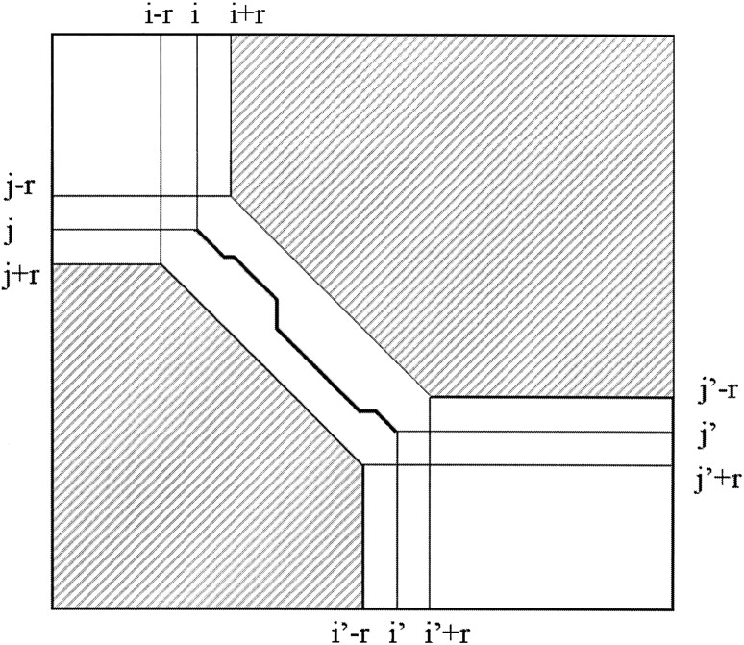
Step 3: Computing the Global Alignment in LAGAN
given an anchor that starts at (i, j) and ends at (i’, j’), LAGAN limits the DP to the unshaded regions
thus anchors are somewhat flexible
Figure from: Brudno et al. Genome Research, 2003

Slide 20
Step 3: Computing the Global Alignment in LAGAN
Figures from: Brudno et al. Genome Research, 2003

Slide 21
Comparing MUMmer and LAGAN
 | Baboon | Chimpanzee | Mouse | Rat | Cow | Pig | Cat | Dog | Chicken | Zebrafish | Fugu | Overall
Exons | 232 | 176 | 230 | 230 | 224 | 174 | 176 | 182 | 68 | 48 | 150 | 1914
MUMmer (% human exons covered by ≥ 90% alignment) | 100 | 100 | 8 | 9 | 40 | 44 | 47 | 37 | 0 | 0 | 0 | 41
LAGAN (% human exons covered by ≥ 90% alignment) | 100 | 100 | 100 | 100 | 99 | 100 | 100 | 99 | 99 | 88 | 77 | 98

Slide 22
Comparing MUMmer and LAGAN
Brudno et al. Genome Research, 2003
Pattern matching to find seeds for global alignment
Find a good chain of anchors
Fill in with standard but constrained alignment
MUMmer
Suffix trees to obtain MUMs
Longest Increasing Subsequence
Smith-Waterman, recursive MUMmer
LAGAN
k-mer trie to obtain seeds
Sparse dynamic programming
Dynamic programming

