Slide 1
Alignment of Long Sequences
BMI/CS 776
www.biostat.wisc.edu/bmi776/
Spring 2019
Colin Dewey
colin.dewey@wisc.edu
These slides, excluding third-party material, are licensed under CC BY-NC 4.0 by Mark Craven, Colin Dewey, and Anthony Gitter

Slide 2
Goals for Lecture
Key concepts
how large-scale alignment differs from the simple case
the canonical three step approach of large-scale aligners
using suffix trees to find maximal unique matching subsequences (MUMs)
The MUMmer system for whole-genome alignment

Slide 3
Pairwise Large-Scale Alignment:
Task Definition
Given
  a pair of large-scale sequences (e.g. chromosomes)
  a method for scoring the alignment (e.g. substitution matrices, insertion/deletion parameters)
Do
  construct global alignment: identify all matching positions between the two sequences

Slide 4

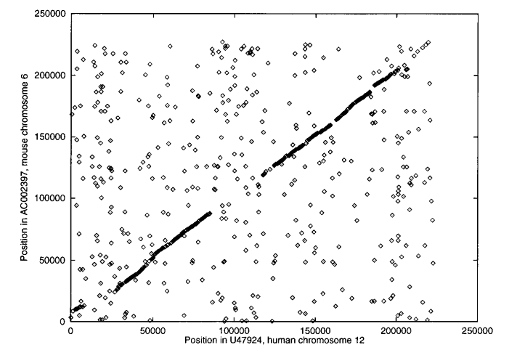

Large Scale Alignment Example
Mouse Chr6 vs. Human Chr12
Figure from: Delcher et al., Nucleic Acids Research 27, 1999

Slide 5
Why the Problem is Challenging
Sequences too big to make O(n²) dynamic-programming methods practical
Long sequences are less likely to be colinear because of rearrangements
  initially we’ll assume colinearity
  we’ll consider rearrangements next

Slide 6
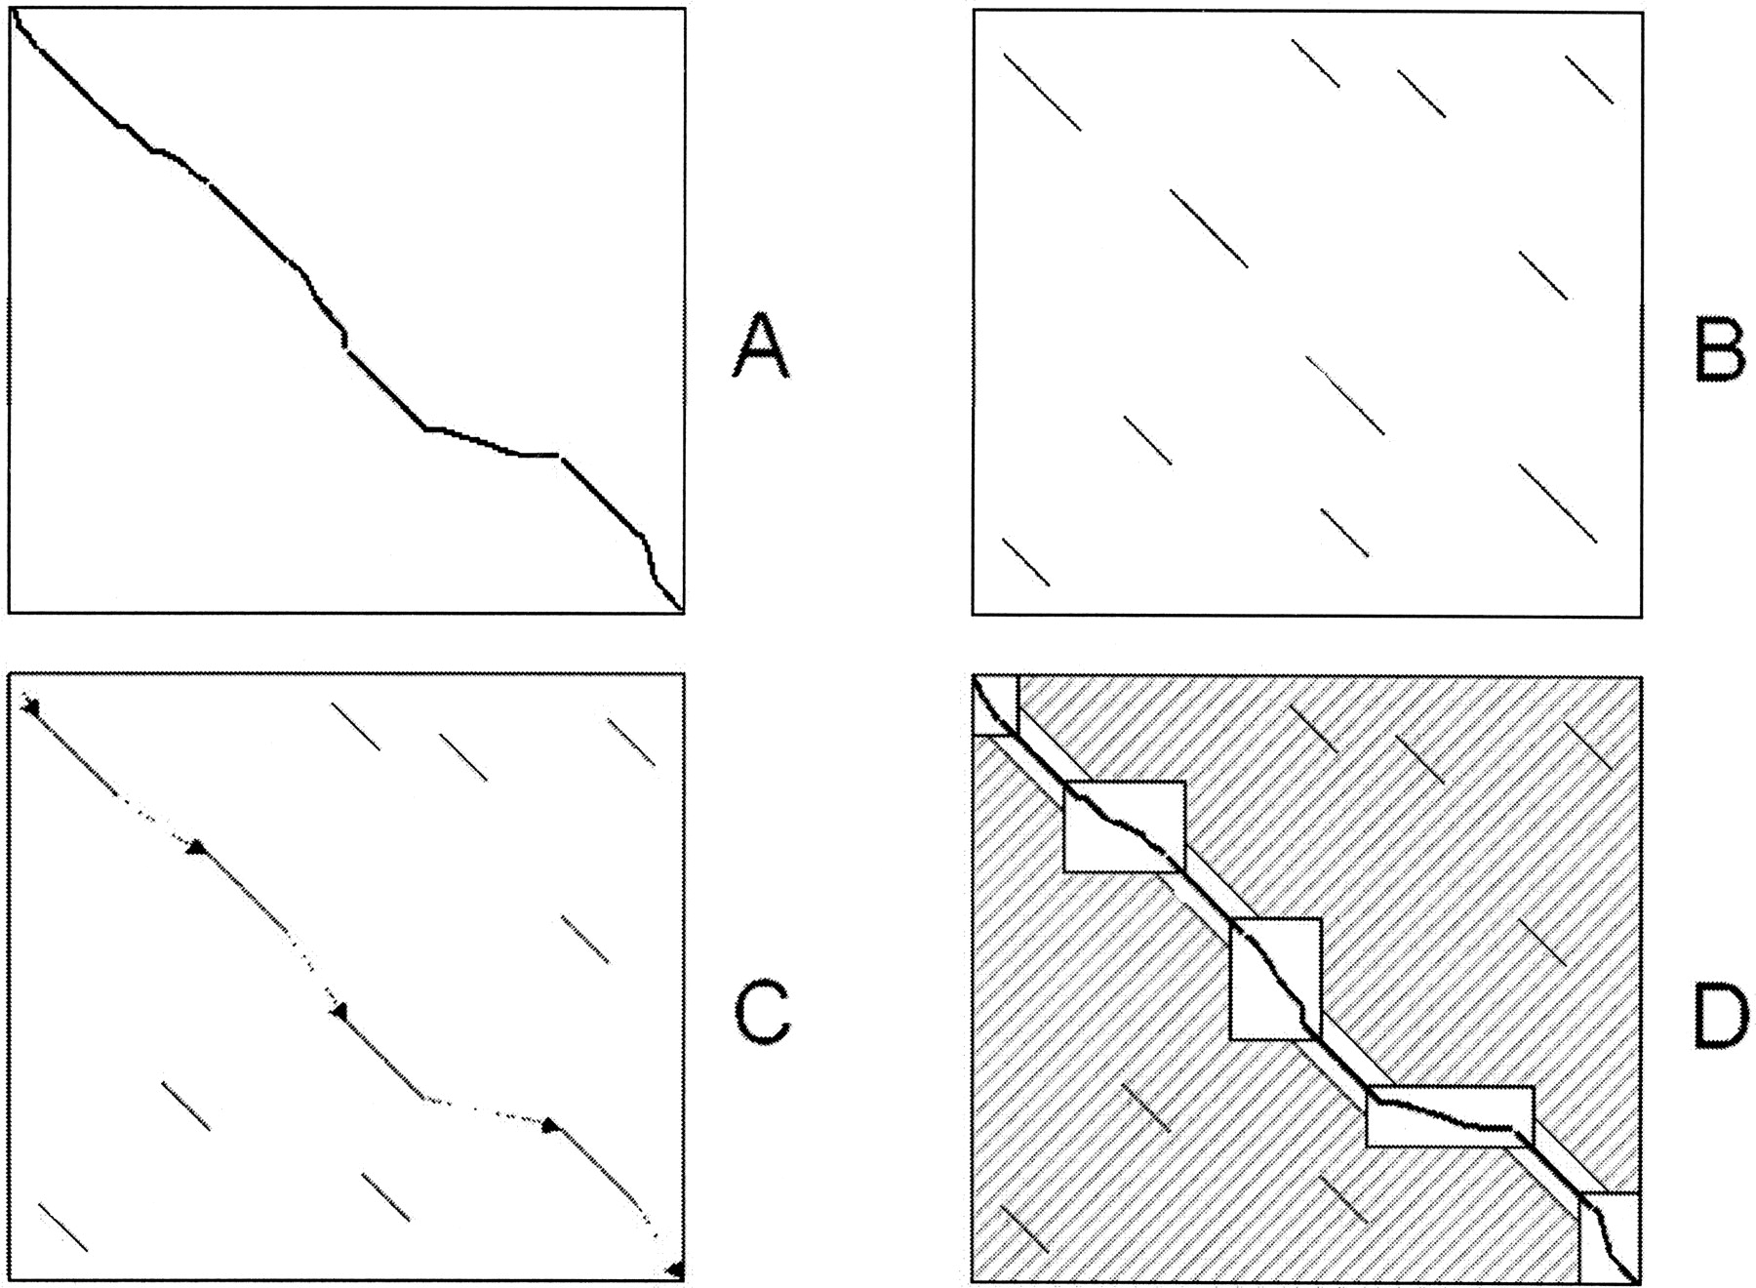
General Strategy
Figure from: Brudno et al. Genome Research, 2003
perform pattern matching to find seeds for global alignment
find a good chain of anchors
fill in remainder with standard but constrained alignment method

Slide 7

Comparison of Large-Scale Alignment Methods
Method | Pattern matching | Chaining
MUMmer | suffix tree - MUMs | LIS variant
AVID | suffix tree - exact & wobble matches | Smith-Waterman variant
LAGAN | k-mer trie, inexact matches | sparse DP

Slide 8
The MUMmer System
Delcher et al., Nucleic Acids Research, 1999
Given: genomes A and B
  find all maximal unique matching subsequences (MUMs)
  extract the longest possible set of matches that occur in the same order in both genomes
  close the gaps

Slide 9
Step 1: Finding Seeds in MUMmer
Maximal unique match:
  occurs exactly once in both genomes A and B
  not contained in any longer MUM
mismatches
Key insight: a significantly long MUM is certain to be part of the global alignment

Slide 10
Suffix Trees
Substring problem:
  given text S of length m
  preprocess S in O(m) time
  such that, given query string Q of length n, find occurrence (if any) of Q in S in O(n) time
Suffix trees solve this problem and others

Slide 11
Suffix Tree Definition
A suffix tree T for a string S of length m is a tree with the following properties:
  rooted and directed
  m leaves, labeled 1 to m
  each edge labeled by a substring of S
  concatenation of edge labels on path from root to leaf i is suffix i of S (we will denote this by Si...m)
  each internal non-root node has at least two children
  edges out of a node must begin with different characters
key property

Slide 12
Suffixes
S = “banana$”
suffixes of S
    $ (special character)
    a$
    na$
    ana$
    nana$
    anana$
    banana$

Slide 13
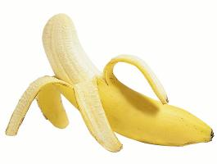
Suffix Tree Example
S = “banana$”
Add ‘$’ to end so that suffix tree exists (no suffix is a prefix of another suffix)
a
b
n
n
a
a
a
n
$
$
a
n
n
n
a
a
$
$
a
$
7
$
$
2
4
6
1
3
5

Slide 14
Solving the Substring Problem
Assume we have suffix tree T and query string Q
FindMatch(Q, T):
  follow (unique) path down from root of T according to characters in Q
  if all of Q is found to be a prefix of such a path
    return label of some leaf below this path
  else, return no match found

Slide 15

Solving the Substring Problem
Q = nan
Q = anab
a
a
n
b
n
b
n
a
n
a
a
$
a
a
a
n
n
$
$
a
STOP
a
n
n
n
n
$
a
a
n
n
$
$
a
a
$
a
a
$
7
$
$
7
$
$
$
$
2
4
6
1
3
5
2
4
6
1
3
5
return 3
return no match found

Slide 16
MUMs and Generalized Suffix Trees
Build one suffix tree for both genomes A and B
Label each leaf node with genome it represents
Genome A: ccacg#
each internal node represents
a repeated sequence
Genome B: cct$
acg#
c
g#
t$
A, 3
A, 5
B, 3
acg#
c
g#
t$
A, 2
A, 4
B, 2
acg#
t$
A, 1
B, 1
each leaf represents a suffix
and its position in sequence

Slide 17
MUMs and Suffix Trees
Unique match: internal node with 2 children, leaf nodes from different genomes
But these matches are not necessarily maximal
Genome A: ccacg#
Genome B: cct$
acg#
c
g#
t$
A, 3
A, 5
B, 3
acg#
c
g#
t$
A, 2
A, 4
B, 2
acg#
t$
represents unique match
A, 1
B, 1

Slide 18
MUMs and Suffix Trees
To identify maximal matches, can compare suffixes following unique match nodes
Genome A: acat#
Genome B: acaa$
a
t#
ca
A, 4
$
a$
ca
t#
t#
a$
B, 4
B, 3
A, 3
A, 2
B, 2
t#
a$
the suffixes following
these two match nodes
are the same; the left one represents a longer match (aca)
A, 1
B, 1

Slide 19
Using Suffix Trees to Find MUMs
O(n) time to construct suffix tree for both sequences (of lengths ≤ n)
O(n) time to find MUMs - one scan of the tree (which is O(n) in size)
O(n) possible MUMs in contrast to O(n²) possible exact matches
Main parameter of approach: length of shortest MUM that should be identified (20 – 50 bases)

Slide 20
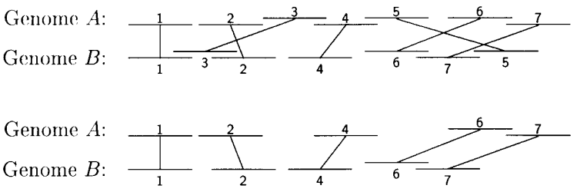
Step 2: Chaining in MUMmer
Sort MUMs according to position in genome A
Solve variation of Longest Increasing Subsequence (LIS) problem to find sequences in ascending order in both genomes
Figure from: Delcher et al., Nucleic Acids Research 27, 1999

Slide 21
Finding Longest Subsequence
Unlike ordinary LIS problems, MUMmer takes into account
  lengths of sequences represented by MUMs
  overlaps
Requires time where k is number of MUMs

Slide 22
Recall: Three Main Steps of Large-Scale Alignment
Brudno et al. Genome Research, 2003
General
Pattern matching to find seeds for global alignment
Find a good chain of anchors
Fill in with standard but constrained alignment
MUMmer
Suffix trees to obtain MUMs
LIS to find colinear MUMs
Smith-Waterman and recursive MUMmer for gap filling

Slide 23
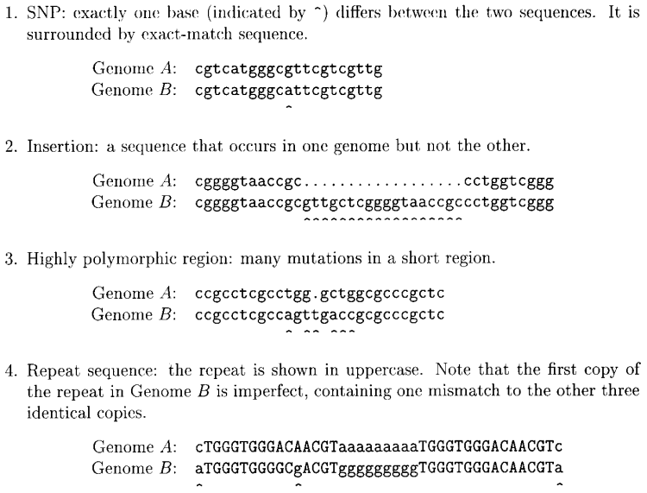
Types of Gaps in a MUMmer Alignment
Figure from: Delcher et al., Nucleic Acids Research 27, 1999

Slide 24
Step 3: Close the Gaps
SNPs:
  between MUMs: trivial to detect
  otherwise: handle like repeats
Insertions
  simple insertions: trivial to detect
  transpositions (subsequences that were deleted from one location and inserted elsewhere): look for out-of-sequence MUMs

Slide 25
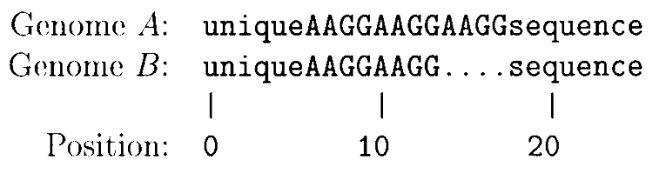
Step 3: Close the Gaps
Polymorphic regions
  short ones: align them with dynamic programming method
  long ones: call MUMmer recursively with reduced minimum MUM length
Repeats
  detected by overlapping MUMs
Figure from: Delcher et al. Nucleic Acids Research 27, 1999

Slide 26
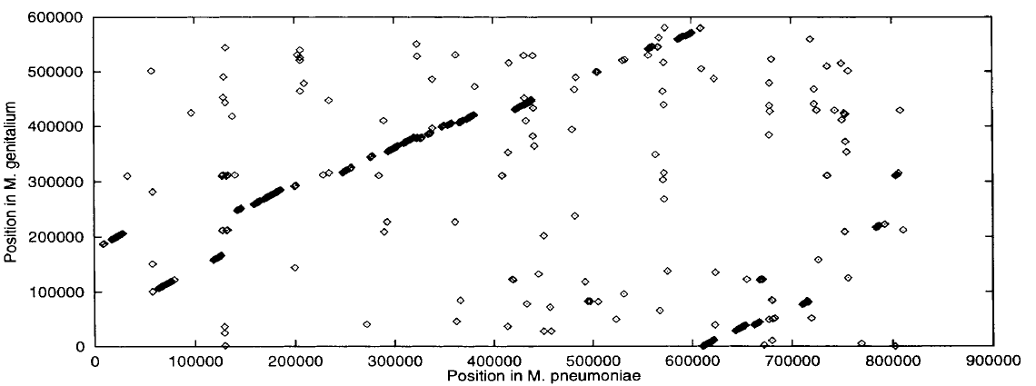
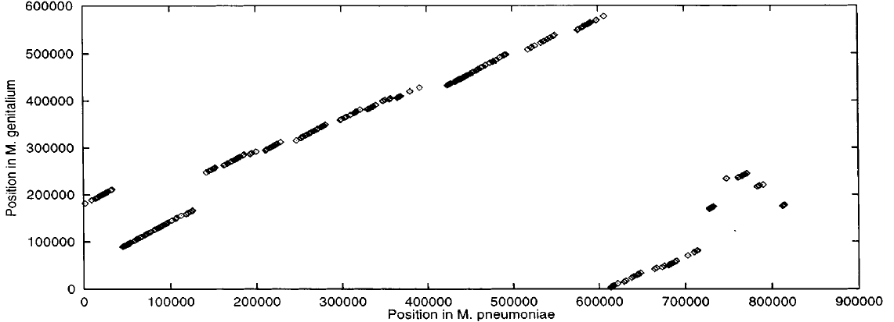
MUMmer Performance
FASTA on 1000 base pair segments
MUMmer
Figure from: Delcher et al. Nucleic Acids Research 27, 1999

Slide 27
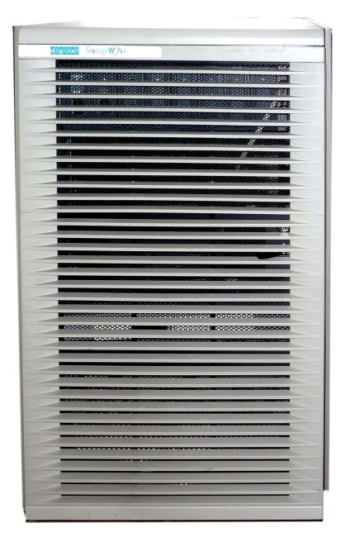
MUMmer Performance
DEC Alpha 4100
Mycoplasma test case
Suffix tree: 6.5s
LIS: 0.02s
Smith-Waterman: 116s
FASTA baseline: many hours
Centre for Computing History

Slide 28
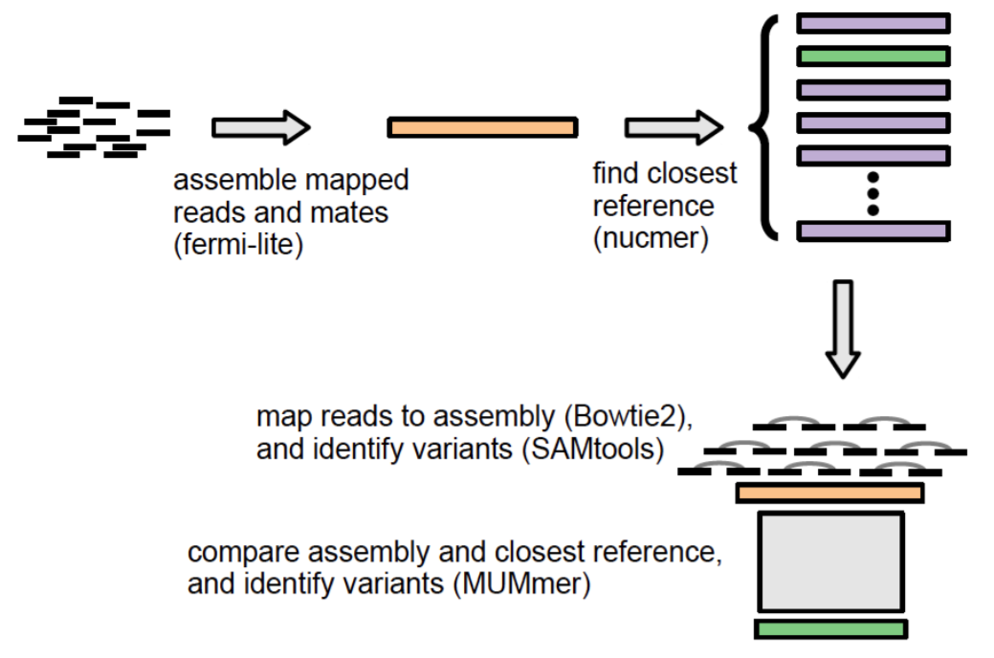
Longevity of MUMmer
Antimicrobial Resistance Identification By Assembly (ARIBA)
Identify antimicrobial resistance genes from Illumina reads
Figure from: Hunt et al. bioRxiv 2017

Slide 29
Longevity of MUMmer
Whole genome alignment still an active area of research
  Jain et al. 2018 (Mashmap2): “we were able to map an error-corrected whole-genome NA12878 human assembly to the hg38 human reference genome in about one minute total execution time and < 4 GB memory using 8 CPU threads”
  Uses MUMmer as ground truth in evaluation

Slide 30
Limitations of MUMmer
MUMs are perfect matches, typically ≥ 20-50 base pairs
Evolutionarily distant may not have sufficient MUMs to anchor global alignment
How can we tolerate minor variation in the seeds?

Slide 31
More recent developments
MUMmer4 uses a suffix array data structure instead
  requires less space than a suffix tree (constant factors are smaller)
Compressed data structures related to suffix arrays are in widespread use
  Burrows-Wheeler transform (BWT)
  Ferragina–Manzini index (FM-index)
  Most commonly used in read mapping applications (e.g., Bowtie, BWA)

