Slide 1
Assembling transcriptomes from RNA-seq data
BMI/CS 776
www.biostat.wisc.edu/bmi776/
Spring 2019
Colin Dewey
colin.dewey@wisc.edu
These slides, excluding third-party material, are licensed under CC BY-NC 4.0 by Colin Dewey, Mark Craven, and Anthony Gitter

Slide 2
Two forms of transcriptome assembly
Reference-based
  Requires knowledge of genome sequence
  Alignment of reads to genome provides information regarding overlaps of reads
De novo
  Genome sequence not required
  Similar to de novo genome assembly
  Read overlaps determined by read to read alignment or indirectly via de Bruijn graphs (or similar)

Slide 3
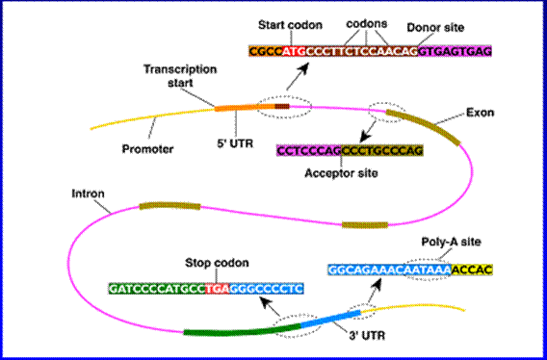
Eukaryotic Gene Structure

Slide 4
Gene finding before RNA-seq
ab initio gene finding
  Predict gene structures using genome sequence information alone
  Relies on sequence-based features and statistical patterns of genes
Protein and cDNA evidence-based
  Align known proteins and cDNA to genome
Comparative
  Use evolutionary conservation information

Slide 5
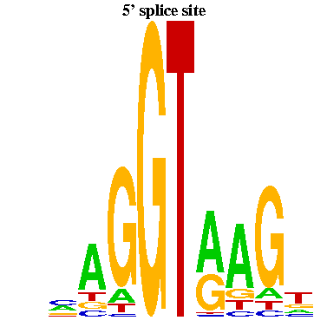
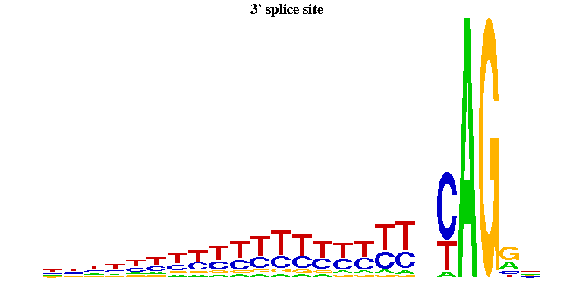
Example features for ab initio gene finding: spice sites
donor sites
acceptor sites
-3
-2
-1
1
2
3
4
5
6
Figures from Yi Xing
exon
exon
Informative for inferring hidden state of HMM

Slide 6
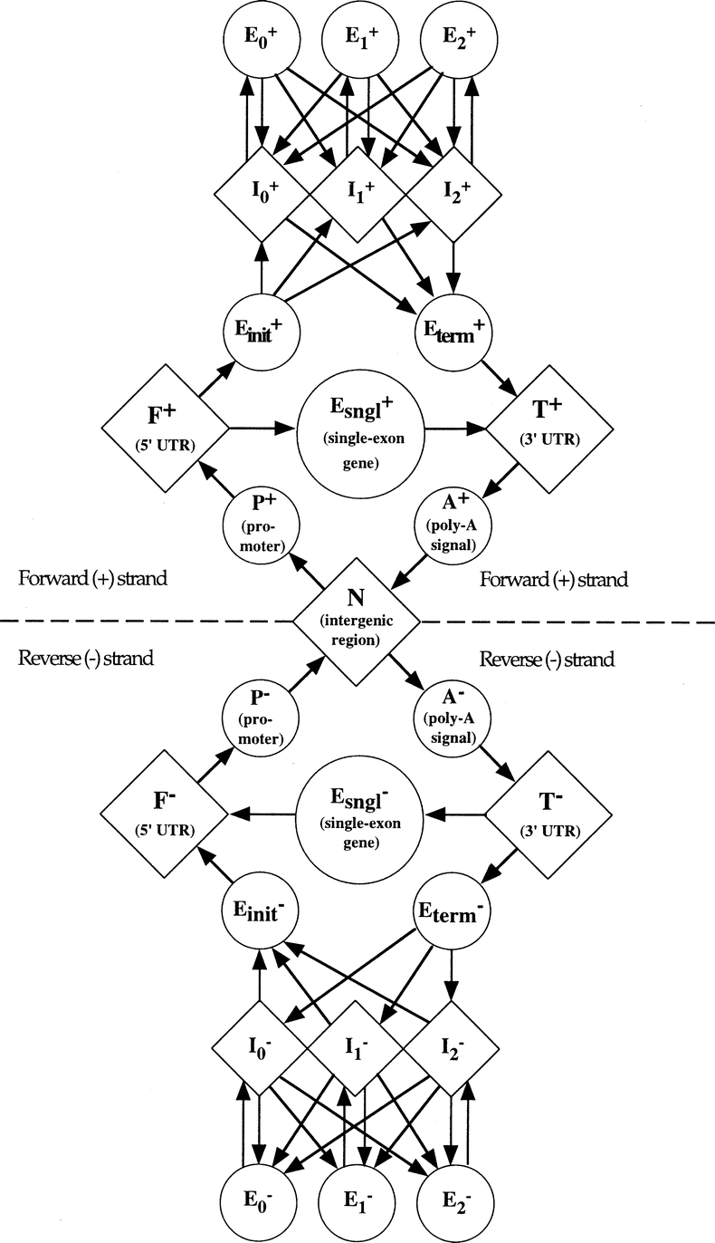
The GENSCAN HMM for Eukaryotic Gene Finding [Burge & Karlin ‘97]
Each shape represents a functional unit
of a gene or genomic region
Pairs of intron/exon units represent
the different ways an intron can interrupt
a coding sequence (after 1st base in codon,
after 2nd base or after 3rd base)
Figure from Burge & Karlin, Journal of Molecular Biology, 1997
Complementary submodel
(not shown) detects genes on
opposite DNA strand

Slide 7
Parsing a DNA Sequence
The Viterbi path represents
a parse of a given sequence,
predicting exons, introns, etc.
ACCGTTACGTGTCATTCTACGTGATCATCGGATCCTAGAATCATCGATCCGTGCGATCGATCGGATTAGCTAGCTTAGCTAGGAGAGCATCGATCGGATCGAGGAGGAGCCTATATAAATCAA
ACCGTTA
CGTGTCATTCTACGTGATCAT
CGGATCCTAGAATCATCGATC
CGTGCGATCGATCGGATTAGCTAGCTTAGCTAGGA
GAGCATCGATCGGATCGAGGAGGAGCCTATATAAATCAA

Slide 8
A generic RNA-Seq protocol
Sample RNA
RNA fragments
cDNA fragments
reads
reverse transcription + amplification
sequencing machine
CCTTCNCACTTCGTTTCCCAC
TTTTTNCAGAGTTTTTTCTTG
GAACANTCCAACGCTTGGTGA
GGAAANAAGACCCTGTTGAGC
CCCGGNGATCCGCTGGGACAA
GCAGCATATTGATAGATAACT
CTAGCTACGCGTACGCGATCG
CATCTAGCATCGCGTTGCGTT
CCCGCGCGCTTAGGCTACTCG
TCACACATCTCTAGCTAGCAT
CATGCTAGCTATGCCTATCTA
fragmentation

Slide 9
Cufflinks
One of the first assembly methods for RNA-seq data
Reference-based method
Key idea: predict transcript structures based on most parsimonious set of transcripts given reads
  here “parsimonious” = smallest number of transcripts
Casts the problem in terms of partially ordered sets and various graph optimization problems
Trapnell et al. Transcript assembly and quantification by RNA-Seq reveals unannotated transcripts and isoform switching during cell differentiation. Nat Biotechnol. 2010;28: 511–515.

Slide 10
Outline of the Cufflinks assembly algorithm
Map (align) reads to the genome (via the TopHat aligner)
Partition mapped reads into non-overlapping sets
Assemble each partition of reads (fragments) independently
  Build an overlap graph of the fragments
  Compute transitive reduction of overlap graph
  Find a minimum path cover of the graph

Slide 11
Overlap graph
Edge from node (fragment) x to node y if
  start(x) < start(y)
  x and y overlap
  x and y are “compatible”
Trapnell et al. Nat Biotech. 2010

Slide 12
Compatible fragment alignments
compatible
incompatible
Trapnell et al. Nat Biotech. 2010
two fragments are compatible if all implied introns in their overlapping region are the same

Slide 13
Transitive reduction
1
2
3
1
2
3
4
5
4
5
6
6
G
transitive_reduction(G)
An edge (u,v) of G is in the transitive reduction of G if the length of the longest path from u to v in G is equal to one.

Slide 14
Minimum path cover
Objective: find a smallest set of transcripts such that
Each fragment is consistent with at least one transcript
Every transcript is “tiled” (covered) by reads
Trapnell et al. Nat Biotech. 2010

Slide 15
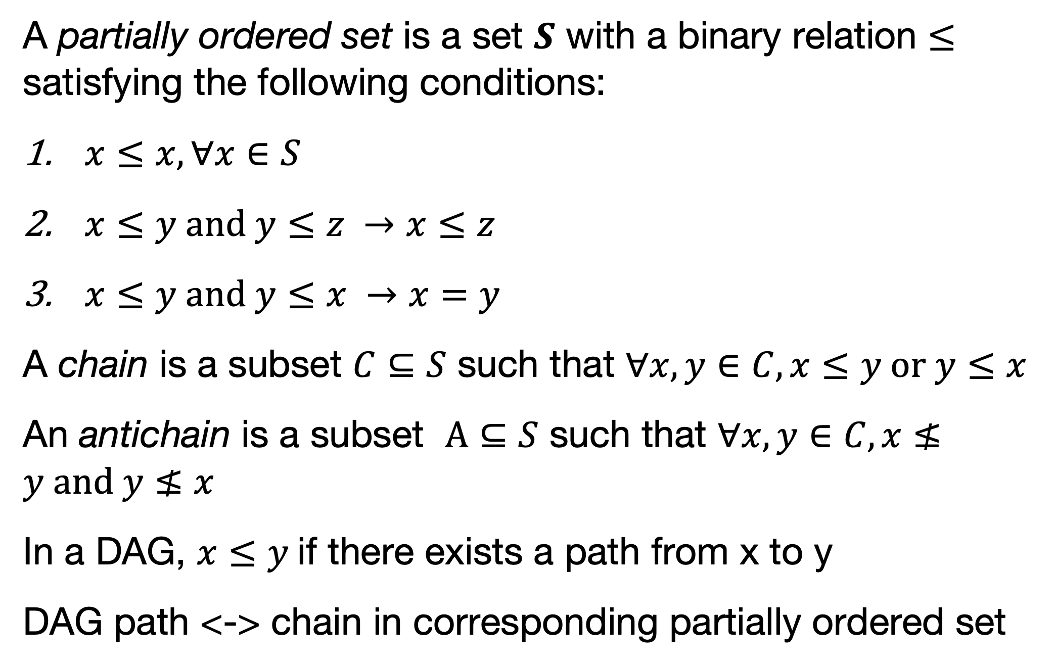
DAG Paths <-> Chains in a partially ordered set
A partially ordered set is a set $S$ with a binary relation $≤$ satisfying the following conditions:
$x≤x, ∀x∈S$
$x≤y \text{and} y≤z →x≤z$
$x≤y \text{and} y≤x →x=y$
A chain is a subset $C⊆S$ such that $∀x,y∈C, x≤y \text{or} y≤x$
An antichain is a subset $A⊆S$ such that $∀x,y∈C, x≰y \text{and} y≰x$
In a DAG, $x≤y$if there exists a path from x to y
DAG path <-> chain in corresponding partially ordered set

Slide 16
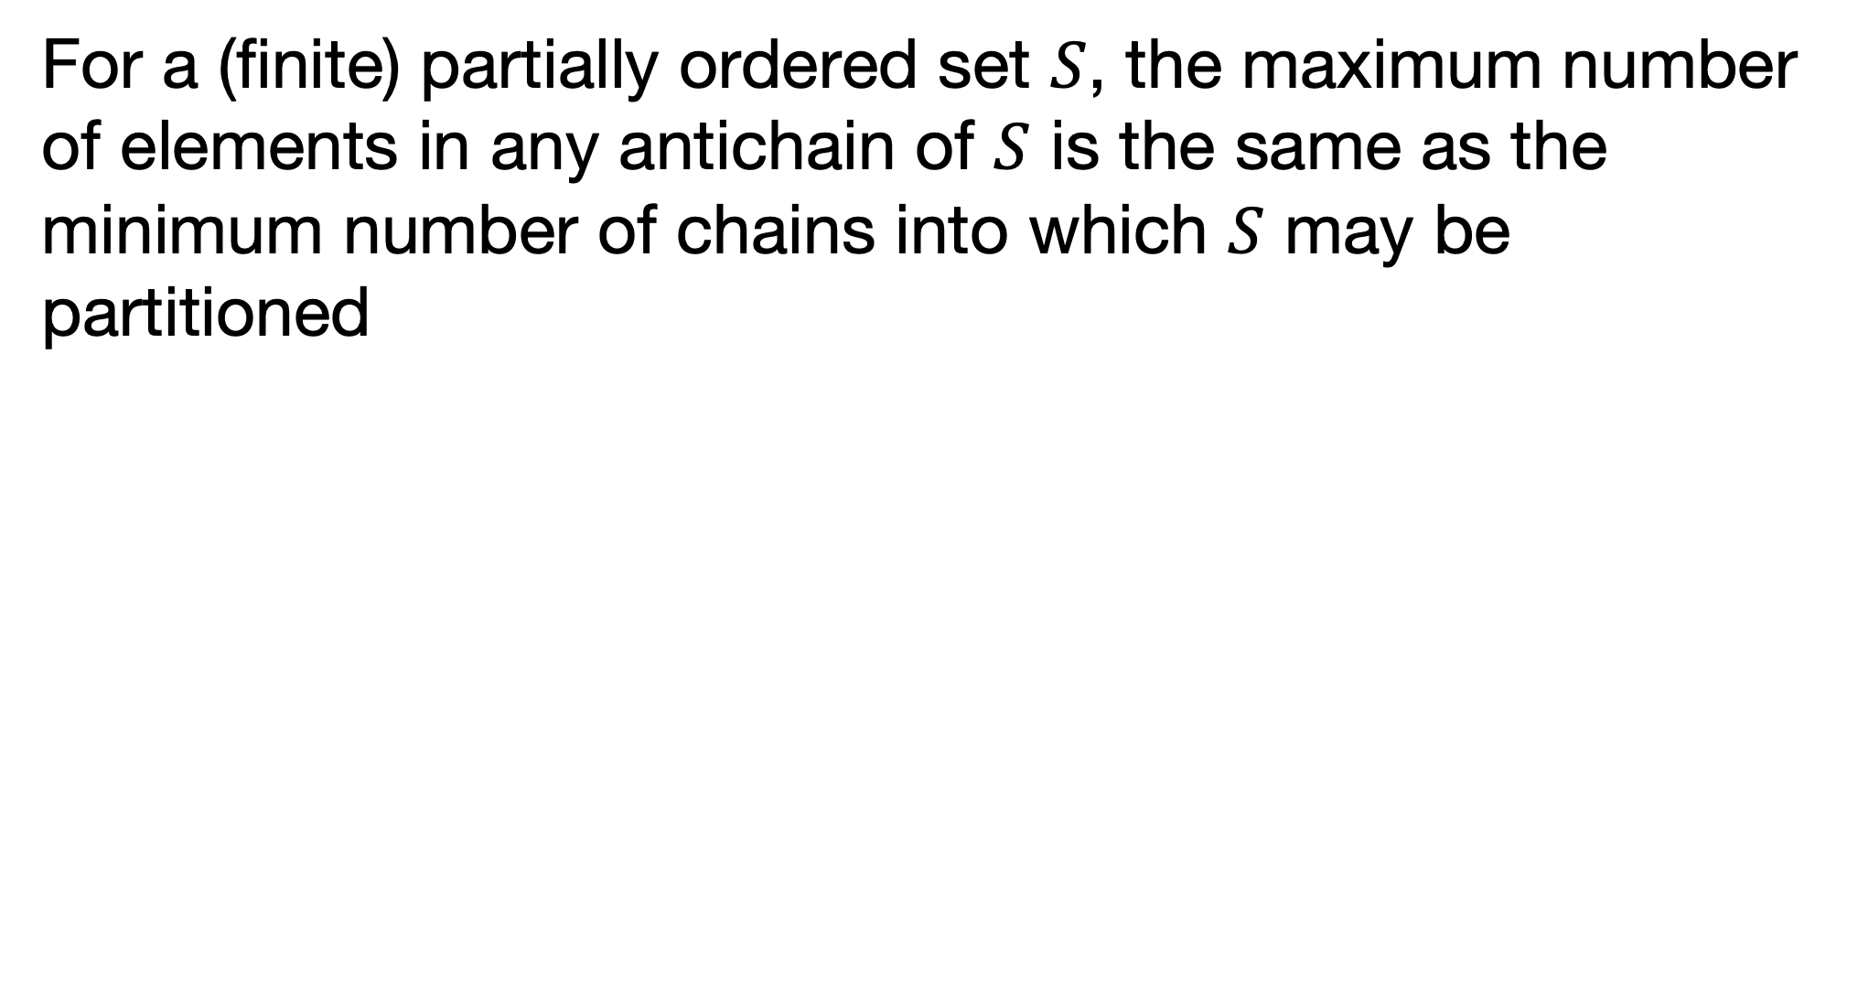
Dilworth’s theorem
For a (finite) partially ordered set $S$, the maximum number of elements in any antichain of $S$ is the same as the minimum number of chains into which $S$ may be partitioned
Example: (Hasse diagram)
Maximum # elements in antichain = 3
Minimum number of chains in partition = 3
Trapnell et al. Nat Biotech. 2010

Slide 17
Dilworth’s theorem <-> König’s theorem
König’s theorem: In a bipartite graph, # of edges in a maximum matching = # of vertices in a minimum vertex cover
Bipartite graph: A graph with a partition of vertices into two subsets, L and R, such that every edge is incident to one vertex in L and one vertex in R
Matching: In a graph, a matching is a subset of edges with the property that no two edges share a common vertex
  Maximum matching: A matching in a graph with the largest number of possible edges
Vertex cover: In a graph, a vertex cover is a subset of vertices such every edge is incident to at least one vertex in the subset
  Minimum vertex cover: The smallest vertex cover in a graph

Slide 18
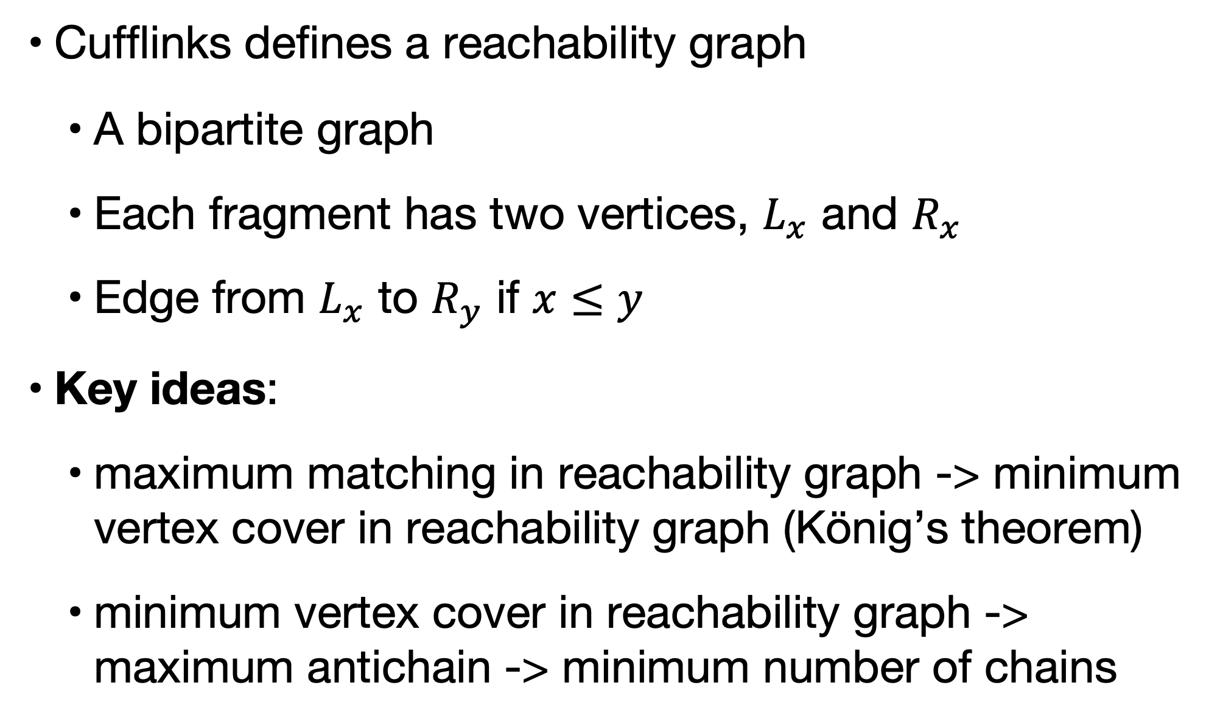
Reachability graph
Cufflinks defines a reachability graph
  A bipartite graph
  Each fragment has two vertices, $L_{x}$ and $R_{x}$
  Edge from $L_{x}$ to $R_{y}$ if $x≤y$
Key ideas:
  maximum matching in reachability graph -> minimum vertex cover in reachability graph (König’s theorem)
  minimum vertex cover in reachability graph -> maximum antichain -> minimum number of chains

Slide 19

Maximum matching in a bipartite graph
Hopcroft-Karp algorithm solves the maximum matching problem in a bipartite graph
Computational complexity: $O(\sqrt{V}E)$
Implementations available in graph libraries

Slide 20
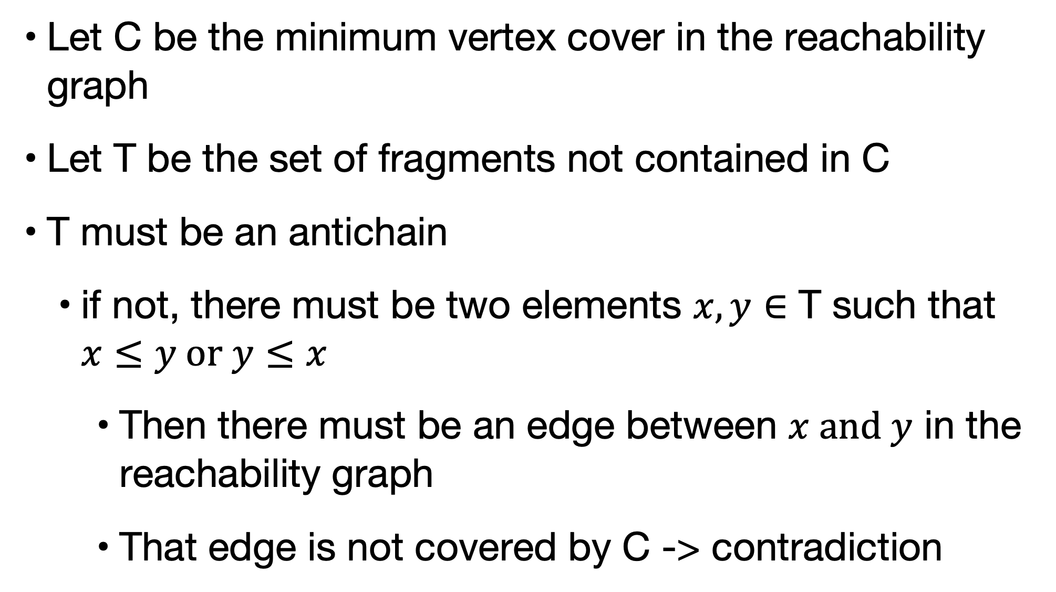
minimum vertex cover in reachability graph -> maximum antichain
Let C be the minimum vertex cover in the reachability graph
Let T be the set of fragments not contained in C
T must be an antichain
  if not, there must be two elements $x,y∈$ T such that $x≤y \text{or} y≤x$
    Then there must be an edge between $x and y$ in the reachability graph
    That edge is not covered by C -> contradiction

Slide 21
Example of Dilworth’s theorem <-> König’s theorem
Trapnell et al. Nat Biotech. 2010

Slide 22
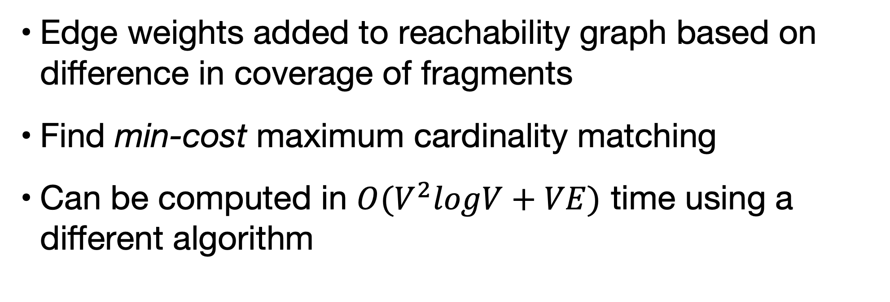
Minimum path covering is not always unique
1
4
1->3->4 and 2->3->5
or
2->3->4 and 1->3->5
3
2
5
Edge weights added to reachability graph based on difference in coverage of fragments
Find min-cost maximum cardinality matching
Can be computed in $O(V^{2}logV+VE)$ time using a different algorithm

Slide 23
Evaluation
Trapnell et al. Nat Biotech. 2010

Slide 24
Summary
Cufflinks takes a parsimonious approach to assembling transcripts
Uses graph theoretic algorithms and Dilworth’s theorem
Solves the task in polynomial time

