Slide 1
Comparative RNA-seq for analysis of regeneration in axolotl
BMI/CS 776
www.biostat.wisc.edu/bmi776/
Spring 2019
Colin Dewey
colin.dewey@wisc.edu
These slides, excluding third-party material, are licensed under CC BY-NC 4.0 by Colin Dewey, Mark Craven, and Anthony Gitter

Slide 2

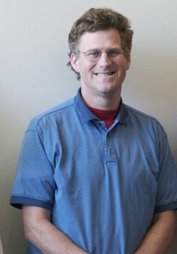


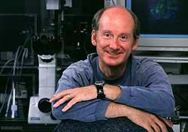
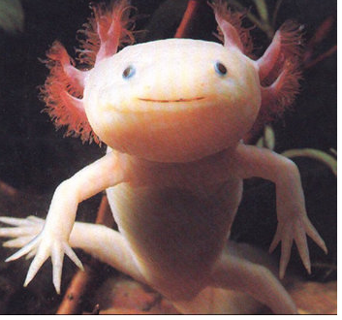
Some motivation
Axolotl
James Thomson
Ron Stewart
Regenerative Biology Laboratory, Morgridge Institute for Research, Madison, WI

Slide 3

Axolotl limb regeneration
David Gardiner - HHMI-UCI

Slide 4
Goals
What are the axolotl genes that are responsible for this remarkable regenerative ability?
Can this knowledge improve our medical treatments of severe wounds and tissue regeneration?

Slide 5
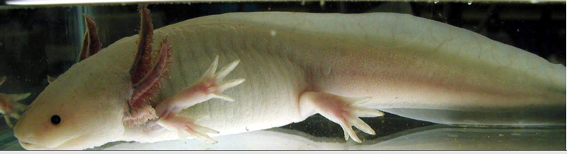
Axolotl background
Ambystoma mexicanum
Natural habitats
  Lake Xochimilco (canals)
  Lake Chalco (drained)
  Endangered
Commonly sold as pets
Neotenous
Regenerative abilities
  Limbs
  Portions of Heart
  Portions of Brain
  Tail and spinal cord

Slide 6
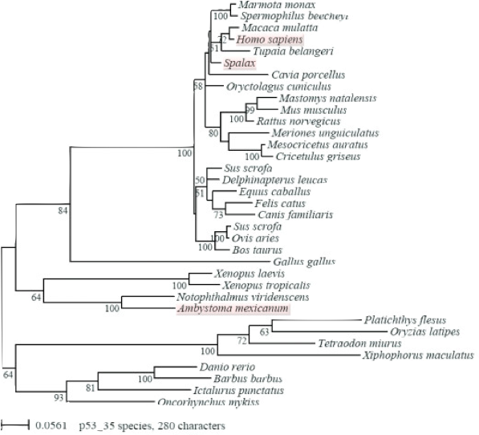
Challenges with genomic studies of Axolotl
No genome sequence available
  genome estimated to be 10x larger than that of human
Distantly related to other model organisms
340 mya
280 mya
Villiard et al. 2007

Slide 7
Prior gene expression studies in Axolotl
Microarrays
  Exist, but not very complete
  Limited amount of mRNA sequence data from Axolotl
  No genome, so can’t use predicted gene sequences

Slide 8
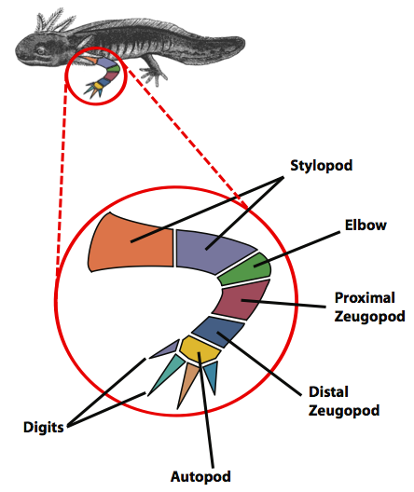
Axolotl experimental setup
Samples
Stylopod (upper arm) (3)
Zeugopod (lower arm) (3)
Autopod (hand) (3)
Digits (3)
30 day blastema (5)
Comparative RNA-seq analysis in the unsequenced axolotl: The oncogene burst highlights early gene expression in the blastema R. Stewart, C. Rascón, S. Tian, J. Nie, C. Barry, L. Chu, R. Wagner, M. Probasco, J. Bolin, N. Leng, S. Sengupta, M. Volkmer, B. Habermann, E. Tanaka, J. Thomson, and C. Dewey
PLoS Computational Biology. 9(3): e1002936. 2013.

Slide 9
Human-based analysis of axolotl transcription
Axolotl RNA-Seq reads
Bowtie/
RSEM
Axolotl transcript contigs
BLAST
Human transcripts
Human genes

Slide 10
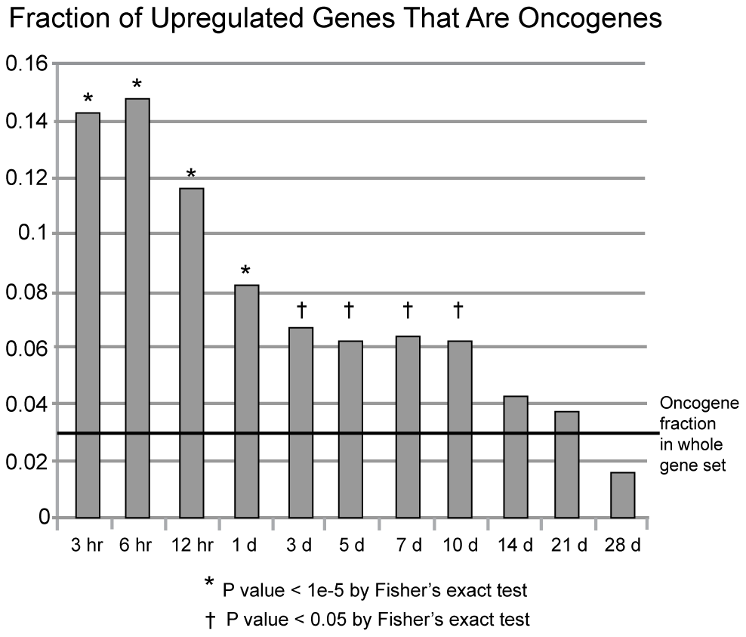
The oncogene burst

Slide 11
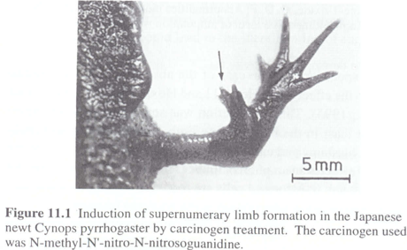
Regeneration as controlled cancer
P Tsonis, Limb Regeneration, 1996, Cambridge University Press
Limb Regeneration -- Oncogenes and tumor suppressors
“Controlled Cancer” --> development and differentiation
Salamanders very resistant to tumorigenesis by carcinogens

