Slide 1
Measuring transcriptomes with RNA-Seq
BMI/CS 776
www.biostat.wisc.edu/bmi776/
Spring 2019
Colin Dewey
colin.dewey@wisc.edu
These slides, excluding third-party material, are licensed under CC BY-NC 4.0 by Colin Dewey, Mark Craven, and Anthony Gitter

Slide 2
Overview
RNA-Seq technology
The RNA-Seq quantification problem
Generative probabilistic models and Expectation-Maximization for the quantification task

Slide 3
Goals for lecture
What is RNA-Seq?
How is RNA-Seq used to measure the abundances of RNAs within cells?
What probabilistic models and algorithms are used for analyzing RNA-Seq?

Slide 4
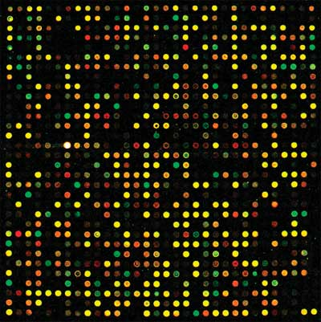
Measuring transcription the old way: microarrays
Each spot has “probes” for a certain gene
Probe: a DNA sequence complementary to a certain gene
Relies on complementary hybridization
Intensity/color of light from each spot is measurement of the number of transcripts for a certain gene in a sample
Requires knowledge of gene sequences

Slide 5
Advantages of RNA-Seq over microarrays
No reference sequence needed
  With microarrays, limited to the probes on the chip
Low background noise
Large dynamic range
  10⁵ compared to 10² for microarrays
High technical reproducibility
Identify novel transcripts and splicing events

Slide 6
RNA-Seq technology
Leverages rapidly advancing sequencing technology
Transcriptome analog to whole genome shotgun sequencing
Two key differences from genome sequencing:
  Transcripts sequenced at different levels of coverage - expression levels
  Sequences already known (in many cases) - coverage is measurement

Slide 7
A generic RNA-Seq protocol
Sample RNA
RNA fragments
cDNA fragments
reads
reverse transcription + amplification
sequencing machine
CCTTCNCACTTCGTTTCCCAC
TTTTTNCAGAGTTTTTTCTTG
GAACANTCCAACGCTTGGTGA
GGAAANAAGACCCTGTTGAGC
CCCGGNGATCCGCTGGGACAA
GCAGCATATTGATAGATAACT
CTAGCTACGCGTACGCGATCG
CATCTAGCATCGCGTTGCGTT
CCCGCGCGCTTAGGCTACTCG
TCACACATCTCTAGCTAGCAT
CATGCTAGCTATGCCTATCTA
fragmentation

Slide 8
RNA-Seq data: FASTQ format
name
@HWUSI-EAS1789_0001:3:2:1708:1305#0/1
CCTTCNCACTTCGTTTCCCACTTAGCGATAATTTG
+HWUSI-EAS1789_0001:3:2:1708:1305#0/1
VVULVBVYVYZZXZZ\ee[a^b`[a\a[\\a^^^\
@HWUSI-EAS1789_0001:3:2:2062:1304#0/1
TTTTTNCAGAGTTTTTTCTTGAACTGGAAATTTTT
+HWUSI-EAS1789_0001:3:2:2062:1304#0/1
a__[\Bbbb`edeeefd`cc`b]bffff`ffffff
@HWUSI-EAS1789_0001:3:2:3194:1303#0/1
GAACANTCCAACGCTTGGTGAATTCTGCTTCACAA
+HWUSI-EAS1789_0001:3:2:3194:1303#0/1
ZZ[[VBZZY][TWQQZ\ZS\[ZZXV__\OX`a[ZZ
@HWUSI-EAS1789_0001:3:2:3716:1304#0/1
GGAAANAAGACCCTGTTGAGCTTGACTCTAGTCTG
+HWUSI-EAS1789_0001:3:2:3716:1304#0/1
aaXWYBZVTXZX_]Xdccdfbb_\`a\aY_^]LZ^
@HWUSI-EAS1789_0001:3:2:5000:1304#0/1
CCCGGNGATCCGCTGGGACAAGCAGCATATTGATA
+HWUSI-EAS1789_0001:3:2:5000:1304#0/1
aaaaaBeeeeffffehhhhhhggdhhhhahhhadh
sequence
read
qualities
paired-end reads
read1
read2
1 Illumina HiSeq 2500 lane
~150 million reads

Slide 9
Tasks with RNA-Seq data
Assembly:
  Given: RNA-Seq reads (and possibly a genome sequence)
  Do: Reconstruct full-length transcript sequences from the reads
Quantification (our focus):
  Given: RNA-Seq reads and transcript sequences
  Do: Estimate the relative abundances of transcripts (“gene expression”)
Differential expression:
  Given: RNA-Seq reads from two different samples and transcript sequences
  Do: Predict which transcripts have different abundances between two samples

Slide 10
RNA-Seq is a relative abundance measurement technology
RNA-Seq gives you reads from the ends of a random sample of fragments in your library
Without additional data this only gives information about relative abundances
Additional information, such as levels of “spike-in” transcripts, are needed for absolute measurements
RNA
sample
cDNA
fragments
reads

Slide 11
Issues with relative abundance measures
Gene | Sample 1 absolute abundance | Sample 1 relative abundance | Sample 2 absolute abundance | Sample 2 relative abundance
1 | 20 | 10% | 20 | 5%
2 | 20 | 10% | 20 | 5%
3 | 20 | 10% | 20 | 5%
4 | 20 | 10% | 20 | 5%
5 | 20 | 10% | 20 | 5%
6 | 100 | 50% | 300 | 75%
Changes in absolute expression of high expressors is a major factor
Normalization is required for comparing samples in these situations

Slide 12
The basics of quantification with RNA-Seq data
For simplicity, suppose reads are of length one (typically they are > 35 bases)
What relative abundances would you estimate for these genes?
Relative abundance is relative transcript levels in the cell, not proportion of observed reads
transcripts
reads
200
100 A
1
60
60 C
2
80
3
40 G

Slide 13

Length dependence
Probability of a read coming from a transcript ∝ relative abundance × length
transcripts
reads
200
100 A
1
60
2
60 C
80
3
40 G
probability of read from transcript 1 = (transcript 1 reads) / (total reads)
transcript 1 relative abundance
transcript 1 length

Slide 14





Length dependence
Probability of a read coming from a transcript ∝ relative abundance × length
transcripts
reads
200
100 A
1
60
2
60 C
80
3
40 G
normalize

Slide 15

The basics of quantification from RNA-Seq data
Basic assumption:
Normalization factor is the mean length of expressed transcripts
expression level
(relative abundance)
length

Slide 16


The basics of quantification from RNA-Seq data
Estimate the probability of reads being generated from a given transcript by counting the number of reads that align to that transcript
Convert to expression levels by normalizing by transcript length
# reads mapping to transcript i
total # of mappable reads

Slide 17
The basics of quantification from RNA-Seq data
Basic quantification algorithm
  Align reads against a set of reference transcript sequences
  Count the number of reads aligning to each transcript
  Convert read counts into relative expression levels

Slide 18


Counts to expression levels
RPKM - Reads Per Kilobase per Million mapped reads
TPM - Transcripts Per Million
Prefer TPM to RPKM because of normalization factor
TPM is a technology-independent measure (simply a fraction)
(estimate of)

Slide 19
What if reads do not uniquely map to transcripts?
The approach described assumes that every read can be uniquely aligned to a single transcript
This is generally not the case
  Some genes have similar sequences - gene families, repetitive sequences
  Alternative splice forms of a gene share a significant fraction of sequence

Slide 20
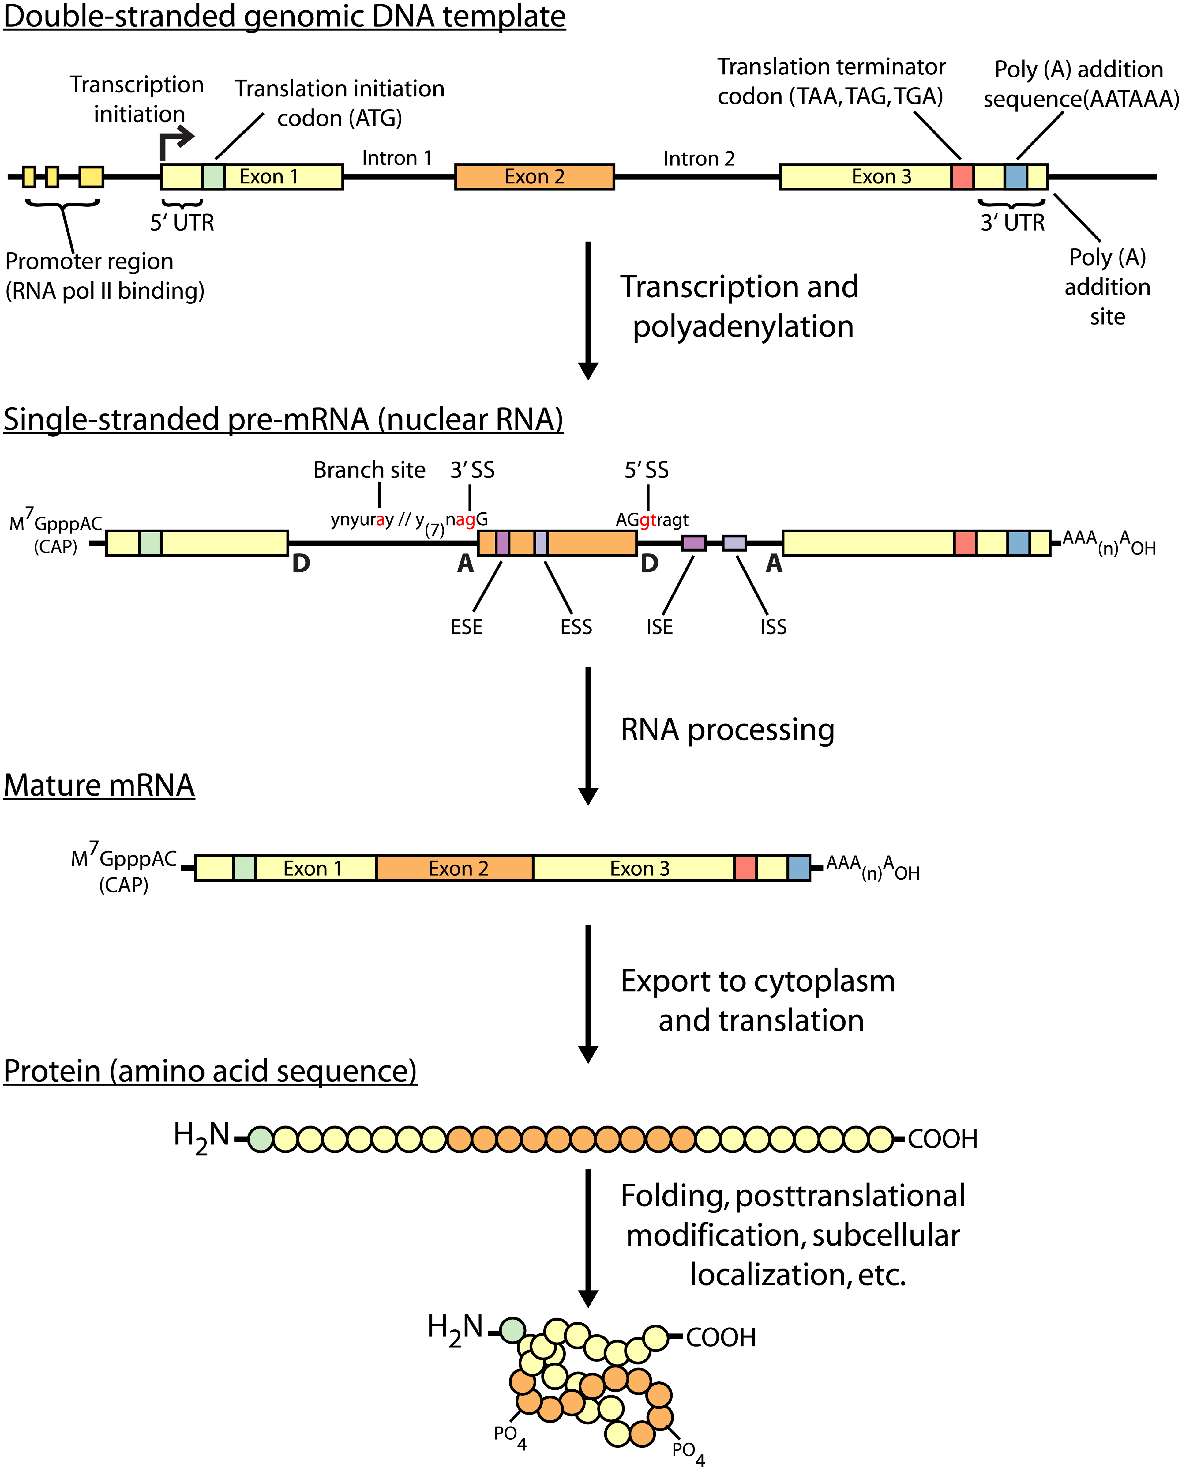
Central dogma of molecular biology
Griffith et al. PLoS Computational Biology 2015

Slide 21
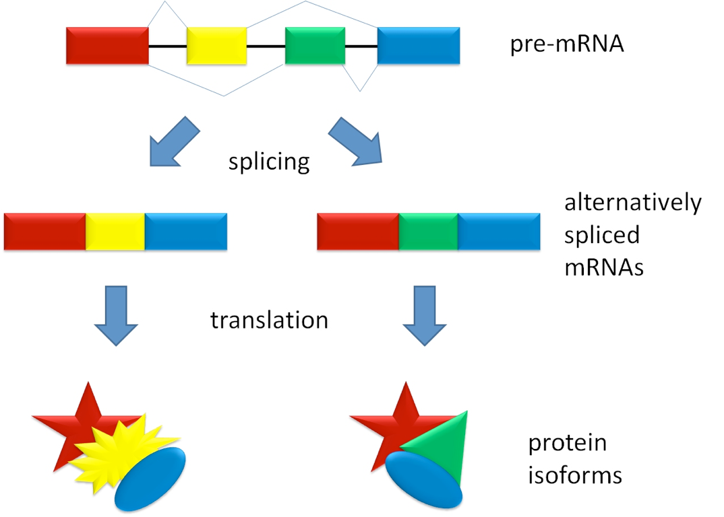
Alternative splicing

Slide 22
Multi-mapping reads in RNA-Seq
Species | Read length | % multi-mapping reads
Mouse | 25 | 17%
Mouse | 75 | 10%
Maize | 25 | 52%
Axolotl | 76 | 23%
Human | 50 | 23%
Throwing away multi-mapping reads leads to
  Loss of information
  Potentially biased estimates of abundance

Slide 23
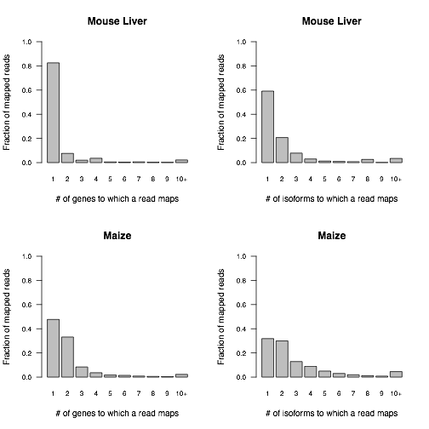
Distributions of alignment counts

Slide 24
What if reads do not uniquely map to transcripts?
Multiread: a read that could have been derived from multiple transcripts
How would you estimate the relative abundances for these transcripts?
transcripts
reads
20 + 180 = 200
90 A
1
2
20 + 40 = 60
40 C
80
3
40 G
30 T

Slide 25
Some options for handling multireads
Discard multireads, estimate based on uniquely mapping reads only
Discard multireads, but use “unique length” of each transcript in calculations
“Rescue” multireads by allocating (fractions of) them to the transcripts
  Three step algorithm
    Estimate abundances based on uniquely mapping reads only
    For each multiread, divide it between the transcripts to which it maps, proportionally to their abundances estimated in the first step
    Recompute abundances based on updated counts for each transcript

Slide 26



Rescue method example - Step 1
transcripts
reads
200
90 A
1
60
40 C
2
80
3
40 G
30 T
Step 1

Slide 27



Rescue method example - Step 2
transcripts
reads
200
90 A
1
60
40 C
2
80
3
40 G
30 T
Step 2

Slide 28



Rescue method example - Step 3
transcripts
reads
200
90 A
1
60
40 C
2
80
3
40 G
30 T
Step 3

Slide 29
An observation about the rescue method
Note that at the end of the rescue algorithm, we have an updated set of abundance estimates
These new estimates could be used to reallocate the multireads
And then we could update our abundance estimates once again
And repeat!
This is the intuition behind the statistical approach to this problem

Slide 30
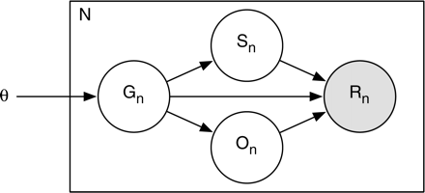
RSEM (RNA-Seq by Expectation-Maximization) - a generative probabilistic model
Simplified view of the model (plate notation)
  Grey – observed variable
  White – latent (unobserved) variables
number of reads
start position
transcript probabilities (expression levels)
read sequence
transcript
orientation

Slide 31
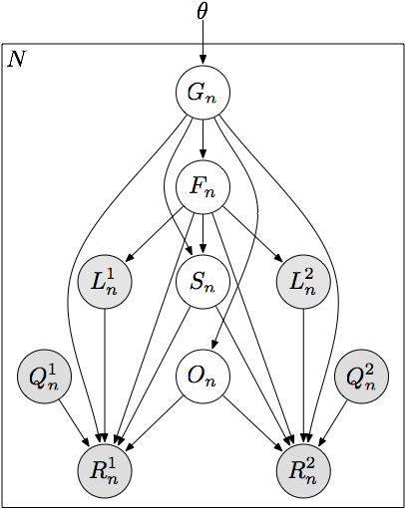
RSEM - a generative probabilistic model
transcript probabilities (expression levels)
number of reads
transcript
fragment length
start position
read length
orientation
paired read
quality scores
read sequence

Slide 32
Quantification as maximum likelihood inference
Observed data likelihood
Likelihood function is concave with respect to θ
  Has a global maximum (or global maxima)
Expectation-Maximization for optimization
“RNA-Seq gene expression estimation with read mapping uncertainty”
Li, B., Ruotti, V., Stewart, R., Thomson, J., Dewey, C.
Bioinformatics, 2010

Slide 33
Approximate inference with read alignments
Full likelihood computation requires O(NML²) time
  N (number of reads) ~ 10⁷
  M (number of transcripts) ~ 10⁴
  L (average transcript length) ~ 10³
Approximate by alignment
all local alignments of read n with at most x mismatches

Slide 34
EM Algorithm
Expectation-Maximization for RNA-Seq
  E-step: Compute expected read counts given current expression levels
  M-step: Compute expression values maximizing likelihood given expected read counts
Rescue algorithm ≈ 1 iteration of EM

Slide 35

HMM Interpretation
transcript 1
transcript 2
start
transcript 3
...
...
transcript M
hidden: read start positions
observed: read sequences
Learning parameters: Baum-Welch Algorithm (EM for HMMs)
Approximation: Only consider a subset of paths for each read

Slide 36
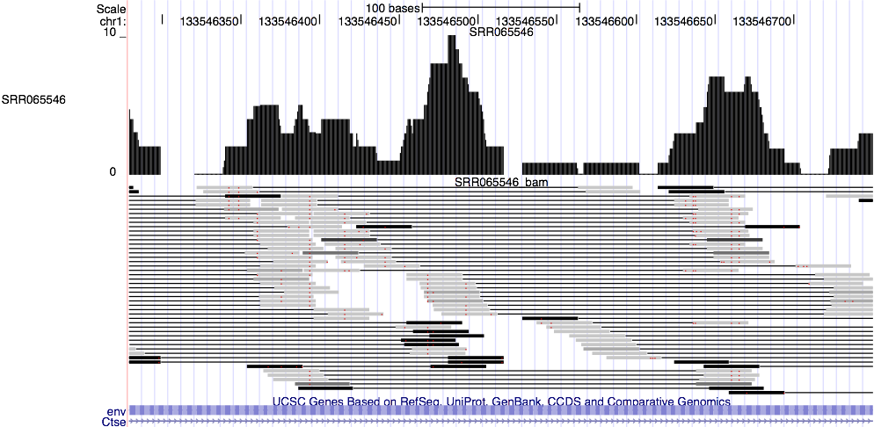
Probabilistically-weighted alignments

Slide 37
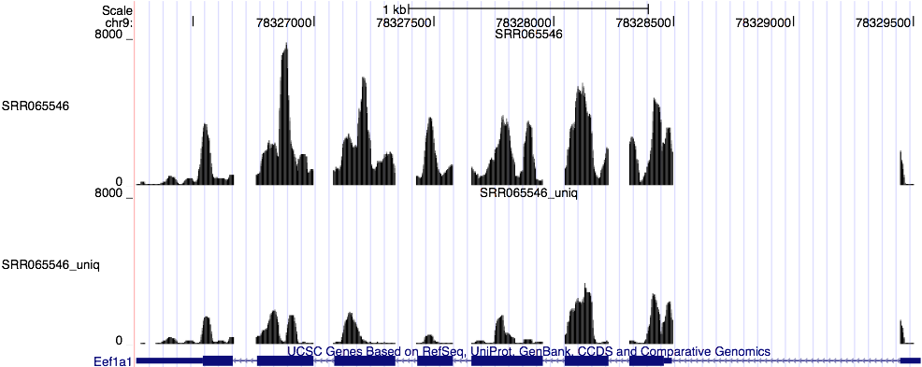
Expected read count visualization

Slide 38
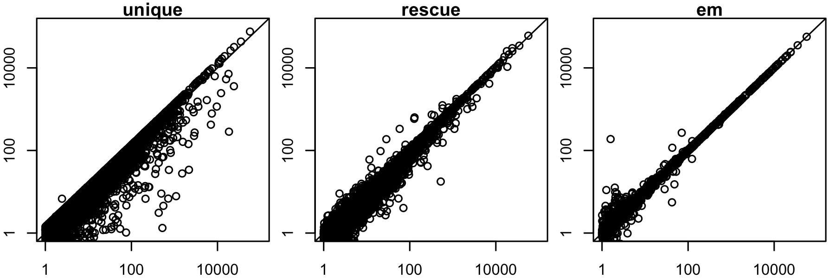
Improved accuracy over unique and rescue
predicted expression level
true expression level
Mouse gene-level expression estimation

Slide 39
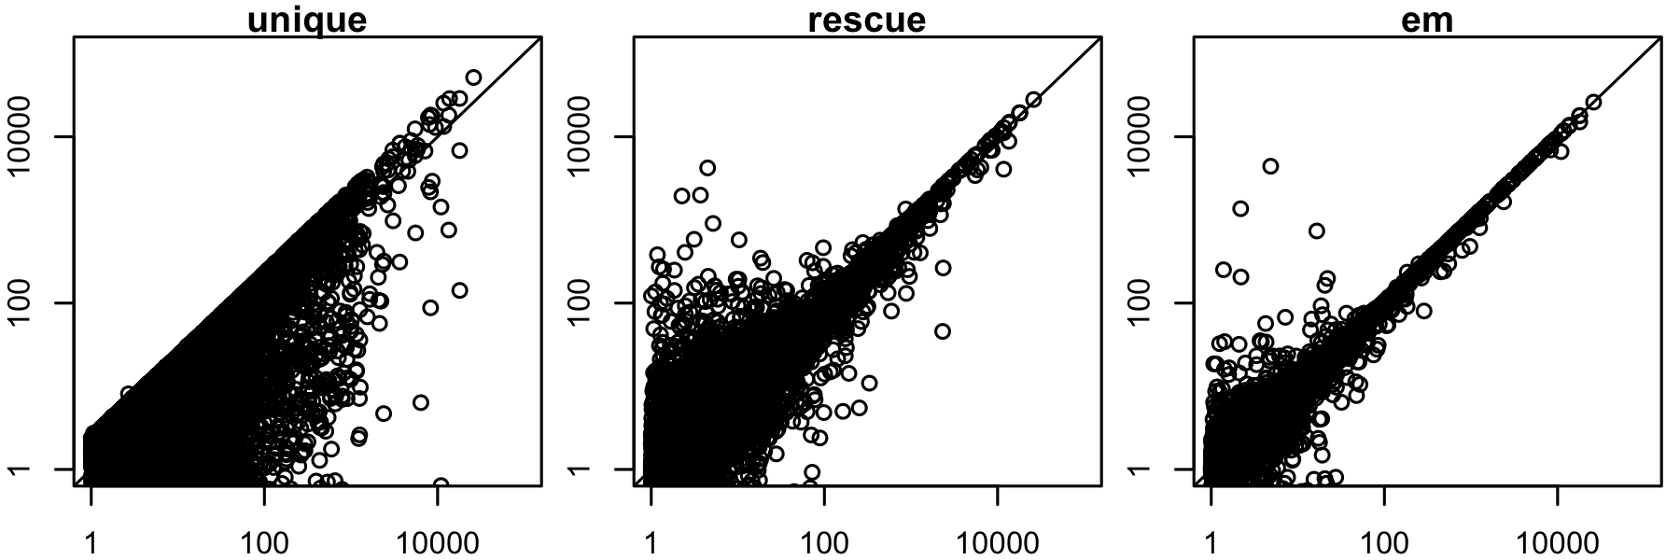
Improving accuracy on repetitive genomes: maize
predicted expression level
true expression level
Maize gene-level expression estimation

Slide 40
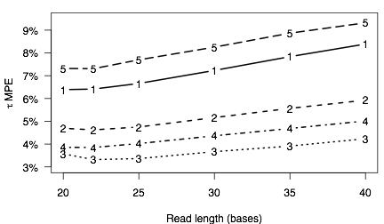
Finding the optimal read length
median percent error
1-3: mouse liver, increasing
base throughput
4: mouse brain
5: maize

Slide 41
RNA-Seq and RSEM summary
RNA-Seq is the preferred technology for transcriptome analysis in most settings
The major challenge in analyzing RNA-Seq data: the reads are much shorter than the transcripts from which they are derived
Tasks with RNA-Seq data thus require handling hidden information: which gene/isoform gave rise to a given read
The Expectation-Maximization algorithm is extremely powerful in these situations

Slide 42
Recent developments in RNA-Seq
Long read sequences: PacBio and Oxford Nanopore
Single-cell RNA-Seq: review
  Observe heterogeneity of cell populations
  Model technical artifacts (e.g. artificial 0 counts)
  Detect sub-populations
  Predict pseudotime through dynamic processes
  Detect gene-gene and cell-cell relationships
Alignment-free quantification:
  Kallisto
  Salmon

Slide 43
Public sources of RNA-Seq data
Gene Expression Omnibus (GEO): http://www.ncbi.nlm.nih.gov/geo/
  Both microarray and sequencing data
Sequence Read Archive (SRA): http://www.ncbi.nlm.nih.gov/sra
  All sequencing data (not necessarily RNA-Seq)
ArrayExpress: https://www.ebi.ac.uk/arrayexpress/
  European version of GEO
Homogenized data: MetaSRA, Toil, recount2, ARCHS⁴

Slide 44
Goals
What are the axolotl genes that are responsible for this remarkable regenerative ability?
Can this knowledge improve our medical treatments of severe wounds and tissue regeneration?

Slide 45

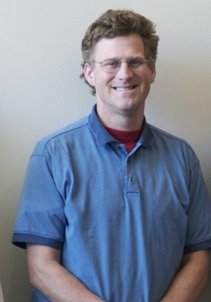


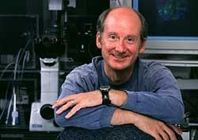

Some motivation
Axolotl
James Thomson
Ron Stewart
Regenerative Biology Laboratory, Morgridge Institute for Research, Madison, WI

Slide 46

Axolotl limb regeneration
David Gardiner - HHMI-UCI

Slide 47
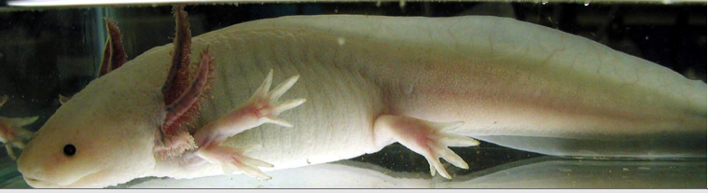
Axolotl background
Ambystoma mexicanum
Natural habitats
  Lake Xochimilco (canals)
  Lake Chalco (drained)
  Endangered
Commonly sold as pets
Neotenous
Regenerative abilities
  Limbs
  Portions of Heart
  Portions of Brain
  Tail and spinal cord

Slide 48
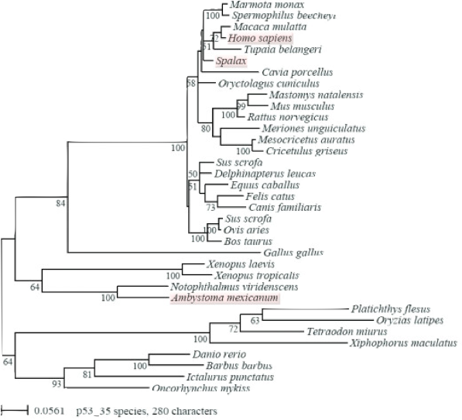
Challenges with genomic studies of Axolotl
No genome sequence available
  genome estimated to be 10x larger than that of human
Distantly related to other model organisms
340 mya
280 mya
Villiard et al. 2007

Slide 49
Prior gene expression studies in Axolotl
Microarrays
  Exist, but not very complete
  Limited amount of mRNA sequence data from Axolotl
  No genome, so can’t use predicted gene sequences

Slide 50
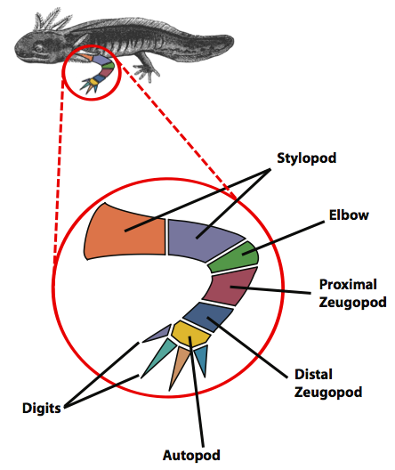
Axolotl experimental setup
Samples
Stylopod (upper arm) (3)
Zeugopod (lower arm) (3)
Autopod (hand) (3)
Digits (3)
30 day blastema (5)
Comparative RNA-seq analysis in the unsequenced axolotl: The oncogene burst highlights early gene expression in the blastema R. Stewart, C. Rascón, S. Tian, J. Nie, C. Barry, L. Chu, R. Wagner, M. Probasco, J. Bolin, N. Leng, S. Sengupta, M. Volkmer, B. Habermann, E. Tanaka, J. Thomson, and C. Dewey
PLoS Computational Biology. 9(3): e1002936. 2013.

Slide 51
Human-based analysis of axolotl transcription
Axolotl RNA-Seq reads
Bowtie/
RSEM
Axolotl transcript contigs
BLAST
Human transcripts
Human genes

Slide 52
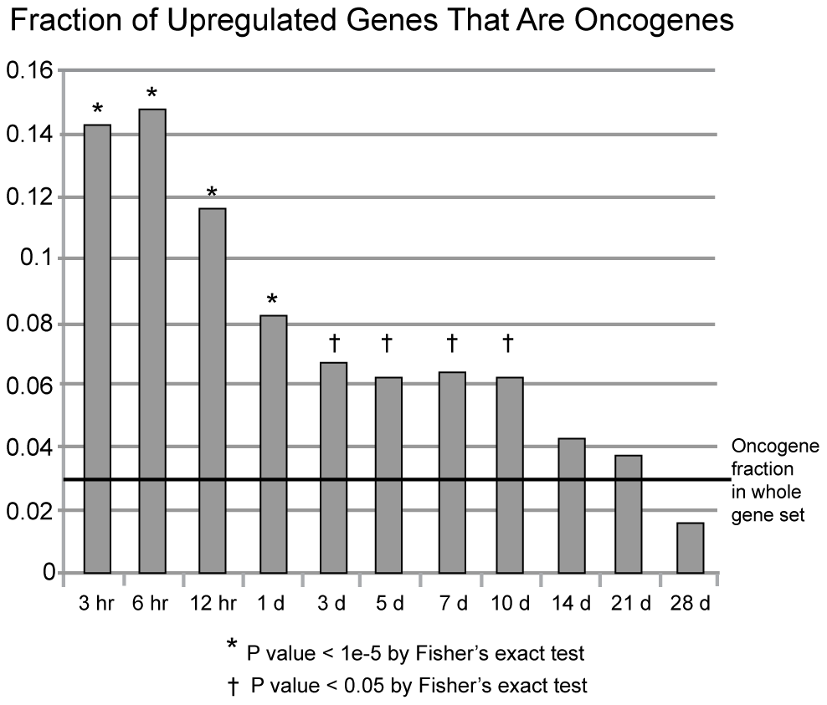
The oncogene burst

Slide 53
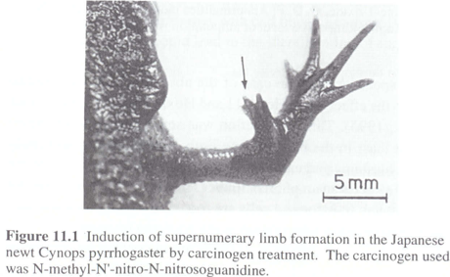
Regeneration as controlled cancer
P Tsonis, Limb Regeneration, 1996, Cambridge University Press
Limb Regeneration -- Oncogenes and tumor suppressors
“Controlled Cancer” --> development and differentiation
Salamanders very resistant to tumorigenesis by carcinogens

