Slide 1
Inference of alternative splicing from RNA-Seq data with probabilistic splice graphs
BMI/CS 776
www.biostat.wisc.edu/bmi776/
Spring 2019
Colin Dewey
cdewey@biostat.wisc.edu

Slide 2
Overview
Part I - Alternative splicing and the challenges it poses
Part II - A solution: Probabilistic Splice Graphs (PSGs)
Part III - Evaluating PSG methodology

Slide 3
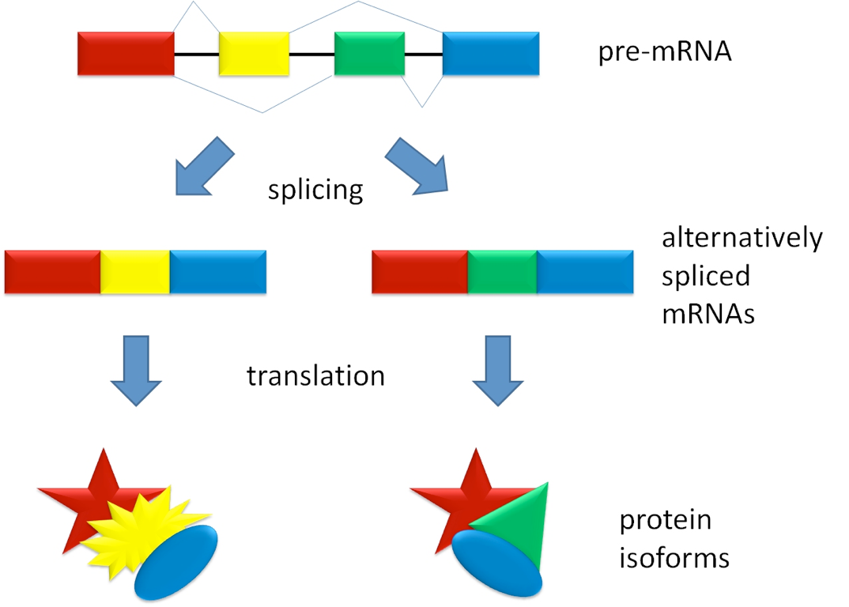
Alternative splicing

Slide 4
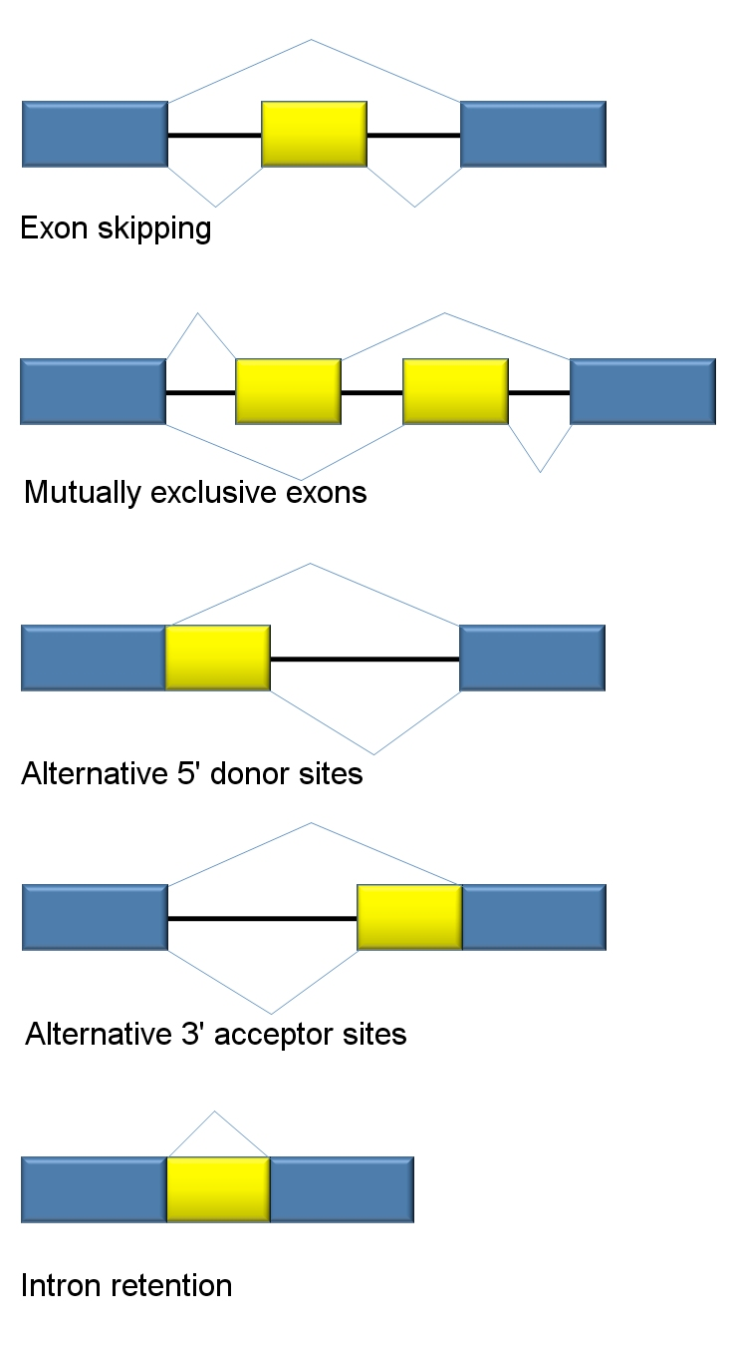
Classes of alternative splicing events

Slide 5
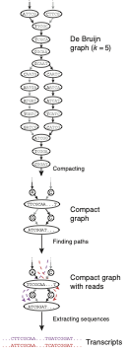
Complication 1: De novo transcriptome assembly
RNA-Seq reads/fragments are relatively short
Often insufficient to reconstruct full-length isoforms in the presence of alternative splicing
Transcriptome assemblies perhaps best left in “graph” form
  De Bruijn graph
  String graphs
Graph constructed by the “Butterfly” module of Trinity
(Grabherr et al. 2011)

Slide 6
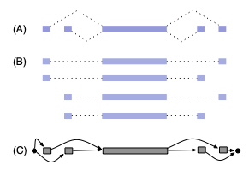
Complication 2: Non-identifiability of full-length isoform models
6
4
10
4
6
4
6
2
4
4
Lacroix et al. 2008; Hiller et al. 2009

Slide 7
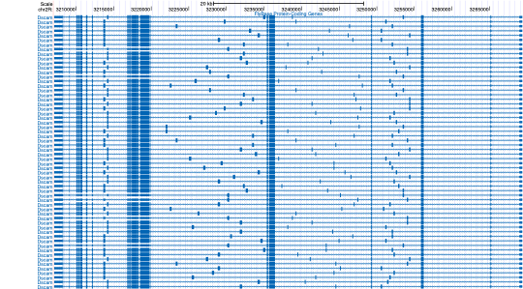
Complication 3: Combinatorial explosion of distinct isoforms
Combinatorial explosion of the number of possible isoforms for each gene
Insufficient data to accurately estimate abundances of thousands of isoforms
Drosophila Dscam: more than 38,000 possible isoforms
(Schmucker et al., 2000)

Slide 8
Overview
Part I - Alternative splicing and the challenges it poses
Part II - A solution: Probabilistic Splice Graphs (PSGs)
Part III - Evaluating PSG methodology

Slide 9
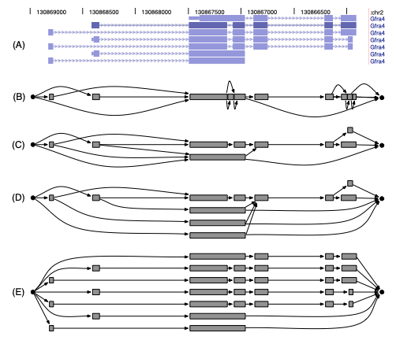
Splice Graphs
Heber et al. 2002
Compact data structure for representing the possible isoforms of a gene

Slide 10
Splice Graphs with EST and RNA-Seq data
Xing et al. 2006
  EM algorithm for estimating abundances of all possible isoforms given splice graph and EST data
Montgomery et al. 2010, Singh et al. 2011
  Graph flow-based methods for quantification/differential splicing given RNA-Seq data
Rogers et al. 2012
  SpliceGrapher: construct splice graph structure given RNA-Seq data

Slide 11
Probabilistic Splice Graphs
Jenkins et al. 2006
Compact probabilistic model representing isoform frequencies in terms of frequencies of individual splice events
Originally used by Jenkins et al. for EST analysis
0.32
0.48
0.8
0.4
0.08
0.12
0.6
0.2

Slide 12
Probabilistic Splice Graph Complexity
known isoforms
“line graph”
“exon graph”
“higher-order exon graph”
“unfactorized graph”

Slide 13
Advantages of PSGs
Compact description of the possible isoforms of a gene
  Models the frequencies of potentially exponentially many isoforms with a polynomial number of parameters
  Models dependence or independence of splice events
The parameters of a PSG are more often identifiable than a model that has a parameter for every possible isoform
Splice graphs are naturally-produced structures from transcriptome assemblers

Slide 14
PSGs are alternative “parsimonious” models
Other methods find smallest set of isoform structures that explain the data
  Cufflinks (Trapnell et al., 2010)
  IsoLasso (Li et al., 2011)
  NSMAP (Xia et al., 2011)
  SLIDE (Li et al., 2011)
PSG models are another form of parsimonious model
  Minimize the number of splice event parameters
  Assumption of independence between splice events

Slide 15
Our contributions
Application of PSGs to RNA-Seq data
  Combined model of PSG with RNA-Seq generative model
  Efficient PSG parameter estimation with EM and dynamic programming
  Identifiability proofs for PSG with RNA-Seq data
  Differential processing (splicing) tests
L. Legault and C. Dewey. Inference of alternative splicing from RNA-Seq data with probabilistic splice graphs. Bioinformatics 29(18):2300-2310.

Slide 16
The PSG parameter inference task
Given: RNA-Seq reads and a PSG structure
Do: Estimate the (ML or MAP) parameters for the model
CCTTCNCACTTCGTTTCCCAC
TTTTTNCAGAGTTTTTTCTTG
GAACANTCCAACGCTTGGTGA
GGAAANAAGACCCTGTTGAGC
CCCGGNGATCCGCTGGGACAA
GCAGCATATTGATAGATAACT
CTAGCTACGCGTACGCGATCG
CATCTAGCATCGCGTTGCGTT
?
?
?
?

Slide 17


A model of RNA-Seq from PSGs
RSEM model extended to probabilistic splice graphs
  fragment length distribution, quality scores, read mapping ambiguity
Dynamic programming algorithms → polynomial time inference for genes with an exponential number of isoforms
Probability of including vertex j given that vertex i was in transcript
Expected prefix length
Expected suffix length

Slide 18


EM for PSG parameter estimation
E-step: compute the expectation of the number of times edge (i,j) is used
M-step: maximize the completely-observed likelihood given the edge counts

Slide 19
Identifiability of PSGs with RNA-Seq data
Identifiability:
Proposition: If for all edges (u, v), there exists a read that is uniquely derived from that edge, or v has indegree 1 and there exists a read that is uniquely derived from v, then the PSG is identifiable.
not identifiable
identifiable

Slide 20






The differential processing (DP) task
Given: RNA-Seq reads from two conditions and a PSG structure
Do: Determine if the processing frequencies are different
condition 1
condition 2
CCTTCNCACTTCGTTTCCCAC
TTTTTNCAGAGTTTTTTCTTG
GAACANTCCAACGCTTGGTGA
GGAAANAAGACCCTGTTGAGC
CCCGGNGATCCGCTGGGACAA
GCAGCATATTGATAGATAACT
CTAGCTACGCGTACGCGATCG
CATCTAGCATCGCGTTGCGTT
CATATCGTCGTAGCTAGTACG
CCACACTAGGCTACGTGCGCA
TCGACGCTACCGGCATCGCGC
ACTAGTACGTACGTAGTAGCT
GGATGCTCAGATGGCTATCGG
CGCATTACGGAAGCTCATCGA
AACCATCGGAAGGCCGTTTAA
CAGCTAGGCGCTAGGCGCTTT
CATGCTAGCGCGATCGCGTAG
GCATCGACTCGCGACCGATCC
ACGCATCGACTCGCGCATCGC

Slide 21

Our approach to the differential processing (DP) task
Simple likelihood ratio tests with PSG model
Test for null hypothesis that all frequencies are the same
Test for null hypothesis that frequencies of edges out of one vertex (i) are the same
LR =
LR =

Slide 22
Overview
Part I - The problem
Part II - A solution: Probabilistic Splice Graphs (PSGs)
Part III - Evaluating PSG methodology

Slide 23
Efficient inference for highly-spliced genes
DSCAM running time test
  23,976 isoforms
  184 read pairs from a modENCODE sample
Method | RSEM | Cufflinks | PSG EM
Running time | Not possible | > 6 hours (> 90 GB RAM) | < 3 seconds

Slide 24
A simple method for comparison
The Junction-Read (JR) method
Keep only reads that align to the splice junctions (edges in the PSG)
Throws away data, but is very robust to model assumption violations
0.4
0.6

Slide 25
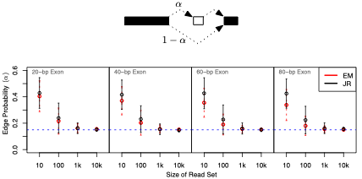
Convergence with simulated data

Slide 26
Comparisons on real data
Require notion of “distance” between estimates from different methods
Our distance measure:
  per vertex
  maximum difference between probability estimates on out-edges of vertex (L-∞ norm)
method A
method B
0.2
0.6
0.5
0.3
0.3
0.1

Slide 27
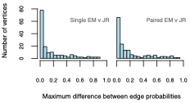
How close are the estimates from JR and EM on real data?
Vertices from 88 most abundant (> 5000 reads) alternatively-spliced genes in a modENCODE fly data set

Slide 28
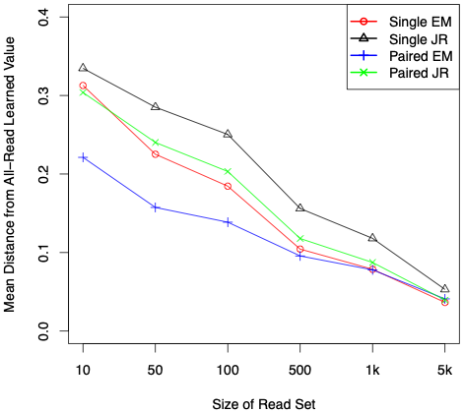
Convergence of estimates on real data

Slide 29
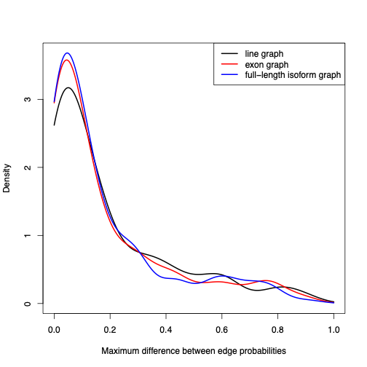
Comparing PSGs of different complexity
Same set of fly data
Estimated with three classes of PSG: line, exon, full-length
Compared estimates to those from JR (gold-standard)
No statistically-significant difference between exon and full-length graph estimates

Slide 30
Summary of Junction-Read comparison results
Estimates using PSG models are generally close to those from the simplistic JR-method
  ⇒PSG model assumptions appear to be reasonable
PSG estimates converge more quickly as the data set increases in size
  ⇒Our EM estimation procedure uses information from all reads, not just those that span splice junctions
Exon-graph estimates as good as those using traditional full-length isoform models
  ⇒Independence assumptions of exon graphs appear to be reasonable

Slide 31
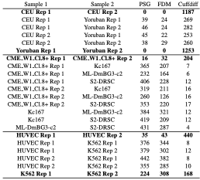
Differential processing detection
DP Accuracy on real data
# of DP genes

Slide 32
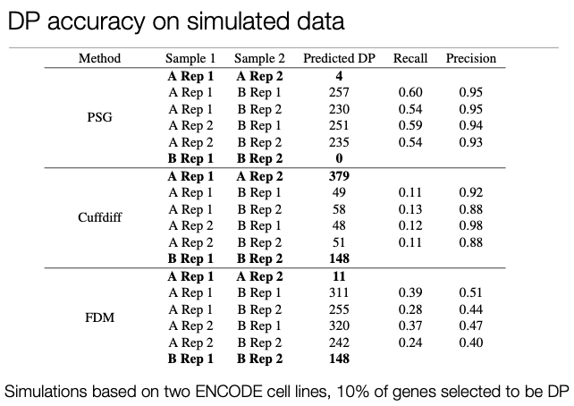
Differential processing detection

Slide 33
Next steps for modeling RNA-Seq with PSGs
Graph construction
  Exon discovery
  Splice junction discovery
Model selection
  Learning dependencies between splice events
or

Slide 34
Summary
Alternative splicing is a significant complication in RNA-Seq analysis
Probabilistic Splice Graphs enable identifiable models for alternatively spliced genes with efficient inference algorithms
Differential processing (splicing) tests with PSG models look promising

