Slide 1
Inferring Models of cis-Regulatory Modules using Information Theory
BMI/CS 776
www.biostat.wisc.edu/bmi776/
Spring 2020
Daifeng Wang
daifeng.wang@wisc.edu
These slides, excluding third-party material, are licensed under CC BY-NC 4.0 by Mark Craven, Colin Dewey, Anthony Gitter and Daifeng Wang

Slide 2
Overview
Biological question
  What is causing differential gene expression?
Goal
  Find regulatory motifs in the DNA sequence
Solution
  FIRE (Finding Informative Regulatory Elements)

Slide 3
Goals for Lecture
Key concepts:
Entropy
Mutual information (MI)
Motif logos
Using MI to identify cis-regulatory module elements

Slide 4

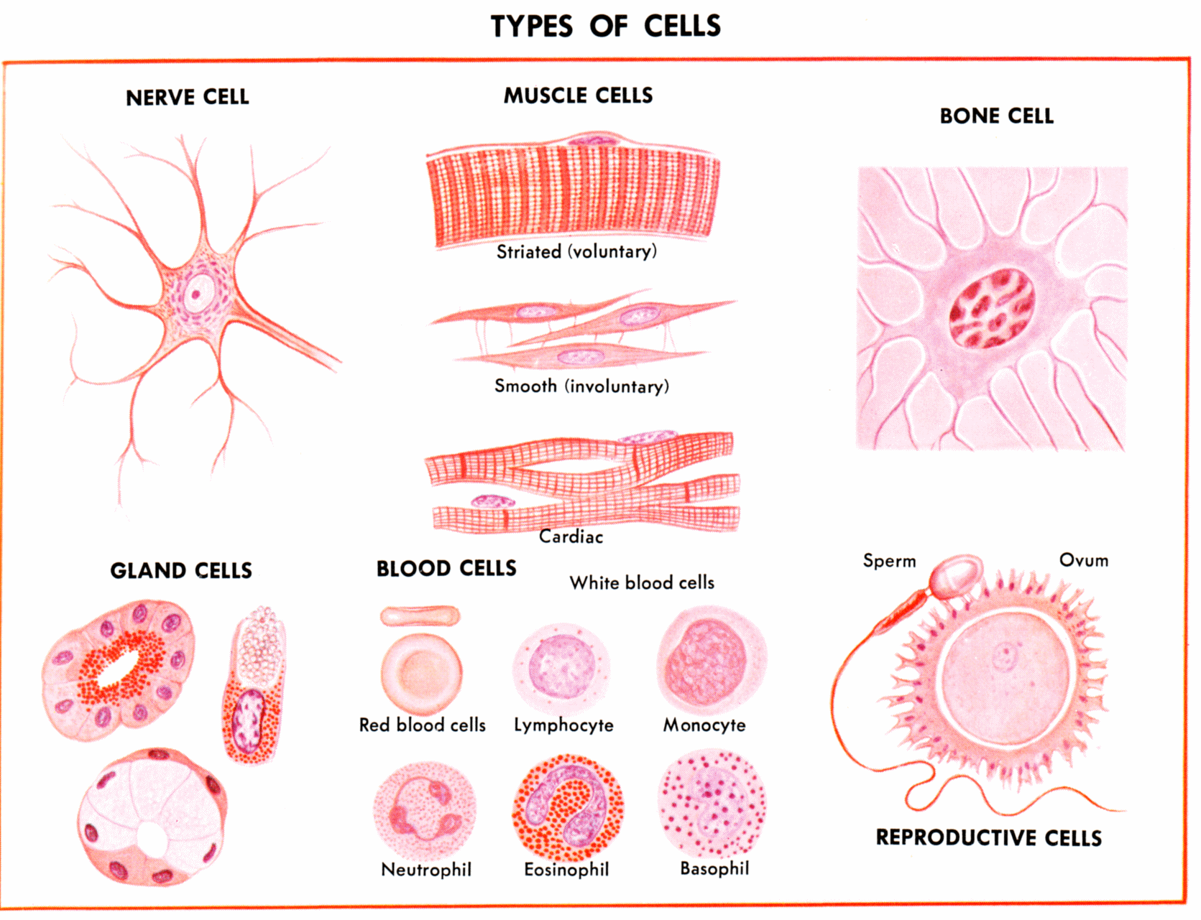
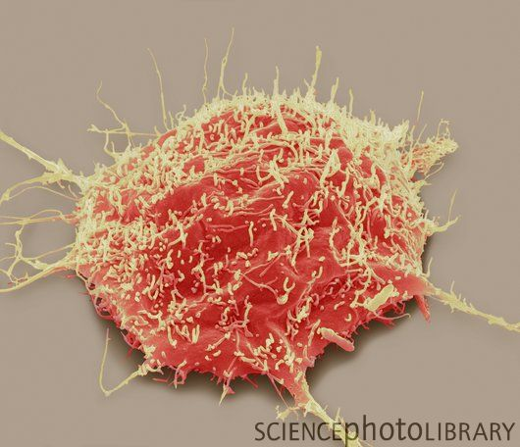
Gene expression and regulation
Identical DNA but different gene expression
Protein
Central dogma
translation
RNA
transcription
Gene
DNA
Gene expression levels (e.g., values to quantify RNA abundances)
nerve
bone
disease
Gene function
Gene regulation: mechanisms controlling
gene expression levels

Slide 5
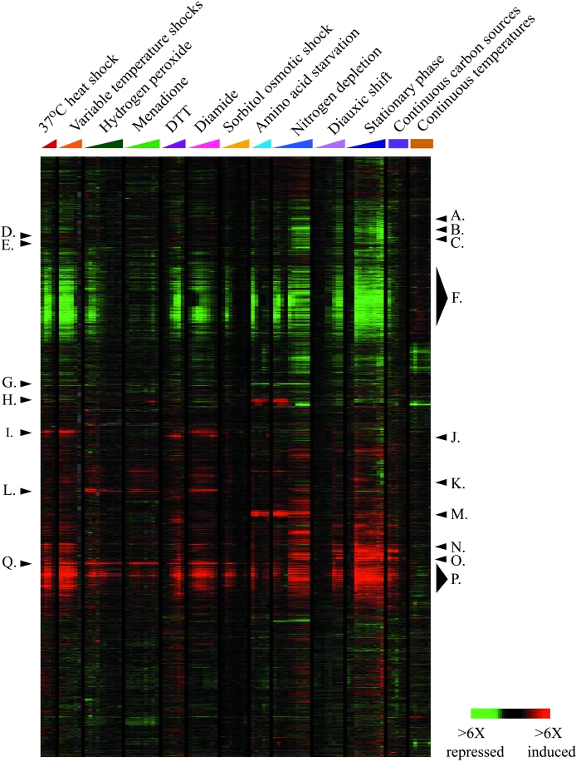
A Common Type of Question
What causes this set of yeast genes to be up-regulated in stress conditions?
Genes
Experiments / Conditions
Figure from Gasch et al., Mol. Biol. Cell, 2000

Slide 6
cis-Regulatory Modules (CRMs)
Co-expressed genes are often controlled by specific configurations of binding sites
RNAP
…accgcgctgaaaaaattttccgatgagtttagaagagtcaccaaaaaattttcatacagcctactggtgttctctgtgtgtgctaccactggctgtcatcatggttgta…
…caaaattattcaagaaaaaaagaaatgttacaatgaatgcaaaagatgggcgatgagataaaagcgagagataaaaatttttgagcttaaatgatctggcatgagcagt…
…gagctggaaaaaaaaaaaatttcaaaagaaaacgcgatgagcatactaatgctaaaaatttttgaggtataaagtaacgaattggggaaaggccatcaatatgaagtcg…
RNAP
RNAP

Slide 7
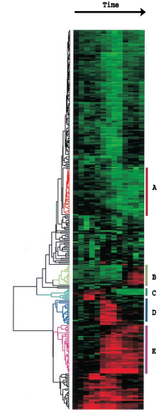
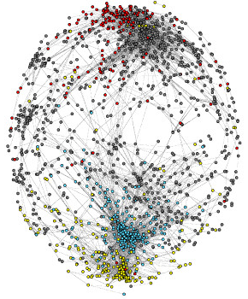
Co-expressed genes have similar functions in single species
Yeast cell cycle
18 time points
A gene co-expression network (relationship) can reveal functional groupings
Hierarchal clustering, K-means, Gaussian mixture model (GMM), Principal component analysis (PCA), …
6000 genes
node: gene
edge: expression correlation
Protein synthesis
Eisen et al., PNAS, 1998.
Carlson et al., BMC Bioinformatics, 2006.

Slide 8
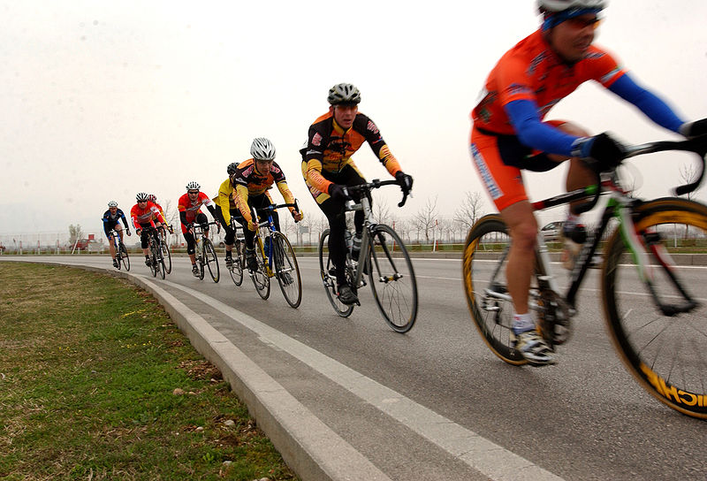

Information Theory Background
Problem
  Create a code to communicate information
Example
  Need to communicate the manufacturer of each bike

Slide 9
Information Theory Background
Four types of bikes
Possible code
Type
code
Trek
11
Specialized
10
Cervelo
01
Serotta
00
Expected number of bits we have to communicate: 2 bits/bike

Slide 10
Information Theory Background
Can we do better?
Yes, if the bike types aren’t equiprobable
Optimal code uses bits for event with probability
Type, probability
# bits
code
1
1
2
01
3
001
3
000

Slide 11
Information Theory Background
Type, probability
# bits
code
1
1
2
01
3
001
3
000
Expected number of bits we have to communicate: 1.75 bits/bike

Slide 12
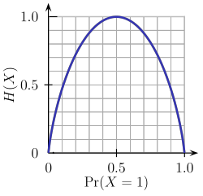
Entropy
Entropy is a measure of uncertainty associated with a random variable
Can be interpreted as the expected number of bits required to communicate the value of the variable
entropy function for
binary variable
Image from Wikipedia

Slide 13
How is entropy related to
DNA sequences?

Slide 14
Sequence Logos
Typically represent a binding site
Height of each character c is proportional to P(c)

Slide 15
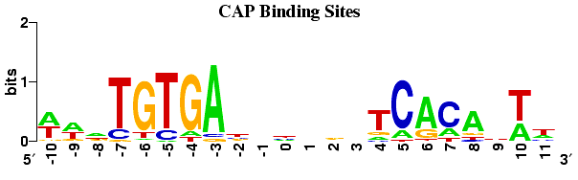
Sequence Logos
Height of logo at a given position determined by decrease in entropy (from maximum possible); i.e., information content
# of characters in alphabet
decrease in entropy

Slide 16
Mutual Information
Mutual information quantifies how much knowing the value of one variable tells about the value of another
entropy of M
conditioned on C
entropy of M

Slide 17
Correlation vs. Mutual information
Human Brain Mapping, Volume: 38, Issue: 3, Pages: 1541-1573, First published: 17 November 2016, DOI: (10.1002/hbm.23471)

Slide 18
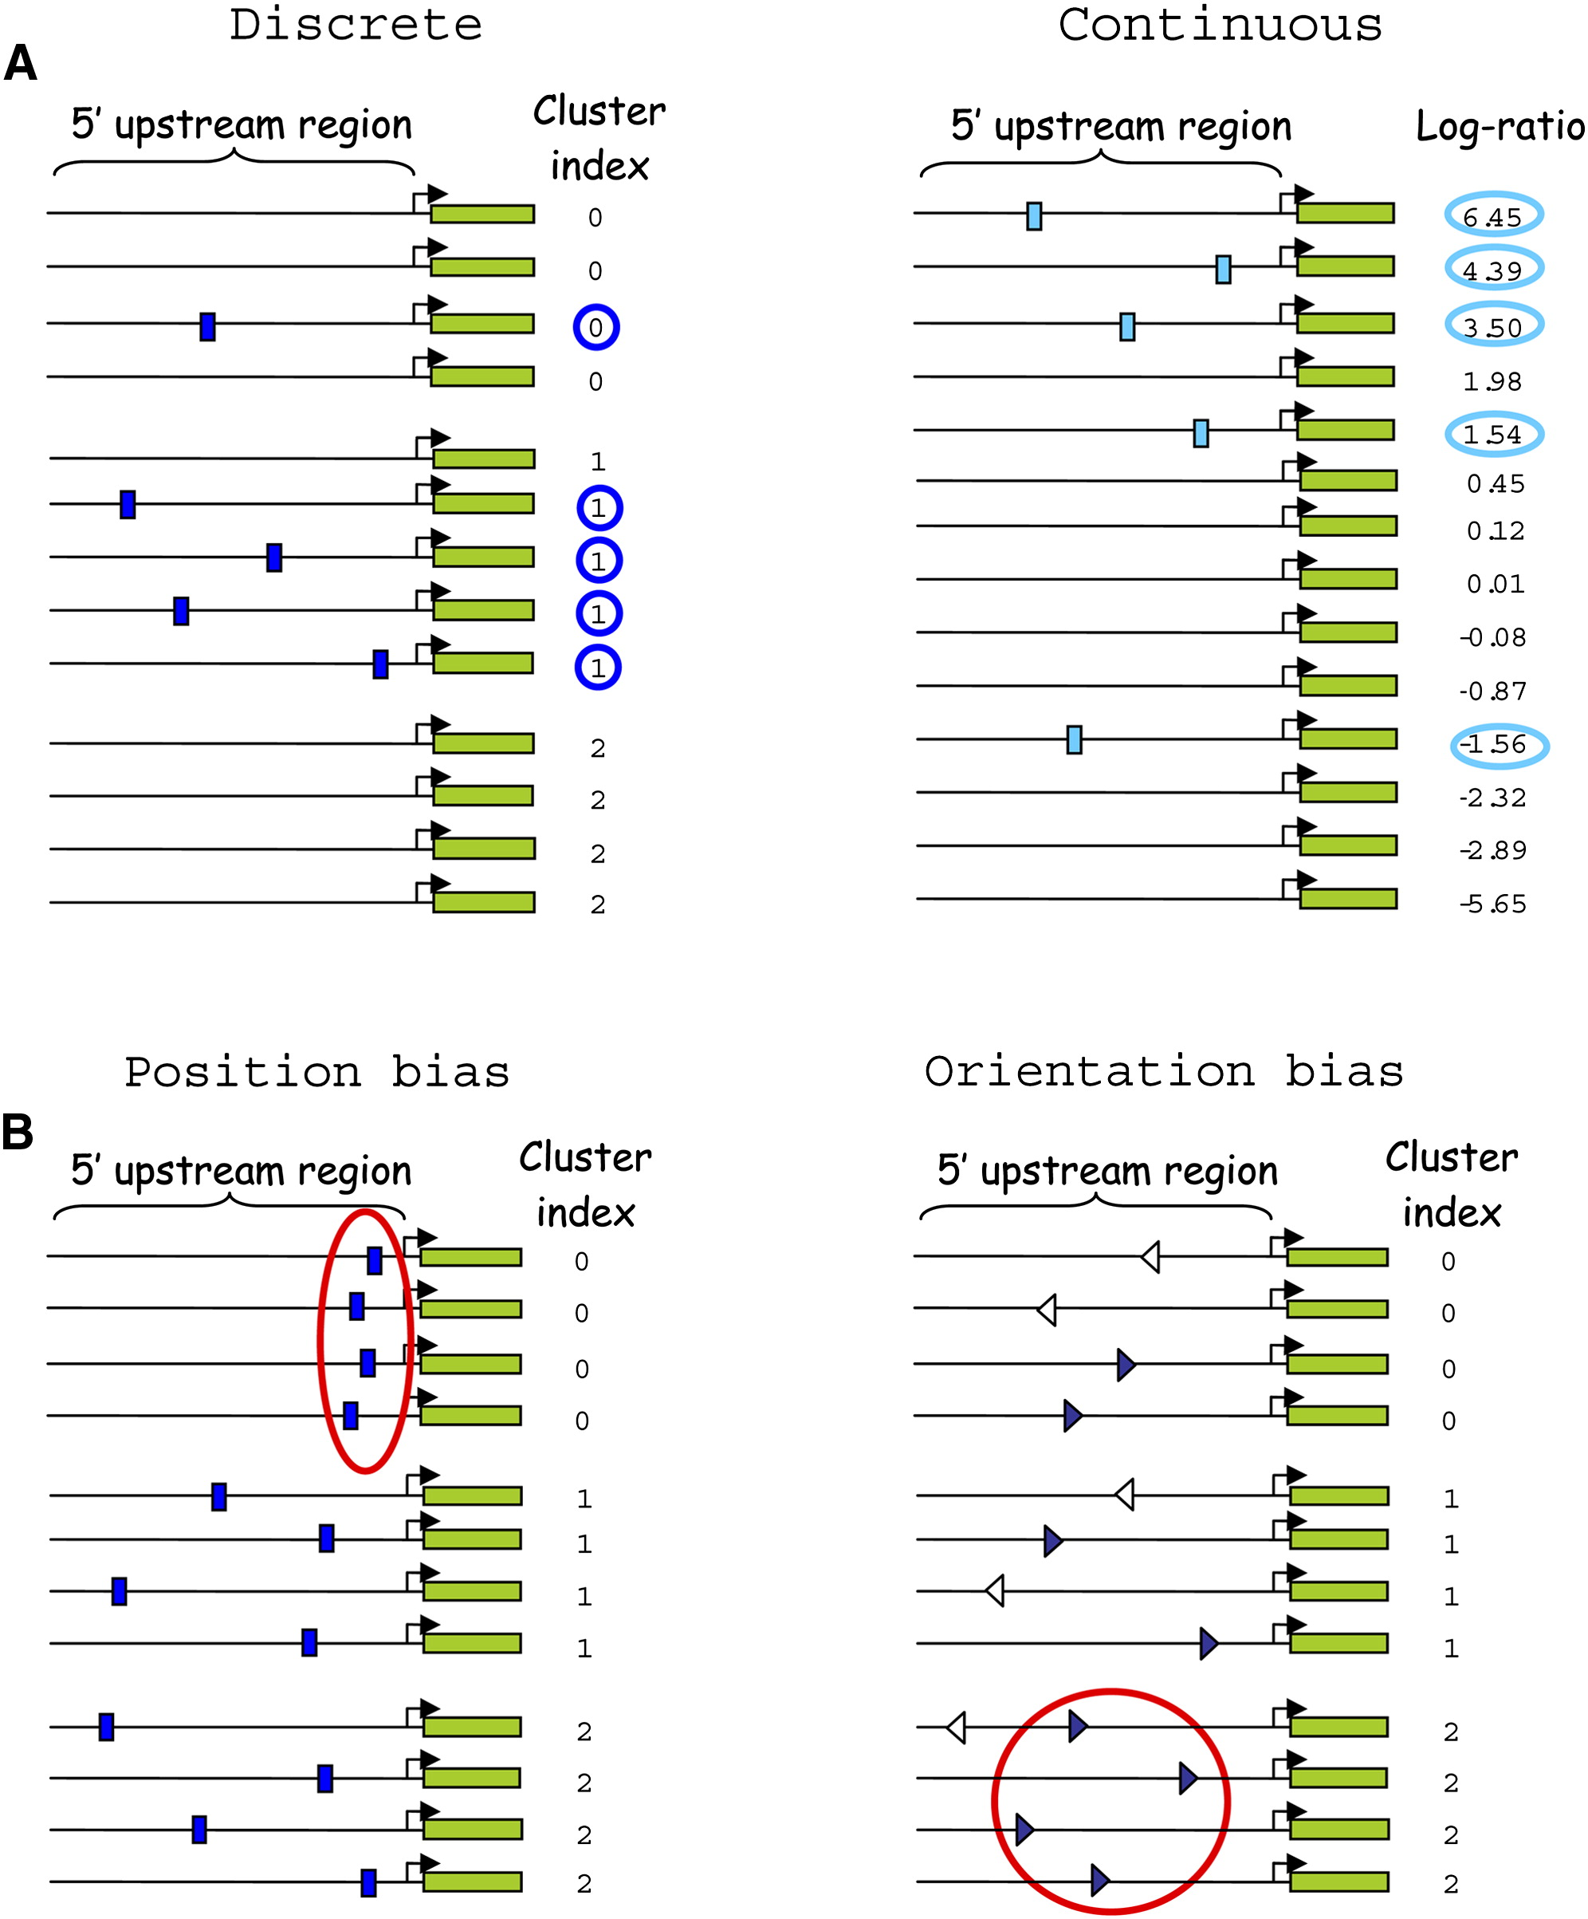
FIRE
Elemento et al., Molecular Cell 2007
Finding Informative Regulatory Elements (FIRE)
Given a set of sequences grouped into clusters
Find motifs, and relationships, that have high mutual information with the clusters
Applicable when sequences have continuous values instead of cluster labels

Slide 19
Mutual Information in FIRE
We can compute the mutual information between a motif and the clusters as follows
m=0, 1 represent absence/presence of motif
c ranges over the cluster labels

Slide 20
Finding Motifs in FIRE
Motifs are represented by regular expressions; initially each motif is represented by a strict k-mer (e.g. TCCGTAC)
Test all k-mers (k=7 by default) to see which have significant mutual information with the cluster label
Filter k-mers using a significance test to obtain motif seeds
Generalize each motif seed
Filter motifs using a significance test

Slide 21
Significance test via randomization
Given an empirical MI value for a motif, I
Randomly shuffle cluster labels of genes (or other variables such as expression), and calculate MI
Repeat shuffling N_{r} times and get N_{r} MI values
Pseudo p-value = sum(I < N_{r} MI values)/N_{r} to see if it is less than a significance threshold (e.g., 1/N_{r})
  Z-score = (I – mean(I_{random}))/sigma(I_{random})
Elemento et al., Molecular Cell 2007, Supplement
Notes:
Evaluating the information significance via randomization tests
To estimate the statistical significance of observed empirical information values, non- parametric randomization tests are applied. Specifically, let I denote the obtained empirical mutual information, e.g., between a given motif profile and the expression profile. Next, we randomly shuffle the expression profile and calculate the information value between the unchanged motif profile and the shuffled expression profile. We repeat the same procedure Nr times to obtain Nr random information values, and consider the original empirical information, I, as statistically significant (with p < (1/Nr)), if and only if it is greater than all Nr random information values. As detailed below, different Nr values are used by default, depending on the context and on the number of hypotheses tested. In addition, a corresponding Z-score is reported, defined as Z=(I- <Irandom>)/σrandom where <Irandom> is the average random information value and σrandom is the corresponding standard deviation. This Z-score is often useful in comparing motifs that pass the randomization test, as it reflects how far the empirical information is, in number of standard deviations, from the average random information. However, we do not use Z-scores directly to determine the significance of mutual information values as the underlying distribution of random information values is not a normal distribution.

Slide 22
Key Step in Generalizing a Motif in FIRE
Randomly pick a position in the motif
Generalize in all ways consistent with current value at position
Score each by computing mutual information
Retain the best generalization
A or G in this position
TCCGTAC
TCC[AG]TAC
TCC[GT]TAC
TCC[CG]TAC
TCC[ACG]TAC
TCC[CGT]TAC
TCC[AGT]TAC
TCC[ACGT]TAC

Slide 23
Generalizing a Motif in FIRE
given: k-mer, n
best ← null
repeat n times
motif ← k-mer
repeat
motif ← GeneralizePosition(motif) // shown on previous slide
until convergence (no improvement at any position)
if score(motif) > score(best)
best ← motif
return: best

Slide 24
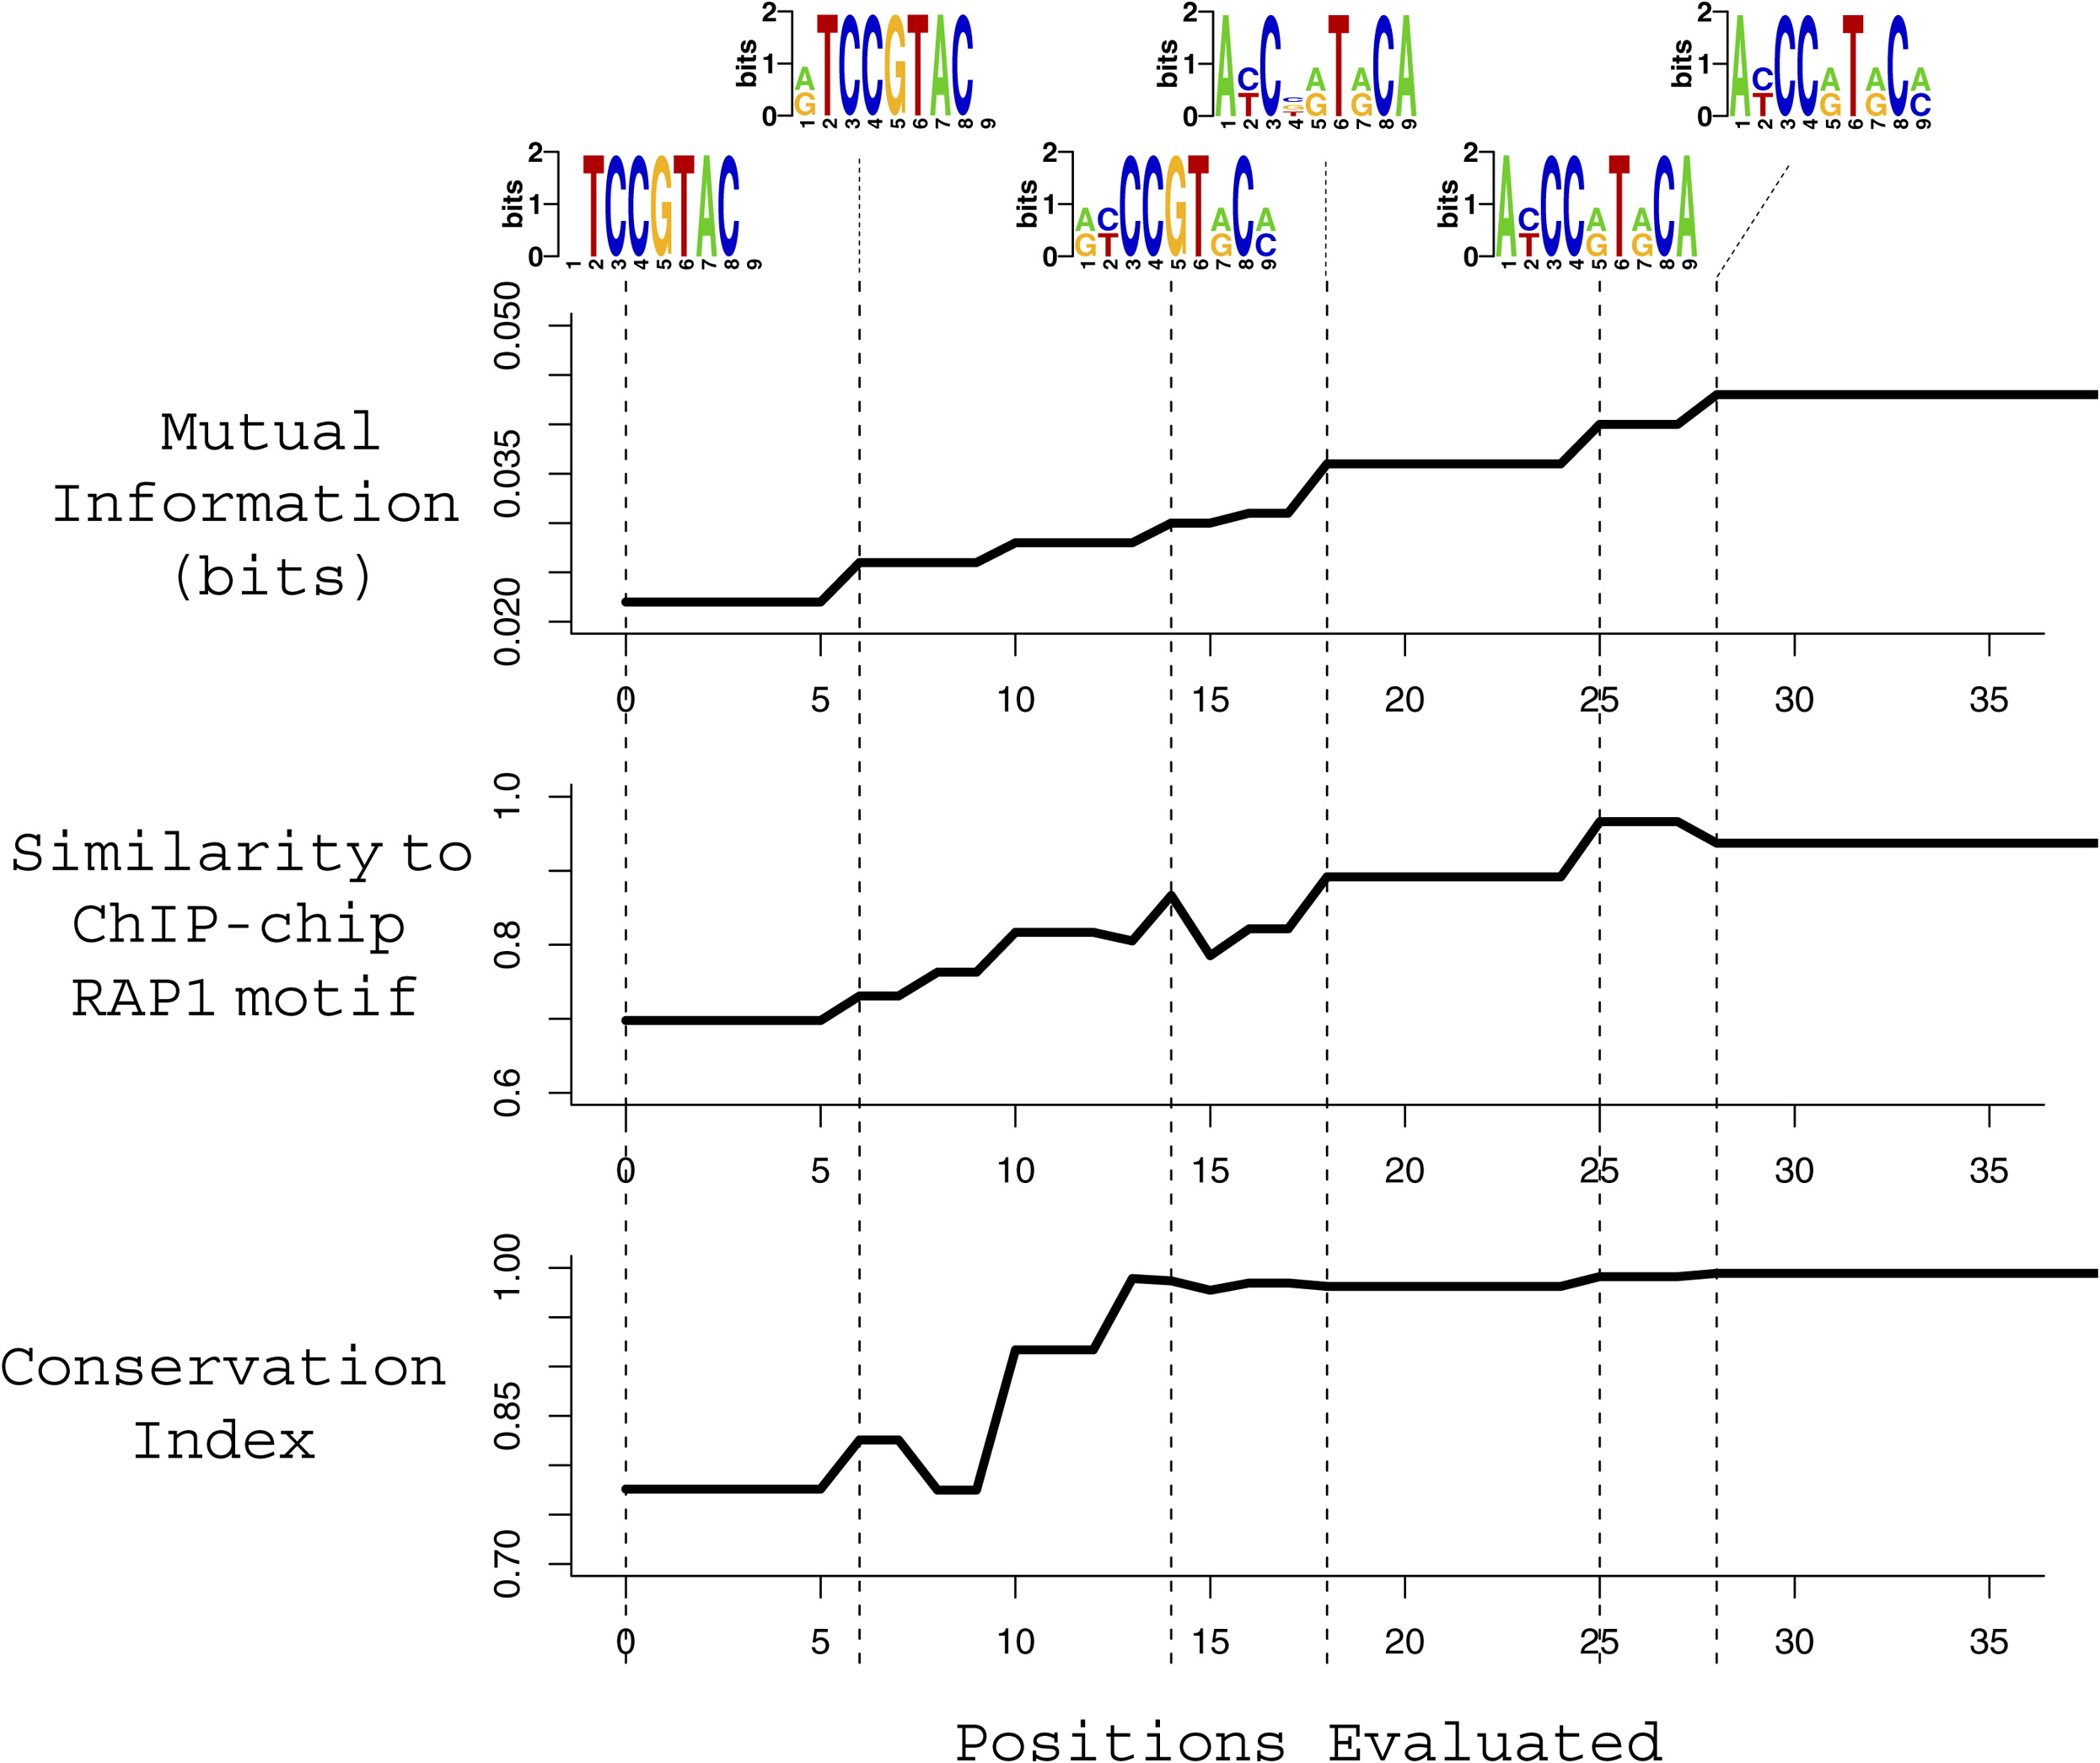
Generalizing a Motif in FIRE: Example
Independent experiment
Cross-species
Figure from Elemento et al. Molecular Cell 2007
Notes:
Figure 2 depicts the optimization process that converted
TCCGTAC into the more informative A[CT]CC[AG]
T[AG]C[AC], which matches the yeast Rap1 binding site
obtained from ChIP-chip experiments (Harbison et al.,
2004). The upper panel shows the intermediate motifs
that progressively increase the mutual information. The
middle panel shows the similarity between these intermediate
motifs and the Rap1 motif obtained from a ChIP-chip
experiment (Harbison et al., 2004) by using an independent
motif-finding program (Hughes et al., 2000). Clearly,
maximizing the information gradually leads to more accurate
representation of the Rap1 motif. The lower panel
illustrates the conservation level of these intermediate
motifs with respect to the related yeast S. bayanus, using
network-level conservation analysis (Elemento and Tavazoie,
2005). Remarkably, conservation increases as we
move toward more informative motif definitions, although
our information maximization algorithm does not use the
S. bayanus genome.

Slide 25
Avoiding Redundant Motifs
Different seeds could converge to similar motifs
Use mutual information to test whether new motif is unique and contributes new information
TCCGTAC
TCCCTAC
TCC[CG]TAC
TCC[CG]TAC
previous motif
new candidate motif
expression clusters

Slide 26
Characterizing Predicted Motifs in FIRE
Mutual information is also used to assess various properties of found motifs
  orientation bias
  position bias
  interaction with another motif

Slide 27
Using MI to Determine Orientation Bias
C indicates cluster
S=1 indicates motif present on transcribed strand
S=0 otherwise (not present or not on transcribed strand)
C S
0
0
1
1
Also compute MI where S=1 indicates motif present on complementary strand
0
1
0
1
1
1
1
1

Slide 28
Using MI to Determine Position Bias
P ranges over position bins
O=0, 1 indicates whether or not the motif is over-represented in a sequence’s cluster
P O
0
1
0
1
0
1
0
1
1
0
Only sequences containing the motif are considered for this calculation
0
0
2
0
0
0
2
0
0
0
1
0
0
0
P
2
1
0

Slide 29
Using MI to Determine Motif Interactions
M₁=0, 1 indicates whether or not a sequence has the motif and is in a cluster for which the motif is over-represented; similarly for M₂
M₁ M₂
0
0
0
0
0
0
0
0
0
1
1
0
1
1
1
1
1
1
0
1
0
0
0
1
0
0

Slide 30
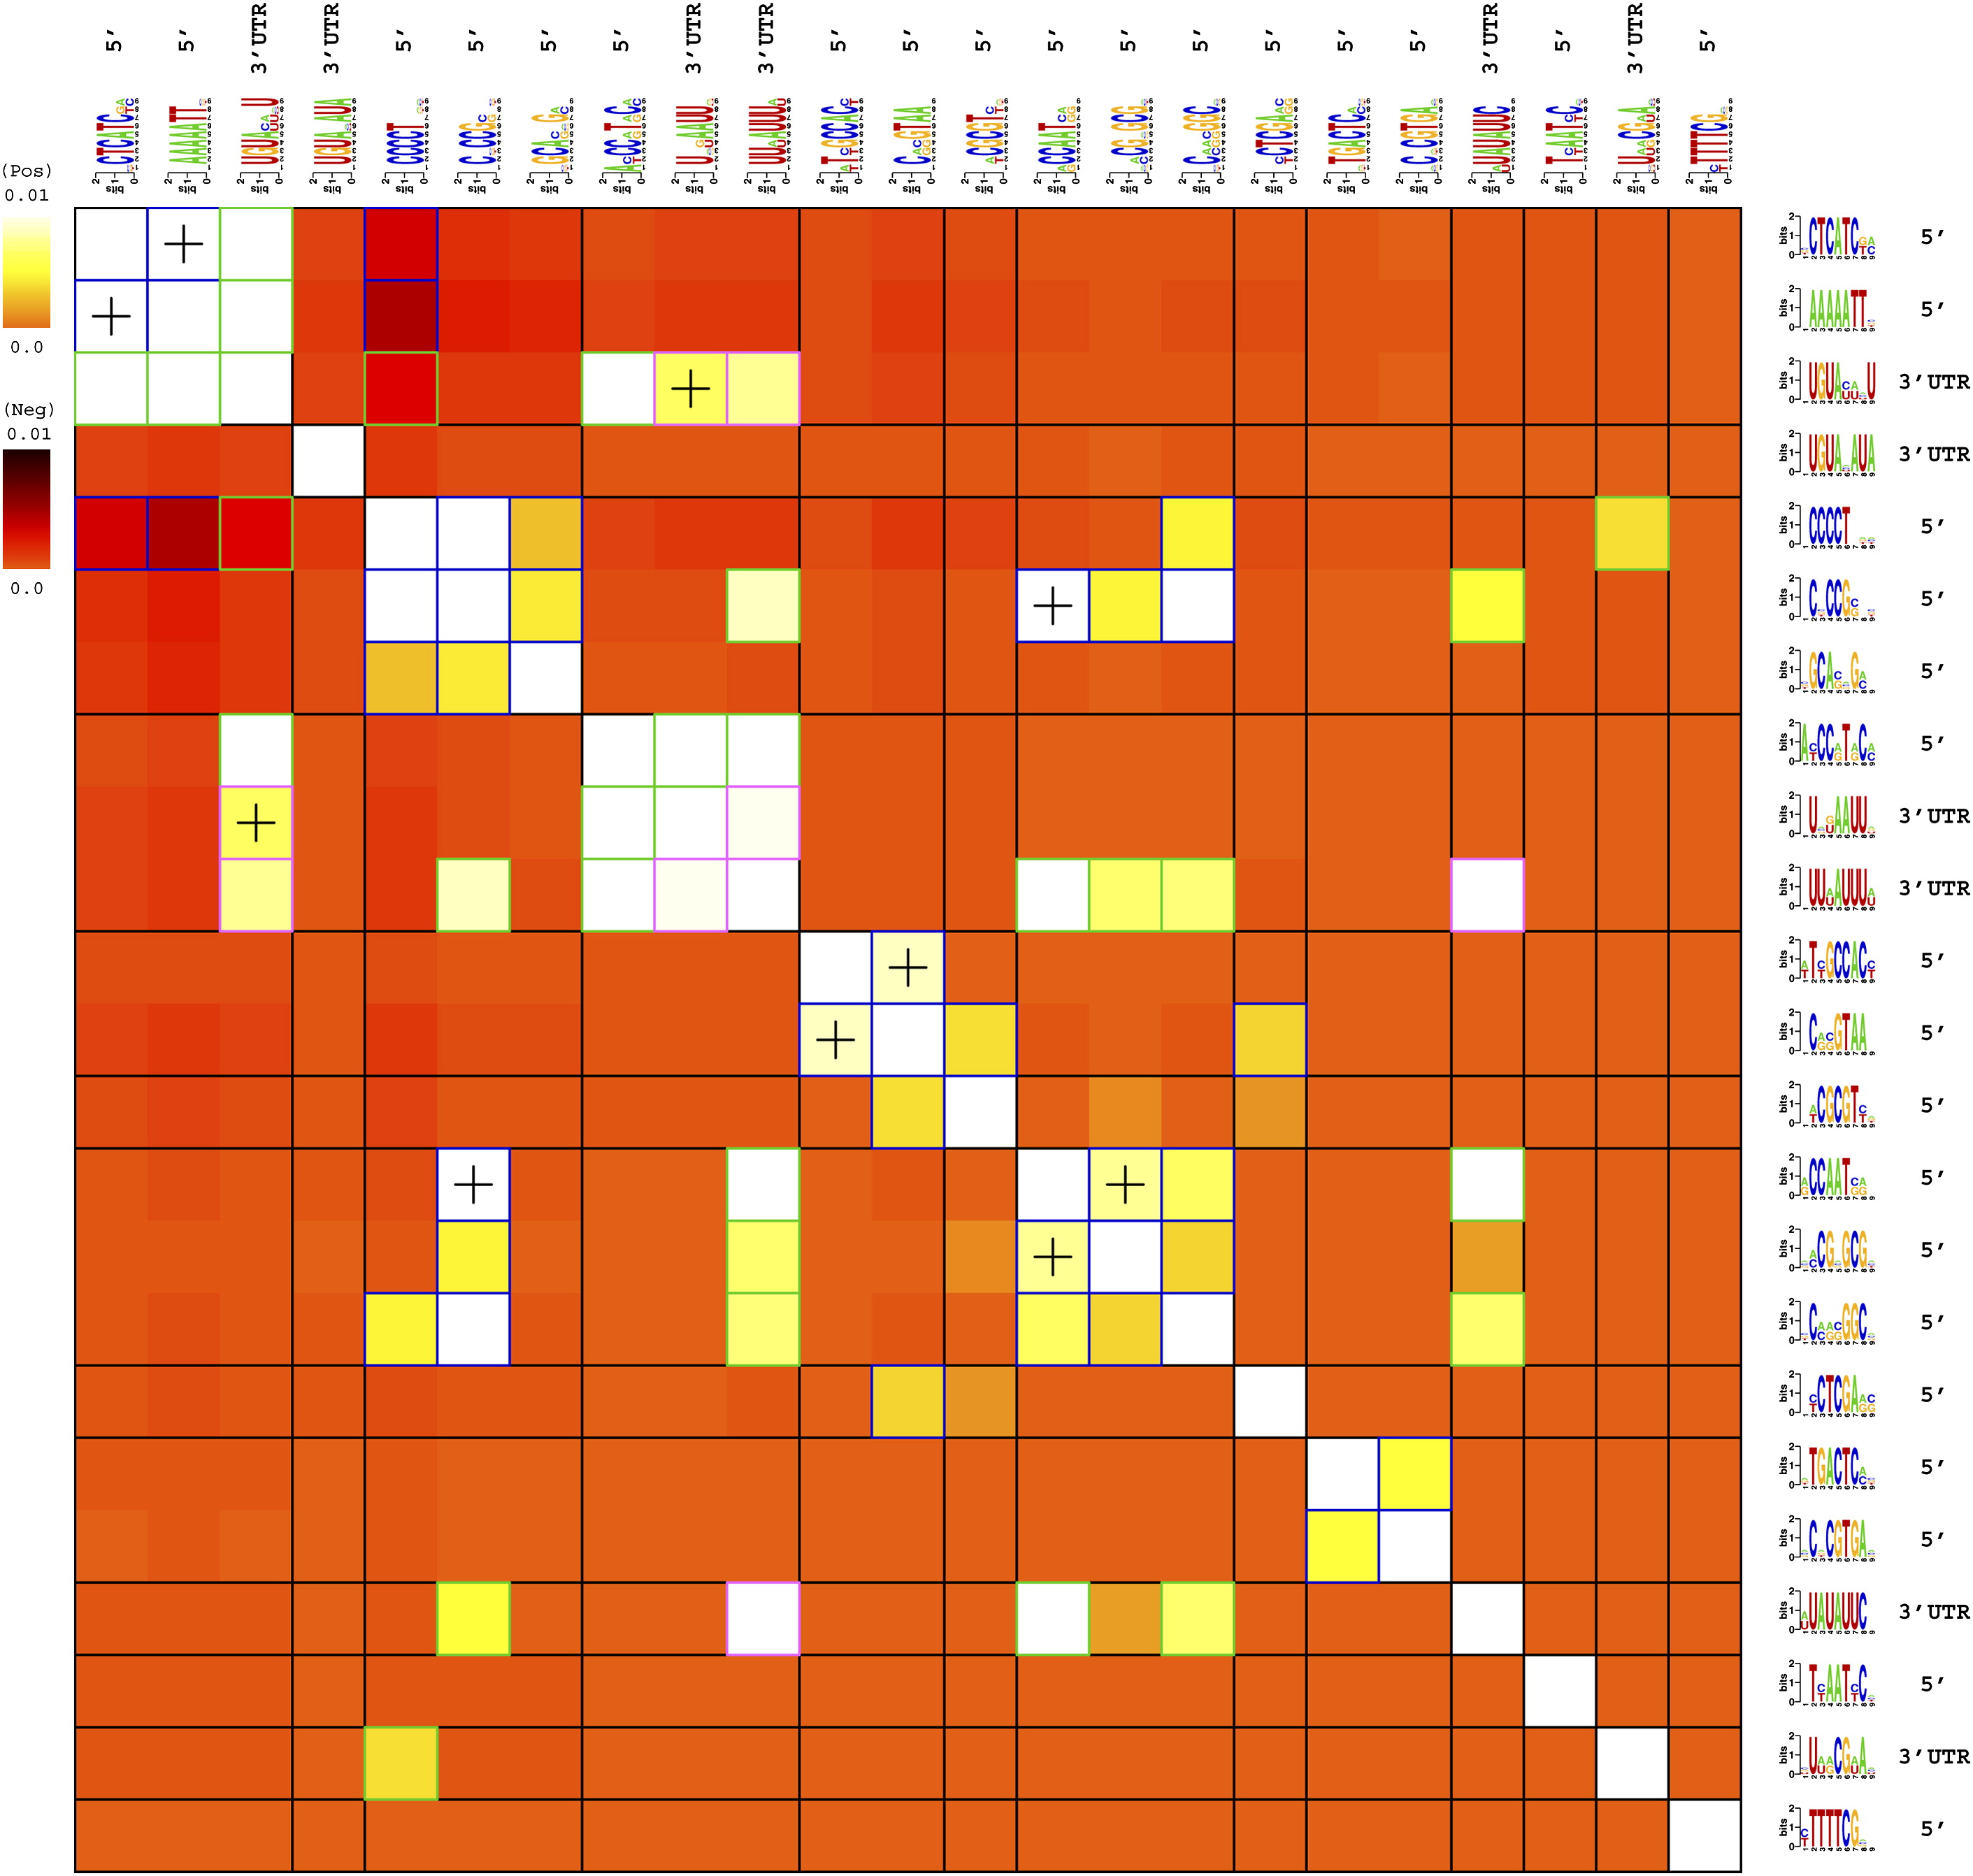
Motif Interactions Example
Yeast motif-motif interactions
White: positive association
Dark red: negative association
Blue box: DNA-DNA
Green box: DNA-RNA
Plus: spatial co-localization

Slide 31
Discussion of FIRE
FIRE
  mutual information used to identify motifs and relationships among them
  motif search is based on generalizing informative k-mers
Consider advantages and disadvantages of k-mers versus PWMs
In contrast to many motif-finding approaches, FIRE takes advantage of negative sequences
FIRE returns all informative motifs found

Slide 32
Mutual Information for Gene Networks
Mutual information and conditional mutual information can also be useful for reconstructing biological networks
Build gene-gene network where edges indicate high MI in genes’ expression levels
Algorithm for the Reconstruction of Accurate Cellular Networks (ARACNE)
Notes:
Ask class about strategies for computing MI with continuous data

Slide 33
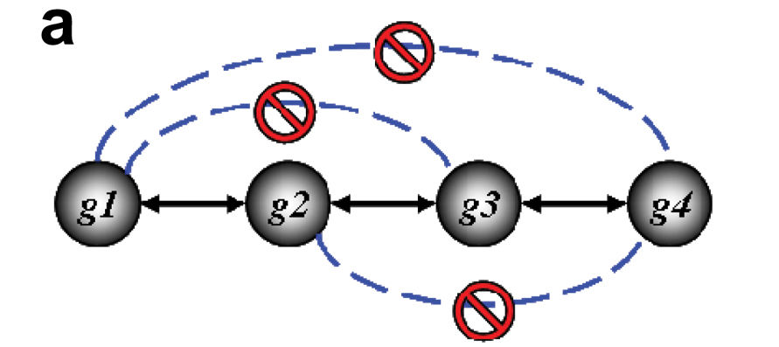
ARACNE
Gaussian kernel estimator to estimate mutual information
  No binning or histograms
Data processing inequality
  Prune indirect edges
Margolin et al. BMC Bioinformatics 2006
Notes:
Draw network:
A->C
B->C
C->D
Discuss how this relates to correlation networks, Bayesian networks from 576
Directed versus undirected edges
Discuss Gaussian kernel, bandwidth parameter, much more of this coming up in Gaussian Process lecture
Histogram versus Gaussian kernel
“The DPI… states that if genes g₁ and g₃ interact only through a third gene, g₂, I(g₁, g₃) ≤ min [I(g₁, g₂); I(g₂, g₃)]”
Start with graph of all edges above MI threshold obtained from data permutation, then enumerate gene triplets, prune edge with smallest MI value, optionally with some tolerance parameter

