Slide 1
Markov Models for Gene Finding
BMI/CS 776
www.biostat.wisc.edu/bmi776/
Spring 2020
Daifeng Wang
daifeng.wang@wisc.edu
These slides, excluding third-party material, are licensed under CC BY-NC 4.0 by Mark Craven, Colin Dewey, Anthony Gitter and Daifeng Wang

Slide 2
Outline for Gene Finding
Interpolated Markov Model
  Finding bacterial genes
Generalized Hidden Markov Model
  Finding eukaryotic genes
  Comparative information

Slide 3
Interpolated Markov Models for Gene Finding
Key concepts
the gene-finding task
the trade-off between potential predictive value and parameter uncertainty in choosing the order of a Markov model
interpolated Markov models

Slide 4
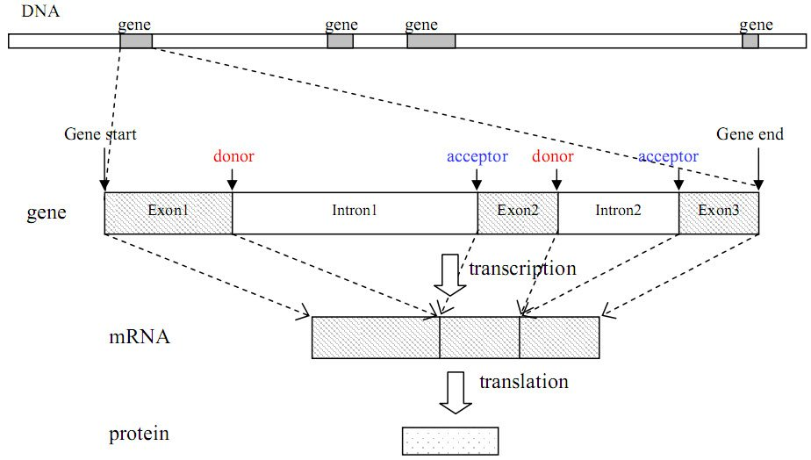
The Gene Finding Task
Given: an uncharacterized DNA sequence
Do: locate the genes in the sequence, including the coordinates of individual exons and introns

Slide 5
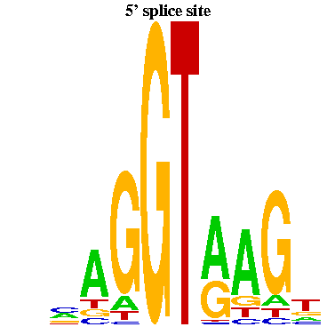
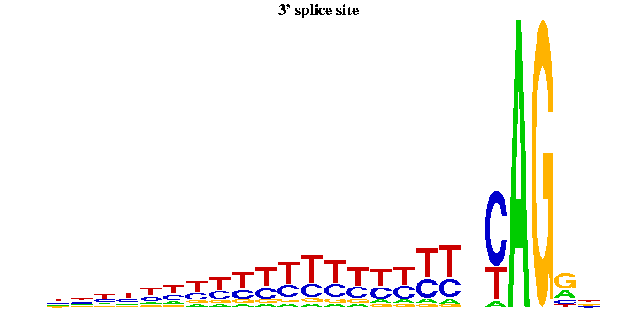
Splice Signals Example
donor sites
acceptor sites
-3
-2
-1
1
2
3
4
5
6
exon
Figures from Yi Xing
exon
There are significant dependencies among non-adjacent positions in donor splice signals
Informative for inferring hidden state of HMM

Slide 6
Sources of Evidence for Gene Finding
Signals: the sequence signals (e.g. splice junctions) involved in gene expression (e.g., RNA-seq reads)
Content: statistical properties that distinguish protein-coding DNA from non-coding DNA (focus in this lecture)
Conservation: signal and content properties that are conserved across related sequences (e.g. orthologous regions of the mouse and human genome)

Slide 7
Gene Finding: Search by Content
Encoding a protein affects the statistical properties of a DNA sequence
  some amino acids are used more frequently than others (Leu more prevalent than Trp)
  different numbers of codons for different amino acids (Leu has 6, Trp has 1)
  for a given amino acid, usually one codon is used more frequently than others
    this is termed codon preference
    these preferences vary by species
Notes:
Tryptophan (Trp)
Leucine (Leu)

Slide 8
Codon Preference in E. Coli
AA codon /1000
----------------------
Gly GGG 1.89
Gly GGA 0.44
Gly GGU 52.99
Gly GGC 34.55
Glu GAG 15.68
Glu GAA 57.20
Asp GAU 21.63
Asp GAC 43.26

Slide 9
Reading Frames
A given sequence may encode a protein in any of the six reading frames
G C T A C G G A G C T T C G G A G C
C G A T G C C T C G A A G C C T C G

Slide 10
Open Reading Frames (ORFs)
An ORF is a sequence that
  starts with a potential start codon (e.g., ATG)
  ends with a potential stop codon, in the same reading frame (e.g., TAG, TAA, TGA)
  doesn’t contain another stop codon in-frame
  and is sufficiently long (say > 100 bases)
An ORF meets the minimal requirements to be a protein-coding gene in an organism without introns
G T T A T G G C T • • • T C G T G A T T

Slide 11
Markov Models & Reading Frames
Consider modeling a given coding sequence
For each “word” we evaluate, we’ll want to consider its position with respect to the reading frame we’re assuming
reading frame
G C T A C G G A G C T T C G G A G C
G C T A C G
G is in 3rd codon position
C T A C G G
G is in 1st position
T A C G G A
A is in 2nd position
Can do this using an inhomogeneous model

Slide 12
Inhomogeneous Markov Model
Homogenous Markov model: transition probability matrix does not change over time or position
Inhomogenous Markov model: transition probability matrix depends on the time or position

Slide 13

Higher Order Markov Models
Higher order models remember more “history”
  n-order
Additional history can have predictive value
Example:
  predict the next word in this sentence fragment “…you__” (are, give, passed, say, see, too, …?)
  now predict it given more history
“…can you___”
“…say can you___”
“…oh say can you___”
YouTube

Slide 14
A Fifth Order Inhomogeneous Markov Model
AAAAA
CTACA
CTACC
start
CTACG
CTACT
GCTAC
TTTTT
position 2

Slide 15
A Fifth Order Inhomogeneous Markov Model
AAAAA
AAAAA
AAAAA
CTACA
CTACA
CTACA
CTACC
CTACC
start
CTACG
CTACG
TACAA
CTACT
CTACT
Trans.
to states
in pos. 2
TACAC
TACAG
GCTAC
GCTAC
TACAT
TTTTT
TTTTT
TTTTT
position 2
position 3
position 1

Slide 16
Selecting the Order of a
Markov Model
But the number of parameters we need to estimate grows exponentially with the order
  for modeling DNA we need parameters for an nth order model
The higher the order, the less reliable we can expect our parameter estimates to be
Suppose we have 100k bases of sequence to estimate parameters of a model
  for a 2nd order homogeneous Markov chain, we’d see each history 6250 times on average
  for an 8th order chain, we’d see each history ~ 1.5 times on average

Slide 17
Interpolated Markov Models
The IMM idea: manage this trade-off by interpolating among models of various orders
Simple linear interpolation:
where

Slide 18
Interpolated Markov Models
We can make the weights depend on the history
  for a given order, we may have significantly more data to estimate some words than others
General linear interpolation
λ is a function of
the given history

Slide 19
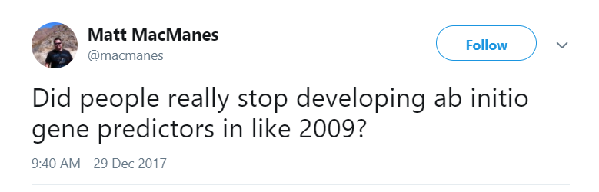
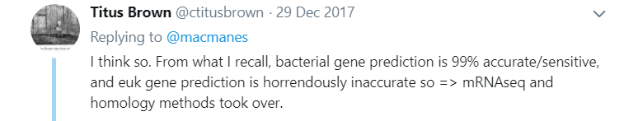
The GLIMMER System
[Salzberg et al., Nucleic Acids Research, 1998]
System for identifying genes in bacterial genomes
Uses 8th order, inhomogeneous, interpolated Markov models

Slide 20
IMMs in GLIMMER
How does GLIMMER determine the values?
First, let’s express the IMM probability calculation recursively
Let be the number of times we see the history in our training set

Slide 21
IMMs in GLIMMER
If we haven’t seen more than 400 times, then compare the counts for the following:
nth order history + base
(n-1)th order history + base
Use a statistical test to assess whether the distributions of depend on the order

Slide 22
IMMs in GLIMMER
nth order history + base
(n-1)th order history + base
Null hypothesis in test: distribution is independent of order
Define
If is small we don’t need the higher order history

Slide 23
IMMs in GLIMMER
Putting it all together
why 400?
  “gives ~95% confidence that the sample probabilities are within ±0.05 of the true probabilities from which the sample was taken”
where

Slide 24
IMM Example
Suppose we have the following counts from our training set
ACGA 25
ACGC 40
ACGG 15
ACGT 20
___
100
CGA 100
CGC 90
CGG 35
CGT 75
___
300
GA 175
GC 140
GG 65
GT 120
___
500
χ² test: d = 0.857
χ² test: d = 0.140
λ₃(ACG) = 0.857 × 100/400 = 0.214
λ₂(CG) = 0 (d < 0.5, c(CG) < 400)
λ₁(G) = 1 (c(G) > 400)

Slide 25
IMM Example (Continued)
Now suppose we want to calculate

Slide 26
Gene Recognition in GLIMMER
Essentially ORF classification
  Train and estimate IMMs
For each ORF
  calculate the probability of the ORF sequence in each of the 6 possible reading frames
  if the highest scoring frame corresponds to the reading frame of the ORF, mark the ORF as a gene
For overlapping ORFs that look like genes
  score overlapping region separately
  predict only one of the ORFs as a gene

Slide 27
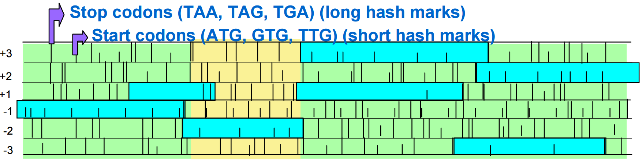
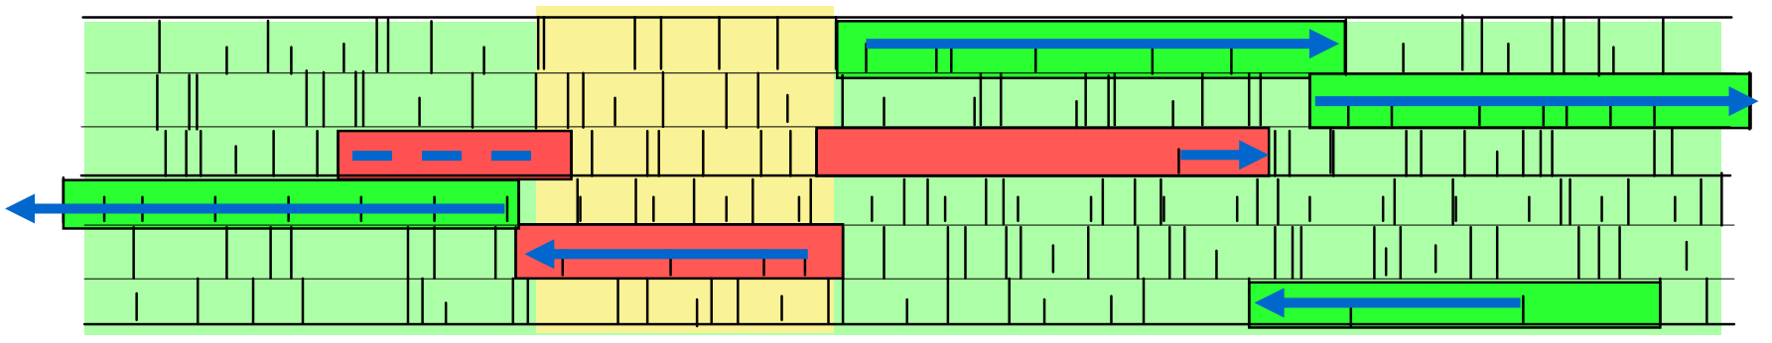
Gene Recognition in GLIMMER
Six possible frames
ORF meeting length requirement
JCVI
Low scoring ORF
High scoring ORF

Slide 28
GLIMMER Experiment
8th order IMM vs. 5th order Markov model
Trained on 1168 genes (ORFs really)
Tested on 1717 annotated (more or less known) genes

Slide 29
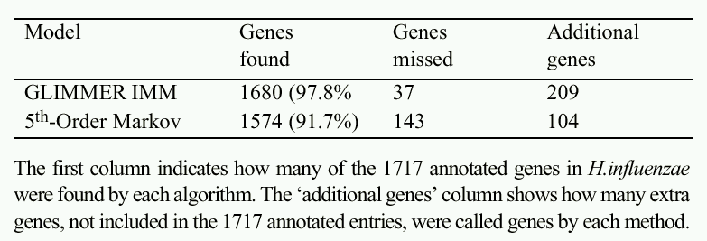
GLIMMER Results
TP
FN
FP & TP?
GLIMMER has greater sensitivity than the baseline
It’s not clear whether its precision/specificity is better

Slide 30
Eukaryotic and Comparative Gene Finding
Key concepts
Incorporating sequence signals into gene finding with HMMs
Modeling durations with generalized HMMs (GENSCAN)
Modeling conversation with pair HMMs
Related genomes as an additional source of evidence for gene finding
Extending GENSCAN to emits pairs of observed variables
Modern gene finding and genome annotation

Slide 31
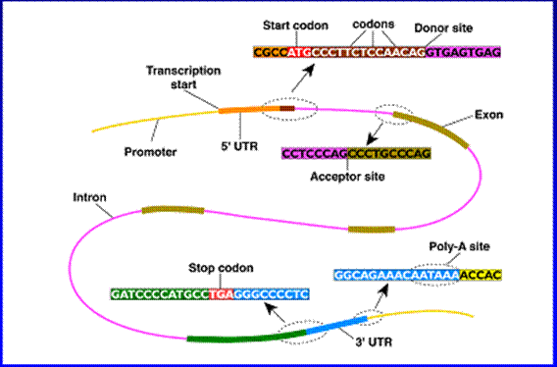
Eukaryotic Gene Structure

Slide 32
Splice Signals Example
donor sites
acceptor sites
-3
-2
-1
1
2
3
4
5
6
exon
Figures from Yi Xing
exon
There are significant dependencies among non-adjacent positions in donor splice signals
Informative for inferring hidden state of HMM

Slide 33
Hidden Markov Model (HMM)
Hidden states
  {fair, biased} for coin tossing
  {Exon, Intron, Intergenic} for Eukaryotic gene
Emission symbols
  {H, T} for coin tossing
  {A, T, C, G} for DNA sequence
Emission probability from state to symbol
  P(A | exon) = 0.85, P(A | intron) = 0.05
Transition probability among states
  P(Exon | Intergenic)

Slide 34
Parsing a DNA Sequence
The HMM Viterbi path represents a parse of a given sequence, predicts exons, acceptor sites, introns, etc.
Hidden state
Intergenic
5’UTR
Exon
Intron
Observed sequence
ACCGTTACGTGTCATTCTACGTGATCATCGGATCCTAGAATCATCGATCCGTGCGATCGATCGGATTAGCTAGCTTAGCTAGGA
ACCGTTA
CGTGTCATTCTACGTGATCAT
CGGATCCTAGAATCATCGATC
CGTGCGATCGATCGGATTAGCTAGCTTAGCTAGGA
How can we properly model the transitions from one state to another and the emissions of sequences?

Slide 35
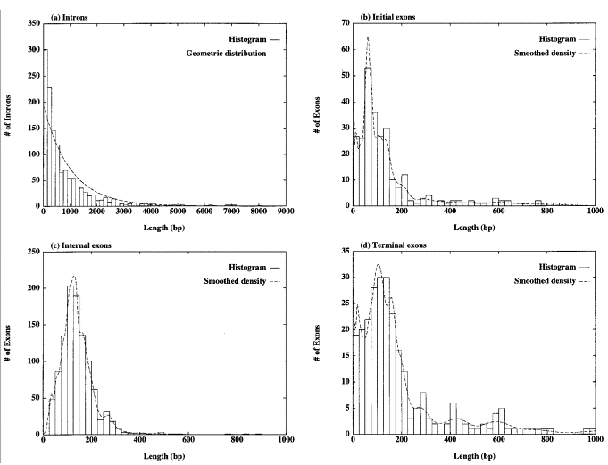
Length Distributions of Introns/Exons
Introns
Initial exons
geometric dist.
provides good fit
Figure from Burge & Karlin, Journal of Molecular Biology, 1997
Internal exons
Terminal exons
geometric dist.
provides poor fit

Slide 36
Duration Modeling in HMMs
Semi-Markov models are well-motivated for some sequence elements (e.g. exons)
  Semi-Markov: explicitly model length duration of hidden states
  Also called generalized hidden Markov model (GHMM)
HMM emits single bases
Semi-Markov or GHMM emits sequences
  Duration is sequent length

Slide 37
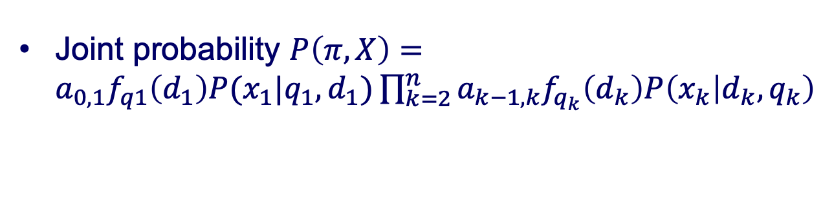
GHMM models DNA Sequences
Given a parse π with the hidden states {q₁, q₂, …} and sequence segments {x₁, x₂, …, x_{n}} with lengths {d₁, d₂, …, d_{n}} for a sequence X
q₁
q₂
Hidden state
Intergenic
5’UTR
Exon
Intron
Segment
ACCGTTACGTGTCATTCTACGTGATCATCGGATCCTAGAATCATCGATCCGTGCGATCGATCGGATTAGCTAGCTTAGCTAGGA
ACCGTTA
CGTGTCATTCTACGTGATCAT
CGGATCCTAGAATCATCGATC
CGTGCGATCGATCGGATTAGCTAGCTTAGCTAGGA
x₁
x₂
Transition probability
Joint probability $P\left(π,X\right)=a_{0,1}f_{q1}\left(d_{1}\right)P(x_{1}|{q_{1},d}_{1})\prod_{k=2}^{n}{a_{k−1,k}f_{q_{k}}\left(d_{k}\right)P\left(x_{k} | d_{k},q_{k}\right)}$
Length probability from previous distributions

Slide 38
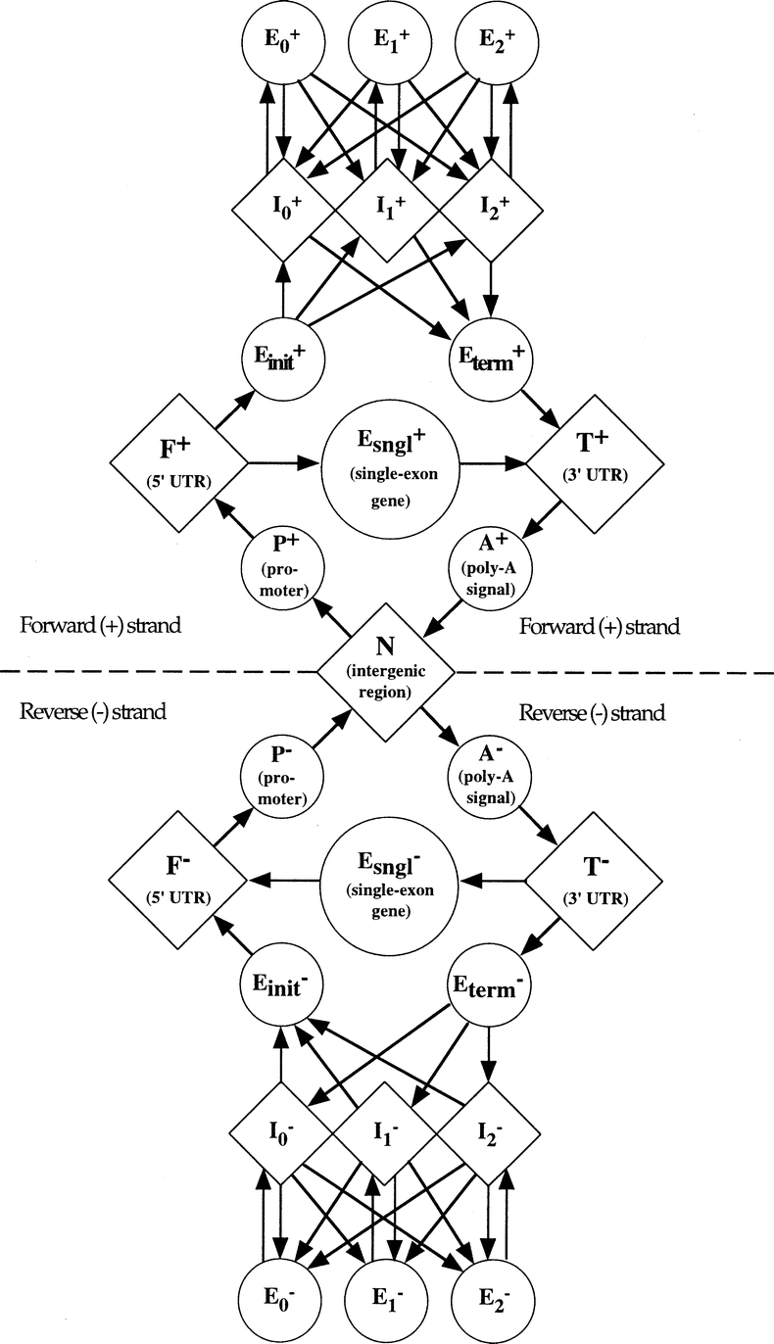
The GENSCAN HMM for Eukaryotic Gene Finding [Burge & Karlin ‘97]
Each shape represents a functional unit
of a gene or genomic region
Pairs of intron/exon units represent
the different ways an intron can interrupt
a coding sequence (after 1st base in codon,
after 2nd base or after 3rd base)
Figure from Burge & Karlin, Journal of Molecular Biology, 1997
Complementary submodel
(not shown) detects genes on
opposite DNA strand

Slide 39
Parsing a DNA Sequence
The Viterbi path represents
a parse of a given sequence,
predicting exons, introns, etc.
ACCGTTACGTGTCATTCTACGTGATCATCGGATCCTAGAATCATCGATCCGTGCGATCGATCGGATTAGCTAGCTTAGCTAGGAGAGCATCGATCGGATCGAGGAGGAGCCTATATAAATCAA
ACCGTTA
CGTGTCATTCTACGTGATCAT
CGGATCCTAGAATCATCGATC
CGTGCGATCGATCGGATTAGCTAGCTTAGCTAGGA
GAGCATCGATCGGATCGAGGAGGAGCCTATATAAATCAA

Slide 40
Comparative methods
genes are among the most conserved elements in the genome
  use conservation to help infer locations of genes
some signals associated with genes are short and occur frequently
  use conservation to eliminate from consideration false candidate sites

Slide 41
Conservation as powerful information source

Slide 42
TWINSCAN
Korf et al., Bioinformatics 2001
prediction with TWINSCAN
  given: a sequence to be parsed, x
  using BLAST, construct a conservation sequence, c
  have HMM simultaneously parse (using Viterbi) x and c
training with TWINSCAN
  given: set of training sequences X with known gene structure annotations
  for each x in X
    construct a conservation sequence c for x
    infer emission parameters for both x and c

Slide 43
Conservation Sequences in TWINSCAN
before processing a given sequence, TWINSCAN first computes a corresponding conservation sequence
ATTTAGCCTACTGAAATGGACCGCTTCAGCATGGTATCC
||:||..........|:|:|||||||||:||:|||::||
matched
unaligned
mismatched
Given: a sequence of length n, a set of aligned BLAST matches
c[1...n] = unaligned
sort BLAST matches by alignment score
for each BLAST match h (from best to worst)
for each position i covered by h
if c[i] == unaligned
c[i] = h[i]

Slide 44
Conservation Sequence Example
given
sequence
ATTTAGCCTACTGAAATGGACCGCTTCAGCATGGTATCC
ATGGACCGCTTCAGC
|:|:|||||||||:|
ACGCACCGCTTCATC
significant BLAST matches
ordered from
best to worst
AGCATGGTATCC
||:|:|||::||
AGAAGGGTCACC
ATTTA
||:||
ATCTA
resulting conservation sequence
ATTTAGCCTACTGAAATGGACCGCTTCAGCATGGTATCC
||:||..........|:|:|||||||||:||:|||::||

Slide 45
Modeling Sequences in TWINSCAN
each state “emits” two sequences
  the given DNA sequence, x
  the conservation sequence, c
it treats them as conditionally independent given the state
q
ATTTAGCCTACTGAAATGGACCGCTTCAGCATGGTATCC
||:||..........|:|:|||||||||:||:|||::||

Slide 46
Modeling Sequences in TWINSCAN
conservation sequence is treated just as a string over a 3-character alphabet (| , : , .)
conservation sequence emissions modeled by
  inhomogeneous 2nd-order chains for splice sites
  homogeneous 5th-order Markov chains for other states
like GENSCAN, based on hidden semi-Markov models
algorithms for learning, inference same as GENSCAN

Slide 47
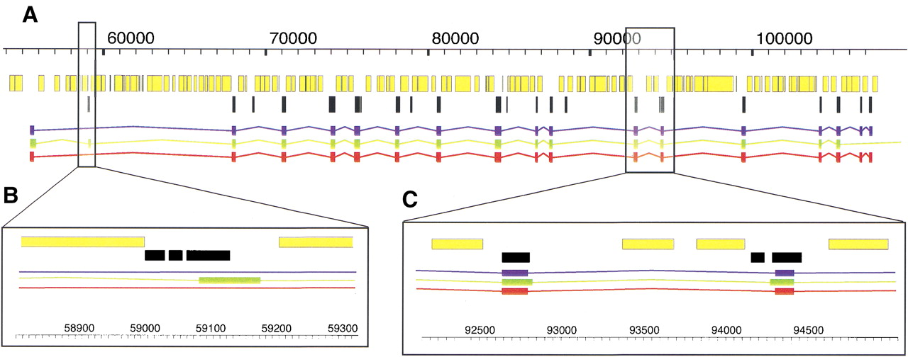
TWINSCAN vs. GENSCAN
mouse alignments
conservation is neither necessary nor sufficient to predict an exon
RefSeq (gold standard)
GENSCAN prediction
TWINSCAN prediction
TWINSCAN correctly omits this exon prediction because conserved region ends within it
TWINSCAN correctly predicts both splice sites because they are within the aligned regions

Slide 48
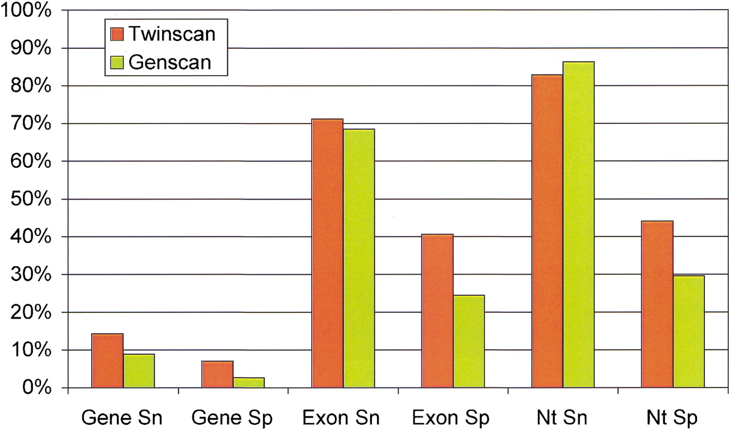
GENSCAN vs. TWINSCAN:
Empirical Comparison
note: the definition of specificity here is somewhat nonstandard; it’s the same as precision
genes exactly
correct?
exons exactly
correct?
nucleotides
correct?
Figure from Flicek et al., Genome Research, 2003

Slide 49
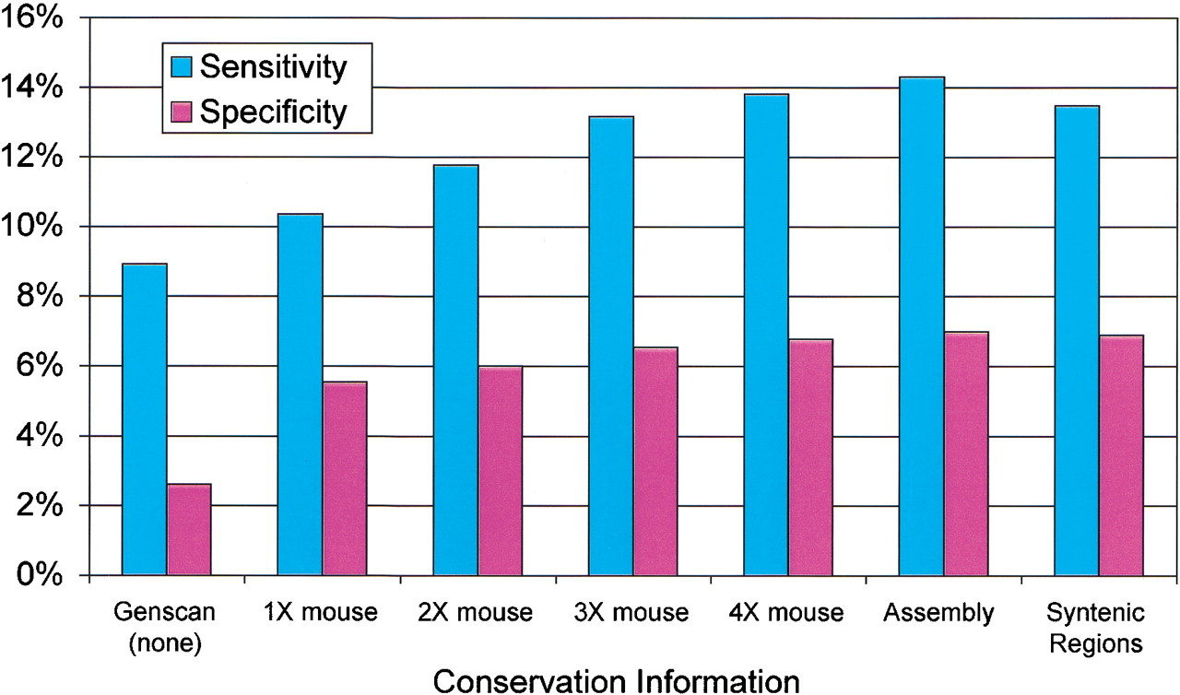
Accuracy of TWINSCAN as a Function of Sequence Coverage
very crude mouse
genome sequence
good mouse
genome sequence

Slide 50
SLAM
Pachter et al., RECOMB 2001
prediction with SLAM
  given: a pair of sequences to be parsed, x and y
  find approximate alignment of x and y
  run constrained Viterbi to have HMM simultaneously parse and align x and y
training with SLAM
  given: a set of aligned pairs of training sequences X
  for each x, y in X
    infer emission/alignment parameters for both x and y

Slide 51
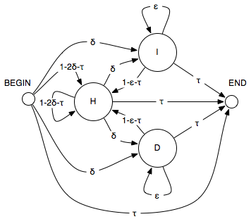
Pair Hidden Markov Models
each non-silent state emits one or a pair of characters
H: homology (match) state
I: insert state
D: delete state

Slide 52
PHMM Paths = Alignments
sequence 1: AAGCGC
sequence 2: ATGTC
hidden:
B
H
A
A
H
A
T
I
G
I
C
H
G
G
D
T
H
C
C
E
observed:

Slide 53

Transition Probabilities
probabilities of moving between states at each step
state i+1
 | B | H | I | D | E
B |  | 1-2δ-τ | δ | δ | τ
H |  | 1-2δ-τ | δ | δ | τ
I |  | 1-ε-τ | ε |  | τ
D |  | 1-ε-τ |  | ε | τ
E
state i

Slide 54
Emission Probabilities
Deletion (D)
Insertion (I)
Homology (H)
A | 0.3
C | 0.2
G | 0.3
T | 0.2
A | 0.1
C | 0.4
G | 0.4
T | 0.1
 | A | C | G | T
A | 0.13 | 0.03 | 0.06 | 0.03
C | 0.03 | 0.13 | 0.03 | 0.06
G | 0.06 | 0.03 | 0.13 | 0.03
T | 0.03 | 0.06 | 0.03 | 0.13
single character
single character
pairs of characters

Slide 55
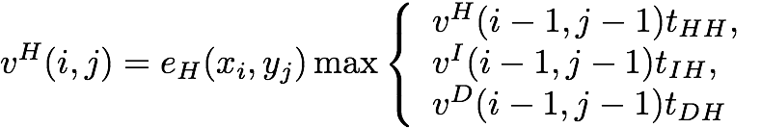
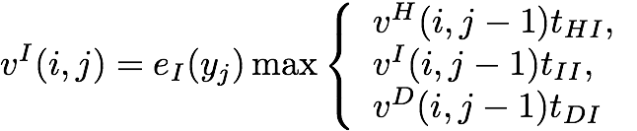
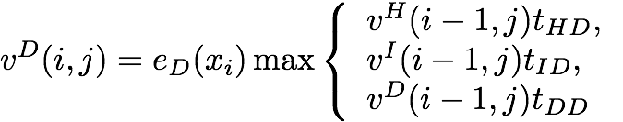
PHMM Viterbi
probability of most likely sequence of hidden states generating length i prefix of x and length j prefix of y, with the last state being:
H
I
D
note that the recurrence relations here allow I→D and D→I transitions

Slide 56
PHMM Alignment
calculate probability of most likely alignment
traceback, as in Needleman-Wunsch (NW), to obtain sequence of state states giving highest probability
HIDHHDDIIHH...

Slide 57
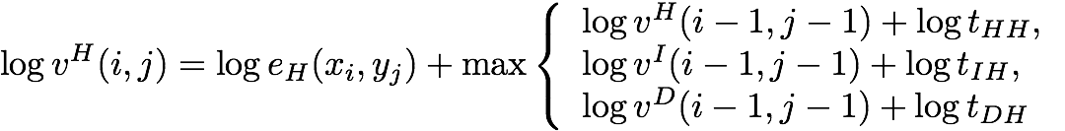
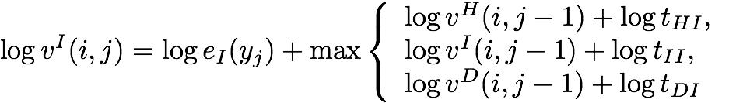
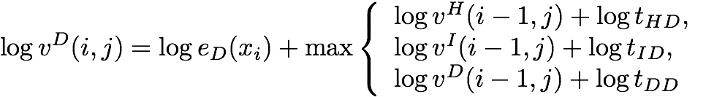
Correspondence with NW
NW values ≈ logarithms of PHMM Viterbi values

Slide 58
Posterior Probabilities
there are similar recurrences for the Forward and Backward values
from the Forward and Backward values, we can calculate the posterior probability of the event that the path passes through a certain state S, after generating length i and j prefixes

Slide 59
Uses for Posterior Probabilities
sampling of suboptimal alignments
posterior probability of pairs of residues being homologous (aligned to each other)
posterior probability of a residue being gapped
training model parameters (EM)

Slide 60
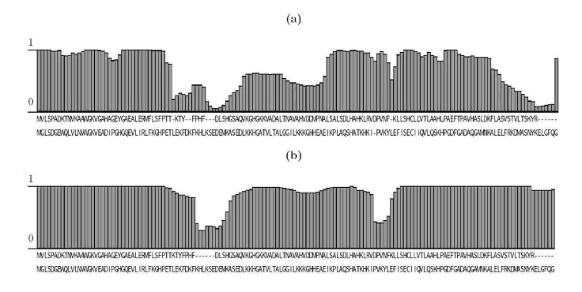
Posterior Probabilities
plot of posterior probability of each alignment column

Slide 61
Parameter Training
supervised training
  given: sequences and correct alignments
  do: calculate parameter values that maximize joint likelihood of sequences and alignments
unsupervised training
  given: sequence pairs, but no alignments
  do: calculate parameter values that maximize marginal likelihood of sequences (sum over all possible alignments)

Slide 62
Generalized Pair HMMs
Represent a parse π, as a sequence of states and a sequence of associated lengths for each input sequence
sequence of hidden states
N
P⁺
F⁺
E_{init}⁺
pair of sequences generated by hidden state
may be gaps
in the sequences
pair of duration times generated by hidden state
SLAM: Pachter et al. RECOMB 2001

Slide 63
Generalized Pair HMMs
representing a parse π, as a sequence of states and associated lengths (durations)
the joint probability of generating parse π and sequences x and y

Slide 64
Generalized Pair HMM Algorithms
Generalized HMM Forward Algorithm
Generalized Pair HMM Algorithm
Viterbi: replace sum with max

Slide 65
Prediction in SLAM
could find alignment and gene predictions by running Viterbi
to make it more efficient
  find an approximate alignment (using a fast anchor-based approach)
  each base in x constrained to align to a window of size h in y
analogous to banded alignment methods
x
y
h

Slide 66
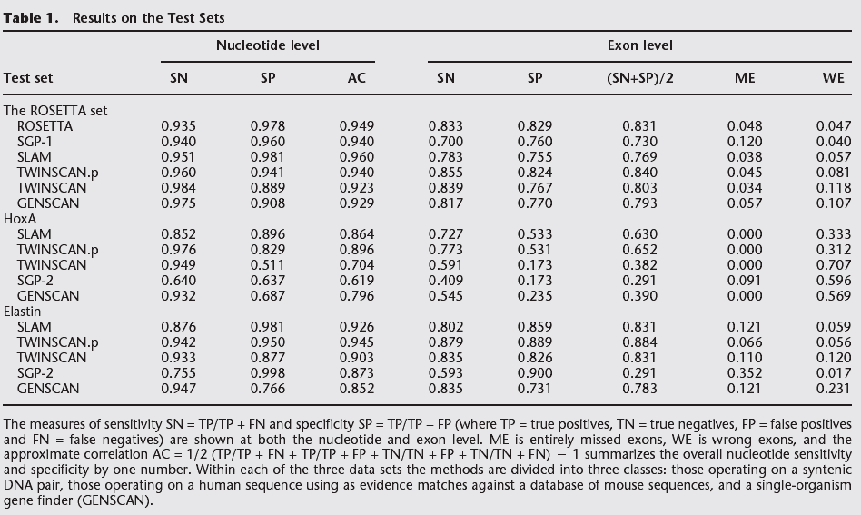
GENSCAN, TWINSCAN, & SLAM

Slide 67
TWINSCAN vs. SLAM
both use multiple genomes to predict genes
both use generalized HMMs
TWINSCAN
  takes as an input a genomic sequence, and a conservation sequence computed from an informant genome
  models probability of both sequences; assumes they’re conditionally independent given the state
  predicts genes only in the genomic sequence
SLAM
  takes as input two genomic sequences
  models joint probability of pairs of aligned sequences
  can simultaneously predict genes and compute alignments

Slide 68
Modern Genome Annotation
RNA-Seq, mass spectrometry, and other technologies provide powerful information for genome annotation

Slide 69
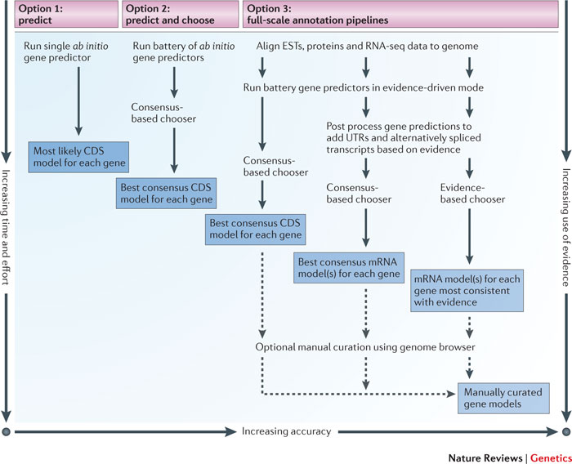
Modern Genome Annotation
Yandell et al. Nature Reviews Genetics 2012

Slide 70
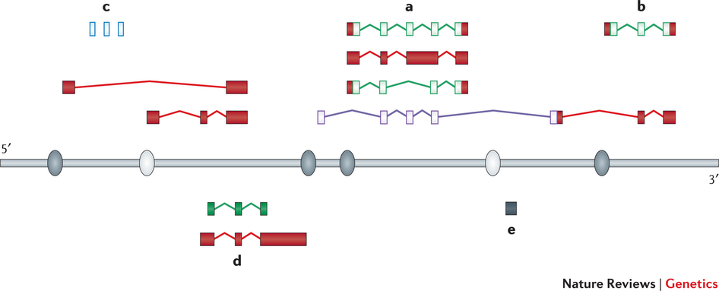
Modern Genome Annotation
protein-coding genes, isoforms, translated regions
small RNAs
long non-coding RNAs
promoters and enhancers
pseudogenes
Mudge and Harrow Nature Reviews Genetics 2016

