Slide 1
Stochastic Context Free Grammars for RNA Structure Modeling
BMI/CS 776
www.biostat.wisc.edu/bmi776/
Spring 2020
Daifeng Wang
daifeng.wang@wisc.edu
These slides, excluding third-party material, are licensed under CC BY-NC 4.0 by Mark Craven, Colin Dewey, Anthony Gitter and Daifeng Wang

Slide 2
Goals for Lecture
Key concepts
transformational grammars
the Chomsky hierarchy
context free grammars
stochastic context free grammars
parsing ambiguity
the Inside and Outside algorithms
parameter learning via the Inside-Outside algorithm

Slide 3
Modeling RNA with
Stochastic Context Free Grammars
Consider tRNA genes
  274 in yeast genome, ~1500 in human genome
  get transcribed, like protein-coding genes
  don’t get translated, therefore base statistics much different than protein-coding genes
  but secondary structure is conserved
To recognize new tRNA genes, model known ones using stochastic context free grammars [Eddy & Durbin, 1994; Sakakibara et al. 1994]
But what is a grammar?

Slide 4
Transformational Grammars
A transformational grammar characterizes a set of legal strings
The grammar consists of
  a set of abstract nonterminal symbols
  a set of terminal symbols (those that actually appear in strings)
  a set of productions

Slide 5
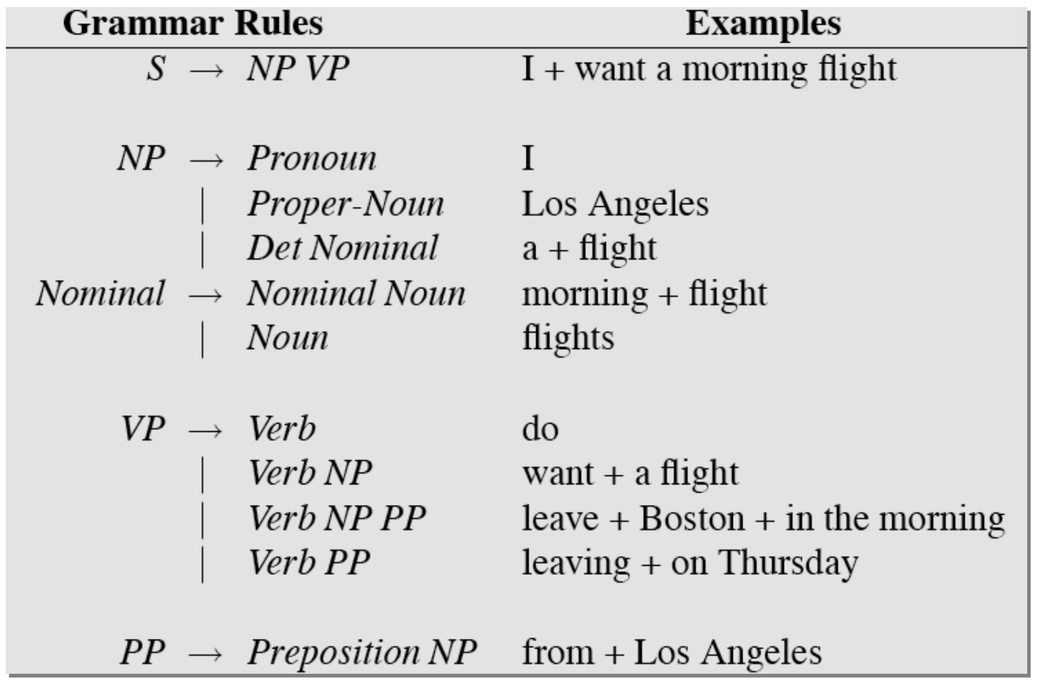
NLP example
Terminals
  Words
Nonterminals
  noun phrases, verb phrases and sentences
Rules
  Equations that consist of a single non-terminal on the left and any number of terminals and nonterminals on the right.
https://web.stanford.edu/~jurafsky/

Slide 6
A Grammar for Stop Codons
This grammar can generate the 3 stop codons: UAA, UAG, UGA
With a grammar we can ask questions like
  what strings are derivable from the grammar?
  can a particular string be derived from the grammar?
  what sequence of productions can be used to derive a particular string from a given grammar?

Slide 7
The Derivation for UAG

Slide 8
The Parse Tree for UAG

Slide 9
Some Shorthand

Slide 10
The Chomsky Hierarchy
unrestricted
context-sensitive
context-free
regular
A hierarchy of grammars defined by restrictions on productions

Slide 11
The Chomsky Hierarchy
Regular grammars
Context-free grammars
Context-sensitive grammars
Unrestricted grammars
are nonterminals
is a terminal
are any sequence of terminals/nonterminals
is any non-null sequence of terminals/nonterminals

Slide 12
CFGs and RNA
Context free grammars are well suited to modeling RNA secondary structure because they can represent base pairing preferences
A grammar for a 3-base stem with a loop of either GAAA or GCAA

Slide 13
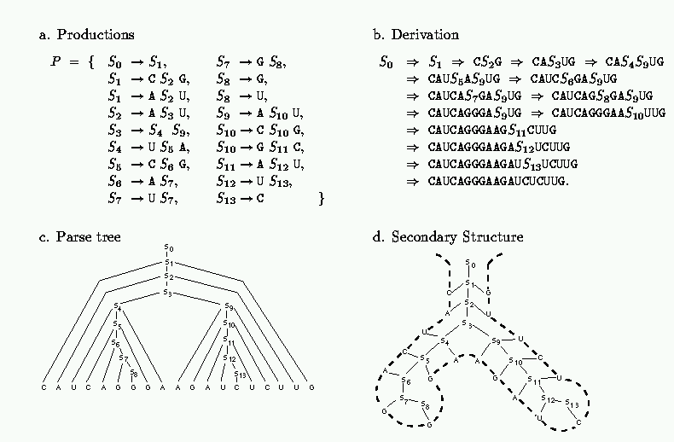
CFGs and RNA
Figure from: Sakakibara et al. Nucleic Acids Research, 1994

Slide 14
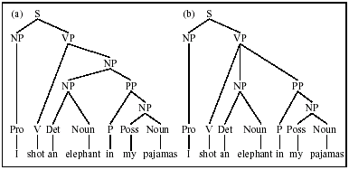

Ambiguity in Parsing
“I shot an elephant in my pajamas. How he got in my pajamas, I’ll never know.” – Groucho Marx

Slide 15
An Ambiguous RNA Grammar
With this grammar, there are 3 parses for the string GGGAACC
s
s
s
G
s
G
s
C
G
s
C
G
s
C
G
s
G
s
C
G
s
C
G
s
C
G
s
A
A
A
A
A
A

Slide 16
A Probabilistic Version of the Stop Codon Grammar
1.0
1.0
0.7
0.2
1.0
0.3
0.8
Each production has an associated probability
Probabilities for productions with the same left-hand side sum to 1
This regular grammar has a corresponding Markov chain model

Slide 17
Stochastic Context Free Grammars (a.k.a. Probabilistic Context Free Grammars)
0.25
0.25
0.25
0.25
0.1
0.4
0.4
0.1
0.25
0.25
0.25
0.25
0.8
0.2

Slide 18
Stochastic Grammars?
…the notion “probability of a sentence” is an entirely useless one, under any known interpretation of this term.
    Noam Chomsky (famed linguist)
Every time I fire a linguist, the performance of the recognizer improves.
    Fred Jelinek (former head of IBM speech recognition group)
Credit for pairing these quotes goes to Dan Jurafsky and James Martin,
Speech and Language Processing

Slide 19
Three Key Questions
How likely is a given sequence?
the Inside algorithm
What is the most probable parse for a given sequence?
the Cocke-Younger-Kasami (CYK) algorithm
How can we learn the SCFG parameters given a grammar and a set of sequences?
the Inside-Outside algorithm

Slide 20
Chomsky Normal Form
It is convenient to assume that our grammar is in Chomsky Normal Form; i.e. all productions are of the form:
Any CFG can be put into Chomsky Normal Form
right hand side consists of two nonterminals
right hand side consists of a single terminal

Slide 21
Converting a Grammar to CNF

Slide 22
Parameter Notation
For productions of the form , we’ll denote the associated probability parameters
For productions of the form , we’ll denote the associated probability parameters
transition
emission

Slide 23
Determining the Likelihood of a Sequence: The Inside Algorithm
Dynamic programming method, analogous to the Forward algorithm
Involves filling in a 3D matrix
representing the probability of all parse subtrees rooted at nonterminal v for the subsequence from i to j

Slide 24
Determining the Likelihood of a Sequence: The Inside Algorithm
v
y
z
1
i
j
L
: the probability of all parse subtrees rooted at nonterminal v for the subsequence from i to j

Slide 25
Inside Calculation Example
s
s
p
s
s
p
s
s
b_{G}
b_{G}
b_{A}
b_{A}
b_{C}
b_{G}
b_{G}
b_{A}
b_{A}
b_{C}
G
G
G
A
A
C
C
G
G
G
A
A
C
C

Slide 26
Determining the Likelihood of a Sequence: The Inside Algorithm
v
y
z
1
i
k
k+1
j
L
M is the number of nonterminals in the grammar

Slide 27
The Inside Algorithm
Initialization (for i = 1 to L, v = 1 to M)
Iteration (for i = L-1 to 1, j = i+1 to L, v = 1 to M)
Termination
start nonterminal

Slide 28
Learning SCFG Parameters
If we know the parse tree for each training sequence, learning the SCFG parameters is simple
  no hidden part of the problem during training
  count how often each parameter (i.e. production) is used
  normalize/smooth to get probabilities
More commonly, there are many possible parse trees per sequence – we don’t know which one is correct
  thus, use an EM approach (Inside-Outside)
  iteratively
    determine expected # times each production is used
      consider all parses
      weight each by its probability
    set parameters to maximize likelihood given these counts

Slide 29
The Inside-Outside Algorithm
We can learn the parameters of an SCFG from training sequences using an EM approach called Inside-Outside
In the E-step, we determine
  the expected number of times each nonterminal is used in parses
  the expected number of times each production is used in parses
In the M-step, we update our production probabilities

Slide 30
The Outside Algorithm
S
v
y
z
1
i
j
L
: the probability of parse trees rooted at the start nonterminal, excluding the probability of all subtrees rooted at nonterminal v covering the subsequence from i to j

Slide 31
Outside Calculation Example
s
p
s
b_{G}
b_{C}
G
G
G
A
A
C
C

Slide 32
The Outside Algorithm
We can recursively calculate from values we’ve calculated for y
The first case we consider is where v is used in productions of the form:
S
y
z
v
1
k
i-1
i
j
L

Slide 33
The Outside Algorithm
The second case we consider is where v is used in productions of the form:
S
y
v
z
1
i
j
j+1
k
L

Slide 34
The Outside Algorithm
Initialization
Iteration (for i = 1 to L, j = L to i, v = 1 to M)

Slide 35
The Inside-Outside Algorithm
We can learn the parameters of an SCFG from training sequences using an EM approach called Inside-Outside
In the E-step, we determine
  the expected number of times each nonterminal is used in parses
  the expected number of times each production is used in parses
In the M-step, we update our production probabilities

Slide 36
The Inside-Outside Algorithm
The EM re-estimation equations (for 1 sequence) are:
cases where v used
to generate A
cases where v used
to generate any subsequence

Slide 37
Finding the Most Likely Parse: The CYK Algorithm
Involves filling in a 3D matrix
representing the most probable parse subtree rooted at nonterminal v for the subsequence from i to j
and a matrix for the traceback
storing information about the production at the top of this parse subtree

Slide 38
The CYK Algorithm
Initialization (for i = 1 to L, v = 1 to M)
Iteration (for i = 1 to L - 1, j = i+1 to L, v = 1 to M)
Termination
start nonterminal

Slide 39
The CYK Algorithm Traceback
Initialization:
  push (1, L, 1) on the stack
Iteration:
  pop (i, j, v) // pop subsequence/nonterminal pair
  (y, z, k) = τ(i, j, v) // get best production identified by CYK
  if (y, z, k) == (0,0,0) // indicating a leaf
    attach x_{i} as the child of v
  else
    attach y, z to parse tree as children of v
    push(i, k, y)
    push(k+1, j, z)

Slide 40
Comparison of SCFG Algorithms to HMM Algorithms
 | HMM algorithm | SCFG algorithm
optimal alignment | Viterbi | CYK
probability of sequence | forward | inside
EM parameter estimation | forward-backward | inside-outside
memory complexity
time complexity

