Slide 1
Epigenetics - Predicting TF binding with DNase-Seq and PIQ
BMI/CS 776
www.biostat.wisc.edu/bmi776/
Spring 2020
Daifeng Wang
daifeng.wang@wisc.edu
These slides, excluding third-party material, are licensed under CC BY-NC 4.0 by Anthony Gitter, Mark Craven, Colin Dewey and Daifeng Wang

Slide 2
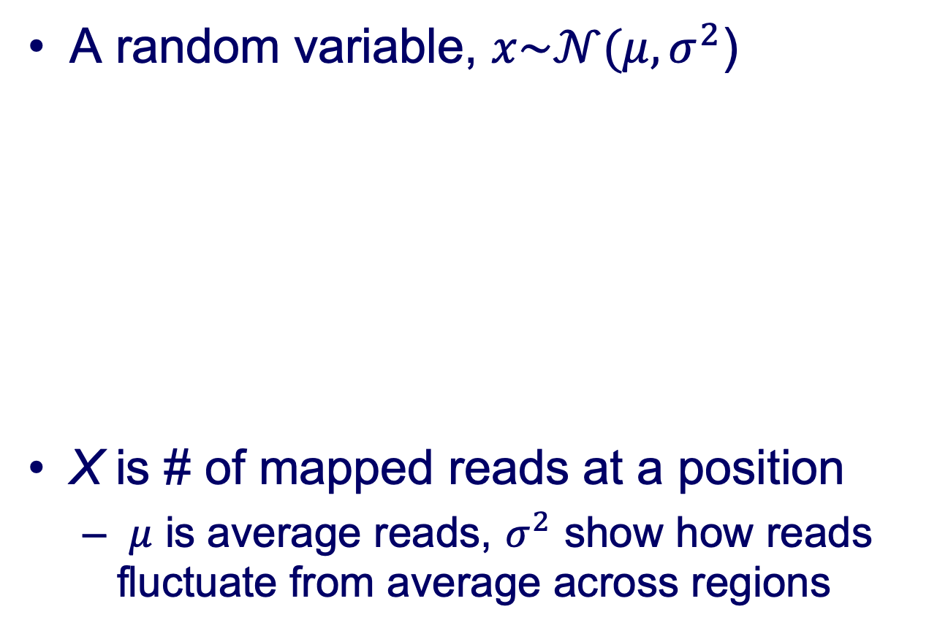
Gaussian distribution
A random variable, $x\sim 𝒩(μ,σ^{2}$)
X is # of mapped reads at a position
  $μ$ is average reads, $σ^{2}$ show how reads fluctuate from average across regions
https://en.wikipedia.org/wiki/Normal_distribution
pdf(x) =

Slide 3
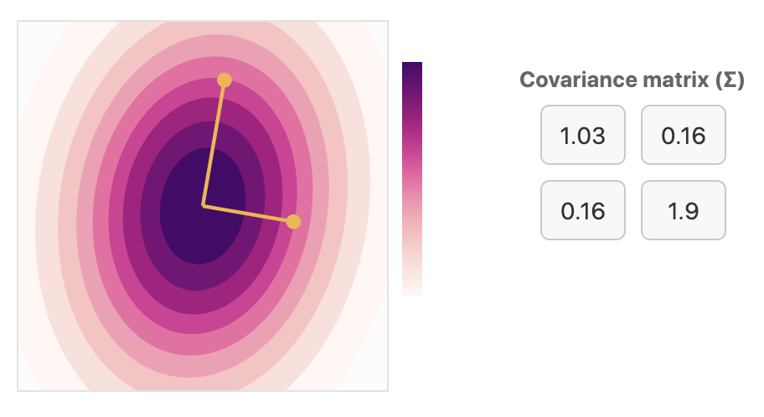
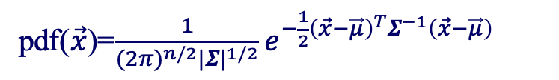
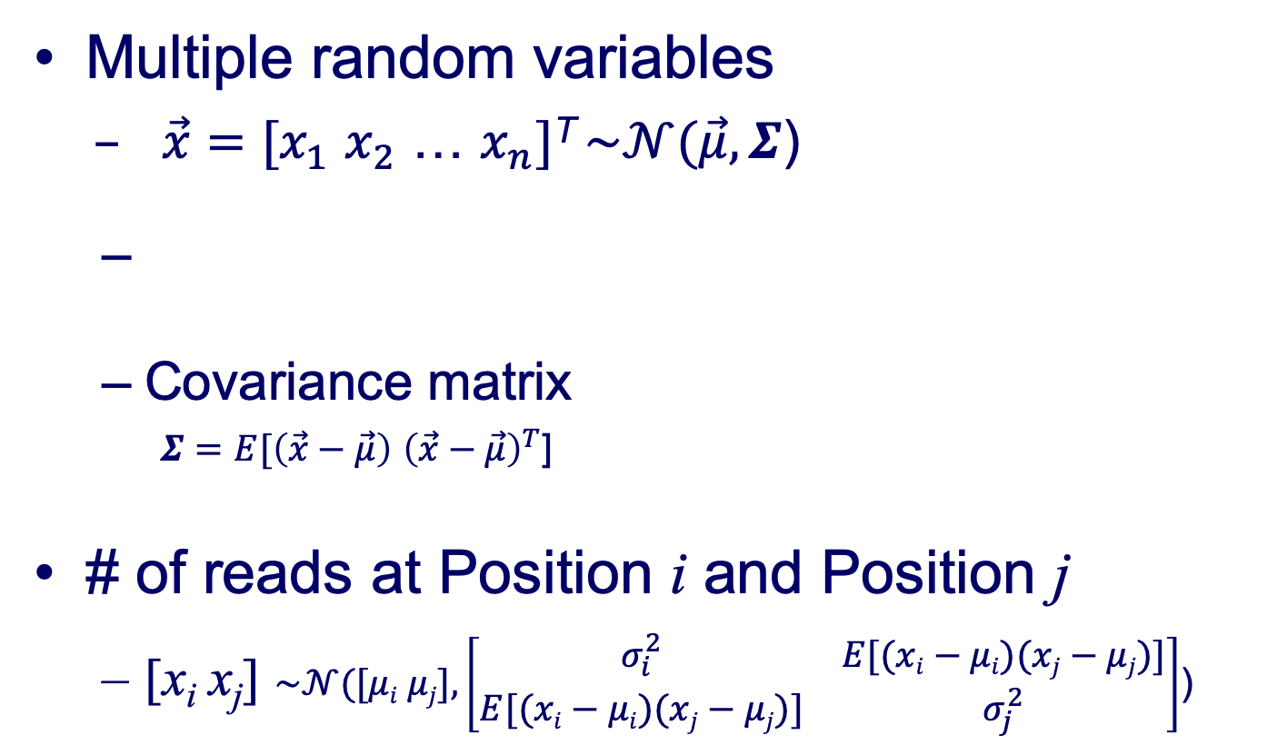
Multivariate Gaussian distributions
Multiple random variables
  $\vec{x}=[x_{1}$ $x_{2}$ … $x_{n}]$^{T} $\sim 𝒩(\vec{μ},Σ$)
  Covariance matrix
  $Σ=E[\left(\vec{x}−\vec{μ}\right)$ ${\left(\vec{x}−\vec{μ}\right)}^{T}$]
# of reads at Position i and Position j
  [x_{i} x_{j}] $\sim 𝒩([μi μj],\left[\begin{matrix}σ_{i}^{2} & E[(xi−μi)(xj−μj)] \\ E[(xi−μi)(xj−μj)] & σ_{j}^{2}\end{matrix}\right]$)
pdf($\vec{x}$)=$\frac{1}{{(2π)}^{n/2}{|Σ|}^{1/2}}e^{−\frac{1}{2}{\left(\vec{x}−\vec{μ}\right)}^{T}Σ^{−1}\left(\vec{x}−\vec{μ}\right)}$
https://distill.pub/2019/visual-exploration-gaussian-processes/#Multivariate

Slide 4
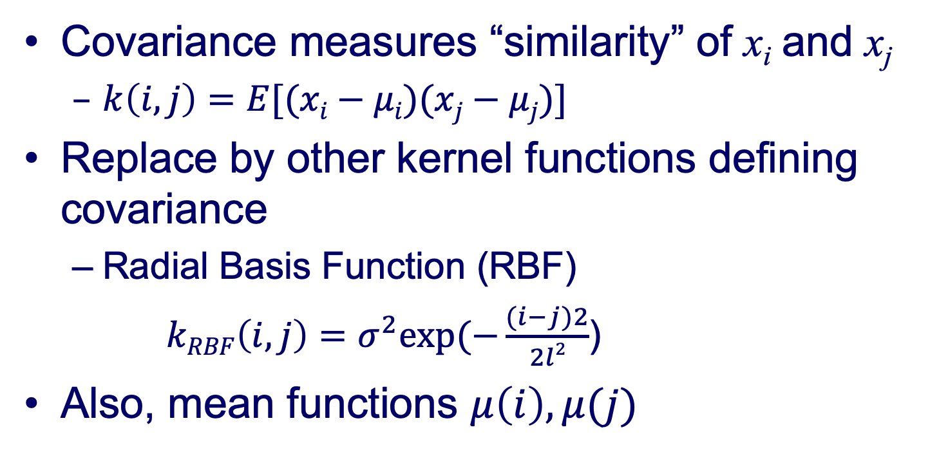
Kernel function for covariance
Covariance measures “similarity” of x_{i} and x_{j}
  $k\left(i,j\right)=E[(xi−μi)(xj−μj)]$
Replace by other kernel functions defining covariance
  Radial Basis Function (RBF)
  $kRBF\left(i,j\right)=$ $σ^{2}exp⁡(−\frac{(i−j)2}{2l2}$)
Also, mean functions $μ\left(i\right),μ(j)$

Slide 5
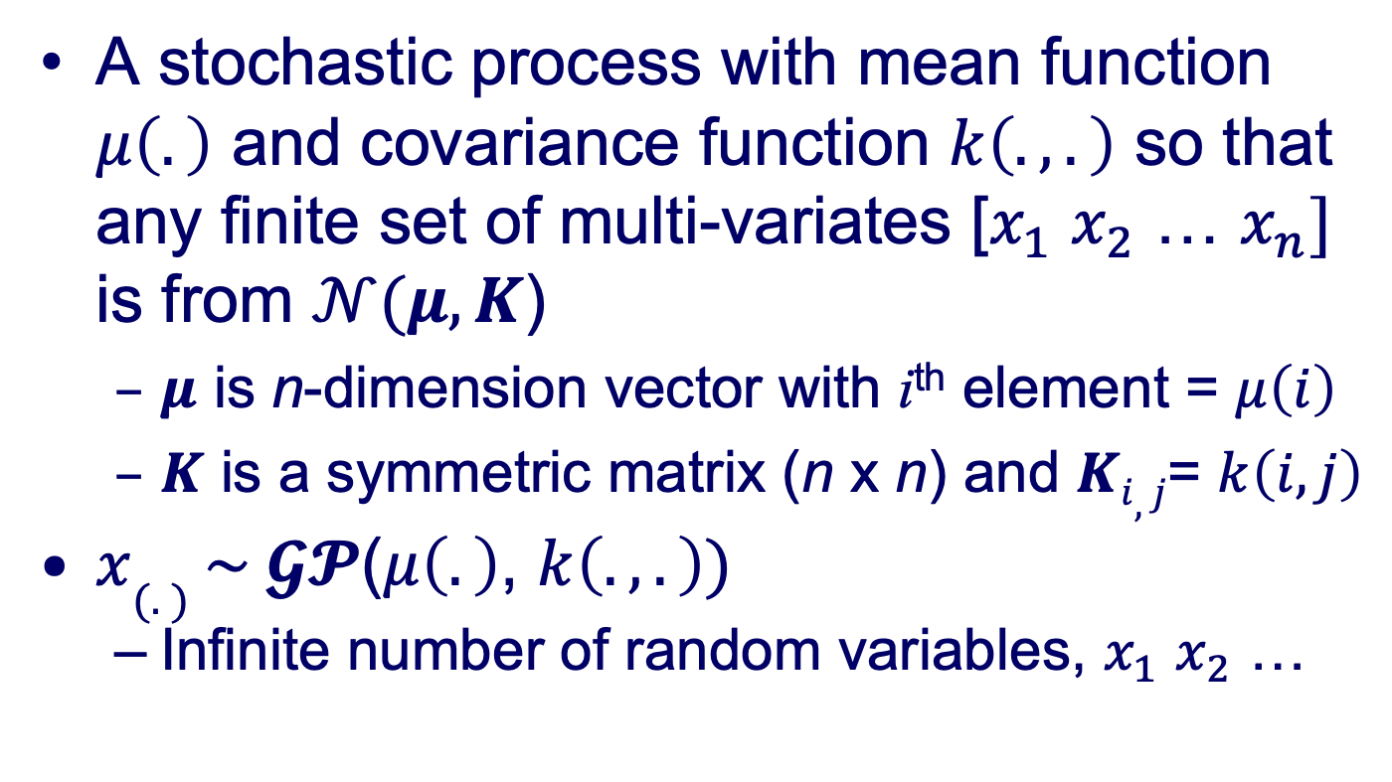
Gaussian process (GP)
A stochastic process with mean function $μ\left(.\right)$ and covariance function $k\left(.,.\right)$ so that any finite set of multi-variates [$x_{1}$ $x_{2}$ … $x_{n}]$ is from $𝒩(μ,K$)
  $μ$ is n-dimension vector with i^{th} element = $μ\left(i\right)$
  $K$ is a symmetric matrix (n x n) and $Ki,j$= $k\left(i,j\right)$
$x(.) \sim 𝓖𝓟$($μ\left(.\right)$, $k\left(.,.\right))$
  Infinite number of random variables, $x_{1}$ $x_{2}$ …

Slide 6
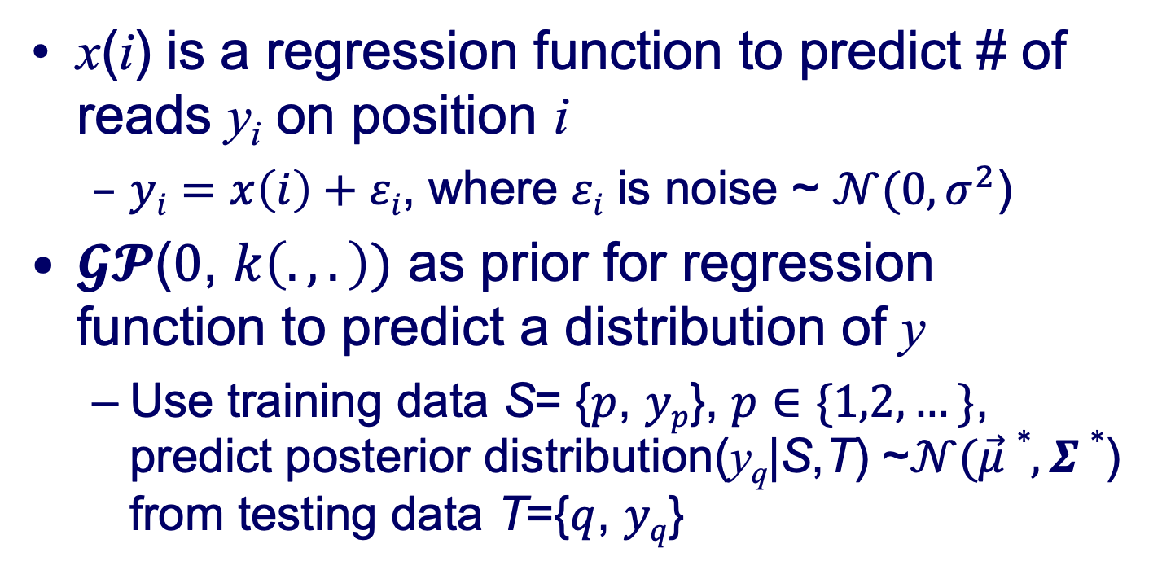

Gaussian process regression
x(i) is a regression function to predict # of reads y_{i} on position i
  $yi=x\left(i\right)+εi$, where $εi$ is noise ~ $𝒩(0,σ^{2}$)
$𝓖𝓟$($0$, $k\left(.,.\right))$ as prior for regression function to predict a distribution of y
  Use training data S= {$p$, $yp$}, $p∈\{1,2,…\}$, predict posterior distribution(y_{q}|S,T) ~$𝒩(\vec{μ}∗,Σ∗$) from testing data T={$q$, $yq$}
$\vec{μ}∗=K(\vec{p},\vec{q})(K\left(\vec{p},\vec{p}\right)+σ^{2}$I)⁻¹${\vec{y_{p}}}_{}$
$Σ∗=K\left(\vec{q},\vec{q}\right)+σ^{2}\text{I}−K(\vec{p},\vec{q})(K\left(\vec{p},\vec{p}\right)+σ^{2}$I)⁻¹$K(\vec{p},\vec{q})$

Slide 7
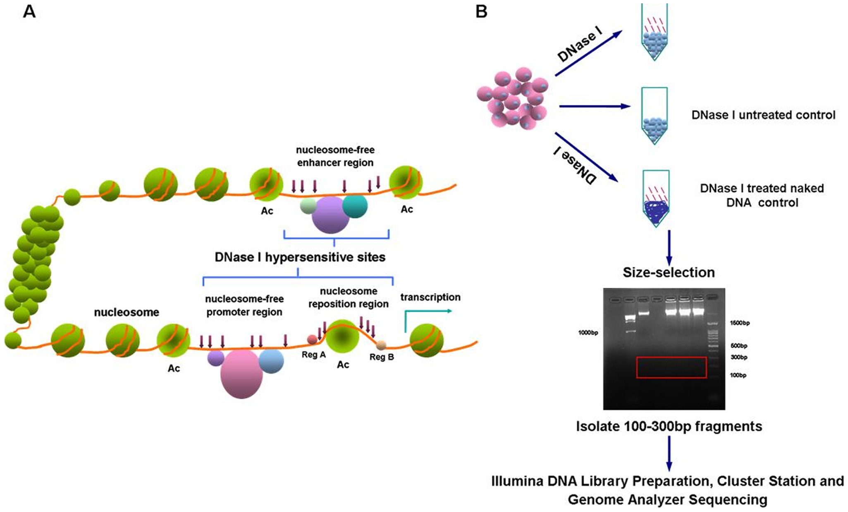
DNase I hypersensitive sites
Arrows indicate DNase I cleavage sites
Obtain short reads that we map to the genome
Wang PLoS ONE 2012

Slide 8
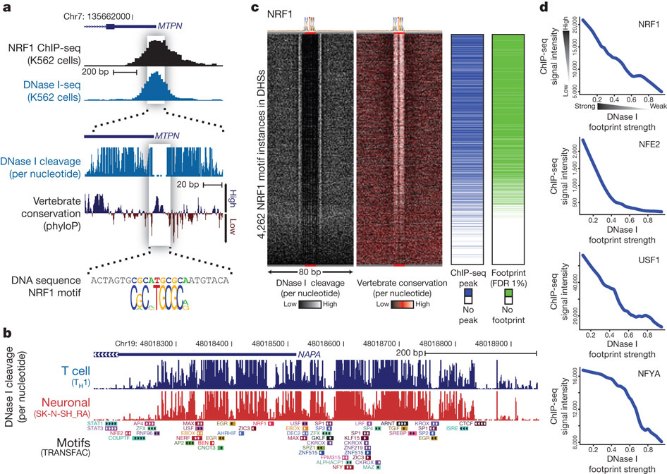
DNase I footprints
Distribution of mapped reads is informative of open chromatin and specific TF binding sites
ChIP-Seq peak
I
Read depth at each position
Nucleosome free “open” chromatin
Zoom in
TF binding prevents DNase cleavage leaving Dnase I “footprint”, only consider 5′ end
Neph Nature 2012

Slide 9
DNase I footprints to TF binding predictions
DNase footprints suggest that some TF binds that location
We want to know which TF binds that location
Two ideas:
  Search for DNase footprint patterns, then match TF motifs
  Search for motif matches in genome, then model proximal DNase-Seq reads
We’ll consider this approach for TF/motif specific effects

Slide 10
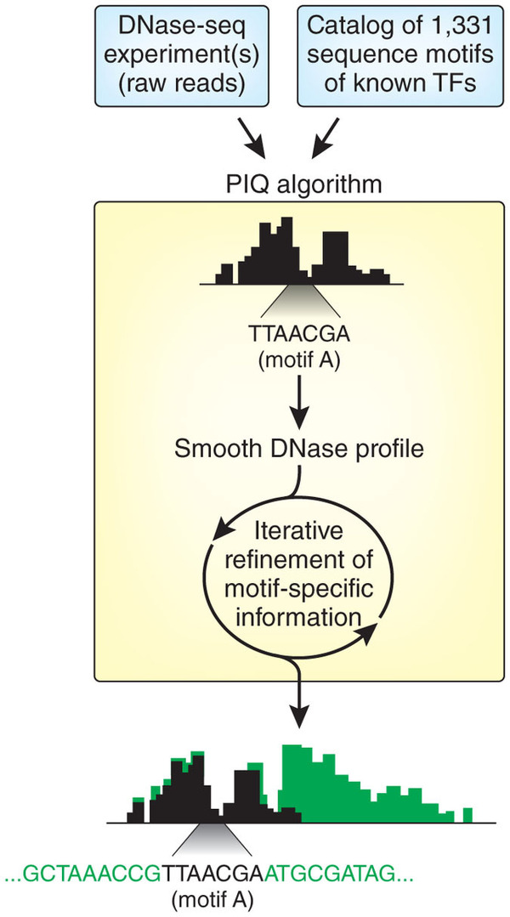
Protein Interaction Quantification (PIQ)
Sherwood et al. Nature Biotechnology 2014
Given: TF motifs and DNase-Seq reads
Do: Predict binding sites of each TF
Rieck and Wright Nature Biotechnology 2014

Slide 11
PIQ main idea
With no TF binding, DNase-Seq reads come from some background distribution
TF binding changes read density in a TF-specific way
Background
TF effects

Slide 12
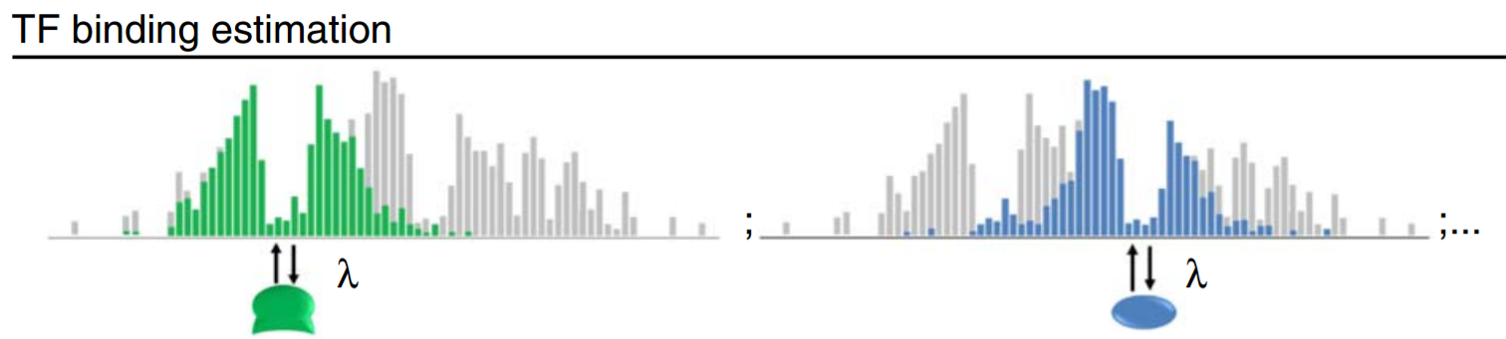
PIQ main idea
Shape of DNase peak and footprint depend on the TF
TF A
TF B
Sherwood Nature Biotechnology 2014

Slide 13
Gaussian processes
Can model and smooth sequential data
Bayesian approach
Jupyter notebook demonstration

Slide 14
PIQ features
We’ll discuss
  Modeling the DNase-Seq background distribution
  How TF binding impacts that distribution
  Priors on TF binding
  Single experiment/strand, single factor
We’ll skip
  Modeling multiple replicates or conditions, cross-experiment and cross-strand effects
  Expectation propagation, iteratively approximating probability distributions
  TF hierarchy: pioneers, settlers, migrants

Slide 15
Algorithm preview
Identify candidate binding sites with PWMs
Build a probabilistic model of the DNase-Seq reads
Estimate TF binding effects
Estimate which candidate binding sites are bound
Predict pioneer, settler, and migrant TFs

Slide 16
DNase-Seq background
Each replicate is noisy, don’t want to over-interpret this noise
  Only counting density of 5′ ends of reads
Manage two competing objectives
  Smooth some of the noise
  Don’t destroy base pair resolution signal

Slide 17
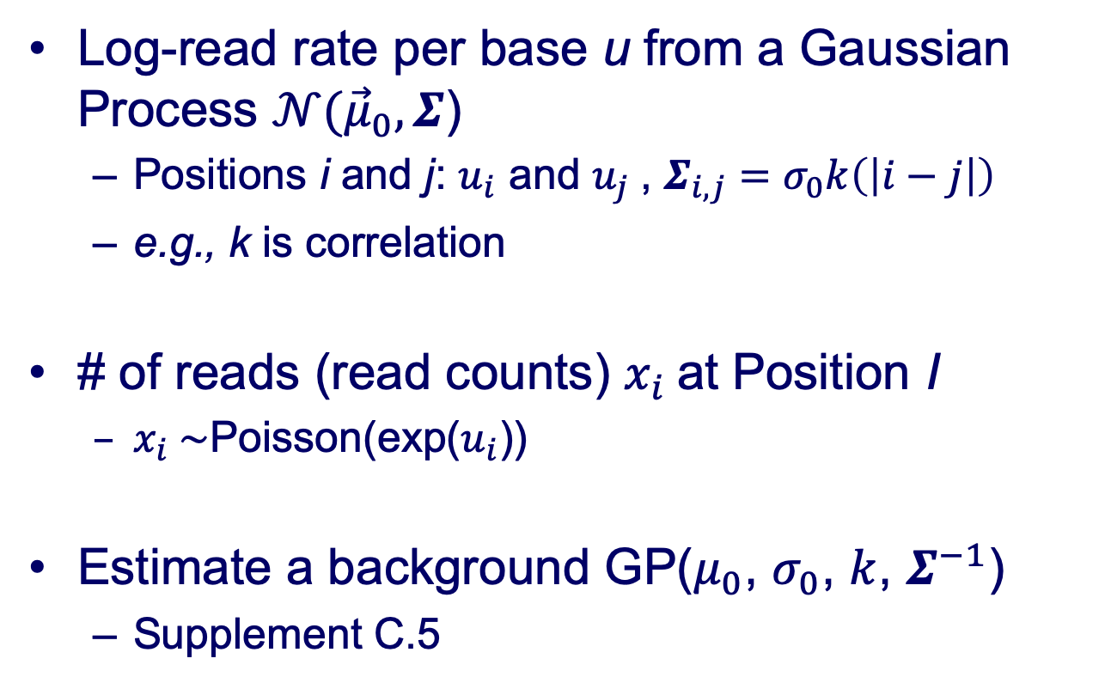
Raw Dnase-seq reads from GP
Log-read rate per base u from a Gaussian Process $𝒩({\vec{μ}}_{0},Σ$)
  Positions i and j: $u_{i}$ and $u_{j}$, $Σ_{i,j}=σ_{0}k\left(\left|i−j\right|\right)$
  e.g., k is correlation
# of reads (read counts) $x_{i}$at Position I
  $x_{i} \sim$Poisson(exp($u_{i}$))
Estimate a background GP($μ_{0}$, $σ_{0}$, $k$, $Σ^{−1}$)
  Supplement C.5

Slide 18
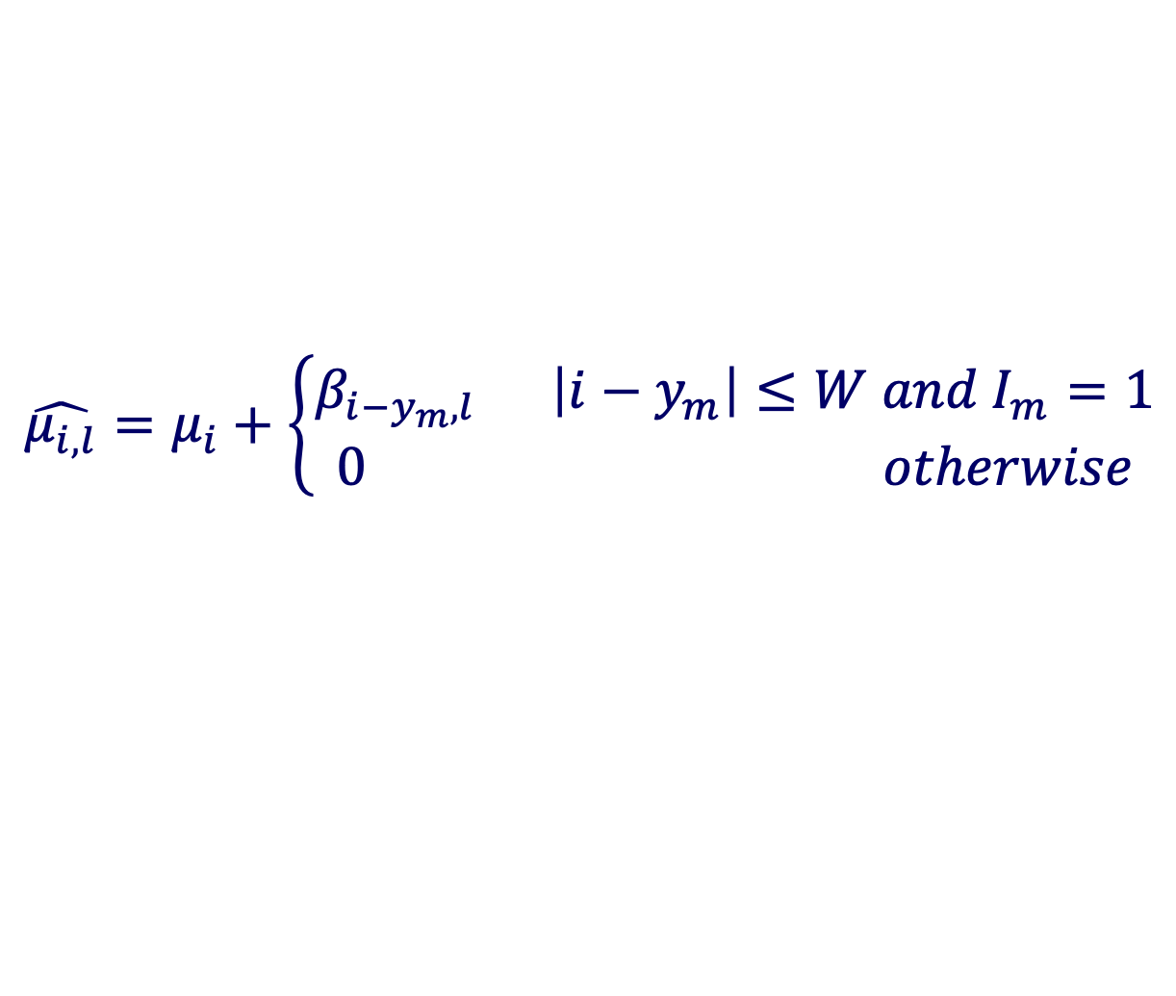
TF-specific DNase profile
Adjust the log-read rate by a TF-specific effect at binding sites
DNase profile for factor l
Whether site m is bound
$$\hat{μ_{i,l}}=μ_{i}+\left\{\begin{aligned}β_{{i−y}_{m},l} \left|{i−y}_{m}\right|≤W and I_{m}=1 \\ 0 otherwise\end{aligned}\right.$$
DNase log-read rate adjusted for binding of factor l
Midpoint location of binding site m
Window size
DNase log-read rate at position i from Gaussian process

Slide 19








TF DNase profile
DNase profiles represented as a vector for each TF
DNase profile for factor l
$$\hat{μ_{i,l}}=μ_{i}+\left\{\begin{aligned}β_{i−y_{m},l} \left|{i−y}_{m}\right|≤W and I_{m}=1 \\ 0 otherwise\end{aligned}\right.$$
Can’t be too far apart
$$y_{m}$$
$$i$$
$$μ$$
I
$$β$$
…
…
$$W$$
$$l=$$
$$W$$

Slide 20
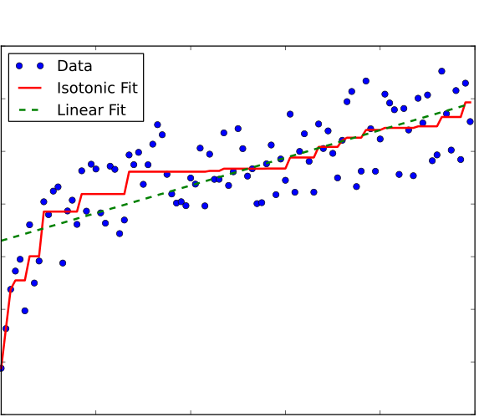


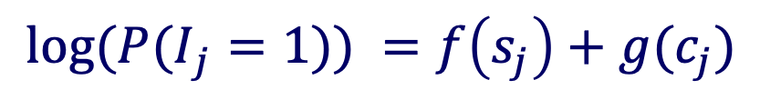



Priors on TF binding
Example only, not realistic data
TF binding event should be more likely when
  motif score is high
  DNase counts are high (around matched motif)
Isotonic (monotonic) regression
$$I_{j}$$
$$s_{j}$$
$$c_{j}$$
$$f\left(s_{j}\right)$$
$$s_{j}$$
Wikipedia
$${log⁡(P(I}_{j}=1)) =f\left(s_{j}\right)+g(c_{j})$$

Slide 21
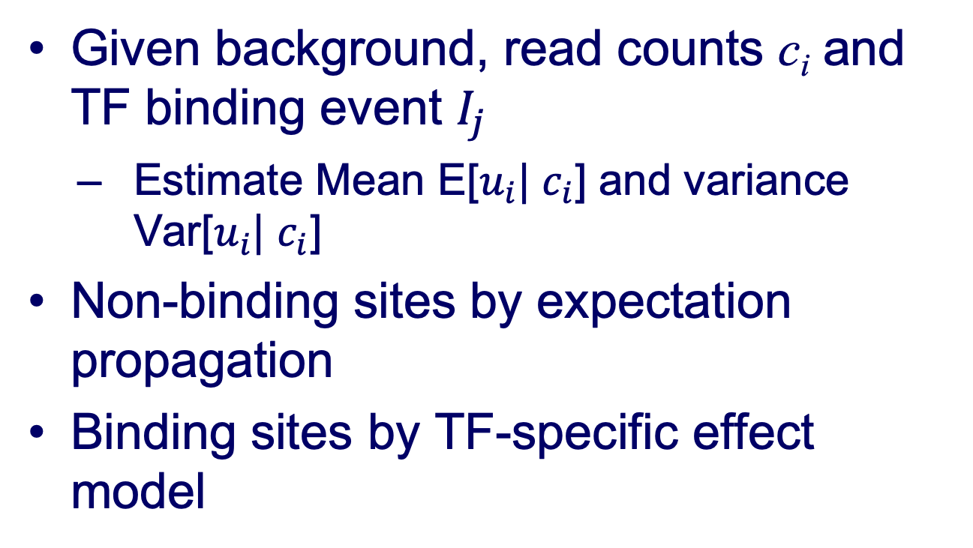
Estimate Gaussian Process posterior
Given background, read counts c_{i} and TF binding event $I_{j}$
  Estimate Mean E[$u_{i}$| $c_{i}$] and variance Var[$u_{i}$| $c_{i}$]
Non-binding sites by expectation propagation
Binding sites by TF-specific effect model

Slide 22
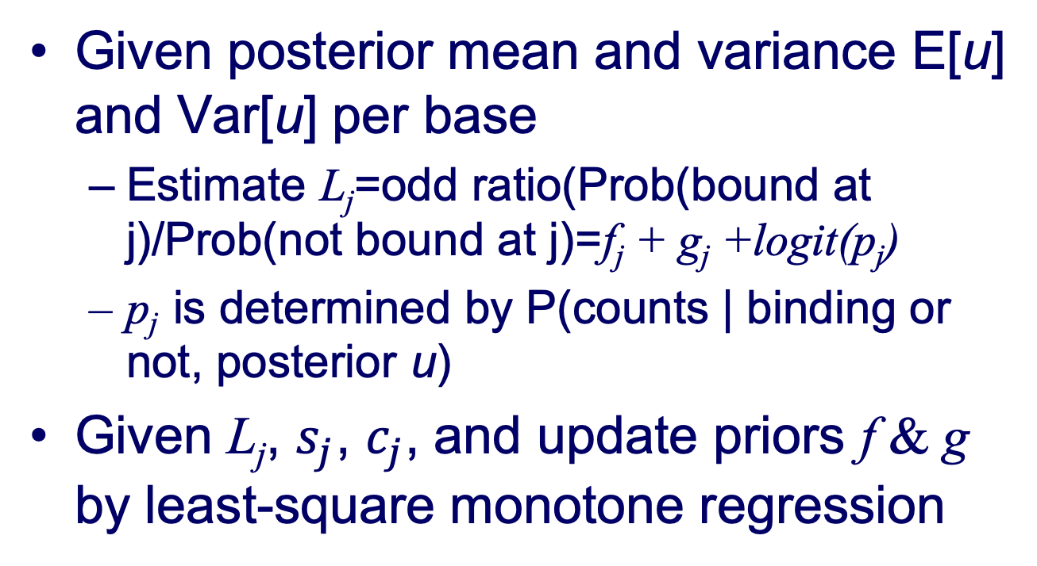
Estimate binding sites
Given posterior mean and variance E[u] and Var[u] per base
  Estimate L_{j}=odd ratio(Prob(bound at j)/Prob(not bound at j)=f_{j} + g_{j} +logit(p_{j})
  p_{j} is determined by P(counts | binding or not, posterior u)
Given L_{j}, $s_{j}$, $c_{j}$, and update priors f & g by least-square monotone regression

Slide 23

Full algorithm
Given: TF motifs and DNase-Seq reads
Do: Predict binding sites of each TF
Identify candidate binding sites with PWMs
Fit Gaussian process parameters for background
Estimate TF binding effects
  using the top 10000 scoring motifs as bound sites
Iterate until parameters converge
  Estimate Gaussian process posterior with expectation propagation
  Estimate expectation of which candidate binding sites are bound
  Update monotonic regression functions for binding priors
$$β_{i−j,l}$$

Slide 24
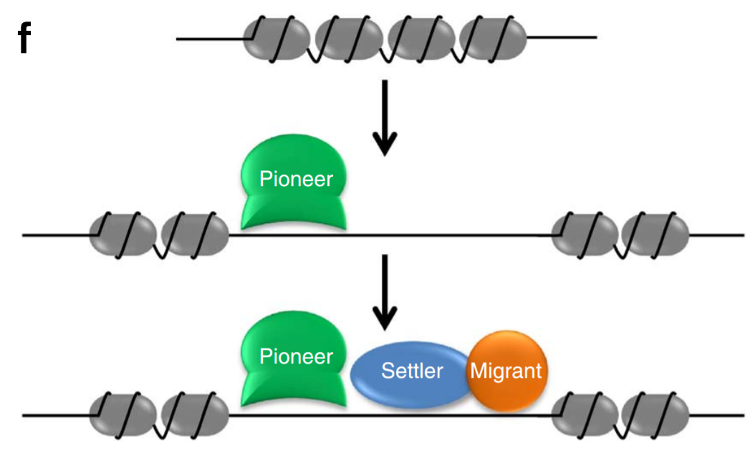
TF binding hierarchy
Pioneer, settler, and migrant TFs
Sherwood Nature Biotechnology 2014

Slide 25
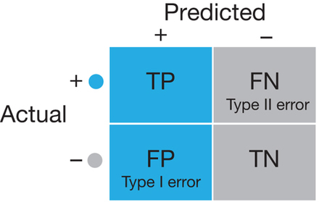
Evaluation: confusion matrix
Compare predictions to actual ground truth (gold standard)
Lever Nature Methods 2016

Slide 26
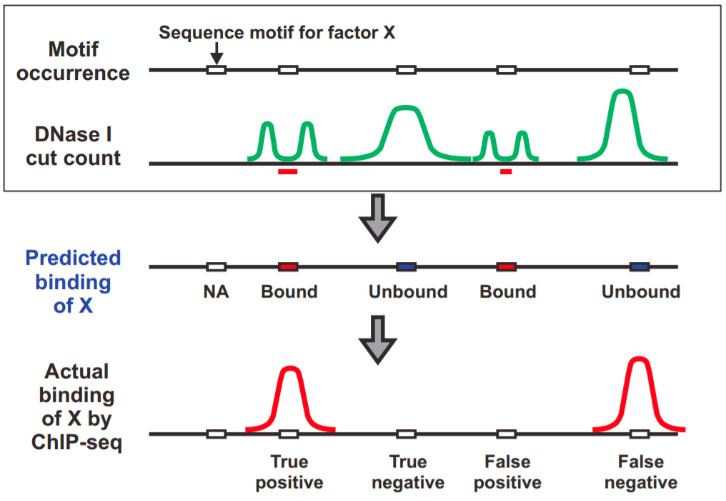
Evaluation: ChIP-Seq gold standard
Sung Molecular Cell 2014

Slide 27
Evaluation: ROC curve
Calculate receiver operating characteristic curve (ROC)
True Positive Rate(TPR) versus False Positive Rate (FPR)
Summarize with area under ROC curve (AUROC)
Includes true negatives
Reason to prefer precision-recall for class imbalanced data
https://en.wikipedia.org/wiki/Receiver_operating_characteristic#/media/File:ROC_curves.svg

Slide 28
Evaluation: ROC curve
TPR and FPR are defined for a set of positive predictions
Need to threshold continuous predictions
Rank predictions
ROC curve assesses all thresholds
Candidate P(bound)
binding site
764 0.99
47 0.96
942 0.91
157 0.87
79 0.83
202 0.72
356 0.66
679 0.51
291 0.43
810 0.40
…
Positive predictions
t
Negative predictions
Calculate TPR and FPR at all thresholds t

Slide 29
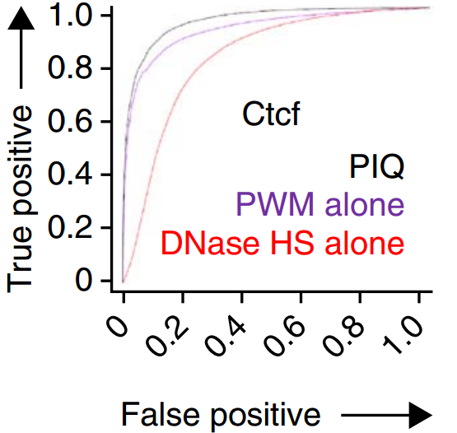
PIQ ROC curve for mouse Ctcf
Compare predictions to ChIP-Seq
Full PIQ model improves upon motifs or DNase alone
Sherwood Nature Biotechnology 2014

Slide 30
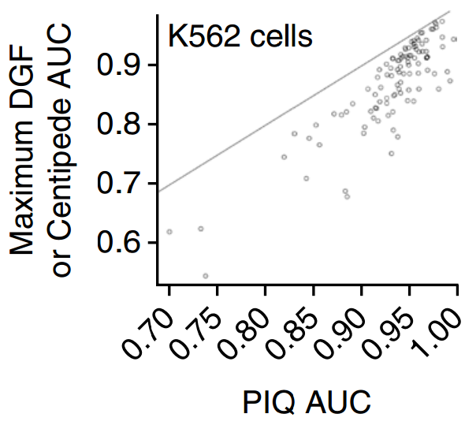
PIQ evaluation
Compare to two standard methods
  303 ChIP-Seq experiments in K562 cells
  Centipede, digital genomic footprinting
Compare AUROC
  PIQ has very high AUROC
  Mean 0.93
  Corresponds to recovering median of 50% of binding sites
Sherwood Nature Biotechnology 2014

Slide 31
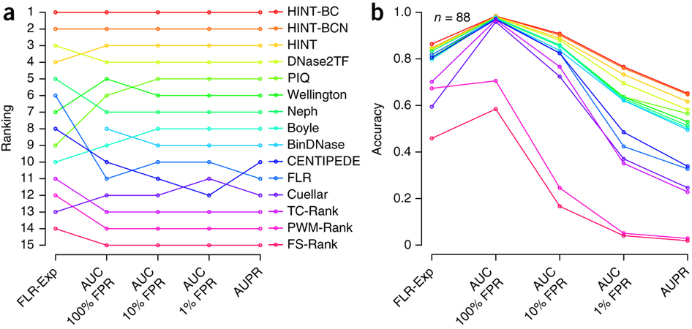
DNase-Seq benchmarking
PIQ among top methods in large scale DNase benchmarking study
HMM-based model HINT was top performer
Gusmao Nature Methods 2016

Slide 32
Downside of AUROC for genome-wide evaluations
Almost all methods look equally good when using full ROC curve
AUROC close to 1.0
Precision-recall curve or truncated ROC curve differentiate methods
Gusmao Nature Methods 2016

Slide 33
PIQ summary
Smooth noisy DNase-Seq data without imposing too much structure
Combine DNase-Seq and motifs to predict condition-specific binding sites
Supports replicates and multiple related conditions (e.g. time series)

