Slide 1
Transcript quantification and Analysis of alternative splicing with RNA-Seq
BMI/CS 776
www.biostat.wisc.edu/bmi776/
Spring 2020
Daifeng Wang
daifeng.wang@wisc.edu
These slides, excluding third-party material, are licensed under CC BY-NC 4.0 by Mark Craven, Colin Dewey, Anthony Gitter and Daifeng Wang

Slide 2
Overview
RNA-Seq technology
The RNA-Seq quantification problem
Generative probabilistic models and Expectation-Maximization for the quantification task
Inference of alternative splicing from RNA-Seq data with probabilistic splice graphs

Slide 3
Goals for lecture
What is RNA-Seq?
How is RNA-Seq used to measure the abundances of RNAs within cells?
What probabilistic models and algorithms are used for analyzing RNA-Seq?

Slide 4
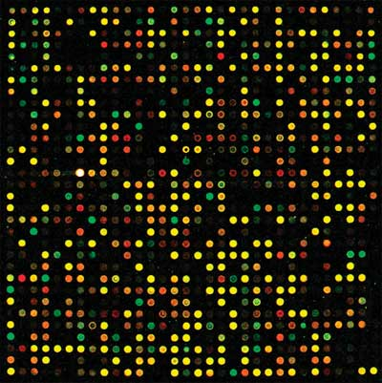
Measuring transcription the old way: microarrays
Each spot has “probes” for a certain gene
Probe: a DNA sequence complementary to a certain gene
Relies on complementary hybridization
Intensity/color of light from each spot is measurement of the number of transcripts for a certain gene in a sample
Requires knowledge of gene sequences

Slide 5
Advantages of RNA-Seq over microarrays
No reference sequence needed
  With microarrays, limited to the probes on the chip
Low background noise
Large dynamic range
  10⁵ compared to 10² for microarrays
High technical reproducibility
Identify novel transcripts and splicing events
Notes:
More suitable for low RNA content samples

Slide 6
RNA-Seq technology
Leverages rapidly advancing sequencing technology
Transcriptome analog to whole genome shotgun sequencing
Two key differences from genome sequencing:
  Transcripts sequenced at different levels of coverage - expression levels
  Sequences already known (in many cases) - coverage is measurement

Slide 7
A generic RNA-Seq protocol
Sample RNA
RNA fragments
cDNA fragments
reads
reverse transcription + amplification
sequencing machine
CCTTCNCACTTCGTTTCCCAC
TTTTTNCAGAGTTTTTTCTTG
GAACANTCCAACGCTTGGTGA
GGAAANAAGACCCTGTTGAGC
CCCGGNGATCCGCTGGGACAA
GCAGCATATTGATAGATAACT
CTAGCTACGCGTACGCGATCG
CATCTAGCATCGCGTTGCGTT
CCCGCGCGCTTAGGCTACTCG
TCACACATCTCTAGCTAGCAT
CATGCTAGCTATGCCTATCTA
fragmentation

Slide 8
RNA-Seq data: FASTQ format
name
@HWUSI-EAS1789_0001:3:2:1708:1305#0/1
CCTTCNCACTTCGTTTCCCACTTAGCGATAATTTG
+HWUSI-EAS1789_0001:3:2:1708:1305#0/1
VVULVBVYVYZZXZZ\ee[a^b`[a\a[\\a^^^\
@HWUSI-EAS1789_0001:3:2:2062:1304#0/1
TTTTTNCAGAGTTTTTTCTTGAACTGGAAATTTTT
+HWUSI-EAS1789_0001:3:2:2062:1304#0/1
a__[\Bbbb`edeeefd`cc`b]bffff`ffffff
@HWUSI-EAS1789_0001:3:2:3194:1303#0/1
GAACANTCCAACGCTTGGTGAATTCTGCTTCACAA
+HWUSI-EAS1789_0001:3:2:3194:1303#0/1
ZZ[[VBZZY][TWQQZ\ZS\[ZZXV__\OX`a[ZZ
@HWUSI-EAS1789_0001:3:2:3716:1304#0/1
GGAAANAAGACCCTGTTGAGCTTGACTCTAGTCTG
+HWUSI-EAS1789_0001:3:2:3716:1304#0/1
aaXWYBZVTXZX_]Xdccdfbb_\`a\aY_^]LZ^
@HWUSI-EAS1789_0001:3:2:5000:1304#0/1
CCCGGNGATCCGCTGGGACAAGCAGCATATTGATA
+HWUSI-EAS1789_0001:3:2:5000:1304#0/1
aaaaaBeeeeffffehhhhhhggdhhhhahhhadh
sequence
read
qualities
paired-end reads
read1
read2
1 Illumina HiSeq 2500 lane
~150 million reads

Slide 9
Tasks with RNA-Seq data
Assembly:
  Given: RNA-Seq reads (and possibly a genome sequence)
  Do: Reconstruct full-length transcript sequences from the reads
Quantification (our focus):
  Given: RNA-Seq reads and transcript sequences
  Do: Estimate the relative abundances of transcripts (“gene expression”)
Differential expression or additional downstream analyses:
  Given: RNA-Seq reads from two different samples and transcript sequences
  Do: Predict which transcripts have different abundances between two samples
Notes:
After quantification, can also do many types of downstream analysis like clustering, motif analysis, eQTL mapping, network reconstruction, etc.

Slide 10
RNA-Seq is a relative abundance measurement technology
RNA-Seq gives you reads from the ends of a random sample of fragments in your library
Without additional data this only gives information about relative abundances
Additional information, such as levels of “spike-in” transcripts, are needed for absolute measurements
RNA
sample
cDNA
fragments
reads

Slide 11
Issues with relative abundance measures
Gene | Sample 1 absolute abundance | Sample 1 relative abundance | Sample 2 absolute abundance | Sample 2 relative abundance
1 | 20 | 10% | 20 | 5%
2 | 20 | 10% | 20 | 5%
3 | 20 | 10% | 20 | 5%
4 | 20 | 10% | 20 | 5%
5 | 20 | 10% | 20 | 5%
6 | 100 | 50% | 300 | 75%
Changes in absolute expression of high expressors is a major factor
Normalization is required for comparing samples in these situations

Slide 12
The basics of quantification with RNA-Seq data
For simplicity, suppose reads are of length one (typically they are > 35 bases)
What relative abundances would you estimate for these genes?
Relative abundance is relative transcript levels in the cell, not proportion of observed reads
transcripts
reads
200
100 A
1
60
60 C
2
80
3
40 G

Slide 13

Length dependence
Probability of a read coming from a transcript ∝ relative abundance × length
transcripts
reads
200
100 A
1
60
2
60 C
80
3
40 G
probability of read from transcript 1 = (transcript 1 reads) / (total reads)
transcript 1 relative abundance
transcript 1 length

Slide 14





Length dependence
Probability of a read coming from a transcript ∝ relative abundance × length
transcripts
reads
200
100 A
1
60
2
60 C
80
3
40 G
normalize

Slide 15

The basics of quantification from RNA-Seq data
Basic assumption:
Normalization factor is the mean length of expressed transcripts
expression level
(relative abundance)
length

Slide 16


The basics of quantification from RNA-Seq data
Estimate the probability of reads being generated from a given transcript by counting the number of reads that align to that transcript
Convert to expression levels by normalizing by transcript length
# reads mapping to transcript i
total # of mappable reads
Notes:
RSEM uses tau for transcript abundance, nu for nucleotide abundance

Slide 17
The basics of quantification from RNA-Seq data
Basic quantification algorithm
  Align reads against a set of reference transcript sequences
  Count the number of reads aligning to each transcript
  Convert read counts into relative expression levels

Slide 18


Counts to expression levels
RPKM - Reads Per Kilobase per Million mapped reads
FPKM (fragments instead of reads, two reads per fragment, for paired end reads)
TPM - Transcripts Per Million
Prefer TPM to RPKM because of normalization factor
  TPM is a technology-independent measure (simply a fraction)
(estimate of)

Slide 19
What if reads do not uniquely map to transcripts?
The approach described assumes that every read can be uniquely aligned to a single transcript
This is generally not the case
  Some genes have similar sequences - gene families, repetitive sequences
  Alternative splice forms of a gene share a significant fraction of sequence

Slide 20
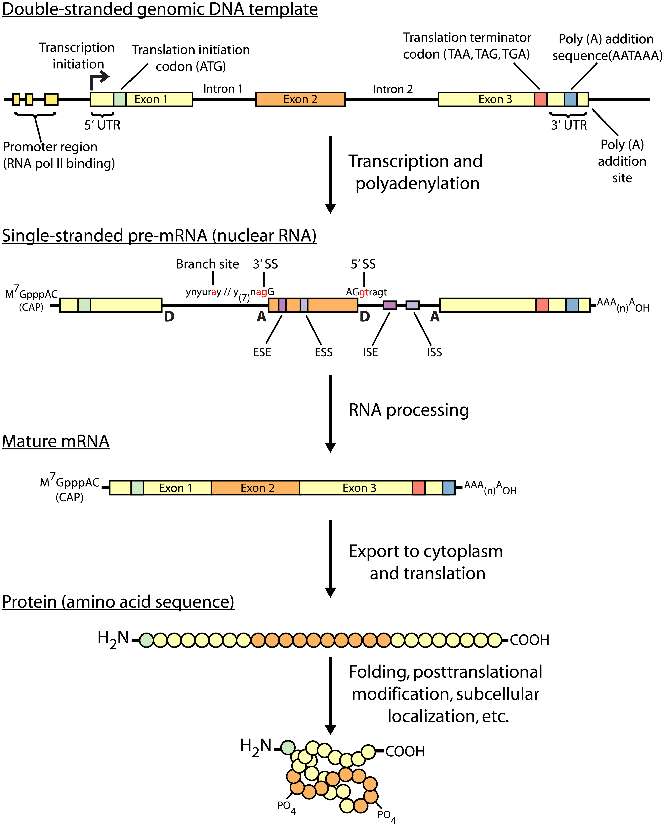
Central dogma of molecular biology
Griffith et al. PLoS Computational Biology 2015

Slide 21
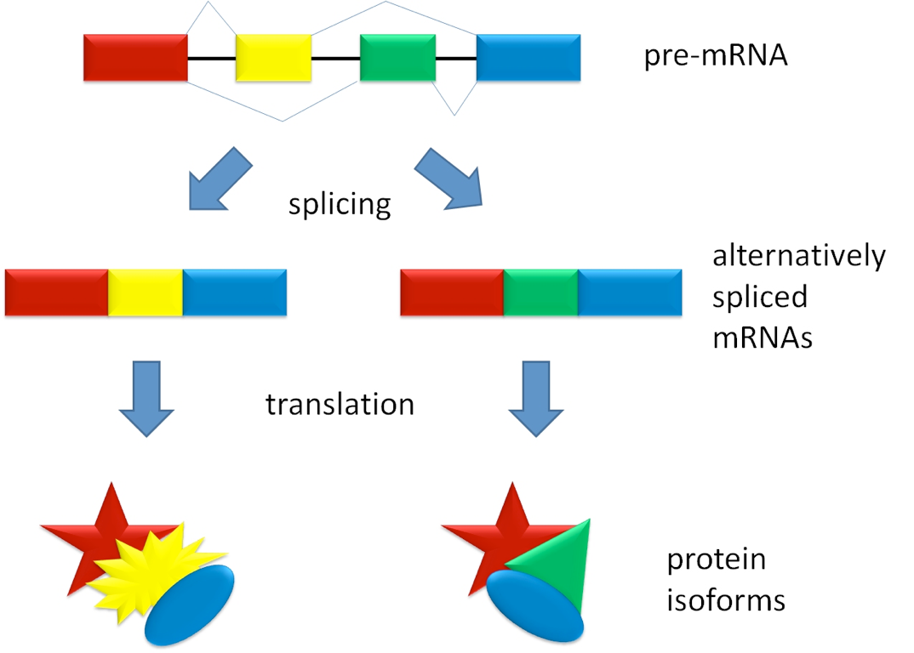
Alternative splicing

Slide 22
Multi-mapping reads in RNA-Seq
Species | Read length | % multi-mapping reads
Mouse | 25 | 17%
Mouse | 75 | 10%
Maize | 25 | 52%
Axolotl | 76 | 23%
Human | 50 | 23%
Throwing away multi-mapping reads leads to
  Loss of information
  Potentially biased estimates of abundance

Slide 23
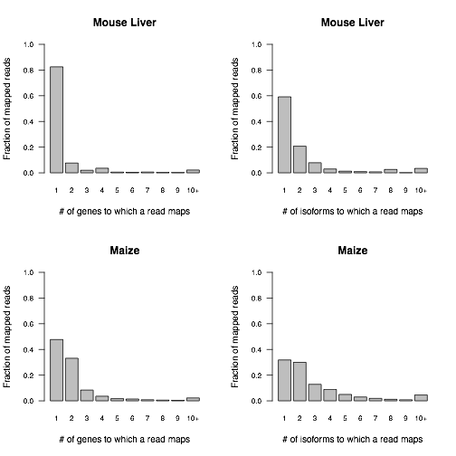
Distributions of alignment counts

Slide 24
What if reads do not uniquely map to transcripts?
Multiread: a read that could have been derived from multiple transcripts
How would you estimate the relative abundances for these transcripts?
transcripts
reads
20 + 180 = 200
90 A
1
20 + 40 = 60
40 C
2
80
3
40 G
30 T

Slide 25
Some options for handling multireads
Discard multireads, estimate based on uniquely mapping reads only
Discard multireads, but use “unique length” of each transcript in calculations
“Rescue” multireads by allocating (fractions of) them to the transcripts
  Three step algorithm
    Estimate abundances based on uniquely mapping reads only
    For each multiread, divide it between the transcripts to which it maps, proportionally to their abundances estimated in the first step
    Recompute abundances based on updated counts for each transcript

Slide 26



Rescue method example - Step 1
transcripts
reads
200
90 A
1
60
40 C
2
80
3
40 G
30 T
Step 1

Slide 27



Rescue method example - Step 2
transcripts
reads
200
90 A
1
60
40 C
2
80
3
40 G
30 T
Step 2

Slide 28



Rescue method example - Step 3
transcripts
reads
200
90 A
1
60
40 C
2
80
3
40 G
30 T
Step 3

Slide 29
An observation about the rescue method
Note that at the end of the rescue algorithm, we have an updated set of abundance estimates
These new estimates could be used to reallocate the multireads
And then we could update our abundance estimates once again
And repeat!
This is the intuition behind the statistical approach to this problem

Slide 30
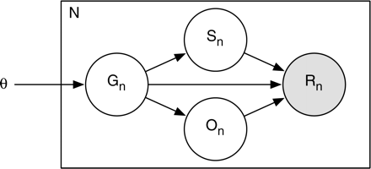
RSEM (RNA-Seq by Expectation-Maximization) - a generative probabilistic model
Simplified view of the model (plate notation)
  Grey – observed variable
  White – latent (unobserved) variables
number of reads
start position
Bayesian network
transcript probabilities (expression levels)
read sequence
transcript
orientation

Slide 31
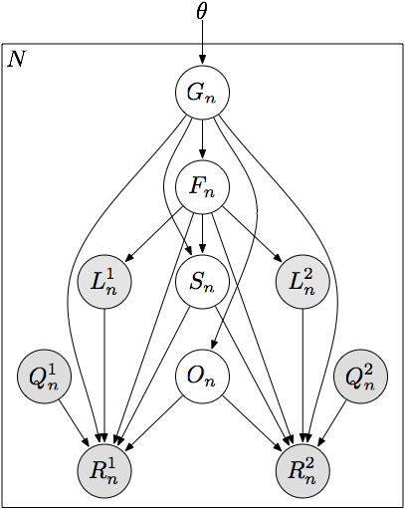
RSEM - a generative probabilistic model
transcript probabilities (expression levels)
number of reads
transcript
fragment length
start position
read length
orientation
paired read
quality scores
read sequence

Slide 32
Quantification as maximum likelihood inference
Observed data likelihood
Likelihood function is concave with respect to θ
  Has a global maximum (or global maxima)
Expectation-Maximization for optimization
“RNA-Seq gene expression estimation with read mapping uncertainty”
Li, B., Ruotti, V., Stewart, R., Thomson, J., Dewey, C.
Bioinformatics, 2010

Slide 33
Approximate inference with read alignments
Full likelihood computation requires O(NML²) time
  N (number of reads) ~ 10⁷
  M (number of transcripts) ~ 10⁴
  L (average transcript length) ~ 10³
Approximate by alignment
all local alignments of read n with at most x mismatches

Slide 34
EM Algorithm
Expectation-Maximization for RNA-Seq
  E-step: Compute expected read counts given current expression levels
  M-step: Compute expression values maximizing likelihood given expected read counts
Rescue algorithm ≈ 1 iteration of EM

Slide 35

HMM Interpretation
transcript 1
transcript 2
start
transcript 3
...
...
transcript M
hidden: read start positions
observed: read sequences
Learning parameters: Baum-Welch Algorithm (EM for HMMs)
Approximation: Only consider a subset of paths for each read

Slide 36
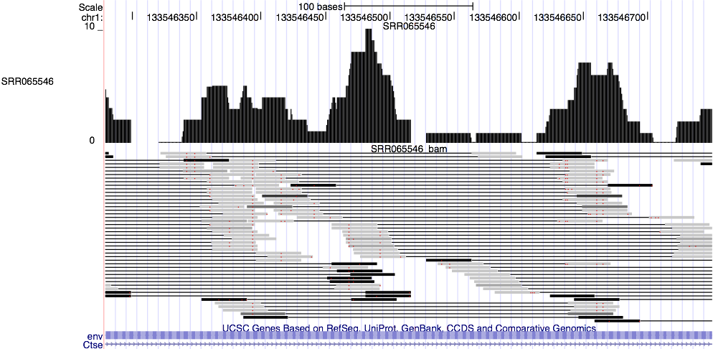
Probabilistically-weighted alignments

Slide 37
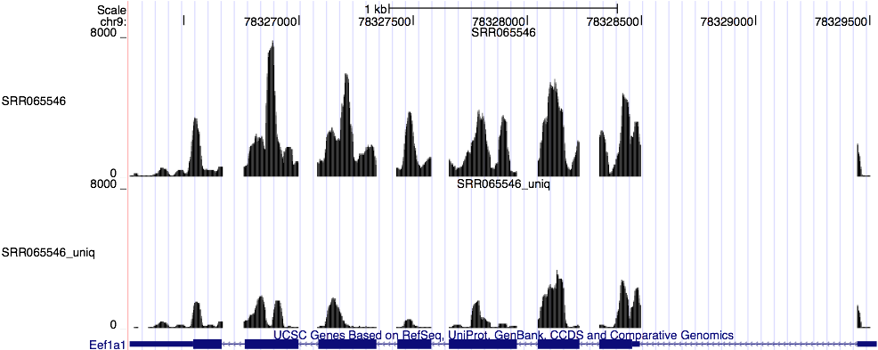
Expected read count visualization

Slide 38
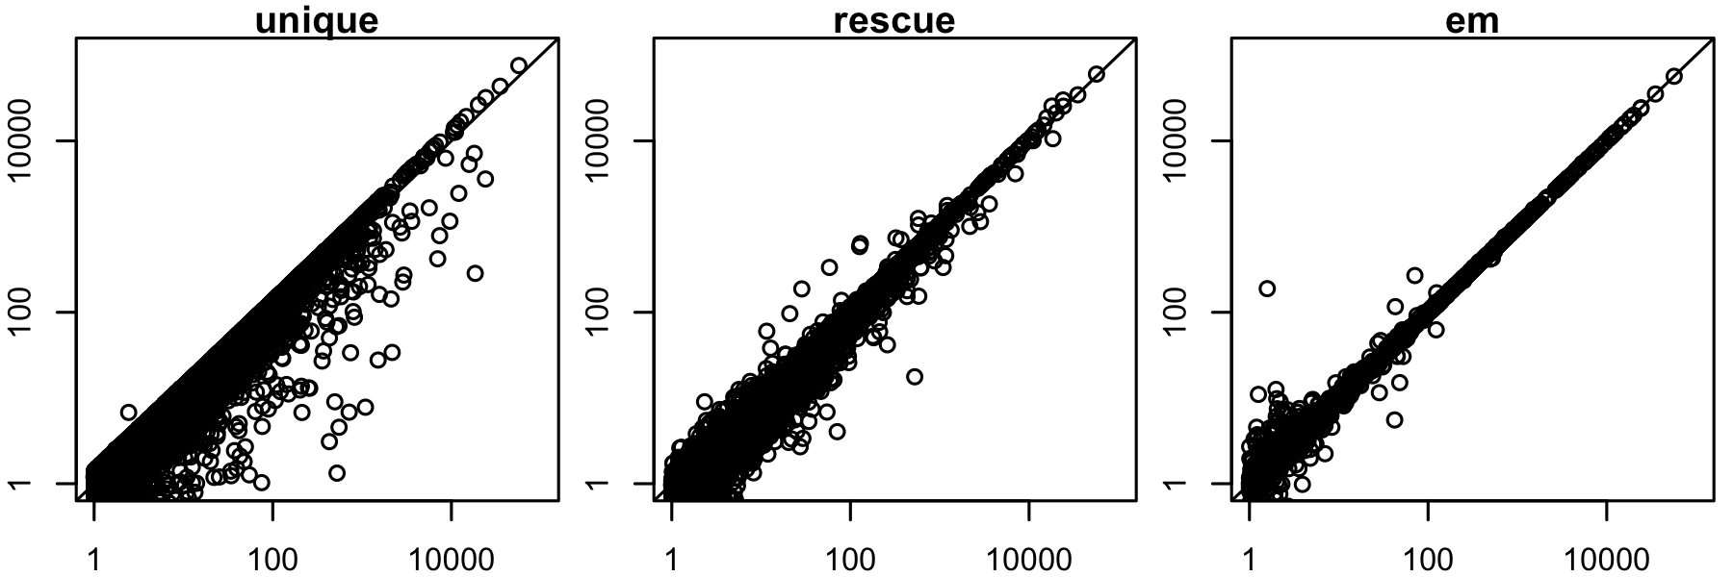
Improved accuracy over unique and rescue
predicted expression level
true expression level
Mouse gene-level expression estimation

Slide 39
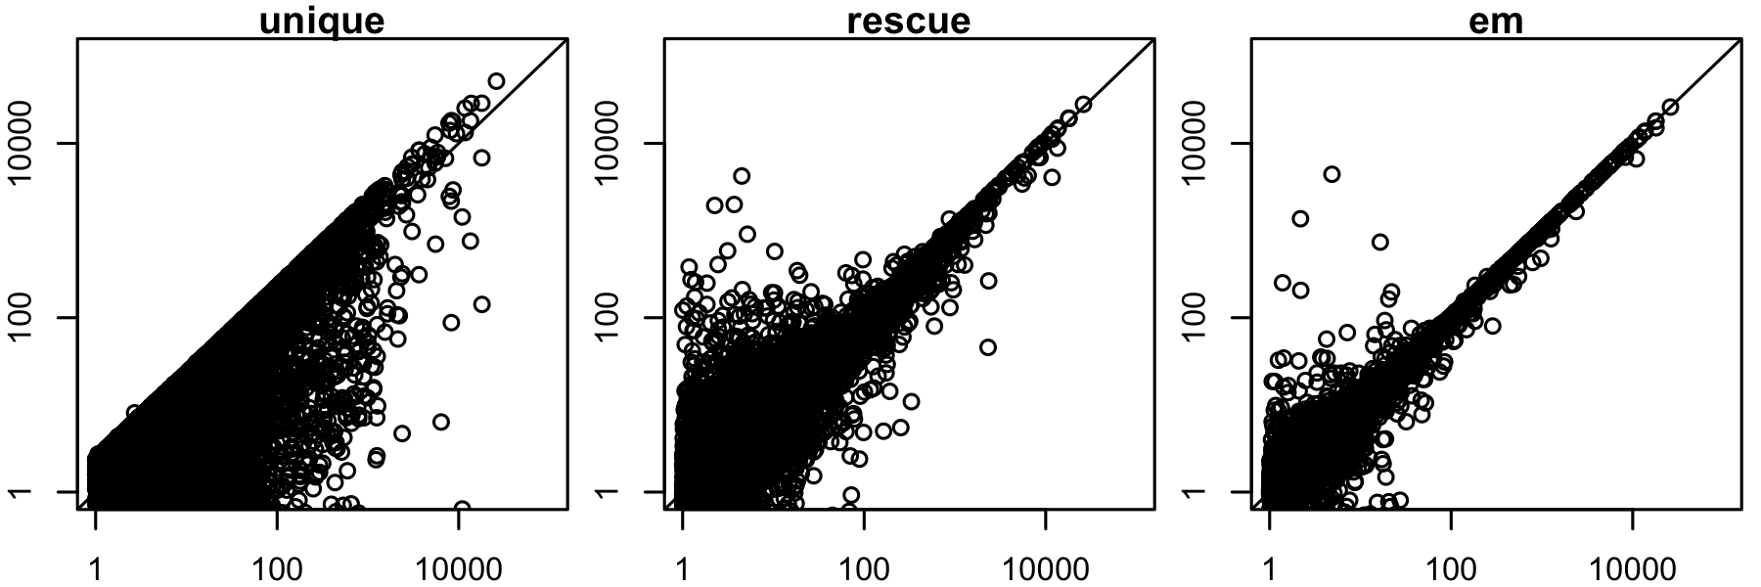
Improving accuracy on repetitive genomes: maize
predicted expression level
true expression level
Maize gene-level expression estimation

Slide 40
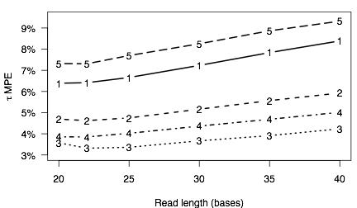
Finding the optimal read length
median percent error
1-3: mouse liver, increasing
base throughput
4: mouse brain
5: maize

Slide 41
RNA-Seq and RSEM summary
RNA-Seq is the preferred technology for transcriptome analysis in most settings
The major challenge in analyzing RNA-Seq data: the reads are much shorter than the transcripts from which they are derived
Tasks with RNA-Seq data thus require handling hidden information: which gene/isoform gave rise to a given read
The Expectation-Maximization algorithm is extremely powerful in these situations

Slide 42
Recent developments in RNA-Seq
Long read sequences: PacBio and Oxford Nanopore
Single-cell RNA-Seq: review
  Observe heterogeneity of cell populations
  Model technical artifacts (e.g. artificial 0 counts)
  Detect sub-populations
  Predict pseudotime through dynamic processes
  Detect gene-gene and cell-cell relationships
Alignment-free quantification:
  Kallisto
  Salmon

Slide 43
Public sources of RNA-Seq data
Gene Expression Omnibus (GEO): http://www.ncbi.nlm.nih.gov/geo/
  Both microarray and sequencing data
Sequence Read Archive (SRA): http://www.ncbi.nlm.nih.gov/sra
  All sequencing data (not necessarily RNA-Seq)
ArrayExpress: https://www.ebi.ac.uk/arrayexpress/
  European version of GEO
Homogenized data: MetaSRA, Toil, recount2, ARCHS⁴

Slide 44
Inference of alternative splicing from RNA-Seq data
Part I - Alternative splicing and the challenges it poses
Part II - A solution: Probabilistic Splice Graphs (PSGs)
Part III - Evaluating PSG methodology

Slide 45
Alternative splicing

Slide 46
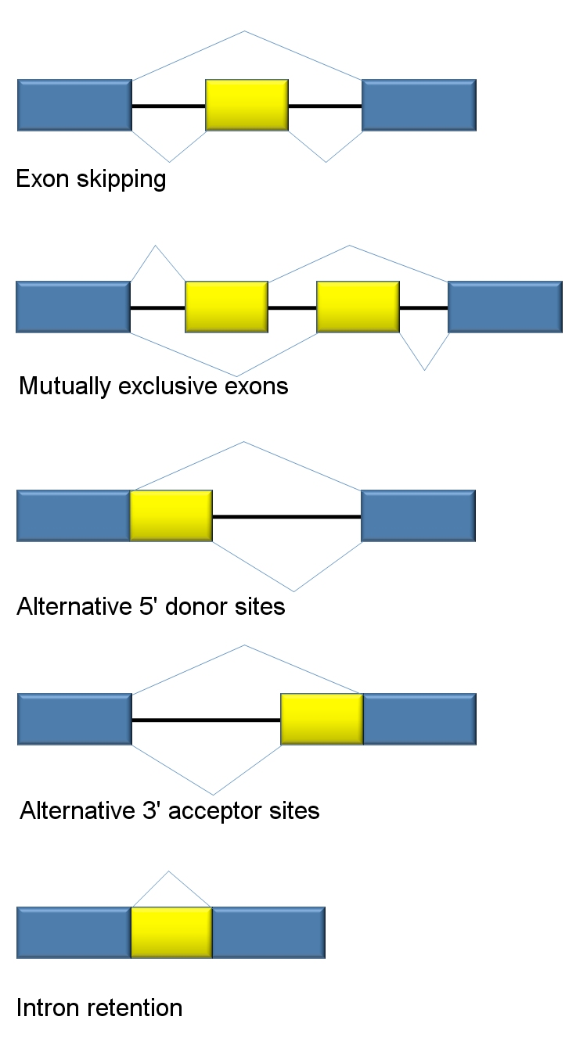
Classes of alternative splicing events

Slide 47
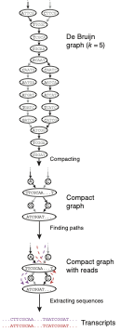
Complication 1: De novo transcriptome assembly
RNA-Seq reads/fragments are relatively short
Often insufficient to reconstruct full-length isoforms in the presence of alternative splicing
Transcriptome assemblies perhaps best left in “graph” form
  De Bruijn graph
  String graphs
Graph constructed by the “Butterfly” module of Trinity
(Grabherr et al. 2011)

Slide 48
Complication 2: Non-identifiability of full-length isoform models
two (of infinitely many) possible isoform abundances
LeGault et al. 2013

Slide 49
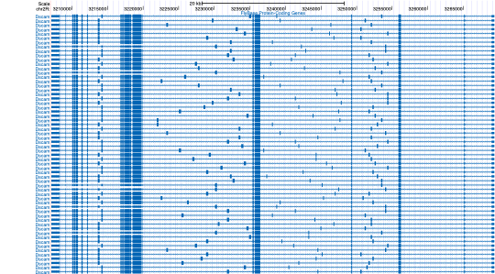
Complication 3: Combinatorial explosion of distinct isoforms
Combinatorial explosion of the number of possible isoforms for each gene
Insufficient data to accurately estimate abundances of thousands of isoforms
Drosophila Dscam: more than 38,000 possible isoforms
(Schmucker et al., 2000)

Slide 50
Inference of alternative splicing from RNA-Seq data
Part I - Alternative splicing and the challenges it poses
Part II - A solution: Probabilistic Splice Graphs (PSGs)
Part III - Evaluating PSG methodology

Slide 51
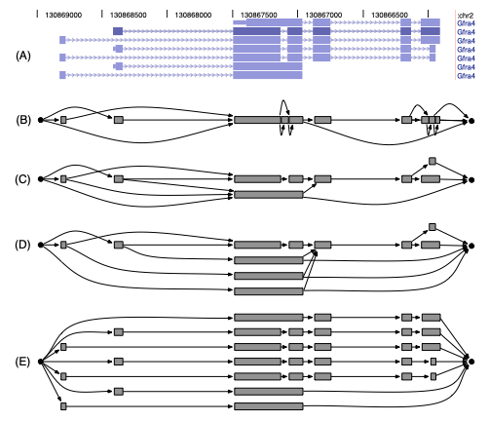
Splice Graphs
Heber et al. 2002
Compact data structure for representing the possible isoforms of a gene

Slide 52
Splice Graphs with EST and RNA-Seq data
Xing et al. 2006
  EM algorithm for estimating abundances of all possible isoforms given splice graph and EST data
  Expressed Sequence Tag (EST), 74.2 million in 2013
Montgomery et al. 2010, Singh et al. 2011
  Graph flow-based methods for quantification/differential splicing given RNA-Seq data
Rogers et al. 2012
  SpliceGrapher: construct splice graph structure given RNA-Seq data

Slide 53
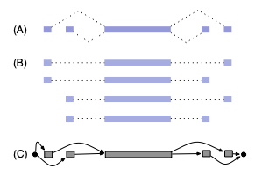
Probabilistic Splice Graphs
Jenkins et al. 2006
Compact probabilistic model representing isoform frequencies in terms of frequencies of individual splice events
Originally used by Jenkins et al. for EST analysis
0.32
0.48
0.8
0.4
0.08
0.12
0.6
0.2

Slide 54
Probabilistic Splice Graph Complexity
known isoforms
“line graph”
“exon graph”
“higher-order exon graph”
“unfactorized graph”

Slide 55
Advantages of PSGs
Compact description of the possible isoforms of a gene
  Models the frequencies of potentially exponentially many isoforms with a polynomial number of parameters
  Models dependence or independence of splice events
The parameters of a PSG are more often identifiable than a model that has a parameter for every possible isoform
Splice graphs are naturally-produced structures from transcriptome assemblers

Slide 56
PSGs are alternative “parsimonious” models
Other methods find smallest set of isoform structures that explain the data
  Cufflinks (Trapnell et al., 2010)
  IsoLasso (Li et al., 2011)
  NSMAP (Xia et al., 2011)
  SLIDE (Li et al., 2011)
PSG models are another form of parsimonious model
  Minimize the number of splice event parameters
  Assumption of independence between splice events

Slide 57
Application of PSGs to RNA-Seq data
L. Legault and C. Dewey. Inference of alternative splicing from RNA-Seq data with probabilistic splice graphs. Bioinformatics 29(18):2300-2310.
  Combined model of PSG with RNA-Seq generative model
  Efficient PSG parameter estimation with EM and dynamic programming
  Identifiability proofs for PSG with RNA-Seq data
  Differential processing (splicing) tests

Slide 58
The PSG parameter inference task
Given: RNA-Seq reads and a PSG structure
Do: Estimate the (ML or MAP) parameters for the model
CCTTCNCACTTCGTTTCCCAC
TTTTTNCAGAGTTTTTTCTTG
GAACANTCCAACGCTTGGTGA
GGAAANAAGACCCTGTTGAGC
CCCGGNGATCCGCTGGGACAA
GCAGCATATTGATAGATAACT
CTAGCTACGCGTACGCGATCG
CATCTAGCATCGCGTTGCGTT
?
?
?
?

Slide 59
PSG notations
A directed acyclic graph (DAC)
Vertex v_{i} is a sequence with length l_{i}
Edge (v_{i}, v_{j}) with weight 0<= α_{i,j} <=1
An isoform is a path s with weight
v₀
α_{i,j}
v_{M}
v_{i}
v_{j}

Slide 60
A model of RNA-Seq from PSGs
RSEM model extended to probabilistic splice graphs
  fragment length distribution, quality scores, read mapping ambiguity
Dynamic programming algorithms → polynomial time inference for genes with an exponential number of isoforms
Probability of including vertex j given that vertex i was in transcript
Expected prefix length from v₀ to v_{i}
Expected suffix length from v_{i} to v_{M}

Slide 61
EM for PSG parameter estimation
E-step: compute the expectation of the number of times edge (i,j) is used
M-step: maximize the completely-observed likelihood given the edge counts

Slide 62
Identifiability of PSGs with RNA-Seq data
Identifiability:
Proposition: If for all edges (u, v), there exists a read that is uniquely derived from that edge, or v has indegree 1 and there exists a read that is uniquely derived from v, then the PSG is identifiable.
not identifiable
identifiable

Slide 63






The differential processing (DP) task
Given: RNA-Seq reads from two conditions and a PSG structure
Do: Determine if the processing frequencies are different
condition 1
condition 2
CCTTCNCACTTCGTTTCCCAC
TTTTTNCAGAGTTTTTTCTTG
GAACANTCCAACGCTTGGTGA
GGAAANAAGACCCTGTTGAGC
CCCGGNGATCCGCTGGGACAA
GCAGCATATTGATAGATAACT
CTAGCTACGCGTACGCGATCG
CATCTAGCATCGCGTTGCGTT
CATATCGTCGTAGCTAGTACG
CCACACTAGGCTACGTGCGCA
TCGACGCTACCGGCATCGCGC
ACTAGTACGTACGTAGTAGCT
GGATGCTCAGATGGCTATCGG
CGCATTACGGAAGCTCATCGA
AACCATCGGAAGGCCGTTTAA
CAGCTAGGCGCTAGGCGCTTT
CATGCTAGCGCGATCGCGTAG
GCATCGACTCGCGACCGATCC
ACGCATCGACTCGCGCATCGC

Slide 64

Our approach to the differential processing (DP) task
Simple likelihood ratio tests with PSG model
Test for null hypothesis that all frequencies are the same
Test for null hypothesis that frequencies of edges out of one vertex (i) are the same
LR =
LR =

Slide 65
Inference of alternative splicing from RNA-Seq data
Part I - The problem
Part II - A solution: Probabilistic Splice Graphs (PSGs)
Part III - Evaluating PSG methodology

Slide 66
Efficient inference for highly-spliced genes
DSCAM running time test
  23,976 isoforms
  184 read pairs from a modENCODE sample
Method | RSEM | Cufflinks | PSG EM
Running time | Not possible | > 6 hours (> 90 GB RAM) | < 3 seconds

Slide 67
A simple method for comparison
The Junction-Read (JR) method
Keep only reads that align to the splice junctions (edges in the PSG)
Throws away data, but is very robust to model assumption violations
0.4
0.6

Slide 68
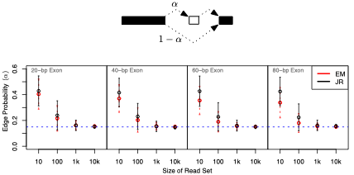
Convergence with simulated data

Slide 69
Comparisons on real data
Require notion of “distance” between estimates from different methods
Our distance measure:
  per vertex
  maximum difference between probability estimates on out-edges of vertex (L-∞ norm)
method A
method B
0.2
0.6
0.5
0.3
0.3
0.1

Slide 70
How close are the estimates from JR and EM on real data?
Vertices from 88 most abundant (> 5000 reads) alternatively-spliced genes in a modENCODE fly data set

Slide 71
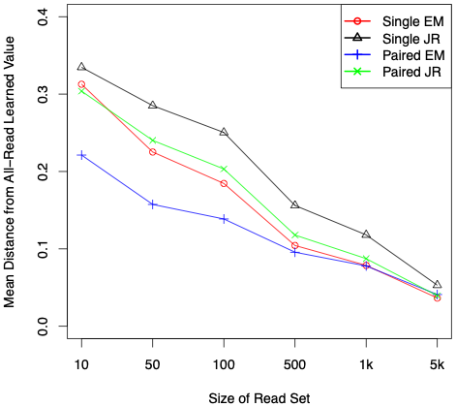
Convergence of estimates on real data

Slide 72
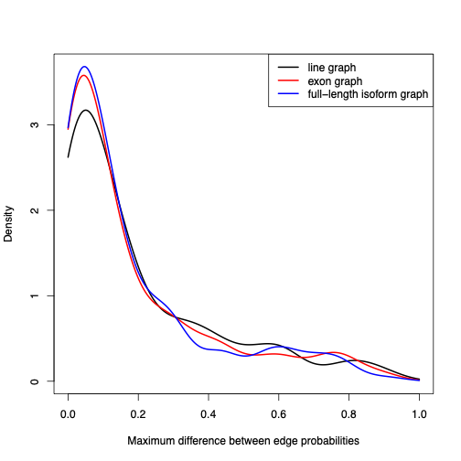
Comparing PSGs of different complexity
Same set of fly data
Estimated with three classes of PSG: line, exon, full-length
Compared estimates to those from JR (gold-standard)
No statistically-significant difference between exon and full-length graph estimates

Slide 73
Summary of Junction-Read comparison results
Estimates using PSG models are generally close to those from the simplistic JR-method
  ⇒PSG model assumptions appear to be reasonable
PSG estimates converge more quickly as the data set increases in size
  ⇒Our EM estimation procedure uses information from all reads, not just those that span splice junctions
Exon-graph estimates as good as those using traditional full-length isoform models
  ⇒Independence assumptions of exon graphs appear to be reasonable

Slide 74
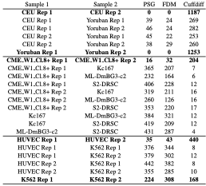
Differential processing detection
DP Accuracy on real data
# of DP genes

Slide 75
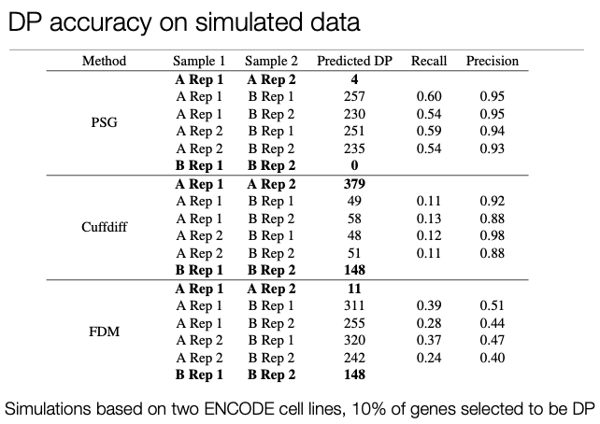
Differential processing detection

Slide 76
Next steps for modeling RNA-Seq with PSGs
Graph construction
  Exon discovery
  Splice junction discovery
Model selection
  Learning dependencies between splice events
or

Slide 77
Summary
Alternative splicing is a significant complication in RNA-Seq analysis
Probabilistic Splice Graphs enable identifiable models for alternatively spliced genes with efficient inference algorithms
Differential processing (splicing) tests with PSG models look promising

