Slide 1
Inferring Genetic Variation and Discovering Associations with Phenotypes
BMI/CS 776
www.biostat.wisc.edu/bmi776/
Spring 2020
Daifeng Wang
daifeng.wang@wisc.edu
These slides, excluding third-party material, are licensed under CC BY-NC 4.0 by Mark Craven, Colin Dewey, Anthony Gitter and Daifeng Wang

Slide 2
Outline
Variation detection
  Array technologies
  Whole-genome sequencing
GWAS and QTL basics
  Testing SNPs for association
  Correcting for multiple-testing

Slide 3
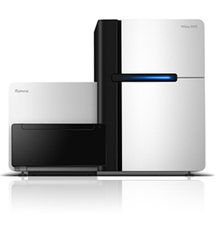
Variation detecting technologies
Array-based technologies
  Relies on hybridization of sample DNA to pre-specified probes
  Each probe is chosen to measure a single possible variant: SNP, CNV, etc.
Sequencing-based technologies
  Whole-genome shotgun sequence, usually at low coverage (e.g., 4-8x)
  Align reads to reference genome: mismatches, indels, etc. indicate variations
  Long read sequencing
Affymetrix SNP chip
Illumina HiSeq sequencer

Slide 4
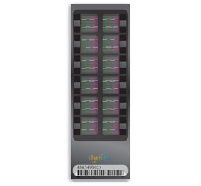
Array-based technologies
Currently two major players
Affymetrix Genome-Wide Human SNP Arrays
  Used for HapMap project, Navigenics service
Illumina BeadChips
  Used by 23andMe, deCODEme services

Slide 5
Affymetrix SNP arrays
Probes for ~900K SNPs
Another ~900K probes for CNV analysis
Differential hybridization – one probe for each possible SNP allele
Fluorescent tag on sample DNA
C
A
T
G
G
G
C
T
A
T
sample DNA
A
C
C
A
G
A
T
A
C
C
C
G
A
T
A
C
C
G
G
A
T
A
C
C
T
G
A
T
Probes for one SNP at a known locus

Slide 6
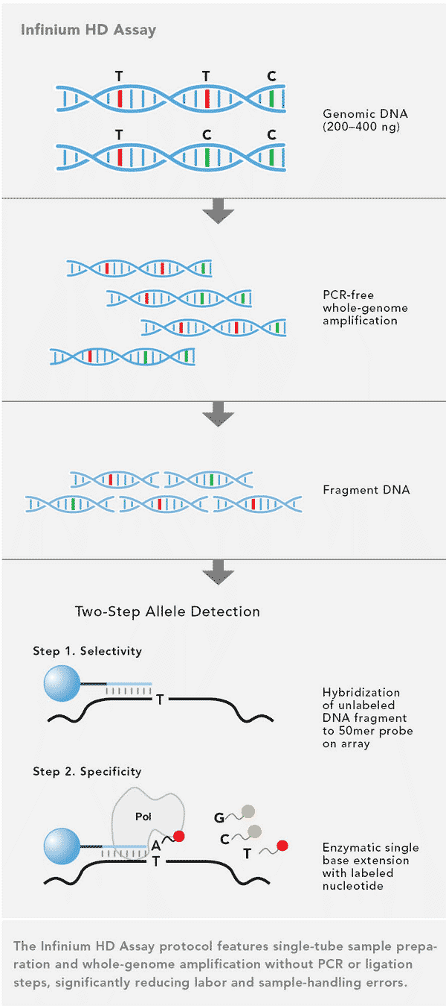
Illumina BeadChips
OmniExpress+
  ~900K SNPs (700K fixed, 200 custom)
Array with probes immediately adjacent to variant location
Single base extension (like sequencing) to determine base at variant location
Illumina

Slide 7
Sequencing-based genotyping
compute
for each genomic position
genotype = GA?
sequencing error?
GATCGTCGCTACGTGCTAG
CTCTACGTACGATCGTCGC
CGATCATCGCTACGTGCTA
reads
TACGATCGTCTCTACGTGC
CTACGTAAGATCATCGCTA
ACGATCATCGCTACGTGCT
CGTACGATCGTCGCTACGT
reference
ACTCTACGTACGATCGTCGCTACGTGCTAGCTAGTCGCAC

Slide 8
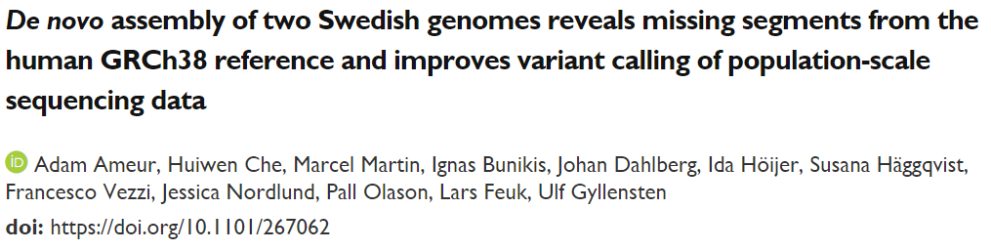
Long read sequencing
Pacific Biosciences SMRT
MinION nanopore
Illumina TruSeq Synthetic
  “over 10 Mb of sequences absent from the human GRCh38 reference in each individual”

Slide 9
GWAS jargon
Locus - genetic position on a chromosome, and a single base pair position in the context of SNPs
SNP - a locus (single base pair) that exhibits variation (polymorphism) in a population
Allele (in the context of SNPs) - the alternative forms of a nucleotide at a particular locus
Genotype - the pair of alleles at a locus, one paternal and one maternal
Heterozygous - the two alleles differ at a locus
Homozygous - the two alleles are identical at a locus
Genotyped SNP - we have observed the genotype at a particular SNP, e.g. because the SNP is among the 1 million on the SNP array we used
Ungenotyped SNP - we have not observed the genotype at a particular locus
Causal SNP - a SNP that directly affects the phenotype, e.g. a mutation changes the amino acid sequence of a protein and changes the protein's function in a way that directly affects a biological process
Haplotype - a group of SNPs that are inherited jointly from a parent
Linkage disequilibrium - alleles at multiple loci that exhibit a dependence (nonrandom association)
Compiled from http://www.nature.com/scitable/definition/allele-48 http://www.nature.com/scitable/definition/genotype-234
http://www.nature.com/scitable/definition/haplotype-142 http://www.nature.com/scitable/definition/snp-295 https://en.wikipedia.org/wiki/Allele
http://www.nature.com/nrg/journal/v9/n6/full/nrg2361.html https://www.snpedia.com/index.php/Glossary

Slide 10
GWAS data
Individual | Genotype at Position 1 | Genotype at Position 2 | Genotype at Position 3 | … | Genotype at Position M | Disease?
1 | CC | AG | GG |  | AA | N
2 | AC | AA | TG |  | AA | Y
3 | AA | AA | GG |  | AT | Y
…
N | AC | AA | TT |  | AT | N
N individuals genotyped at M positions
Disease status (or other phenotype) is measured for each individual

Slide 11
GWAS task
Given: genotypes and phenotypes of individuals in a population
Do: identify which genomic positions are associated with a given phenotype

Slide 12
Can we identify causal SNPs?
Typically only genotype at 1 million sites
Humans vary at ~100 million sites
Unlikely that an associated SNP is causal
Tag SNPs: associated SNPs “tag” blocks of the genome that contain the causal variant
Genotyped SNP
Ungenotyped causal SNP
Ungenotyped SNP
Haplotype block: interval in which little recombination has been observed

Slide 13
Direct and indirect associations
Phenotype
direct association
indirect association
direct association (haplotype block)

Slide 14
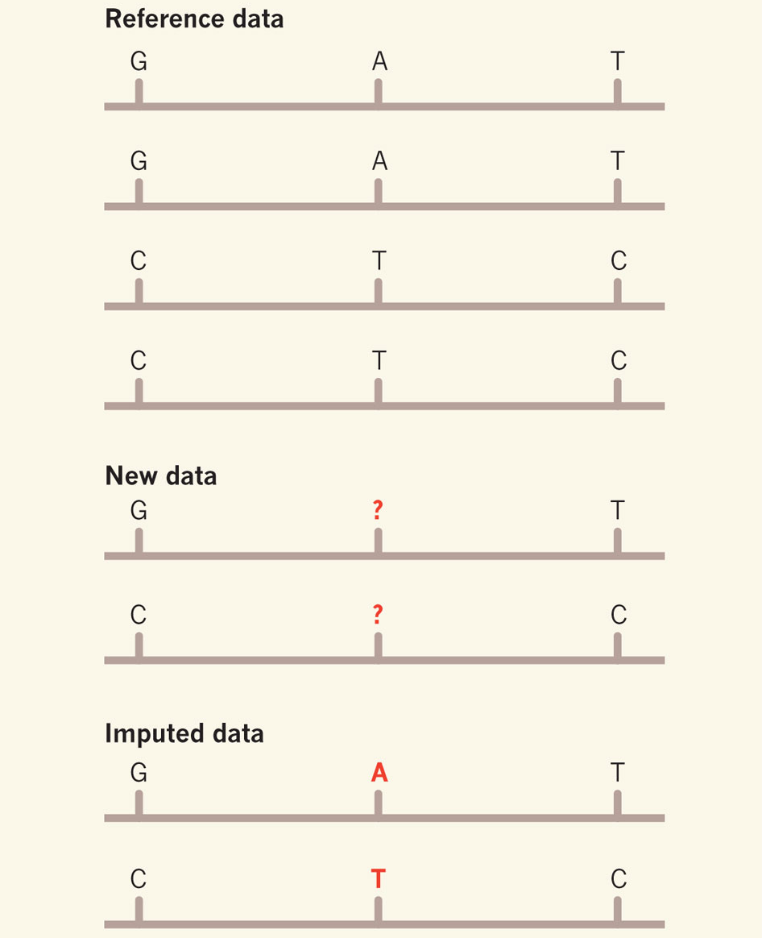
SNP imputation
Estimate the ungenotyped SNPs using reference haplotypes
1000 Genomes
SNP array
Nielsen Nature 2010

Slide 15
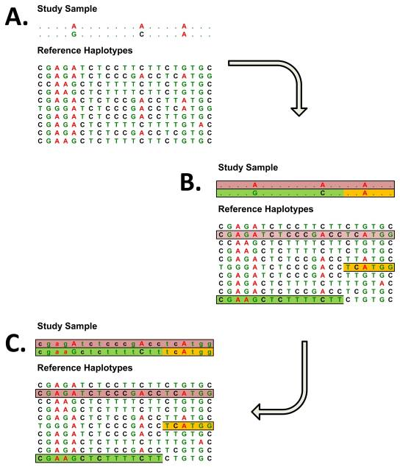
Genotype imputation
Evaluate the evidence for association at genetic markers that are not directly genotyped
Increases power of genome-wide association scans
Useful for combining data from studies that rely on different genotyping platforms
*Genotype imputation.
Li Y, et al, Annu Rev Genomics Hum Genet. 2009

Slide 16
A pipeline for genotype imputation
Raw Genotype Calls
Sample level quality control
  examining call rate
  Heterozygosity
  relatedness between genotyped individuals
  correspondence between sex chromosome genotypes and reported gender
Marker level quality control
  examining call rates
  excluding low frequency SNPs
Strand flip
SNP QC using PLINK
Split data by chromosomes
1000 Genome/HRC Reference Panel
Pre-Phasing
using SHAPEIT2/ Eagle2
haplotypes are estimated for all available samples
SNP imputation using IMPUTE2/
Minimac3
missing alleles are imputed directly onto these phased haplotypes
Processing Steps
QC
Genotype filtering
Convert to SNP dosage
Genotype
Data Files
Wang et al., Science, 2018
16

Slide 17
Basics of association testing
Test each site individually for association with a statistical test
  each site is assigned a p-value for the null hypothesis that the site is not associated with the phenotype
Correct for the fact that we are testing multiple hypotheses

Slide 18
Basic genotype test
Assuming binary phenotype (e.g., disease status)
Test for significant association with Pearson’s Chi-squared test or Fisher’s Exact Test
genotype
 | AA | AT | TT
Disease | 40 | 30 | 30
No disease | 70 | 20 | 10
phenotype
Chi-squared test p-value = 4.1e-5 (2 degrees of freedom)
Fisher’s Exact Test p-value = 3.4e-5

Slide 19
Armitage (trend) test
Can gain more statistical power if we can assume that probability of trait is linear in the number of one of the alleles
Balding Nature Reviews
Genetics 2006
TT
AT
AA

Slide 20
Trend test example
genotype
 | AA | AT | TT
Disease | 40 | 30 | 30
No disease | 70 | 20 | 10
phenotype
Disease proportion | 0.36 | 0.60 | 0.75
Trend in Proportions test p-value = 8.1e-6
(note that this is a smaller p-value than from the basic genotype test)

Slide 21
GWAS Versus QTL
Both associate genotype with phenotype
GWAS pertains to discrete phenotypes
  For example, disease status is binary
QTL pertains to quantitative (continuous) phenotypes
  Height
  Gene expression
  Splicing events
  Metabolite abundance

Slide 22
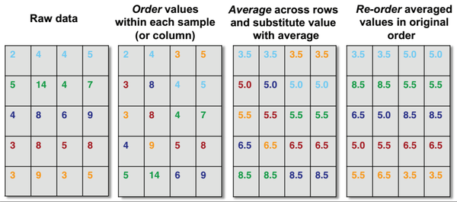
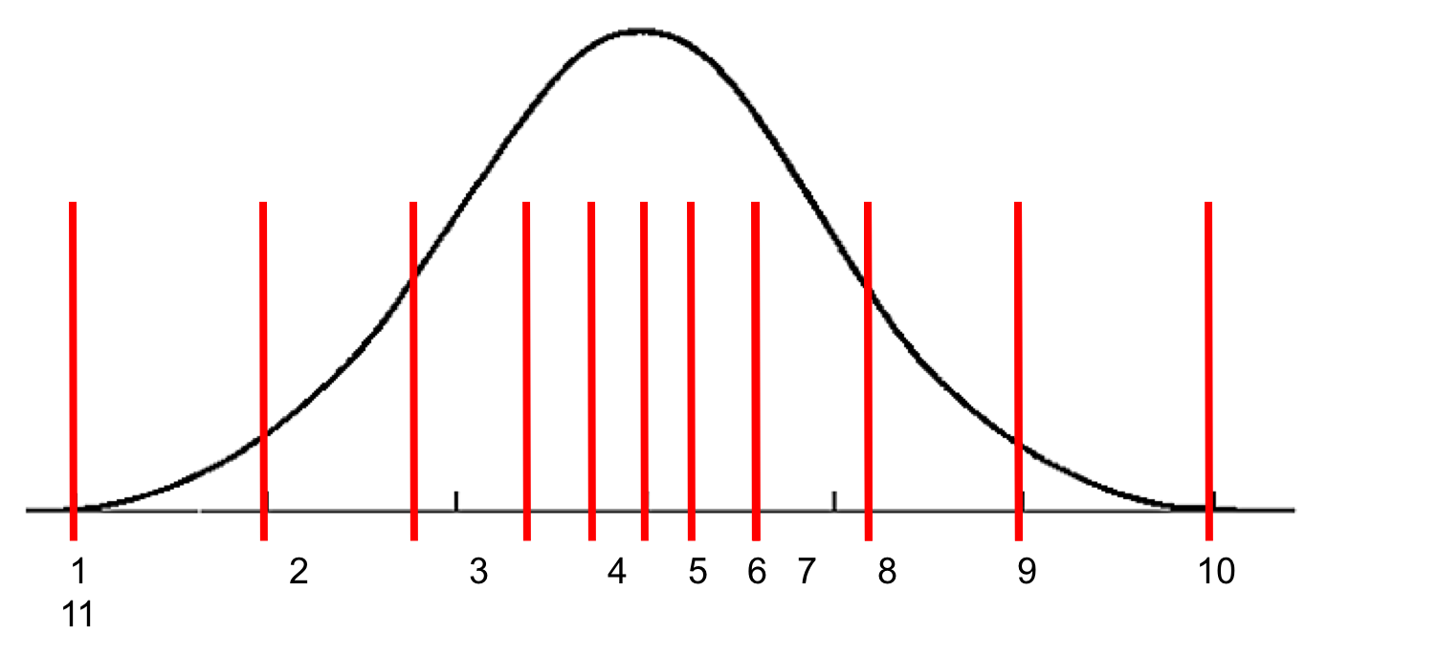
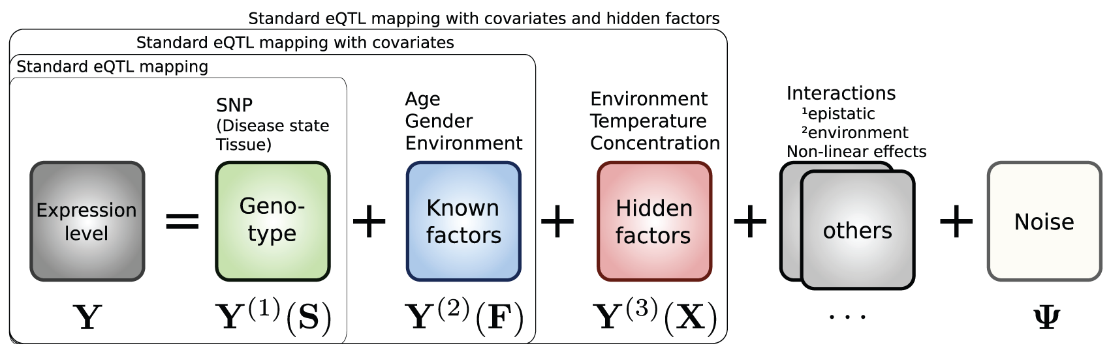
Expression QTL (eQTL)
traits are expression levels of various genes
Merge expression from all studies
Filtered out the very lowly-expressed genes by minimum of 50 samples having an FPKM value of at least 0.1
Inverse quantile
normalization
Quantile normalization
PEER calculations
RA Irizarry (web post)
Stegle et al, (2010)

Slide 23
A pipeline for eQTLs
MAF>=0.01
R2>0.3
Hardy-Weinberg Equilibrium p<1x10⁻⁶
  Gene expression
65 covariates
  Top 3 genotyping principal components
  Probabilistic Estimation of Expression Residuals (PEER) factors
  Genotyping array platform
  Gender
  Disease status
Imputed Genotype
Phenotypic data
Covariates
QTLtools
QTLs
2Mb
Wang et al., Science, 2018

Slide 24
Challenges of association studies (e.g., GWAS)
Population structure
Interacting variants
Multiple testing
Interpreting hits

Slide 25
Population structure issues
If certain populations disproportionally represent cases or controls, then spurious associations may be identified
One SNP for N = 40 individuals
AA
ACTCTACGTAC
ACTCTACGTAC
Individual with genotype 1
TT
ACTCTTCGTAC
ACTCTTCGTAC
Individual with genotype 2
Balding Nature Reviews Genetics 2006

Slide 26
Interacting variants
Most traits are complex: not the result of a single gene or genomic position
Ideally, we’d like to test subsets of variants for associations with traits
  But there are a huge number of subsets!
  Multiple testing correction will likely result in zero association calls
Area of research
  Only test carefully selected subsets
  Bayesian version: put prior on subsets

Slide 27
Multiple testing
In the genome-age, we have the ability to perform large numbers of statistical tests simultaneously
  SNP associations (~1 million)
  Gene differential expression tests (~ 20 thousand)
Do traditional p-value thresholds apply in these cases?

Slide 28
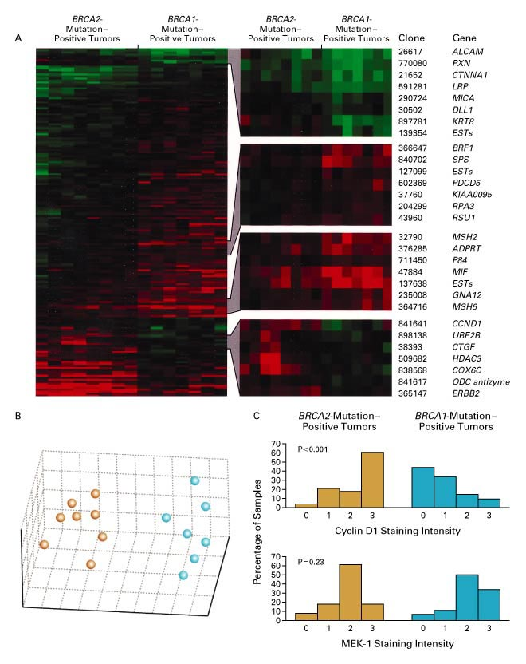
Expression in BRCA1 and BRCA2 Mutation-Positive Tumors
Hedenfalk et al., New England Journal
of Medicine 344:539-548, 2001.
7 patients with BRCA1 mutation-positive tumors vs. 7 patients with BRCA2 mutation-positive tumors
5631 genes assayed

Slide 29
Expression in BRCA1 and BRCA2 Mutation-Positive Tumors
Key question: which genes are differentially expressed in these two sets of tumors?
Methodology: for each gene, use a statistical test to assess the hypothesis that the expression levels differ in the two sets

Slide 30
Hypothesis testing
Consider two competing hypotheses for a given gene
  null hypothesis: the expression levels in the first set come from the same distribution as the levels in the second set
  alternative hypothesis: they come from different distributions
First calculate a test statistic for these measurements, and then determine its p-value
p-value: the probability of observing a test statistic that is as extreme or more extreme than the one we have, assuming the null hypothesis is true

Slide 31
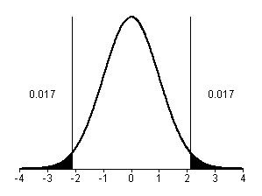
Calculating a p-value
Calculate test statistic (e.g. T statistic)
See how much mass in null distribution with value this extreme or more
BRAC2
BRAC1
where
If test statistic is here, p = 0.034

Slide 32
Multiple testing problem
If we’re testing one gene, the p-value is a useful measure of whether the variation of the gene’s expression across two groups is significant
Suppose that most genes are not differentially expressed
If we’re testing 5000 genes that don’t have a significant change in their expression (i.e. the null hypothesis holds), we’d still expect about 250 of them to have p-values ≤ 0.05
Can think of p-value as the false positive rate over null genes

Slide 33
Family-wise error rate
One way to deal with the multiple testing problem is to control the probability of rejecting at least one null hypothesis when all genes are null
This is the family-wise error rate (FWER)
Suppose you tested 5000 null genes and predicted that all genes with p-values ≤ 0.05 were differentially expressed
  you are guaranteed to be wrong at least once!
  above assumes tests are independent

Slide 34
Bonferroni correction
Simplest approach
Choose a p-value threshold β such that the FWER is ≤ α
where g is the number of genes (tests)
For g=5000 and α=0.05 we set a p-value threshold of β=1e-5

Slide 35
Loss of power with FWER
FWER, and Bonferroni in particular, reduce our power to reject null hypotheses
  As g gets large, p-value threshold gets very small
For expression analysis, FWER and false positive rate are not really the primary concern
  We can live with false positives
  We just don’t want too many of them relative to the total number of genes called significant

Slide 36
The False Discovery Rate
[Benjamini & Hochberg‘95; Storey & Tibshirani ‘02]
gene p-value rank
C 0.0001 1
F 0.001 2
G 0.016 3
J 0.019 4
I 0.030 5
B 0.052 6
A 0.10 7
D 0.35 8
H 0.51 9
E 0.70 10
Suppose we pick a threshold, and call genes above this threshold “significant”
The false discovery rate is the expected fraction of these that are mistakenly called significant (i.e. are truly null)

Slide 37
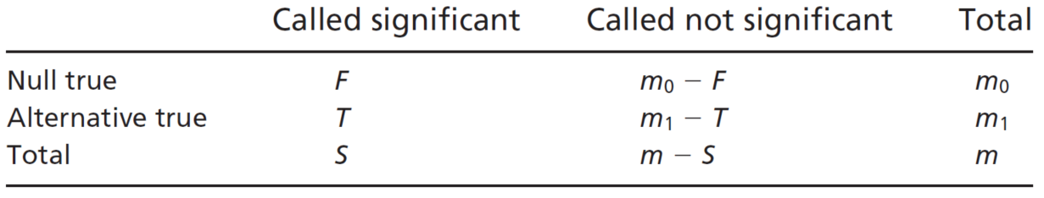
The False Discovery Rate
false positives (false discoveries)
Storey & Tibshirani PNAS 100(16), 2002
total significant at threshold
features (genes)
true positives

Slide 38
The False Discovery Rate
gene p-value rank
C 0.0001 1
F 0.001 2
G 0.016 3
J 0.019 4
I 0.030 5
B 0.052 6
A 0.10 7
D 0.35 8
H 0.51 9
E 0.70 10
# genes
t
p-value threshold

Slide 39
The False Discovery Rate
To compute the FDR for a threshold t, we need to estimate E[F(t)] and E[S(t)]
estimate by the observed S(t)
So how can we estimate E[F(t)]?

Slide 40
Estimating E[F(t)]
Two approaches we’ll consider
  Benjamini-Hochberg (BH)
  Storey-Tibshirani (q-value)
Different assumptions about null features (m₀)

Slide 41
Benjamini-Hochberg
Suppose the fraction of genes that are truly null is very close to 1 so
Then
Because p-values are uniformly distributed over [0,1] under the null model
Suppose we choose a threshold t and observe that S(t) = k

Slide 42
Benjamini-Hochberg
Suppose we want FDR ≤ α
Observation:

Slide 43
Benjamini-Hochberg
Algorithm to obtain FDR ≤ α
Sort the p-values of the genes so that they are in increasing order
Select the largest k such that
where we use P_{(k)} as the p-value threshold t

Slide 44
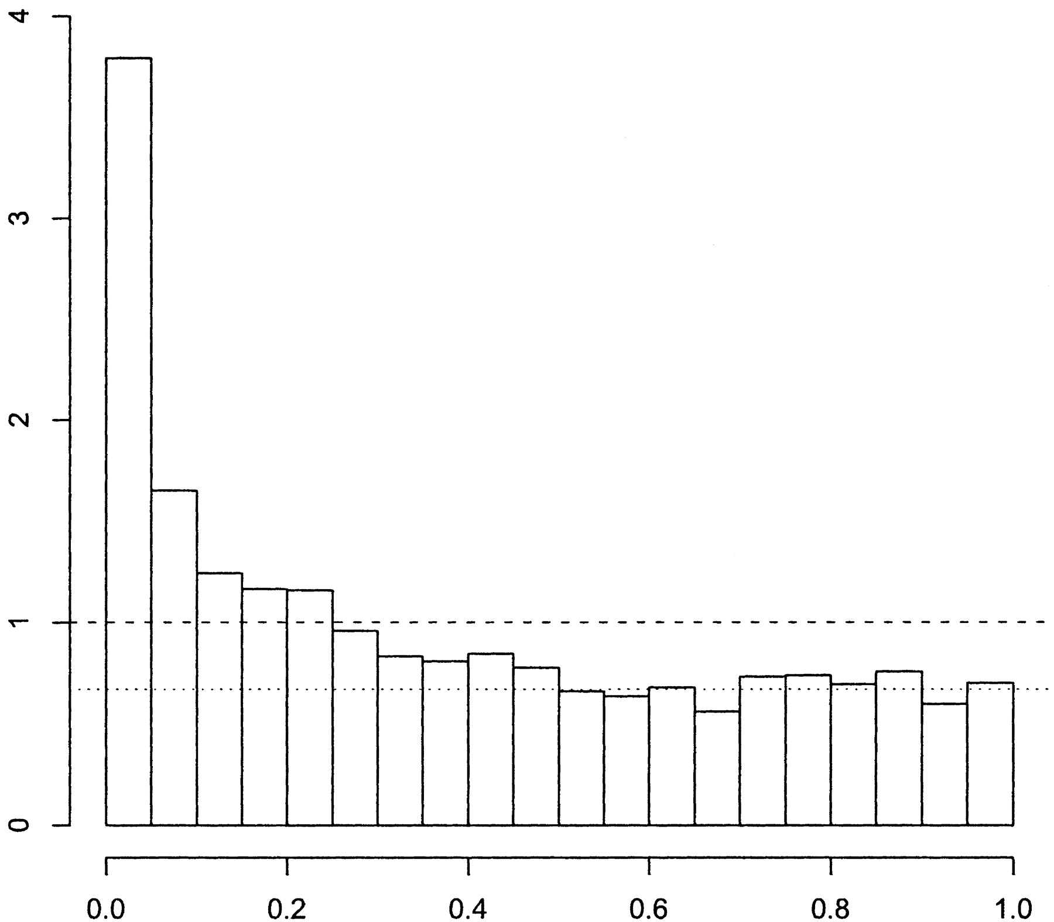
What fraction of the genes are truly null?
Consider the p-value histogram from Hedenfalk et al.
  includes both null and alternative genes
  but we expect null p-values to be uniformly distributed
estimated proportion of null p-values
expected histogram if all genes were null
actual proportion of null p-values
Storey & Tibshirani PNAS 100(16), 2002

Slide 45
Storey & Tibshirani approach
estimated proportion of
null p-values
# genes
p-value threshold
gene p-value rank
C 0.0001 1
F 0.001 2
G 0.016 3
J 0.019 4
I 0.030 5
B 0.052 6
A 0.10 7
D 0.35 8
H 0.51 9
E 0.70 10
q-value
0.0010
0.0050
0.0475
0.0475
0.0600
0.0867
0.1430
0.4380
0.5670
0.7000
t
pick minimum FDR for all greater thresholds

Slide 46
q-value example for gene J
gene p-value rank
C 0.0001 1
F 0.001 2
G 0.016 3
J 0.019 4
I 0.030 5
B 0.052 6
A 0.10 7
D 0.35 8
H 0.51 9
E 0.70 10
q-value
0.0010
0.0050
0.0475
0.0475
0.0600
0.0867
0.1430
0.4380
0.5670
0.7000
t
In this case, already have minimum FDR for all greater thresholds

Slide 47
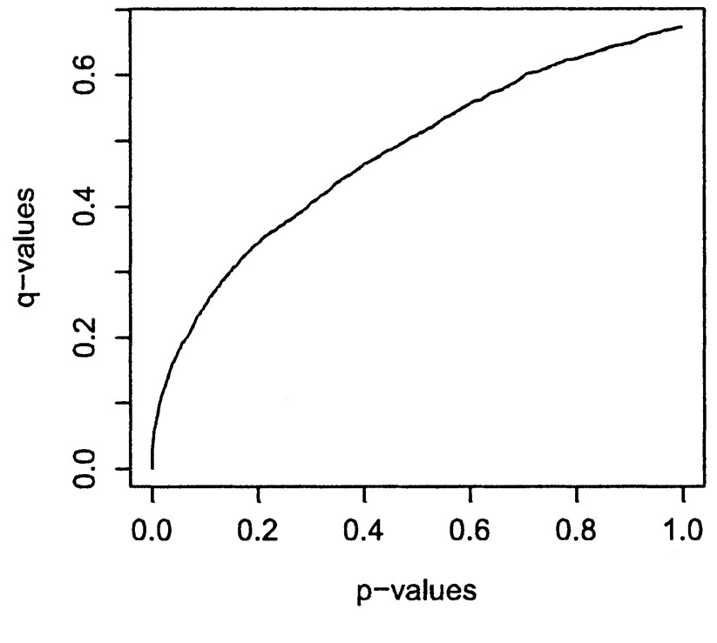
q-values vs. p-values for Hedenfalk et al.
p-value of 0.05 implies that 5% of all tests will result in false positives
q-value of 0.05 implies that 5% of significant tests will result in false positives
Storey & Tibshirani PNAS 100(16), 2002

Slide 48
FDR summary
In many high-throughput experiments, we want to know what is different across two sets of conditions/individuals (e.g. which genes are differentially expressed)
Because of the multiple testing problem, p-values may not be so informative in such cases
FDR, however, tells us which fraction of significant features are likely to be null
q-values based on the FDR can be readily computed from p-values (see Storey’s R package qvalue)

