Slide 1
Network Biology
BMI/CS 776
www.biostat.wisc.edu/bmi776/
Spring 2021
Daifeng Wang
daifeng.wang@wisc.edu
These slides, excluding third-party material, are licensed under CC BY-NC 4.0 by Anthony Gitter, Mark Craven, Colin Dewey and Daifeng Wang

Slide 2
Goals for lecture
Biological networks
Challenges of integrating high-throughput assays
Connecting relevant genes/proteins with interaction networks
ResponseNet algorithm
Evaluating pathway predictions
Classes of signaling pathway prediction methods

Slide 3
High-throughput screening
Which genes are involved in which cellular processes?
Hit: gene that affects the phenotype
Phenotypes include:
  Growth rate
  Cell death
  Cell size
  Intensity of some reporter
  Many others

Slide 4
Types of screens
Genetic screening
  Test genes individually or in parallel
  Knockout, knockdown (RNA interference), overexpression, CRISPR/Cas genome editing
Chemical screening
  Which genes are affected by a stimulus?

Slide 5
Differentially expressed genes
Compare mRNA transcript levels between control and treatment conditions
Genes whose expression changes significantly are also involved in the cellular process
Alternatively, differential protein abundance or phosphorylation

Slide 6
Interpreting screens
Differentially expressed genes
Screen hits
Very few genes detected in both

Slide 7
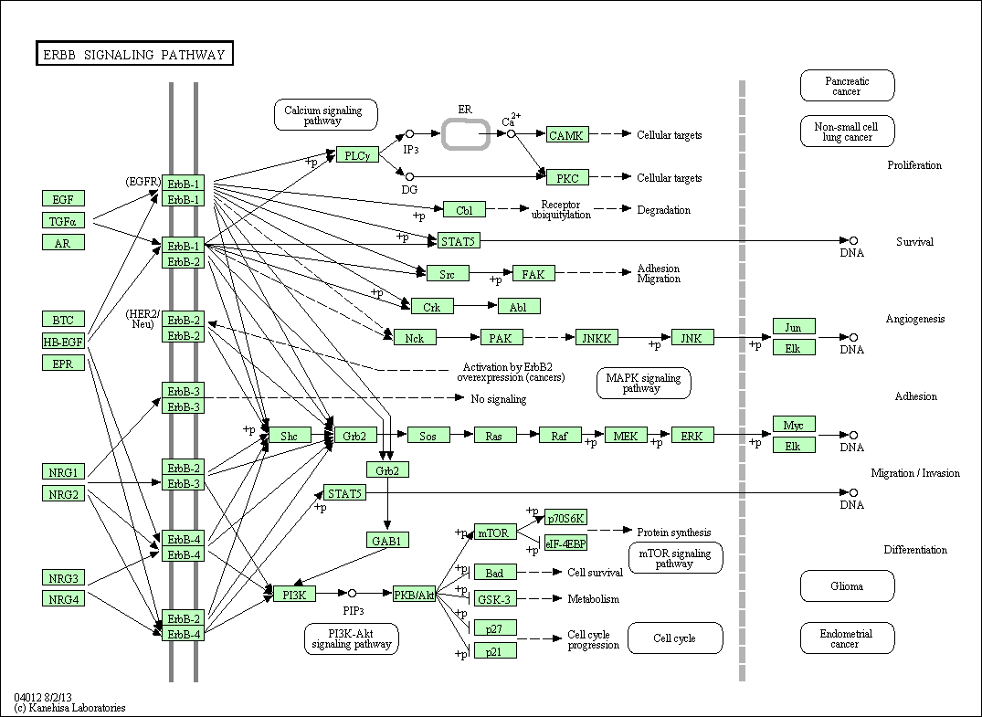
Assays reveal different parts of a cellular process
Database representation of a “pathway”
KEGG

Slide 8
Assays reveal different parts of a cellular process
Differentially expressed genes
Genetic screen hits

Slide 9
Pathways connect the disjoint gene lists
Can’t rely on pathway databases
High-quality, low coverage
Instead learn condition-specific pathways computationally
Combine data with generic physical interaction networks

Slide 10
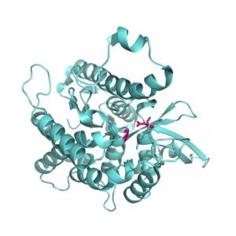
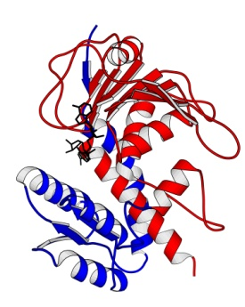

Physical interactions
Protein-protein interactions (PPI)
Metabolic
Protein-DNA (transcription factor-gene)
Genes and proteins are different node types
Prot A
Prot B
Appling
Graz
TF
Gene
Yeger-Lotem2009

Slide 11
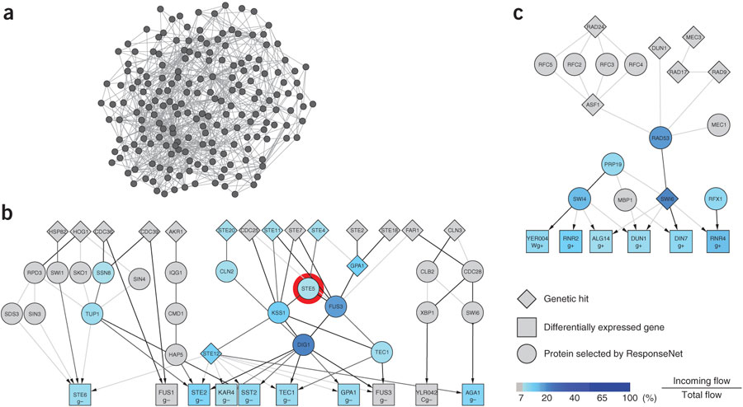
Hairball networks
Networks are highly connected
Can’t use naïve strategy to connect screen hits and differentially expressed genes
Yeger-Lotem2009

Slide 12
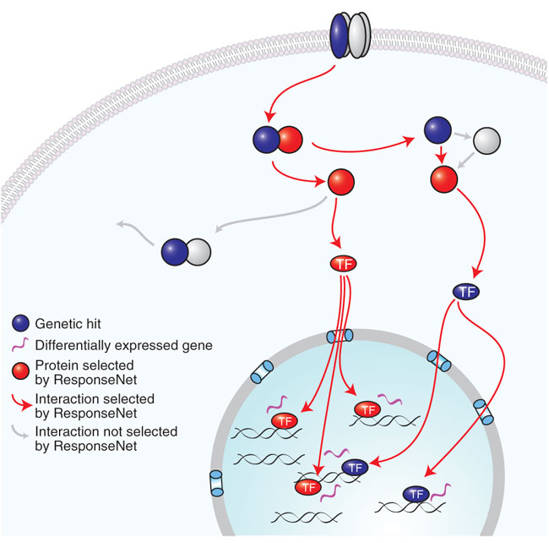
Identify connections within an interaction network
Yeger-Lotem2009

Slide 13
Biological Network Properties
Degree: number of neighbors of a node
Power law degree distribution
  Most nodes have low degrees
  Few highly connected nodes (hubs)
Robust to random attacks
  e.g., structure resilient to mutations
  Mutations in hubs can damage the network
Modular organization
  High clustering coefficient (short paths)
  Efficient signal propagation

Slide 14
Power law degree distribution
A. fulgidus (Archae)
Bacterium
C. elegans (Eukaryote),
averaged over 43 organisms
H. Jeong et al., Nature, 407 (2000)
Probability of finding a highly connected node decreases exponentially with K

Slide 15
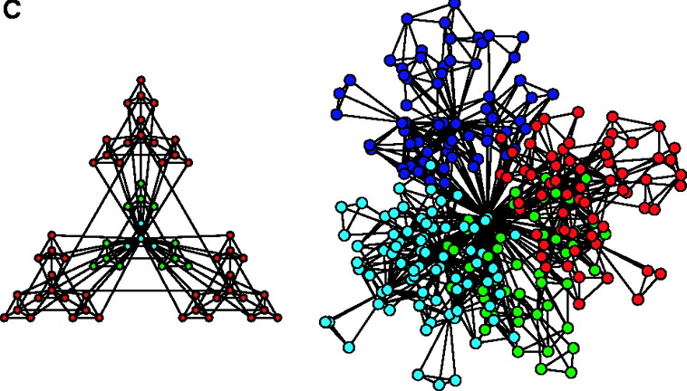
Modularity
E. Ravasz et al., Science 297, 1551 -1555 (2002)
Small highly connected cohesive clusters that combine to form larger units
Communication between clusters through hubs
Hierarchical modularity overlaps with known metabolic functions

Slide 16
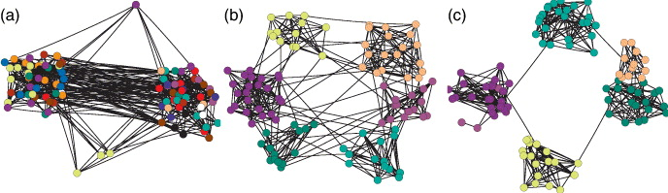
Measurement of Modularity
low
high
Brede, Europhysics Letters, 2010.
Modularity Q: measurement on strength of network division
sum over nodes within a group (module)
normalization
m: total number of edges
edge weight between nodes i and j
=expected edge weight that would go between i and j
Clustering goal: assign each node a module
to maximize “modularity” as an objective function
(module is a group of highly connected nodes)
Newman, PNAS, 2006.
Notes:
for a single network clustering, we always try to divide nodes into groups / modules such that connections within groups are relatively dense while those between groups are sparse.
then, the modularity has been proposed to measure strength of division using your clustering method. e.g., right clustering is good because modularity is high. Thus, a common clustering strategy is that we can use modularity as objective function, and find the modules that maximize modularity from all possible divisions of a network.
http://www.cs.cmu.edu/~ckingsf/bioinfo-lectures/modularity.pdf

Slide 17
Clustering coefficient
Measures the average probability that two neighbors of a node are connected
n_{I}: # edges between node I’s neighbors
k: # of neighbors of I

Slide 18
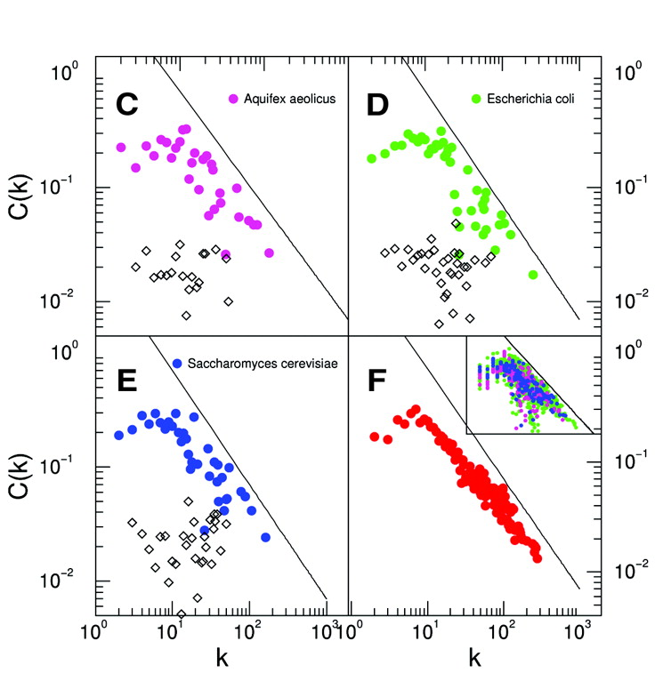
Clustering coefficient
High degree nodes -> low clustering coefficient CC
Network’s modularity -> CC averaged over all nodes
Metabolic networks have high intrinsic modularity
E. Ravasz et al., Science 297, 1551 -1555 (2002)

Slide 19
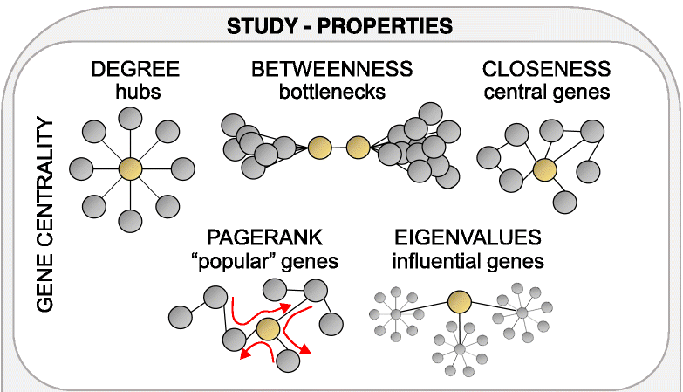
Network centralities
Topological importance of a node
G. Iacono et al., Genome Biology 20 (2019)

Slide 20
Network problems
Network inference
  Infer network structure
Motif finding
  Identify common subgraph topologies
Pathway or module detection
  Identify subgraphs of genes that perform the same function or active in same condition
Network comparison, alignment, querying
Conserved modules
  Identify modules that are shared in networks of multiple species/conditions

Slide 21

Network motifs
Problem: Find subgraph topologies that are statistically more frequent than expected
Brute force approach
  Count all topologies of subgraphs of size m
  Randomize graph (retain degree distribution) and count again
  Output topologies that are over/under represented
Feed-forward loop: over-represented in regulatory networks
not very common

Slide 22
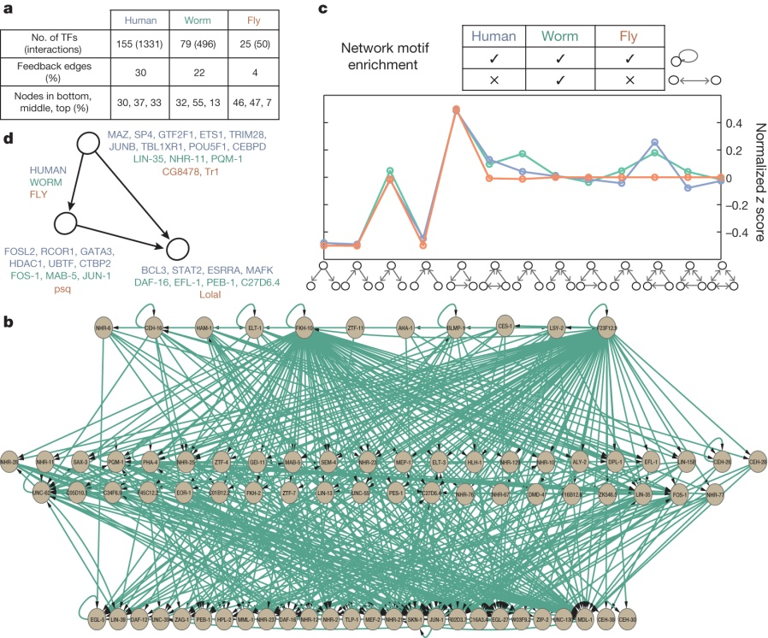
Gene regulatory network motifs
AP Boyle et al. Nature 512 , 453-456 (2014) doi:10.1038/nature13668

Slide 23
Network modules
Modules: dense (highly-connected) subgraphs (e.g., large cliques or partially incomplete cliques)
Problem: Identify the component modules of a network
Difficulty: definition of module is not precise
  Hierarchical networks have modules at multiple scales
  At what scale to define modules?

Slide 24
How to define a computational “pathway”
Given:
  Partially directed network of known physical interactions (e.g. PPI, kinase-substrate, TF-gene)
  Scores on source nodes
  Scores on target nodes
Do:
  Return directed paths in the network connecting sources to targets

Slide 25
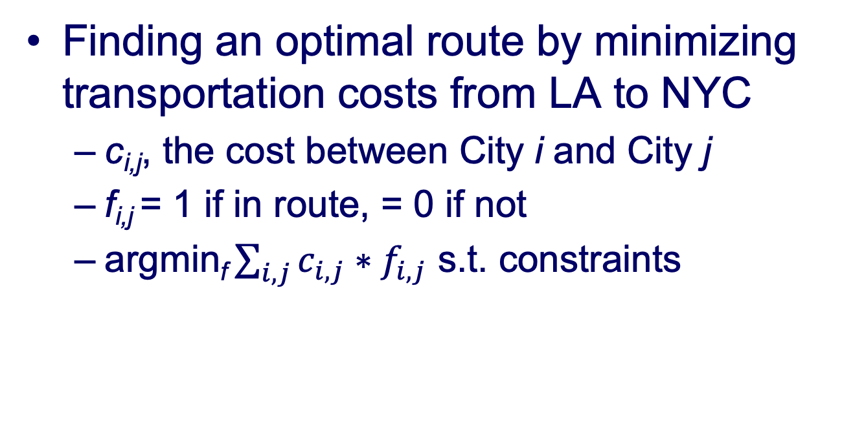
Network flow problem
Finding an optimal route by minimizing transportation costs from LA to NYC
  c_{i,j}, the cost between City i and City j
  f_{i,j} = 1 if in route, = 0 if not
  argmin_{f} $\sum_{i,j}{c_{i,j}∗f_{i,j}}$ s.t. constraints
NYC
LA
https://www.visualcapitalist.com/u-s-interstate-highways-transit-map/

Slide 26
ResponseNet optimization goals
Connect screen hits and differentially expressed genes
Recover sparse connections
Identify intermediate proteins missed by the screens
Prefer high-confidence interactions
Minimum cost flow formulation can meet these objectives

Slide 27
Construct the interaction network
Protein
Gene

Slide 28
Transform to a flow problem
S
T

Slide 29
Max flow on graphs
Each edge can tolerate different level of flow or have different preference of sending flow along that edge
S
Pump flow from source
Incoming and outgoing flow conserved at each node
T
Flow conserved to target

Slide 30
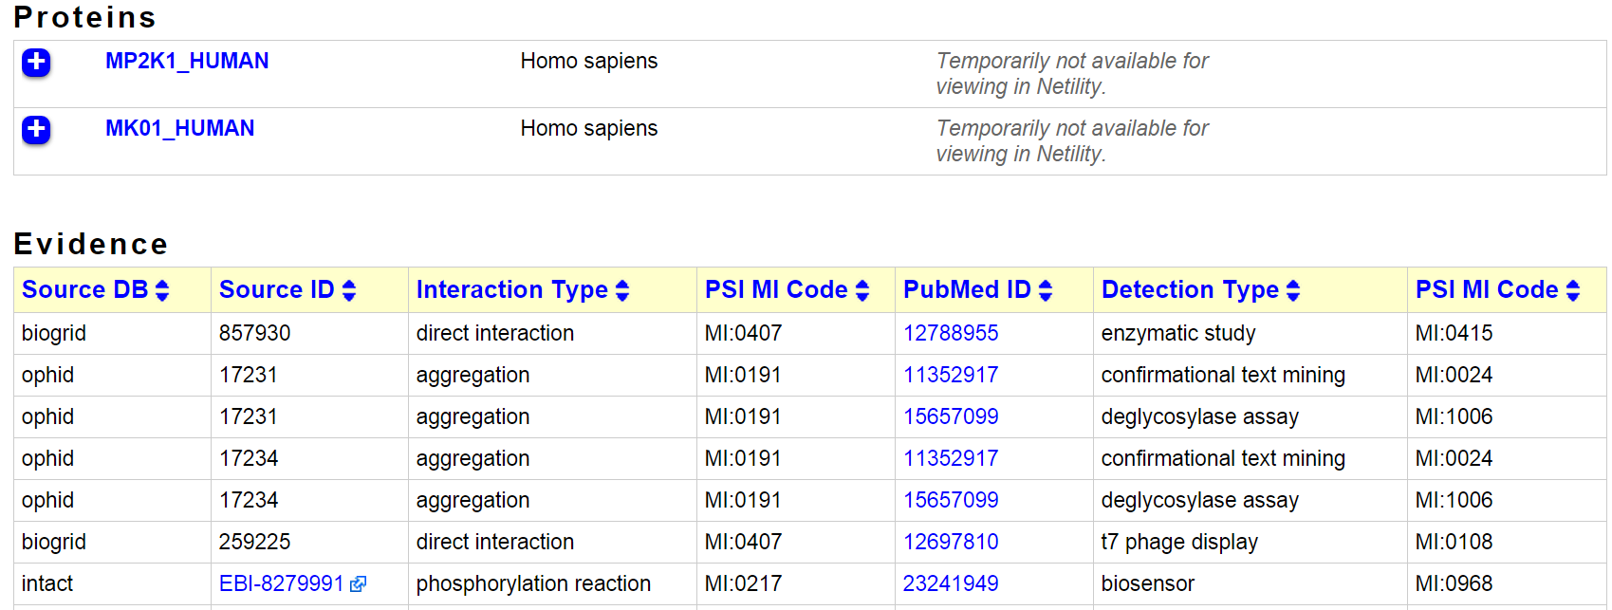
Weighting interactions
Probability-like confidence of the interaction
Example evidence: edge score of 1.0
16 distinct publications supporting the edge
iRefWeb

Slide 31
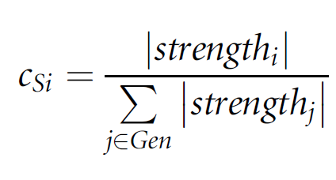
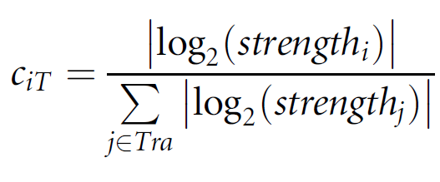
Weights and capacities on edges
S
c_{ij}= 1
Flow capacity
(w_{ij}, c_{ij})
w_{ij} from interaction network confidence
T

Slide 32
Find the minimum cost flow
S
Prefer no flow on the low-weight edges if alternative paths exist
Return the edges with non-zero flow
T

Slide 33
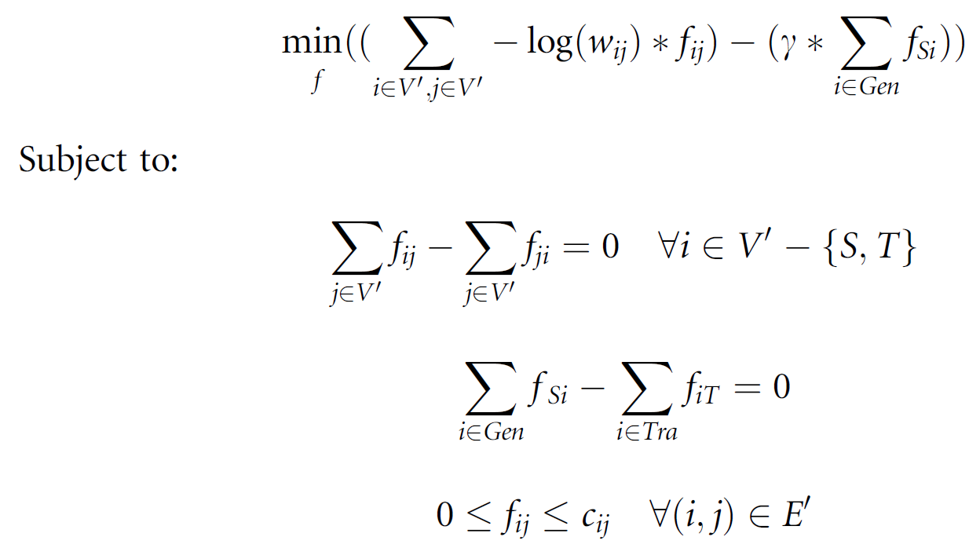
Formal minimum cost flow
Positive flow on an edge incurs a cost
Cost is greater for low-weight edges
Flow on an edge
Parameter controlling the amount of flow from the source

Slide 34
Formal minimum cost flow
Flow coming in to a node equals flow leaving the node

Slide 35
Formal minimum cost flow
Flow leaving the source equals flow entering the target

Slide 36
Formal minimum cost flow
Flow is non-negative and does not exceed edge capacity

Slide 37
Formal minimum cost flow

Slide 38

Linear programming
Optimization problem is a linear program
Canonical form
Polynomial time complexity
Many off-the-shelf solvers
Practical Optimization: A Gentle Introduction
  Introduction to linear programming
  Simplex method
  Network flow
Wikipedia

Slide 39
ResponseNet pathways
Identifies pathway members that are neither hits nor differentially expressed
Ste5 recovered when STE5 deletion is the perturbation

Slide 40
ResponseNet summary
Advantages
  Computationally efficient
  Integrates multiple types of data
  Incorporates interaction confidence
  Identifies biologically plausible networks
Disadvantages
  Direction of flow is not biologically meaningful
  Path length not considered
  Requires sources and targets
  Dependent on completeness and quality of input network

Slide 41
Evaluating pathway predictions
Unlike PIQ, we don’t have a complete gold standard available for evaluation
Can simulate “gold standard” pathways from a network
Compare relative performance of multiple methods on independent data

Slide 42
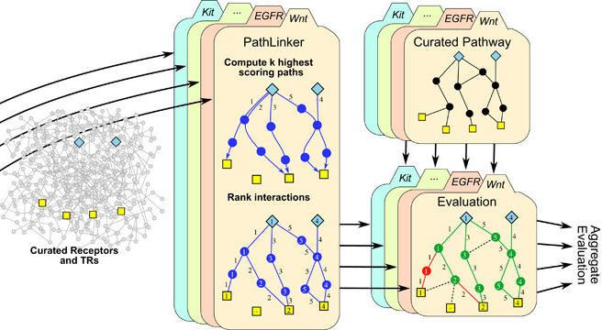
Evaluating pathway predictions
Ritz2016
https://www.nature.com/articles/npjsba20162.pdf

Slide 43
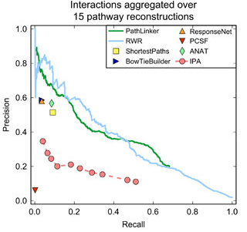
Evaluating pathway predictions
Ritz2016

Slide 44
Evaluating pathway predictions
MacGilvray2018
PR curves can evaluate node or edge recovery but not the global pathway structure

Slide 45
Evaluation beyond pathway databases
Natural language processing can also help semi-automated evaluation
  Literome
  Chilibot
  iHOP

Slide 46
Classes of pathway prediction algorithms
Are edges important?
No
Network diffusion
Yes
Sources and targets?
No
Yes
Steiner tree
Spanning tree
Next slide…

Slide 47
Classes of pathway prediction algorithms
Have sources and targets
What path properties are important?
Total path length or score
Shortest paths
Total source-target connectivity
Network flow
Connectivity in minimum cost network
Steiner tree
Complex properties
Integer program
Symbolic solver
Graphical model

Slide 48
Alternative pathway identification algorithms
k-shortest paths
  Ruths2007
  Shih2012
Random walks / network diffusion / circuits
  Tu2006
  eQTL electrical diagrams (eQED)
  HotNet
Integer programs
  Signaling-regulatory Pathway INferencE (SPINE)
  Chasman2014

Slide 49
Alternative pathway identification algorithms
Path-based objectives
  Physical Network Models (PNM)
  Maximum Edge Orientation (MEO)
  Signaling and Dynamic Regulatory Events Miner (SDREM)
Steiner tree
  Prize-collecting Steiner forest (PCSF)
  Belief propagation approximation (msgsteiner)
  Omics Integrator implementation
Hybrid approaches
  PathLinker: random walk + shortest paths
  ANAT: shortest paths + Steiner tree

Slide 50
Recent developments in pathway discovery
Multi-task learning: jointly model several related biological conditions
  ResponseNet extension: SAMNet
  Steiner forest extension: Multi-PCSF
  SDREM extension: MT-SDREM
Temporal data
  ResponseNet extension: TimeXNet
  Steiner forest extension and ST-Steiner
  Temporal Pathway Synthesizer

Slide 51
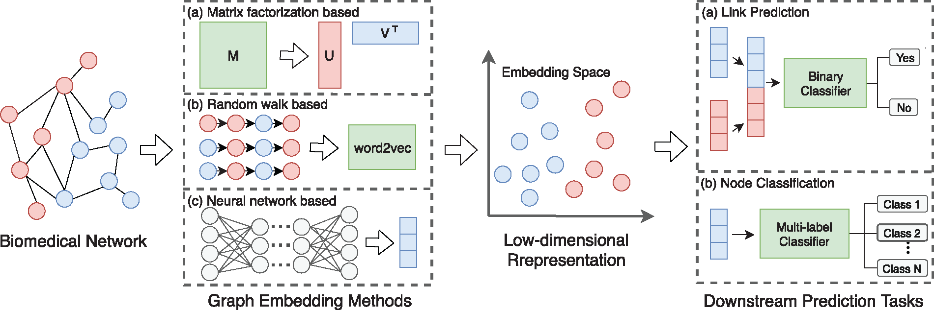
Graph embedding for biological networks
Bioinformatics, Volume 36, Issue 4, 15 February 2020, Pages 1241–1251, https://doi.org/10.1093/bioinformatics/btz718

Slide 52
Condition-specific genes/proteins used as input
Genetic screen hits (as causes or effects)
Differentially expressed genes
Transcription factors inferred from gene expression
Proteomic changes (protein abundance or post-translational modifications)
Kinases inferred from phosphorylation
Genetic variants or DNA mutations
Enzymes regulating metabolites
Receptors or sensory proteins
Protein interaction partners
Pathway databases or other prior knowledge

