Slide 1
Single cell RNA-seq analysis
Part II: understanding cell types
BMI/CS 776
www.biostat.wisc.edu/bmi776/
Spring 2022
Daifeng Wang
daifeng.wang@wisc.edu
Thanks to Ting Jin for slides!
These slides, excluding third-party material, are licensed under CC BY-NC 4.0 by Mark Craven, Colin Dewey, Anthony Gitter and Daifeng Wang

Slide 2
Outline
scRNA-seq data analysis
  Cell type annotation
    SingleR
  Cell type markers identification
  Pseudo timing
    Monocle
  Cell-type gene regulatory networks
    SCENIC
    BEELINE
  Single cell deconvolution
    CIBERSORTx

Slide 3
Outline
scRNA-seq data analysis
  Cell type annotation
    SingleR
  Cell type markers identification
  Pseudo timing
    Monocle
  Cell-type gene regulatory networks
    SCENIC
    BEELINE
  Single cell deconvolution
    CIBERSORTx

Slide 4
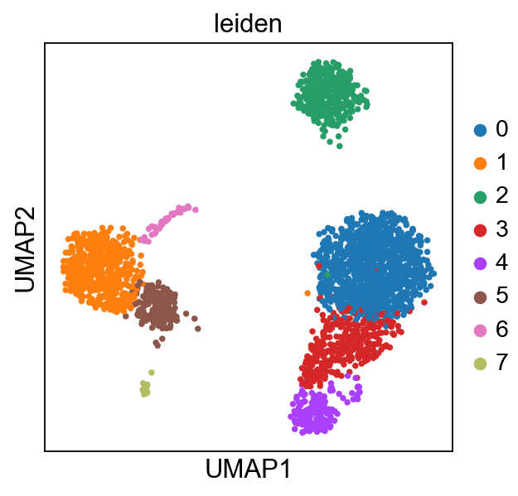
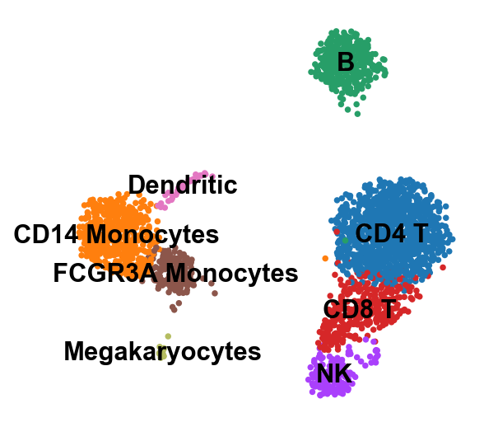
Cell type annotation
Cell types -> cellular functions
Assign the cell type for each cell
Annotation
https://btep.ccr.cancer.gov/wp-content/uploads/Celltype_Annotation_final.pdf
https://biocellgen-public.svi.edu.au/mig_2019_scrnaseq-workshop/public/clustering-and-cell-annotation.html
https://bioconductor.org/books/release/OSCA/cell-type-annotation.html

Slide 5
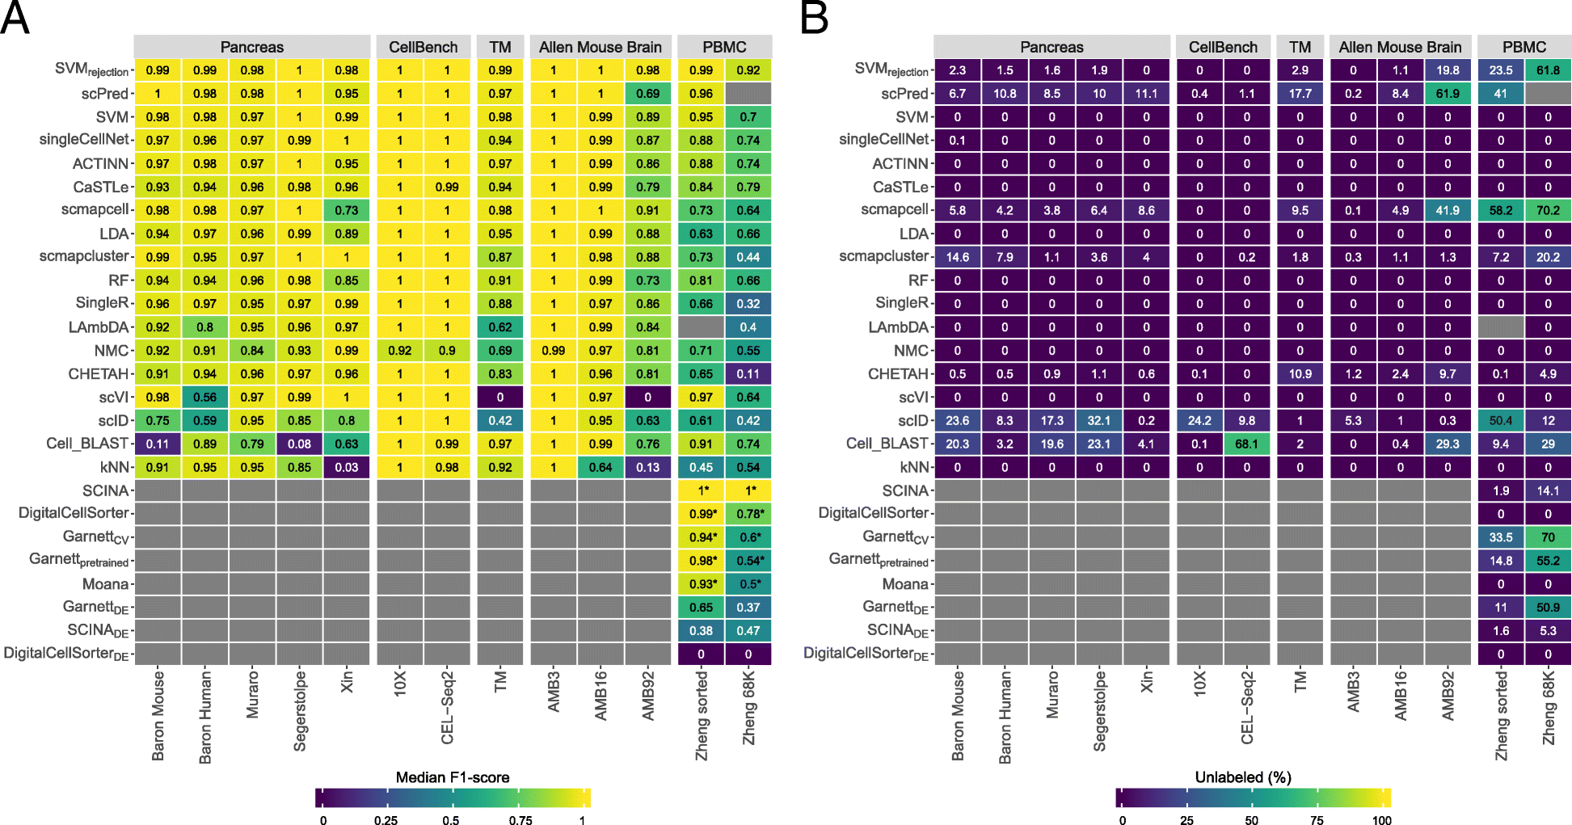
Cell type annotation tools
Supervised methods: a training dataset labeled with the corresponding cell population is needed to train the classifier
  SingleR, ACTINN, CaSTle
Prior-knowledge based methods: either a marker gene file is required as an input or a pretrained classifier for specific cell populations is provided
  DigitalCelllSorter, Moana
https://btep.ccr.cancer.gov/wp-content/uploads/Celltype_Annotation_final.pdf
https://biocellgen-public.svi.edu.au/mig_2019_scrnaseq-workshop/public/clustering-and-cell-annotation.html
https://bioconductor.org/books/release/OSCA/cell-type-annotation.html

Slide 6
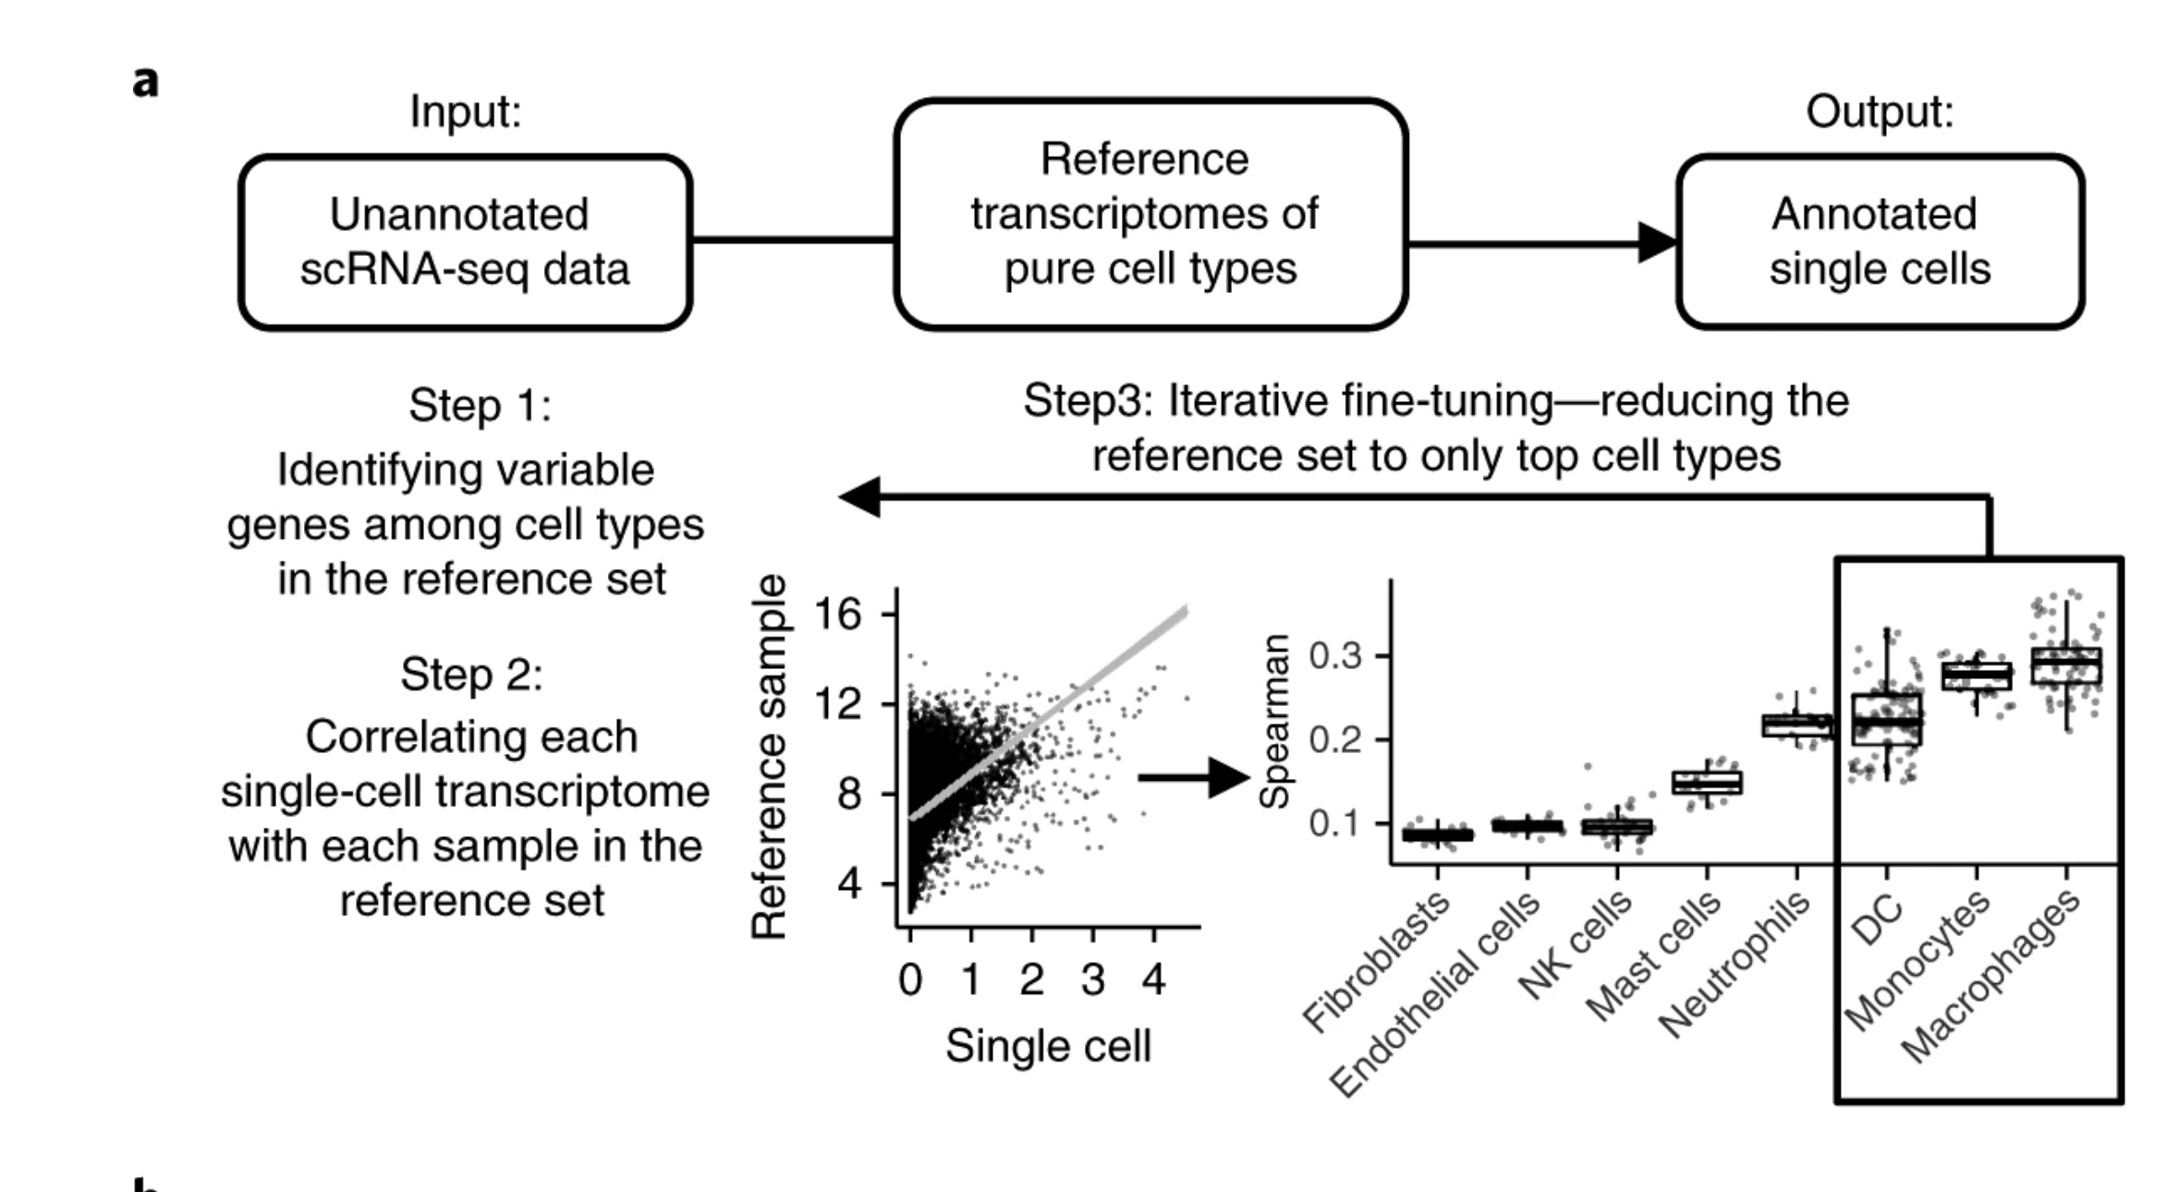
SingleR: Reference-based annotation of scRNA-seq
SingleR pipeline is based on correlating reference bulk transcriptomic data sets of pure cell types with single-cell gene expression.
Reference set: a comprehensive transcriptomic dataset (microarray or RNA-seq) of pure cell types
Human
  Human Primary Cell Atlas (HPCA) : 38 main cell types, 169 subtypes, 713 samples
  Blueprint+Encode: 43 cell types, 259 bulk RNAseq samples
Mouse
  Immunological Genome Project (ImmGen) : 20 main cell types, 830 microarray samples
  mouse RNA-seq samples (brain-specific) : 28 cell types, 358 RNA-seq samples
Aran, D., Looney, A.P., Liu, L. et al. Reference-based analysis of lung single-cell sequencing reveals a transitional profibrotic macrophage. Nat Immunol 20, 163–172 (2019). https://doi.org/10.1038/s41590-018-0276-y

Slide 7
SingleR: Reference-based annotation of scRNA-seq
Aran, D., Looney, A.P., Liu, L. et al. Reference-based analysis of lung single-cell sequencing reveals a transitional profibrotic macrophage. Nat Immunol 20, 163–172 (2019). https://doi.org/10.1038/s41590-018-0276-y

Slide 8
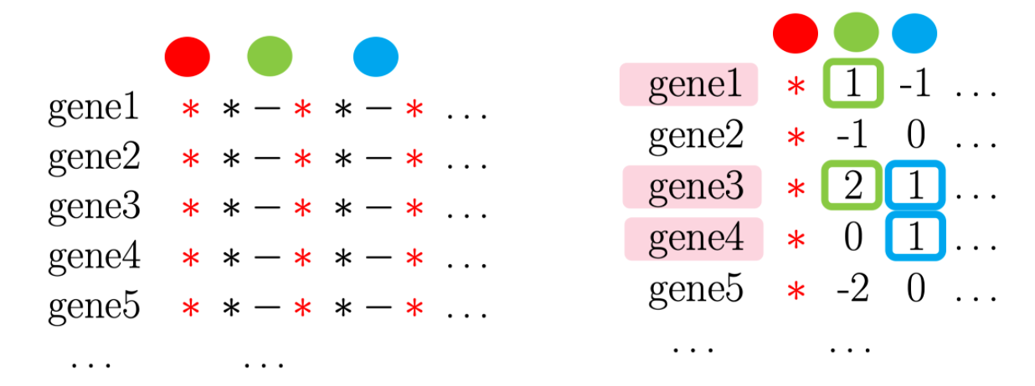
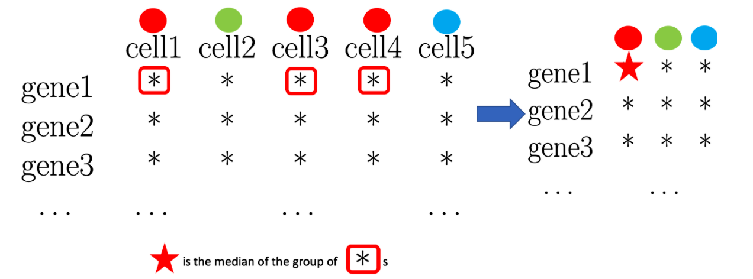
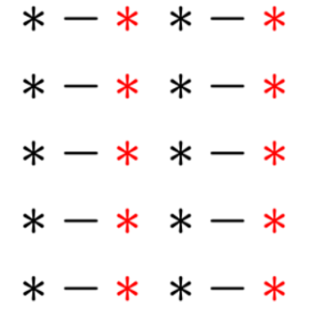
Step 1: Identifying variable genes among cell types in the reference set
For each cell type, identify the top N variable genes that have a higher median expression in that cell type than in every other cell type
Take the ’red’ cell type as an example
  For every gene, median expression values grouped by cell type were obtained.
  Differential expression between each other cell type and the 'red' cell type was calculated and all genes with positive differential expression values were selected.
  All selected genes were sorted by differential expression values, and then the top N genes were selected as variable genes for the 'red' cell type.
https://biocellgen-public.svi.edu.au/mig_2019_scrnaseq-workshop/public/clustering-and-cell-annotation.html
Aran, D., Looney, A.P., Liu, L. et al. Reference-based analysis of lung single-cell sequencing reveals a transitional profibrotic macrophage. Nat Immunol 20, 163–172 (2019). https://doi.org/10.1038/s41590-018-0276-y

Slide 9
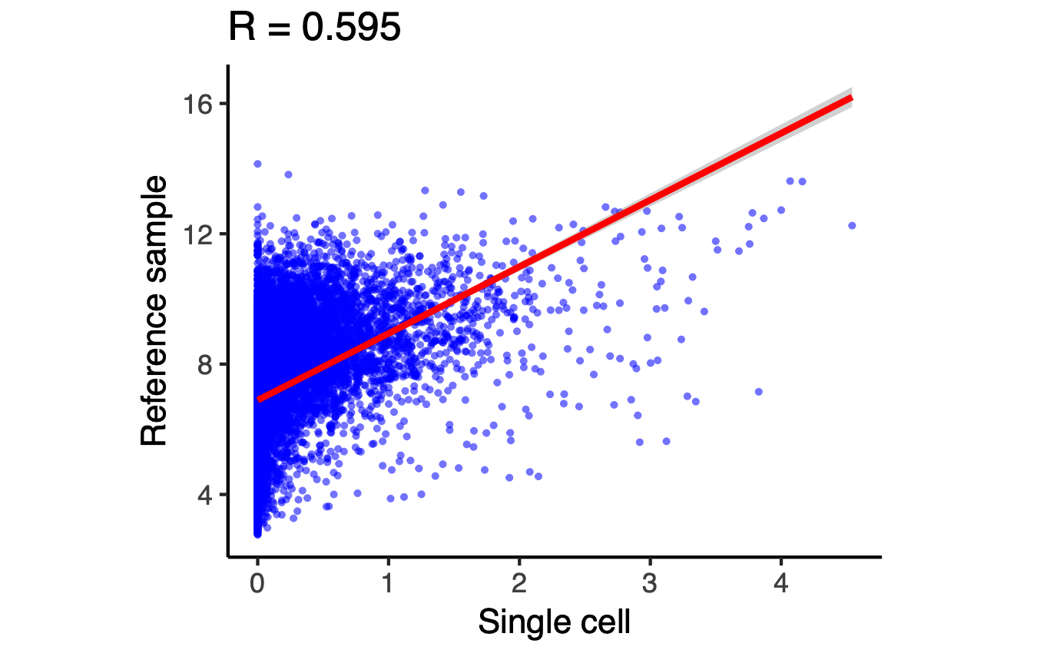
Step 2: Correlating each single-cell transcriptome with each sample in the reference set
Spearman coefficient is calculated for single cell expression with each of the samples in the reference dataset.
The correlation analysis is performed only on variable genes in the reference dataset.
Correlation
Expression of a
reference sample
a gene
Expression of a single cell
https://biocellgen-public.svi.edu.au/mig_2019_scrnaseq-workshop/public/clustering-and-cell-annotation.html

Slide 10
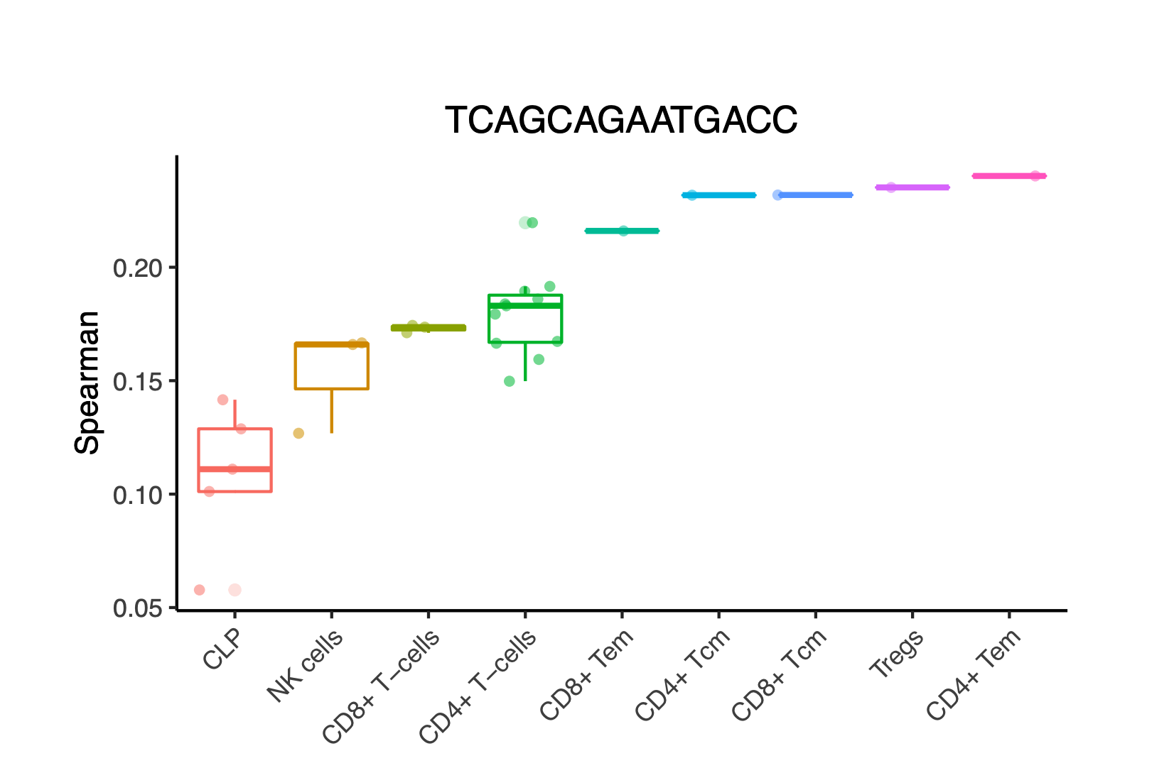
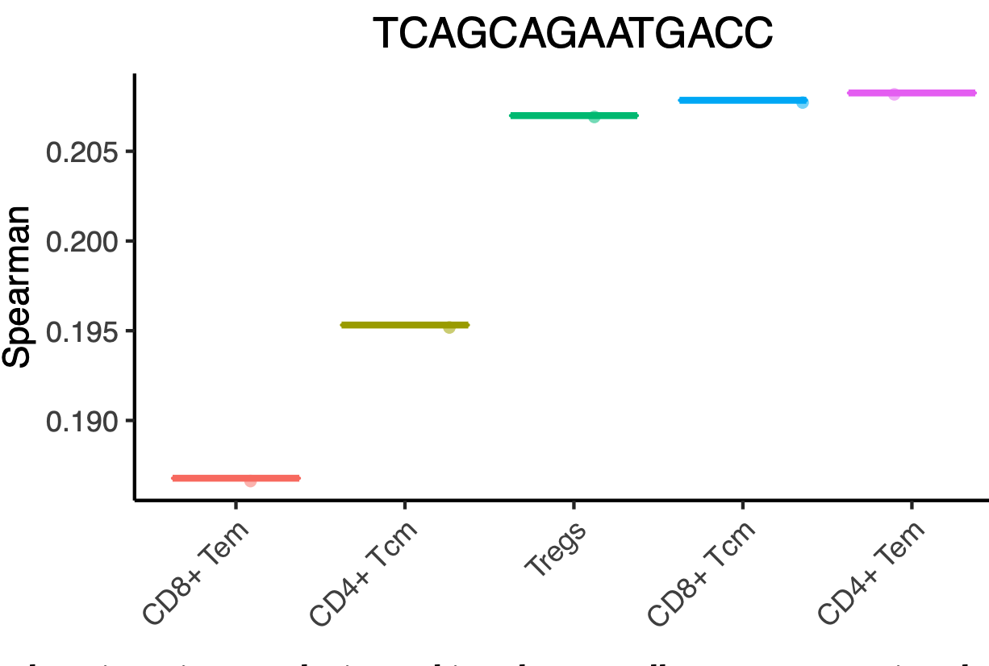
Step 3: Iterative fine-tuning - reducing the reference to only top cell types
For a single cell and each cell type, multiple Spearman correlation coefficients are aggregated into a “cell-type score”
  The SingleR score for each cell type is the 80 percentile in each of the boxplots.
Cell types with the lowest score or a score below will be removed
Repeat from step 1 until only one cell type remained
One single cell (barcode)
For each iteration, top-scoring cell types are retained
Each point is a reference sample
https://biocellgen-public.svi.edu.au/mig_2019_scrnaseq-workshop/public/clustering-and-cell-annotation.html

Slide 11
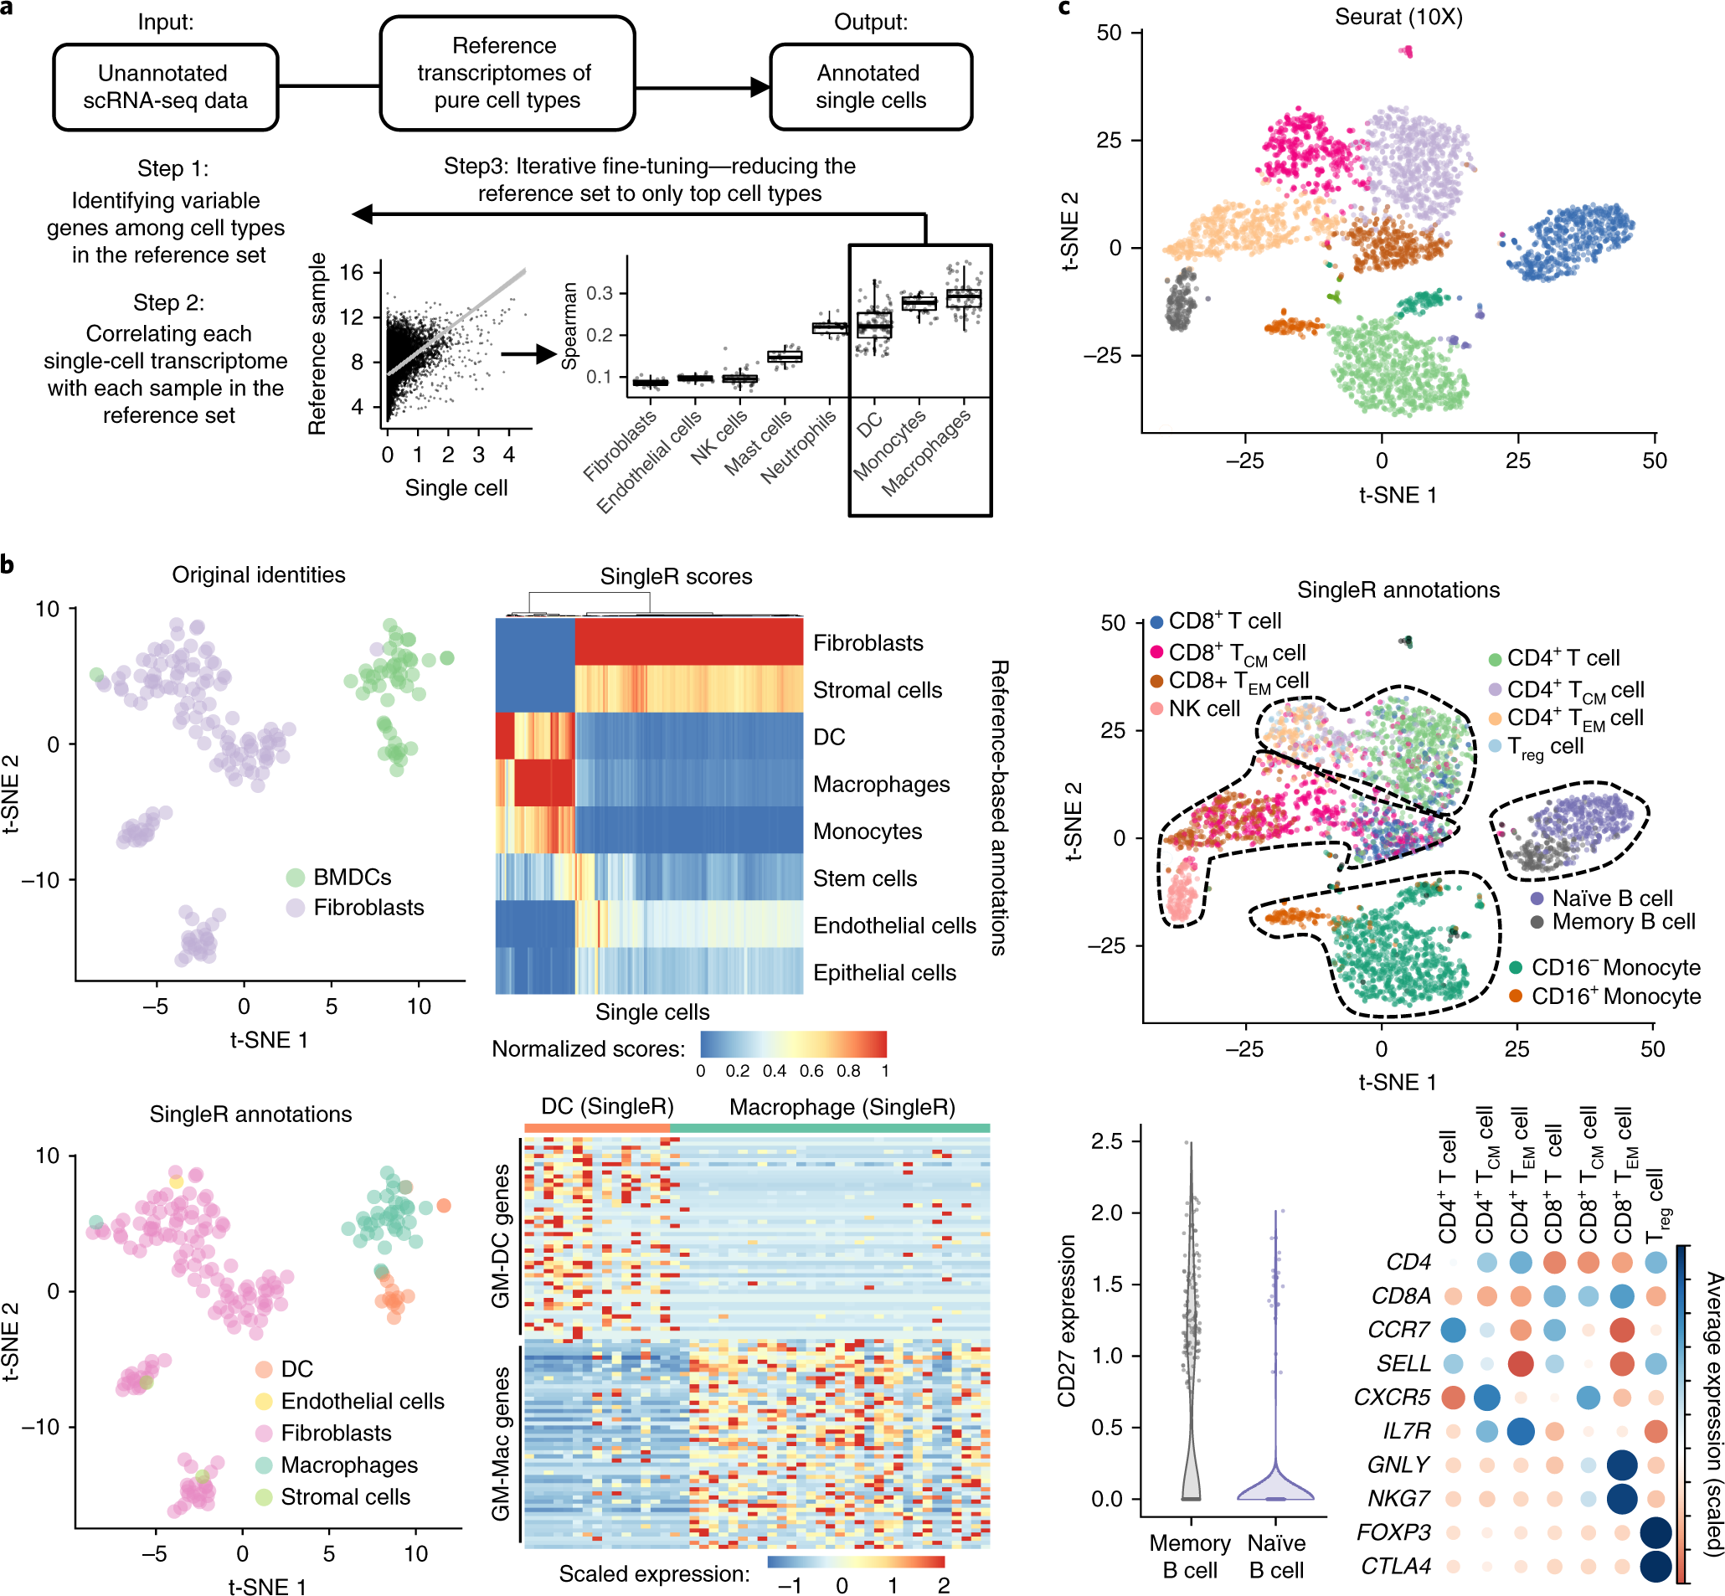
SingleR: Reference-based annotation of scRNA-seq
Aran, D., Looney, A.P., Liu, L. et al. Reference-based analysis of lung single-cell sequencing reveals a transitional profibrotic macrophage. Nat Immunol 20, 163–172 (2019). https://doi.org/10.1038/s41590-018-0276-y

Slide 12
Outline
scRNA-seq data analysis
  Cell type annotation
    SingleR
  Cell type markers identification
  Pseudo timing
    Monocle
  Cell-type gene regulatory networks
    SCENIC
    BEELINE
  Single cell deconvolution
    CIBERSORTx

Slide 13
Cell type markers identification
Differential expression analysis
Non-parametric tests
  Wilcoxon rank sum test
  Student’s t-test
Methods specific for scRNA-seq
  MAST : GLM-framework that treats cellular detection rate as a covariate (Finak et al, Genome Biology, 2015)
Methods for bulk RNA-seq
  DESeq2 : DE based on a model using the negative binomial distribution (Love et al, Genome Biology 2014)
Finak, G., McDavid, A., Yajima, M. et al. MAST: a flexible statistical framework for assessing transcriptional changes and characterizing heterogeneity in single-cell RNA sequencing data. Genome Biol 16, 278 (2015). https://doi.org/10.1186/s13059-015-0844-5
Love MI, Huber W, Anders S (2014). “Moderated estimation of fold change and dispersion for RNA-seq data with DESeq2.” Genome Biology, 15, 550. doi: 10.1186/s13059-014-0550-8.
https://satijalab.org/seurat/archive/v3.1/immune_alignment.html

Slide 14

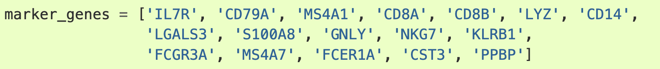
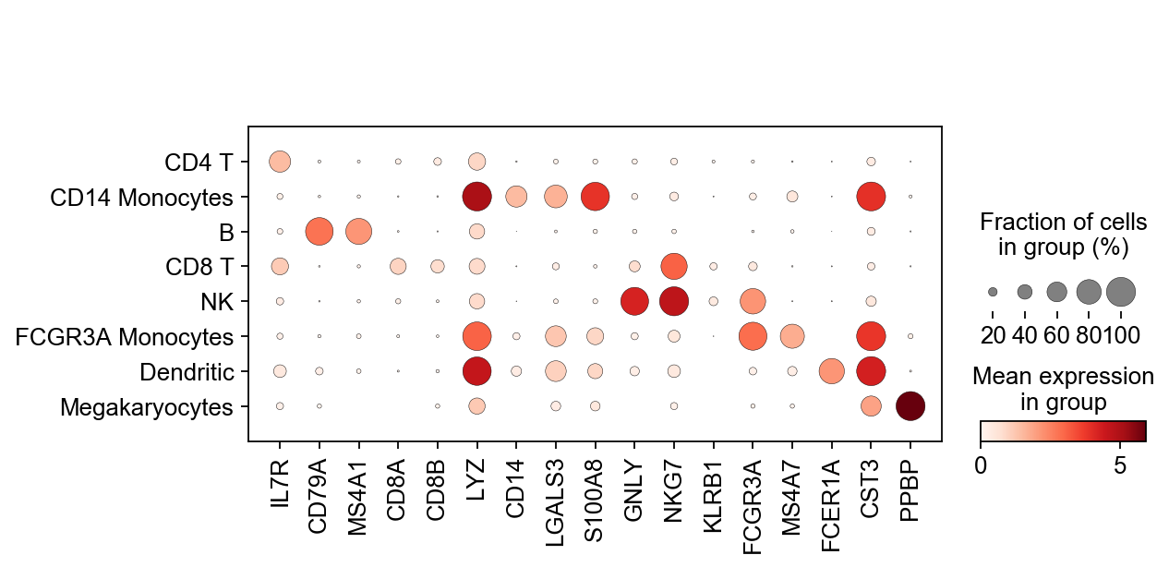
Cell type markers identification
Differential testing and visualization in Scanpy
Finak, G., McDavid, A., Yajima, M. et al. MAST: a flexible statistical framework for assessing transcriptional changes and characterizing heterogeneity in single-cell RNA sequencing data. Genome Biol 16, 278 (2015). https://doi.org/10.1186/s13059-015-0844-5
Love MI, Huber W, Anders S (2014). “Moderated estimation of fold change and dispersion for RNA-seq data with DESeq2.” Genome Biology, 15, 550. doi: 10.1186/s13059-014-0550-8.
https://satijalab.org/seurat/archive/v3.1/immune_alignment.html
https://zenodo.org/record/4317764#.YlI7gdPMKCg
Notes:
Split two

Slide 15
Outline
scRNA-seq data analysis
  Cell type annotation
    SingleR
  Cell type markers identification
  Pseudo timing
    Monocle
  Cell-type gene regulatory networks
    SCENIC
    BEELINE
  Single cell deconvolution
    CIBERSORTx

Slide 16
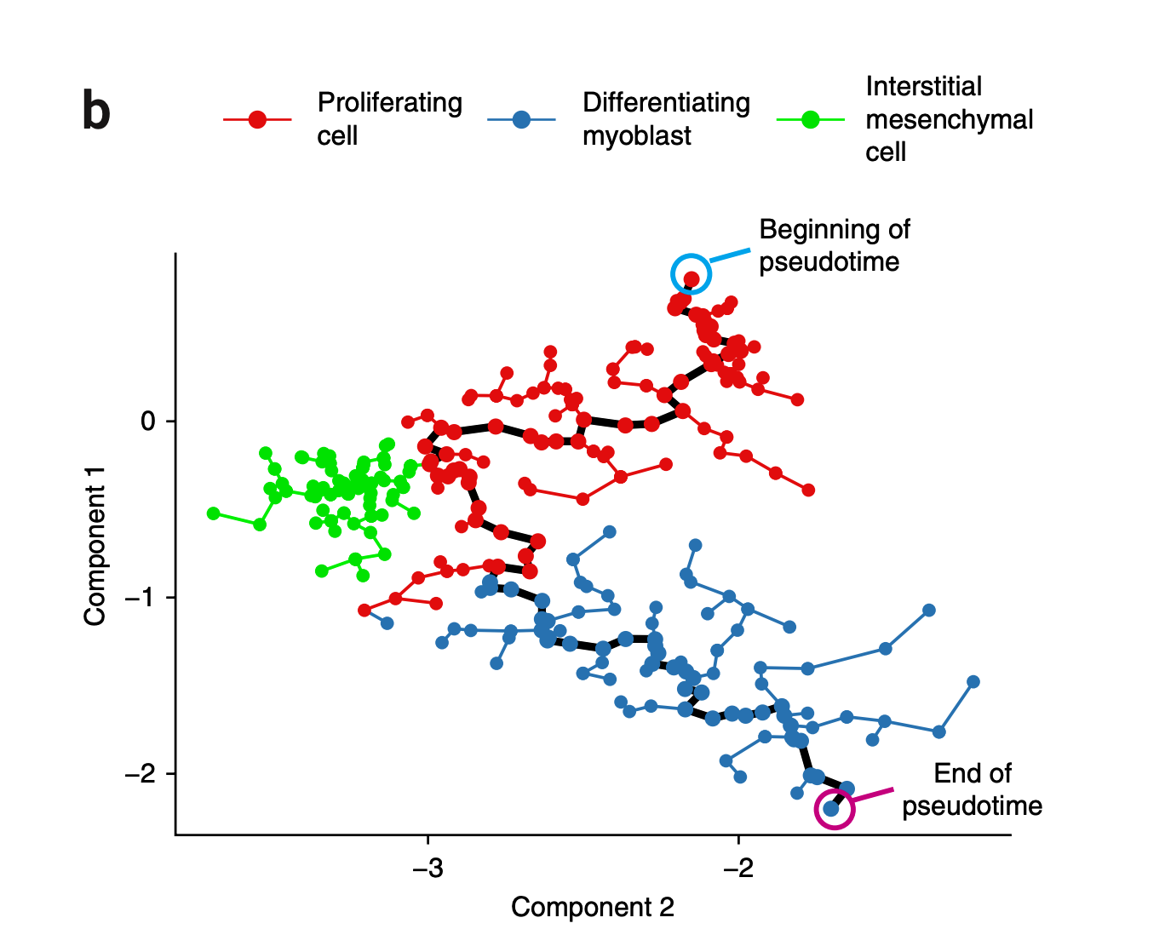
Pseudo timing
Many cell differentiation processes take place during development
We order the cells along one or more trajectories representing the underlying developmental processes
This ordering is called ‘pseudotime’
Trajectory inference (TI) aims to reconstruct a cellular dynamic process
http://cole-trapnell-lab.github.io/monocle-release/docs/#constructing-single-cell-trajectories
https://scrnaseq-course.cog.sanger.ac.uk/website/biological-analysis.html#pseudotime-analysis
Saelens, W., Cannoodt, R., Todorov, H. et al. A comparison of single-cell trajectory inference methods. Nat Biotechnol 37, 547–554 (2019). https://doi.org/10.1038/s41587-019-0071-9
Trapnell, C., Cacchiarelli, D., Grimsby, J. et al. The dynamics and regulators of cell fate decisions are revealed by pseudotemporal
ordering of single cells. Nat Biotechnol 32, 381–386 (2014). https://doi.org/10.1038/nbt.2859

Slide 17
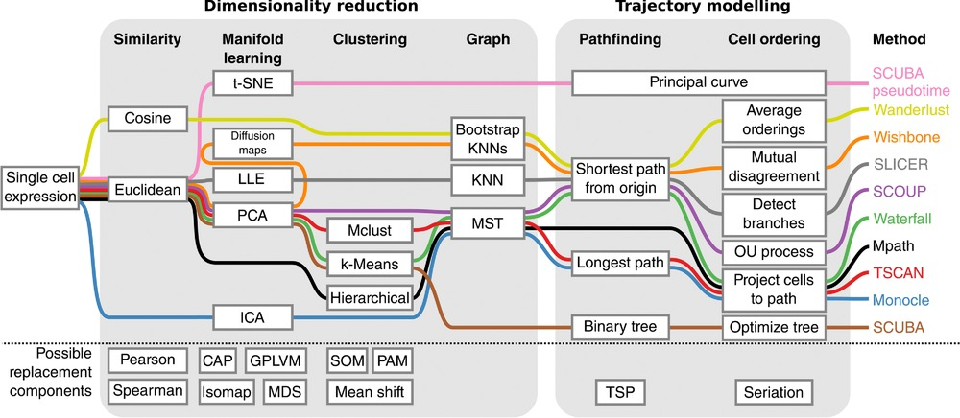

Pseudo timing
Using single-cell-omics data, many trajectory inference (TI) methods could computationally order cells along trajectories, allowing the unbiased study of cellular dynamic processes
http://cole-trapnell-lab.github.io/monocle-release/docs/#constructing-single-cell-trajectories
https://scrnaseq-course.cog.sanger.ac.uk/website/biological-analysis.html#pseudotime-analysis
Saelens, W., Cannoodt, R., Todorov, H. et al. A comparison of single-cell trajectory inference methods. Nat Biotechnol 37, 547–554 (2019). https://doi.org/10.1038/s41587-019-0071-9

Slide 18
Monocle
Constructing single cell trajectories
Monocle, an unsupervised algorithm to build single-cell trajectories, and find cell fate decisions and dynamically regulated genes.
Step 1: Choose genes that define progress
Step 2: Reduce data dimensionality
  independent component analysis (ICA)
Step 3: Construct minimum spanning tree (MST) on the cells
Step 4: Find the longest path through the MST
Step 5: Order cells along the trajectory
http://cole-trapnell-lab.github.io/monocle-release/docs/#constructing-single-cell-trajectories
Trapnell, C., Cacchiarelli, D., Grimsby, J. et al. The dynamics and regulators of cell fate decisions are revealed by pseudotemporal ordering of single cells. Nat Biotechnol 32, 381–386 (2014). https://doi.org/10.1038/nbt.2859

Slide 19
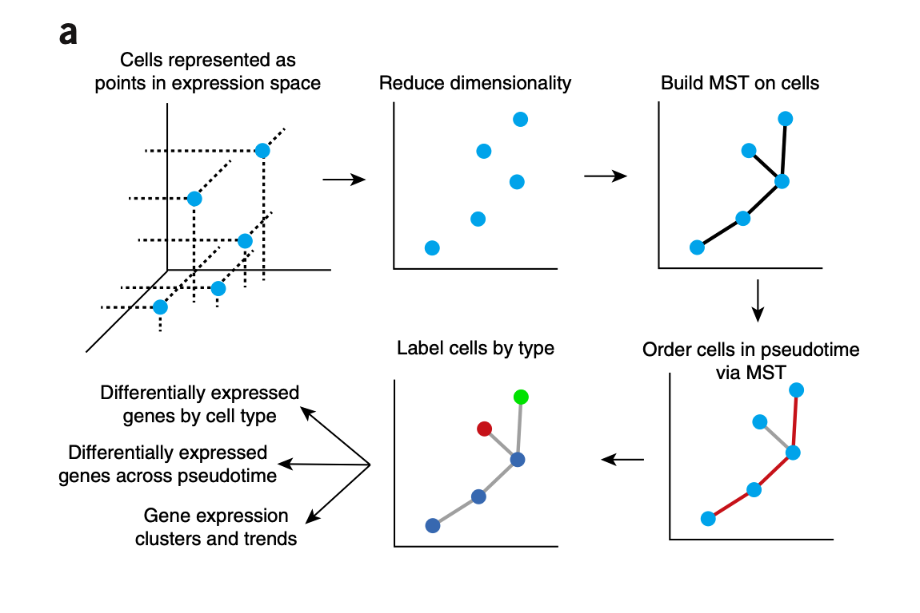
Step 1: Choose genes that define progress
Represent the expression profile of each cell as a point in a high-dimensional Euclidean space, with one dimension for each gene
Trapnell, C., Cacchiarelli, D., Grimsby, J. et al. The dynamics and regulators of cell fate decisions are revealed by pseudotemporal
ordering of single cells. Nat Biotechnol 32, 381–386 (2014). https://doi.org/10.1038/nbt.2859

Slide 20
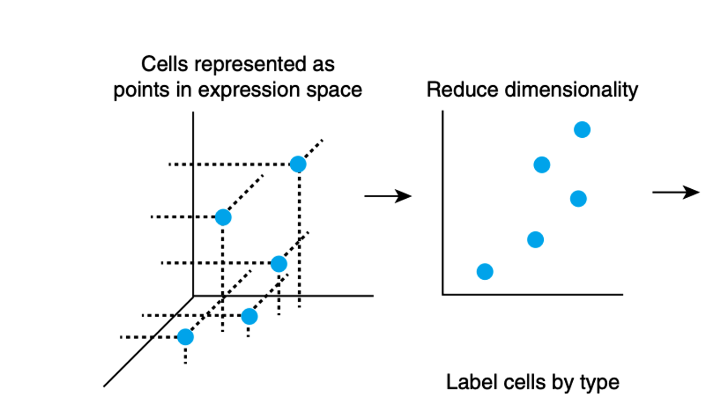
Step 2: Reduce data dimensionality
Reduce dimensionality using independent component analysis (ICA)
Transform the cell data from a high-dimensional space into a low-dimensional one that preserves essential relationships between cell populations
https://github.com/NBISweden/excelerate-scRNAseq/blob/master/session-trajectories/trajectory_inference_analysis.pdf
https://www.cs.cmu.edu/~tom/10701_sp11/recitations/Recitation_11.pdf
Trapnell, C., Cacchiarelli, D., Grimsby, J. et al. The dynamics and regulators of cell fate decisions are revealed by pseudotemporal ordering of single cells. Nat Biotechnol 32, 381–386 (2014). https://doi.org/10.1038/nbt.2859

Slide 21
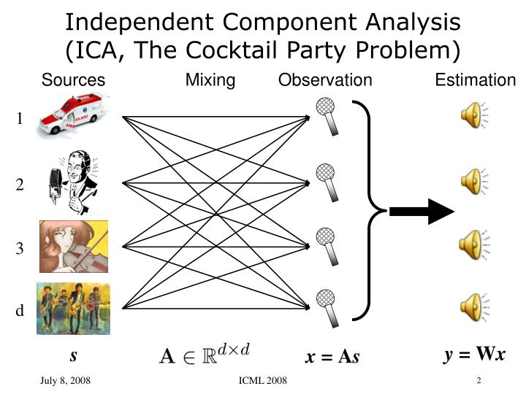
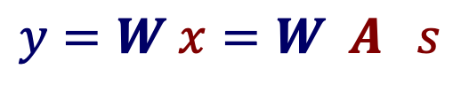
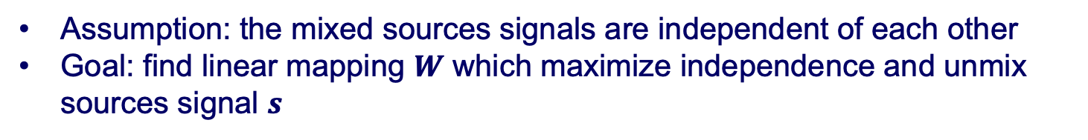
ICA
Assumption: the mixed sources signals are independent of each other
Goal: find linear mapping $W$ which maximize independence and unmix sources signal $s$
Mixed variables
Mixing matrix
$y=W x=W A s$
Source
Linear mapping
https://github.com/NBISweden/excelerate-scRNAseq/blob/master/session-trajectories/trajectory_inference_analysis.pdf
https://www.slideserve.com/vladimir-kirkland/ica-and-isa-using-schweizer-wolff-measure-of-dependence

Slide 22
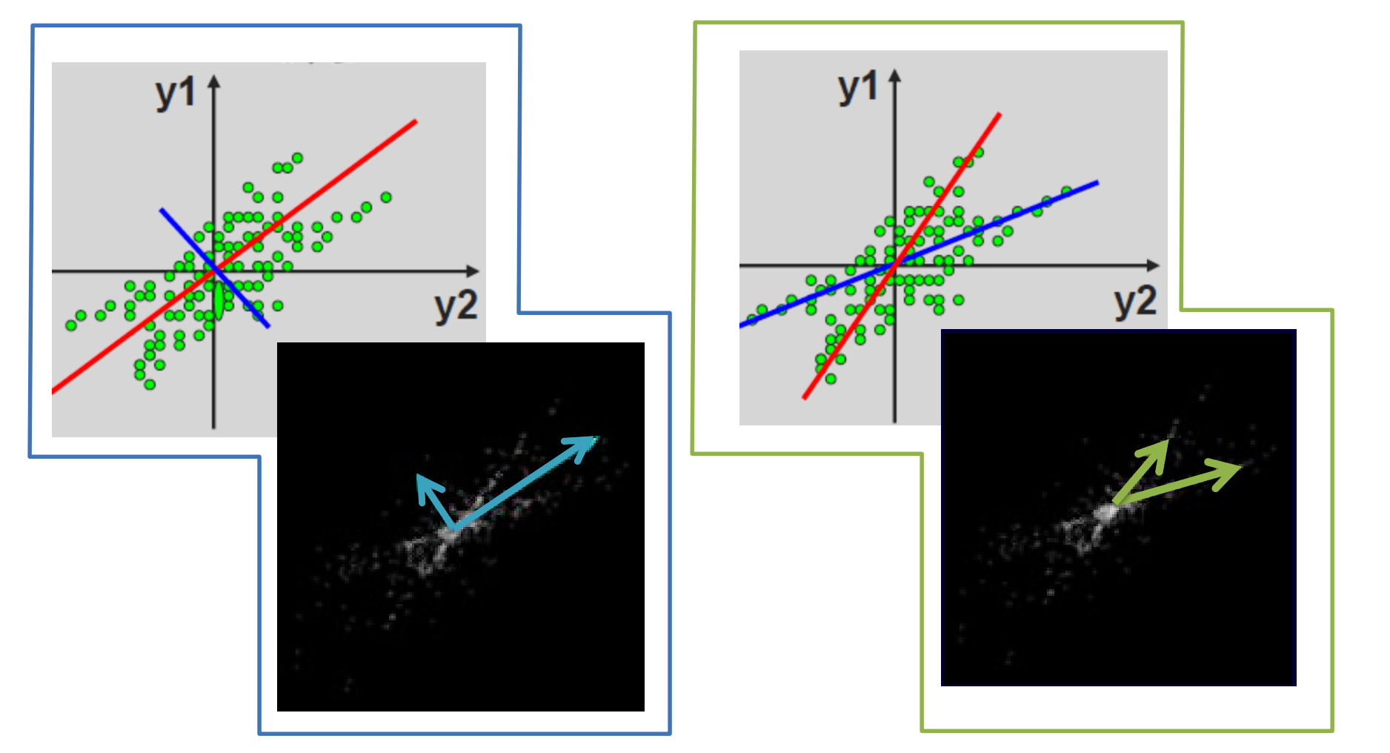
ICA vs PCA
PCA : Find the directions of maximal variance
ICA : Find the directions of maximal independence
  The values in each source have non-Gaussian distributions
https://github.com/NBISweden/excelerate-scRNAseq/blob/master/session-trajectories/trajectory_inference_analysis.pdf
https://scikit-learn.org/stable/modules/decomposition.html#independent-component-analysis-ica

Slide 23
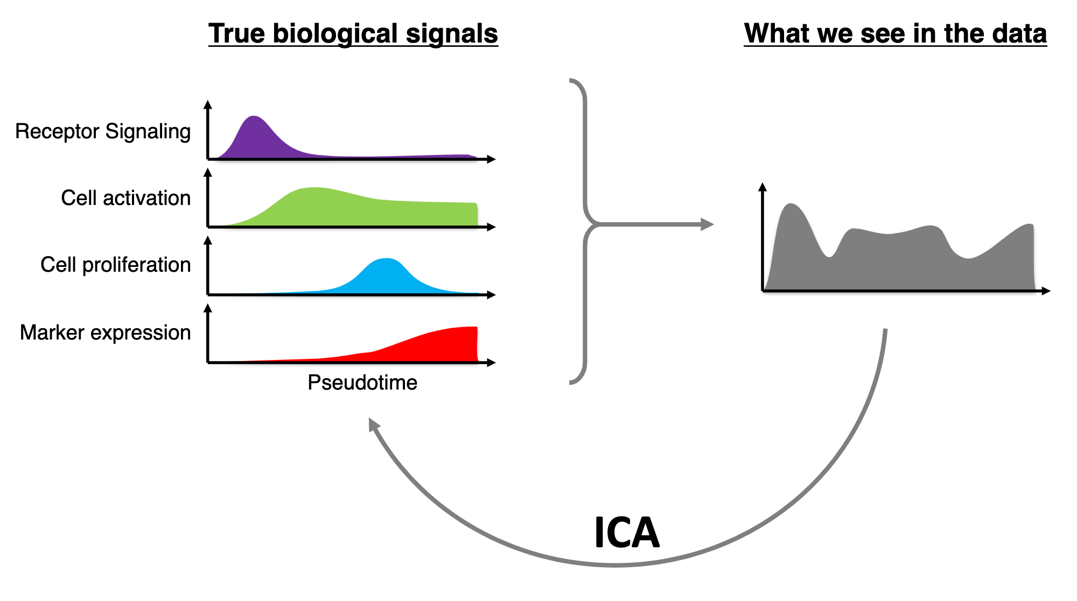
Why ICA
https://github.com/NBISweden/excelerate-scRNAseq/blob/master/session-trajectories/trajectory_inference_analysis.pdf
https://scikit-learn.org/stable/modules/decomposition.html#independent-component-analysis-ica

Slide 24
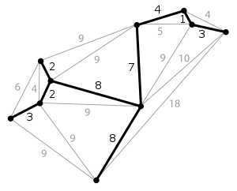
Step 3: Construct minimum spanning tree (MST) on the cells
Minimum spanning tree (MST)
  The undirected graph connecting all vertices with the smallest sum of all distances
  No cycles
Vertex : Cell
Edge weights: cell-cell distances
Trapnell, C., Cacchiarelli, D., Grimsby, J. et al. The dynamics and regulators of cell fate decisions are revealed by pseudotemporal
ordering of single cells. Nat Biotechnol 32, 381–386 (2014). https://doi.org/10.1038/nbt.2859
https://en.wikipedia.org/wiki/Minimum_spanning_tree

Slide 25
Step 4: Find the longest path
through the MST
Correspond to the longest sequence of similar cells (e.g., gene expression)
Trapnell, C., Cacchiarelli, D., Grimsby, J. et al. The dynamics and regulators of cell fate decisions are revealed by pseudotemporal
ordering of single cells. Nat Biotechnol 32, 381–386 (2014). https://doi.org/10.1038/nbt.2859

Slide 26
Step 5: Order cells along the trajectory
Produce a ‘trajectory’ of an individual cell’s progress through differentiation
Trapnell, C., Cacchiarelli, D., Grimsby, J. et al. The dynamics and regulators of cell fate decisions are revealed by pseudotemporal
ordering of single cells. Nat Biotechnol 32, 381–386 (2014). https://doi.org/10.1038/nbt.2859

Slide 27
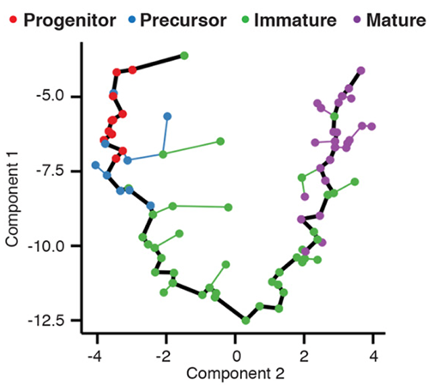
Developmental trajectory of olfactory neurons in mice
Each point is a cell, which is connected to an MST
The pseudotime value of each cell is measured as the distance along the trajectory from its position back to the beginning
https://cole-trapnell-lab.github.io/projects/sc-trajectories/

Slide 28
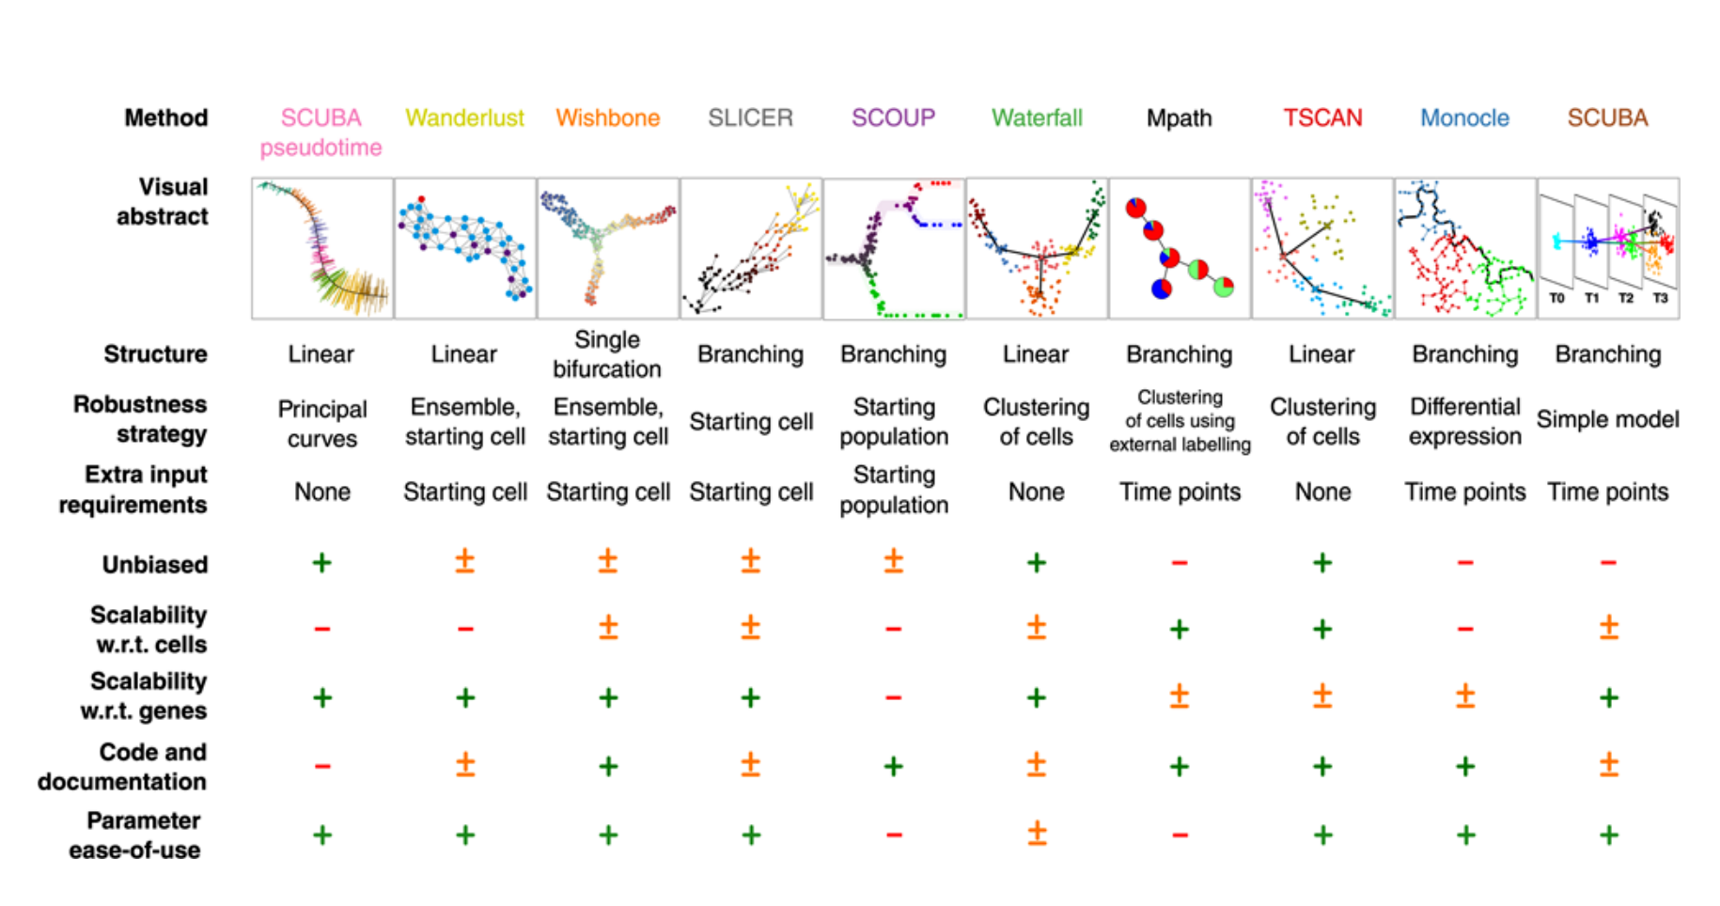
Pseudo timing
The performance of TI methods mostly depend on the topology of the trajectory in the single-cell data.
http://cole-trapnell-lab.github.io/monocle-release/docs/#constructing-single-cell-trajectories
https://indico.math.cnrs.fr/event/3780/contributions/3242/attachments/2195/2550/Slides-maugis-181018.pdf
https://scrnaseq-course.cog.sanger.ac.uk/website/biological-analysis.html#pseudotime-analysis
Saelens, W., Cannoodt, R., Todorov, H. et al. A comparison of single-cell trajectory inference methods. Nat Biotechnol 37, 547–554 (2019). https://doi.org/10.1038/s41587-019-0071-9

Slide 29
Outline
scRNA-seq data analysis
  Cell type annotation
    SingleR
  Cell type markers identification
  Pseudo timing
    Monocle
  Cell-type gene regulatory networks
    SCENIC
    BEELINE
  Single cell deconvolution
    CIBERSORTx

Slide 30
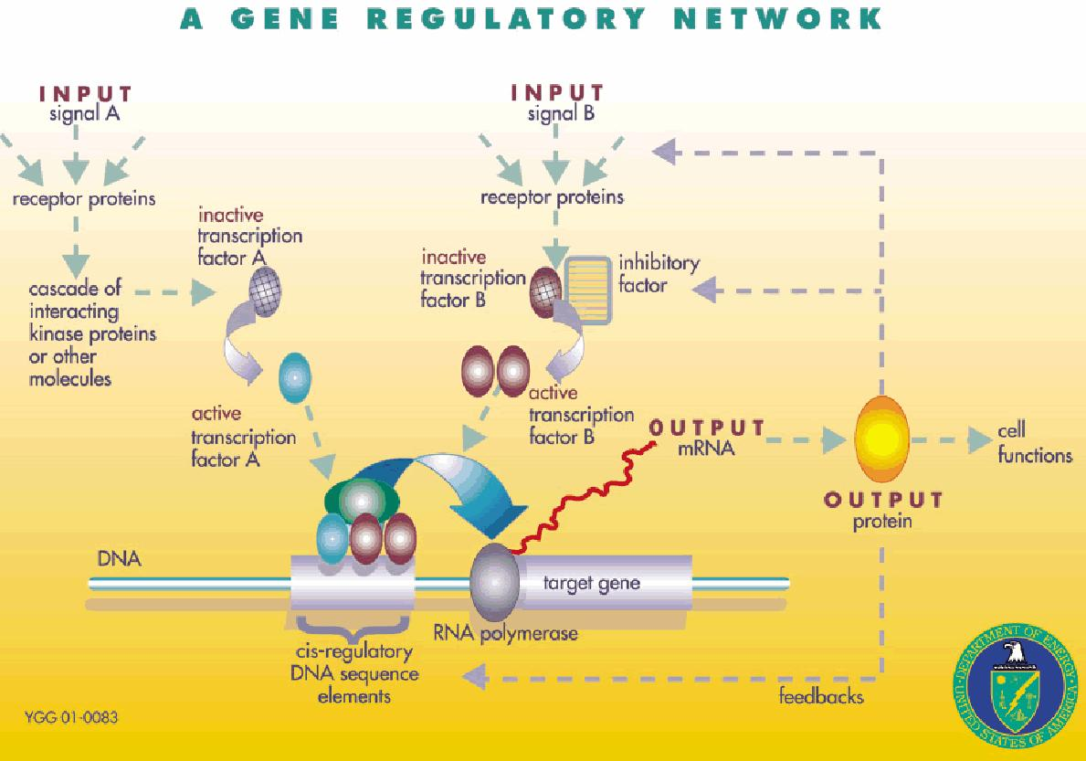
Gene regulation
Gene regulation is the process of controlling which genes in a cell's DNA are expressed (used to make a functional product such as a protein).
https://www.cs.purdue.edu/homes/ayg/TALKS/STC_CHICAGO10/Introductory_material/regulatory_networks.ppt
Notes:
Sources: http://www.ornl.gov/sci/techresources/Human_Genome/graphics/slides/images/REGNET.jpg

Slide 31
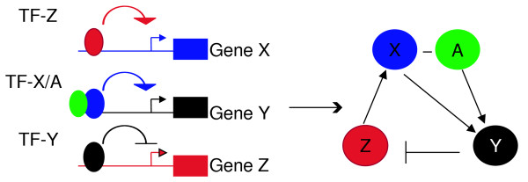
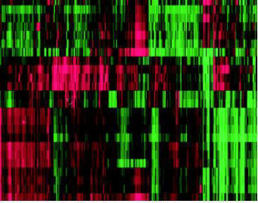
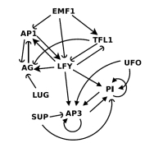
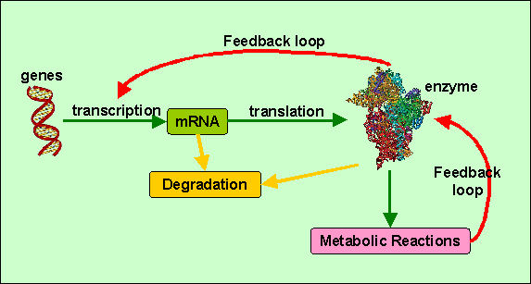
Gene regulatory network
Gene regulatory networks (GRNs) like on-off switches of a cell operating at the gene level
Two genes are connected if the expression of one gene modulates expression of another one by either activation or inhibition
GRN can be inferred from correlations in gene expression data, time-series gene expression data, and/or gene knock-out experiments
Observation
Inference
https://www.cs.purdue.edu/homes/ayg/TALKS/STC_CHICAGO10/Introductory_material/regulatory_networks.ppt

Slide 32
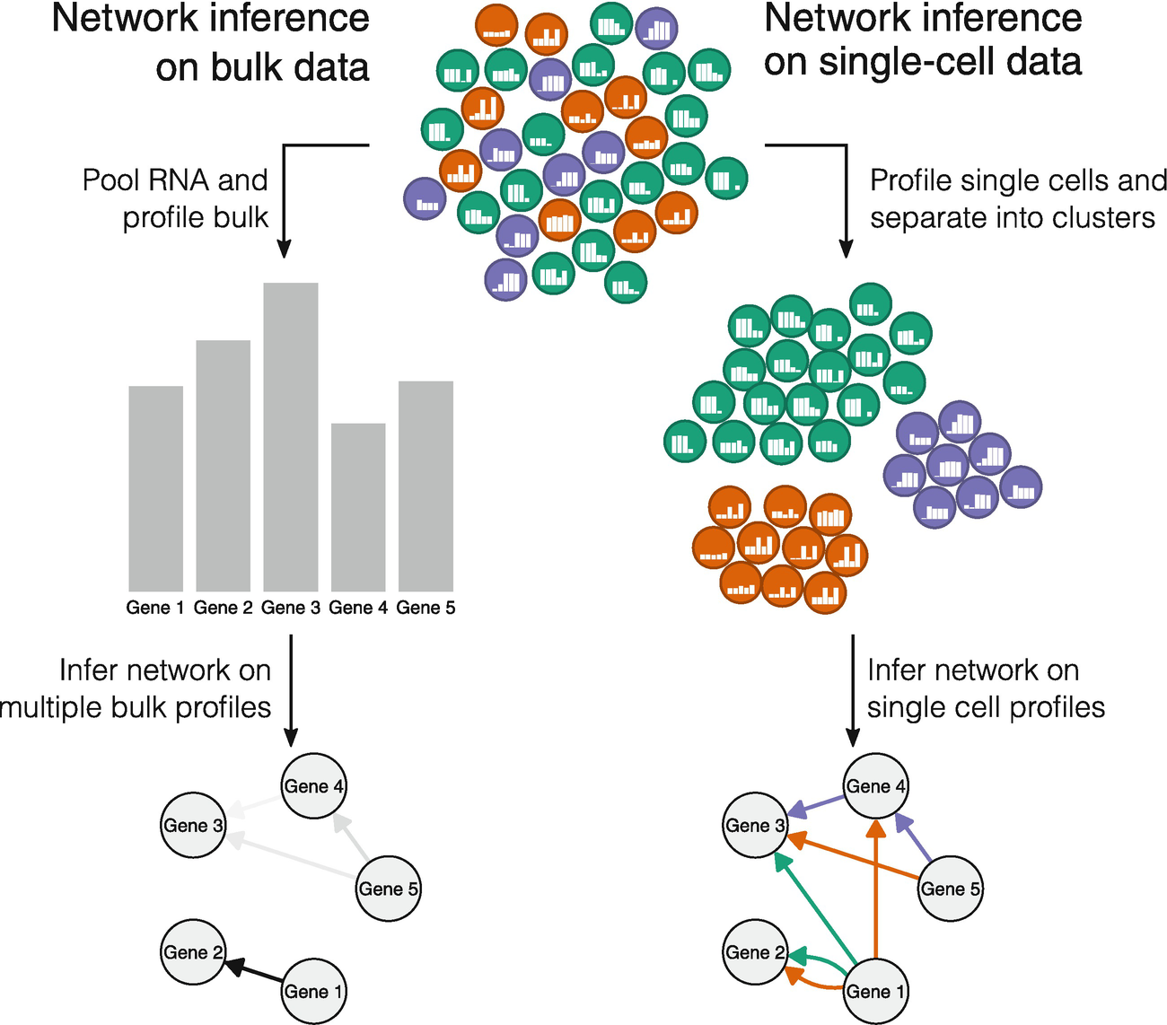
Cell-type gene regulatory networks
Cell-type-specific GRNs would be key tools for the study of cellular heterogeneity
(NI)
Todorov H., Cannoodt R., Saelens W., Saeys Y. (2019) Network Inference from Single-Cell Transcriptomic Data. In: Sanguinetti G., Huynh-Thu V. (eds) Gene Regulatory Networks. Methods in Molecular Biology, vol 1883. Humana Press, New York, NY. https://doi.org/10.1007/978-1-4939-8882-2_10

Slide 33
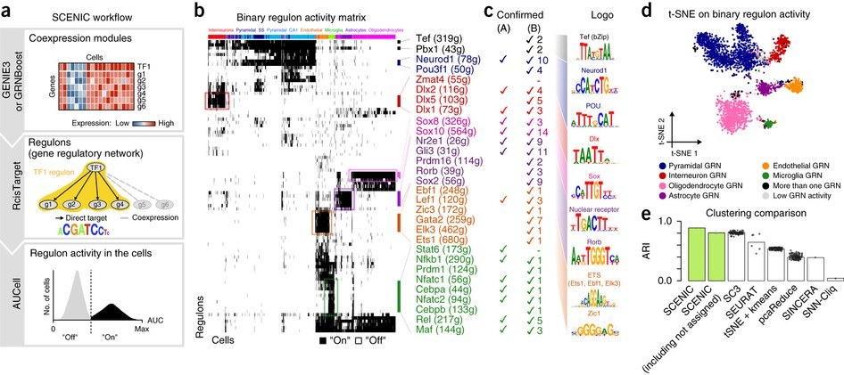
SCENIC single-cell regulatory network inference and clustering
Simultaneously reconstruct gene regulatory networks and identify stable cell states from single-cell RNA-seq data, based on three tools
  GENIE3 or GRNboost
  RcisTarget
  AUCell
The gene regulatory network is inferred based on co-expression and DNA motif analysis, and then the network activity is analyzed in each cell to identify the recurrent cellular states.
Aibar et al. (2017) SCENIC: single-cell regulatory network inference and clustering. Nature Methods. doi: 10.1038/nmeth.4463.

Slide 34
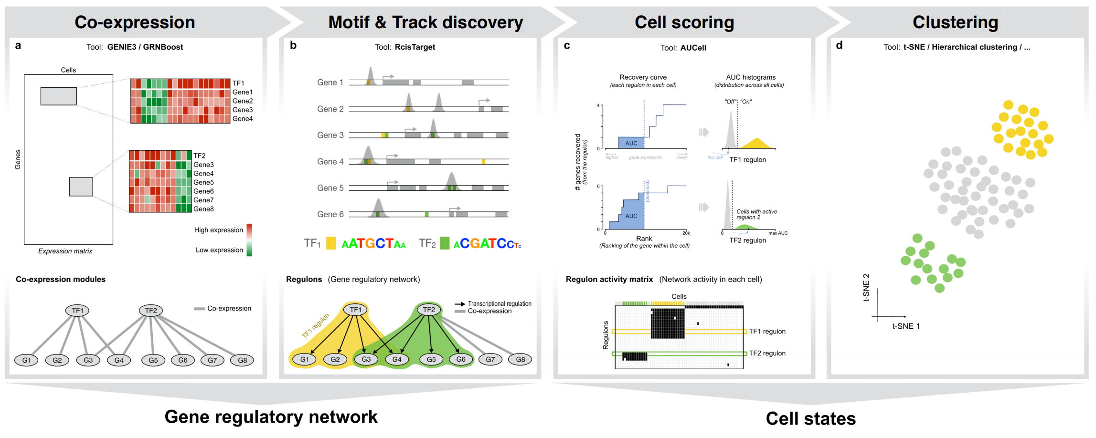

Step 1: TF-based co-expression network
SCENIC
GENIE3
or
GRNBoost
Aibar et al. (2017) SCENIC: single-cell regulatory network inference and clustering. Nature Methods. doi: 10.1038/nmeth.4463.

Slide 35
Step 2: Identification of transcription factor binding motifs
SCENIC
RcisTarget
cis-regulatory sequence analysis
Aibar et al. (2017) SCENIC: single-cell regulatory network inference and clustering. Nature Methods. doi: 10.1038/nmeth.4463.

Slide 36
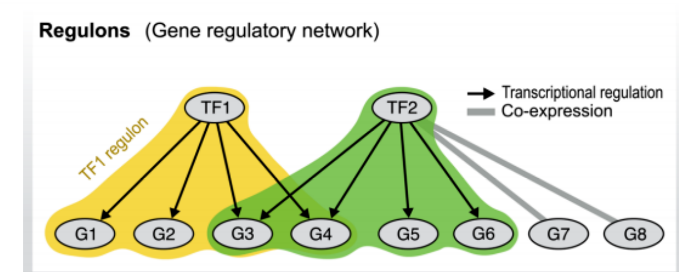
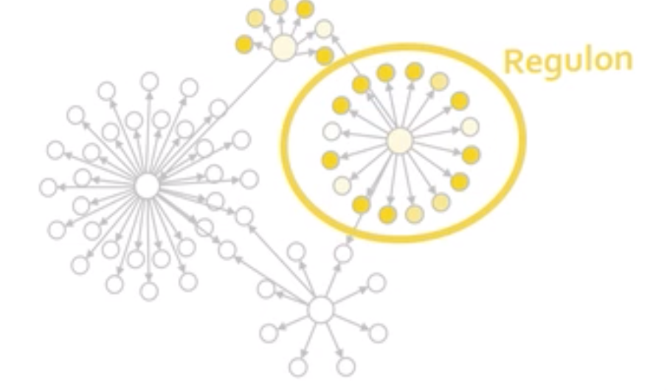
Regulon
Regulon: a group of genes that are regulated as a unit
Aibar et al. (2017) SCENIC: single-cell regulatory network inference and clustering. Nature Methods. doi: 10.1038/nmeth.4463.

Slide 37
AUCell score
AUCell uses the “Area Under the Curve” (AUC) to calculate whether a critical subset of the input gene set is enriched within the expressed genes for each cell.
AUCell score: measure how active a regulon is in a cell
  Step 1: For each cell, build gene-expression ranking
  Step 2: Calculate enrichment for the gene signatures (AUC)
  Step 3: Determine the cells with given regulon
Aibar et al. (2017) SCENIC: single-cell regulatory network inference and clustering. Nature Methods. doi: 10.1038/nmeth.4463.

Slide 38
Step 3: Regulon activities in each cell
SCENIC
AUCell
Identifying cells with active gene-sets
Aibar et al. (2017) SCENIC: single-cell regulatory network inference and clustering. Nature Methods. doi: 10.1038/nmeth.4463.

Slide 39

Top regulons on the Mouse brain
Aibar et al. (2017) SCENIC: single-cell regulatory network inference and clustering. Nature Methods. doi: 10.1038/nmeth.4463.

Slide 40
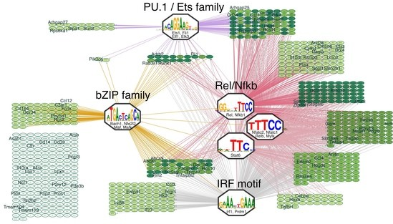
Microglia GRN on the Mouse brain
The regulons associated to microglia can be summarized based on the binding motif of the associated TF .
The predicted network for microglia contains many well-known regulators of microglial fate and/or microglial activation, including PU.1, Nfkb, Irf, and AP-1/Maf.
Aibar et al. (2017) SCENIC: single-cell regulatory network inference and clustering. Nature Methods. doi: 10.1038/nmeth.4463.

Slide 41

Evaluate GRN inference methods
Ground truth of GRNs is usually unknown.
How do we evaluate the performance of existing GRN inference methods from scRNA-seq data?
  BEELINE

Slide 42
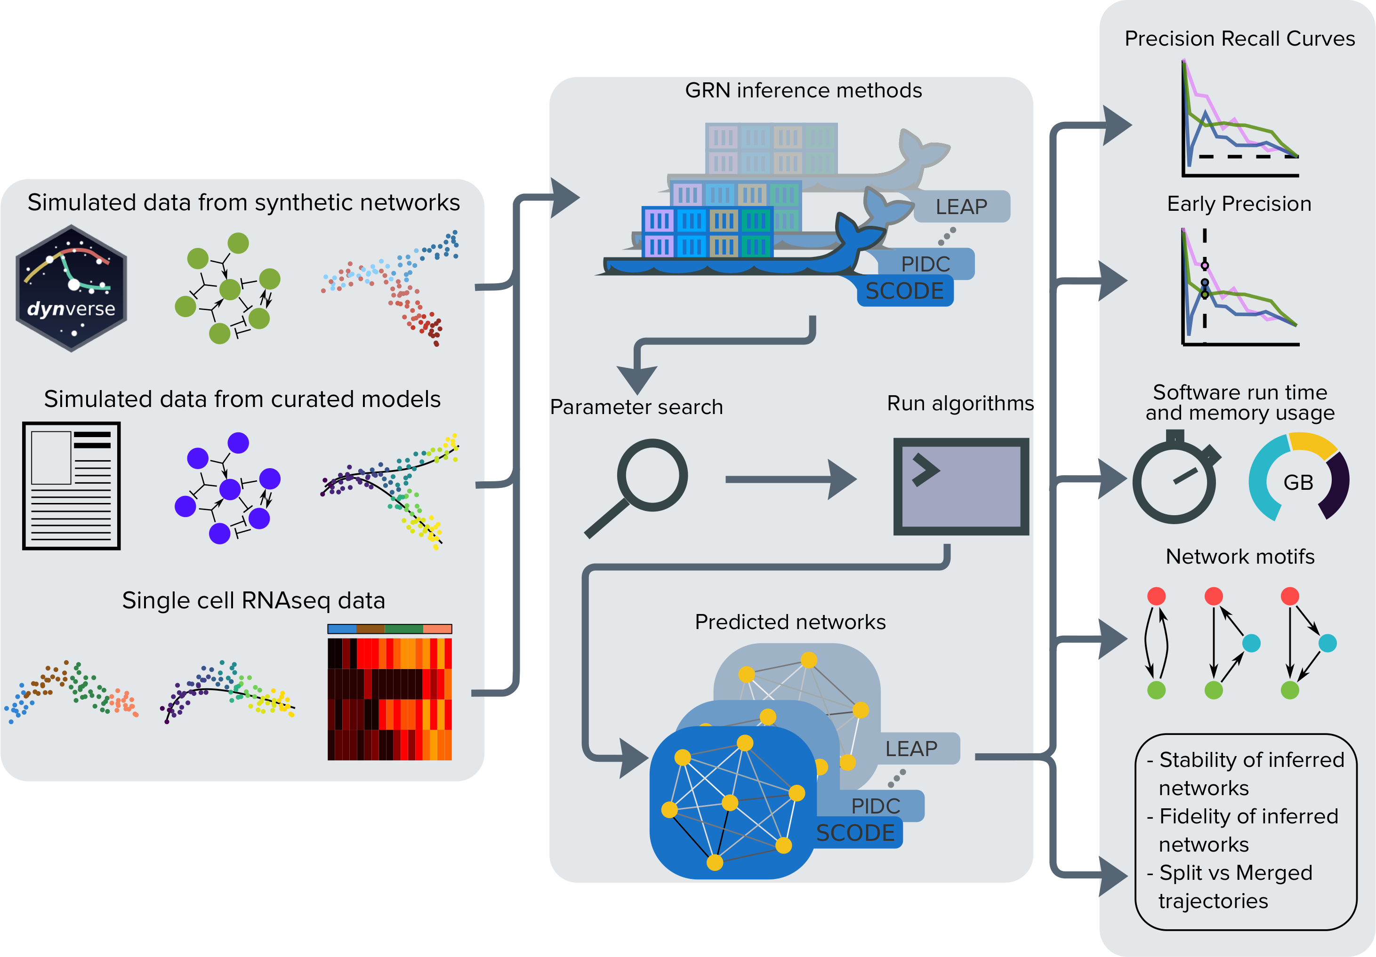
BEELINE
Benchmarking gene regulatory network inference from single-cell transcriptomic data
BEELINE is an evaluation framework incorporating 12 diverse GRN inference algorithms to assess the accuracy, robustness, and efficiency of GRN inference techniques for single-cell gene expression data.
Step 1: preprocessing
  Input type 1: Simulated data from synthetic networks
  Input type 2: Simulated data from curated models
  Input type 3: Experimental single-cell RNA-seq datasets
Step 2: Run GRN inference algorithms
Step 3: postprocessing and evaluation
Pratapa A, Jalihal AP, Law JN, Bharadwaj A, Murali TM. Benchmarking algorithms for gene regulatory network inference from single-cell transcriptomic data. Nat Methods. 2020;17(2):147-154. doi:10.1038/s41592-019-0690-6

Slide 43
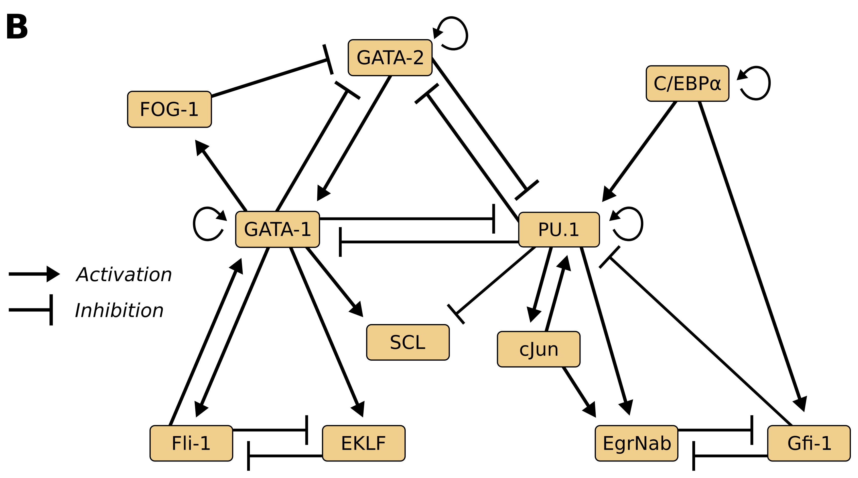
BoolODE for simulation
Generate inputs for BEELINE
Convert a Boolean model into a system of stochastic differential equations
Read a model definition file, and outputs the simulated expression data for a given model.
GRN
BoolODE
Genes
Cells
Pratapa A, Jalihal AP, Law JN, Bharadwaj A, Murali TM. Benchmarking algorithms for gene regulatory network inference from single-cell transcriptomic data. Nat Methods. 2020;17(2):147-154. doi:10.1038/s41592-019-0690-6

Slide 44
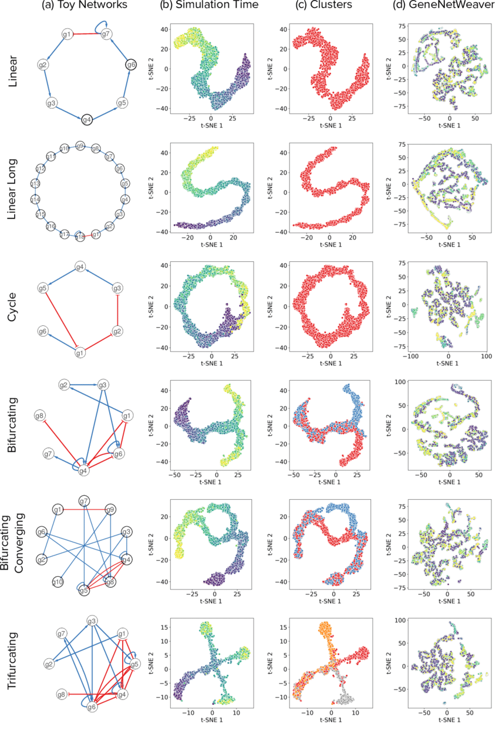
Input type 1:
Simulated datasets from synthetic networks
Synthetic network types:
Linear
Linear long
Cycle
Bifurcating
Bifurcating converging
Trifurcating
Bifurcating
Converging
Linear
Linear long
Cycle
Bifurcating
Trifurcating
Saelens, W., Cannoodt, R., Todorov, H. et al. A comparison of single-cell trajectory inference methods. Nat Biotechnol 37, 547–554 (2019). https://doi.org/10.1038/s41587-019-0071-9

Slide 45
Input type 1:
Simulated datasets from synthetic networks
Bifurcating trajectory
The color of each ‘cell’ is determined by the timepoint at which it was sampled in the simulation
Darker colors indicate earlier time points
BoolODE
Saelens, W., Cannoodt, R., Todorov, H. et al. A comparison of single-cell trajectory inference methods. Nat Biotechnol 37, 547–554 (2019). https://doi.org/10.1038/s41587-019-0071-9

Slide 46
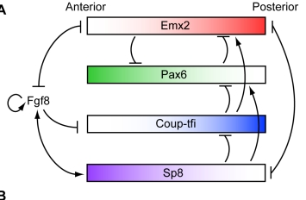
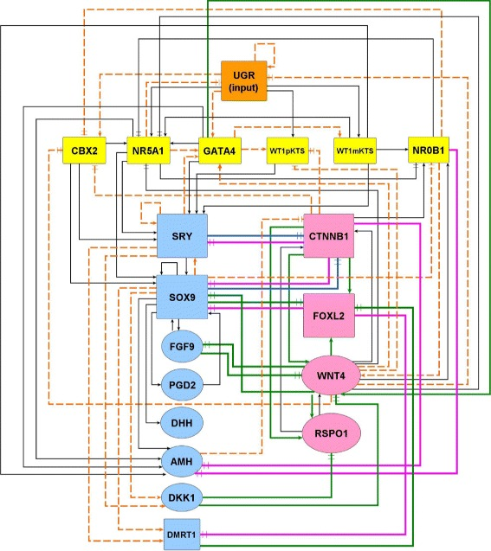
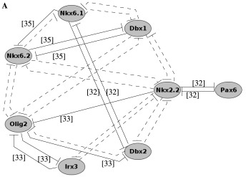

Input type 2:
Simulated datasets from curated models (Boolean)
Four published Boolean models:
Mammalian Cortical Area Development (mCAD)¹
Ventral Spinal Cord Development (VSC)²
Hematopoietic Stem Cell Differentiation (HSC)³
Gonadal Sex Determination (GSD)⁴
mCAD
GSD
HSC
VSC
Giacomantonio CE & Goodhill GJ A boolean model of the gene regulatory network underlying mammalian cortical area development. PLoS Comput. Biol. 6, e1000936 (2010).
Lovrics A et al. Boolean Modelling reveals new regulatory connections between transcription factors orchestrating the development of the ventral spinal cord. PLoS One 9, e111430 (2014).
Krumsiek J, Marr C, Schroeder T & Theis FJ Hierarchical Differentiation of Myeloid Progenitors Is Encoded in the Transcription Tactor Network. PLoS One 6, e22649 (2011).
Ríos O et al. A Boolean network model of human gonadal sex determination. Theor. Biol. Med. Model. 12, 26 (2015).

Slide 47
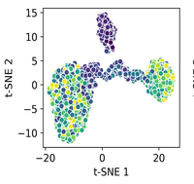
Input type 2:
Simulated datasets from curated models (Boolean)
mCAD
Visualizations of t-SNE from the BoolODE output
The color of each point indicates the corresponding simulation time.
mCAD
BoolODE
Giacomantonio CE & Goodhill GJ A boolean model of the gene regulatory network underlying mammalian cortical area development. PLoS Comput. Biol. 6, e1000936 (2010).
Lovrics A et al. Boolean Modelling reveals new regulatory connections between transcription factors orchestrating the development of the ventral spinal cord. PLoS One 9, e111430 (2014).
Krumsiek J, Marr C, Schroeder T & Theis FJ Hierarchical Differentiation of Myeloid Progenitors Is Encoded in the Transcription Tactor Network. PLoS One 6, e22649 (2011).
Ríos O et al. A Boolean network model of human gonadal sex determination. Theor. Biol. Med. Model. 12, 26 (2015).

Slide 48
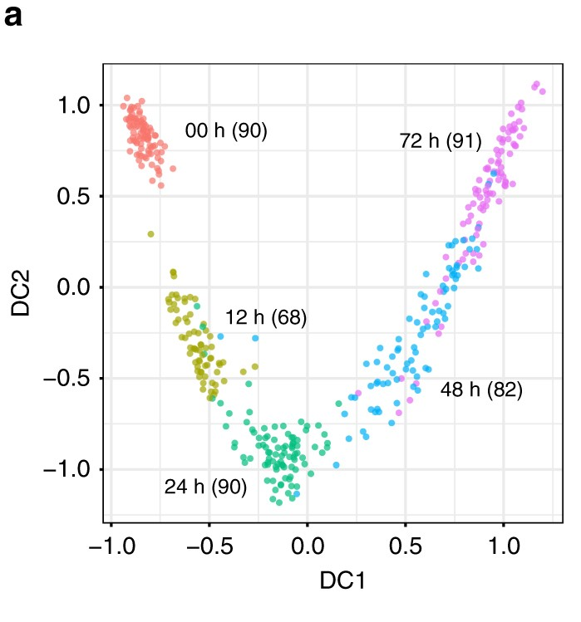
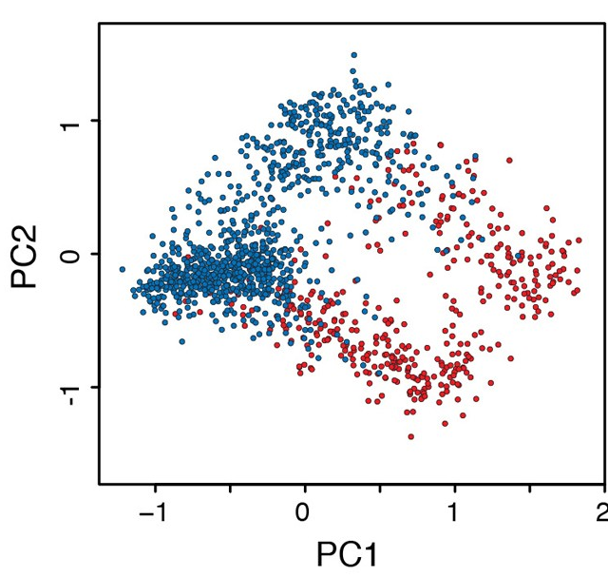
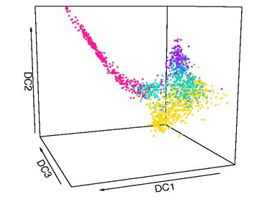
Input type 3:
Experimental scRNA-seq datasets (Mouse)
Embryonic stem cells
hematopoietic
stem cells
dendritic cells
Nestorowa, S. et al. A single-cell resolution map of mouse hematopoietic stem and progenitor cell differentiation. Blood 128, 20–31 (2016).
Hayashi, T. et al. Single-cell full-length total RNA sequencing uncovers dynamics of recursive splicing and enhancer RNAs. Nat. Commun. 9, 619 (2018).
Shalek, A. K. et al. Single-cell RNA-seq reveals dynamic paracrine control of cellular variation. Nature 510, 363–369 (2014).
Camp, J. G. et al. Multilineage communication regulates human liver bud development from pluripotency. Nature 546, 533–538 (2017).
Chu, L. F. et al. Single-cell RNA-seq reveals novel regulators of human embryonic stem cell differentiation to definitive endoderm. Genome Biol. 17, 173 (2016).

Slide 49
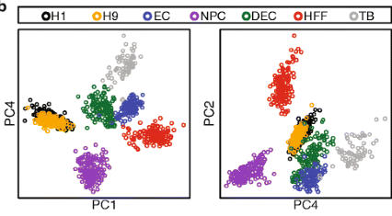
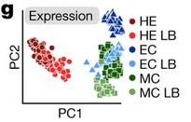
Input type 3:
Experimental scRNA-seq datasets (Human)
Embryonic stem cells
hepatocytes
Nestorowa, S. et al. A single-cell resolution map of mouse hematopoietic stem and progenitor cell differentiation. Blood 128, 20–31 (2016).
Hayashi, T. et al. Single-cell full-length total RNA sequencing uncovers dynamics of recursive splicing and enhancer RNAs. Nat. Commun. 9, 619 (2018).
Shalek, A. K. et al. Single-cell RNA-seq reveals dynamic paracrine control of cellular variation. Nature 510, 363–369 (2014).
Camp, J. G. et al. Multilineage communication regulates human liver bud development from pluripotency. Nature 546, 533–538 (2017).
Chu, L. F. et al. Single-cell RNA-seq reveals novel regulators of human embryonic stem cell differentiation to definitive endoderm. Genome Biol. 17, 173 (2016).

Slide 50
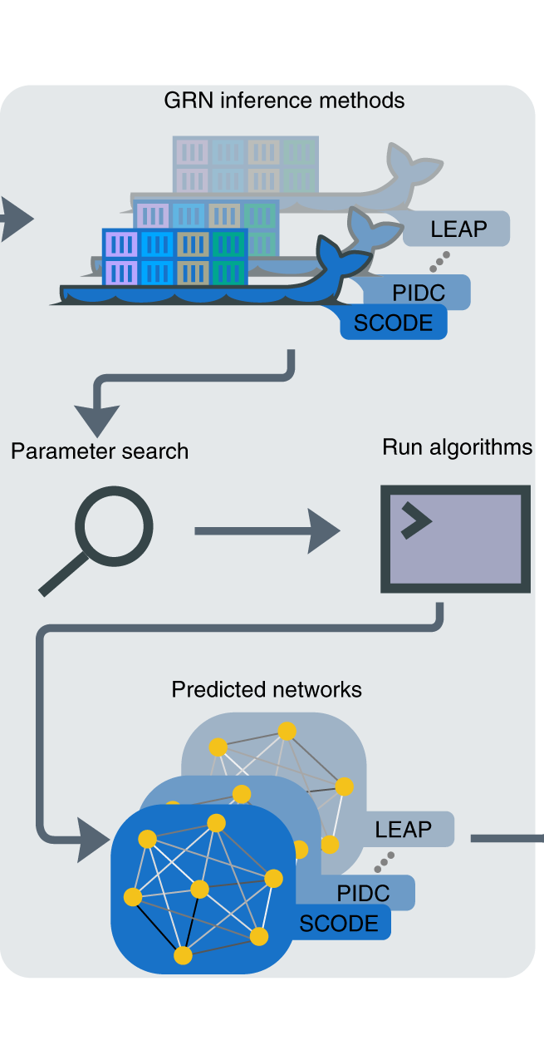
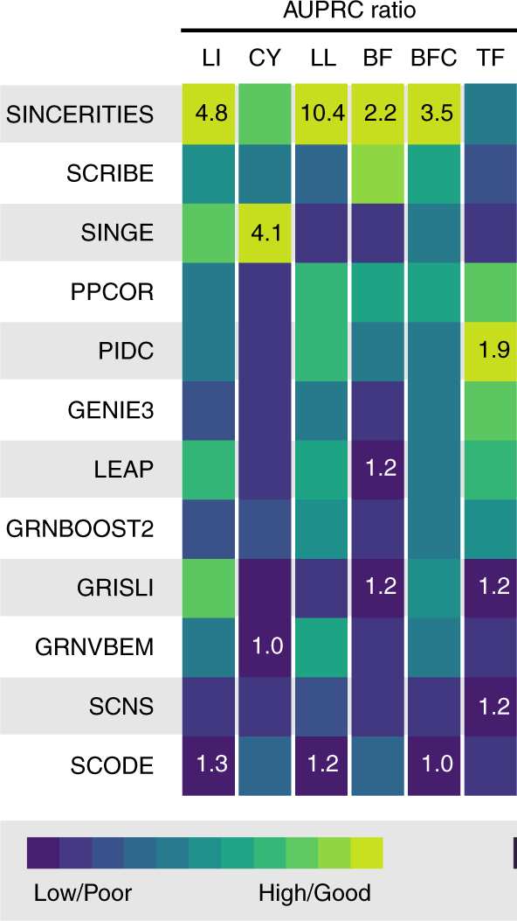
Run GRN inference algorithms
Incorporation of 12 diverse GRN inference algorithms
Synthetic network types
Pratapa A, Jalihal AP, Law JN, Bharadwaj A, Murali TM. Benchmarking algorithms for gene regulatory network inference from single-cell transcriptomic data. Nat Methods. 2020;17(2):147-154. doi:10.1038/s41592-019-0690-6

Slide 51
Evaluation
Accuracy (AUPRC and early precision)
Stability of results (across simulations, in the presence of dropouts and across algorithms)
Analysis of network motifs
Scalability
Pratapa A, Jalihal AP, Law JN, Bharadwaj A, Murali TM. Benchmarking algorithms for gene regulatory network inference from single-cell transcriptomic data. Nat Methods. 2020;17(2):147-154. doi:10.1038/s41592-019-0690-6

Slide 52

BEELINE summary
Pratapa A, Jalihal AP, Law JN, Bharadwaj A, Murali TM. Benchmarking algorithms for gene regulatory network inference from single-cell transcriptomic data. Nat Methods. 2020;17(2):147-154. doi:10.1038/s41592-019-0690-6

Slide 53

Network inference algorithms summary
Todorov H., Cannoodt R., Saelens W., Saeys Y. (2019) Network Inference from Single-Cell Transcriptomic Data. In: Sanguinetti G., Huynh-Thu V. (eds) Gene Regulatory Networks. Methods in Molecular Biology, vol 1883. Humana Press, New York, NY. https://doi.org/10.1007/978-1-4939-8882-2_10

Slide 54
Outline
scRNA-seq data analysis
  Cell type annotation
    SingleR
  Cell type markers identification
  Pseudo timing
    Monocle
  Cell-type gene regulatory networks
    SCENIC
    BEELINE
  Single cell deconvolution
    CIBERSORTx

Slide 55

Single cell deconvolution
Pros for Bulk-seq
Can assay entire sample at once
Can help identify transcription changes in individual cell types
Huge amount of data out there already
Cheap
Cons
Lose single cell information
Bulk
$200/sample (Novogene)
Single cell
$4000 ~ 10000/sample
How to computationally figure out what went into the mixture?
Bulk transcriptomic analyses lose single cell information
https://projects.iq.harvard.edu/files/chanbioinformatics/files/cell_type_deconvolution.pdf
ASHG 2019 scRNAseq HiPlex oral presentation https://www.youtube.com/watch?v=YlRemO_TE3Y
Single cell transcriptomic analyses retain single cell

Slide 56

Single cell deconvolution
Qualify cell types in mixture
Finotello, F. & Trajanoski, Z. Quantifying tumorinfiltrating immune cells from transcriptomics data. Cancer Immunol. Immunother. 67, 1031–1040 (2018).

Slide 57

CIBERSORTx cell-type identification by estimating relative subsets of RNA transcripts
Infer cell-type-specific gene expression profiles without physical cell isolation
Newman, A.M., Steen, C.B., Liu, C.L. et al. Determining cell type abundance and expression from bulk tissues with digital cytometry. Nat Biotechnol 37, 773–782 (2019). https://doi.org/10.1038/s41587-019-0114-2

Slide 58


CIBERSORTx cell-type identification by estimating relative subsets of RNA transcripts
Unknown fractions of each cell type in the mixture
mRNA mixture
Gene expression profiles signature matrix
$$m =f × B$$
Support vector regression
(SVR)
Newman, A.M., Steen, C.B., Liu, C.L. et al. Determining cell type abundance and expression from bulk tissues with digital cytometry. Nat Biotechnol 37, 773–782 (2019). https://doi.org/10.1038/s41587-019-0114-2

Slide 59

MuSiC
Multi-Subject Single Cell deconvolution
A method for characterizing the cell type composition of large amounts of RNA sequencing data in complex tissues using cell type-specific gene expression in single-cell RNA sequencing (RNA-seq) data
Wang, X., Park, J., Susztak, K. et al. Bulk tissue cell type deconvolution with multi-subject single-cell expression reference. Nat Commun 10, 380 (2019). https://doi.org/10.1038/s41467-018-08023-x

Slide 60

BSEQ-sc
Deconvolution of Bulk Sequencing Experiments using Single Cell Data
Leverage single-cell sequencing data to estimate cell type proportion and cell type-specific gene expression differences from RNA-seq data from bulk tissue samples
A single-cell transcriptomic map of the human and mouse pancreas reveals inter- and intra-cell population structure M. Baron, A. Veres, S.L. Wolock, A. L. Faust, R. Gaujoux, A. Vetere, J. Hyoje Ryu, B. K. Wagner, S. Shen-Orr, A. M. Klein, D. A. Melton, I. Yanai Cell Systems. 2016 Oct 26 10.1016/j.cels.2016.08.011

Slide 61
Single cell RNA-seq data for human brain
8 excitatory and 8 inhibitory adult neuronal subtypes (i.e., cell expression clusters)
Major adult non-neuronal types: astrocytes, endothelial, microglia, oligodendrocytes, and oligodendrocyte progenitor (OPC), pericyte
Developmental neuronal and non-neuronal types
Read-count based; e.g., Transcripts Per Kilobase Million (TPM)
Molecular-count based; e.g., Unique molecular identifiers (UMI)
~3000 cells (Lake et al., Science, 2016)
~10319 cells (Lake et al., Nature Biotech, 2018)
~400 cells (Darmanis et al., PNAS, 2015)
~ 900 cells (PsychENCODE)
~ 17,093 cells (PsychENCODE)
Wang, et al., Science, 2018

Slide 62
Single cell deconvolution
Step 1: unsupervised learning to see brain cell types
1866 individuals
25 top components
Non-negative matrix factorization (NMF)
1866 individuals
Unsupervised
decomposition
(NMF)
Bulk
expression
(B)
NMF
comp
(V)
NMF comp fractions
(H)
All genes (∼20K)
≈
All genes
25 top components
×
Single cell signatures
~14,000 cells (Lake et al., Science, 2016&2018)
~400 cells (Darmanis et al., PNAS, 2015)
~18,000 cells (PsychENCODE)
Wang, et al., Science, 2018

Slide 63
Single cell deconvolution
Step 2: supervised learning to estimate cell fractions
single cell expression for a gene
a cell type
a cell type fraction
Non-negative least square
Wang, et al., Science, 2018

Slide 64


Cell fractions explain cross-population variation in human brain
Individual and cross-population reconstruction accuracy via deconvolution
Comparison with existing methods
Experimental validation
Wang, et al., Science, 2018

Slide 65


Neuronal and glial cell fraction changes in gender and disorders
Excitatory to Inhibitory imbalance at neuronal subtype level for ASD*
Astrocyte and Microglia increase in ASD**
* Rubenstein et al., Model of autism: increased ratio of excitation/inhibition in key neural systems, Genes Brain Behav. 2003
** Gandal et al., Shared molecular neuropathology across major psychiatric disorders parallels polygenic overlap, Science 2018
Wang, et al., Science, 2018

Slide 66

Cell-type fraction changes in Age
Somatostatin (SST)
Astrocyte
Oligodendrocyte
Microglia
Wang, et al., Science, 2018

Slide 67

Cell-type fraction changes in human brain development
Li, …, Wang, ..., Sestan, Science, 2018

Slide 68
Resources
Tutorial
https://github.com/hbctraining/scRNA-seq
https://bioconductor.org/books/release/OSCA/
http://data-science-sequencing.github.io/
https://broadinstitute.github.io/2019_scWorkshop/
https://biocellgen-public.svi.edu.au/mig_2019_scrnaseq-workshop/public/index.html
Tools
https://github.com/seandavi/awesome-single-cell

