Slide 1
Advanced Bioinformatics
Biostatistics & Medical Informatics 776
Computer Sciences 776
Spring 2022
Daifeng Wang
daifeng.wang@wisc.edu
www.biostat.wisc.edu/bmi776/
These slides, excluding third-party material, are licensed under CC BY-NC 4.0 by Mark Craven, Colin Dewey, Anthony Gitter and Daifeng Wang

Slide 2
Agenda Today
Introductions
Course information
Overview of topics

Slide 3
Course Web Site
www.biostat.wisc.edu/bmi776/
Syllabus and policies
Readings
Tentative schedule
Lecture slides (draft posted before lecture)
Announcements
Homework
Project information
Link to Piazza discussion board

Slide 4
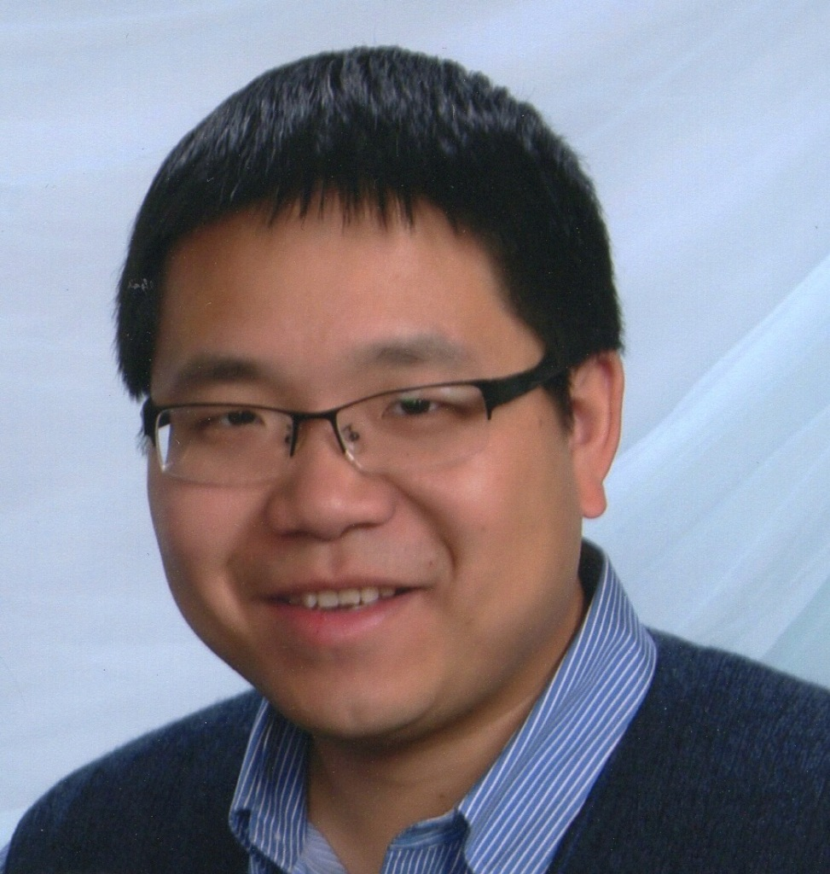
Your Instructor: Daifeng Wang
Email: daifeng.wang@wisc.edu
Website: https://daifengwanglab.org/
Office: Waisman Center 517
Class Location: 2534 Engineering Hall
Class Times: Tue/Thu 1:00 – 2:15 pm CST
Office for Office Hours: Medical Sciences Center 6740
Office Hours: Tues 2:30-3:30pm, Thus 2:30-3:30pm CST
Assistant Professor in the Department of Biostatistics & Medical Informatics and Investigator in Waisman Center
Research interests: interpretable machine learning, network biology, functional genomics, comparative genomics, brain diseases, precision medicine

Slide 5
My research in Waisman Center
Mission of Waisman Center
  Advance knowledge about human development, developmental disabilities, and neurodegenerative diseases
Goal of my research
https://www.waisman.wisc.edu/2020/01/07/new-researcher-uses-machine-learning-to-decode-genomic-information/

Slide 6
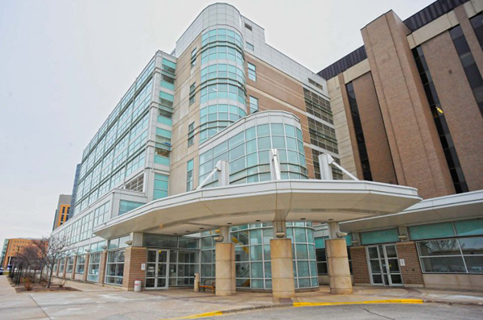
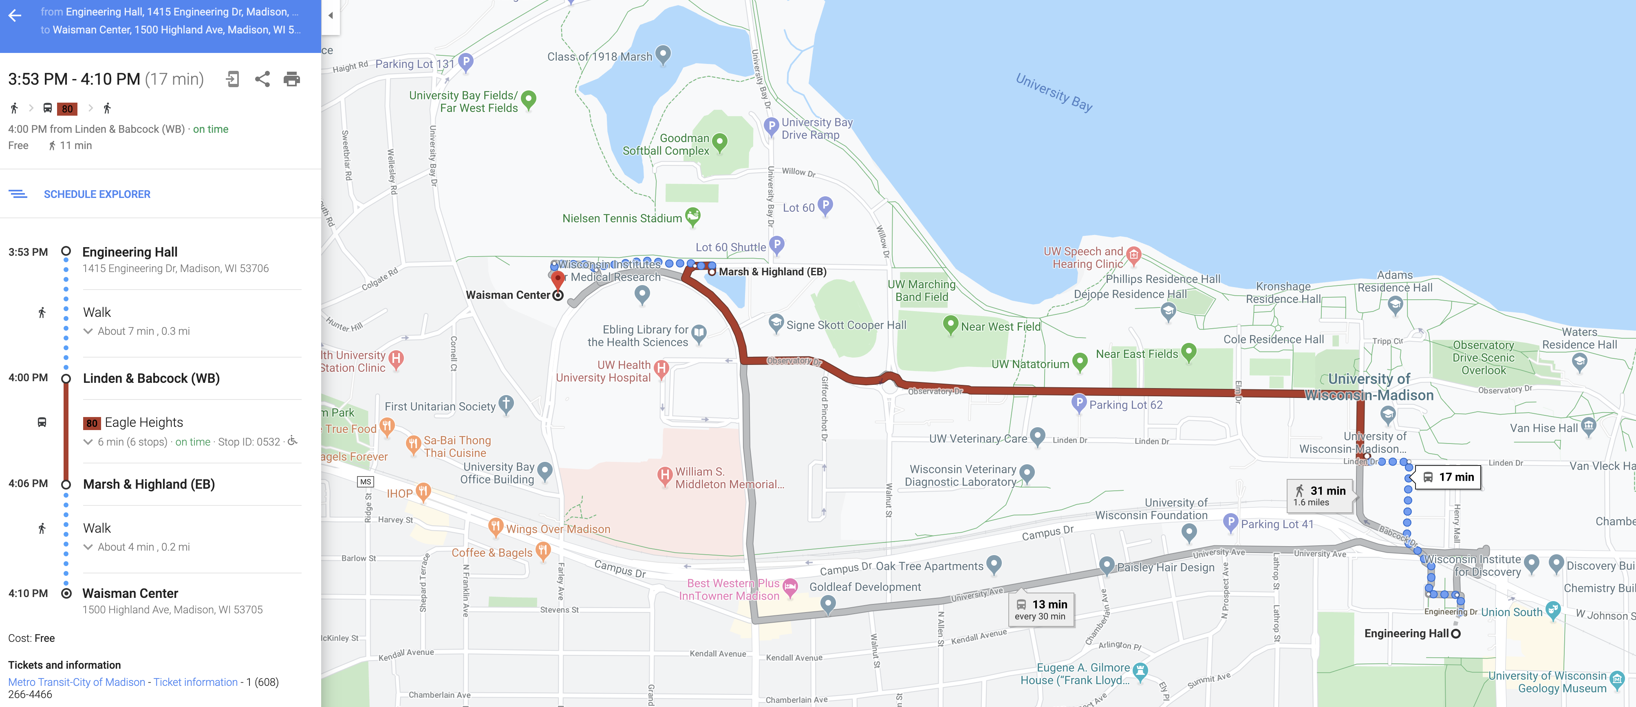
Finding My Office:
517 Waisman Center
Far away, most west building
Take No. 80 Bus or Bike/Walk for exercise

Slide 7
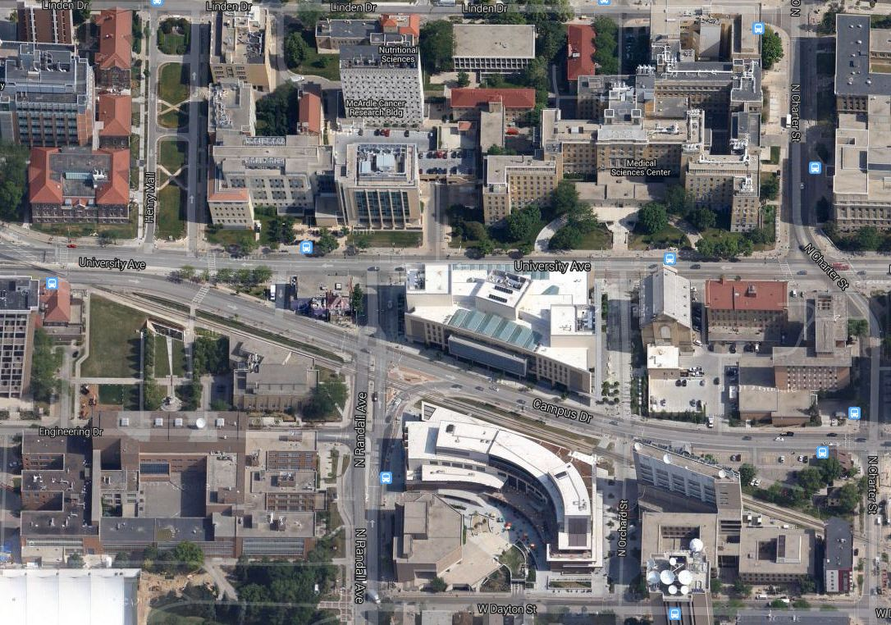
Finding the Office for in-person Office Hours:
MSC 6740
Office for Office Hours
Genetics-
Biotechnology
Center
MSC
Engineering Hall
Computer Sciences
very confusing building
best bet: use 420 North Charter St entrance

Slide 8
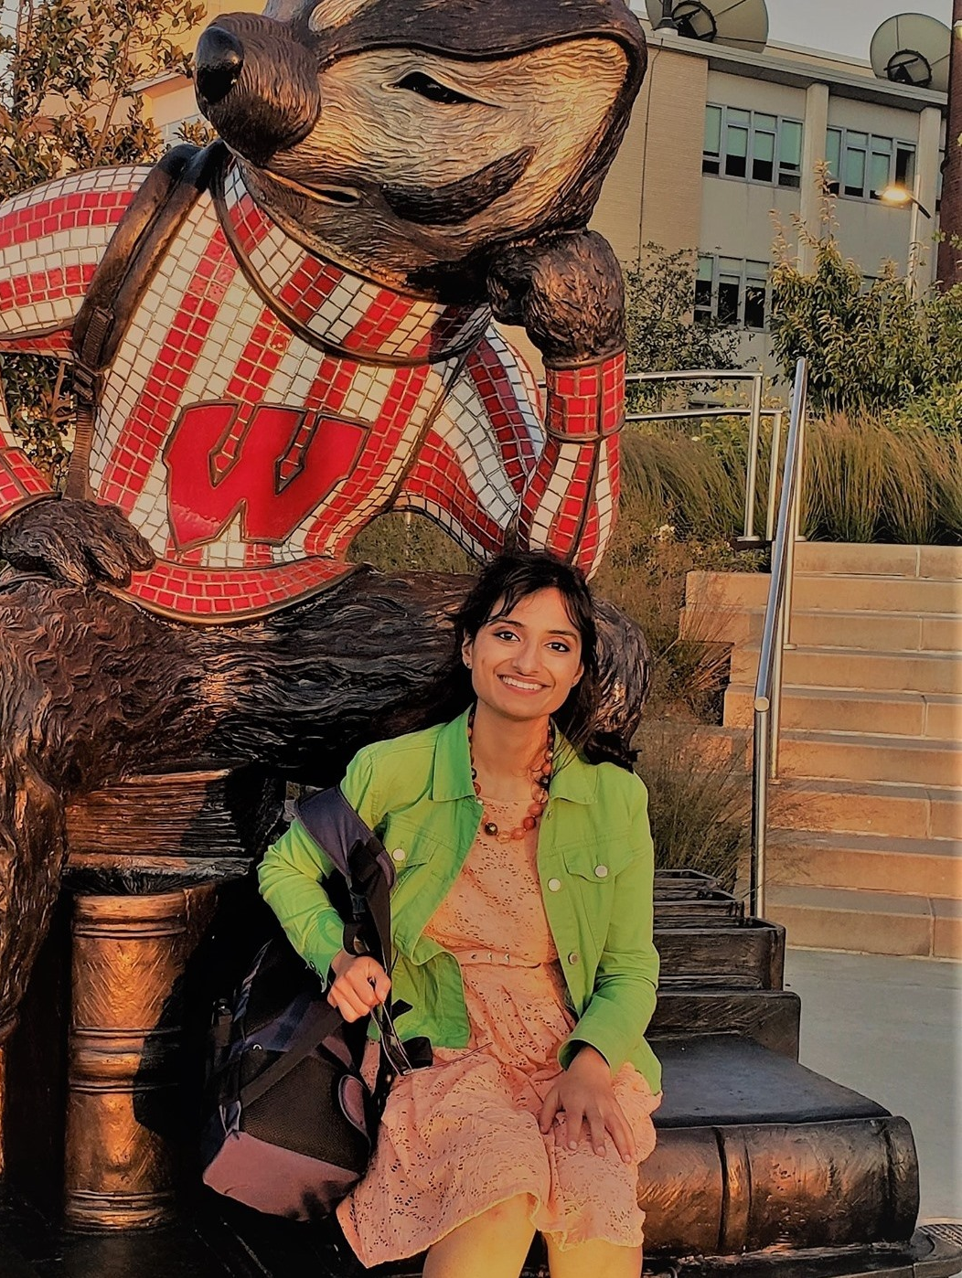

Course TA:
Saniya Khullar
  Email: skhullar2@wisc.edu
  Skype: saniya0605
  Office Hours (1 virtual, 1 in-person Office Hour):
    Virtual: Fridays 9 am to 10 am CST (https://zoom.us/j/2593679726)
    In-person: Mondays 9 a.m. to 10 a.m. CST in Waisman 520
    Available by appointment as well
  Ph.D. candidate
    Biomedical Data Science
  Educational YouTube channel (with content related to Advanced Bioinformatics and Beyond): https://www.youtube.com/c/SaniyaKhullar

Slide 9
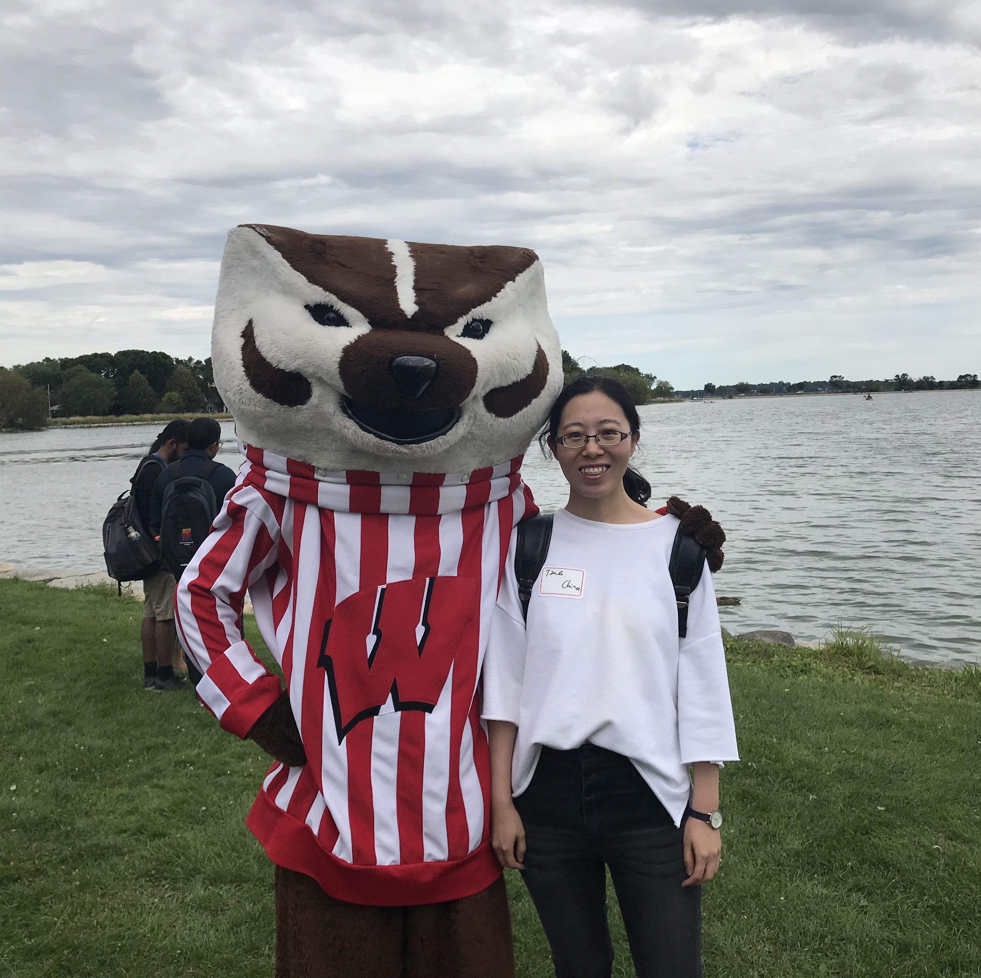
Course TA:
Ting Jin
  Email: tjin27@wisc.edu
  Ph.D. student
    Biomedical Data Science
  Office Hours (Virtual)
    Friday: 10 – 11am (Zoom)
  Grading student assignments and providing feedback
Our Course TAs are here to help support you!
Please do reach out with any questions!

Slide 10
Office Hours
Tue 2:30-3:30pm, Thu 2:30-3:30pm
  MSC 6740
Will begin next week
Free to schedule an individual meeting
  Waisman Center or Zoom
You are encouraged to visit our office hours!
Notes:
Stay tuned for email re: doodle poll

Slide 11
You
So that we can all get to know each other better, please tell us your (by email)
  name
  major or graduate program
  research interests and/or topics you’re especially interested in learning about
  favorite programming language

Slide 12
Course Requirements
4 homework assignments: ~40%
  Written exercises
  Programming (Python)
  Computational experiments (e.g. measure the effect of varying parameter x in algorithm y)
  Five late days permitted
Project: ~25%
Midterm: ~15%
Final exam: ~15%
Class participation: ~5%

Slide 13
Exams
Midterm: Thursday, March 10, in class
Final: Monday May 8, 10:05 AM – 12:05 PM
Let me know immediately if you have a conflict with either of these exam times

Slide 14
Computing Resources for the Class
Linux servers in Dept. of Biostatistics & Medical Informatics
  No “lab”, must log in remotely (use WiscVPN)
  Will create accounts for everyone on course roster
  Two machines
    mi1.biostat.wisc.edu
    mi2.biostat.wisc.edu
  HW0 tests your access to these machines
  Homework must be able to run on these machines
Resources:
  TA Saniya prepared a video on working on a remote server (pushing, pulling, running files remotely to Biostat servers, WiscVPN): Video Link along with other helpful videos on Servers
  CS department usually offers Unix orientation sessions at beginning of semester

Slide 15
Programming Assignments
All programming assignments require Python
  Project can be in any language
Have a Python 3 environment on biostat servers
  Permitted packages on course website
  Can request others
HW0 will be Python introduction
Use Piazza for Python discussion
  If you know Python, please help answer questions

Slide 16
Project
Design and implement a new computational method for a task in molecular biology
Improve an existing method
Perform an evaluation of several existing methods
Run on real biological data
Suggestions will be provided
Not simply your existing research
Can email me now to discuss ideas

Slide 17
Participation
Do the assigned readings before class
Show up to class
No one will have the perfect background
  Ask questions about computational or biological concepts
Correct me when I am wrong
  Seriously, it will happen
Piazza discussion board
  Questions and answers

Slide 18
Piazza Discussion Board
Instead of a mailing list
https://piazza.com/wisc/spring2022/bmics776
Post your questions to Piazza instead of emailing the instructor or TA
  Unless it is a private issue or project-related
Answer your classmates’ questions
Announcements will also be posted to Piazza
Supplementary material for lecture topics

Slide 19
Course Readings
Mostly articles from the primary literature
Must be using a campus IP address to download some of the articles (can use WiscVPN from off campus)

Slide 20
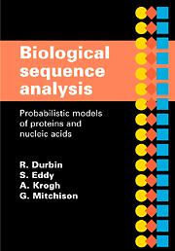
Recommended textbook
Biological Sequence Analysis: Probabilistic Models of Proteins and Nucleic Acids. R. Durbin, S. Eddy, A. Krogh, and G. Mitchison. Cambridge University Press, 1998.

Slide 21
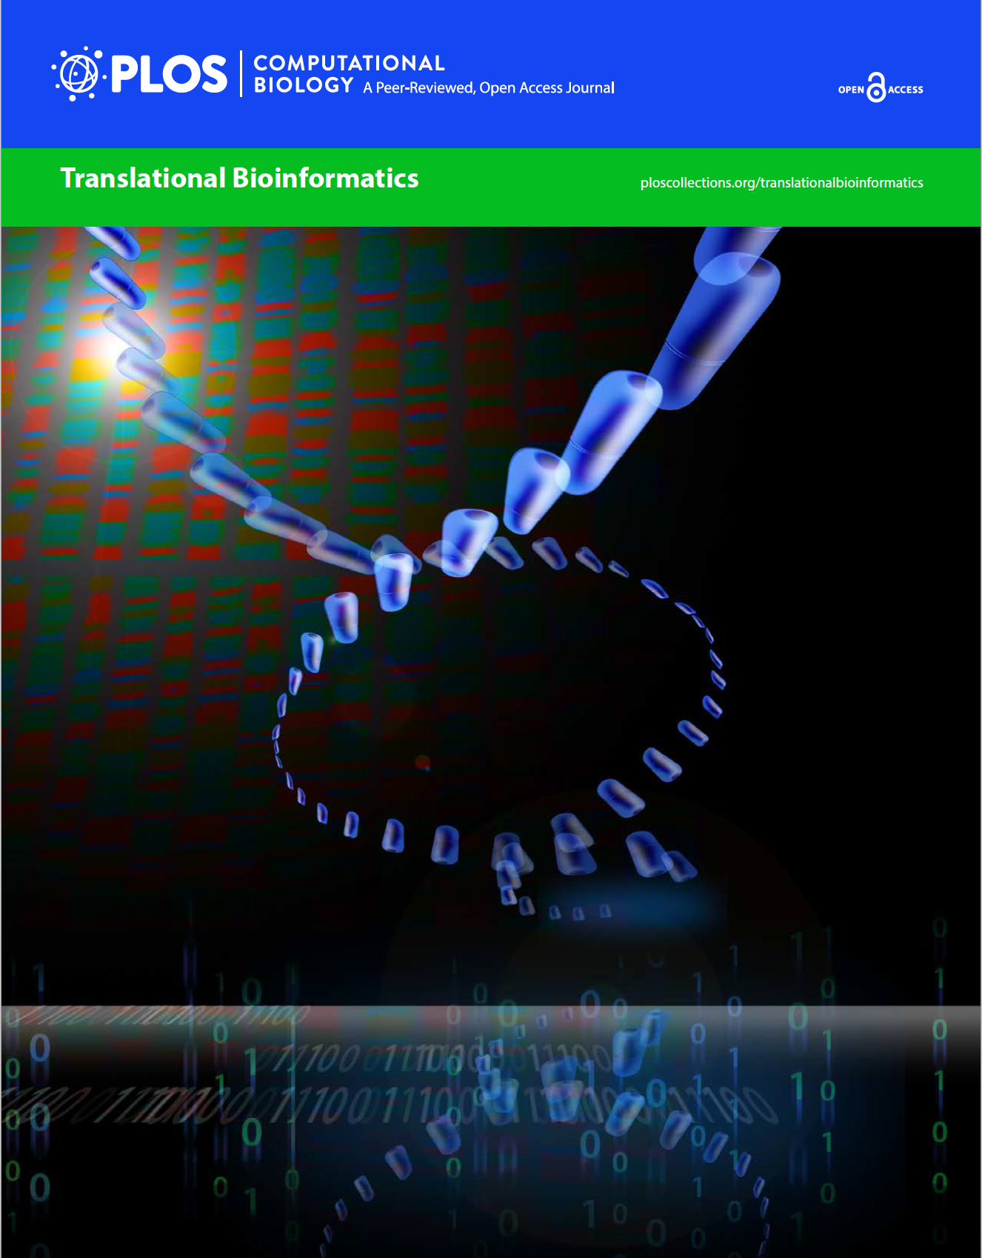
Recommended online reading
Translational Bioinformatics
  https://collections.plos.org/translational-bioinformatics
Notes:
The field that focuses on design and implementation of computational methods on big data to discovery clinically relevant pattern and translation of that pattern into a clinical solution.
What is big data for translation?
Genome, Transcriptome, Proteome, Metabalome, Interactome, Microbiome, Phenome, Envirome.
What can we do?
Diagnose, Predict outcomes, Design Therapies

Slide 22
Python references
https://docs.python.org
If you want a book:
  Python 3 for programmers
Many other good books and online resources
https://www.manning.com/books/the-quick-python-book-third-edition

Slide 23
Prerequisites
BMI/CS 576 or equivalent
Knowledge of basic biology and methods from that course will be assumed
May want to go over the material on the 576 website to refresh
http://www.biostat.wisc.edu/bmi576/

Slide 24
What you should get out of this course
An understanding of some of the major problems in computational biology and bioinformatics
Familiarity with the techniques for addressing these problems
  Computational, statistical, machine learning
How to think about different data types
At the end you should be able to
  Read the bioinformatics literature
  Apply the methods you have learned to other problems both within and outside of bioinformatics
  Write a short bioinformatics research paper

Slide 25
Major Topics to be Covered
(the algorithms perspective)
Expectation Maximization
Gibbs sampling
Mutual information
Network flow algorithms
Multiple hypothesis testing correction
Deep learning (e.g., Convolutional neural networks)
Linear programming
Clustering
More machine learning approaches (e.g., manifold alignment)

Slide 26
Major Topics to be Covered
(the task perspective)
Modeling of motifs and cis-regulatory modules
Identification of transcription factor binding sites
Transcriptome quantification
Transcriptome assembly
Regulatory information in epigenomic data
Genotype analysis and association studies
Quantitative Trait Locus (QTL) Analysis
Pathways in cellular networks
Single cell RNA-seq
Gene regulatory network

Slide 27
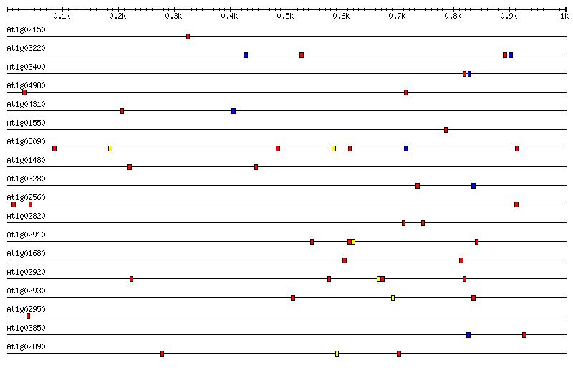
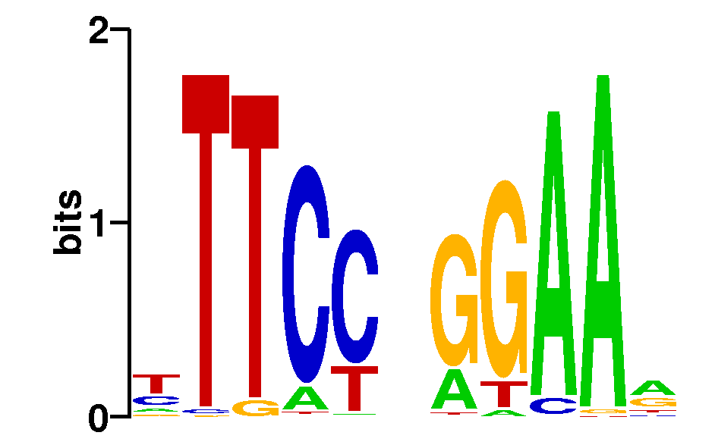
Motif Modeling
What sequence motif do these promoter regions have in common?

Slide 28
cis-Regulatory Modules
What configuration of sequence motifs do these promoter regions have in common?
RNAP
…accgcgctgaaaaaattttccgatgagtttagaagagtcaccaaaaaattttcatacagcctactggtgttctctgtgtgtgctaccactggctgtcatcatggttgta…
…caaaattattcaagaaaaaaagaaatgttacaatgaatgcaaaagatgggcgatgagataaaagcgagagataaaaatttttgagcttaaatgatctggcatgagcagt…
…gagctggaaaaaaaaaaaatttcaaaagaaaacgcgatgagcatactaatgctaaaaatttttgaggtataaagtaacgaattggggaaaggccatcaatatgaagtcg…
RNAP
RNAP

Slide 29
Transcriptome Analysis with RNA-Seq
What genes are expressed and at what levels?

Slide 30
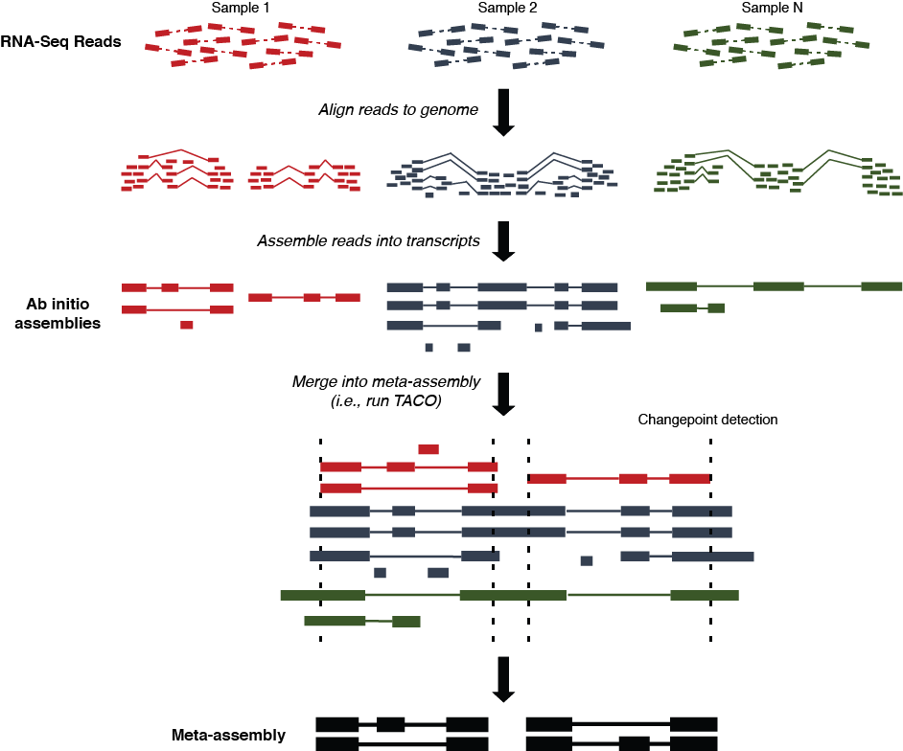
Transcriptome assembly
https://tacorna.github.io/

Slide 31
RNA Sequence and Structure Modeling
How can we identify sequences that encode this RNA structure?

Slide 32
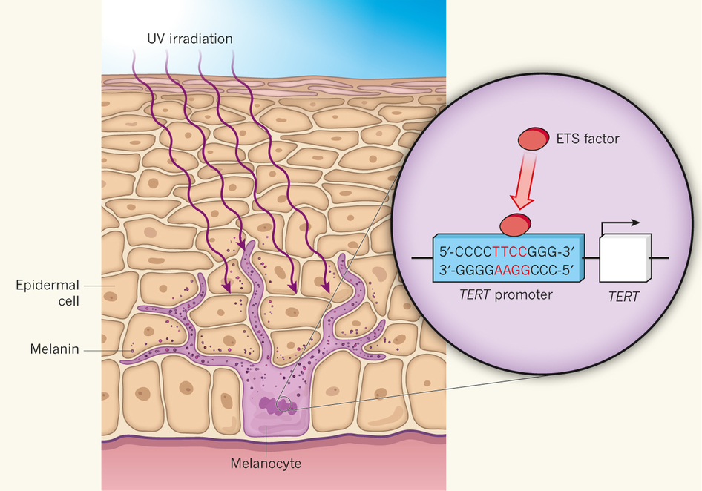
Noncoding Genetic Variants
How do genetic variants outside protein coding regions impact phenotypes?
Patton and Harrington, Nature, 2013

Slide 33
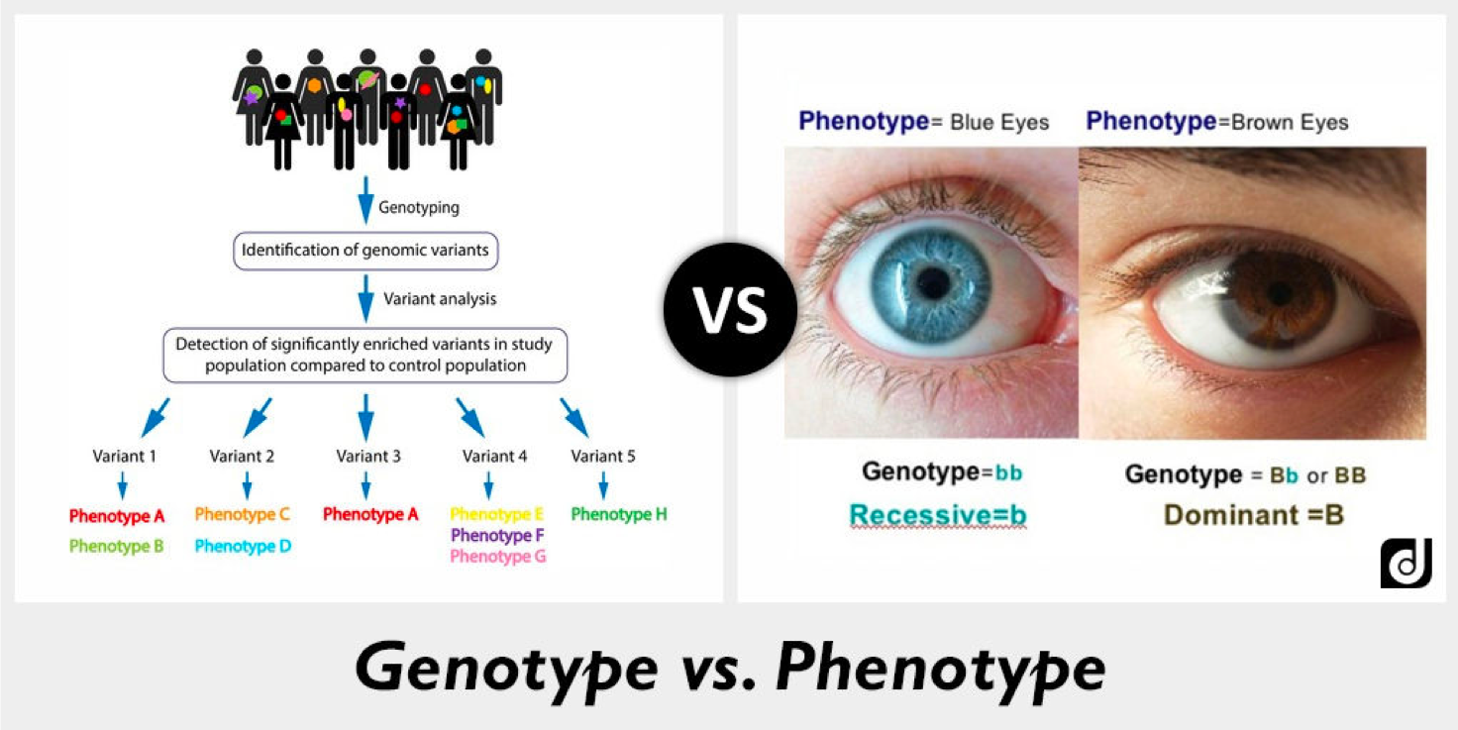
Genotype to Phenotype

Slide 34
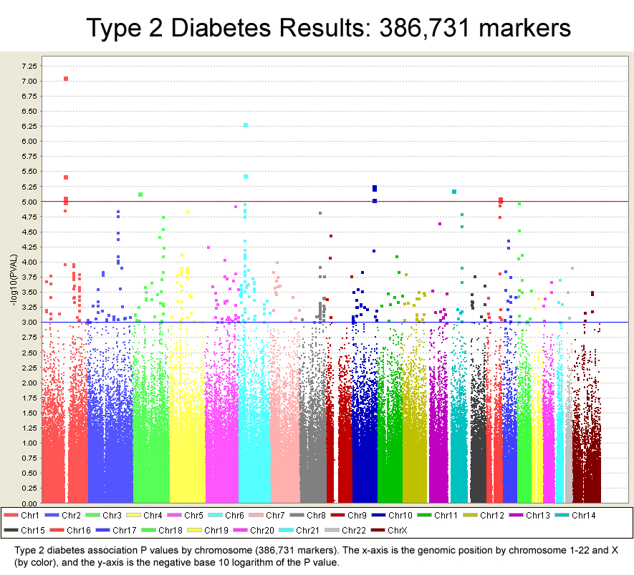
Genome-wide Association Studies
Which genes are involved in diabetes?

Slide 35
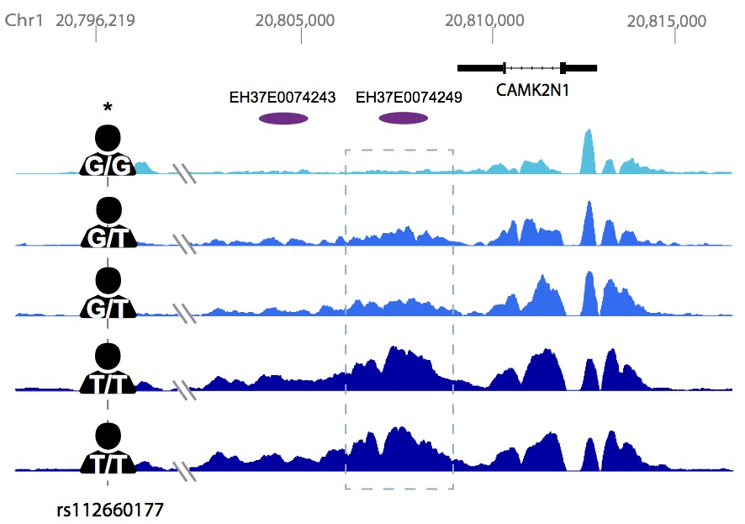
Quantitative Trait Locus (QTL) analysis

Slide 36
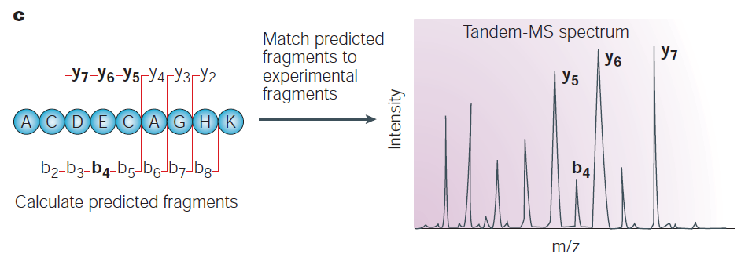
Proteomic Analysis with Mass Spectrometry
What proteins are expressed and at what levels?
Steen and Mann, Nature Reviews Molecular Cell Biology, 2004

Slide 37
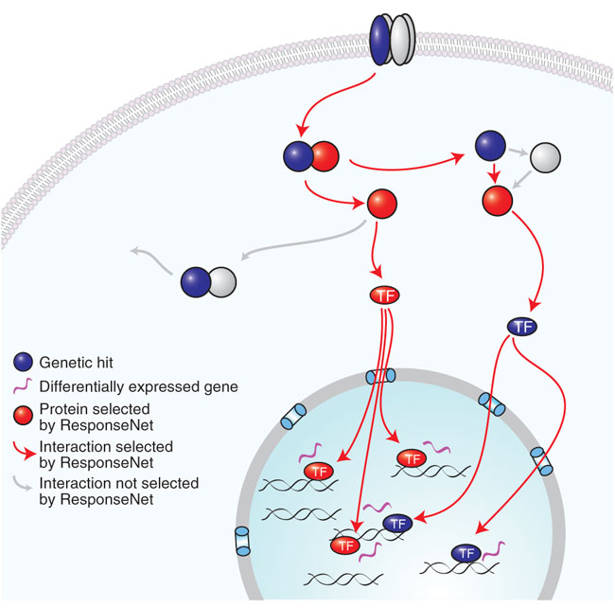
Identifying Signaling Pathways
How do proteins coordinate to transmit information?
Yeger-Lotem et al., Nature Genetics, 2009

Slide 38
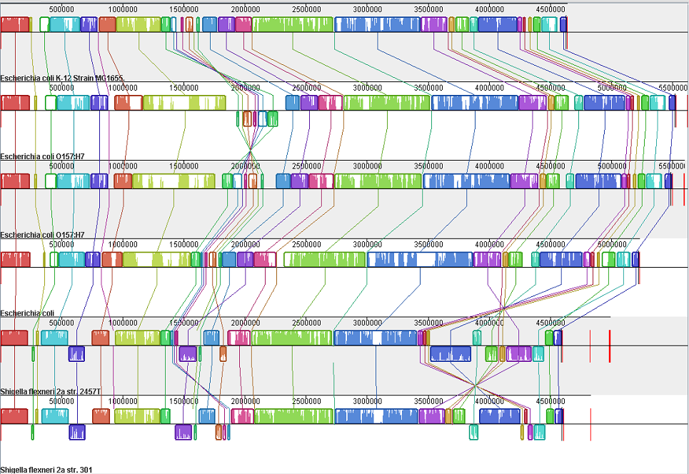
Large Scale Sequence Alignment
What is the best alignment of these 6 genomes?

Slide 39
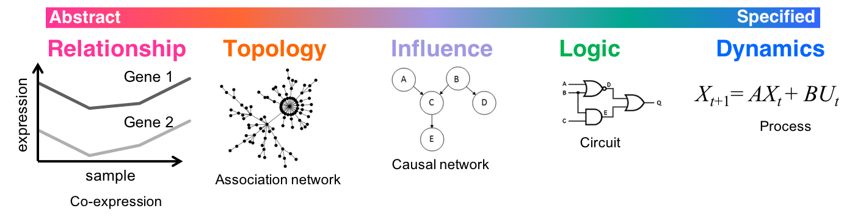
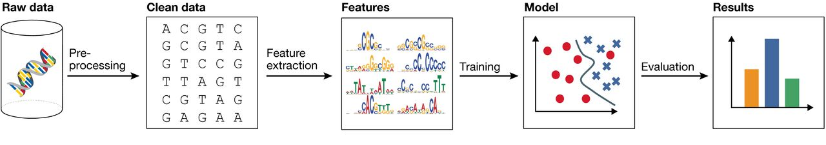
Machine learning and integrative analysis
Phenotype
BPD
AGE
…
Higher-order groupings
(e.g., pathways, circuits)
Inspired from Ideker & Lauffenburger, Trends in Biotechnology, 2003
Biological Interpretation
Interactions between elements (e.g., co-expression, regulation)
Cell types
Modules
Integrative & Predictive model (e.g., deep neural network)
Regulatory elements
Genes
Genomic elements (e.g., GWAS, differentially expressed genes)
Genotype
Christof Angermueller et al. Mol Syst Biol 2016;12:878
Notes:
Gene regulatory mechanisms to be robust biomarkers, rather than individual genomic variants
synthetic biology
genome engineering
circuit design
control theory
epigenetic drugs

Slide 40
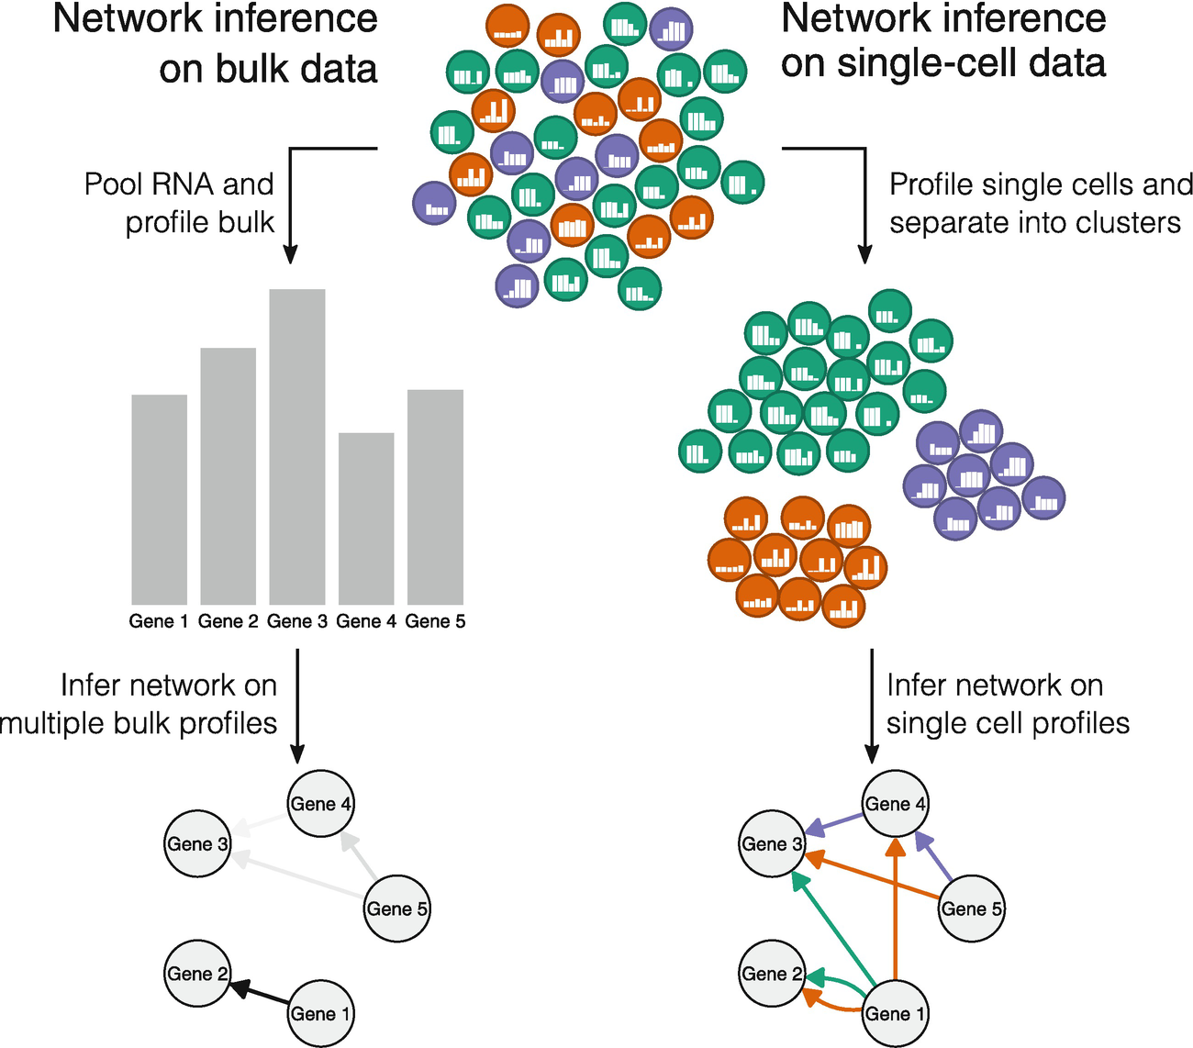
Cell-type gene regulatory networks
(NI)
Cell-type-specific GRNs would be key tools for the study of cellular heterogeneity
Cell-type-specific GRNs will reveal key regulatory factors and circuits for specific cell types, facilitating mapping between disease-associated variants and affected cell types
Todorov H., Cannoodt R., Saelens W., Saeys Y. (2019) Network Inference from Single-Cell Transcriptomic Data. In: Sanguinetti G., Huynh-Thu V. (eds) Gene Regulatory Networks. Methods in Molecular Biology, vol 1883. Humana Press, New York, NY. https://doi.org/10.1007/978-1-4939-8882-2_10

Slide 41
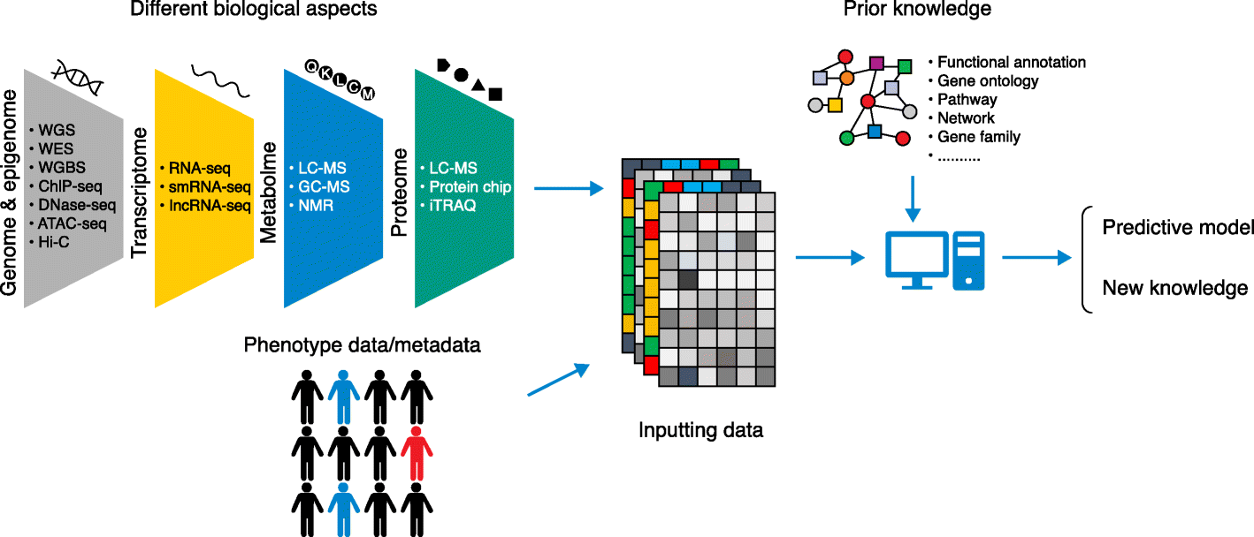





Machine Learning for Multiomics
Regularization
$$Ω(⋅)$$
$$X^{(1)}…X^{\left(n\right)}$$
$$f^{∗}(⋅)$$
$$Y$$
Machine learning
algorithm
$$\min_{f}{ℓ\left(f\right)+Ω(f)}$$
Interpretability
Xu. Genome Bio. 2019

Slide 42
Other Topics
Many topics we aren’t covering
  Protein structure prediction
  Protein function annotation
  Metagenomics
  Metabolomics
  Graph genomes
  Mass Spectrometry
  Text mining
  Others?

Slide 43
Reading Groups
Computational Systems Biology Reading Group
  http://lists.discovery.wisc.edu/mailman/listinfo/compsysbiojc
AI Reading Group
  http://lists.cs.wisc.edu/mailman/listinfo/airg
ComBEE Python Study Group
  https://combee-uw-madison.github.io/studyGroup/
Many relevant seminars on campus

