Slide 1
Introduction to Epigenetics
BMI/CS 776
www.biostat.wisc.edu/bmi776/
Spring 2022
Daifeng Wang
daifeng.wang@wisc.edu
These slides, excluding third-party material, are licensed under CC BY-NC 4.0 by Anthony Gitter, Mark Craven, Colin Dewey and Daifeng Wang

Slide 2
Goals for lecture
Key concepts
Importance of epigenetic data for understanding transcriptional regulation
Use of epigenetic data for predicting transcription factor binding sites

Slide 3

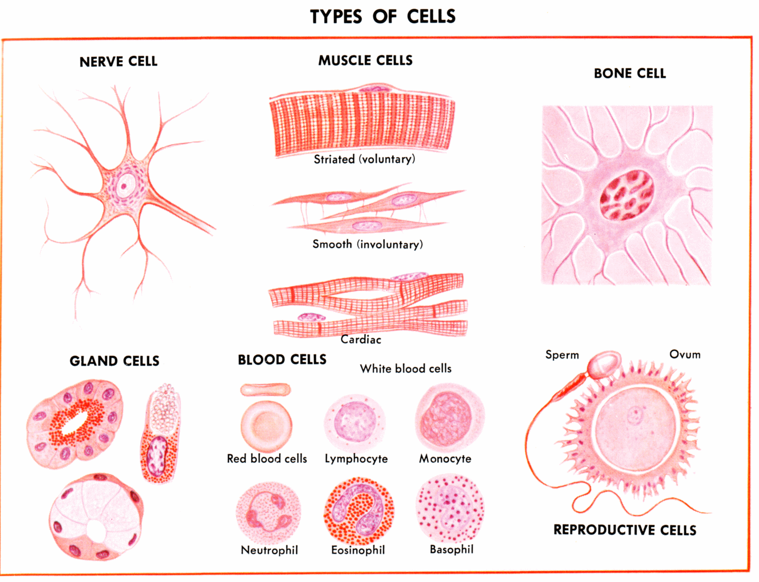
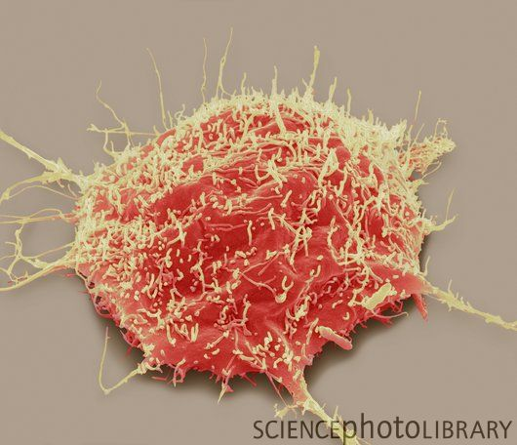
Gene expression and regulation
Identical DNA but different gene expression
Protein
Central dogma
translation
RNA
transcription
Gene
DNA
Gene expression levels (e.g., values to quantify RNA abundances)
nerve
skin
disease
Cell type
Gene regulation: which & how genes express?

Slide 4
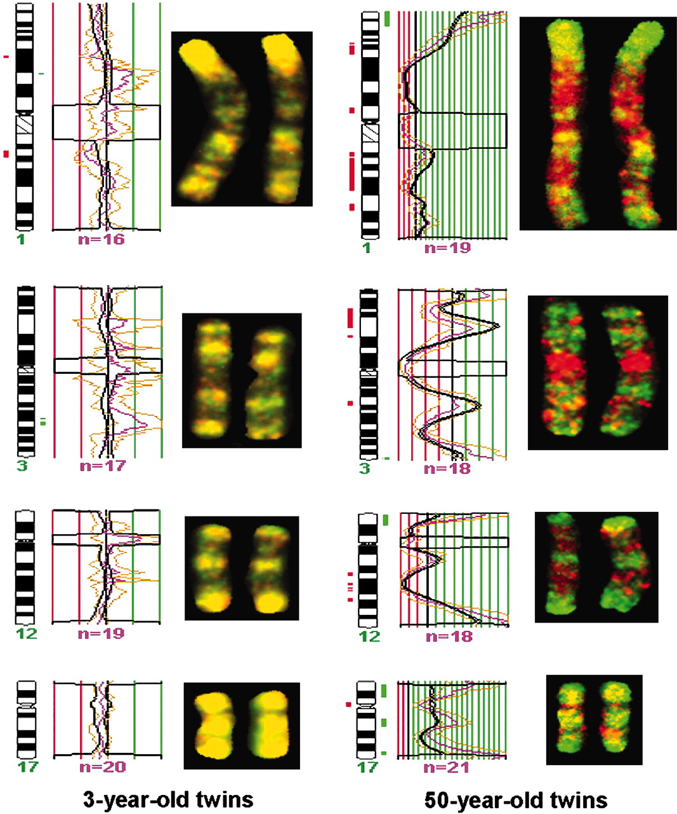
Identical DNAs but identical fates?
DNA methylation
Chromosomes
PNAS July 26, 2005 102 (30) 10604-10609; https://doi.org/10.1073/pnas.0500398102

Slide 5
Defining epigenetics
Formally: attributes that are “in addition to” genetic sequence or sequence modifications
  “Epigenetic code” (vs. genetic code)
Informally: experiments that reveal the context of DNA sequence
  DNA has multiple states and modifications
G A C T A G T G C G T T A C T
vs.
modification
inaccessible
A
G T G C G T T A C T
T
C
Histones
A
G

Slide 6
Chromatin packages DNA around Histones
(pack six feet of DNA into a cell)
NGHRI genetics glossary
Nature volume 489, pages52–54(2012)

Slide 7
Importance of epigenetics
Better understand
DNA binding and transcriptional regulation
Differences between cell and tissue types
Development and other important processes

Slide 8
PWMs are not enough
Genome-wide motif scanning is imprecise
Transcription factors (TFs) bind < 5% of their motif matches
Same motif matches in all cells and conditions

Slide 9
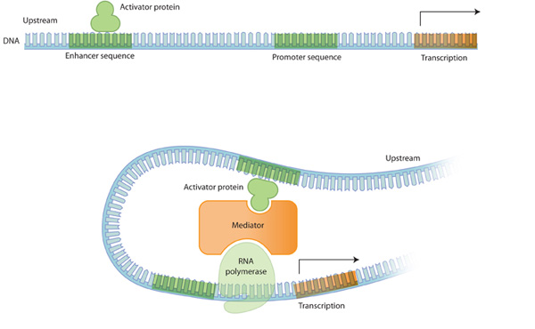
PWMs are not enough
DNA looping can bring distant binding sites close to transcription start sites
Which genes does an enhancer regulate?
Promoter: DNA binding site for TFs, close to gene
transcription start site
Enhancer: DNA binding site for TFs, can be far from affected gene
Nature Education 2010

Slide 10
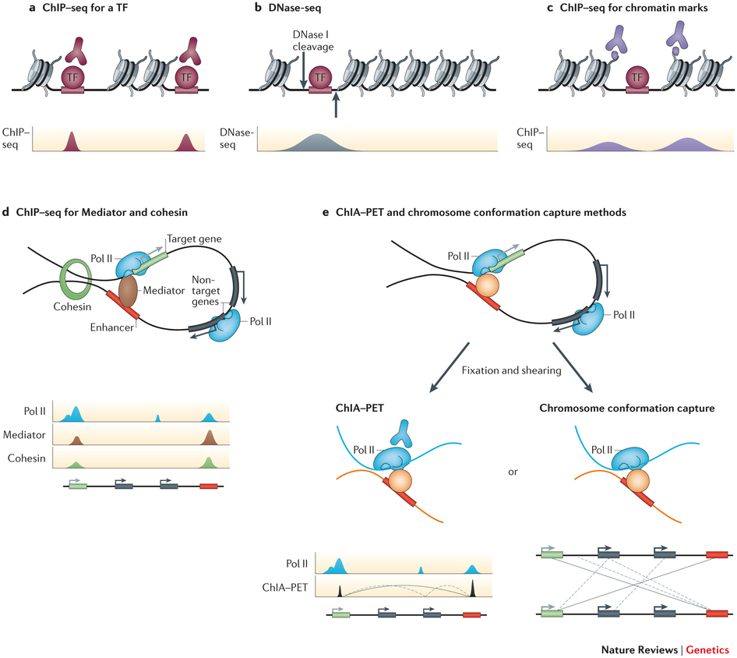
Mapping regulatory elements genome-wide
Can do much better than motif scanning with additional data
ChIP-seq measures binding sites for one TF at a time
Shlyueva Nature Reviews Genetics 2014
Epigenetic data suggests where some TF binds
Notes:
Search running cars, find roads first

Slide 11
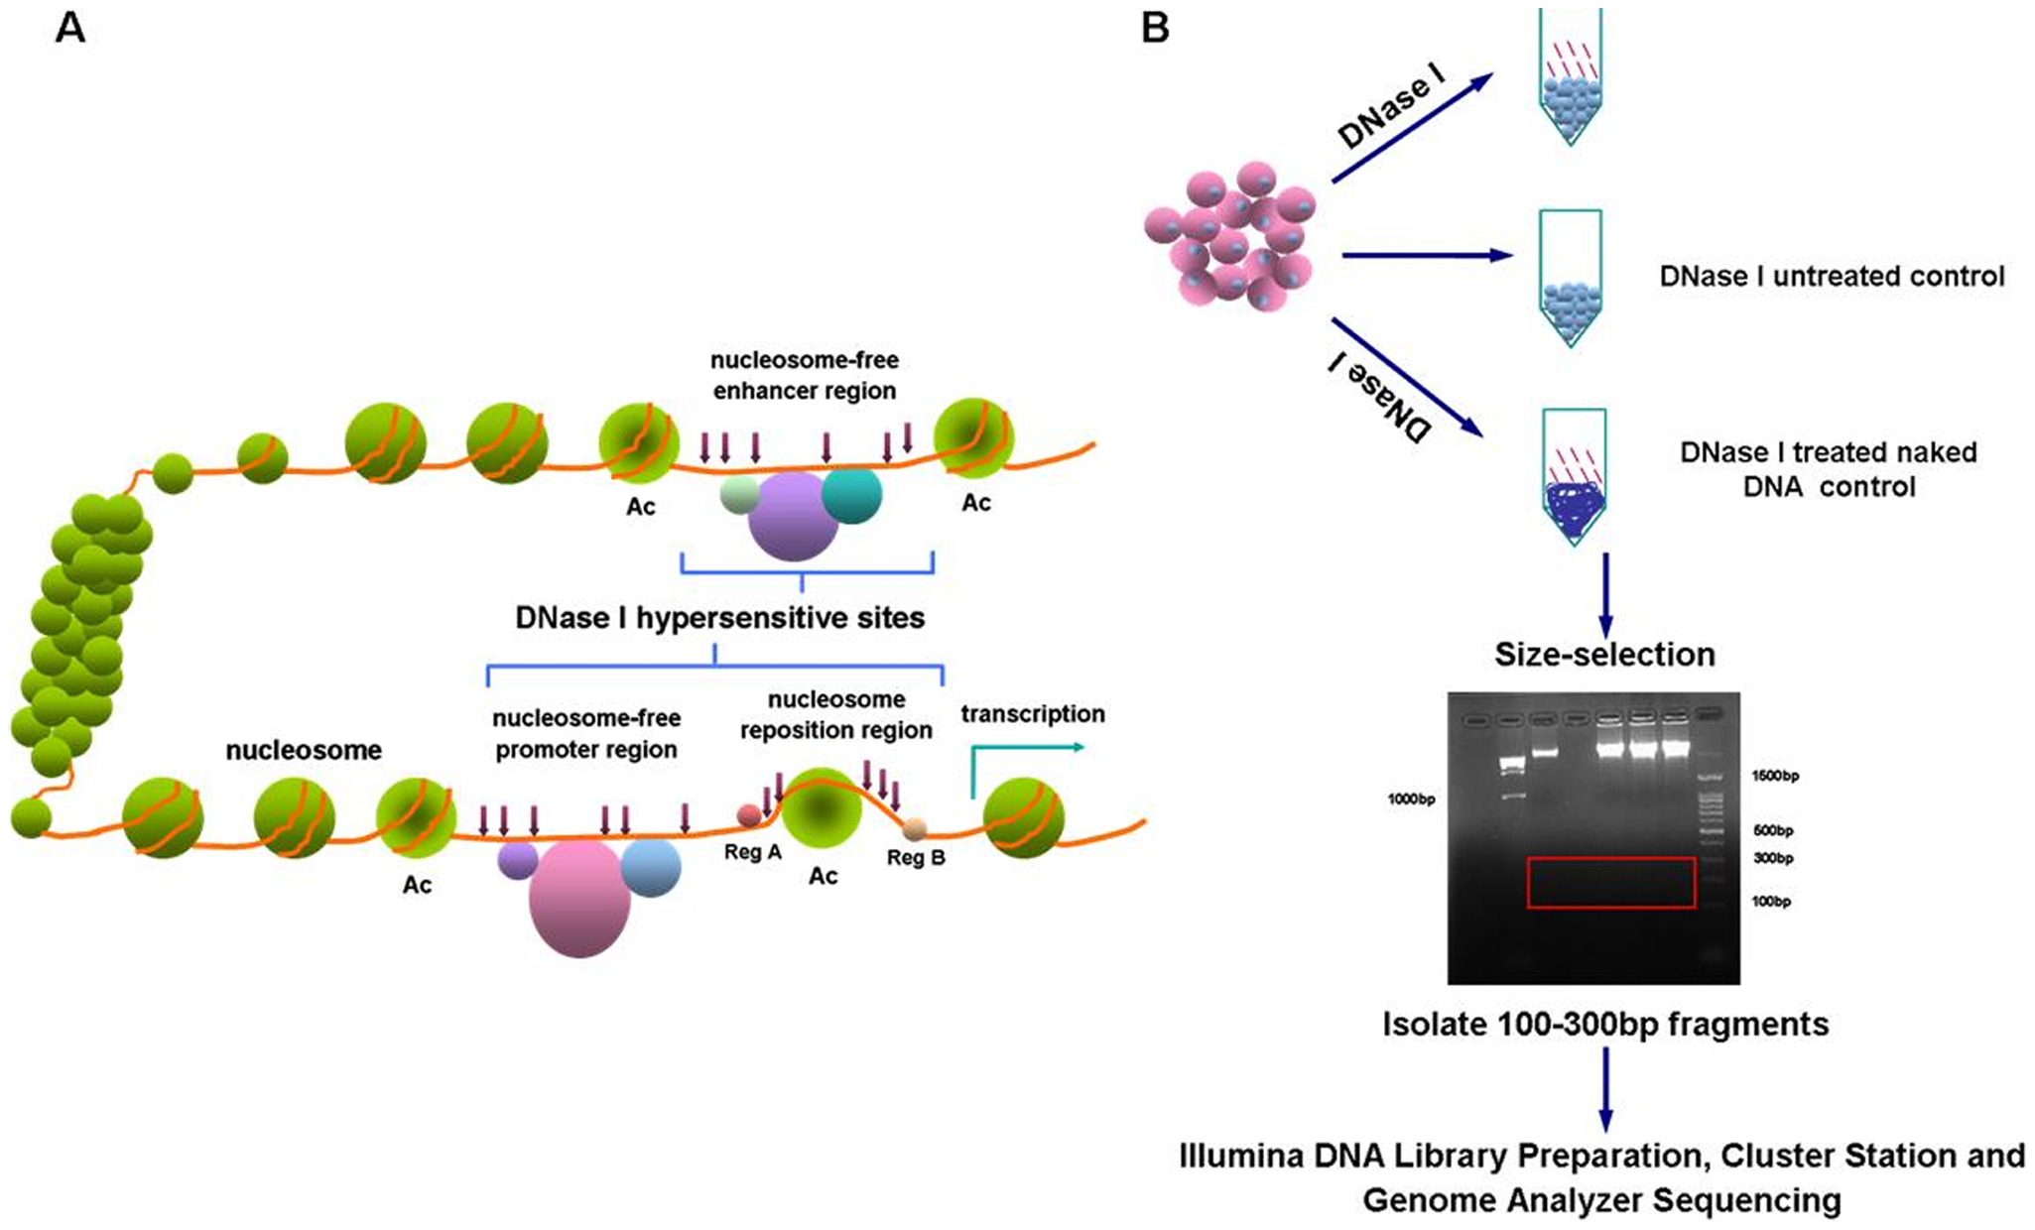
DNase I hypersensitivity
Regulatory proteins bind accessible DNA
DNase I enzyme cuts open chromatin regions that are not protected by nucleosomes
Nucleosome: DNA wrapped around histone proteins
Wang PLoS ONE 2012

Slide 12
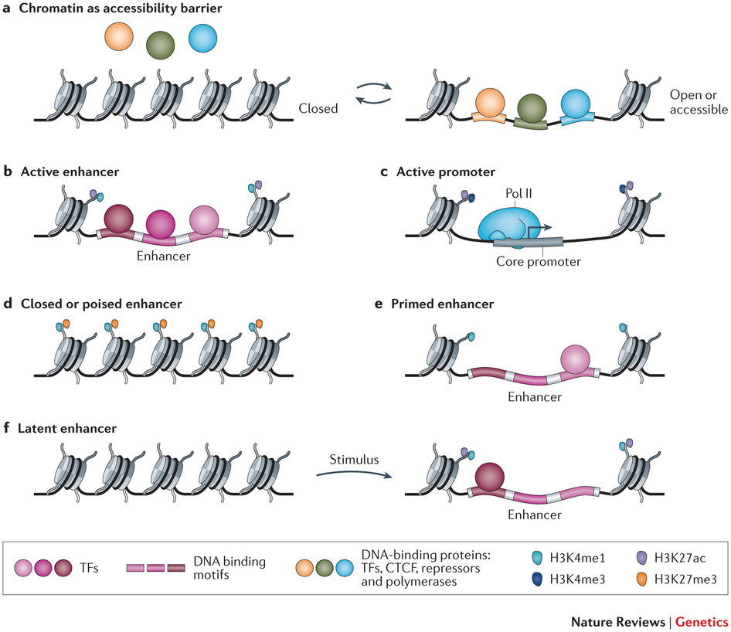
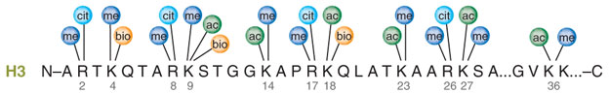
Histone modifications
Mark particular regulatory configurations
H3 (protein) K27 (amino acid) ac (modification)
Two copies of histone proteins H2A, H2B, H3, H4
Shlyueva Nature Reviews Genetics 2014
Me, methylation;
Ac, acetylation;
Cit, citrullination;
Latham Nature Structural & Molecular Biology 2007; Katie Ris-Vicari

Slide 13
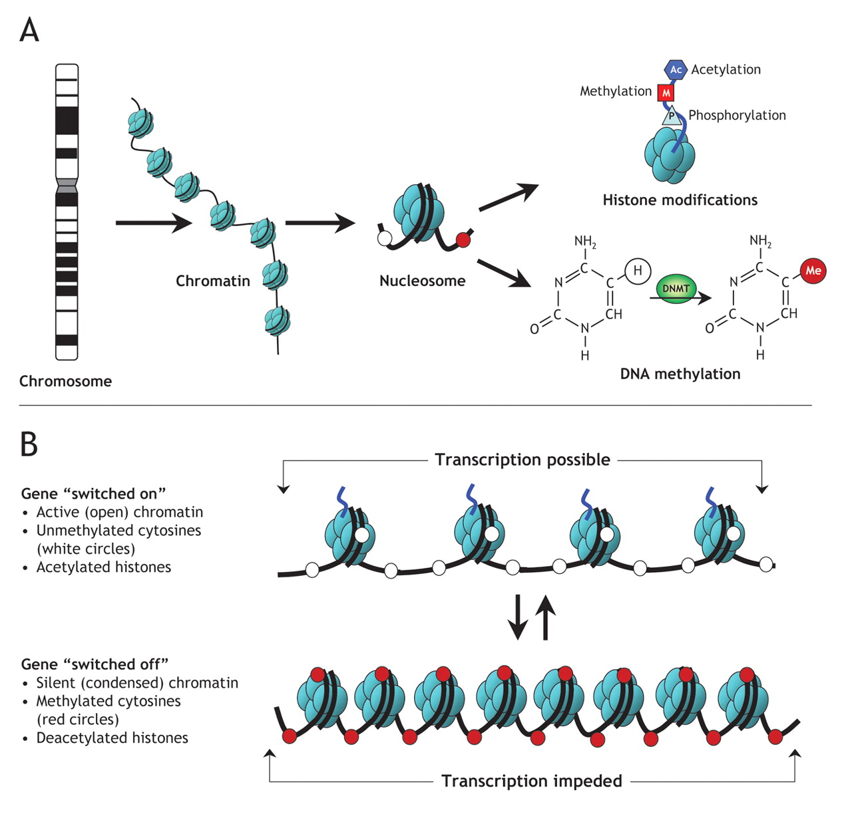
DNA methylation
Reversible DNA modification
Represses gene expression
DNA methyl transferases (DNMTs)
OpenStax CNX

Slide 14
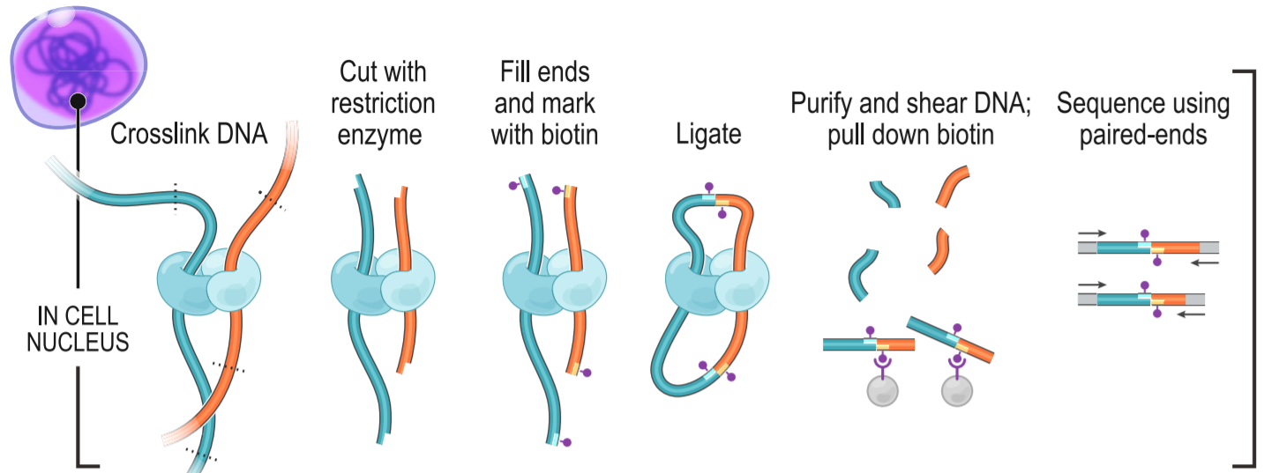
3D organization of chromatin
YouTube: The 3D Organization of Our Genome
Algorithms to predict long range enhancer-promoter interactions
Or measure with chromosome conformation capture (3C, Hi-C, etc.)
Rao Cell 2014

Slide 15
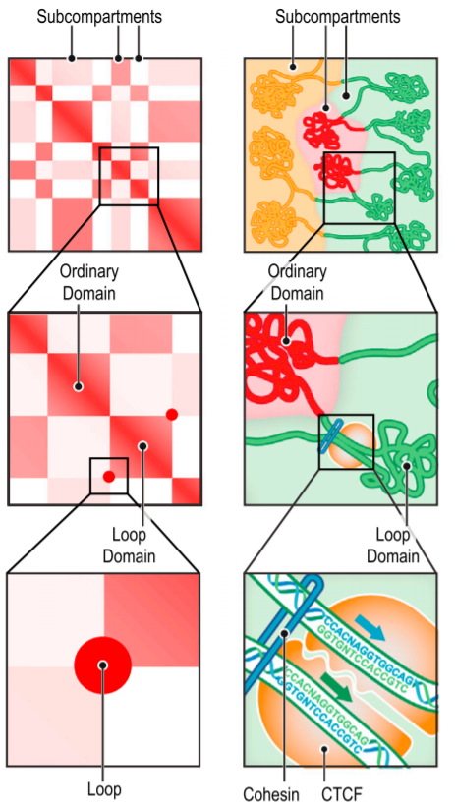
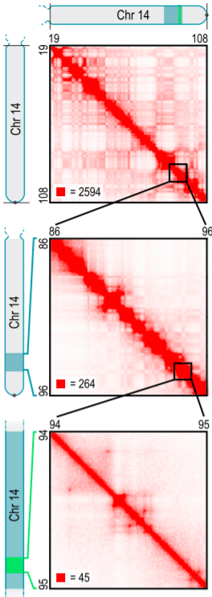
3D organization of chromatin
Hi-C produces 2D chromatin contact maps
Learn domains, enhancer-promoter interactions
500 kb
50 kb
5 kb
Rao Cell 2014

Slide 16
Next Generation Sequencing (NGS) for epigenomics

Slide 17
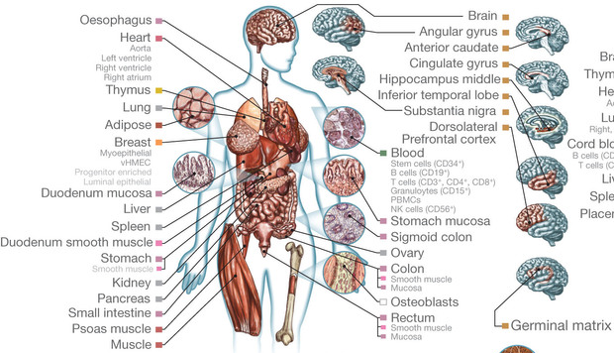
Large-scale epigenetic maps
Epigenomes are condition-specific
Roadmap Epigenomics Consortium and ENCODE surveyed over 100 types of cells and tissues
Roadmap Epigenomics Consortium Nature 2015

Slide 18
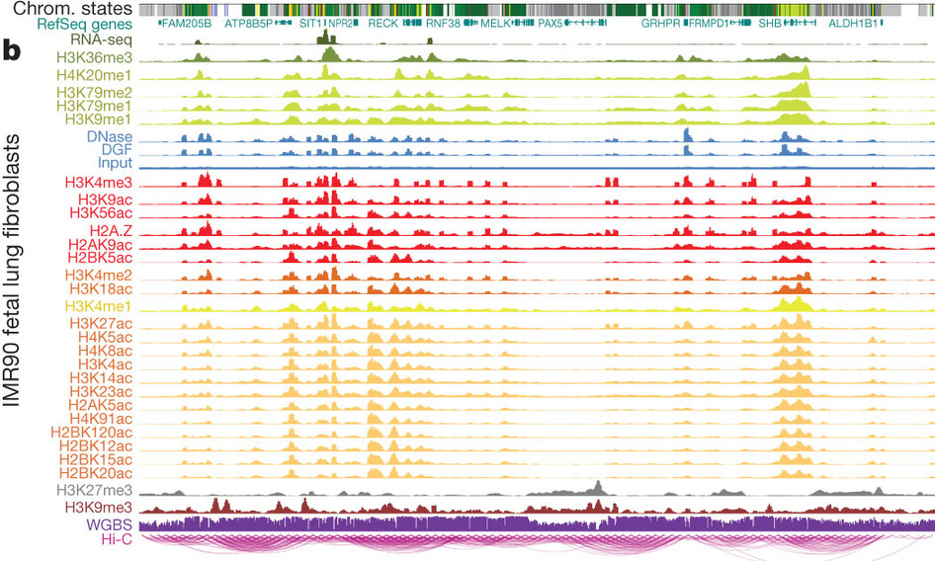
Genome annotation
Combinations of epigenetic signals can predict functional state
  ChromHMM: Hidden Markov Model
  Segway: Dynamic Bayesian network
Roadmap Epigenomics Consortium Nature 2015

Slide 19
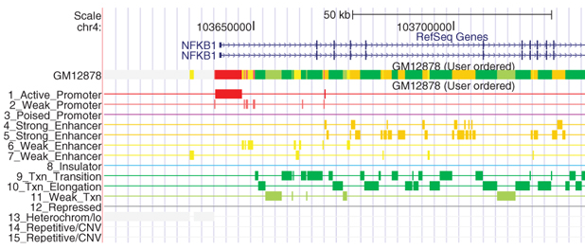
Genome annotation
States are more interpretable than raw data
Ernst and Kellis Nature Methods 2012

Slide 20
Predicting TF binding with DNase-Seq

Slide 21
DNase I hypersensitive sites
Arrows indicate DNase I cleavage sites
Obtain short reads that we map to the genome
Wang PLoS ONE 2012

Slide 22
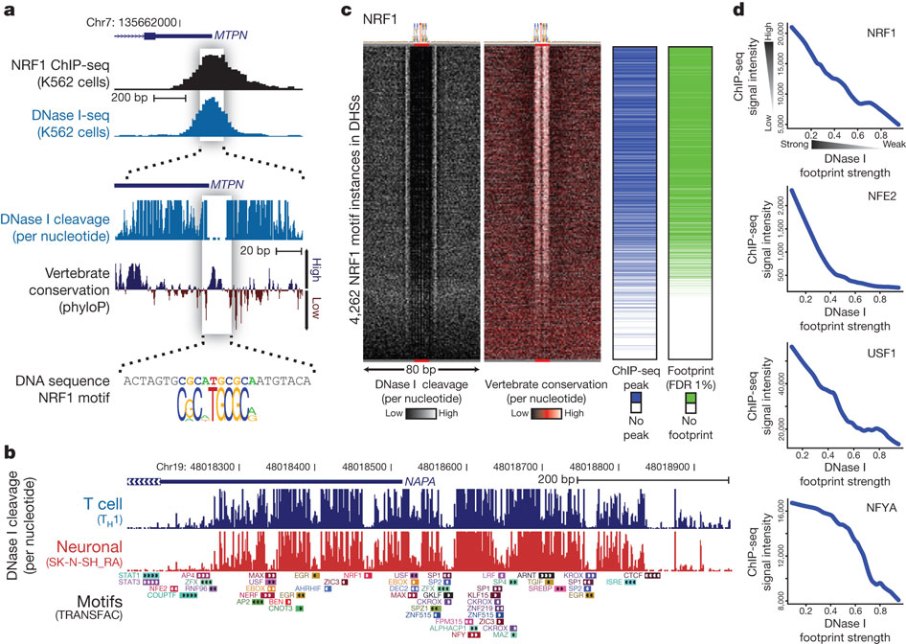
DNase I footprints
Distribution of mapped reads is informative of open chromatin and specific TF binding sites
ChIP-Seq peak
I
Read depth at each position
Nucleosome free “open” chromatin
Zoom in
TF binding prevents DNase cleavage leaving Dnase I “footprint”, only consider 5′ end
Neph Nature 2012

Slide 23
DNase I footprints to TF binding predictions
DNase footprints suggest that some TF binds that location
We want to know which TF binds that location
Two ideas:
  Search for DNase footprint patterns, then match TF motifs
  Search for motif matches in genome, then model proximal DNase-Seq reads
We’ll consider this approach

