Slide 1
Linking Genetic Variation to Phenotypes
BMI/CS 776
www.biostat.wisc.edu/bmi776/
Spring 2022
Daifeng Wang
daifeng.wang@wisc.edu
These slides, excluding third-party material, are licensed under CC BY-NC 4.0 by Mark Craven, Colin Dewey, Anthony Gitter and Daifeng Wang

Slide 2
Outline
How does the genome vary between individuals?
How do we identify associations between genetic variations and simple phenotypes/diseases?
How do we identify associations between genetic variations and complex phenotypes/diseases?

Slide 3


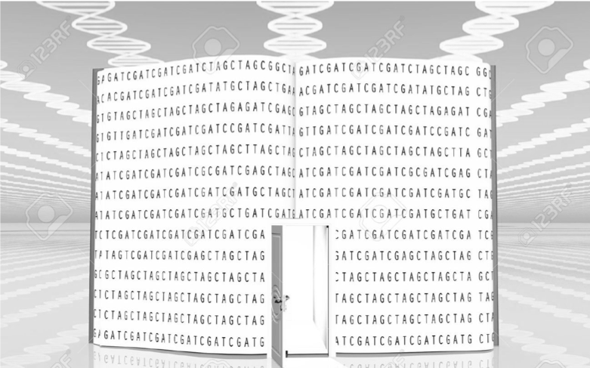
How to read sentences/genes for understanding book/genome?
Book | Genome
Chapters | Chromosomes
Sentences | Genes
Words | Elements
Letters | Bases
“On most days, I enter the Capitol through the basement. A small subway train carries me from the Hart Building, where …”
Key words
Non-key words
Coding elements (Exon, 2%)
  Become proteins carrying out functions
Non-coding elements (98%)
Gene 1
Gene 2
https://goo.gl/images/vMaz4T

Slide 4
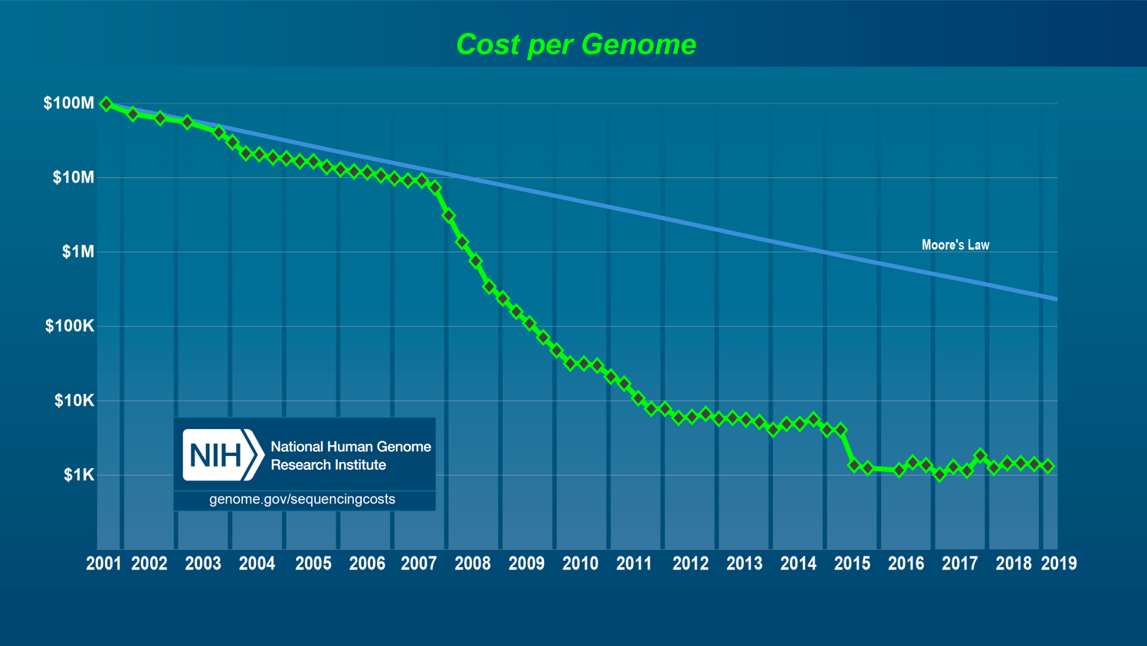
Low sequencing cost enables reading our whole genome

Slide 5
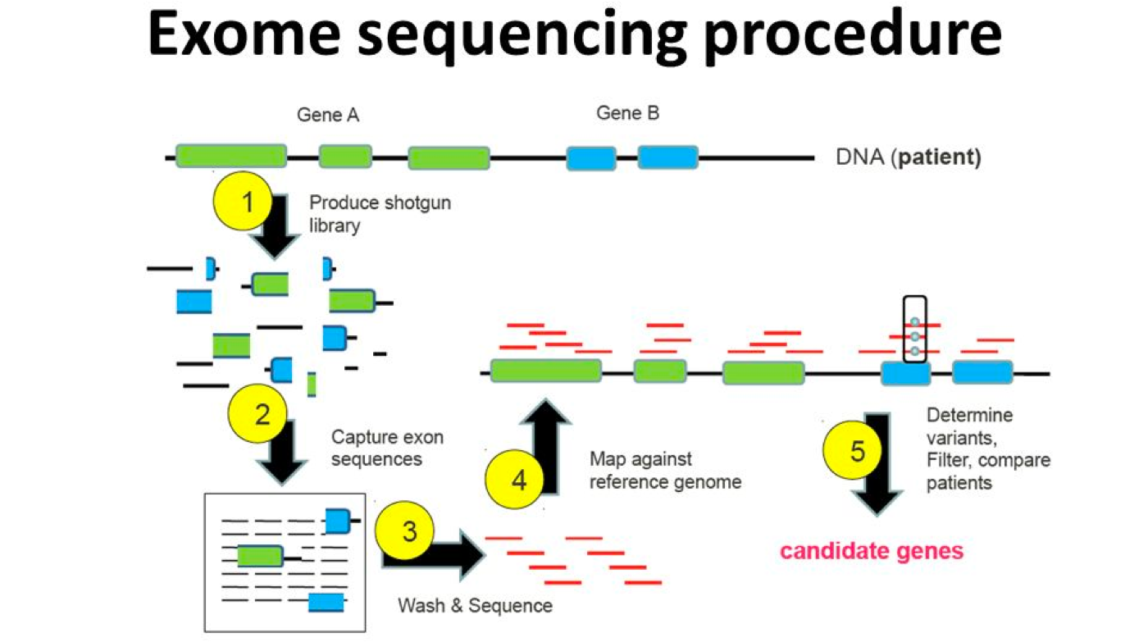
Whole Exome Sequencing (WES) reads 2% coding elements of human genome

Slide 6
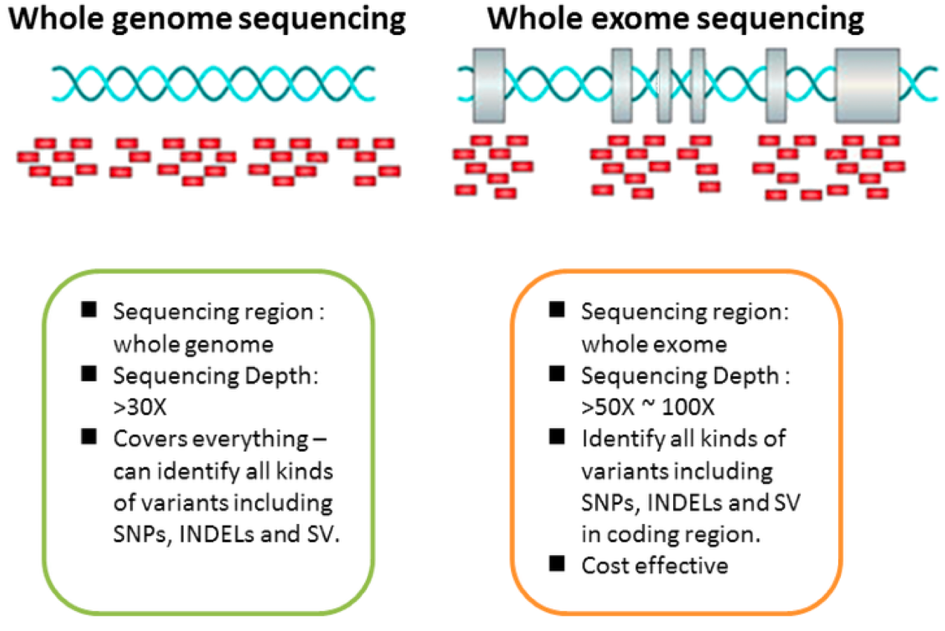
Whole Genome Sequencing (WGS) reads 100%!
DNA
Coding elements
http://www.genomesop.com/somatic-mutations/

Slide 7
Understanding Human Genetic Variation
The “human genome” was determined by sequencing DNA from a small number of individuals (2001)
The HapMap project (initiated in 2002) looked at polymorphisms in 270 individuals (Affymetrix GeneChip)
The 1000 Genomes project (initiated in 2008) sequenced the genomes of 2500 individuals from diverse populations
23andMe genotyped its 1 millionth customer in 2015
Genomics England sequenced 100k whole genomes and linked with medical records (Dec 2018)

Slide 8
Gametic vs. Somatic Mutations
https://www.pathwayz.org/Tree/Plain/GAMETIC+VS.+SOMATIC+MUTATIONS

Slide 9
Classes of Variants
Single Nucleotide Polymorphisms (SNPs)
Indels (insertions/deletions)
Structural variants
Formal definitions: https://www.snpedia.com/index.php/Glossary

Slide 10
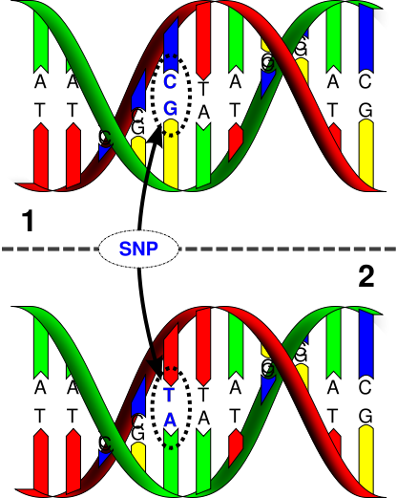
Single Nucleotide Polymorphisms (SNPs)
One nucleotide changes
Variation occurs with some minimal frequency in a population
Pronounced “snip”
www.mdpi.com

Slide 11
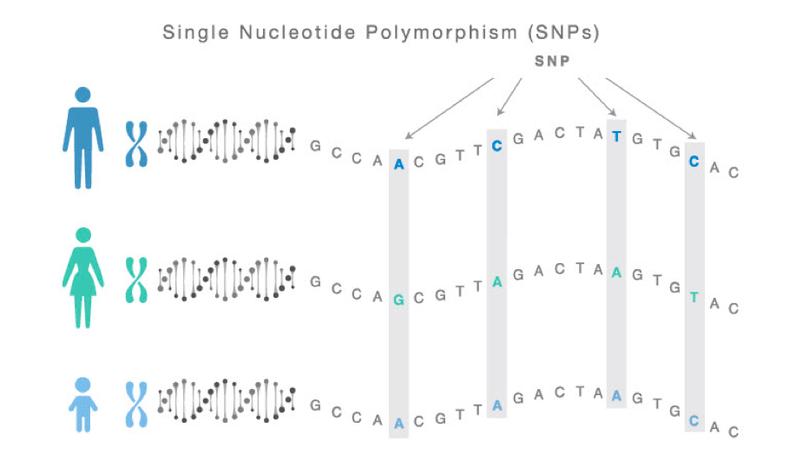
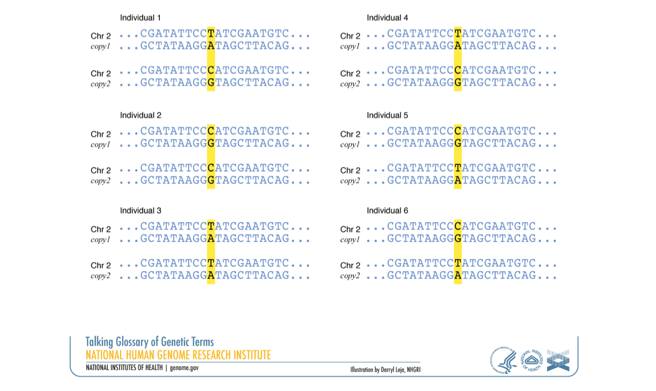

After reading our genomes, we find differences: DNA mutations (i.e., genomic variants)
Single Nucleotide Polymorphisms (SNPs) normally happen ~1% on individual human genome.
Most SNPs are harmless but some matter

Slide 12
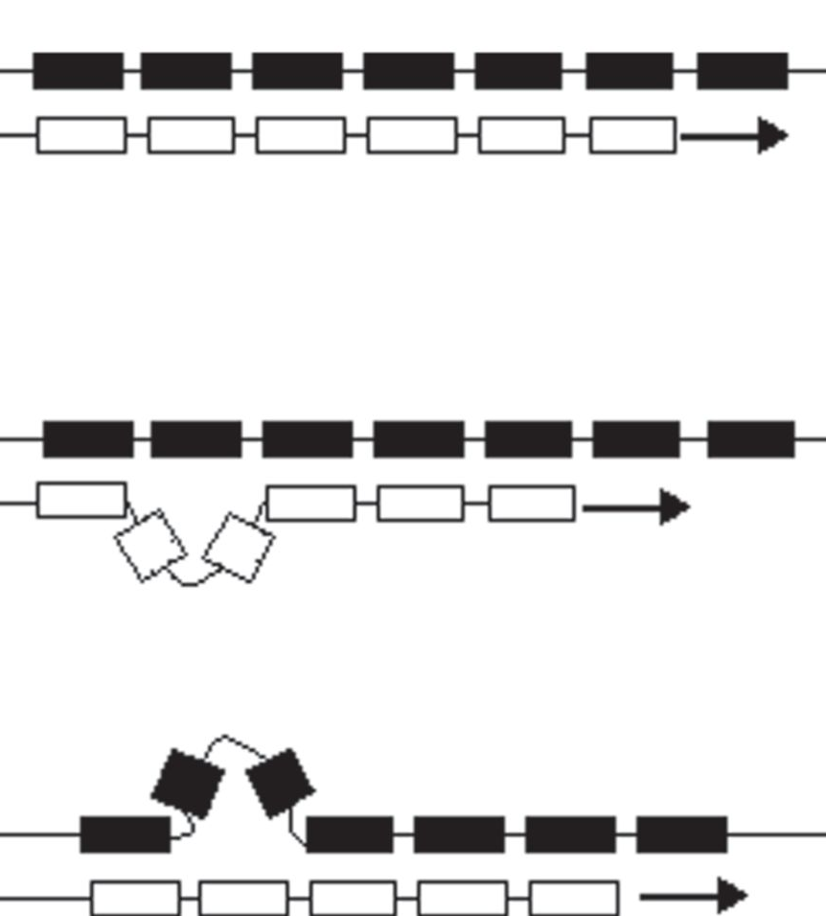
Insertions and Deletions
Black box: DNA template strand
White box: newly replicated DNA
Insertion: slippage inserts extra nucleotides
Deletion: slippage excludes template nucleotides
Forster et al. Proc. R. Soc. B 2015

Slide 13
Structural Variants
Copy number variants (CNVs)
  Gain or loss of large genomic regions, even entire chromosomes
Inversions
  DNA subsequence is reversed
Translocations
  DNA subsequence is moved to a different chromosome

Slide 14
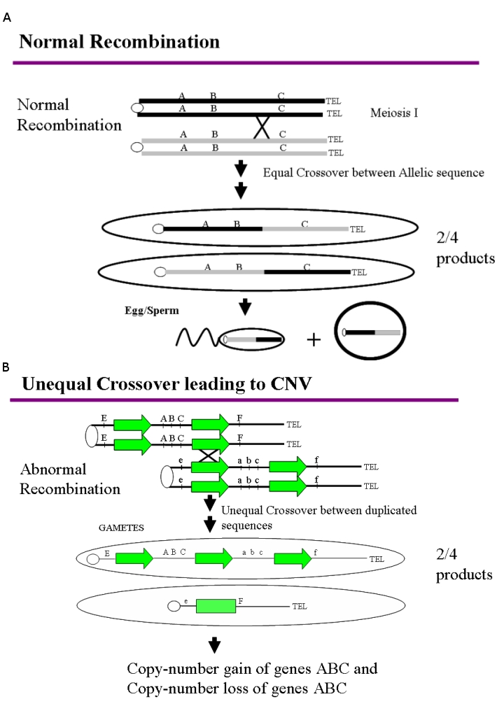
Genetic Recombination

Slide 15
Recombination Errors Lead to
Copy Number Variants (CNVs)

Slide 16
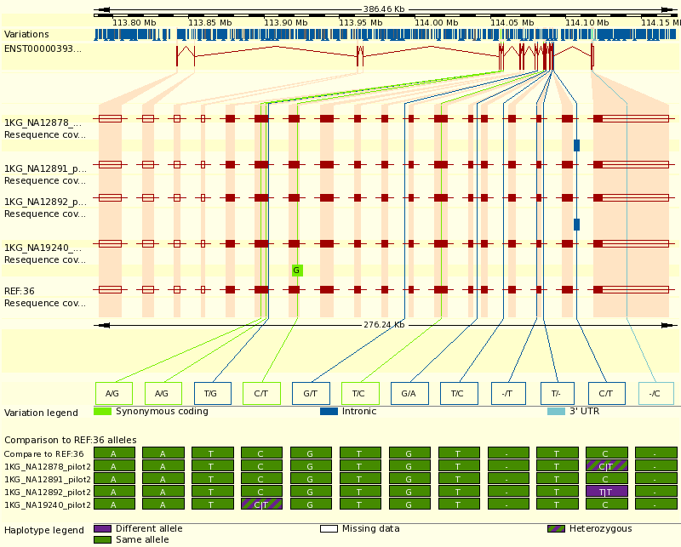
1000 Genomes Project
Project goal: produce a catalog of human variation down to
variants that occur at >= 1% frequency over the genome

Slide 17
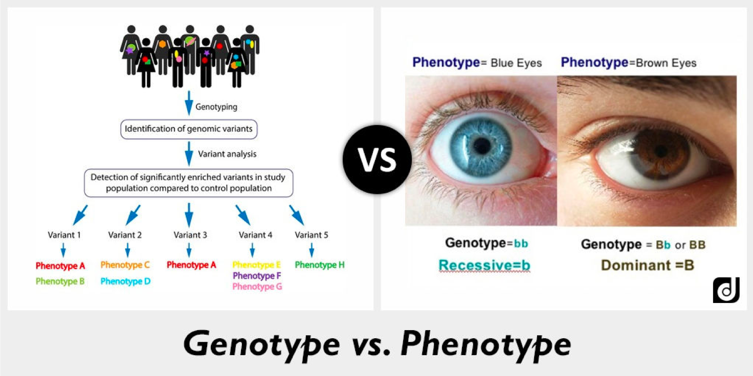
Genotype to Phenotype

Slide 18
Understanding Associations Between Genetic Variation and Disease
Genome-wide association study (GWAS)
Gather some population of individuals
Genotype each individual at polymorphic markers (usually SNPs)
Test association between state at marker and some variable of interest (say disease)
Adjust for multiple comparisons
Phenotypes: observable traits

Slide 19
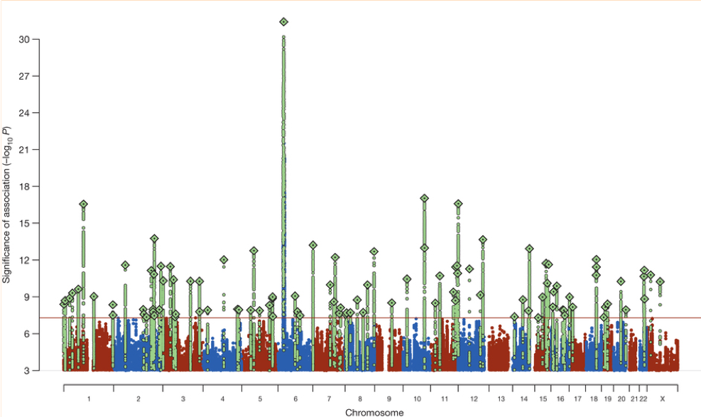
Example: Genome-Wide Association Study (GWAS) identifies disease associated genetic variants
36,989 schizophrenia cases and 113,075 controls in Psychiatric Genomics Consortium
Associated SNPs
P=5*10⁻⁸
Schizophrenia Working Group of the Psychiatric Genomics Consortium, Nature (2014)
19

Slide 20
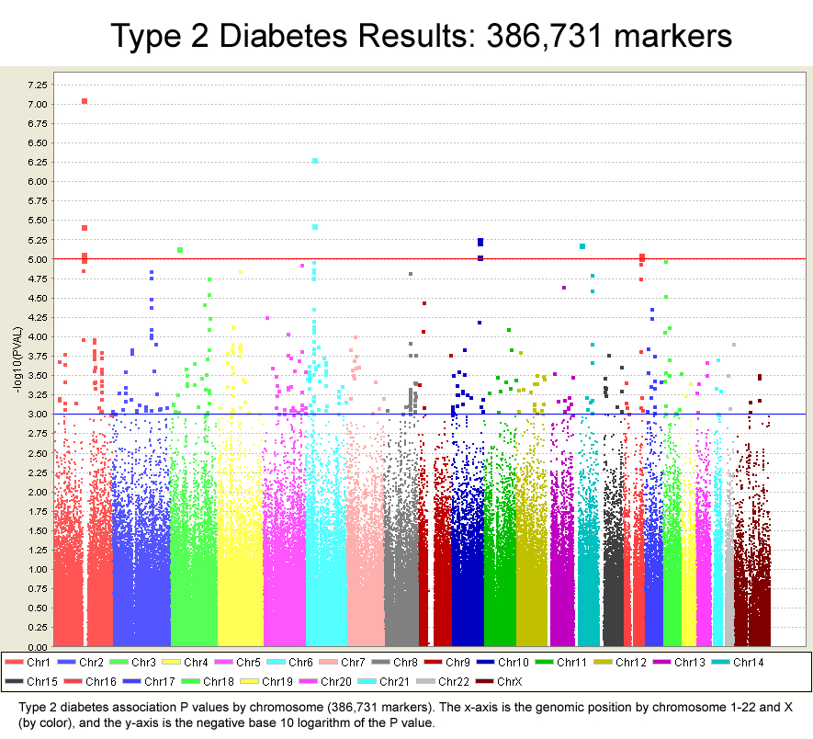
p = E-5
p = E-3

Slide 21
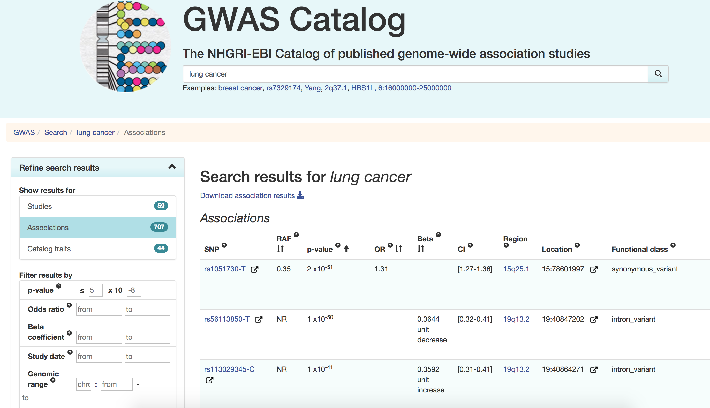
https://www.ebi.ac.uk/gwas/

Slide 22
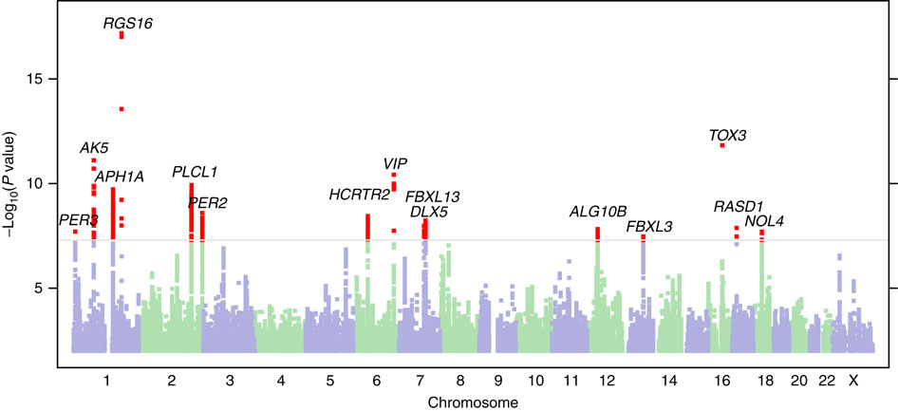
Morning Person GWAS
P = 5.0 × 10⁻⁸
Hu et al. Nature Communications 2016

Slide 23
Understanding Associations Between Genetic Variation and Disease
International Cancer Genome Consortium
Includes NIH’s The Cancer Genome Atlas
Sequencing DNA from 500 tumor samples for each of 50 different cancers
Goal is to distinguish drivers (mutations that cause and accelerate cancers) from passengers (mutations that are byproducts of cancer’s growth)

Slide 24
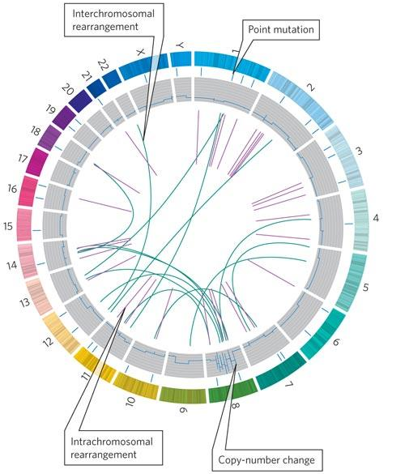
A Circos Plot

Slide 25
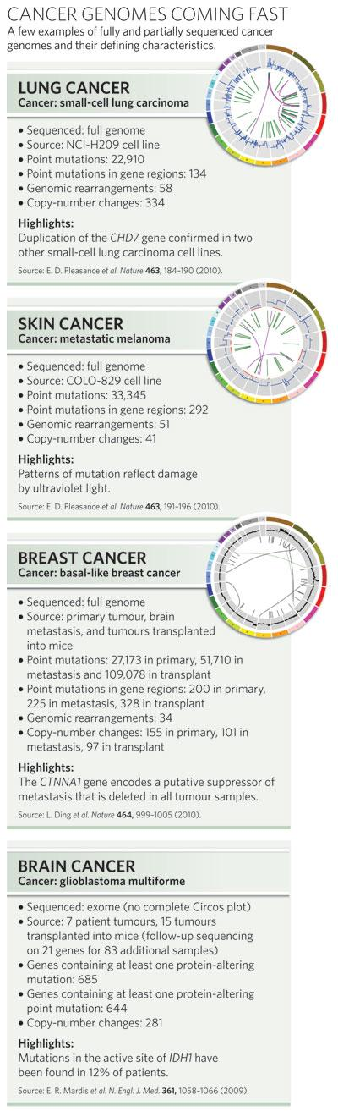
Some Cancer Genomes

Slide 26
Understanding Associations Between Genetic Variation and Complex Phenotypes
Quantitative trait loci (QTL) mapping
Gather some population of individuals
Genotype each individual at polymorphic markers
Map quantitative trait(s) of interest to chromosomal locations that seem to explain variation in trait

Slide 27
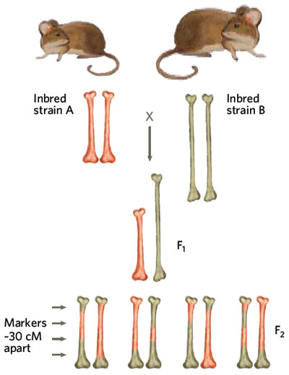
QTL Mapping Example

Slide 28
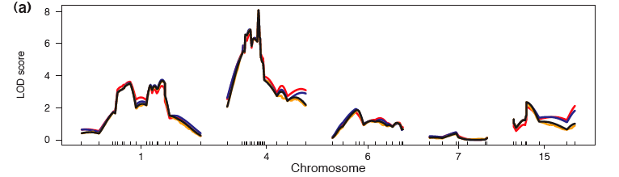
QTL Mapping Example
QTL mapping of mouse blood pressure, heart rate [Sugiyama et al., Broman et al.]
Logarithm of Odds
quantitative trait
position in the genome

Slide 29
QTL Example: Genotype-Tissue Expression Project (GTEx)
Expression QTL (eQTL): traits are expression levels of various genes
Map genotype to gene expression in different human tissues

Slide 30
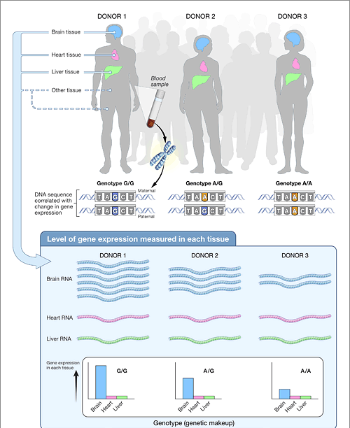
QTL Example: GTEx
https://www.genome.gov/27543767/

Slide 31
GWAS Versus QTL
Both associate genotype with phenotype
GWAS pertains to discrete phenotypes
  For example, disease status is binary
QTL pertains to quantitative (continuous) phenotypes
  Height
  Gene expression
  Splicing events
  Metabolite abundance

Slide 32
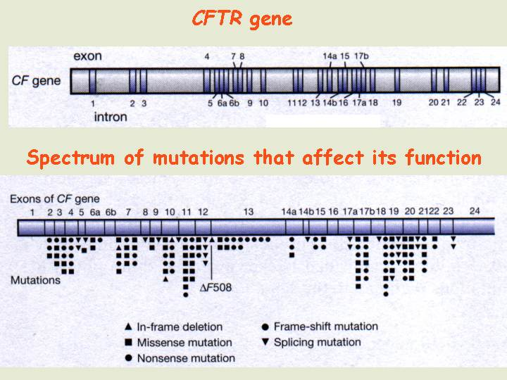
Determining Association is Not Enough
A simple case: CFTR (Cystic Fibrosis Transmembrane Conductance Regulator)

Slide 33
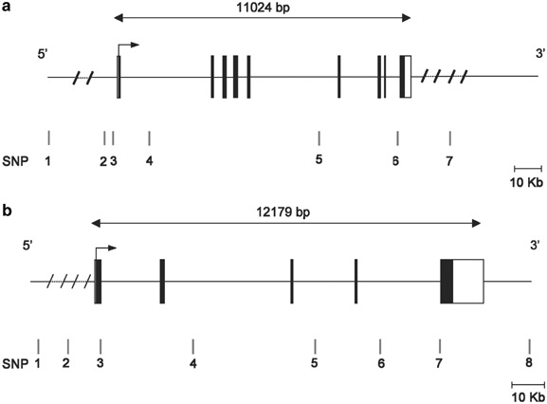
Many Measured SNPs Not in Coding Regions
Genes encoding CD40 and CD40L with relative positions of the SNPs studied
Chadha et al. Eur J Hum Genet 2005

Slide 34
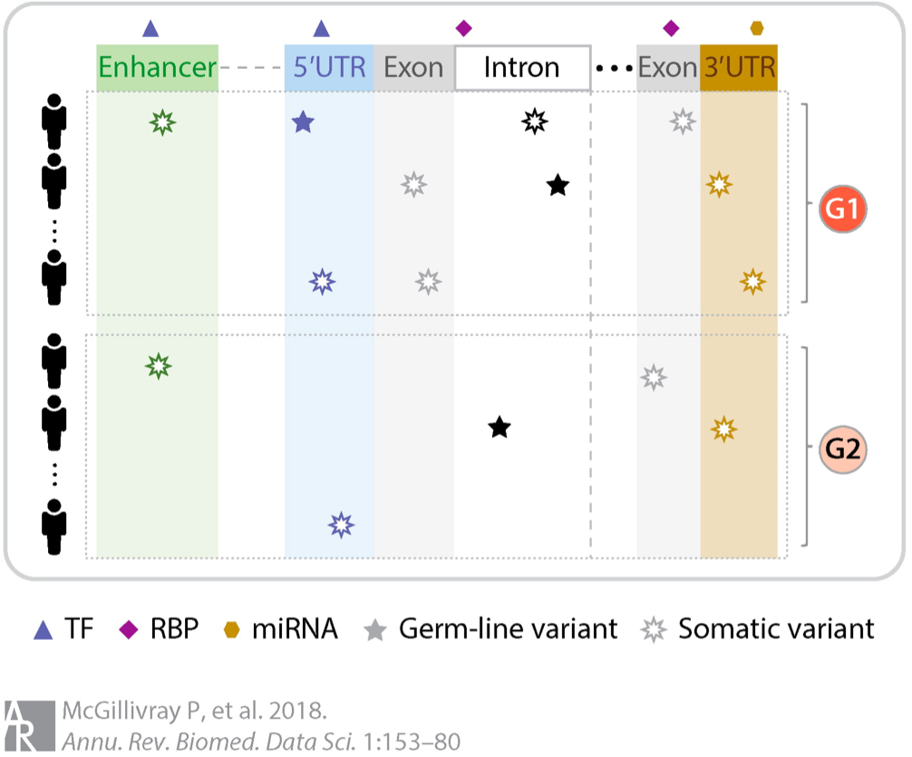
Non-coding variants
Non-coding
Coding
Non-coding
Disease
Health

Slide 35
Computational Problems
Assembly and alignment of thousands of genomes
Detecting large structural variants
Data structures to capture extensive variation
Identifying functional roles of markers of interest (which genes/pathways does a mutation affect and how?)
Identifying interactions in multi-allelic diseases (which combinations of mutations lead to a disease state?)
Identifying genetic/environmental interactions that lead to disease
Inferring network models that exploit all sources of evidence: genotype, expression, metabolic, etc.

