Slide 1
Learning Sequence Motif Models Using Expectation Maximization (EM)
BMI/CS 776
www.biostat.wisc.edu/bmi776/
Spring 2022
Daifeng Wang
daifeng.wang@wisc.edu
These slides, excluding third-party material, are licensed under CC BY-NC 4.0 by Mark Craven, Colin Dewey, Anthony Gitter and Daifeng Wang

Slide 2
Goals for Lecture
Key concepts
the motif finding problem
using EM to address the motif-finding problem
the OOPS and ZOOPS models

Slide 3

Your genome is your genetic codebook
Book | Genome
Chapters | Chromosomes
Sentences | Genes
Words | Elements
Letters | Bases
Human
46 chromosomes
~ 20,000 – 25,000 genes
~ Millions elements
4 unique bases (A, T, C, G), ~3 billion in total
https://goo.gl/images/vMaz4T
3

Slide 4


How to read your genetic codebook?
Book | Genome
Chapters | Chromosomes
Sentences | Genes
Words | Elements
Letters | Bases
“On most days, I enter the Capitol through the basement. A small subway train carries me from the Hart Building, where …”
Key words
Non-key words
Coding elements (Exon, 2%)
  Become proteins carrying out functions
Non-coding elements (98%)
Gene 1
Gene 2
https://goo.gl/images/vMaz4T
4

Slide 5
Grammar for book is clear but not for genome
Book | Genome
Chapters | Chromosomes
Sentences | Genes
Words | Elements
Letters | Bases
Sentence 1
Gene 1
Sentence 2
Grammar
Functions
Pattern
Gene 2
Sentence 3
Gene 3
Set up “rules” in translating genetic codes to functions
Broken rules ->
Abnormal functions
Unclear
Key words
Non-key words
Coding elements
Non-coding
elements
5

Slide 6
Sequence Motifs
What is a sequence motif ?
  a sequence pattern of biological significance
Examples
  DNA sequences corresponding to protein binding sites
  protein sequences corresponding to common functions or conserved pieces of structure

Slide 7
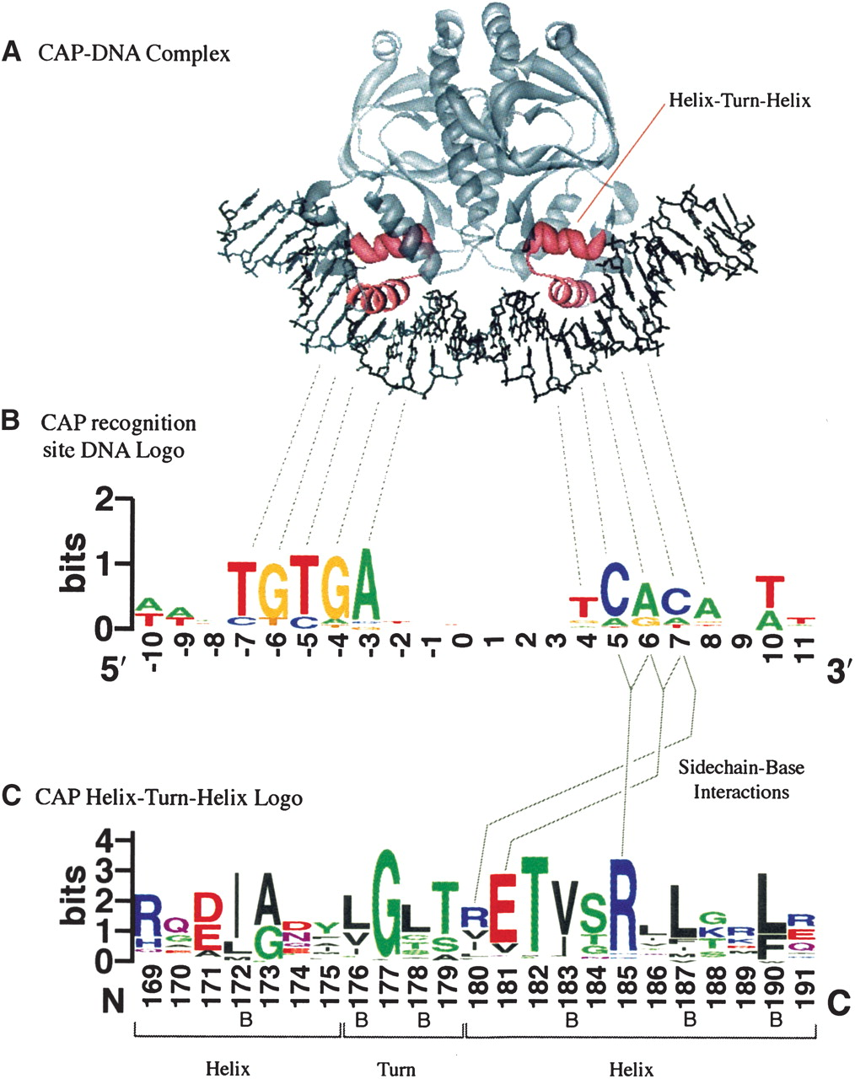
Sequence Motifs Example
CAP-binding motif model based on 59 binding sites in E.coli
helix-turn-helix motif model based on 100 aligned protein sequences
Crooks et al., Genome Research 14:1188-90, 2004.

Slide 8
The Motif Model Learning Task
given: a set of sequences that are thought to contain
occurrences of an unknown motif of interest
do:
  infer a model of the motif
  predict the locations of the motif occurrences in the given sequences

Slide 9
Why is this important?
To further our understanding of which regions of sequences are “functional”
DNA: biochemical mechanisms by which the expression of genes are regulated
Proteins: which regions of proteins interface with other molecules (e.g., DNA binding sites)
Mutations in these regions may be significant (e.g., non-coding variants)

Slide 10
Motifs and Profile Matrices
(a.k.a. Position Weight Matrices)
Given a set of aligned sequences, it is straightforward to construct a profile matrix characterizing a motif of interest
shared motif
sequence positions
1
2
3
4
5
6
7
8
A
0.1
0.3
0.1
0.2
0.2
0.4
0.3
0.1
C
0.5
0.2
0.1
0.1
0.6
0.1
0.2
0.7
G
0.2
0.2
0.6
0.5
0.1
0.2
0.2
0.1
T
0.2
0.3
0.2
0.2
0.1
0.3
0.3
0.1
Each element represents the probability of given character at a specified position

Slide 11
Sequence Logos
1
2
3
4
5
6
7
8
A
0.1
0.3
0.1
0.2
0.2
0.4
0.3
0.1
C
0.5
0.2
0.1
0.1
0.6
0.1
0.2
0.7
G
0.2
0.2
0.6
0.5
0.1
0.2
0.2
0.1
T
0.2
0.3
0.2
0.2
0.1
0.3
0.3
0.1
or
Information content (IC) at position n =
log₂(4) – Entropy(position n)
Entropy(position n) = -P(n=A)log₂ P(n=A) -P(n=T)log₂ P(n=T) -P(n=C)log₂ P(n=C) -P(n=G)log₂ P(n=G)
frequency logo
information content logo
Notes:
http://www.cs.utsa.edu/~jruan/teaching/cs5263_fall_2007/papers/information_content_stormo.pdf

Slide 12
Motifs and Profile Matrices
How can we construct the profile if the sequences aren’t aligned?
In the typical case we don’t know what the motif looks like.

Slide 13
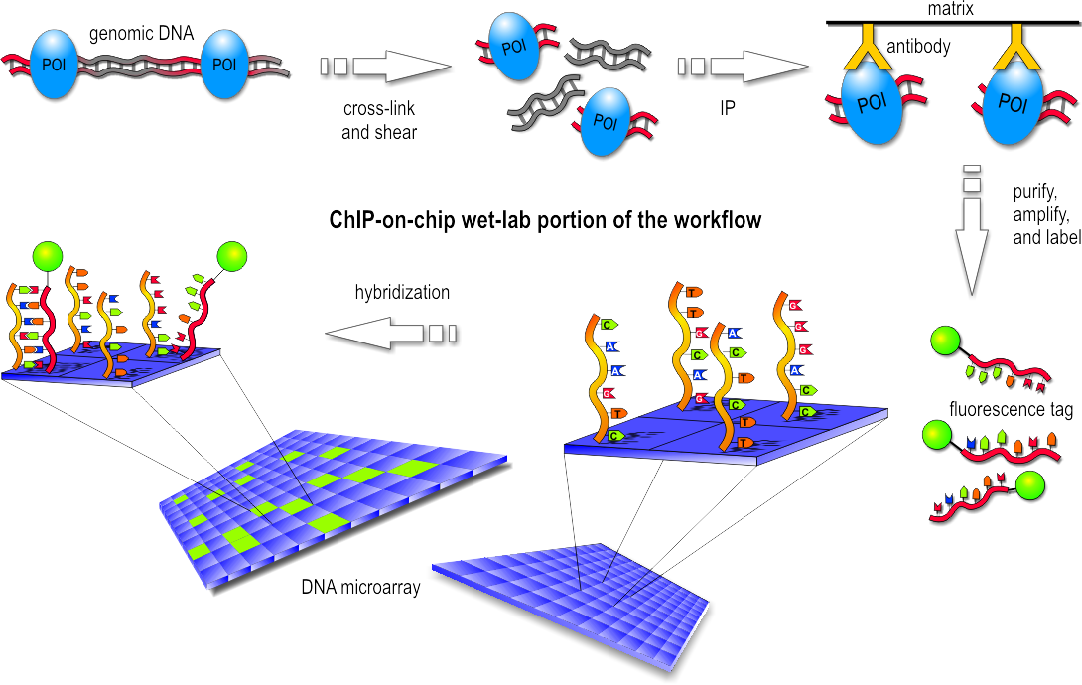
Unaligned Sequence Example
ChIP-chip experiment tells which probes are bound (though this protocol has been replaced by ChIP-seq)
Figure from https://en.wikipedia.org/wiki/ChIP-on-chip

Slide 14
The Expectation-Maximization (EM) Approach
[Lawrence & Reilly, 1990; Bailey & Elkan, 1993, 1994, 1995]
EM is a family of algorithms for learning probabilistic models in problems that involve hidden state
In our problem, the hidden state is where the motif starts in each training sequence

Slide 15
Overview of EM
Method for finding the maximum likelihood (ML) parameters (θ) for a model (M) and data (D)
Useful when
  it is difficult to optimize directly
  likelihood can be decomposed by the introduction of hidden information (Z)
  and it is easy to optimize the function (with respect to θ):
(see optional reading and text section 11.6 for details)
Notes:
See my notes on EM nature biotech

Slide 16
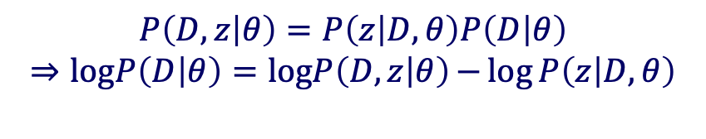
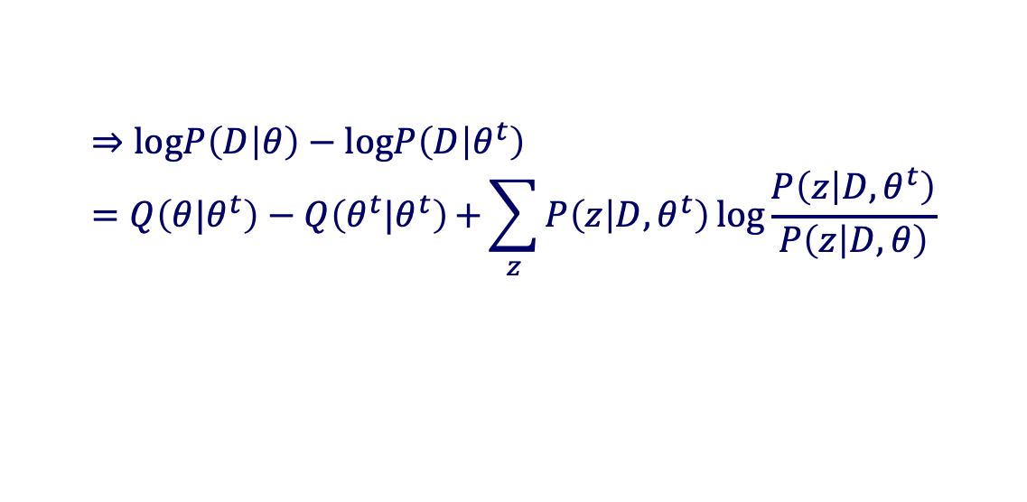

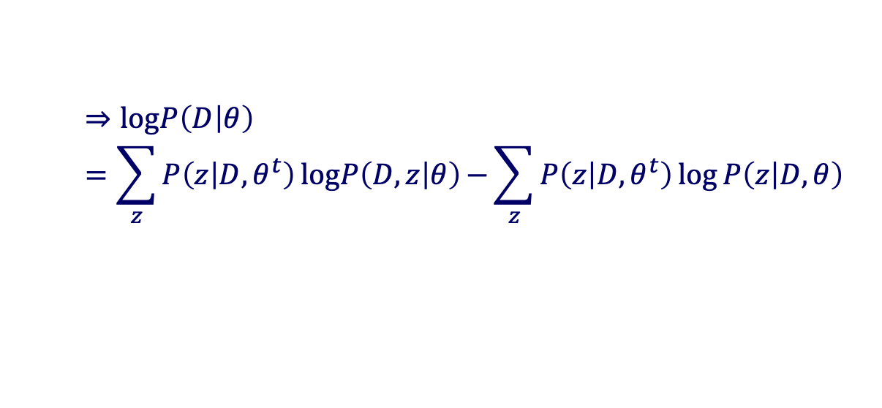
Proof of EM algorithm
$$P\left(D,z | θ\right)=P\left(z | D,θ\right)P\left(D | θ\right)$$
$$⇒logP\left(D | θ\right)=logP\left(D,z | θ\right)⁡−\log{P\left(z | D,θ\right)}$$
Multiple $P\left(z | D,θ^{t}\right)$ for given $θ^{t}$at both sides and sum over all z values
$$⇒logP\left(D | θ\right)=\sum_{z}{P\left(z | D,θ^{t}\right)}logP\left(D,z | θ\right)⁡−\sum_{z}{P\left(z | D,θ^{t}\right)}log{P\left(z | D,θ\right)}$$
$$Q\left(θ|θ^{t}\right)$$
$$⇒logP\left(D | θ\right)−logP\left(D | θ^{t}\right)=Q\left(θ|θ^{t}\right)−Q\left(θ^{t}|θ^{t}\right)⁡+\sum_{z}{P\left(z | D,θ^{t}\right)}log{\frac{P\left(z | D,θ^{t}\right)}{P\left(z | D,θ\right)}}$$
Non-negative
$$⇒logP\left(D | θ\right)−logP\left(D | θ^{t}\right)≥Q\left(θ|θ^{t}\right)−Q\left(θ^{t}|θ^{t}\right)$$
(see optional reading and text section 11.6 for details)

Slide 17

Applying EM to the Motif Finding Problem
First define the probabilistic model and likelihood function
Identify the hidden variables (Z)
  In this application, they are the locations of the motifs
Write out the Expectation (E) step
  Compute the expected values of the hidden variables given current parameter values θ^{t}
Write out the Maximization (M) step
  Determine the parameters that maximize the Q function, given the expected values of the hidden variables
$$θ^{t+1}={argmax}_{θ}Q\left(θ|θ^{t}\right)$$

Slide 18


Convergence of the EM algorithm
M-step:
M-step:
M-step:
E-step:
Q($θ$|$θ^{t+1}$)
E-step:
Q($θ$|$θt$)
https://www.nature.com/articles/nbt1406

Slide 19
Representing Motifs in MEME
MEME: Multiple EM for Motif Elicitation
A motif is
  assumed to have a fixed width, W
  represented by a matrix of probabilities: p_{c, k} represents the probability of character c in column k
Also represent the “background” (i.e. sequence outside the motif): p_{c,0} represents the probability of character c in the background
Data D is a collection of sequences, denoted X

Slide 20
Representing Motifs in MEME
Example: a motif model of length 3
0 1 2 3
A 0.25 0.1 0.5 0.2
C 0.25 0.4 0.2 0.1
G 0.25 0.3 0.1 0.6
T 0.25 0.2 0.2 0.1
background
motif positions

Slide 21
Representing Motif Starting Positions in MEME
The element Z_{i,j} of the matrix Z is an indicator random variable that takes value 1 if the motif starts in position j in sequence i (and takes value 0 otherwise)
Example: given DNA sequences where L=6 and W=3
Possible starting positions m = L – W + 1
1 2 3 4
seq1 0 0 1 0
seq2 1 0 0 0
seq3 0 0 0 1
seq4 0 1 0 0
G T C A G G
G A G A G T
A C G G A G
C C A G T C

Slide 22
Probability of a Sequence Given a Motif Starting Position
before motif
motif
after motif
is the i th sequence
is 1 if motif starts at position j in sequence i
is the character at position k in sequence i

Slide 23
Sequence Probability Example
G C T G T A G
0 1 2 3
A 0.25 0.1 0.5 0.2
C 0.25 0.4 0.2 0.1
G 0.25 0.3 0.1 0.6
T 0.25 0.2 0.2 0.1

Slide 24
Likelihood Function
EM (indirectly) optimizes log likelihood of observed data
M step requires joint log likelihood
See Section IV.C of Bailey’s dissertation for details

Slide 25
Basic EM Approach
given: length parameter W, training set of sequences
  t=0
  set initial values for p⁽⁰⁾
  do
  ++t
    re-estimate Z^{(t)} from p^{(t-1)} (E-step)
    re-estimate p^{(t)} from Z^{(t)} (M-step)
  until change in p^{(t)} < ε (or change in likelihood is < ε)
return: p^{(t)}, Z^{(t)}

Slide 26
Expected Starting Positions
During the E-step, we compute the expected values of Z given X and p^{(t-1)}
We denote these expected values
For example:
G C T G T A
indicator random
variable
G C T G T A
expected value at
iteration t
G C T G T A
G C T G T A
1 2 3 4
seq1 0.1 0.1 0.2 0.6
seq2 0.4 0.2 0.1 0.3
seq3 0.3 0.1 0.5 0.1

Slide 27
The E-step: Computing Z^{(t)}
To estimate the starting positions in Z at step t
This comes from Bayes’ rule applied to

Slide 28
The E-step: Computing Z^{(t)}
Assume that it is equally likely that the motif will start in any position

Slide 29
Example: Computing Z^{(t)}
G C T G T A G
0 1 2 3
A 0.25 0.1 0.5 0.2
C 0.25 0.4 0.2 0.1
G 0.25 0.3 0.1 0.6
T 0.25 0.2 0.2 0.1
...
Then normalize so that

Slide 30
The M-step: Estimating p
Recall represents the probability of character c in position k ; values for k=0 represent the background
pseudo-counts
# of c’s at position k
sum over positions
where c appears
total # of c’s
in data set

Slide 31
Example: Estimating p
A C A G C A
A G G C A G
T C A G T C

Slide 32
The ZOOPS Model
The approach as we’ve outlined it, assumes that each sequence has exactly one motif occurrence per sequence; this is the OOPS model
The ZOOPS model assumes zero or one occurrences per sequence

Slide 33
E-step in the ZOOPS Model
We need to consider another alternative: the ith sequence doesn’t contain the motif
We add another parameter (and its relative)
Possible starting positions m = L – W + 1
prior probability of a sequence containing a motif
prior probability that any position in a sequence is the start of a motif

Slide 34
E-step in the ZOOPS Model
Q_{i} is a random variable for which Q_{i} = 1 if sequence X_{i} contains a motif, Q_{i} = 0 otherwise

Slide 35
M-step in the ZOOPS Model
Update p same as before
Update as follows:

Slide 36
Extensions to the Basic EM Approach in MEME
Varying the approach (TCM model) to assume zero or more motif occurrences per sequence
Choosing the width of the motif
Finding multiple motifs in a group of sequences
Choosing good starting points for the parameters
Using background knowledge to bias the parameters

Slide 37
Starting Points in MEME
EM is susceptible to local maxima, so it’s a good idea to try multiple starting points
Insight: motif must be similar to some subsequence in data set
For every distinct subsequence of length W in the training set
  derive an initial p matrix from this subsequence
  run EM for 1 iteration
Choose motif model (i.e. p matrix) with highest likelihood
Run EM to convergence

Slide 38
Using Subsequences as Starting Points for EM
Set values matching letters in the subsequence to some value π
Set other values to (1- π)/(M-1) where M is the length of the alphabet
Example: for the subsequence TAT with π =0.7
1 2 3
A 0.1 0.7 0.1
C 0.1 0.1 0.1
G 0.1 0.1 0.1
T 0.7 0.1 0.7

Slide 39

MEME web server
http://meme-suite.org/

