Slide 1
Multi-modal data analysis
- with an application to brain functional genomics
BMI/CS 776
Spring 2022
Daifeng Wang, Ph.D.
Assistant Professor
Department of Biostatistics and Medical Informatics
Department of Computer Sciences (affiliate)
Investigator, Waisman Center
University of Wisconsin – Madison
daifeng.wang@wisc.edu
https://daifengwanglab.org/

Slide 2
Machine learning to open “black box” from genotype to phenotype
Goal
  Advance biological knowledge on genomics in brain diseases
Approach
  Machine learning, Bioinformatics, Computational Biology
https://www.waisman.wisc.edu/2020/01/07/new-researcher-uses-machine-learning-to-decode-genomic-information/

Slide 3
Outline
Background
  Functional genomics & multi-omics
  Gene regulation
Multi-view learning for multi-modal data
  Multi-view Empirical Risk Minimization (MV-ERM)
  Manifold alignment
App 1: single-cell multi-modal data integration
  Predicting neuronal electrophysiology from gene expression
App 2: deep manifold-regularized classification
  Predicting cortical layers of neurons from multi-modalities
App 3: biologically interpretable neural network modeling
  Disease prediction and functional prioritization

Slide 4
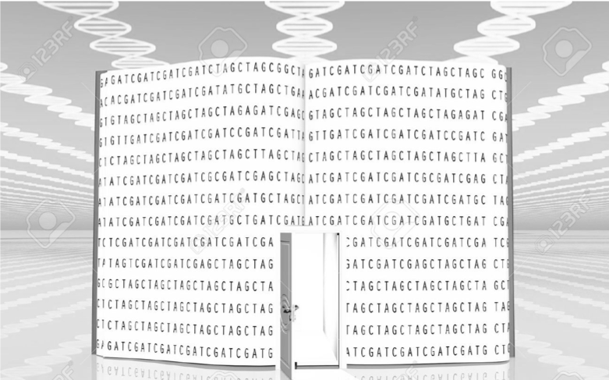
Your genome is your genetic code book
Book | Genome
Chapters | Chromosomes
Sentences | Genes
Words | Elements
Letters | Bases
Human
46 chromosomes
~ 20,000 – 25,000 genes
~ Millions elements
4 unique bases (A, T, C, G), ~3 billion in total
https://goo.gl/images/vMaz4T

Slide 5


How to read your genetic code book?
Book | Genome
Chapters | Chromosomes
Sentences | Genes
Words | Elements
Letters | Bases
“On most days, I enter the Capitol through the basement. A small subway train carries me from the Hart Building, where …”
Key words
Non-key words
Coding elements (Exon, 2%)
  Become proteins carrying out functions
Non-coding elements (98%)
Gene 1
Gene 2
https://goo.gl/images/vMaz4T

Slide 6
Grammar for book is clear but not for genome
Book | Genome
Chapters | Chromosomes
Sentences | Genes
Words | Elements
Letters | Bases
Sentence 1
Gene 1
Sentence 2
Gene 2
Grammar
Functions
Gene regulation
Sentence 3
Gene 3
Set up “rules” in translating genetic codes to functions
Broken rules ->
Abnormal functions
Unclear
Key words
Non-key words
Coding elements
Non-coding
elements

Slide 7
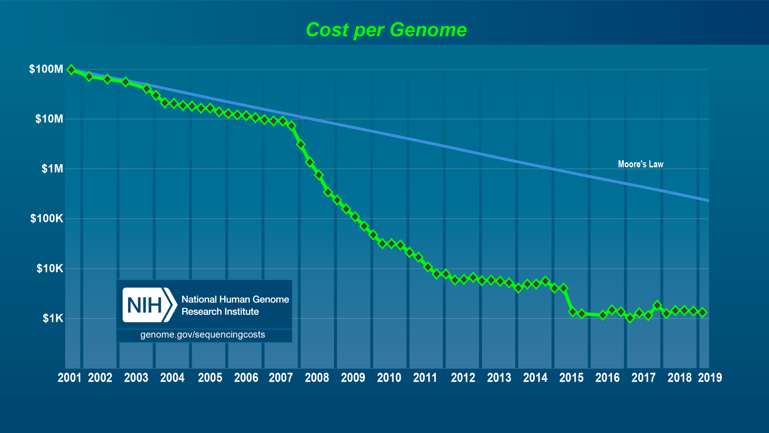
Low sequencing cost enables reading our whole genome

Slide 8
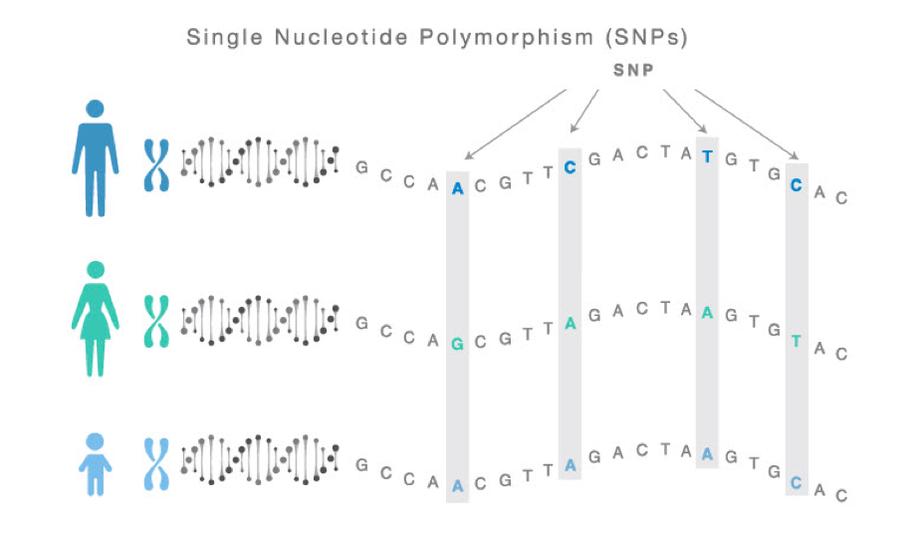
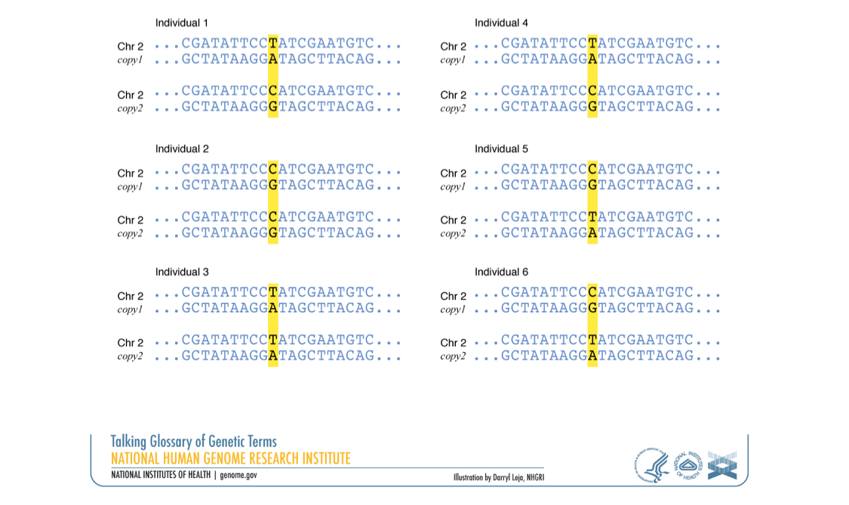

Differences across our genomes: DNA variants
Single Nucleotide Polymorphisms (SNPs) normally happen ~1% on individual human genome.
Most SNPs are harmless but some break “rules”

Slide 9
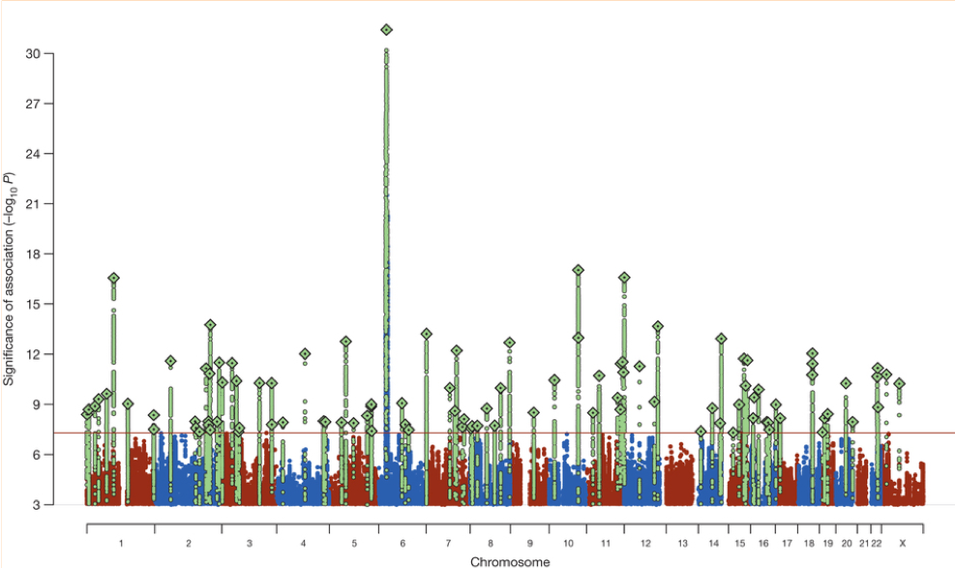
Genome-Wide Association Study (GWAS) identifies disease associated genetic variants
36,989 schizophrenia cases and 113,075 controls in Psychiatric Genomics Consortium
Schizophrenia risk SNPs
P=5*10⁻⁸
Schizophrenia Working Group of the Psychiatric Genomics Consortium, Nature (2014)
However, genotype-phenotype association can’t tell mechanisms

Slide 10
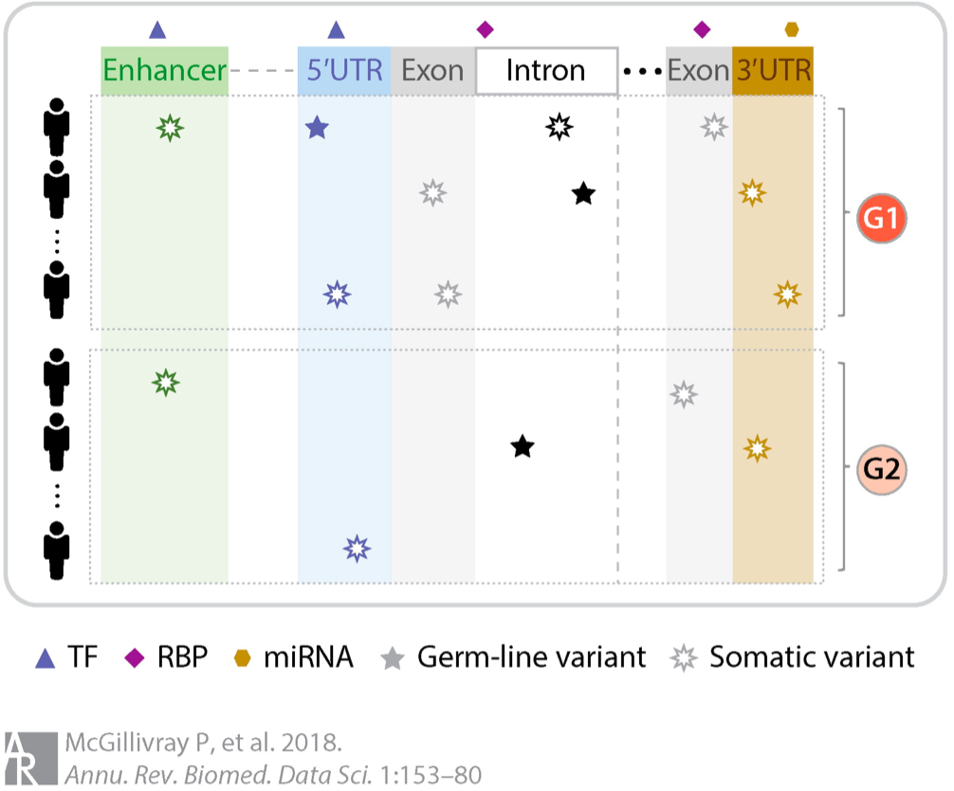
How to link non-coding disease SNPs to genes?
Non-coding
Coding
Non-coding
Disease
Health

Slide 11
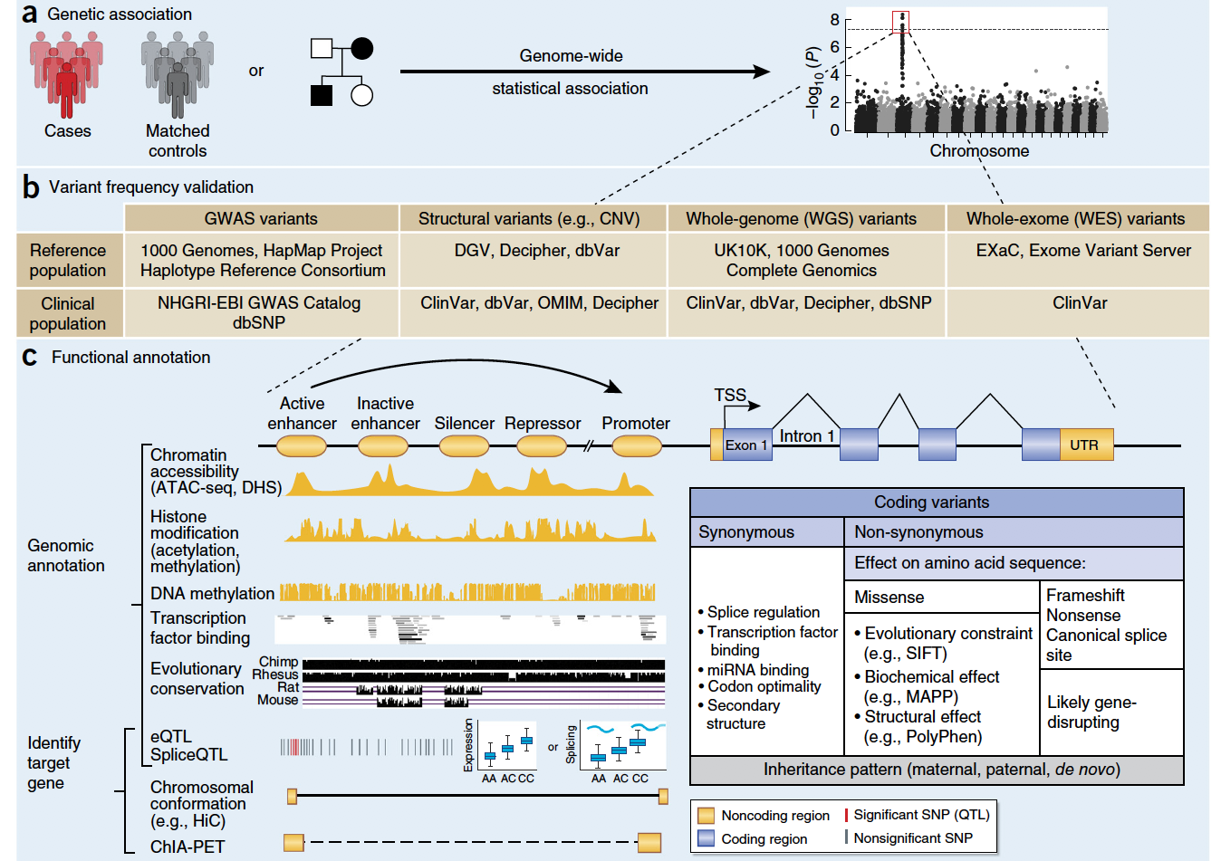
Complex mechanisms from genotype to phenotype
Disease-associated genomic variants
How do variants function?
Gandal et al., Nature Neuroscience, 2016

Slide 12
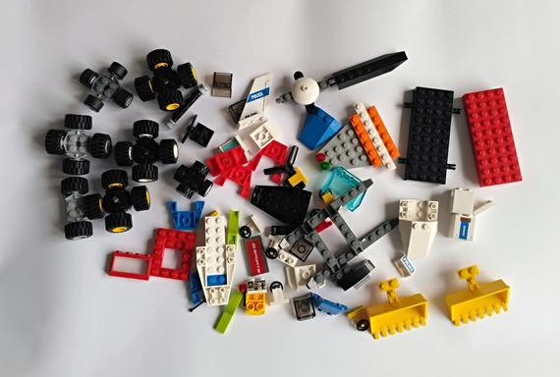

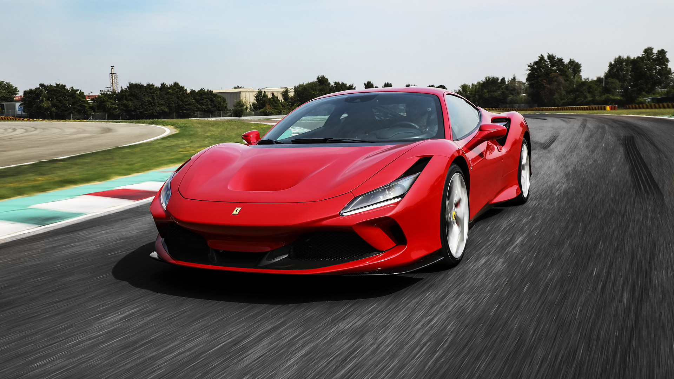
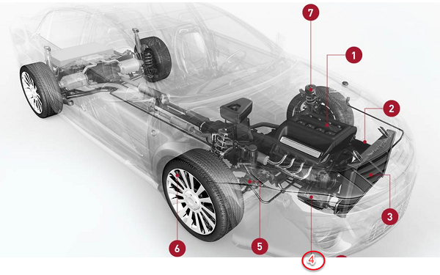
Hierarchical understanding from genotype to phenotype
Functional Elements
variants
Interactions
gene regulation
Mechanisms
pathways
genes
chromatin interaction
TF binding
Prediction & Prioritization
circuits
disease variants & genes
networks
cell types
processes
regulatory regions

Slide 13
Multi-omics data for various functional elements

Slide 14

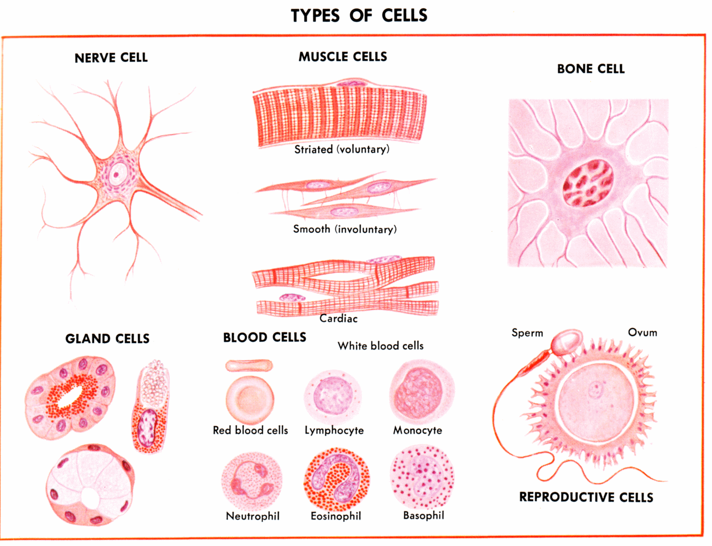
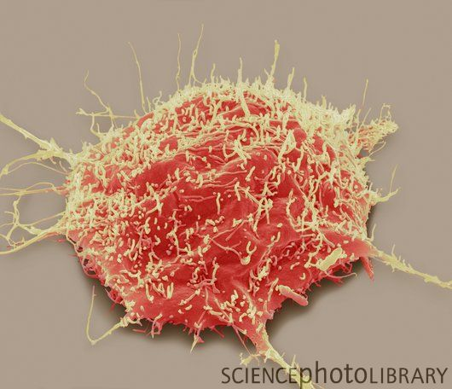
Gene expression and regulation
Protein
Identical DNA but different gene expression
Central dogma
translation
RNA
transcription
Gene
DNA
Gene expression levels (e.g., values to quantify RNA abundances)
nerve
bone
disease
Gene function
Gene regulation: mechanisms controlling
gene expression levels
Notes:
First, I would like to briefly introduce gene expression and regulation.
Twins: twins have identical DNA but why do they look differently? a important reason is their genes express differentially.
Central dogma: then, what’s gene expression? let’s look at central dogma in biology. e.g., a red gene, a piece of DNA, first is transcribed to RNA, which is called transcription. then, its RNA is translated to functional protein, which is called translation.
Gene expression: basically, the process that a gene becomes RNA and protein is called gene expression.
Gene expression level: people then use a value to quantify how many RNAs are transcribed from this gene. we call this this value as gene expression level. a same gene can have different expression levels across different cell types. like same person sometimes speak loudly, sometimes speak quietly.
Gene function: gene expression levels reflect its function. eventually, all gene expression levels determine the phenotypes such as twins.
Gene regulation: finally, in short, we call the mechanisms that control gene expression levels are gene regulation.
***********************************
http://ghr.nlm.nih.gov/glossary=generegulation
Gene regulation is the process of turning genes on and off. During early development, cells begin to take on specific functions. Gene regulation ensures that the appropriate genes are expressed at the proper times. Gene regulation can also help an organism respond to its environment. Gene regulation is accomplished by a variety of mechanisms including chemically modifying genes and using regulatory proteins to turn genes on or off.
http://en.wikipedia.org/wiki/Gene_expression#Measurement
Ideally measurement of expression is done by detecting the final gene product (for many genes this is the protein) however it is often easier to detect one of the precursors, typically mRNA, and infer gene expression level.

Slide 15
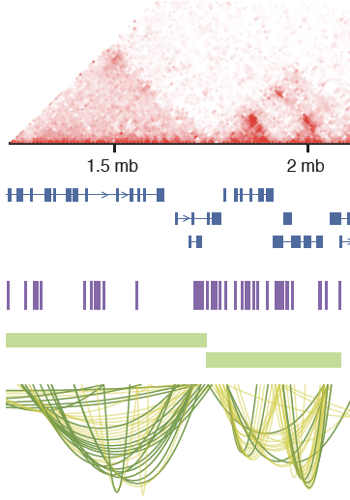
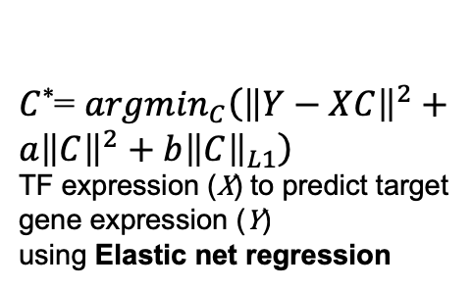
Gene regulatory networks linking functional elements from multi-omics
1. Multi-omics data integration
2. Reference network
TFBS on promoter
Transcription Factor
Binding Sites (TFBSs)
Hi-C
TFBS on enhancer
Gene
Potential E-P interaction in TAD
Enhancers
3. Predicting TF-target via Elastic net
Topologically Associating
Domain (TAD)
C*₁
$C$*= ${argmin}_{C}\left({\left\|Y−XC\right\|}^{2}+a{\left\|C\right\|}^{2}+b{\left\|C\right\|}_{L1}\right)$
TF expression (X) to predict target gene expression (Y)
using Elastic net regression
C*₂
Potential Enhancer-Promoter (E-P) interaction in TAD
C*₃
4. Imputed gene regulatory network
TF
Enhancer
Imputed TF-target linkage by Elastic Net
Target gene
Imputed E-P interaction via TF-target linkages
Jin et al, Genome Medicine, 2021

Slide 16
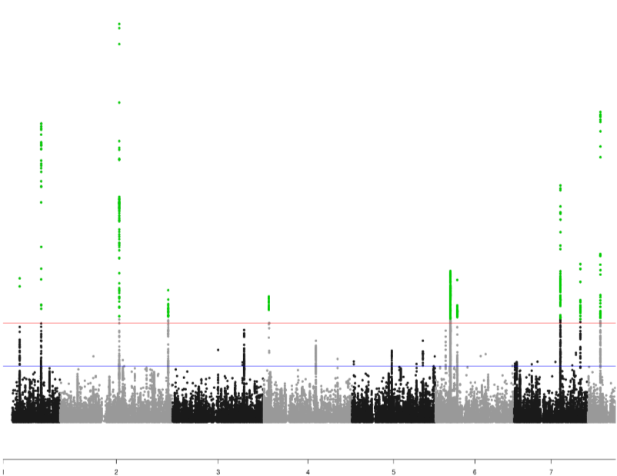
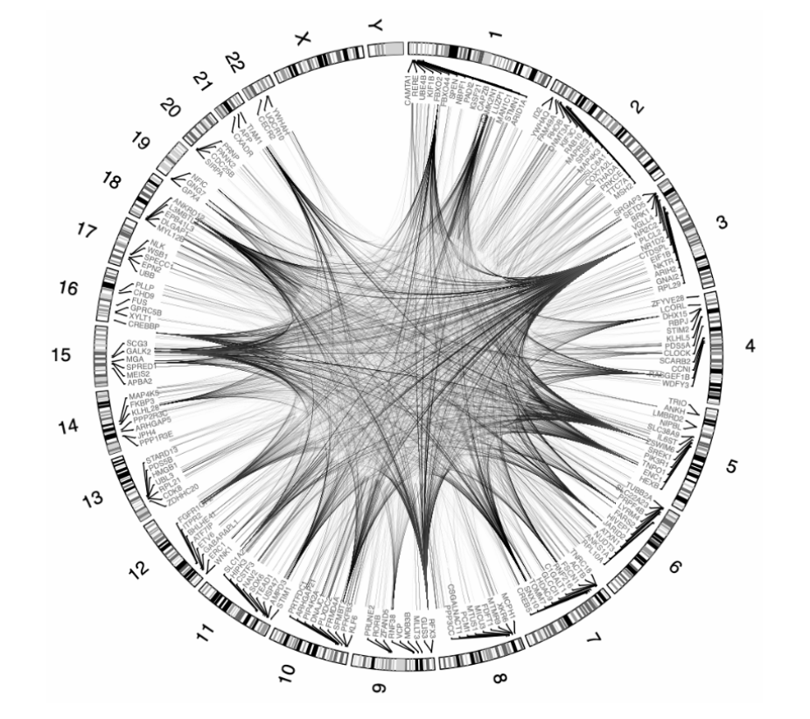

Gene regulatory networks linking GWAS SNPs to disease genes
1. Predicting cell-type gene regulatory networks (GRNs) via multi-omics
2. Identifying cell-type disease genes via GWAS and cell-type GRNs
GWAS SNPs for AD/SCZ
Cell-type GRN
GWAS SNPs interrupt TFBSs in Cell-type GRN
3. Microglia GRN, cell-type disease gene functions
Output: Cell-type disease genes, networks and functions
SNP -> TF -> enhancer -> cell-type disease gene -> function
SNP -> TF -> cell-type disease gene -> function
Ting Jin (Ph.D. student, Biomedical Data Science)
Jin et al, Genome Medicine, 2021

Slide 17
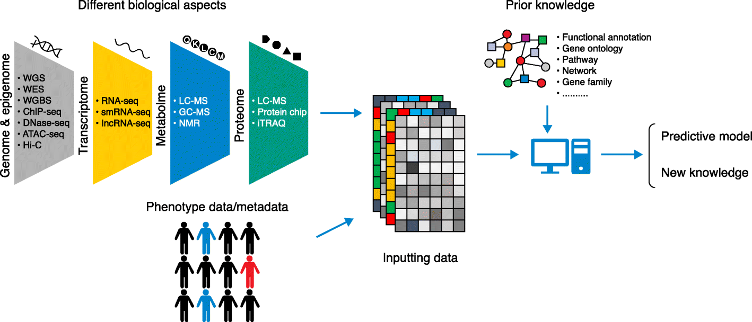





Machine learning for multi-omics analysis, prediction and interpretation
Regularization
$$Ω(⋅)$$
$$X^{(1)}…X^{\left(n\right)}$$
$$f^{∗}(⋅)$$
$$Y$$
Machine learning
algorithm
$$\min_{f}{ℓ\left(f\right)+Ω(f)}$$
Interpretability
Xu. Genome Bio. 2019

Slide 18
Outline
Background
  Functional genomics & multi-omics
  Gene regulation
Multi-view learning for multi-modal data
  Multi-view Empirical Risk Minimization (MV-ERM)
  Manifold alignment
App 1: single-cell multi-modal data integration
  Predicting neuronal electrophysiology from gene expression
App 2: deep manifold-regularized classification
  Predicting cortical layers of neurons from multi-modalities
App 3: biologically interpretable neural network modeling
  Disease prediction and functional prioritization

Slide 19
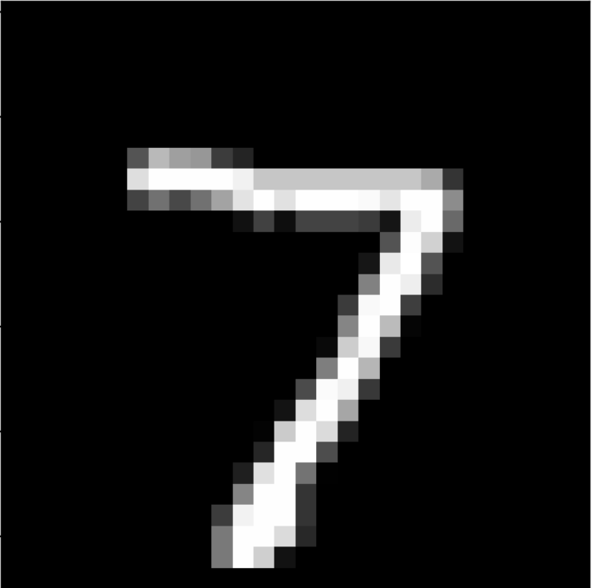
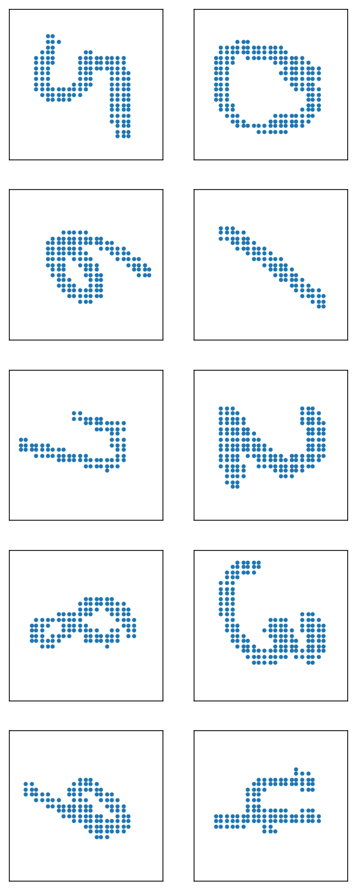



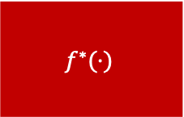
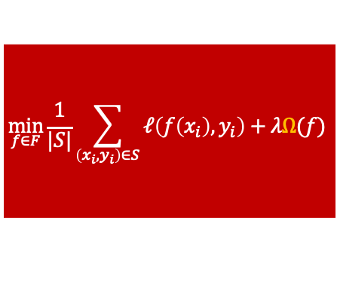

Empirical Risk Minimization (ERM)
loss function $ℓ$
$$\min_{f∈F}{\frac{1}{|S|}\sum_{\left(x_{i},y_{i}\right)∈S}{ℓ\left(f\left(x_{i}\right),y_{i}\right)}+λΩ(f)}$$
$$f^{∗}(⋅)$$
data$\left(x_{i},y_{i}\right)∈S$
Empirical Risk
7
hypothesis space $F$
$Ω$: regularize $f$ by knowledge

Slide 20
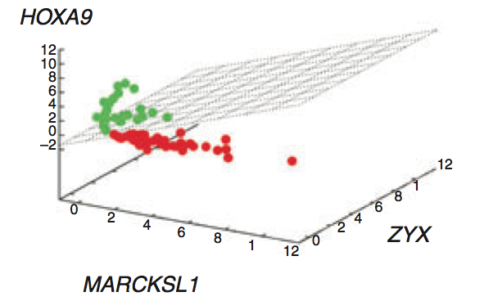
Empirical Risk Minimization (ERM) for single-omics (single-view learning)
e.g., Leukemia patient classification
  y_{i}: Acute lymphoblastic leukemia (ALL) vs. Acute myeloid leukemia (AML)
  x_{i}: gene expression
  f: SVM
^{Nobel, Nature Biotech, 2006}
Nguyen, Wang, PLoS Computational Biology, 2020

Slide 21
Example: single-view unsupervised learning
1866 individuals
25 top components
Non-negative matrix factorization (NMF)
1866 individuals
Unsupervised
decomposition
(NMF)
Bulk
expression
(B)
NMF
comp
(V)
NMF comp fractions
(H)
All genes (∼20K)
≈
All genes
25 top components
×
Single cell signatures
~14,000 cells (Lake et al., Science, 2016&2018)
~400 cells (Darmanis et al., PNAS, 2015)
~18,000 cells (PsychENCODE)
Wang, et al., Science, 2018

Slide 22
Multi-view learning for multi-omics integration
For example, gene regulation involves
  Genomics; e.g., SNPs
  Transcriptomics; e.g., genes
  Proteomics; e.g., transcription factors (TFs)
Cross-omics interactions
Ω_{co}(f⁽¹⁾,f⁽³⁾): SNPs break TF binding sites
Ω_{co}(f⁽²⁾,f⁽³⁾): TFs control gene expression
Ω_{co}(f⁽¹⁾,f⁽²⁾): SNPs associate with gene expression (e.g, eQTLs)
Nguyen, Wang, PLoS Computational Biology, 2020

Slide 23


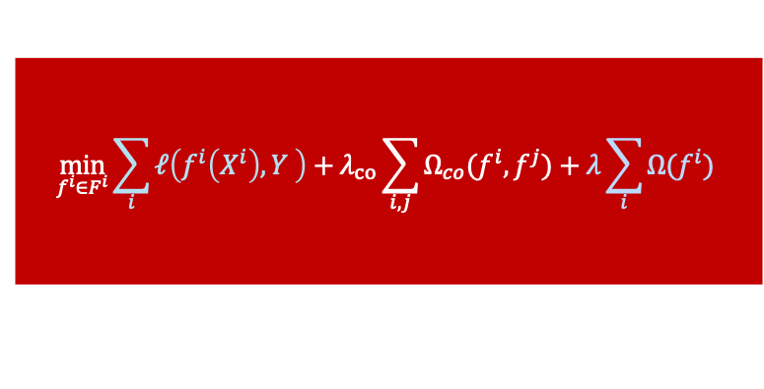










Multiview Empirical Risk Minimization (MV-ERM)
loss function $ℓ$
(optional)
$$X^{1}$$
$$\min_{f^{i}∈F^{i}}{\sum_{i}{ℓ\left(f^{i}\left(X^{i}\right),Y \right)}+λ_{co}\sum_{i,j}{Ω_{co}(f^{i},f^{j})}+λ\sum_{i}{Ω(f^{i})}}$$
regularization
across multiomics
regularization
from a single-omics
$$f^{1}$$
data from
$n$ views
$$X^{2}$$
$$f^{2}$$
$$Y,$$
…
optional
consensus
complementary
$$f^{n}$$
$$X^{n}$$
…
$n$ hypothesis spaces $F^{1}$
$$F^{2}$$
$$F^{n}$$
Complementary regularization
Unique information from each view
Consensus regularization
Relationship information across views
Nguyen, Wang, PLoS Computational Biology, 2020
Notes:
To deal with Multiview data coming from multiple unknown distributions, we propose the Multiview ERM framework.
Given a Multiview datasets with v views, we need to choose v hypothesis space, and depend on whether it is a prediction problem or not, a loss function. Loss function here is optional because these v data views are matched to each other to some degree. This term between constraining model f and ground truth Y is optional because we already have this term constraining the models f_i, f_j for 2 different data views. It is the co-regularization term and support the consensus principle of Multiview learning, aiming to maximize the agreement between 2 views.
The other principle, complementary, aiming to achieve the information that only exhibit in each view, is supported by this term.
We did a systematic review on state-of-the-art Multiview methods to see if they support these principles or not.
And also, we categorize these methods into two families
dots....

Slide 24


Factorization-based MV-ERM
Complementary $G^{(i)}$
Consensus $\tilde{F}$
e.g., solved by Multi-view NMF (Liu et al., SIAM ICDM, 2013)
Nguyen, Wang, PLoS Computational Biology, 2020

Slide 25
Alignment-based MV-ERM
Unseen relationships across multi-omics
Common latent space
Complementary
Consensus
Nguyen, Wang, PLoS Computational Biology, 2020

Slide 26
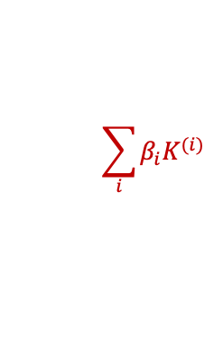

Alignment-based multi-view learning methods
Multiple kernel learning | Subspace learning
learn a combination of predefined kernels | obtains a common latent subspace
not data dependent | data dependent → more general
expensive | non-expensive
Only support complementary principle non-linear | CCA (Canonical Correlation Analysis) Only support consensus principle linear
$$\sum_{i}{β_{i}K^{(i)}}$$
$$\max_{f,g}{corr\left(f\left(X\right),g\left(Y\right)\right)}$$
Xu, Chang, Dacheng Tao, and Chao Xu. "A survey on multi-view learning." arXiv preprint arXiv:1304.5634 (2013)
Can we support both principles?
Notes:
I’ll talk a little about 2 popular alignment-based methods first before talking about ManiNetCluster.
In multiple kernel learning, we learn a combination of predefined kernels representing different views while, in subspace learning, we learn a common subspace share by different views.
Multiple kernel learning is non-linear but expensive in terms of space complexity, while subspace learning, like CCA, is non-expensive but linear.
Especially, one only supports complementary principle, the other supports only consensus principle.
That’s why we developed ManiNetCluster, which is both non-linear and non-expensive by employing manifold learning.

Slide 27
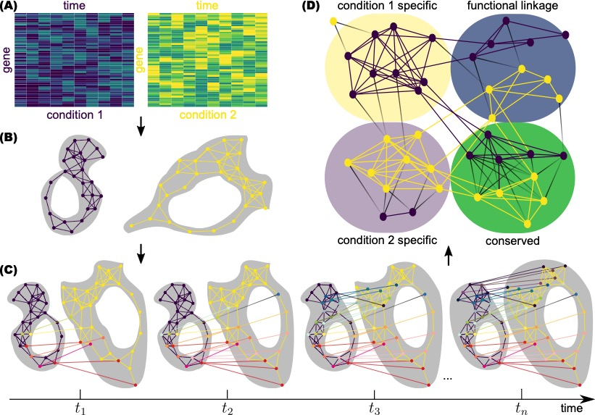
ManiNetCluster: manifold alignment to reveal the functional links between gene networks
Multi-view datasets (e.g., diseases, species, conditions)
Functional linkages across views
Alignment step
ManiNetCluster is a subspace learning, non-linear and non-expensive
(by employing manifold learning) & support both principles
Nguyen, Blaby, Wang, BMC Genomics, 2019 (Best Poster Award, ACM BCB 2018)

Slide 28
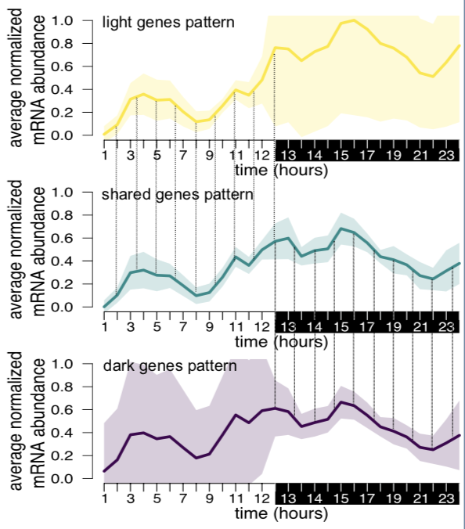
ManiNetCluster: manifold alignment to reveal the functional links between gene networks
Application: genomic functional linkages between light and dark periods of green alga
Nguyen, Blaby, Wang, BMC Genomics, 2019 (Best Poster Award, ACM BCB 2018)

Slide 29
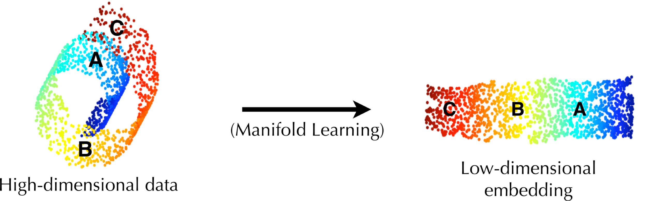
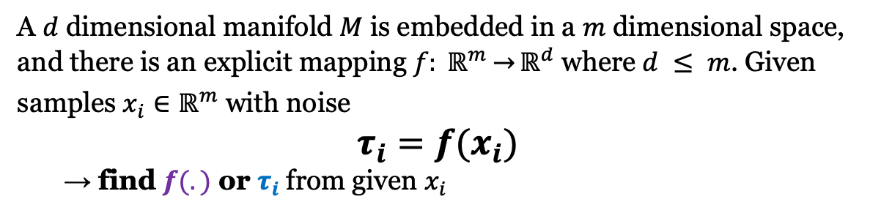


Manifold Learning
Parametric
Non-parametric
$$f(.)$$
$$τ_{A}$$
A $d$ dimensional manifold $M$ is embedded in a $m$ dimensional space, and there is an explicit mapping $f: ℝ^{m}\overset{→}{}ℝ^{d}$ where $d ≤ m$. Given samples $x_{i}∈ℝ^{m}$ with noise
$τ_{i}=f(x_{i})$
→ find $f(.)$ or $τ_{i}$from given $x_{i}$
Parametric & generalizable (e.g., linear manifold learning)
Nonparametric & nongeneralizable (e.g., nonlinear manifold learning)
Notes:
Manifold learning is a family of non-linear dimension reduction, aiming to achieve the data shape, or the low dimensional submanifold concentrating the distribution of data which is embedded in the high dimensional ambient space.
Here is a 2-dimensional manifold embedded in a 3d Euclidian space. If using PCA, we can get a representation where C is close to A, but, using manifold learning, we can achieve the true shape where C is faraway from A.
Manifold learning can be parametric by learning the mapping f or non-parametric by learning directly the new coordinates tau.

Slide 30

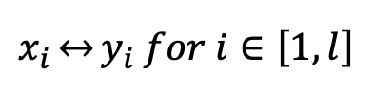

Manifold Alignment
two datasets
$$X=\left[x_{1},…,x_{m}\right], x_{i}∈ℝ^{p}$$
$$Y=\left[y_{1},…,y_{n}\right],y_{j}∈ℝ^{q}$$
$$x_{i}\overset{↔}{}y_{i} for i∈\left[1,l\right]$$
To find mapping function $f\left(.\right),g(.)$
And learn common manifolds between two datasets (views)
Alignment step
Notes:
Mathematically, given two data views X & Y, and correspondence between them, we want to find a mapping f and g to minimize this cost function.

Slide 31
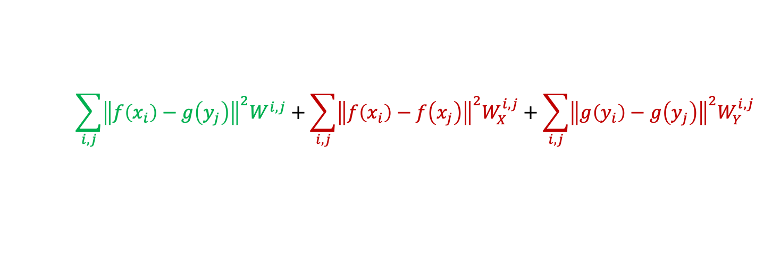
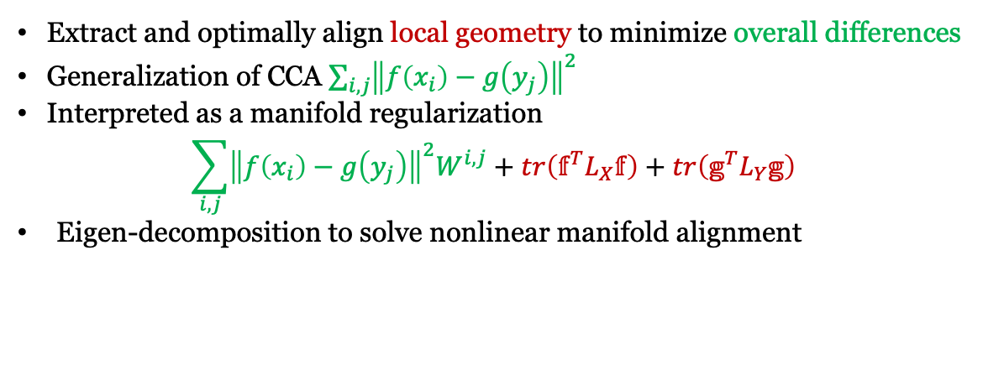
Manifold Alignment framed by MV-ERM
Learn common manifolds between two datasets (views)
$$X=\left[x_{1},…,x_{m}\right], x_{i}∈ℝ^{p}$$
$$Y=\left[y_{1},…,y_{n}\right],y_{j}∈ℝ^{q}$$
$$x_{i}\overset{↔}{}y_{i} for i∈\left[1,l\right]$$
To find mapping function $f\left(.\right),g(.)$ to minimize the cost function
Inter-view correspondence
Intra-view correspondence
$$\sum_{i,j}{{\left\|f\left(x_{i}\right)−g\left(y_{j}\right)\right\|}^{2}W^{i,j}}+\sum_{i,j}{{\left\|f\left(x_{i}\right)−f\left(x_{j}\right)\right\|}^{2}W_{X}^{i,j}}+\sum_{i,j}{{\left\|g\left(y_{i}\right)−g\left(y_{j}\right)\right\|}^{2}W_{Y}^{i,j}}$$
global consistency
local smoothness
consensus
complementary
Extract and optimally align local geometry to minimize overall differences
Generalization of CCA $\sum_{i,j}{{\left\|f\left(x_{i}\right)−g\left(y_{j}\right)\right\|}^{2}}$
Interpreted as a manifold regularization
$$\sum_{i,j}{{\left\|f\left(x_{i}\right)−g\left(y_{j}\right)\right\|}^{2}W^{i,j}}+tr\left(𝕗^{T}L_{X}𝕗\right)+tr\left(𝕘^{T}L_{Y}𝕘\right)$$
Eigen-decomposition to solve nonlinear manifold alignment
Notes:
Mathematically, given two data views X & Y, and correspondence between them, we want to find a mapping f and g to minimize this cost function.

Slide 32
Outline
Background
  Functional genomics & multi-omics
  Gene regulation
Multi-view learning for multi-modal data
  Multi-view Empirical Risk Minimization (MV-ERM)
  Manifold alignment
App 1: single-cell multi-modal data integration
  Predicting neuronal electrophysiology from gene expression
App 2: deep manifold-regularized classification
  Predicting cortical layers of neurons from multi-modalities
App 3: biologically interpretable neural network modeling
  Disease prediction and functional prioritization

Slide 33
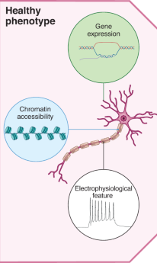

Single-cell multi-modal data by Patch-seq (beyond omics)
Neuron
Nature Computational Science News & Views, Jan 2022

Slide 34

Manifold alignment of single neurons by electrophysiology and gene expression
Patch-seq data of ~3k neuronal cells in the mouse visual cortex from BRAIN Initiative
Jiawei Huang (M.S., Statistics, 2021)
Huang, Sheng, Wang, Communications Biology, 2021
Notes:
Also, we are developing another open-source pipeline to predict regulatory variants for additional disease phenotypes such as progression stages and also across multiple brain regions.
Further, we are building an interactive functional genomic resource as web app for AD and psychiatric disorders. For instance, users can query a gene like bmp4, the web app will pop up related regulatory network showing how variants interrupt TFBSs that regulate the gene and how the gene is related to disease phenotypes.

Slide 35
Nonlinear Manifold Alignment (NMA) uncovers trajectory with multi-modal changes
time taken from membrane potential to AP peak for ramp stimulus
UnionCom
PCA
t-SNE
Transcriptomic type
Electrophysiological features
MAGAN
UMAP
PHATE
Huang, Sheng, Wang, Communications Biology, 2021

Slide 36
NMA aligned cells form cross-modal clusters, suggesting related genes and electrophysiological features
Mouse visual cortex (3654 cells)
Mouse motor cortex (1227 cells)
Huang, Sheng, Wang, Communications Biology, 2021

Slide 37
Predicting electrophysiological features by differentially expressed genes in cross-modal clusters
Multivariate regression
Highly predictive e-phys features
Differentially expressed genes
Can we align multi-modal features to improve phenotype prediction?
Huang, Sheng, Wang, Communications Biology, 2021

Slide 38
Outline
Background
  Functional genomics & multi-omics
  Gene regulation
Multi-view learning for multi-modal data
  Multi-view Empirical Risk Minimization (MV-ERM)
  Manifold alignment
App 1: single-cell multi-modal data integration
  Predicting neuronal electrophysiology from gene expression
App 2: deep manifold-regularized classification
  Predicting cortical layers of neurons from multi-modalities
App 3: biologically interpretable neural network modeling
  Disease prediction and functional prioritization

Slide 39

deepManReg: a deep manifold-regularized learning model for phenotype prediction from multi-modal data
Nam Nguyen (Ph.D. 2021, Computer Science, now Lane Fellow in CMU)
Nguyen, Huang, Wang, Nature Computational Science, 2022

Slide 40
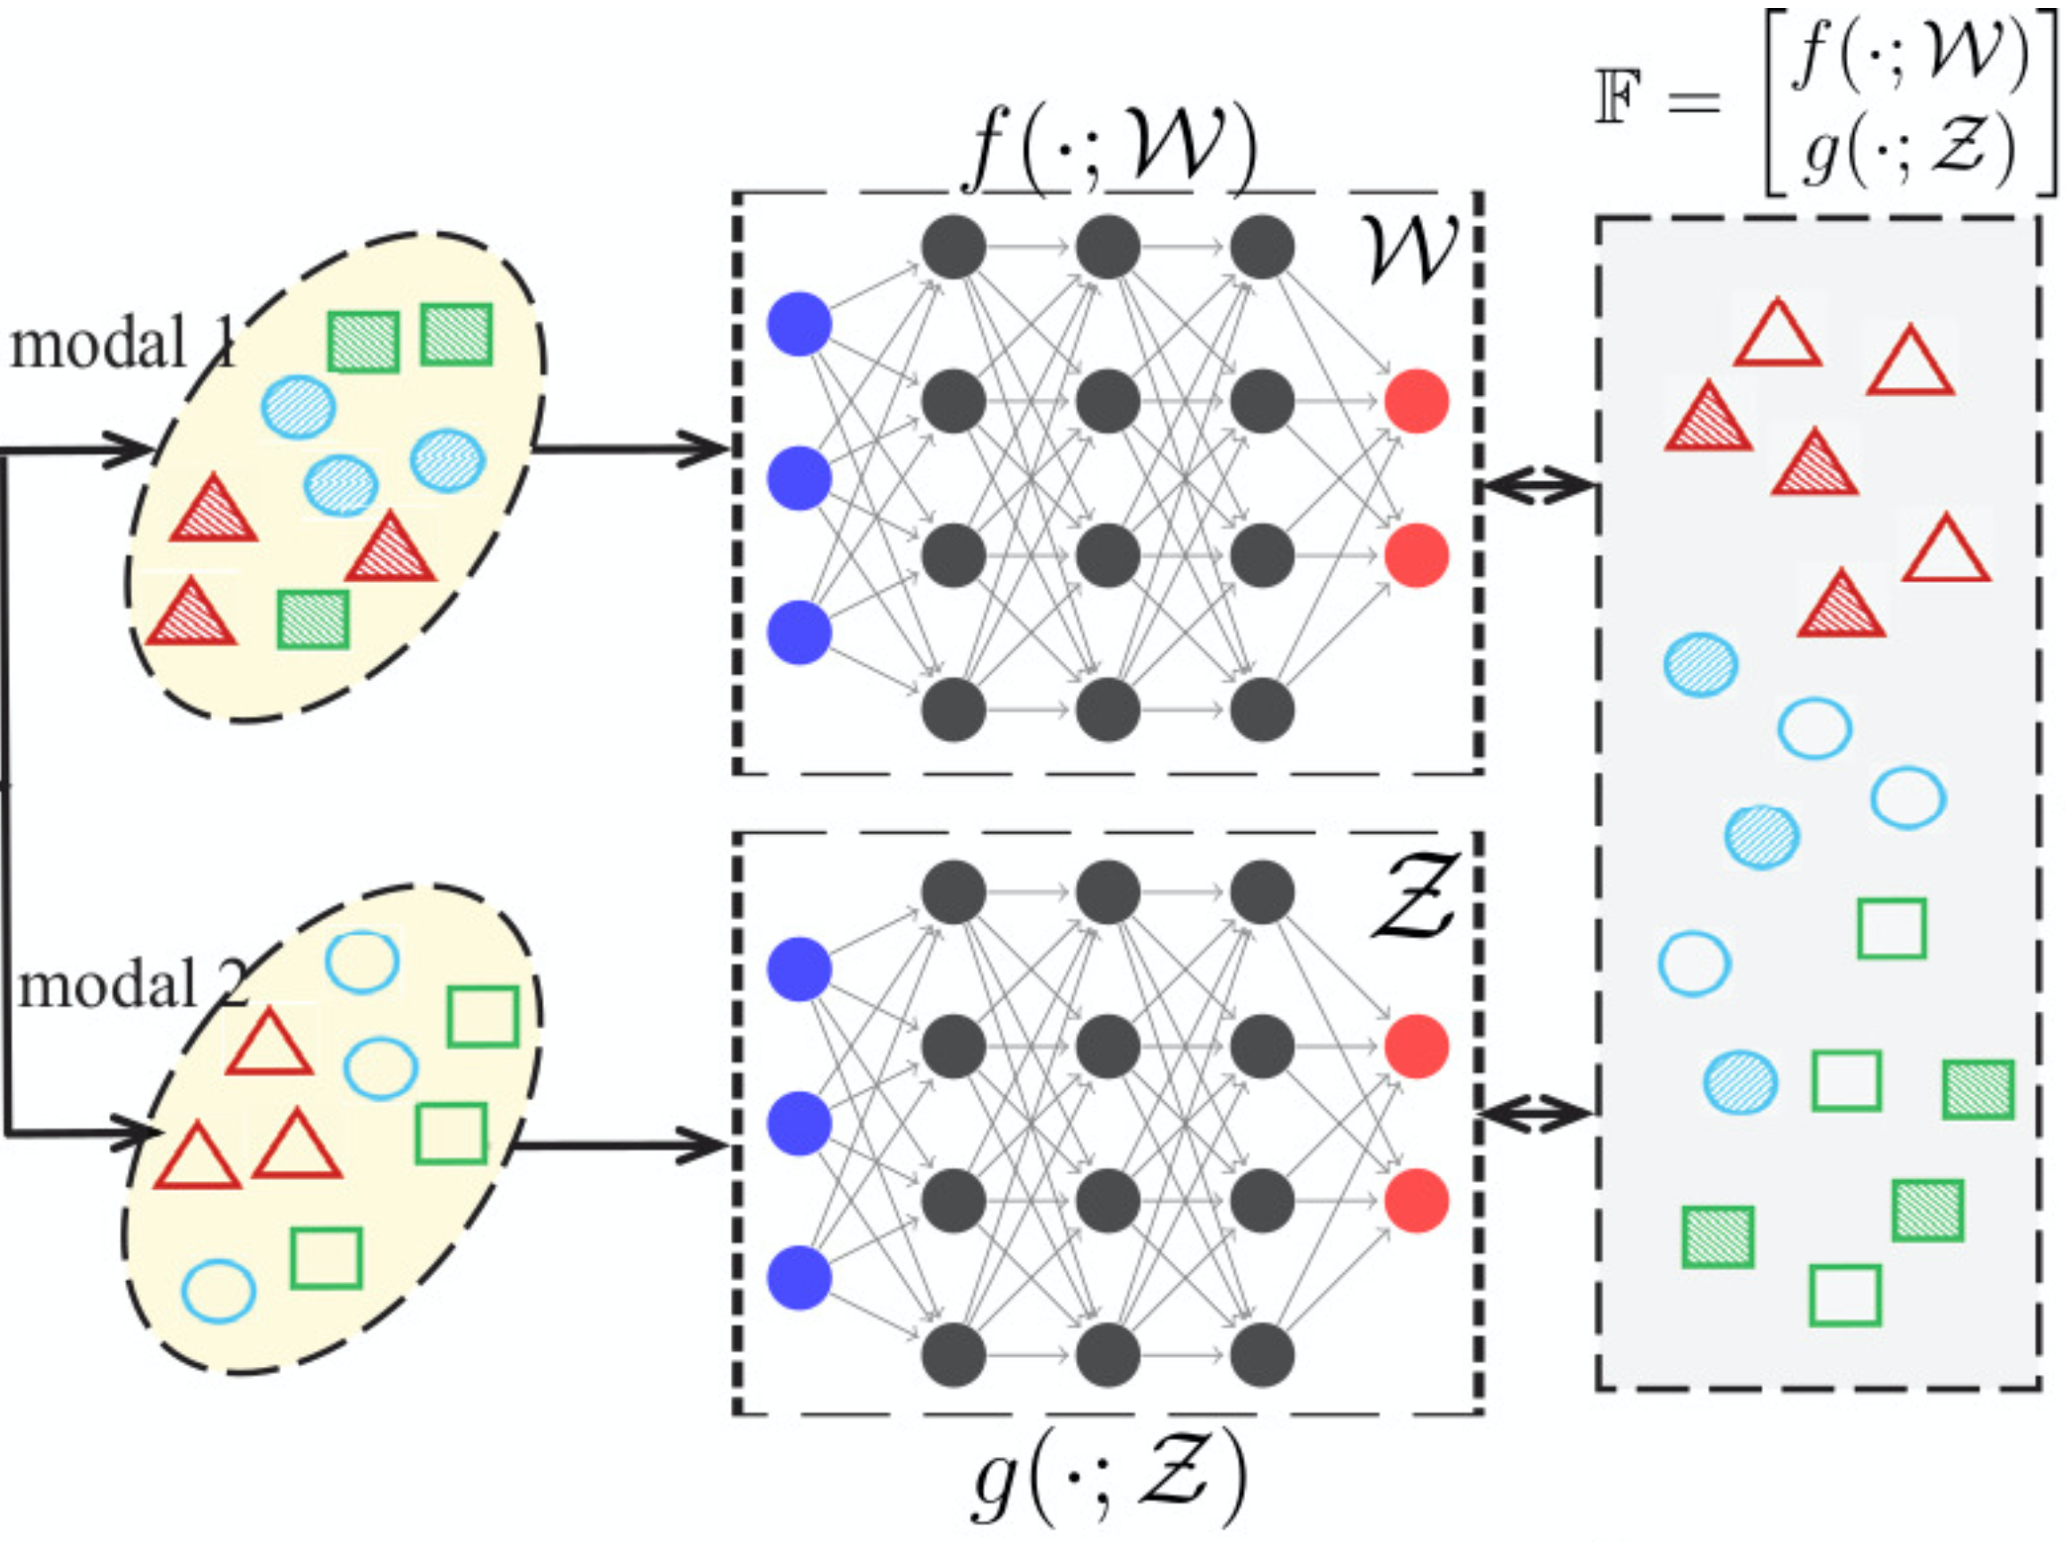
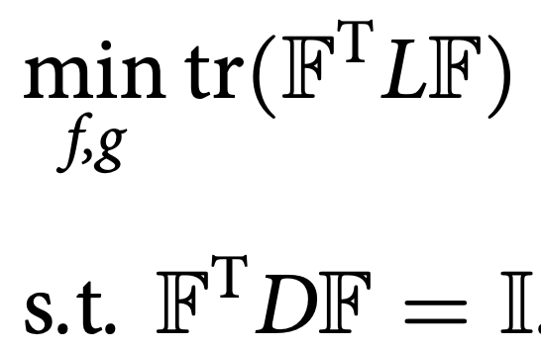
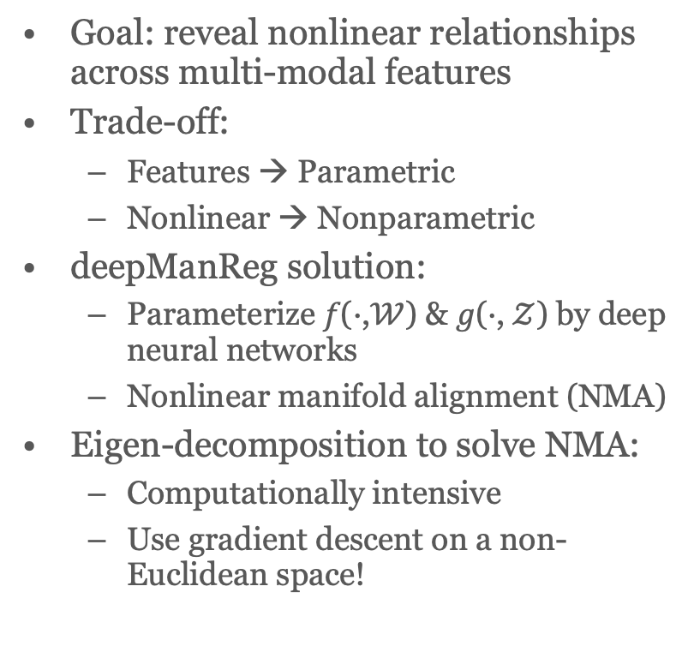
Phase 1: deep manifold alignment of multi-modal features
Goal: reveal nonlinear relationships across multi-modal features
Trade-off:
  Features → Parametric
  Nonlinear → Nonparametric
deepManReg solution:
  Parameterize 𝑓(⋅,$𝒲$) & 𝑔(⋅, $𝒵$) by deep neural networks
  Nonlinear manifold alignment (NMA)
Eigen-decomposition to solve NMA:
  Computationally intensive
  Use gradient descent on a non-Euclidean space!
Feature alignment
Nonlinear manifold alignment
Nguyen, Huang, Wang, Nature Computational Science, 2022

Slide 41
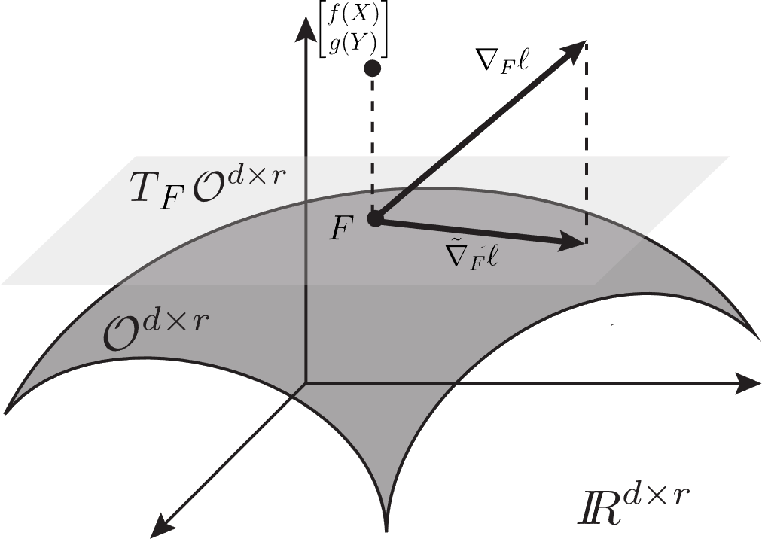
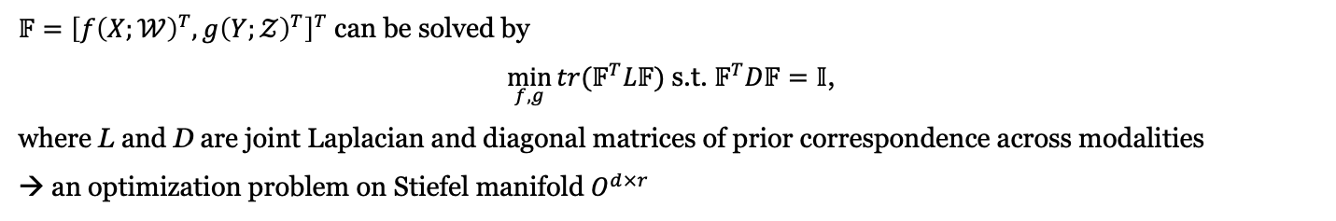
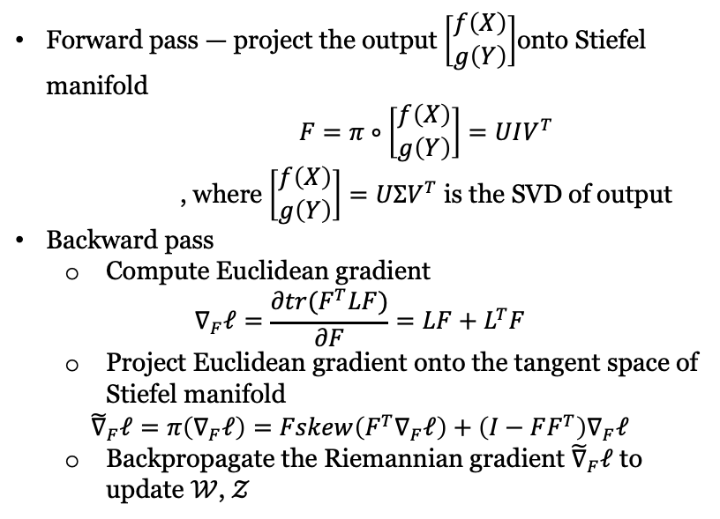
Optimization for deepManReg alignment
$𝔽={\left[f{\left(X;𝒲\right)}^{T},g{\left(Y;𝒵\right)}^{T}\right]}^{T}$ can be solved by
$\min_{f,g}{{tr(𝔽}^{T}L𝔽)}$ s.t. $𝔽^{T}D𝔽=𝕀$,
where L and D are joint Laplacian and diagonal matrices of prior correspondence across modalities
→ an optimization problem on Stiefel manifold $O^{d×r}$
Forward pass — project the output $\left[\begin{matrix}f\left(X\right) \\ g\left(Y\right)\end{matrix}\right]$onto Stiefel manifold
$F=π∘\left[\begin{matrix}f\left(X\right) \\ g\left(Y\right)\end{matrix}\right]=UIV^{T}$
, where $\left[\begin{matrix}f\left(X\right) \\ g\left(Y\right)\end{matrix}\right]=UΣV^{T}$ is the SVD of output
Backward pass
  Compute Euclidean gradient
$$∇_{F}ℓ=\frac{∂tr(F^{T}LF)}{∂F}=LF+L^{T}F$$
  Project Euclidean gradient onto the tangent space of
  Stiefel manifold
$${\tilde{∇}}_{F}ℓ=π\left(∇_{F}ℓ\right)=Fskew\left(F^{T}∇_{F}ℓ\right)+\left(I−FF^{T}\right)∇_{F}ℓ$$
  Backpropagate the Riemannian gradient ${\tilde{∇}}_{F}ℓ$ to update $𝒲$, $𝒵$
Cunningham et al. The Journal of Machine Learning Research 16.1 (2015): 2859-2900.
Nguyen, Huang, Wang, Nature Computational Science, 2022
Notes:
I’ll explain why. Because we want to solve for the matrix F this optimization problem min FtLF with the feasible set of orthogonality constraints on F, and this is the Stiefel manidold of all orthogonal matrix with a specific size.
For example, in this figure, R to the d times r is the Euclidean space of all matrix with that size, but our solution lies on the submanifold embedded in this ambient space, the manifold of all orthogonal matrix with that size.
So, when training the 2 neural nets, we need to do 2 things in each training step.
First, in the forward pass, we project the output F onto the manifold, F to R as in here.
Second, in the backward pass, we project the Euclidean gradient of the loss l with respect to the output F onto the tangent space of this manifold. And then we backpropagate with this projected gradient.

Slide 42
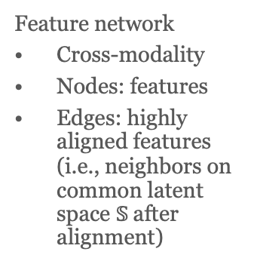
Phase 2: classification regularized by cross-modal feature network (aligned features)
Feature network
Cross-modality
Nodes: features
Edges: highly aligned features (i.e., neighbors on common latent space $𝕊$after alignment)
Sample classification regularized by cross-modal feature network
Nguyen, Huang, Wang, Nature Computational Science, 2022

Slide 43
deepManReg alignment & classification of handwritten digits
Multi-modal feature alignment
Digit classification
2000 images of handwritten digits 0-9 (mfeat data)
Two types of features:
216 profile correlations, 76 Fourier coefficients
Breukelen et al. Kybernetika, 34(4):381–386, 1998.
Nguyen, Huang, Wang, Nature Computational Science, 2022
Notes:
Multi-modal feature alignment of handwritten digits. Scatter plots show that deepManReg out- performs alternative methods to align cross-modal data on the common latent space (2D). Two modalities, Fourier coefficient (Orange) and profile correlation (Blue), are projected after alignment onto a 2D common space. The total sum of pairwise distances between the two modalities on the latent space are 72442841533, 258, and 144 for CCA, LMA, and deepManReg respectively.
cite mfeat
deepManReg alignment for multi hand

Slide 44
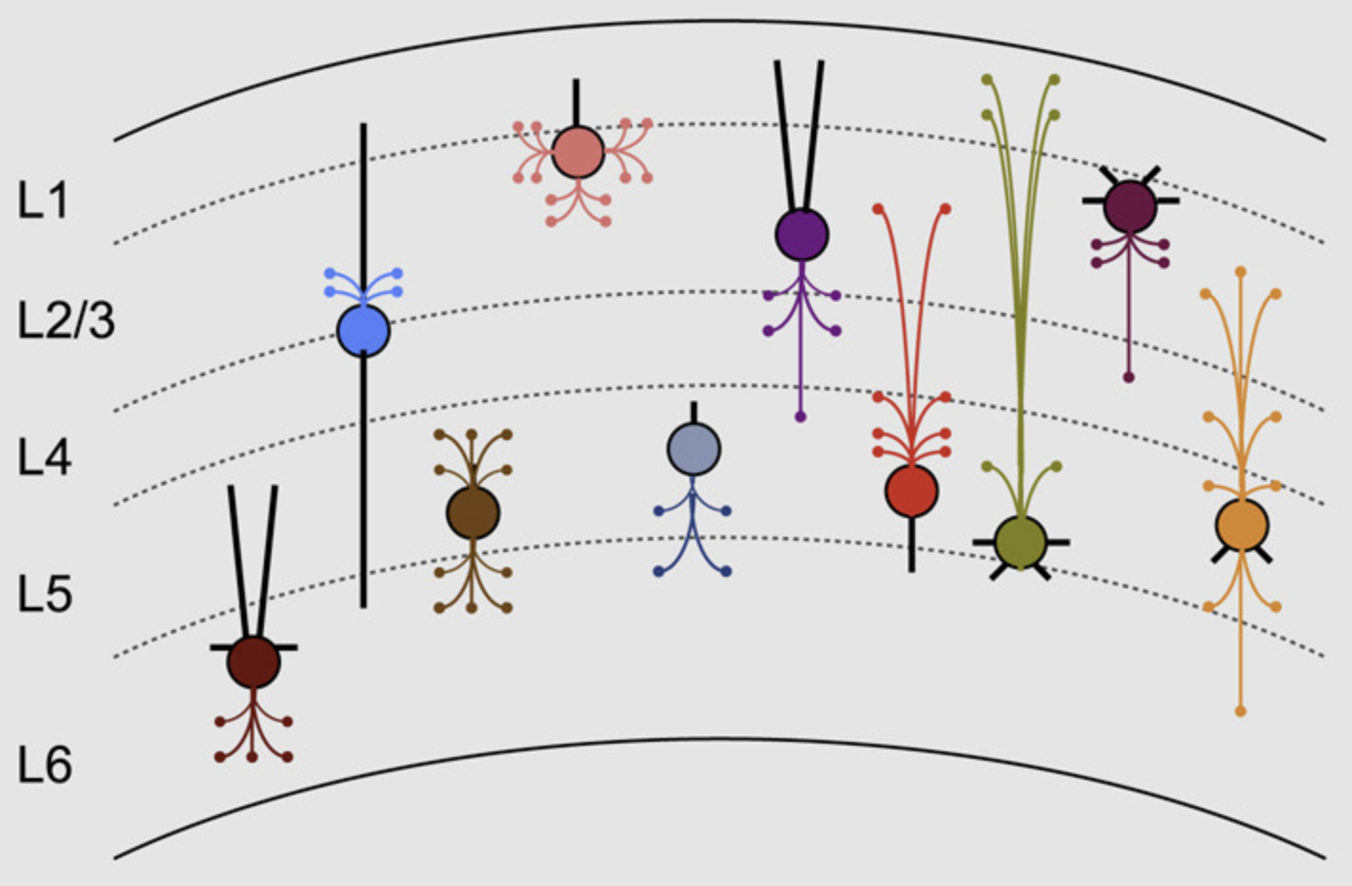
deepManReg alignment & classification of neuronal cells
Single-cell multi-modal data by Patch-seq
3654 GABAergic cortical neurons in mouse visual cortex
Modality 1: Electrophysiological features
  By hyperpolarizing and depolarizing current injection stimuli and responses of short (3 ms) current pulses, long (1 s) current steps, and slow (25 pA/s) current ramps.
Modality 2: Genes
  Expression levels
Phenotype: 5 cortical layers, L1, L2/3, L4, L5, and L6
Running time (alignment only)
  CCA (725.96 seconds)
  Manifold Alignment (663.43 seconds) MATCHER (150.94 seconds)
  deepManReg (57.90 seconds by GPUs GTX 1060Ti and 90.10 seconds by CPU i5-8250U)
Gouwens et al. Cell 183.4 (2020): 935-953.
Nguyen, Huang, Wang, Nature Computational Science, 2022
Notes:
and five cell layers revealing the locations of cells on the visual cortex: L1, L2/3, L4, L5, and L6.
classifcation for mfeat first
single cell multimodal
remove motor cortex
remove t-types
cite, insert figure

Slide 45
Cross-modal feature network linking aligned genes and electrophysiological features
Nguyen, Huang, Wang, Nature Computational Science, 2022

Slide 46
Feature-network-regularized classification of cortical layers of neuronal cells
Nguyen, Huang, Wang, Nature Computational Science, 2022

Slide 47
Outline
Background
  Functional genomics & multi-omics
  Gene regulation
Multi-view learning for multi-modal data
  Multi-view Empirical Risk Minimization (MV-ERM)
  Manifold alignment
App 1: single-cell multi-modal data integration
  Predicting neuronal electrophysiology from gene expression
App 2: deep manifold-regularized classification
  Predicting cortical layers of neurons from multi-modalities
App 3: biologically interpretable neural network modeling
  Disease prediction and functional prioritization

Slide 48

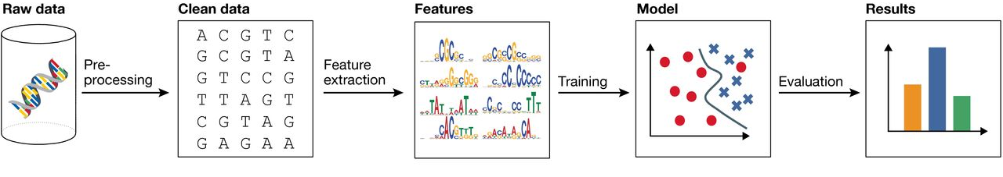
Machine learning opens “black box” for disease prediction and functional interpretation
Risk variants, genes, elements
Functions, mechanisms
Population multi-omics (e.g., SNPs, genes)
Disease diagnosis
…
Machine Learning

Slide 49
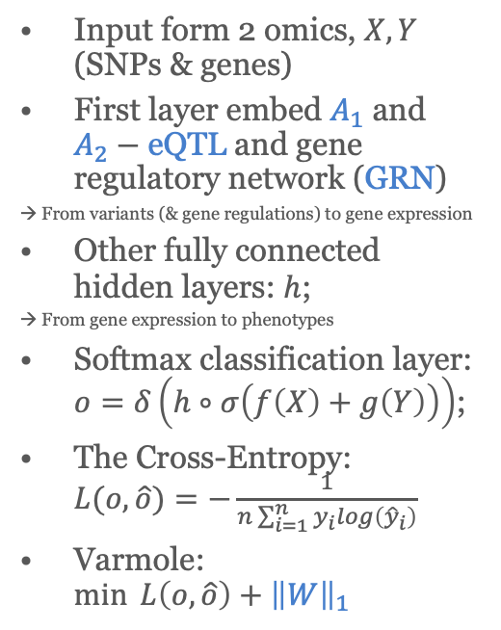
Varmole: Interpretable deep neural network model prioritizes disease variants and genes via DropConnect
Disease (or health)
Input form 2 omics, $X, Y$ (SNPs & genes)
First layer embed $A_{1}$ and $A_{2}−$ eQTL and gene regulatory network (GRN)
→ From variants (& gene regulations) to gene expression
Other fully connected hidden layers: $h$;
→ From gene expression to phenotypes
Softmax classification layer: $o=δ\left(h∘σ\left(f\left(X\right)+g\left(Y\right)\right)\right)$;
The Cross-Entropy: $L(o,\hat{o})=−\frac{1}{n\sum_{i=1}^{n}{y_{i}}log\left({\hat{y}}_{i}\right)}$
Varmole: $\min{L\left(o,\hat{o}\right)+{\left\|W\right\|}_{1}}$
eQTL
GRN
Nguyen, Jin, Wang, Bioinformatics, 2021

Slide 50
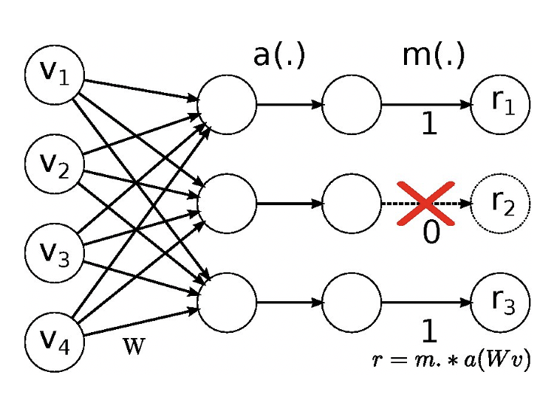
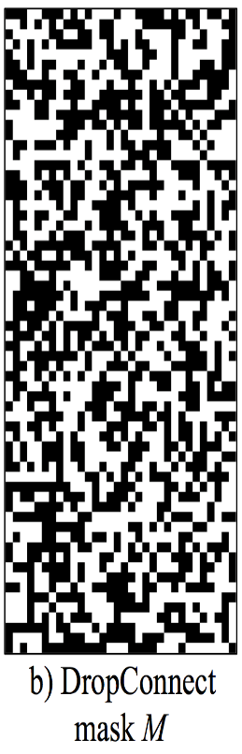
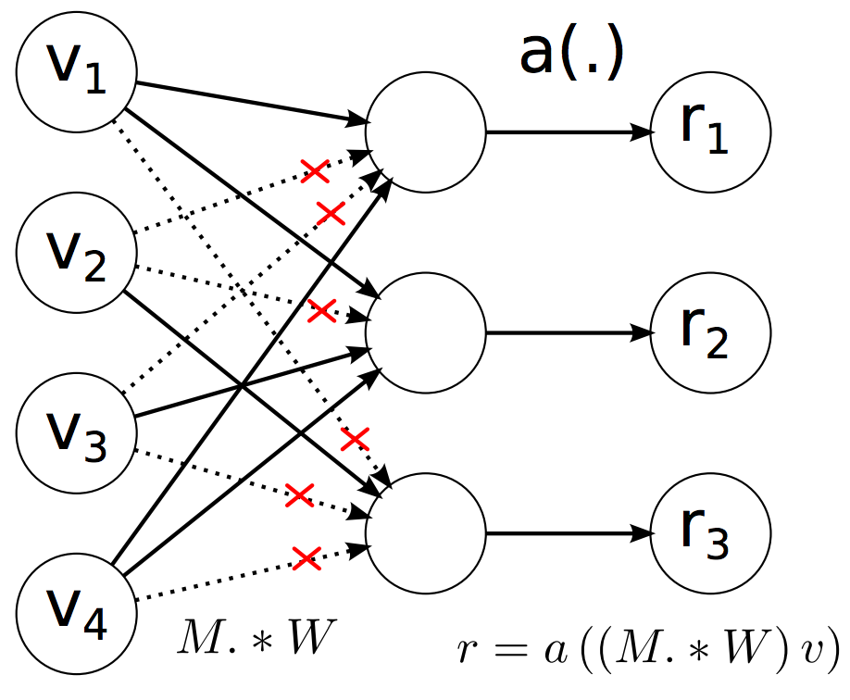





Drop-connect
Drop-out and drop-connect are 2 simple but effective regularization techniques
$$σ\left(⋅\right)$$
$$σ\left(⋅\right)$$
$$W$$
$$⊙$$
$$r=σ\left(A_{1}⊙W_{1}\right)v$$
The drop-connect mask is eQTL or GRN ($A_{1}$ or $A_{2}$)

Slide 51
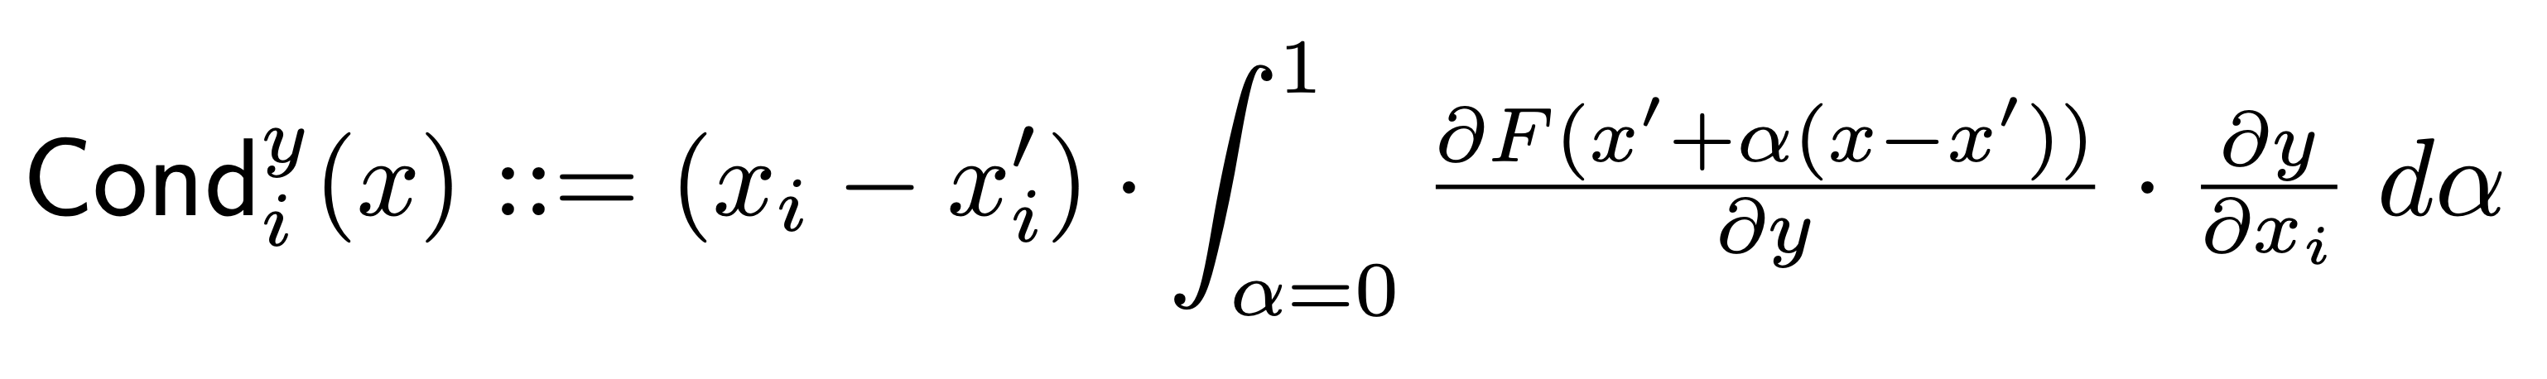
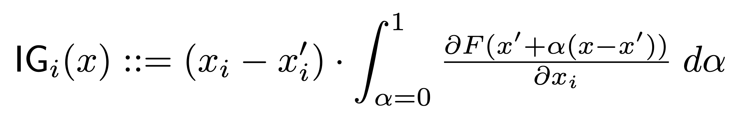





Interpretation: prioritization via Integrated Gradients
Given a model $F$, an input $x$, and the output $F(x)$ of the model for input in question, an attribution methods returns the ‘relevance’ of each input feature $i$ to the output
How importance a gene (SNP, eQTL link, TF-gene link) to the disease outcome
$$y$$
SNP
$$x_{i}$$
Gene
Importance score
of link $x_{i}→y$
Importance score
of feature $i$ of input $x$
Sundararajan, M., Taly, A., & Yan, Q. (2017). arXiv preprint arXiv:1703.01365.
Nguyen, Jin, Wang, Bioinformatics, 2021
Notes:
After training, to interpret the prioritization of genes, SNPs, and all possible links among them, we employ a method call integrated gradient calculate the importance score of each feature.
So, given a model F, an input x, the output F(x), the method returns the ‘relevance’ of each input feature i to that specific output.
Using this, we can get the prioritization of gene and SNP score, and with a little generalization, we can also get the link importance score between gene to gene or SNP to gene.
These prioritizations are then used for enrichment analysis.

Slide 52

Application for schizophrenia
Dataset:
  RNA-seq gene expression & genotype data (dosage) for 487 schizophrenia (scz) vs. 891 non-scz human brain samples (front cortex)
  Embedding GTEx eQTLs & PsychENCODE GRN for human brain front cortex
  → 127304 SNPs, 2598 genes
Nguyen, Jin, Wang, Bioinformatics, 2021

Slide 53
Prioritized gene functions & regulatory links for schizophrenia
A list of enriched functions (FDR<0.05) from prioritized genes:
  neuron development
  axon guidance
  cell adhesion
  calcium signaling
  response to external stimulus
  NMDA receptor
  insulin secretion
Prioritized SNP-gene pairs
  SNP-gene pairs on the interacting enhancers and promoters (Hi-C) have significantly higher importance scores (p<5e-5)
  Potential regulatory roles of prioritized SNPs to genes via enhancers
Nguyen, Jin, Wang, Bioinformatics, 2021

Slide 54
Outline
Background
  Functional genomics & multi-omics
  Gene regulation
Multi-view learning for multi-modal data
  Multi-view Empirical Risk Minimization (MV-ERM)
  Manifold alignment
App 1: single-cell multi-modal data integration
  Predicting neuronal electrophysiology from gene expression
App 2: deep manifold-regularized classification
  Predicting cortical layers of neurons from multi-modalities
App 3: biologically interpretable neural network modeling
  Disease prediction and functional prioritization

Slide 55

Thank you!
Current lab members
Dr. Shuang Liu (Data Scientist III)
Dr. Pramod Chandrashekar (Postdoc)
Dr. Chirag Gupta (Postdoc)
Dr. Chenfeng He (Postdoc)
Dr. Kalpana H. Arachchilage (Postdoc)
Saniya Khullar (CIBM fellow & Ph.D. candidate, Biomedical Data Science)
Ting Jin (Ph.D. student, Biomedical Data Science)
Sayali Alatkar (Ph.D. student, Computer Sciences)
Noah Cohen Kalafut (Ph.D. student, Computer Sciences)
Jie Sheng (Biostatistician, Waisman Center)
Jonathan Bryan (Undergraduate, Neurobiology)
Recent graduates
Nam Nguyen (Ph.D. 2021, Computer Science, Lane Fellow in Carnegie Mellon University)
Jiawei Huang (M.S. 2021, Statistics, Ph.D. student in University of Cincinnati)
Yudi Mu (M.S. 2021, Statistics, Ph.D. student in University of California Riverside)
Mufang Yin (M.S. 2020, Statistics, Ph.D. student in Rutgers University)
Peter Rehani (B.S. 2020, Neurobiology, Morgridge Institute for Research)
Funding acknowledgment
NSF Career 2144475
NIH R01AG067025
NIH R21CA237955
NIH R21NS127432
NIH R03NS123969
NIH U01MH116492
NIH P50HD105353
NIH R01HD106197
DOE QPSI
daifeng.wang@wisc.edu
https://daifengwanglab.org/
Various positions available!

