Slide 1
RNA-Seq Analysis and Gene Discovery
BMI/CS 776
www.biostat.wisc.edu/bmi776/
Spring 2022
Daifeng Wang
daifeng.wang@wisc.edu
These slides, excluding third-party material, are licensed under CC BY-NC 4.0 by Mark Craven, Colin Dewey, Anthony Gitter and Daifeng Wang

Slide 2
Overview
RNA-Seq technology
The RNA-Seq quantification problem
Interpolated Markov Model
  Finding bacterial genes

Slide 3
Goals for lecture
What is RNA-Seq?
How is RNA-Seq used to measure the abundances of RNAs within cells?
What probabilistic models and algorithms are used for analyzing RNA-Seq?
Finding genes

Slide 4
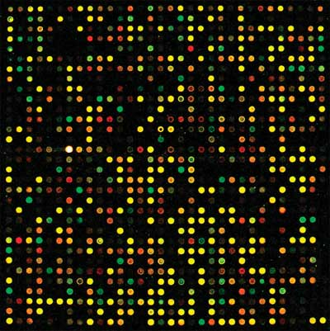
Measuring transcription the old way: microarrays
Each spot has “probes” for a certain gene
Probe: a DNA sequence complementary to a certain gene
Relies on complementary hybridization
Intensity/color of light from each spot is measurement of the number of transcripts for a certain gene in a sample
Requires knowledge of gene sequences

Slide 5
Advantages of RNA-Seq over microarrays
No reference sequence needed
  With microarrays, limited to the probes on the chip
Low background noise
Large dynamic range
  10⁵ compared to 10² for microarrays
High technical reproducibility
Identify novel transcripts and splicing events
Notes:
More suitable for low RNA content samples

Slide 6
RNA-Seq technology
Leverages rapidly advancing sequencing technology
Transcriptome analog to whole genome shotgun sequencing
Two key differences from genome sequencing:
  Transcripts sequenced at different levels of coverage - expression levels
  Sequences already known (in many cases) - coverage is measurement

Slide 7
A generic RNA-Seq protocol
Sample RNA
RNA fragments
cDNA fragments
reads
reverse transcription + amplification
sequencing machine
CCTTCNCACTTCGTTTCCCAC
TTTTTNCAGAGTTTTTTCTTG
GAACANTCCAACGCTTGGTGA
GGAAANAAGACCCTGTTGAGC
CCCGGNGATCCGCTGGGACAA
GCAGCATATTGATAGATAACT
CTAGCTACGCGTACGCGATCG
CATCTAGCATCGCGTTGCGTT
CCCGCGCGCTTAGGCTACTCG
TCACACATCTCTAGCTAGCAT
CATGCTAGCTATGCCTATCTA
fragmentation

Slide 8
RNA-Seq data: FASTQ format
name
@HWUSI-EAS1789_0001:3:2:1708:1305#0/1
CCTTCNCACTTCGTTTCCCACTTAGCGATAATTTG
+HWUSI-EAS1789_0001:3:2:1708:1305#0/1
VVULVBVYVYZZXZZ\ee[a^b`[a\a[\\a^^^\
@HWUSI-EAS1789_0001:3:2:2062:1304#0/1
TTTTTNCAGAGTTTTTTCTTGAACTGGAAATTTTT
+HWUSI-EAS1789_0001:3:2:2062:1304#0/1
a__[\Bbbb`edeeefd`cc`b]bffff`ffffff
@HWUSI-EAS1789_0001:3:2:3194:1303#0/1
GAACANTCCAACGCTTGGTGAATTCTGCTTCACAA
+HWUSI-EAS1789_0001:3:2:3194:1303#0/1
ZZ[[VBZZY][TWQQZ\ZS\[ZZXV__\OX`a[ZZ
@HWUSI-EAS1789_0001:3:2:3716:1304#0/1
GGAAANAAGACCCTGTTGAGCTTGACTCTAGTCTG
+HWUSI-EAS1789_0001:3:2:3716:1304#0/1
aaXWYBZVTXZX_]Xdccdfbb_\`a\aY_^]LZ^
@HWUSI-EAS1789_0001:3:2:5000:1304#0/1
CCCGGNGATCCGCTGGGACAAGCAGCATATTGATA
+HWUSI-EAS1789_0001:3:2:5000:1304#0/1
aaaaaBeeeeffffehhhhhhggdhhhhahhhadh
sequence
read
qualities
paired-end reads
read1
read2
1 Illumina HiSeq 2500 lane
~150 million reads

Slide 9
Tasks with RNA-Seq data
Assembly:
  Given: RNA-Seq reads (and possibly a genome sequence)
  Do: Reconstruct full-length transcript sequences from the reads
Quantification (our focus):
  Given: RNA-Seq reads and transcript sequences
  Do: Estimate the relative abundances of transcripts (“gene expression”)
Differential expression or additional downstream analyses:
  Given: RNA-Seq reads from two different samples and transcript sequences
  Do: Predict which transcripts have different abundances between two samples
Notes:
After quantification, can also do many types of downstream analysis like clustering, motif analysis, eQTL mapping, network reconstruction, etc.

Slide 10
RNA-Seq is a relative abundance measurement technology
RNA-Seq gives you reads from the ends of a random sample of fragments in your library
Without additional data this only gives information about relative abundances
Additional information, such as levels of “spike-in” transcripts, are needed for absolute measurements
RNA
sample
cDNA
fragments
reads

Slide 11
Issues with relative abundance measures
Gene | Sample 1 absolute abundance | Sample 1 relative abundance | Sample 2 absolute abundance | Sample 2 relative abundance
1 | 20 | 10% | 20 | 5%
2 | 20 | 10% | 20 | 5%
3 | 20 | 10% | 20 | 5%
4 | 20 | 10% | 20 | 5%
5 | 20 | 10% | 20 | 5%
6 | 100 | 50% | 300 | 75%
Changes in absolute expression of high expressors is a major factor
Normalization is required for comparing samples in these situations

Slide 12
The basics of quantification with RNA-Seq data
For simplicity, suppose reads are of length one (typically they are > 35 bases)
What relative abundances would you estimate for these genes?
Relative abundance is relative transcript levels in the cell, not proportion of observed reads
transcripts
reads
200
100 A
1
60
60 C
2
80
3
40 G

Slide 13

Length dependence
Probability of a read coming from a transcript ∝ relative abundance × length
transcripts
reads
200
100 A
1
60
2
60 C
80
3
40 G
probability of read from transcript 1 = (transcript 1 reads) / (total reads)
transcript 1 relative abundance
transcript 1 length

Slide 14





Length dependence
Probability of a read coming from a transcript ∝ relative abundance × length
transcripts
reads
200
100 A
1
60
2
60 C
80
3
40 G
normalize

Slide 15

The basics of quantification from RNA-Seq data
Basic assumption:
Normalization factor is the mean length of expressed transcripts
expression level
(relative abundance)
length

Slide 16


The basics of quantification from RNA-Seq data
Estimate the probability of reads being generated from a given transcript by counting the number of reads that align to that transcript
Convert to expression levels by normalizing by transcript length
# reads mapping to transcript i
total # of mappable reads
Notes:
RSEM uses tau for transcript abundance, nu for nucleotide abundance

Slide 17
The basics of quantification from RNA-Seq data
Basic quantification algorithm
  Align reads against a set of reference transcript sequences
  Count the number of reads aligning to each transcript
  Convert read counts into relative expression levels

Slide 18


Counts to expression levels
RPKM - Reads Per Kilobase per Million mapped reads
FPKM (fragments instead of reads, two reads per fragment, for paired end reads)
TPM - Transcripts Per Million
Prefer TPM to RPKM because of normalization factor
  TPM is a technology-independent measure (simply a fraction)
(estimate of)

Slide 19
What if reads do not uniquely map to transcripts?
The approach described assumes that every read can be uniquely aligned to a single transcript
This is generally not the case
  Some genes have similar sequences - gene families, repetitive sequences
  Alternative splice forms of a gene share a significant fraction of sequence

Slide 20
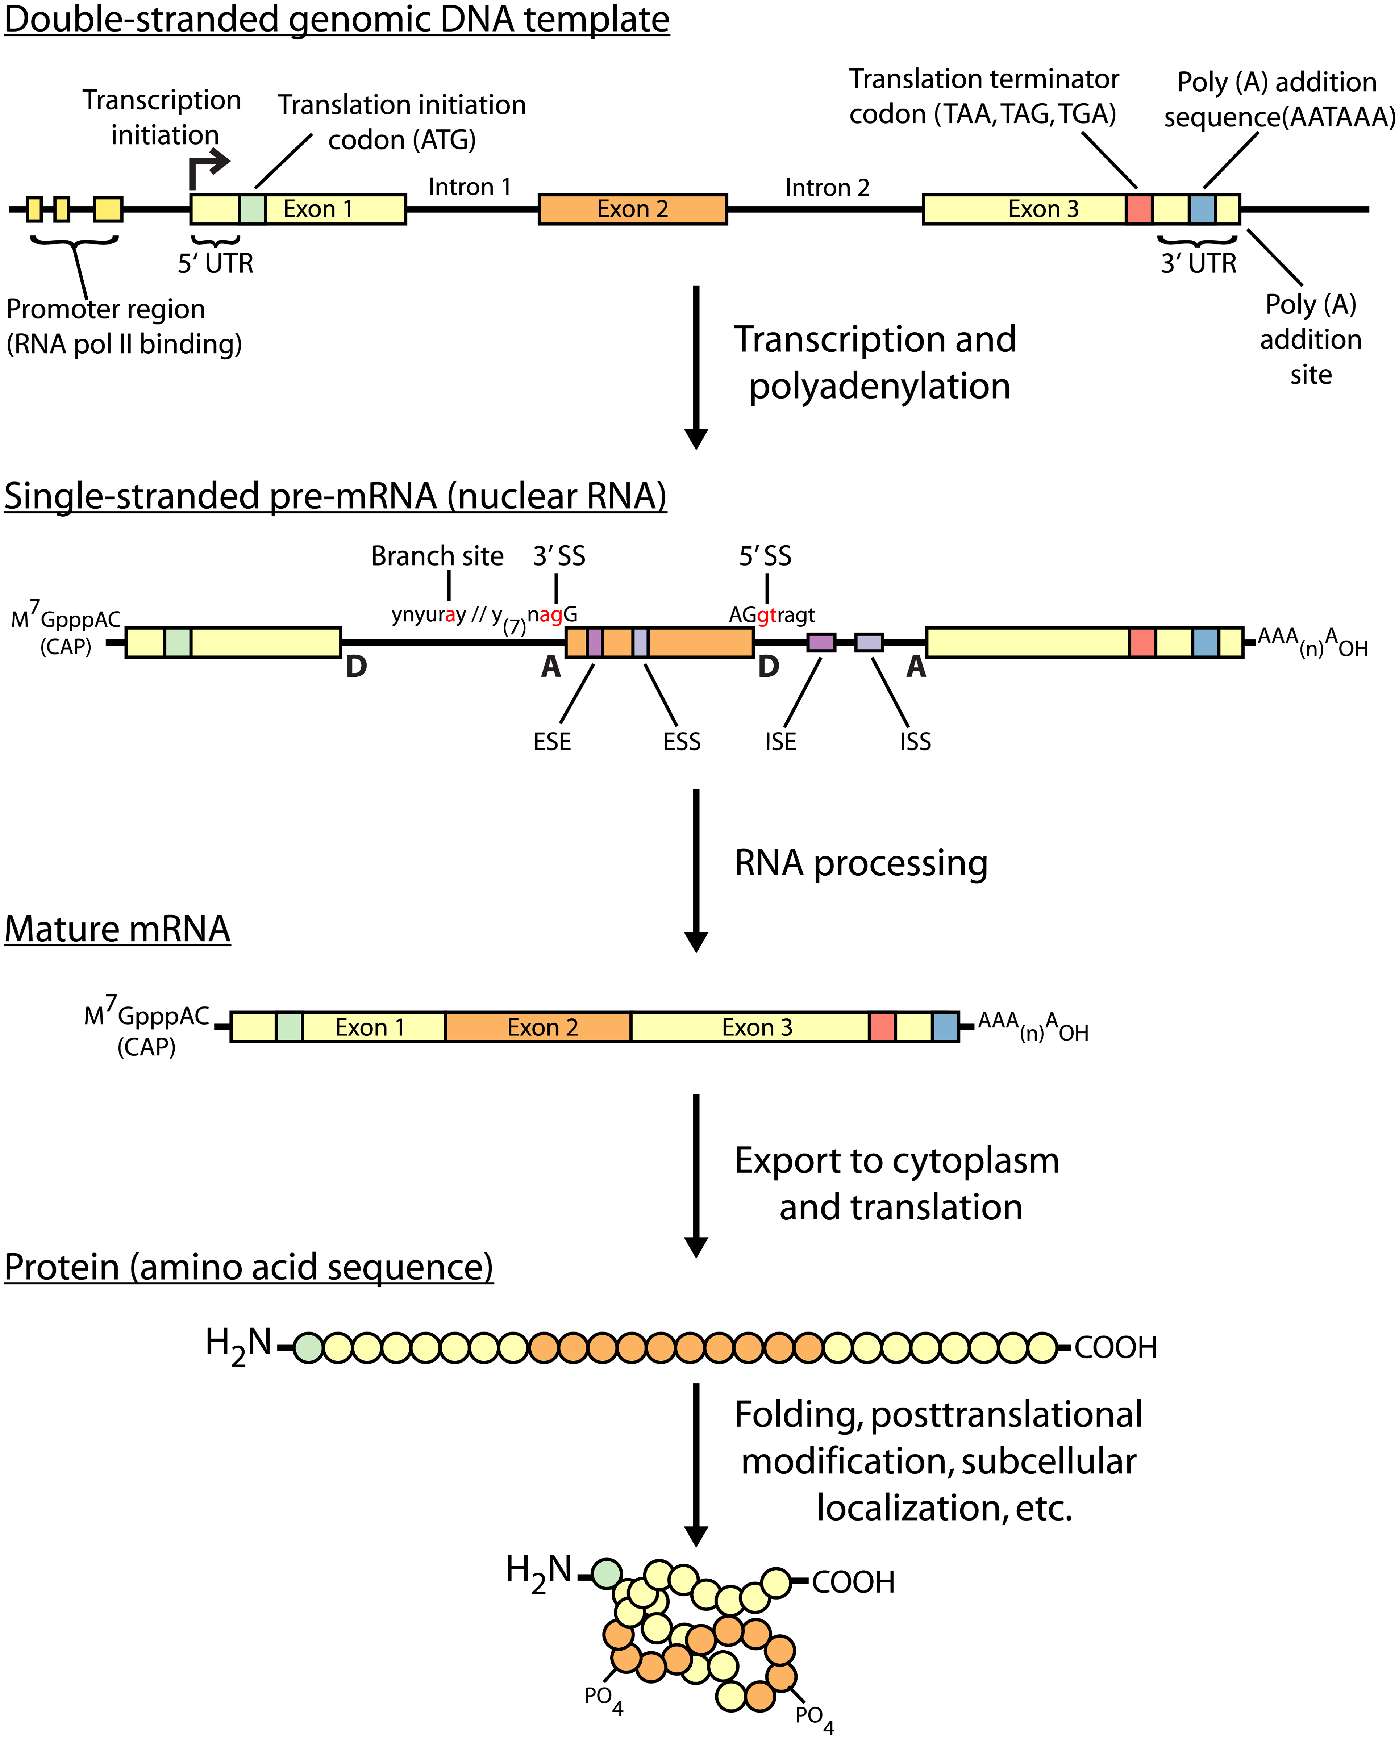
Central dogma of molecular biology
Griffith et al. PLoS Computational Biology 2015

Slide 21
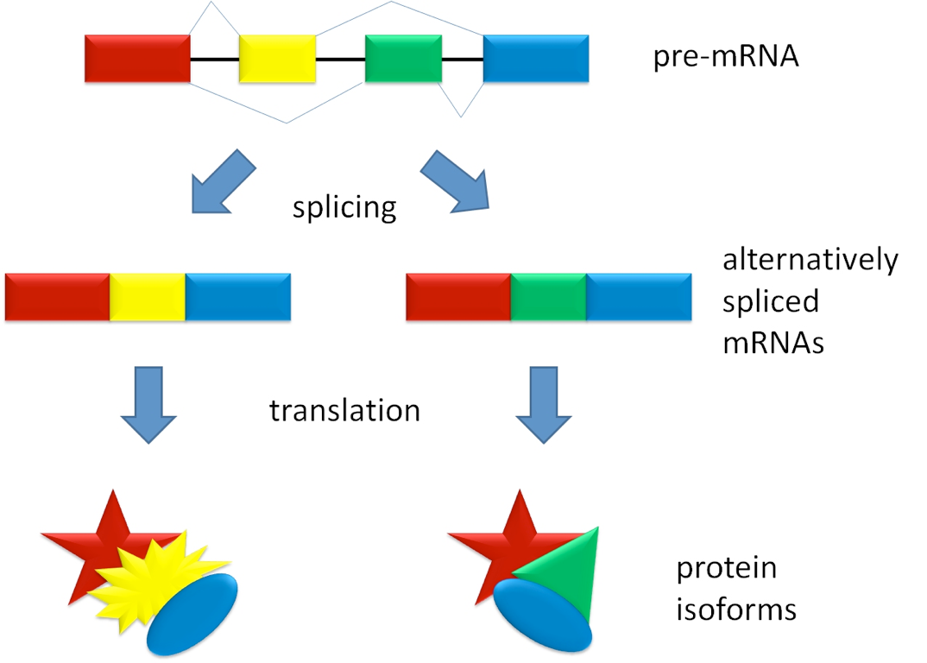
Alternative splicing

Slide 22
Multi-mapping reads in RNA-Seq
Species | Read length | % multi-mapping reads
Mouse | 25 | 17%
Mouse | 75 | 10%
Maize | 25 | 52%
Axolotl | 76 | 23%
Human | 50 | 23%
Throwing away multi-mapping reads leads to
  Loss of information
  Potentially biased estimates of abundance

Slide 23
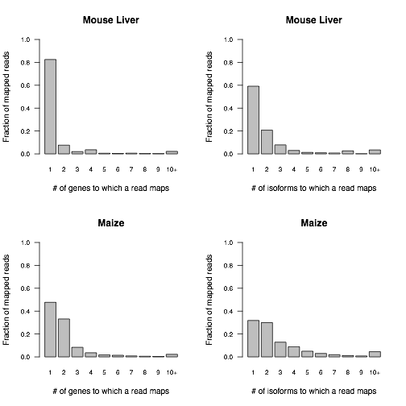
Distributions of alignment counts

Slide 24
What if reads do not uniquely map to transcripts?
Multiread: a read that could have been derived from multiple transcripts
How would you estimate the relative abundances for these transcripts?
transcripts
reads
20 + 180 = 200
90 A
1
20 + 40 = 60
40 C
2
80
3
40 G
30 T

Slide 25
Some options for handling multireads
Discard multireads, estimate based on uniquely mapping reads only
Discard multireads, but use “unique length” of each transcript in calculations
“Rescue” multireads by allocating (fractions of) them to the transcripts
  Three step algorithm
    Estimate abundances based on uniquely mapping reads only
    For each multiread, divide it between the transcripts to which it maps, proportionally to their abundances estimated in the first step
    Recompute abundances based on updated counts for each transcript

Slide 26



Rescue method example - Step 1
transcripts
reads
200
90 A
1
60
40 C
2
80
3
40 G
30 T
Step 1

Slide 27



Rescue method example - Step 2
transcripts
reads
200
90 A
1
60
40 C
2
80
3
40 G
30 T
Step 2

Slide 28



Rescue method example - Step 3
transcripts
reads
200
90 A
1
60
40 C
2
80
3
40 G
30 T
Step 3

Slide 29
An observation about the rescue method
Note that at the end of the rescue algorithm, we have an updated set of abundance estimates
These new estimates could be used to reallocate the multireads
And then we could update our abundance estimates once again
And repeat!
This is the intuition behind the statistical approach to this problem

Slide 30
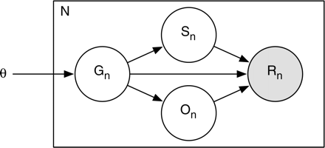
RSEM (RNA-Seq by Expectation-Maximization) - a generative probabilistic model
Simplified view of the model (plate notation)
  Grey – observed variable
  White – latent (unobserved) variables
“RNA-Seq gene expression estimation with read mapping uncertainty”
Li, B., Ruotti, V., Stewart, R., Thomson, J., Dewey, C.
Bioinformatics, 2010
number of reads
start position
Bayesian network
transcript probabilities (expression levels)
read sequence
transcript
orientation

Slide 31
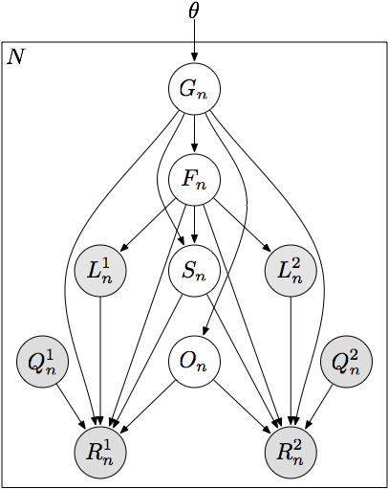
RSEM - a generative probabilistic model
transcript probabilities (expression levels)
number of reads
transcript
fragment length
start position
read length
orientation
paired read
quality scores
read sequence

Slide 32
Quantification as maximum likelihood inference
Observed data likelihood
Likelihood function is concave with respect to θ
  Has a global maximum (or global maxima)
Expectation-Maximization for optimization
“RNA-Seq gene expression estimation with read mapping uncertainty”
Li, B., Ruotti, V., Stewart, R., Thomson, J., Dewey, C.
Bioinformatics, 2010

Slide 33
Approximate inference with read alignments
Full likelihood computation requires O(NML²) time
  N (number of reads) ~ 10⁷
  M (number of transcripts) ~ 10⁴
  L (average transcript length) ~ 10³
Approximate by alignment
all local alignments of read n with at most x mismatches

Slide 34
EM Algorithm
Expectation-Maximization for RNA-Seq
  E-step: Compute expected read counts given current expression levels
  M-step: Compute expression values maximizing likelihood given expected read counts
Rescue algorithm ≈ 1 iteration of EM

Slide 35
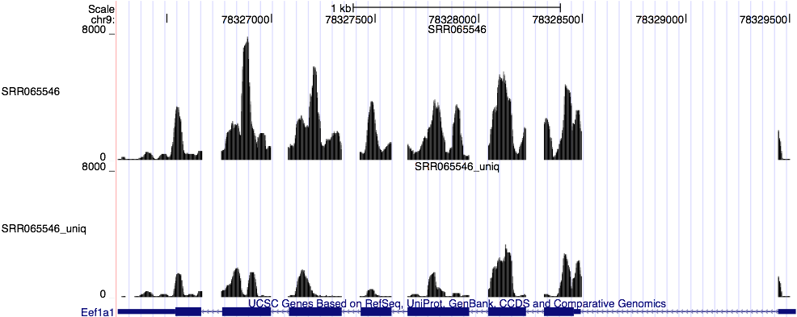
Expected read count visualization

Slide 36
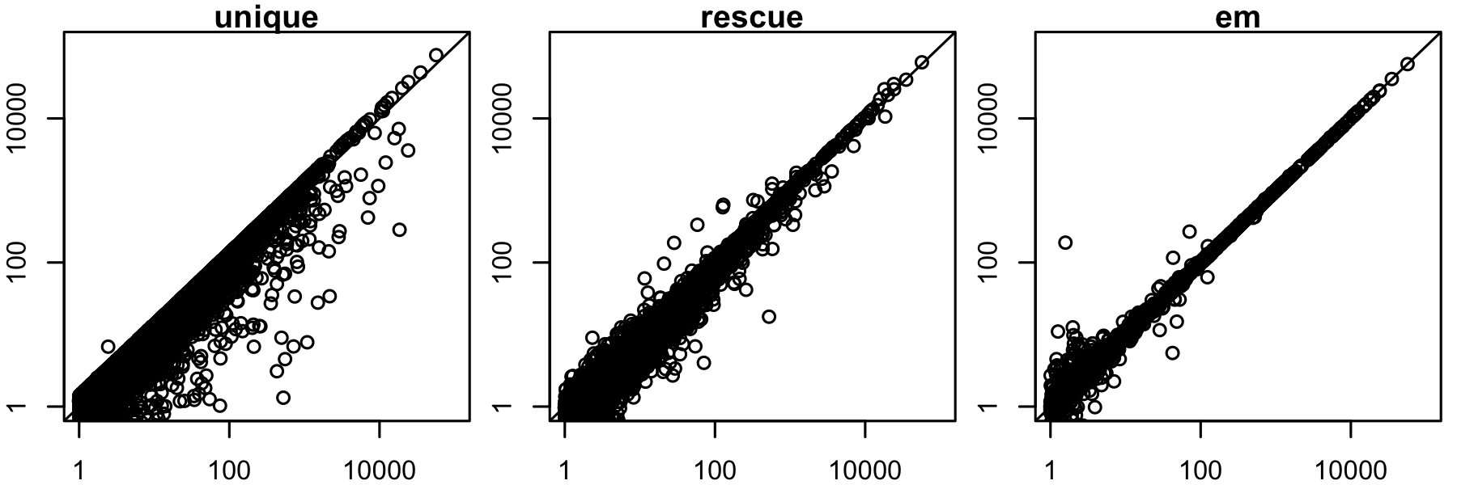
Improved accuracy over unique and rescue
predicted expression level
true expression level
Mouse gene-level expression estimation

Slide 37
RNA-Seq summary
RNA-Seq is the preferred technology for transcriptome analysis in most settings
The major challenge in analyzing RNA-Seq data: the reads are much shorter than the transcripts from which they are derived
Tasks with RNA-Seq data thus require handling hidden information: which gene/isoform gave rise to a given read
The Expectation-Maximization algorithm is extremely powerful in these situations, e.g., RSEM

Slide 38
Recent developments in RNA-Seq
Long read sequences: PacBio and Oxford Nanopore
Single-cell RNA-Seq: review
  Observe heterogeneity of cell populations
  Model technical artifacts (e.g. artificial 0 counts)
  Detect sub-populations
  Predict pseudotime through dynamic processes
  Detect gene-gene and cell-cell relationships
Alignment-free quantification:
  Kallisto
  Salmon

Slide 39
Public sources of RNA-Seq data
Gene Expression Omnibus (GEO): http://www.ncbi.nlm.nih.gov/geo/
  Both microarray and sequencing data
Sequence Read Archive (SRA): http://www.ncbi.nlm.nih.gov/sra
  All sequencing data (not necessarily RNA-Seq)
ArrayExpress: https://www.ebi.ac.uk/arrayexpress/
  European version of GEO
Homogenized data: MetaSRA, Toil, recount2, ARCHS⁴

Slide 40
Interpolated Markov Models for Gene Finding
Key concepts
the gene-finding task
the trade-off between potential predictive value and parameter uncertainty in choosing the order of a Markov model
interpolated Markov models

Slide 41
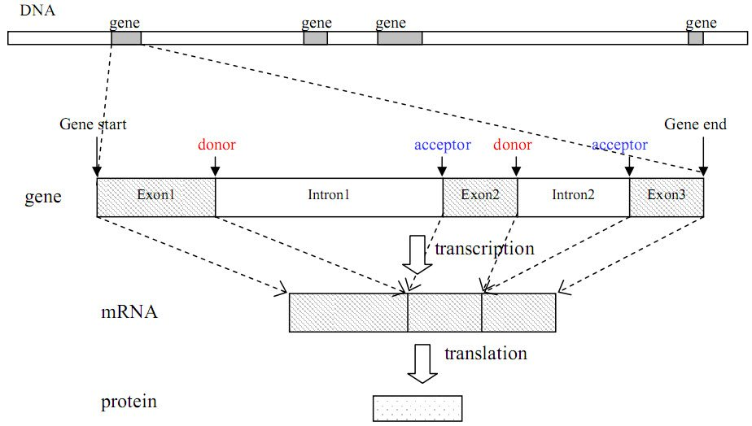
The Gene Finding Task
Given: an uncharacterized DNA sequence
Do: locate the genes in the sequence, including the coordinates of individual exons and introns

Slide 42
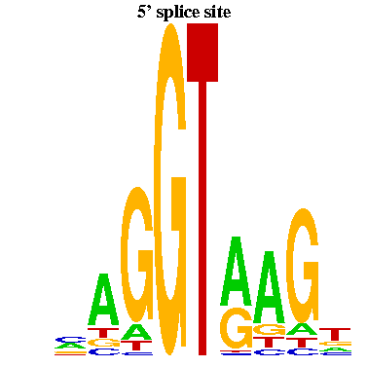
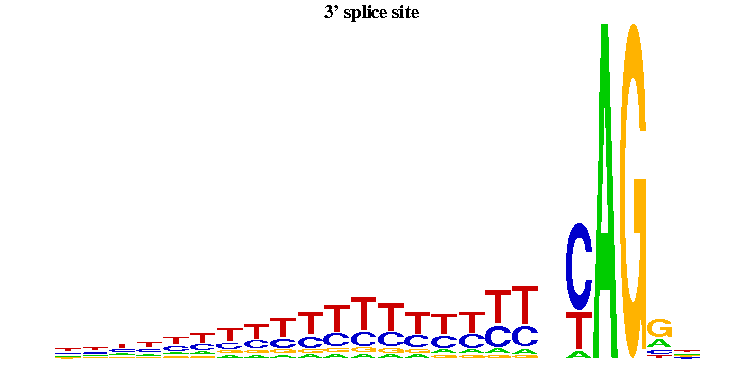
Splice Signals Example
donor sites
acceptor sites
-3
-2
-1
1
2
3
4
5
6
exon
Figures from Yi Xing
exon
There are significant dependencies among non-adjacent positions in donor splice signals
Informative for inferring hidden state of HMM

Slide 43
Sources of Evidence for Gene Finding
Signals: the sequence signals (e.g. splice junctions) involved in gene expression (e.g., RNA-seq reads)
Content: statistical properties that distinguish protein-coding DNA from non-coding DNA (focus in this lecture)
Conservation: signal and content properties that are conserved across related sequences (e.g. orthologous regions of the mouse and human genome)

Slide 44
Gene Finding: Search by Content
Encoding a protein affects the statistical properties of a DNA sequence
  some amino acids are used more frequently than others (Leu more prevalent than Trp)
  different numbers of codons for different amino acids (Leu has 6, Trp has 1)
  for a given amino acid, usually one codon is used more frequently than others
    this is termed codon preference
    these preferences vary by species
Notes:
Tryptophan (Trp)
Leucine (Leu)

Slide 45
Codon Preference in E. Coli
AA codon /1000
----------------------
Gly GGG 1.89
Gly GGA 0.44
Gly GGU 52.99
Gly GGC 34.55
Glu GAG 15.68
Glu GAA 57.20
Asp GAU 21.63
Asp GAC 43.26

Slide 46
Reading Frames
A given sequence may encode a protein in any of the six reading frames (three on each strand)
G C T A C G G A G C T T C G G A G C
C G A T G C C T C G A A G C C T C G

Slide 47
Open Reading Frames (ORFs)
An ORF is a sequence that
  starts with a potential start codon (e.g., ATG)
  ends with a potential stop codon, in the same reading frame (e.g., TAG, TAA, TGA)
  doesn’t contain another stop codon in-frame
  and is sufficiently long (say > 100 bases)
An ORF meets the minimal requirements to be a protein-coding gene in an organism without introns
NHGRI ORF
G T T A T G G C T • • • T C G T G A T T

Slide 48
Markov Models & Reading Frames
Consider modeling a given coding sequence
For each “word” we evaluate, we’ll want to consider its position with respect to the reading frame we’re assuming
reading frame
G C T A C G G A G C T T C G G A G C
G C T A C G
G is in 3rd codon position
C T A C G G
G is in 1st position
T A C G G A
A is in 2nd position
Can do this using an inhomogeneous model

Slide 49
Inhomogeneous Markov Model
Homogenous Markov model: transition probability matrix does not change over time or position
Inhomogenous Markov model: transition probability matrix depends on the time or position

Slide 50

Higher Order Markov Models
Higher order models remember more “history”
  n-order
Additional history can have predictive value
Example:
  predict the next word in this sentence fragment “…you__” (are, give, passed, say, see, too, …?)
  now predict it given more history
“…can you___”
“…say can you___”
“…oh say can you___”
YouTube

Slide 51
A Fifth Order Inhomogeneous Markov Model
AAAAA
CTACA
CTACC
start
CTACG
CTACT
GCTAC
TTTTT
position 2

Slide 52
A Fifth Order Inhomogeneous Markov Model
AAAAA
AAAAA
AAAAA
CTACA
CTACA
CTACA
CTACC
CTACC
start
CTACG
CTACG
TACAA
CTACT
CTACT
Trans.
to states
in pos. 2
TACAC
TACAG
GCTAC
GCTAC
TACAT
TTTTT
TTTTT
TTTTT
position 2
position 3
position 1

Slide 53
Selecting the Order of a
Markov Model
But the number of parameters we need to estimate grows exponentially with the order
  for modeling DNA we need parameters for an nth order model
The higher the order, the less reliable we can expect our parameter estimates to be
Suppose we have 100k bases of sequence to estimate parameters of a model
  for a 2nd order homogeneous Markov chain, we’d see each history 6250 times on average
  for an 8th order chain, we’d see each history ~ 1.5 times on average

Slide 54
Interpolated Markov Models
The IMM idea: manage this trade-off by interpolating among models of various orders
Simple linear interpolation:
where

Slide 55
Interpolated Markov Models
We can make the weights depend on the history
  for a given order, we may have significantly more data to estimate some words than others
General linear interpolation
λ is a function of
the given history

Slide 56
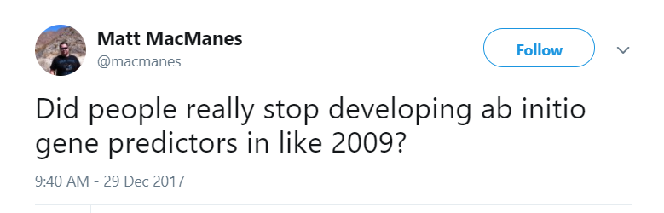
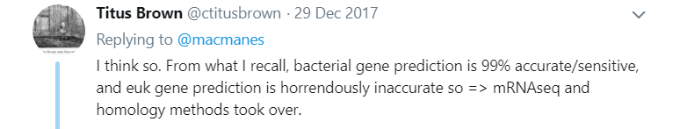
The GLIMMER System
[Salzberg et al., Nucleic Acids Research, 1998]
System for identifying genes in bacterial genomes
Uses 8th order, inhomogeneous, interpolated Markov models

Slide 57
IMMs in GLIMMER
How does GLIMMER determine the values?
First, let’s express the IMM probability calculation recursively
Let be the number of times we see the history in our training set

Slide 58
IMMs in GLIMMER
If we haven’t seen more than 400 times, then compare the counts for the following:
nth order history + base
(n-1)th order history + base
Use a statistical test to assess whether the distributions of depend on the order

Slide 59
IMMs in GLIMMER
nth order history + base
(n-1)th order history + base
Null hypothesis in test: distribution is independent of order
Define
If is small we don’t need the higher order history

Slide 60
IMMs in GLIMMER
Putting it all together
why 400?
  “gives ~95% confidence that the sample probabilities are within ±0.05 of the true probabilities from which the sample was taken”
where

Slide 61
IMM Example
Suppose we have the following counts from our training set
ACGA 25
ACGC 40
ACGG 15
ACGT 20
___
100
CGA 100
CGC 90
CGG 35
CGT 75
___
300
GA 175
GC 140
GG 65
GT 120
___
500
χ² test: d = 0.857
χ² test: d = 0.140
λ₃(ACG) = 0.857 × 100/400 = 0.214
λ₂(CG) = 0 (d < 0.5, c(CG) < 400)
λ₁(G) = 1 (c(G) > 400)

Slide 62
IMM Example (Continued)
Now suppose we want to calculate

Slide 63
Gene Recognition in GLIMMER
Essentially ORF classification
  Train and estimate IMMs
For each ORF
  calculate the probability of the ORF sequence in each of the 6 possible reading frames
  if the highest scoring frame corresponds to the reading frame of the ORF, mark the ORF as a gene
For overlapping ORFs that look like genes
  score overlapping region separately
  predict only one of the ORFs as a gene

Slide 64
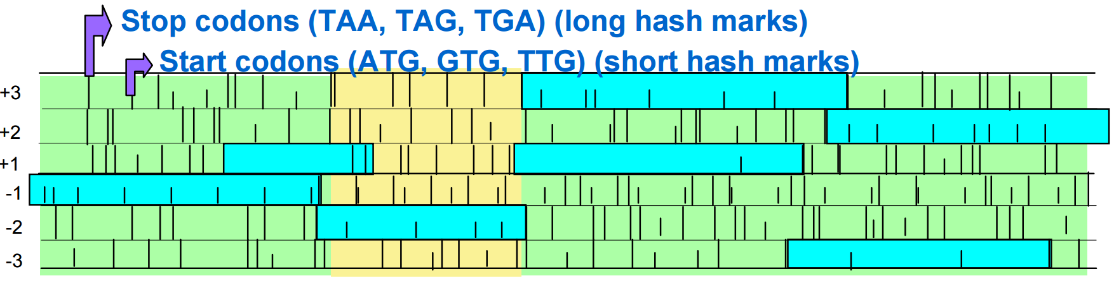
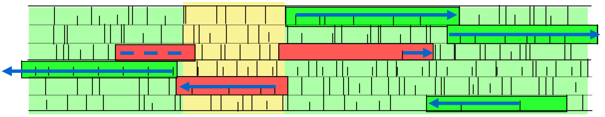
Gene Recognition in GLIMMER
Six possible frames
ORF meeting length requirement
JCVI
Low scoring ORF
High scoring ORF

Slide 65
GLIMMER Experiment
8th order IMM vs. 5th order Markov model
Trained on 1168 genes (ORFs really)
Tested on 1717 annotated (more or less known) genes

Slide 66
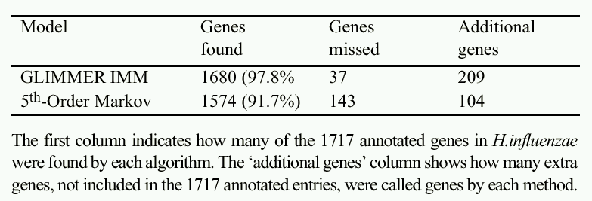
GLIMMER Results
TP
FN
FP & TP?
GLIMMER has greater sensitivity than the baseline
It’s not clear whether its precision/specificity is better

