Slide 1
Single cell RNA-seq analysis
Part I: data processing & analysis
BMI/CS 776
www.biostat.wisc.edu/bmi776/
Spring 2022
Daifeng Wang
daifeng.wang@wisc.edu
Thanks to Ting Jin for slides!
These slides, excluding third-party material, are licensed under CC BY-NC 4.0 by Mark Craven, Colin Dewey, Anthony Gitter and Daifeng Wang

Slide 2
Outline
Introduction on single cell RNA sequencing
Single cell RNA sequencing (scRNA-seq) data processing
scRNA-seq data analysis

Slide 3

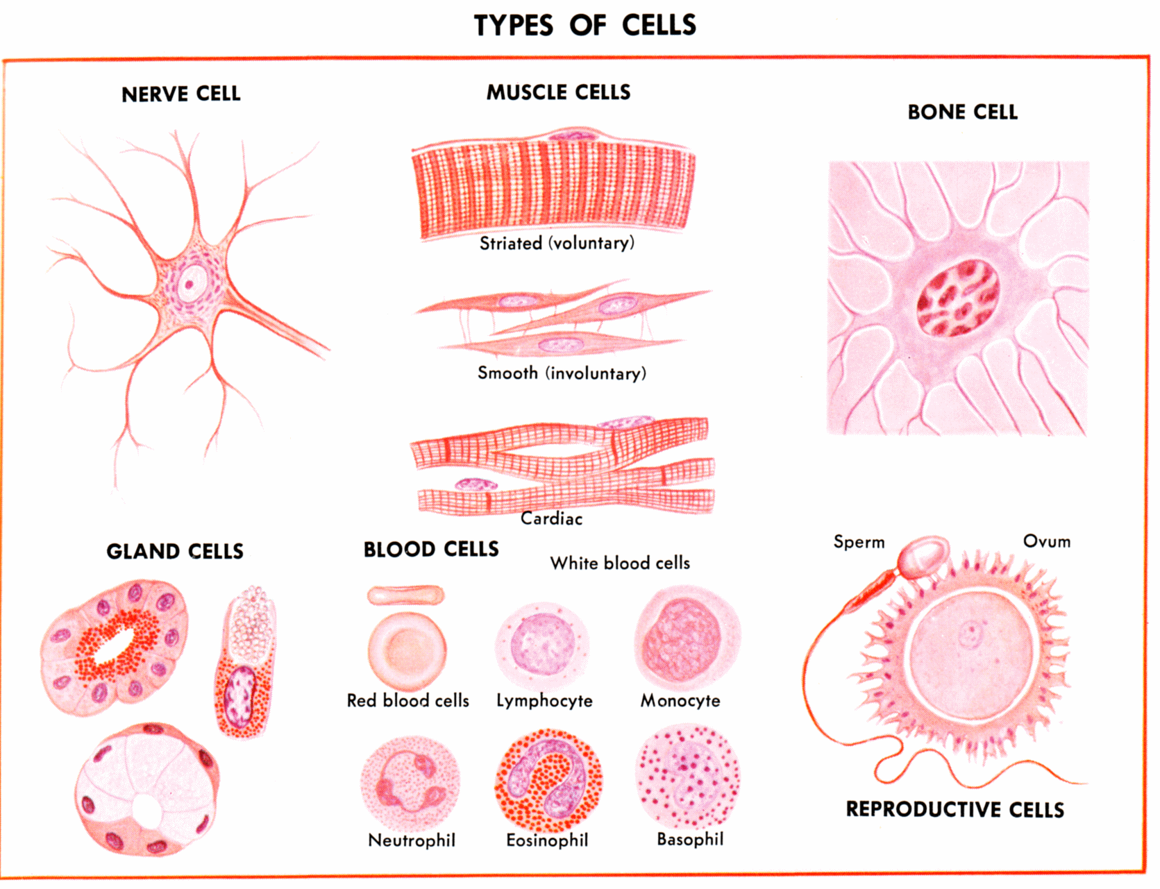
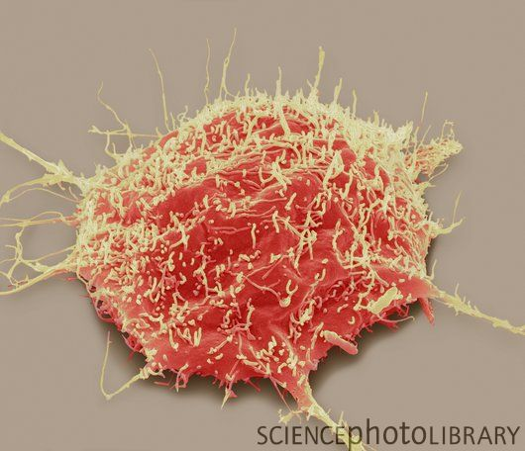
Gene expression and regulation
Identical DNA but different gene expression
Protein
Central dogma
translation
RNA
transcription
Gene
DNA
Gene expression levels (e.g., values to quantify RNA abundances)
nerve
skin
disease
Cell type
Gene regulation: which & how genes express?

Slide 4
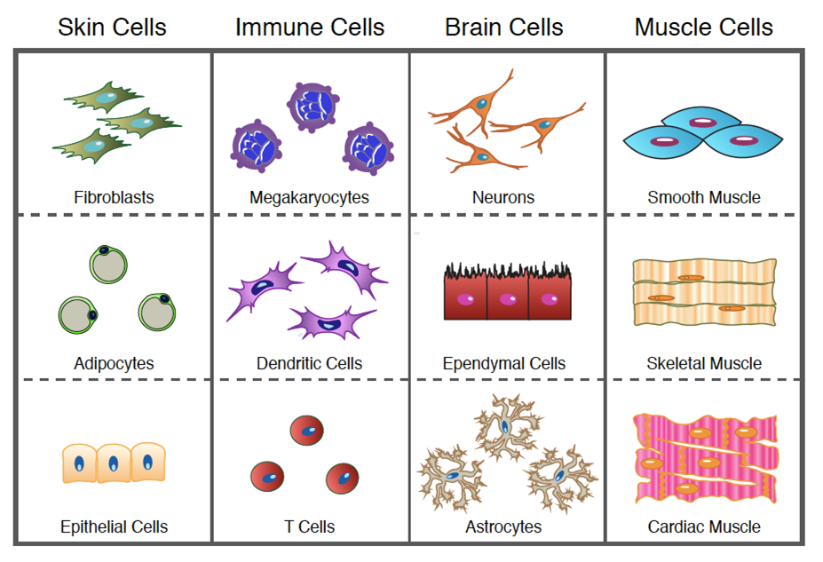

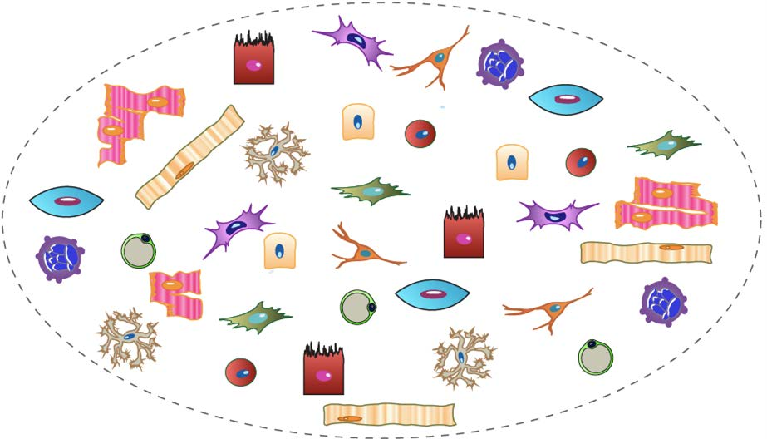
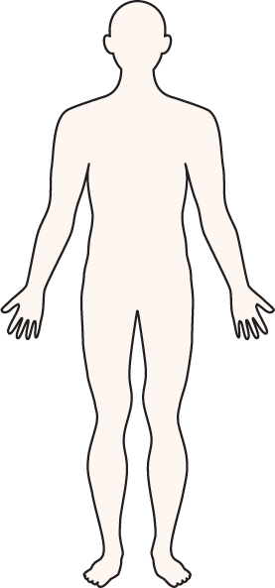
Why study single cells?
Cells are our core constituents, are classified by characteristic molecules, structures, and functions
https://www.youtube.com/watch?v=PRjX3-m16cw

Slide 5
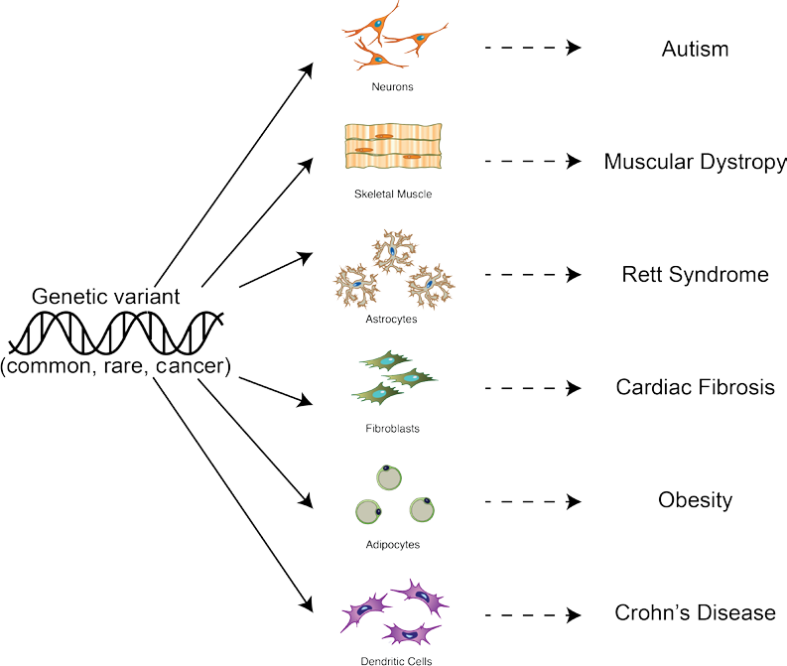

Why study single cells?
Genotype Cell Phenotype
Cells are key intermediate from genotype to phenotype, e.g., essential functional dissection of genetic variants
https://bioinformatics-core-shared-training.github.io/cruk-summer-school-2018/SingleCell/slides/2018-07-25_CRUK_CI_summer_school-scRNAseq.pdf
https://www.youtube.com/watch?v=PRjX3-m16cw

Slide 6



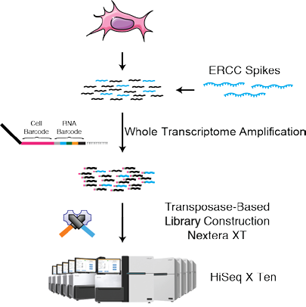
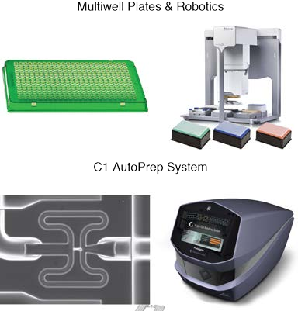
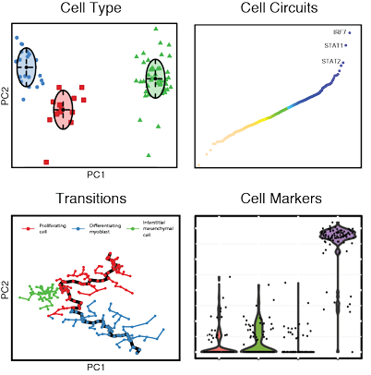
Sequencing RNAs in singe cells
Core technology
Sample prep
Computation
2012: 18 cells
2020: ~100,000 cells
https://www.youtube.com/watch?v=PRjX3-m16cw

Slide 7
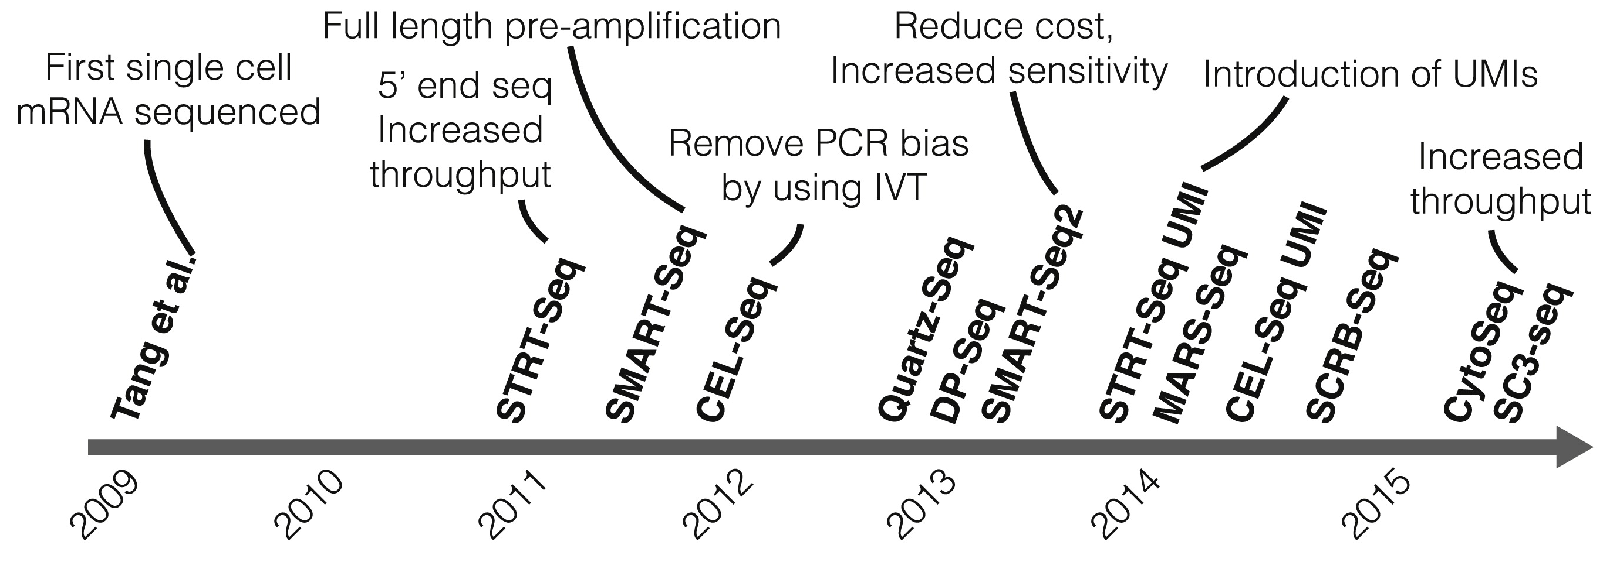
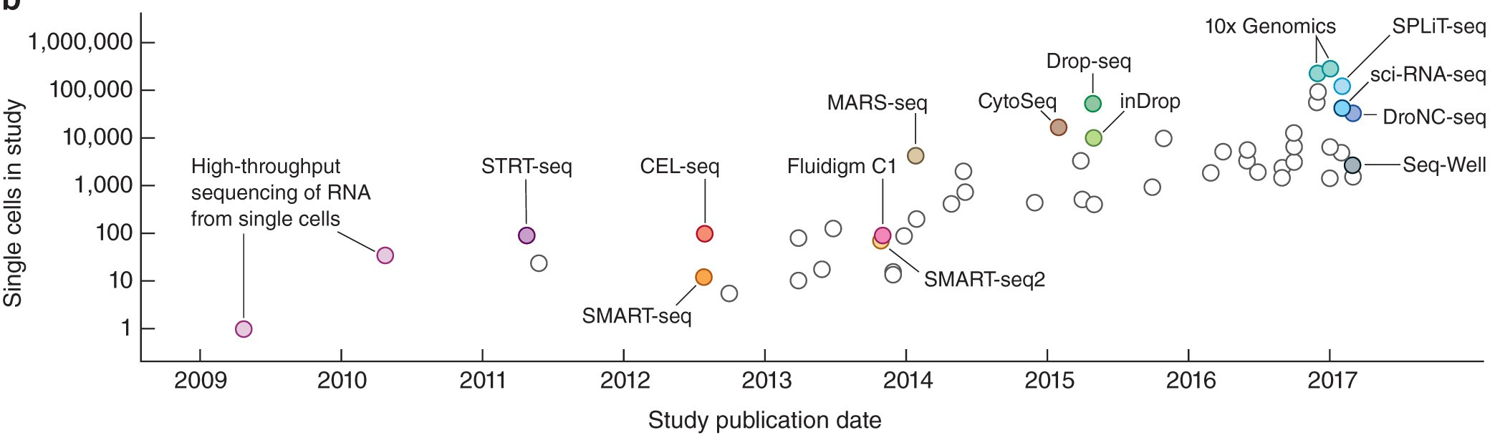
Evolution of single cell sequencing
High-throughput technologies enable the profiling of thousands of cells in parallel, providing an unbiased view of the heterogeneity of single cells within a population. Fan et al., 2015
Cell numbers reported in representative publications by publication date
Kolodziejczyk et al, Mol Cell (2015)
Svensson V, Vento-Tormo R, Teichmann SA. Nat Protoc. 2018 Apr;13(4):599-604

Slide 8
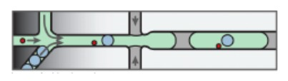
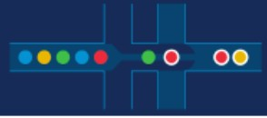
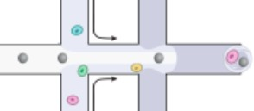
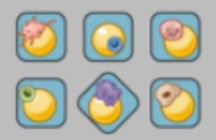
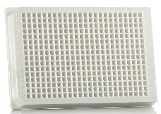
Single cell RNA sequencing (scRNA-seq) technology
 | inDrops | 10x Genomics | Drop-seq | Seq-well (Honeycomb) | SMART-seq
Cell capture efficiency | ~70-80% | ~50-70% | ~10% | ~80% | ~80%
Time to capture 10k cells | ~30min | 10min | 1-2 hours | 5-10min | --
Encapsulation type | Droplet | Droplet | Droplet | Nanolitre well | Plate-based
Library prep | CEL-seq Linear amplification by IVT | SMART-seq Exponential PCR based amplification | SMART-seq Exponential PCR based amplification | SMART-seq Exponential PCR based amplification | SMART-seq Exponential PCR based amplification
Commercial | Yes | Yes | -- | Yes (Summer 2020) | Yes
Cost (~$ per cell) | ~0.06 | ~0.2 | ~0.06 | ~0.15 | 1
Strengths | Good cell capture Cost-effective Real-time monitoring Customizable | Good cell capture Fast and easy to run Parallel sample collection High gene / cell counts | Cost-effective Customizable | Good cell capture Cost-effective Real-time monitoring Customizable | Good cell capture Good mRNA capture Full-length transcript No UMI
Weaknesses | Difficult to run | Expensive | Difficult to run & low cell capture efficiency | Available Soon | Expensive
https://github.com/hbctraining/scRNA-seq/blob/master/slides/Single_Cell_2_27_20.pdf

Slide 9
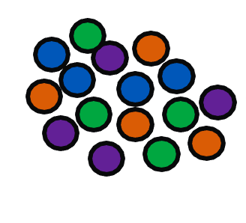
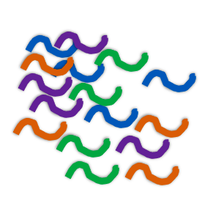






























Bulk vs scRNA-seq
average
expression
level
Bulk RNA-seq
quantifying expression signatures from ensembles
insufficient for studying heterogeneous system
Population 1
Population 2
Population 3
Population 4
distribution of expression levels
scRNA-seq
inference of gene regulatory networks across the cells
heterogeneity of cell responses
cell type identification

Slide 10
Outline
Introduction on single cell RNA sequencing
Single cell RNA sequencing (scRNA-seq) data processing
scRNA-seq data analysis

Slide 11
Single-cell RNA sequencing
(scRNA-seq) process
Step1: Sample preparation
Step2: Single-cell RNA sequencing
Step3: Data processing
Step4: Data analysis
Lafzi et al. Tutorial: guidelines for the experimental design of single-cell RNA sequencing studies, Nature Protocols 2018 (https://doi.org/10.1038/s41596-018-0073-y)

Slide 12
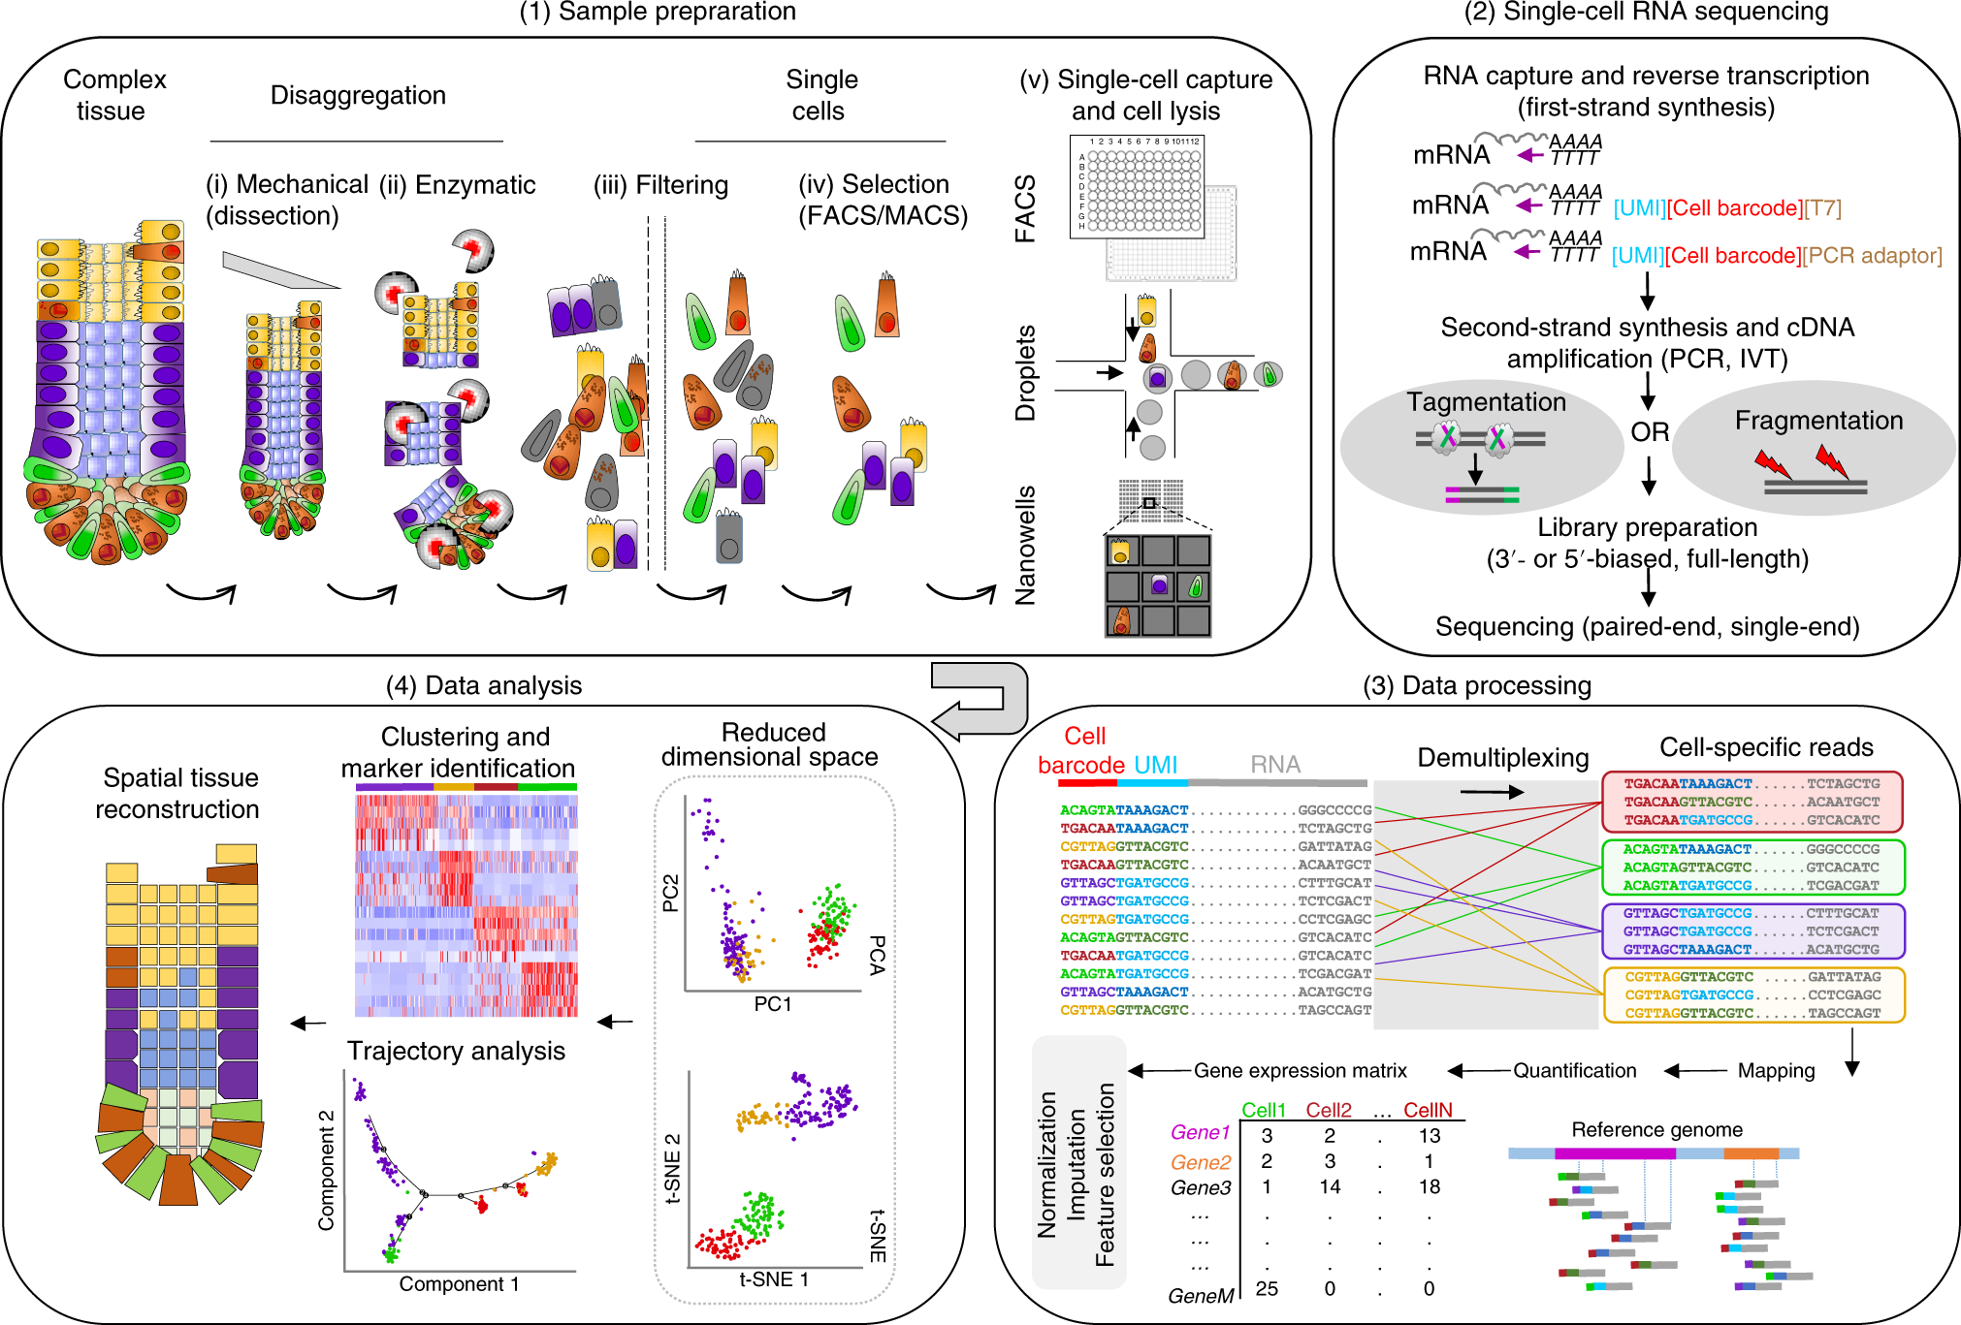
scRNA-seq process
Step 1 - Sample preparation: cells are physically separated into a single-cell solution from which specific cell types can be enriched or excluded
Step 2 - Single-cell RNA sequencing
Lafzi et al. Tutorial: guidelines for the experimental design of single-cell RNA sequencing studies, Nature Protocols 2018 (https://doi.org/10.1038/s41596-018-0073-y)

Slide 13
scRNA-seq process
Step 3 - Data processing
  Unique molecular identifier (UMI)
  Gene counts
  Drop-outs in single cell
  Imputation method: MAGIC
Lafzi et al. Tutorial: guidelines for the experimental design of single-cell RNA sequencing studies, Nature Protocols 2018 (https://doi.org/10.1038/s41596-018-0073-y)

Slide 14
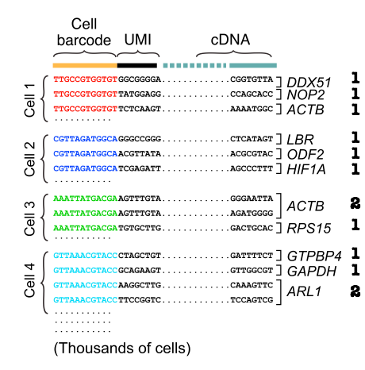
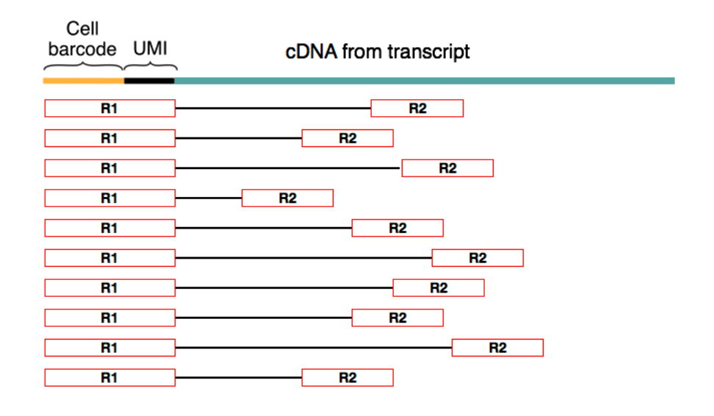
Unique molecular identifier (UMI)
UMIs are short (4-10bp) random barcodes added to transcripts during reverse-transcription.
Biased paired-end reads
Grouping barcodes to assign reads to cells
http://data-science-sequencing.github.io/Win2018/lectures/lecture16/
https://bioinformatics-core-shared-training.github.io/cruk-summer-school-2018/SingleCell/slides/2018-07-25_CRUK_CI_summer_school-scRNAseq.pdf

Slide 15
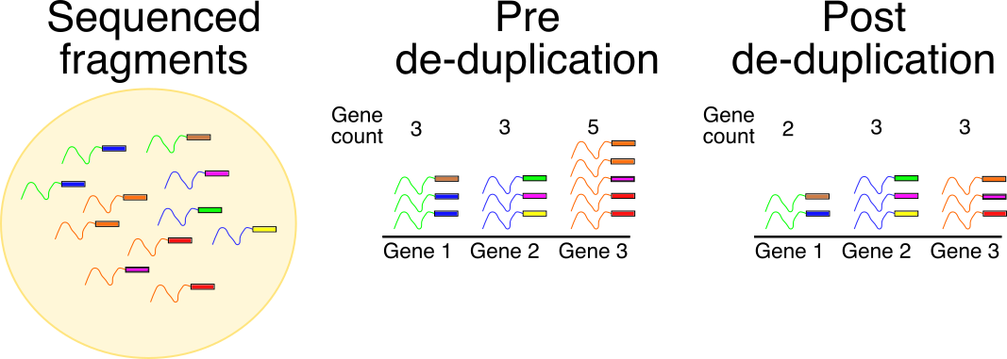
Unique molecular identifier (UMI)
They enable sequencing reads to be assigned to individual transcript molecules and thus the removal of amplification noise and biases from scRNA-Seq data
They reduce the amplification noise by allowing (almost) complete de-duplication of fragments
http://data-science-sequencing.github.io/Win2018/lectures/lecture16/
https://bioinformatics-core-shared-training.github.io/cruk-summer-school-2018/SingleCell/slides/2018-07-25_CRUK_CI_summer_school-scRNAseq.pdf

Slide 16
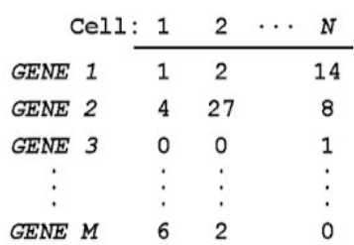
Gene Counts
In each gene, within each cell, the total number of unique UMI is counted and reported as the number of transcripts of that gene for a given cell.
Hundreds of millions of reads
Thousands of cells
cDNA alignment to
Genome and group
Results by cell
Count unique UMIs
for each gene in each cell
Create digital
expression matrix
Gene counts matrix
http://data-science-sequencing.github.io/Win2018/lectures/lecture16/
https://bioinformatics-core-shared-training.github.io/cruk-summer-school-2018
/SingleCell/slides/2018-07-25_CRUK_CI_summer_school-scRNAseq.pdf

Slide 17
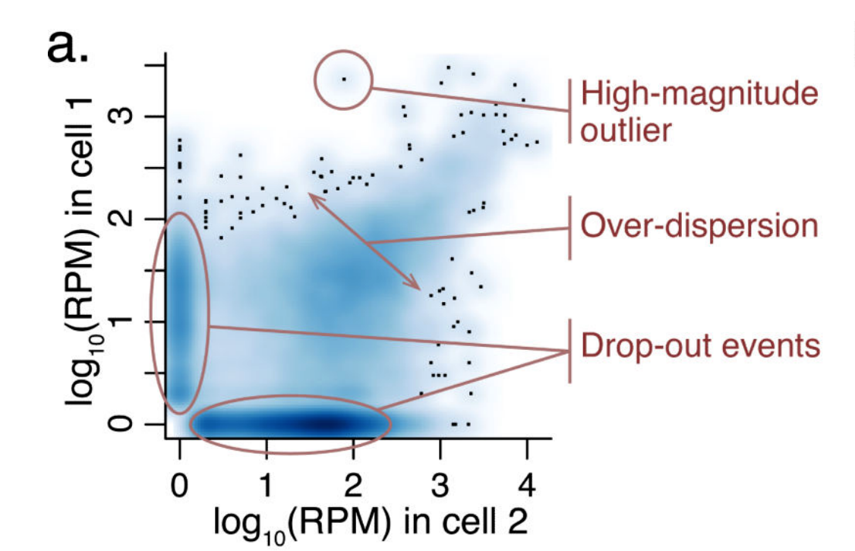
Drop-outs in single cell
a gene is observed at a moderate or high expression level in one cell but is not detected in another cell
Why do dropouts occur in single cell?
technical artifacts
cell type differences
statistical sampling
biological factors
Kharchenko, P., Silberstein, L. & Scadden, D. Bayesian approach to single-cell differential expression analysis. Nat Methods 11, 740–742 (2014).

Slide 18

What should we do about dropouts?
Drop-outs in single cell
Ignore zero inflation
Preprocess/reduce dimensions
Impute scRNA-seq gene count matrix before analysis
Why do we need imputation methods?
Downstream analyses relying on the accuracy of
gene expression measurements
Imputation Methods
MAGIC
Droplet
DrImpute
scDoc

Slide 19
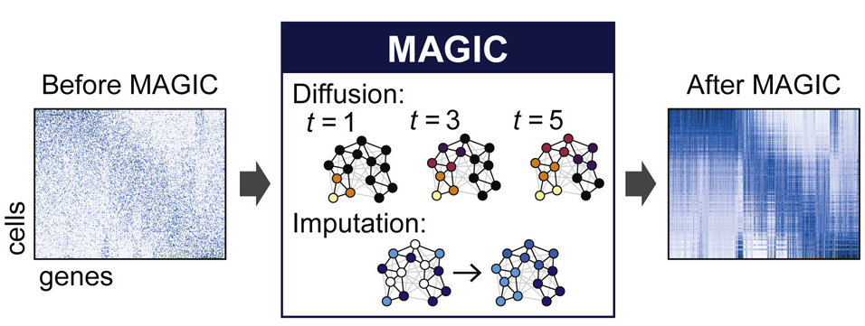
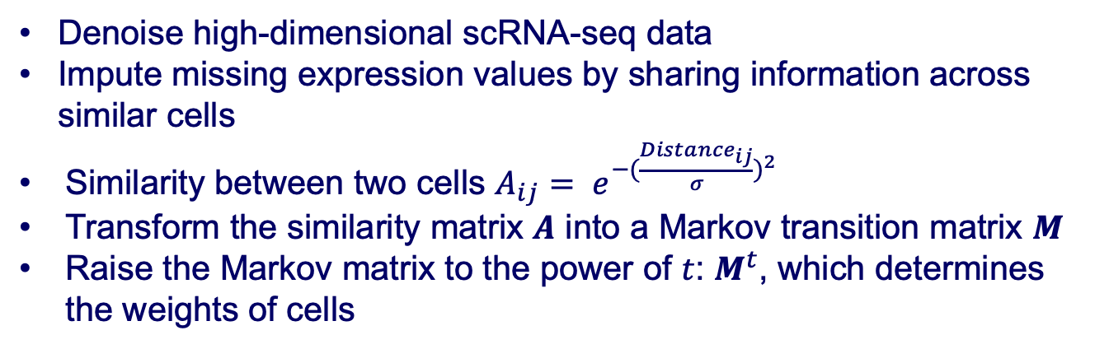
MAGIC
Markov affinity-based graph imputation of cells
Denoise high-dimensional scRNA-seq data
Impute missing expression values by sharing information across similar cells
Similarity between two cells $A_{ij}= e^{−{(\frac{{Distance}_{ij}}{σ})}^{2}}$
Transform the similarity matrix $A$ into a Markov transition matrix $M$
Raise the Markov matrix to the power of $t$: $M^{t}$, which determines the weights of cells
http://jsb.ucla.edu/sites/default/files/scImpute.pdf
van Dijk D, Sharma R, Nainys J, Yim K, Kathail P, Carr AJ, Burdziak C, Moon KR, Chaffer CL, Pattabiraman D, Bierie B, Mazutis L, Wolf G, Krishnaswamy S, Pe'er D. Recovering Gene Interactions from Single-Cell Data Using Data Diffusion. Cell. 2018 Jul 26;174(3):716-729.e27. doi: 10.1016/j.cell.2018.05.061. Epub 2018 Jun 28. PMID: 29961576; PMCID: PMC6771278.

Slide 20
scRNA-seq process
Step 4 - Data analysis
  Dimensionality reduction
  Clustering and marker identification
  Trajectory analysis
Lafzi et al. Tutorial: guidelines for the experimental design of single-cell RNA sequencing studies, Nature Protocols 2018 (https://doi.org/10.1038/s41596-018-0073-y)

Slide 21
Outline
Introduction on single cell RNA sequencing
Single cell RNA sequencing (scRNA-seq) data processing
scRNA-seq data analysis

Slide 22
scRNA-seq data analysis
Introduction of single cell analysis
Dimensionality reduction
  Linear: PCA
  Non-linear: t-SNE, UMAP
Cell clustering
  K-means
  hierarchical clustering
  graph-based clustering

Slide 23
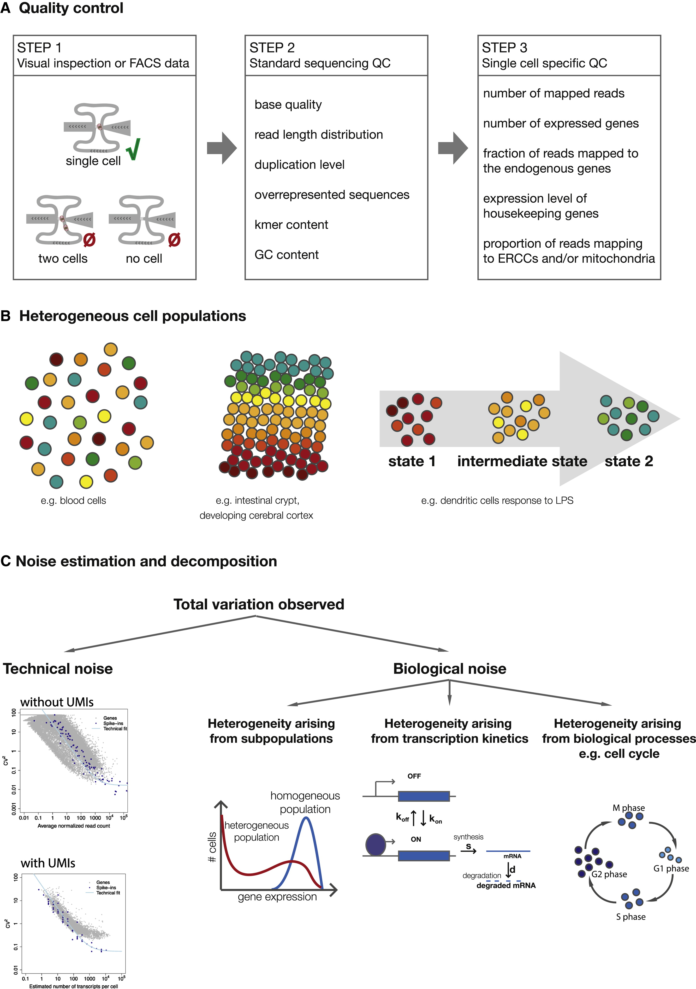
Why single-cell analysis ?
Single-cell data opens the door to several types of biological questions:
  What cell types exist within a population of cells in a particular sample?
  What does this high-resolution view of cellular transitions tell us about switches in cell states?
  How can gene regulatory networks drive cell types or states?
Kolodziejczyk et al, Mol Cell (2015)

Slide 24
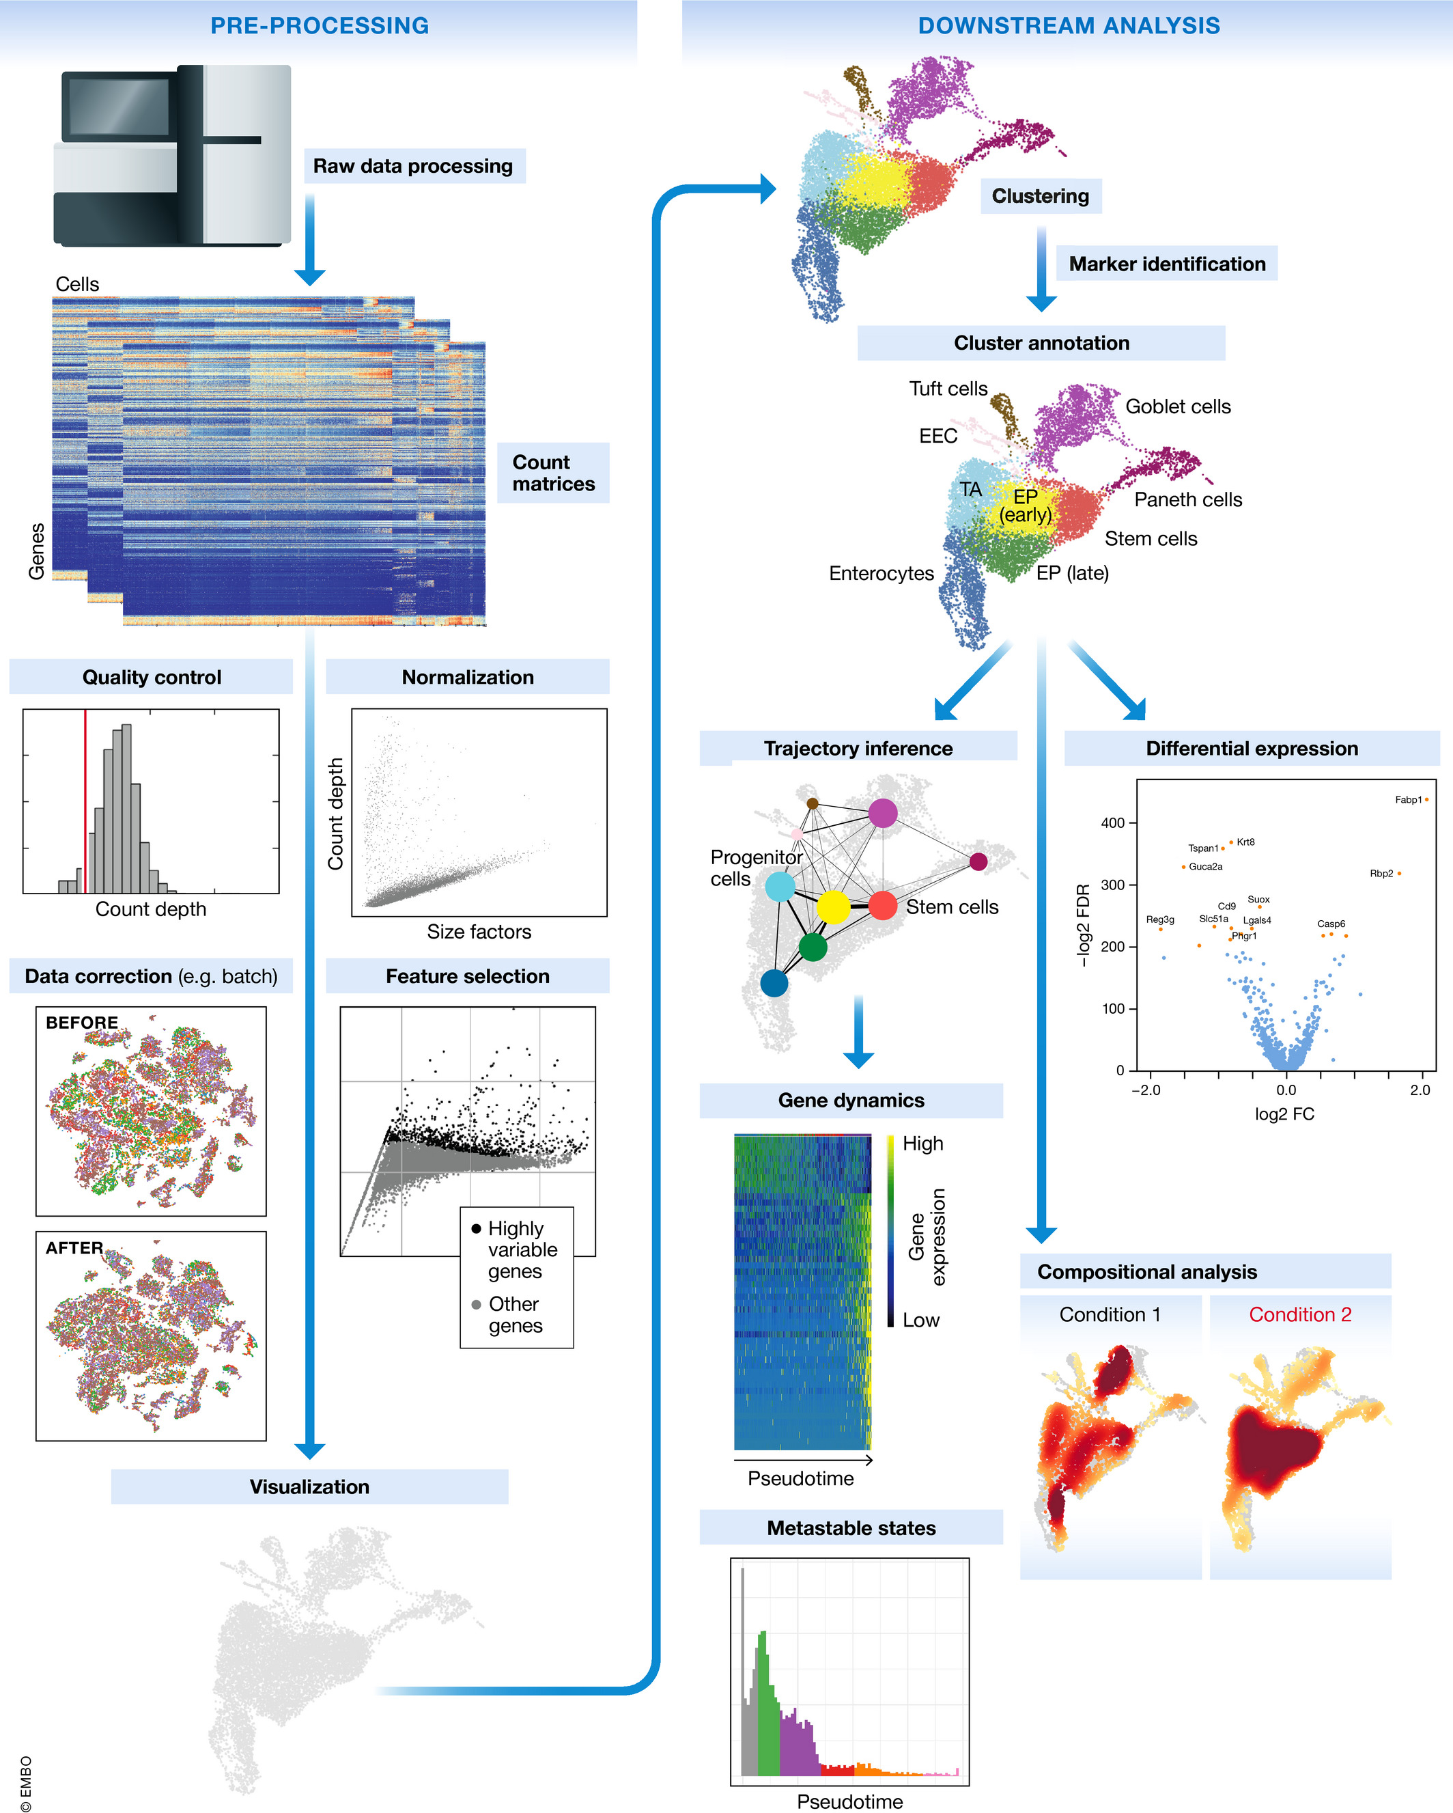
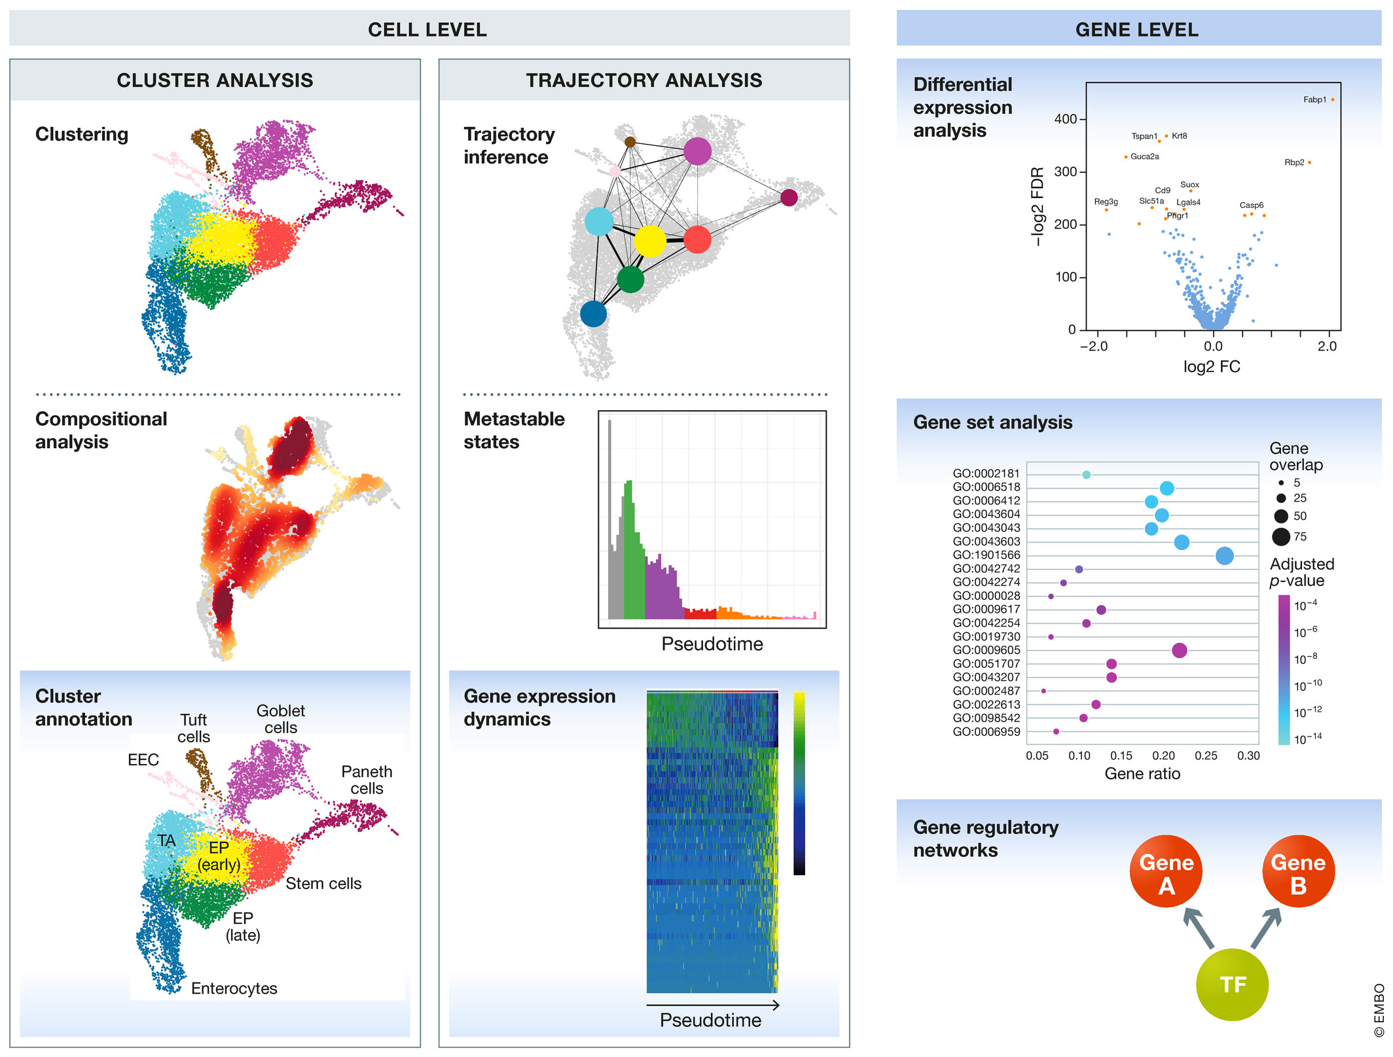

scRNA-seq analysis
Cell-level analysis
Marker gene identification
Cluster analysis
Trajectory analysis
Gene-level analysis
Single-cell differential expression analysis
Gene set analysis
Gene regulatory networks
Python for scRNA-seq data analysis
Luecken, MD and Theis, FJ. Current best practices in single‐cell RNA‐seq analysis: a tutorial, Mol Syst Biol 2019 (doi: https://doi.org/10.15252/msb.20188746)

Slide 25
Single-cell RNA sequencing analysis
Introduction of single cell analysis
Dimensionality reduction
  Linear: PCA
  Non-linear: t-SNE, UMAP
Cell clustering
  K-means
  hierarchical clustering
  graph-based clustering

Slide 26
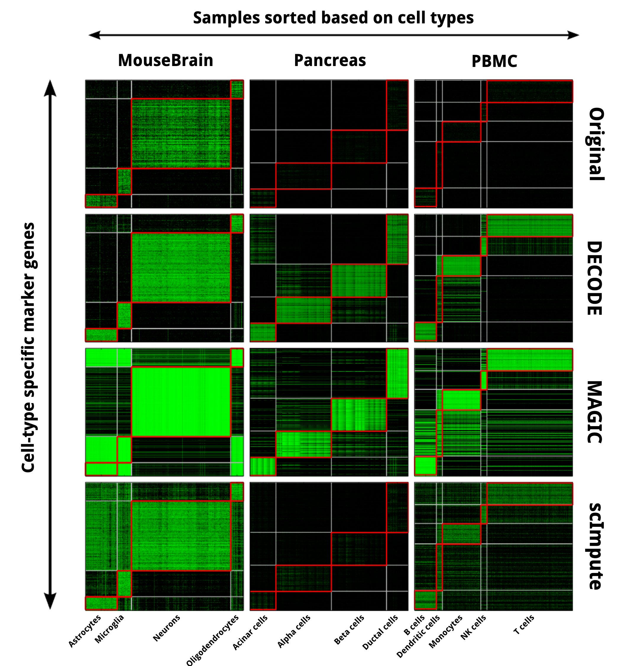
Dimensionality Reduction
Dimensionality reduction announces that cells could cluster together into groups.
https://doi.org/10.3389/fgene.2021.646936
https://www.biorxiv.org/content/10.1101/241646v1.full
Luecken, MD and Theis, FJ. Current best practices in single‐cell RNA‐seq analysis: a tutorial, Mol Syst Biol 2019 (doi: https://doi.org/10.15252/msb.20188746)

Slide 27
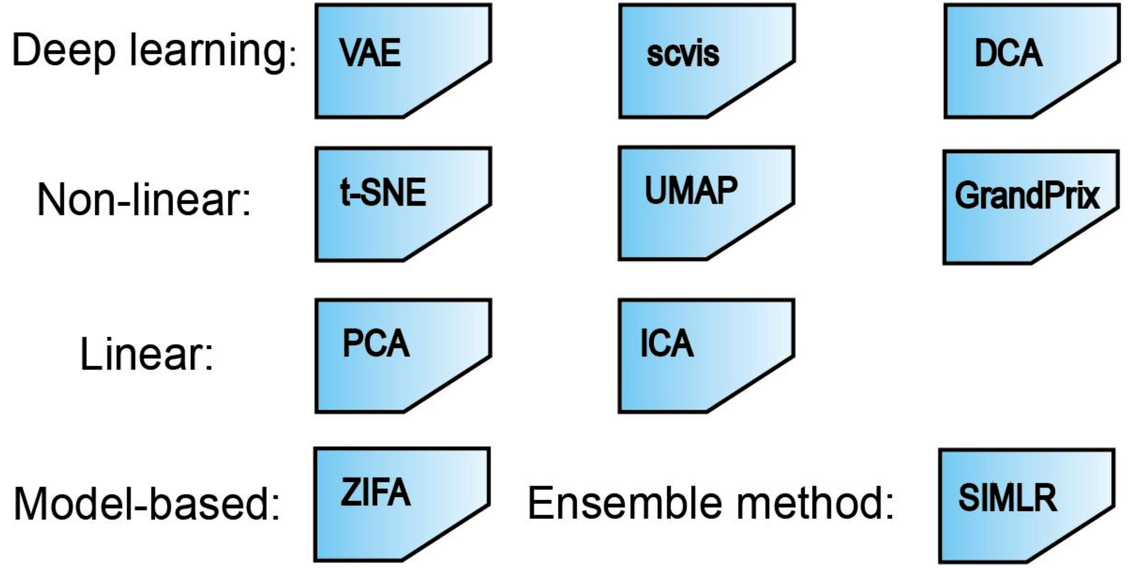
Dimensionality Reduction
Reduce noise, sparsity
Easier for visualization and processing
Linear methods:
  PCA (principal component analysis)
Non-linear methods:
  t-SNE
  UMAP
https://doi.org/10.3389/fgene.2021.646936
https://www.biorxiv.org/content/10.1101/241646v1.full

Slide 28
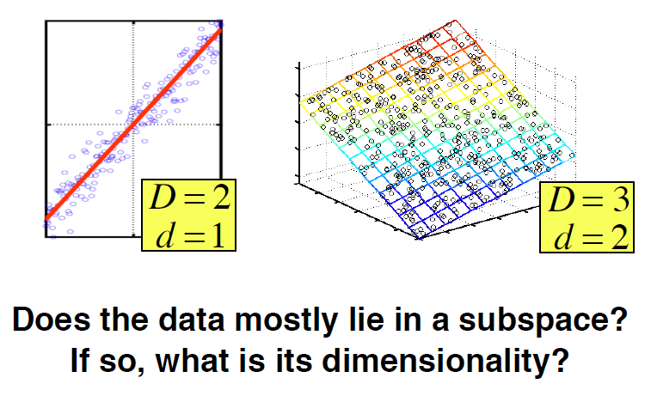
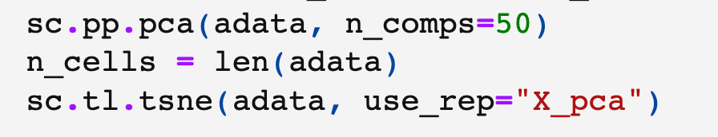
PCA
Principal component analysis
It is a linear algebraic method of dimensionality reduction
Any matrix can be decomposed as a multiplication of other matrices
PC1 represents the most of variance for the data, then PC2, PC3
2nd PC
1st PC
Reduce D genes to d PCs of cells, where d<<D
https://github.com/NBISweden/excelerate-scRNAseq

Slide 29
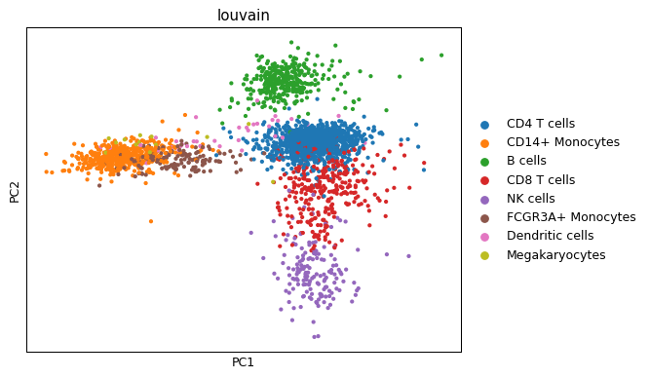
PCA of Peripheral Blood Mononuclear Cells (PBMC)

Slide 30
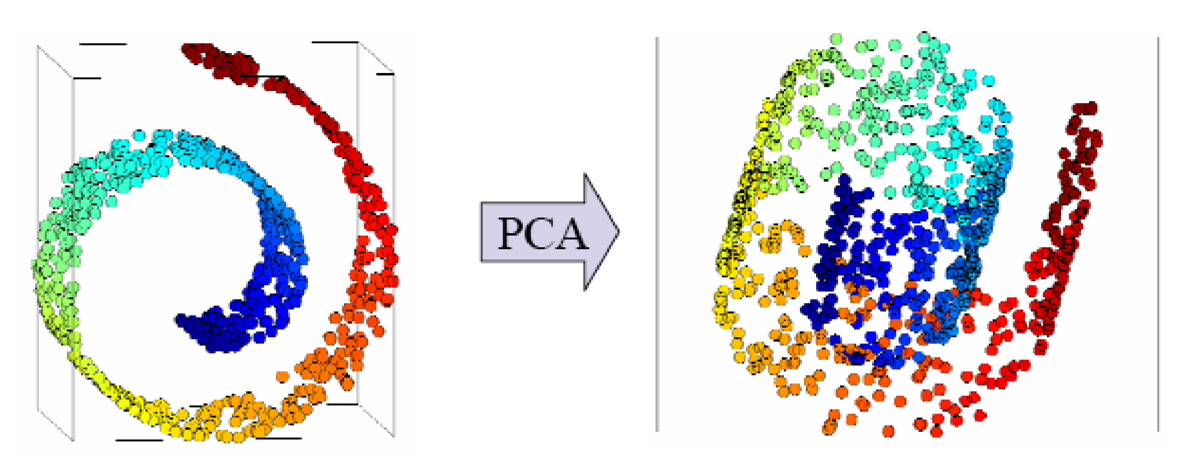
Limitation of PCA
PCs represent linear combination of individual features (e.g., genes)
PCA fails to find non-linear structure in the data
High dimensions
Low dimensions
https://www.cs.cmu.edu/~bapoczos/Classes/ML10715_2015Fall/slides/ManifoldLearning.pdf

Slide 31
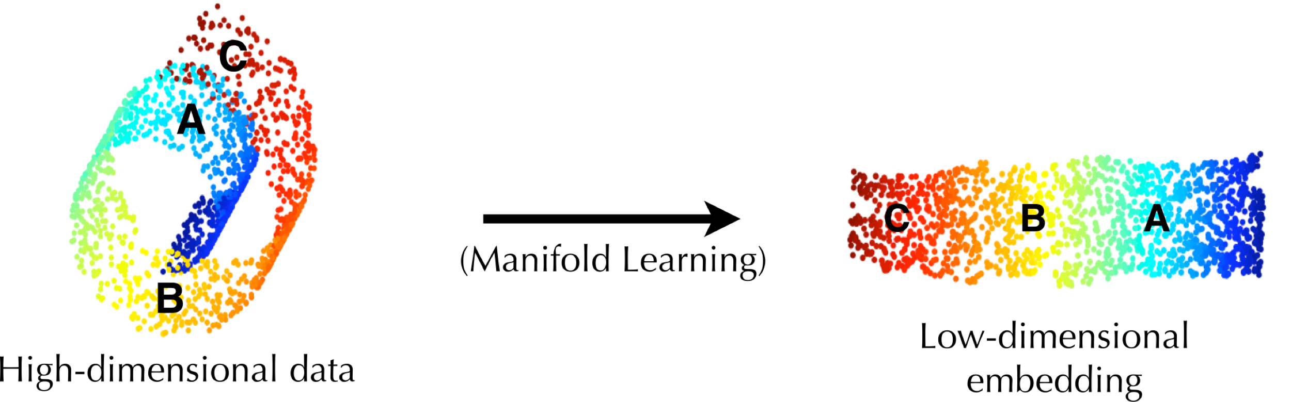

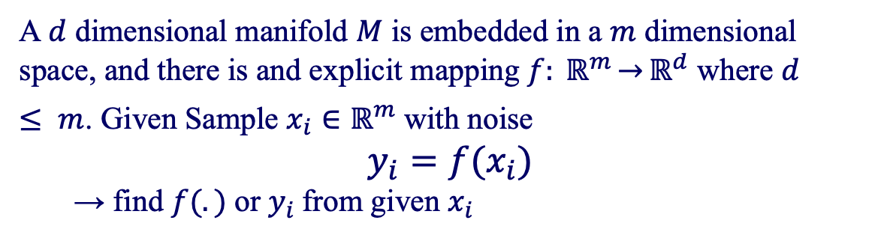


Manifold learning
A manifold is a topological space that locally resembles Euclidean space near each point
$$f(.)$$
$$x_{A}$$
$$y_{A}$$
A $d$ dimensional manifold $M$ is embedded in a $m$ dimensional space, and there is and explicit mapping $f: ℝ^{m}\overset{→}{}ℝ^{d}$ where $d ≤ m$. Given Sample $x_{i}∈ℝ^{m}$ with noise
$y_{i}=f(x_{i})$
→ find $f(.)$ or $y_{i}$from given $x_{i}$
Parametric & generalizable (e.g., linear manifold learning)
Nonparametric & nongeneralizable (e.g., nonlinear manifold learning)
31

Slide 32
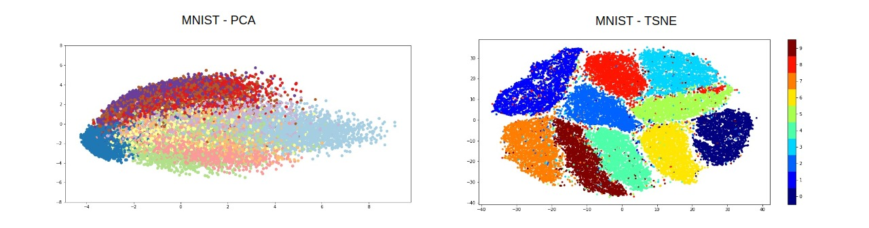
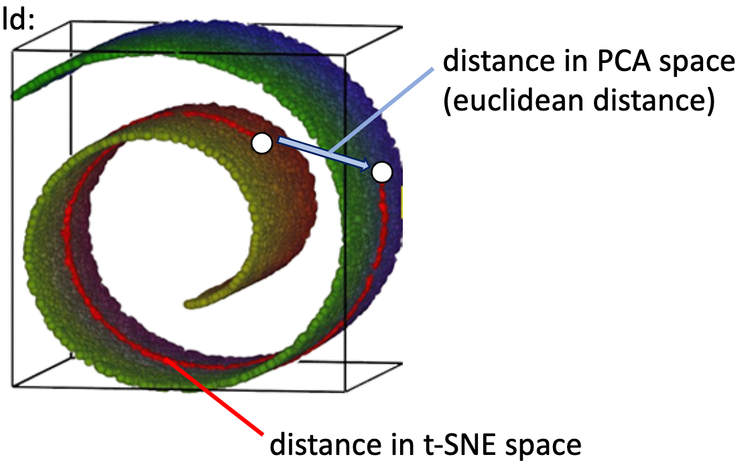
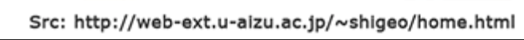
t-SNE t-Stochastic Neighbor Embedding
t-SNE is a manifold embedding algorithm for nonlinear dimensionality reduction (”keep manifold structures on low dimension space”)
L.J.P. van der Maaten and G.E. Hinton. Visualizing High-Dimensional Data Using t-SNE. JMLR2008
https://nbviewer.org/github/YeoLab/single-cell-bioinformatics/tree/master/
https://mit6874.github.io/assets/sp2020/slides/L11_PCA_tSNE_Autoencoders.pdf

Slide 33






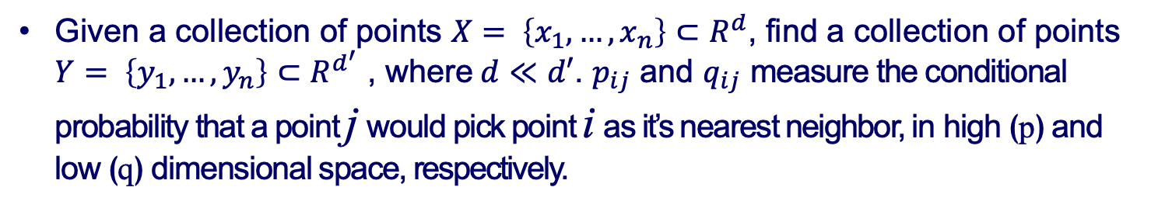




t-SNE
Given a collection of points $X= \left\{x_{1},…,x_{n}\right\}⊂R^{d}$, find a collection of points $Y= \left\{y_{1},…,y_{n}\right\}⊂R^{d^{′}}$ , where$d≪d′$. $p_{ij}$ and $q_{ij}$ measure the conditional probability that a point j would pick point i as it’s nearest neighbor, in high (p) and low (q) dimensional space, respectively.
High dimension
Low dimension
i
i
${=p}_{ij}$
${=q}_{ij}$
j
j
$x_{i}$
$x_{j}$
$y_{i}$
$y_{j}$
We want to learn
L.J.P. van der Maaten and G.E. Hinton. Visualizing High-Dimensional Data Using t-SNE. JMLR2008

Slide 34
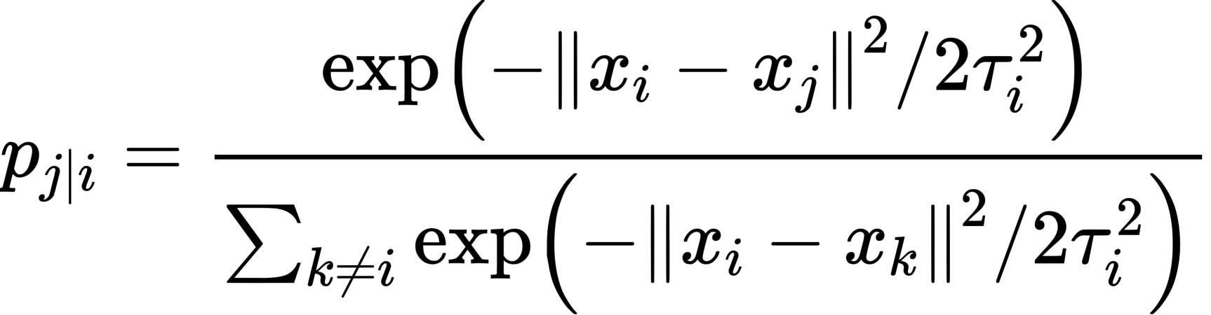
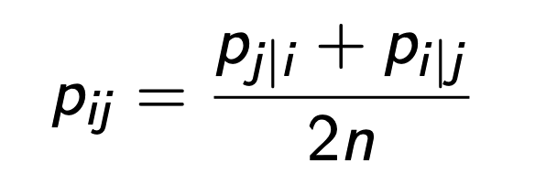
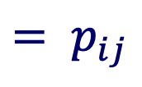
Similarity matrix at high dimension
High dimension
i
$$= p_{ij}$$
j
where τ_{i}² is the variance for the Gaussian distribution centered around x_{i}
L.J.P. van der Maaten and G.E. Hinton. Visualizing High-Dimensional Data Using t-SNE. JMLR2008

Slide 35
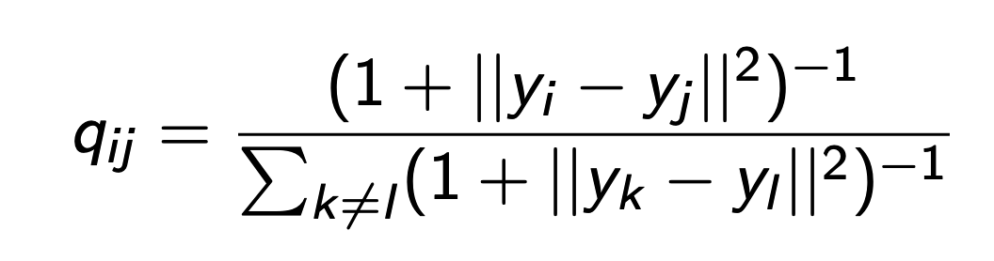
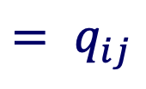
Similarity matrix at low dimension
Low dimension
i
$$= q_{ij}$$
j
L.J.P. van der Maaten and G.E. Hinton. Visualizing High-Dimensional Data Using t-SNE. JMLR2008

Slide 36
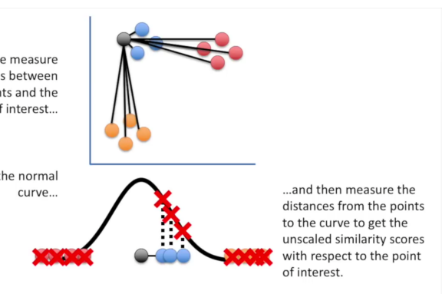
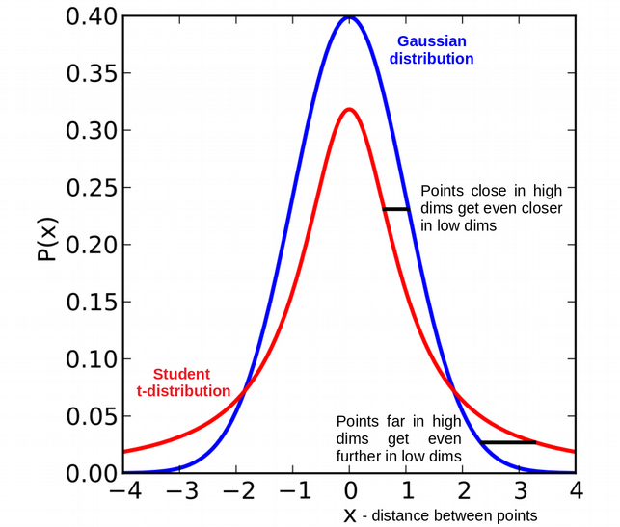

Why a Student-t distribution ?
$$∝$$
The student t-distribution with a single degree of freedom has heavier tails than the normal distribution.
Dissimilar points have to be modeled as far apart in the map to avoid overcrowding
Mapping of distances
Normal vs Student-T (Cauchy) Distribution
Measure distances
Plot the distances on the curve
Calculate the similarity scores
https://towardsdatascience.com/an-introduction-to-t-sne-with-python-example-5a3a293108d1
https://www.youtube.com/watch?v=NEaUSP4YerM
L.J.P. van der Maaten and G.E. Hinton. Visualizing High-Dimensional Data Using t-SNE. JMLR2008
https://towardsdatascience.com/how-exactly-umap-works-13e3040e1668

Slide 37
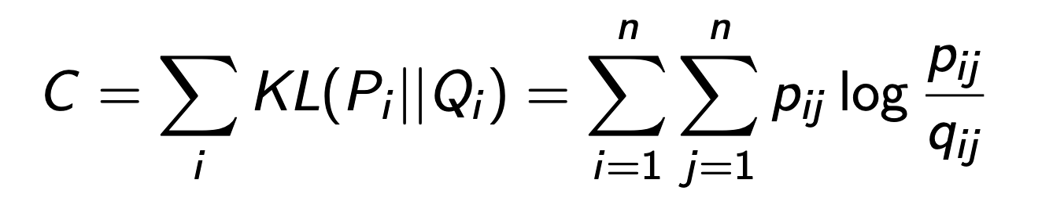
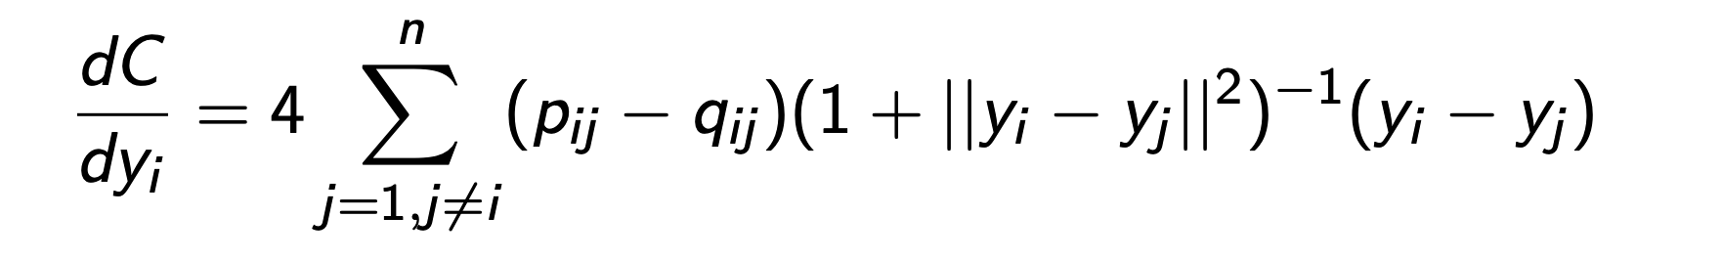

Cost Function
Kullback-Leibler divergence
Find optimal {y_{i}}: Minimize a single Kullback-Leibler divergence between a joint probability $P$, in the high-dimensional space and a joint probability $Q$, in the low-dimensional space.
The gradient is given by
The result of this optimization is a map that reflects the similarities between the high-dimensional inputs.
L.J.P. van der Maaten and G.E. Hinton. Visualizing High-Dimensional Data Using t-SNE. JMLR2008

Slide 38

Summary of t-SNE
t-SNE minimizes the divergence between two similarity distributions:
  pairwise similarities of the input data points on the high dimensional space {p_{ij}}
  pairwise similarities of the corresponding low-dimensional points {q_{ij}}
Main steps for t-SNE
Construct a similarity matrix over pairs of high-dimensional points
  Similar data points are assigned a higher probability, while dissimilar points are assigned a lower probability.
Define a similarity matrix in the low-dimensional embedding space
Minimize the $KL$ divergence between two similarity distributions using gradient descent to find optimal low dimensional coordinates of data points
L.J.P. van der Maaten and G.E. Hinton. Visualizing High-Dimensional Data Using t-SNE. JMLR2008

Slide 39

Limitation of t-SNE
t-SNE mainly preserves local similarity structure of data, not global similarity.
Only within cluster distances are meaningful while between cluster similarities are not guaranteed.
https://towardsdatascience.com/how-exactly-umap-works-13e3040e1668

Slide 40

UMAP
Uniform Manifold Approximation and Projection
Instead of randomly assigning points as in t-SNE, UMAP constructs a high dimensional graph representation of the data and then optimizes a low-dimensional graph to be as structurally similar as possible
UMAP could preserve both global and local data structures
UMAP on MNIST dataset
t-SNE on MNIST dataset
https://www.youtube.com/watch?v=nq6iPZVUxZU
https://nbisweden.github.io/excelerate-scRNAseq/session-dim-reduction/lecture_dimensionality_reduction.pdf
https://umap-learn.readthedocs.io/en/latest/how_umap_works.html
https://pair-code.github.io/understanding-umap/

Slide 41
Main steps for UMAP
Construct a weighted k nearest neighbors graph for defining a similarity matrix in high-dimensional space
  The edge weights represent the likelihood that two data points are connected (i.e., “similarity”)
Define a similarity matrix in low-dimensional space
Minimize the cross-entropy cost function at each point using gradient descent to find the most similar graph in lower dimensions
L.J.P. van der Maaten and G.E. Hinton. Visualizing High-Dimensional Data Using t-SNE. JMLR2008
https://pair-code.github.io/understanding-umap/supplement.html

Slide 42



Similarity matrix at high dimension
$ρ_{i}$, the distance from x_{i} to the k nearest neighbors in high dimension (e.g., kNN graph)
UMAP uses an exponential probability distribution in high dimension
Raw distance
Distance to nearest neighbor
$$p_{j|i}= e^{− \frac{d\left(x_{i}, x_{j}\right)− ρ_{i}}{σ_{i}}}$$
The symmetrization of high dimension similarity score and the definition of number of nearest neighbors
https://towardsdatascience.com/how-exactly-umap-works-13e3040e1668
arXiv:1802.03426

Slide 43




Similarity matrix at high dimension
For each data point, it has a locally adaptive exponential kernel, so the distance metric varies from point to point.
Raw distance
Distance to nearest neighbor
$$p_{j|i}= e^{− \frac{d\left(x_{i}, x_{j}\right)− ρ_{i}}{σ_{i}}}$$
Graph
https://towardsdatascience.com/how-exactly-umap-works-13e3040e1668
arXiv:1802.03426
https://www.youtube.com/watch?v=jth4kEvJ3P8

Slide 44




Cost Function
binary cross-entropy (CE)
Similarity matrix at low dimension
the family of curves $1/a×y^{2b}$ for modelling distance probabilities in low dimensions, $a$ and $b$ are hyperparameters
Cross-entropy cost function makes UMAP to capture the global and local data structures
The gradient of the CE to find optimal {y_{i}}
arXiv:1802.03426
https://towardsdatascience.com/how-exactly-umap-works-13e3040e1668

Slide 45

UMAP examples
https://scanpy-tutorials.readthedocs.io/en/latest/pbmc3k.html

Slide 46
Single-cell RNA sequencing analysis
Introduction of single cell analysis
Dimensional reduction
  Non-linear: t-SNE, UMAP
  Linear: PCA
Cell clustering
  K-means
  hierarchical clustering
  graph-based clustering

Slide 47

Cell clustering
Feature selection and dimensionality reduction extract the most informative genes and represented features from background noise, respectively
Cell–cell distances are then calculated in the low dimensional space for clustering cells to clusters
Kiselev, V.Y., Andrews, T.S. & Hemberg, M. Challenges in unsupervised clustering of single-cell RNA-seq data. Nat Rev Genet 20, 273–282 (2019). https://doi.org/10.1038/s41576-018-0088-9

Slide 48

Clustering methods for scRNA-seq
Clustering methods:
K-means
hierarchical clustering
graph-based clustering
Tools for graph-based clustering:
Seurat: Louvain, Leiden, SLM
igraph:fast greedy, Louvain, optimal, walktrap, spinglass, infomap
Kiselev, V.Y., Andrews, T.S. & Hemberg, M. Challenges in unsupervised clustering of single-cell RNA-seq data. Nat Rev Genet 20, 273–282 (2019). https://doi.org/10.1038/s41576-018-0088-9
Notes:
Add a check

Slide 49

Graph-based clustering
One of most popular clustering algorithms in scRNA-seq data analysis
Node -> cell
Edge -> similarity between two cells
    Louvain community detection: (Blondel et al. 2008)
    Leiden community detection: (Traag, Waltman, and Eck 2019)
Freytag, Saskia, Luyi Tian, Ingrid Lönnstedt, Milica Ng, and Melanie Bahlo. 2018. “Comparison of Clustering Tools in R for Medium-Sized 10x Genomics Single-Cell Rna-Sequencing Data.” F1000Research 7. Faculty of 1000 Ltd.
Wasserman, S. & Faust, K. (1994) Social Network Analysis (Cambridge Univ. Press, Cambridge, U.K.).
https://biocellgen-public.svi.edu.au/mig_2019_scrnaseq-workshop/public/clustering-and-cell-annotation.html#ref-freytag2018comparison

Slide 50

Modularity
low
high
Brede, Europhysics Letters, 2010.
Modularity Q: measurement on strength of network division
sum over nodes within a group (module)
normalization
m: total number of edges
edge weight between nodes i and j
=expected edge weight that would go between i and j
Clustering goal: assign each node a module
to maximize “modularity” as an objective function
(module is a group of highly connected nodes)
Newman, PNAS, 2006.

Slide 51


Louvain community detection
Start with every node in its own community (i.e., module/cluster)
Step1: Modularity optimization
  Order the nodes and for each node $i$, move $i$ to the community of neighbor $j$ that leads to maximum $∆Q$
  If all $∆Q<0$ the $i$ remains in its current community
  Repeatedly cycle through all nodes until $∆Q=0$
Step2 : Community aggregation
  Create a weighted network of communities from Step1
  Nodes : communities in Step1
  Edge weights : sum of weights of edges between communities
  Edges within a community become two self-loops
Repeat: Apply Step1 & Step2 to resulting network, and so on until $∆Q=0$
https://biocellgen-public.svi.edu.au/mig_2019_scrnaseq-workshop/public/clustering-and-cell-annotation.html#ref-freytag2018comparison
https://www.youtube.com/watch?v=QNv7rKWCgM8

Slide 52

Examples of Louvain clustering
Belgian mobile phone network
2M nodes
Red nodes:
French speakers
Green nodes:
Dutch speakers
Blondel et al.2008

Slide 53


Examples of Louvain clustering
The Louvain algorithm clusters millions of cell with reasonable computational complexity.
Luecken MD, Theis FJ (2019) Current best practices in single-cell RNA-seq analysis: a tutorial. Mol Syst Biol 15:e8746
Han X, Zhou Z, Fei L, Sun H, Wang R, Chen Y, Zhou Y (2020) Construction of a human cell landscape at single-cell level. Nature 581:303–309. https://doi.org/10.1038/s41586-020-2157-4
Seow, J.J.W., Wong, R.M.M., Pai, R. et al. Single‐Cell RNA Sequencing for Precision Oncology: Current State-of-Art. J Indian Inst Sci 100, 579–588 (2020). https://doi.org/10.1007/s41745-020-00178-1

