Slide 1
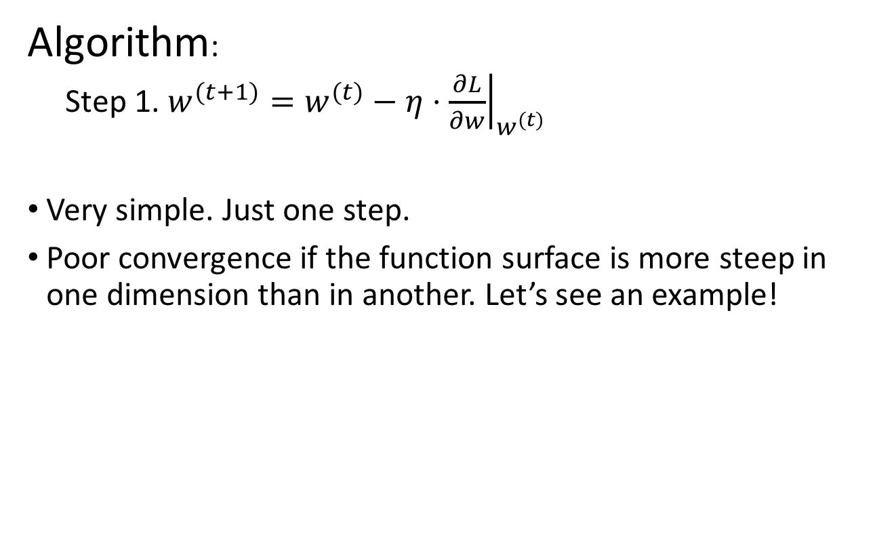
Steepest Descent
Algorithm:
  Step 1. $w^{(t+1)}=w^{(t)}−η⋅{\left.\frac{∂L}{∂w}\right|}_{w^{(t)}}$
Very simple. Just one step.
Poor convergence if the function surface is more steep in one dimension than in another. Let’s see an example!

Slide 2
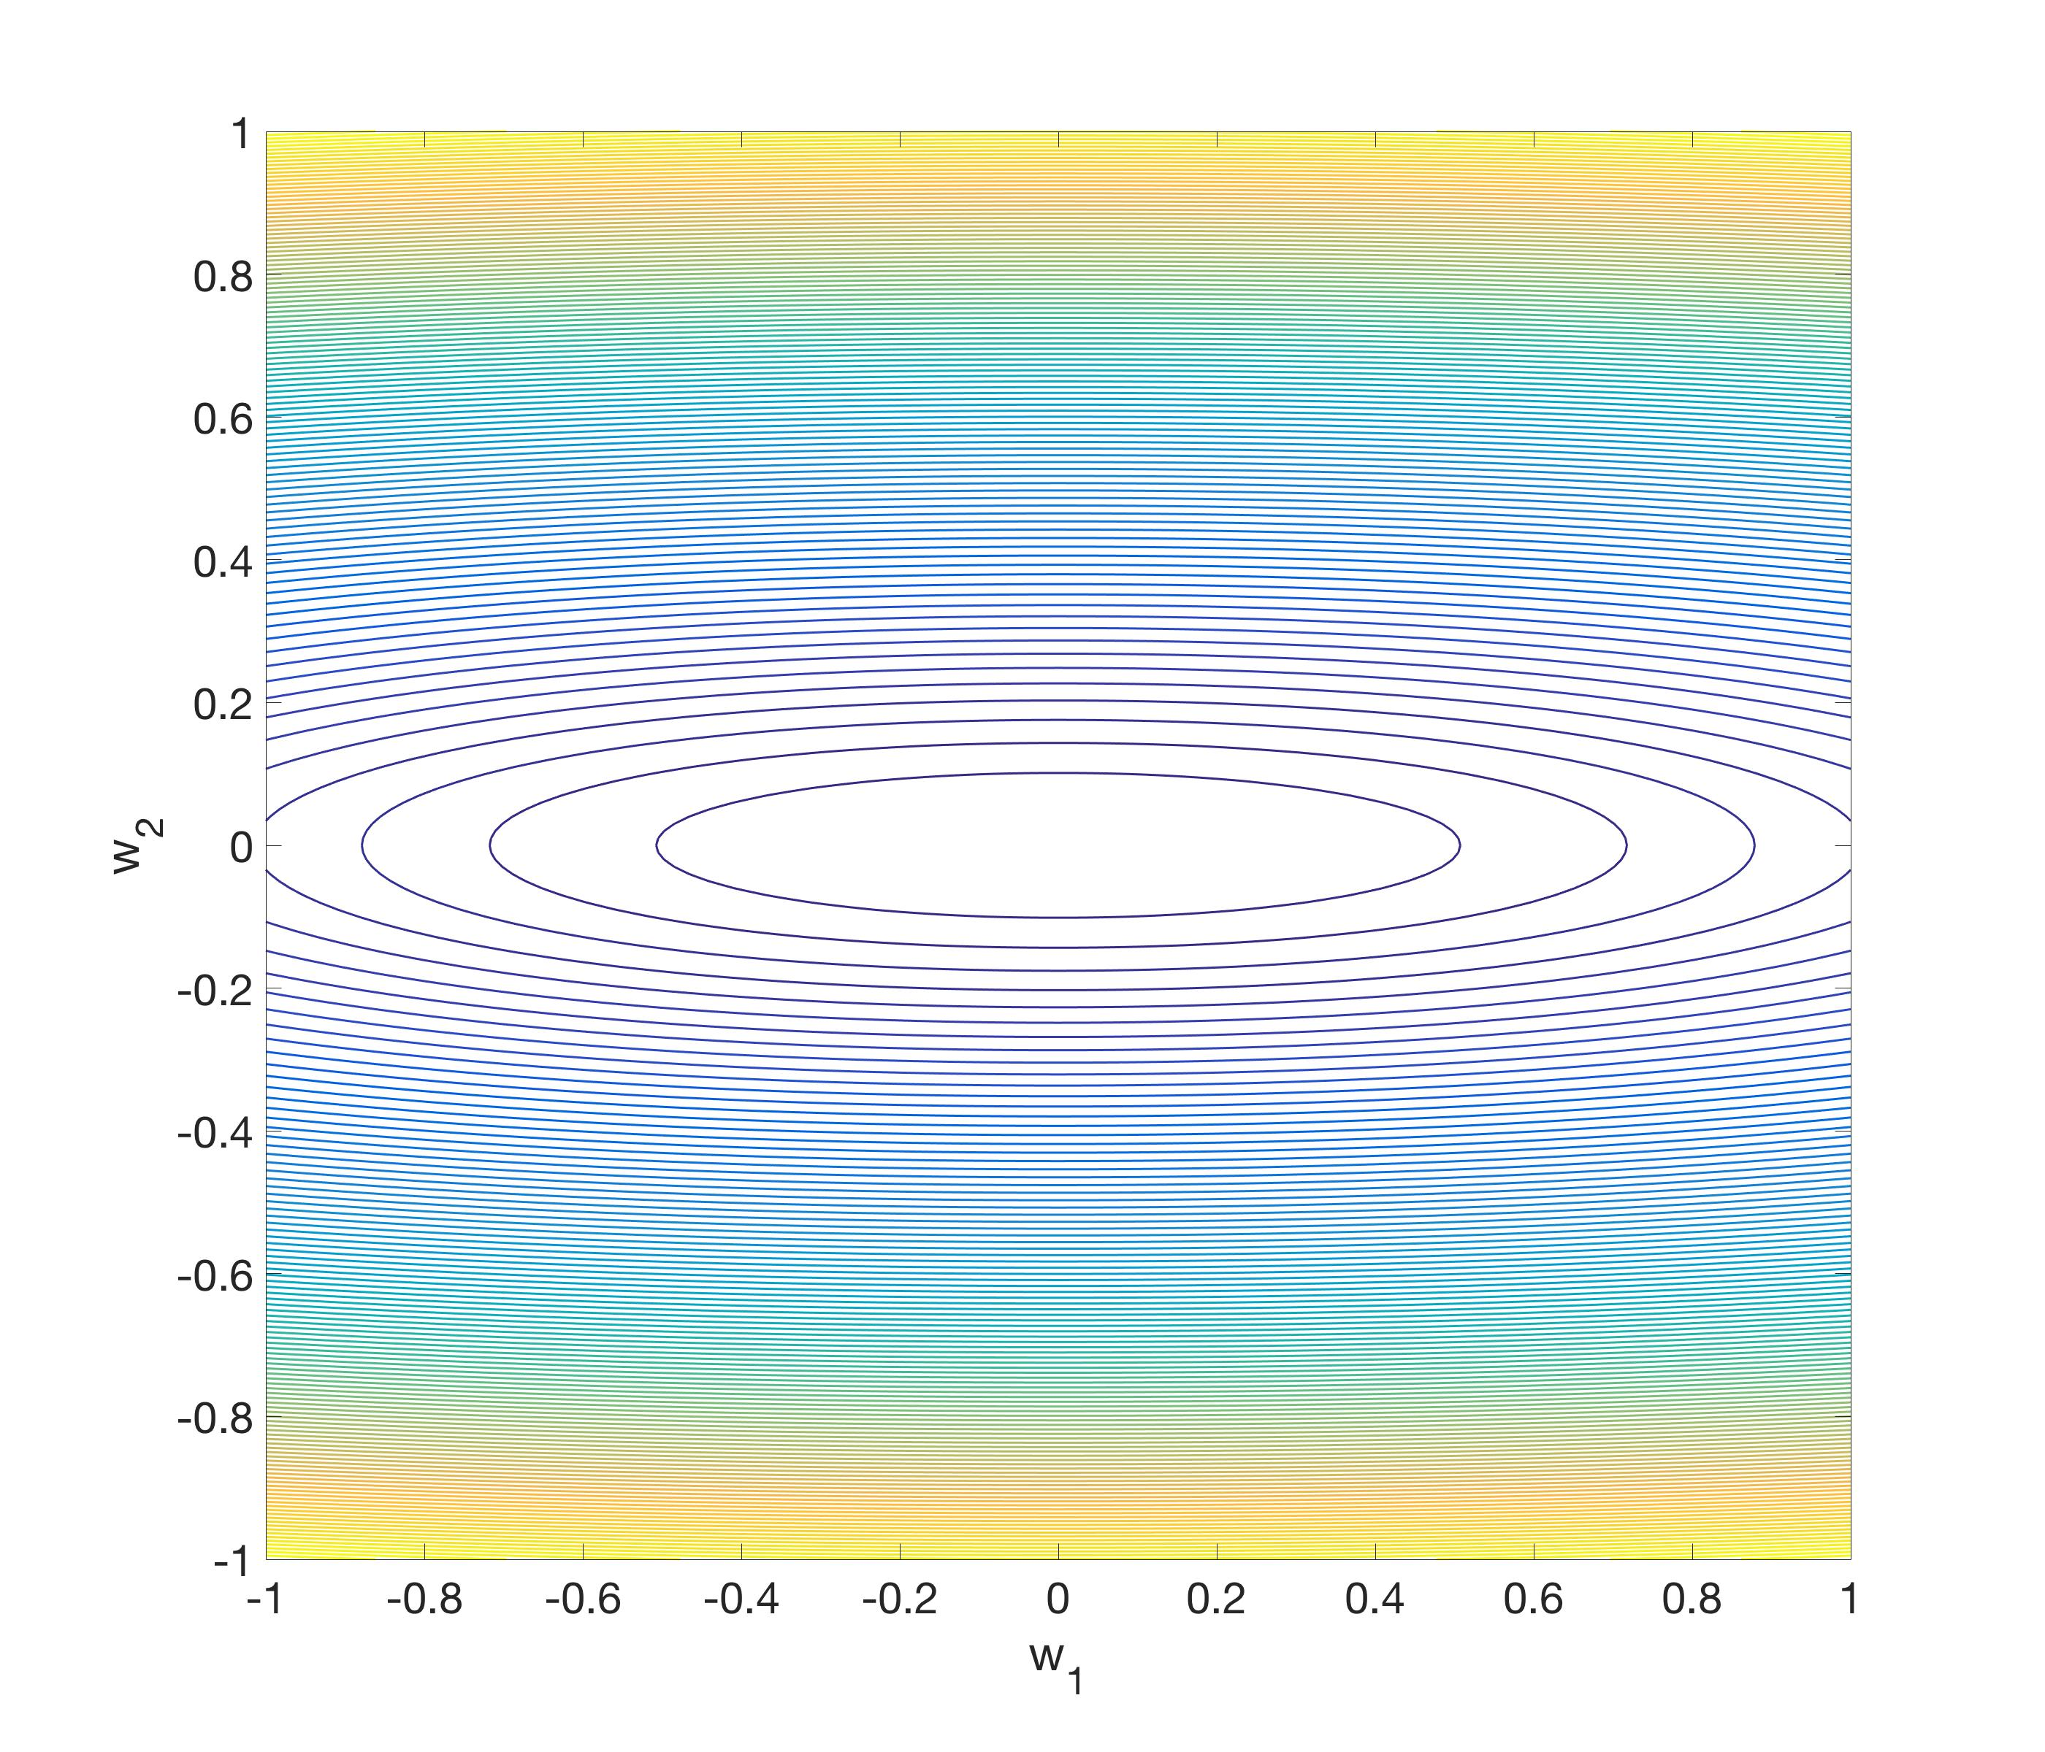
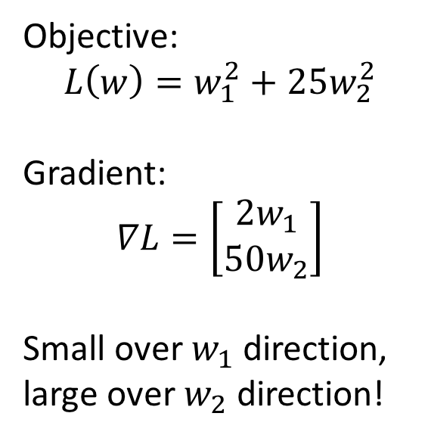


Steepest Descent
Objective:
$$L\left(w\right)=w_{1}^{2}+25w_{2}^{2}$$
Gradient:
$$∇L=\left[\begin{matrix}2w_{1} \\ 50w_{2}\end{matrix}\right]$$
Small over $w_{1}$ direction,
large over $w_{2}$ direction!
-$50w_{2}$
$$−2w_{1}$$

Slide 3
Steepest Descent
Zigzag behavior!
Move very slowly on the flat direction, oscillate on the steep direction.

Slide 4
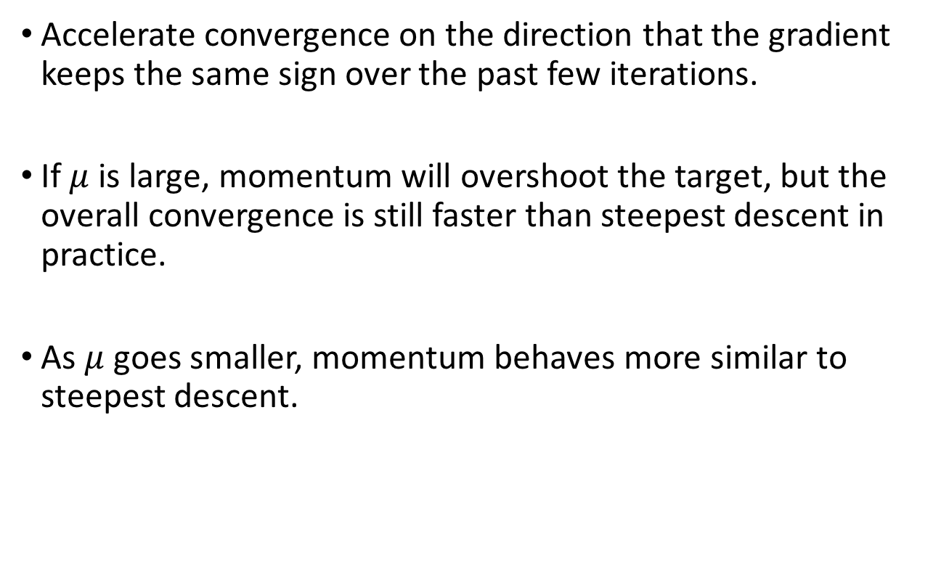
Momentum
Accelerate convergence on the direction that the gradient keeps the same sign over the past few iterations.
If $μ$ is large, momentum will overshoot the target, but the overall convergence is still faster than steepest descent in practice.
As $μ$ goes smaller, momentum behaves more similar to steepest descent.

Slide 5
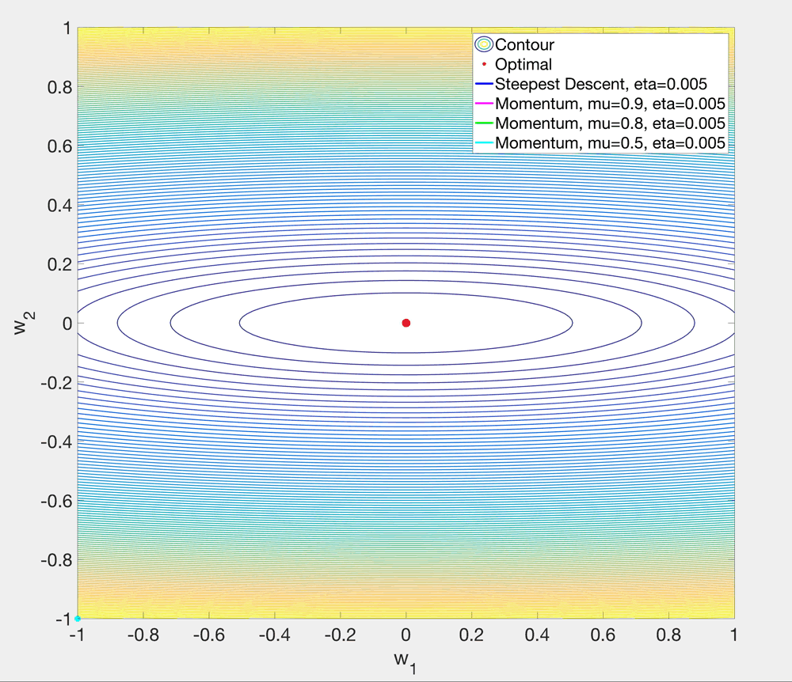

Slide 6
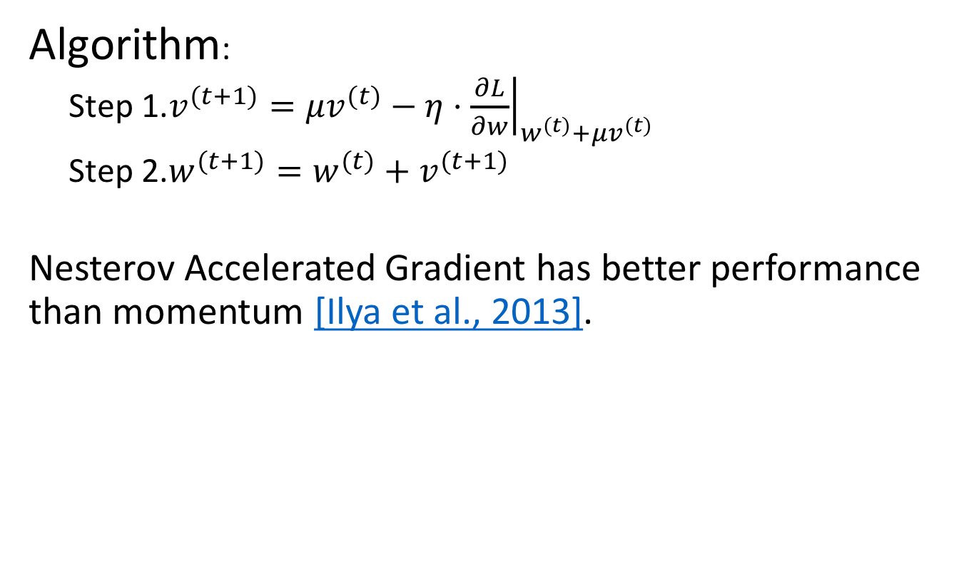
Nesterov Accelerated Gradient
Algorithm:
  Step 1.$v^{(t+1)}=μv^{(t)}−η⋅{\left.\frac{∂L}{∂w}\right|}_{w^{(t)}+μv^{(t)}}$
  Step 2.$w^{(t+1)}=w^{(t)}+v^{(t+1)}$
Nesterov Accelerated Gradient has better performance than momentum [Ilya et al., 2013].

Slide 7
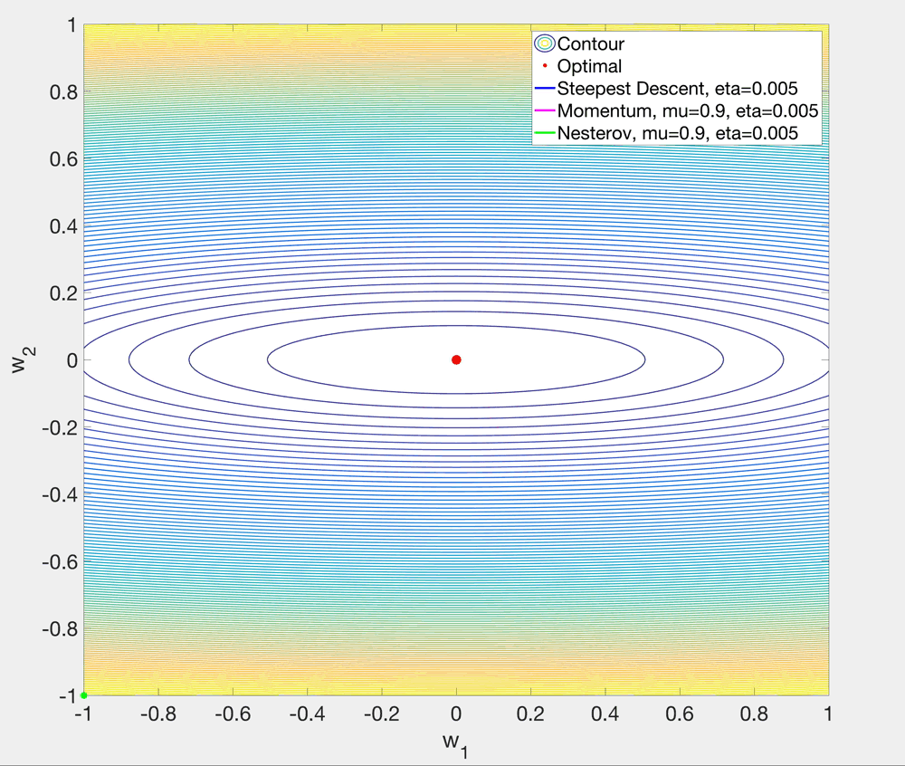

Slide 8
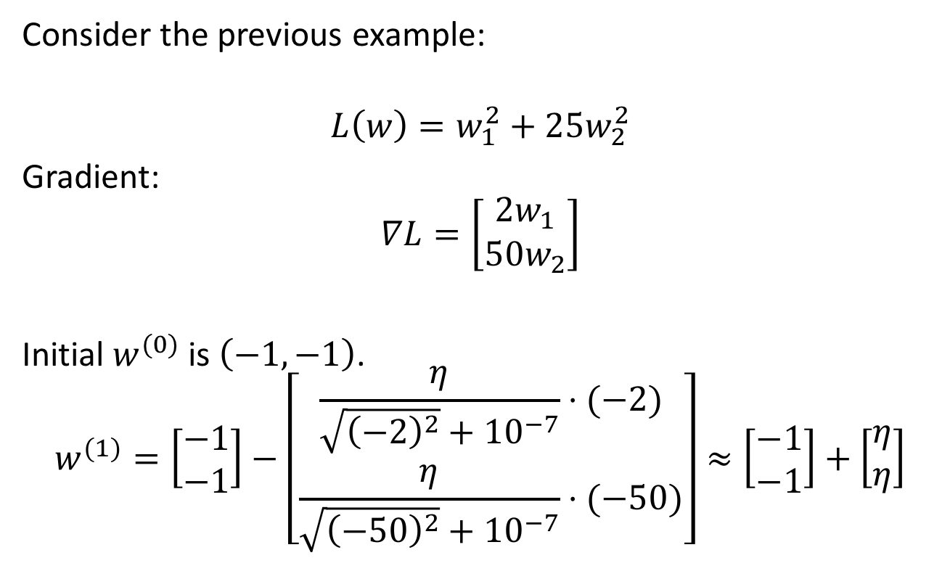
AdaGrad (Adaptive Gradient)
Consider the previous example:
$$L\left(w\right)=w_{1}^{2}+25w_{2}^{2}$$
Gradient:
$$∇L=\left[\begin{matrix}2w_{1} \\ 50w_{2}\end{matrix}\right]$$
Initial $w^{(0)}$ is $\left(−1,−1\right)$.
$$w^{(1)}=\left[\begin{matrix}−1 \\ −1\end{matrix}\right]−\left[\begin{matrix}\frac{η}{\sqrt{{\left(−2\right)}^{2}}+{10}^{−7}}⋅(−2) \\ \frac{η}{\sqrt{{\left(−50\right)}^{2}}+{10}^{−7}}⋅(−50)\end{matrix}\right]≈\left[\begin{matrix}−1 \\ −1\end{matrix}\right]+\left[\begin{matrix}η \\ η\end{matrix}\right]$$
Will follow the diagonal direction!

Slide 9
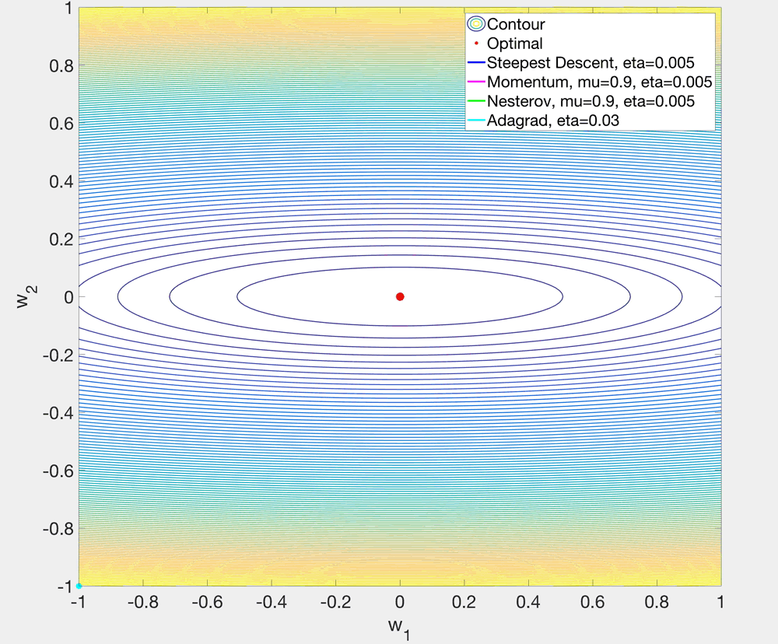

Slide 10
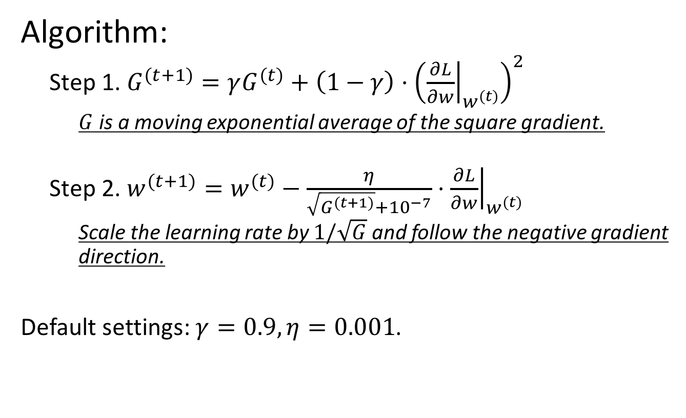
RMSProp (Root Mean Square Propagation)
Algorithm:
  Step 1. $G^{(t+1)}=γG^{(t)}+\left(1−γ\right)⋅{\left({\left.\frac{∂L}{∂w}\right|}_{w^{(t)}}\right)}^{2}$
    $G$ is a moving exponential average of the square gradient.
  Step 2. $w^{(t+1)}=w^{(t)}−\frac{η}{\sqrt{G^{(t+1)}}+{10}^{−7}}⋅{\left.\frac{∂L}{∂w}\right|}_{w^{(t)}}$
    Scale the learning rate by $1/\sqrt{G}$ and follow the negative gradient direction.
Default settings: $γ=0.9, η=0.001$.

Slide 11
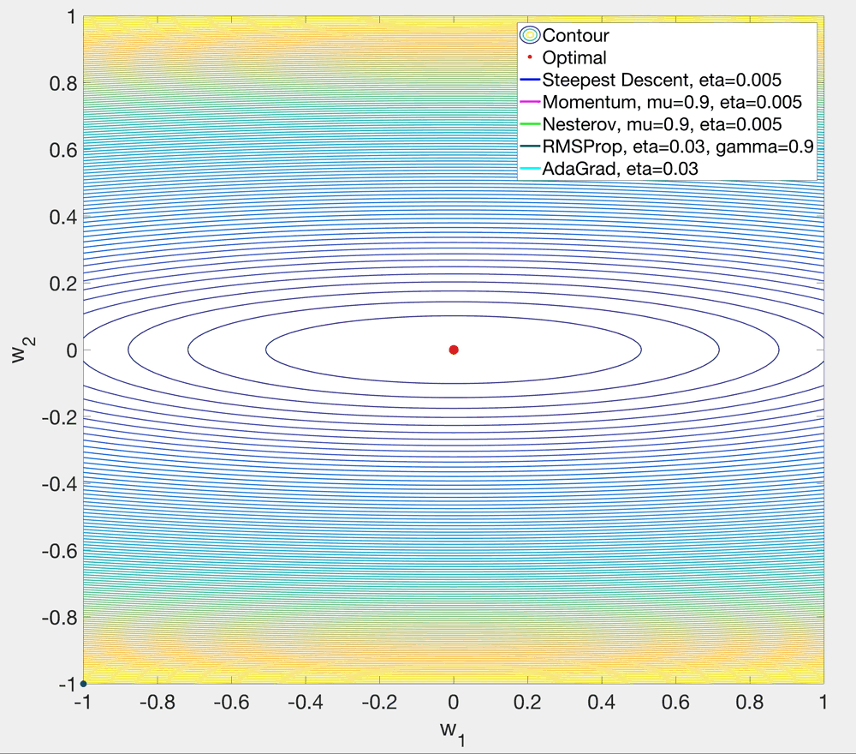

Slide 12
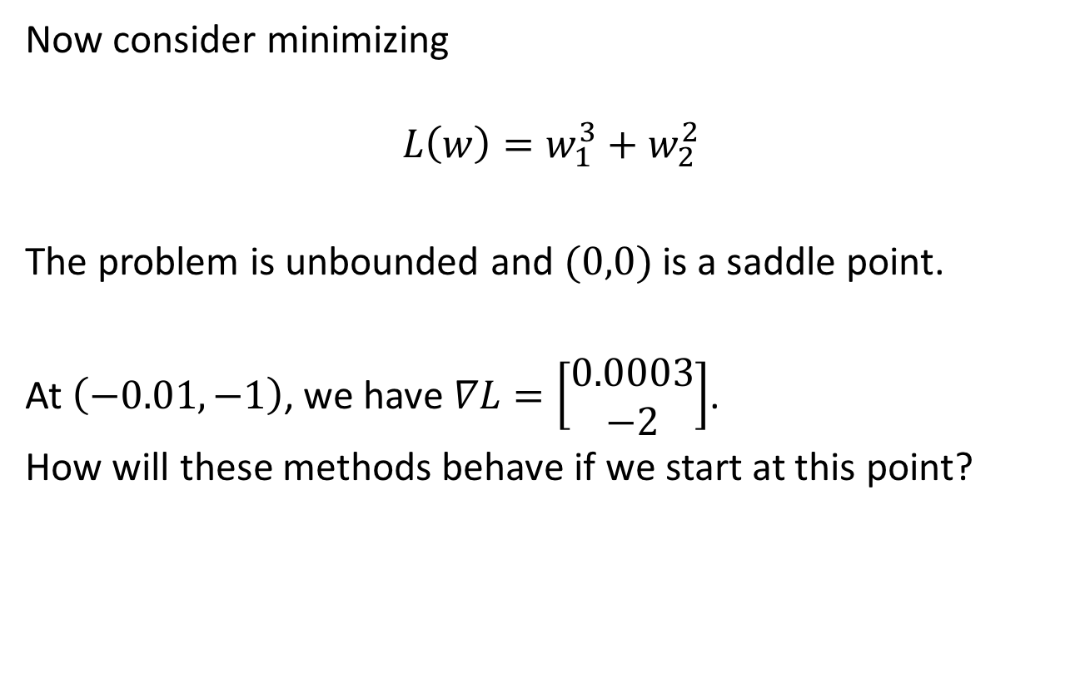
Another example (saddle point)
Now consider minimizing
$$L\left(w\right)=w_{1}^{3}+w_{2}^{2}$$
The problem is unbounded and $(0,0)$ is a saddle point.
At $\left(−0.01,−1\right)$, we have $∇L=\left[\begin{matrix}0.0003 \\ −2\end{matrix}\right]$.
How will these methods behave if we start at this point?

Slide 13
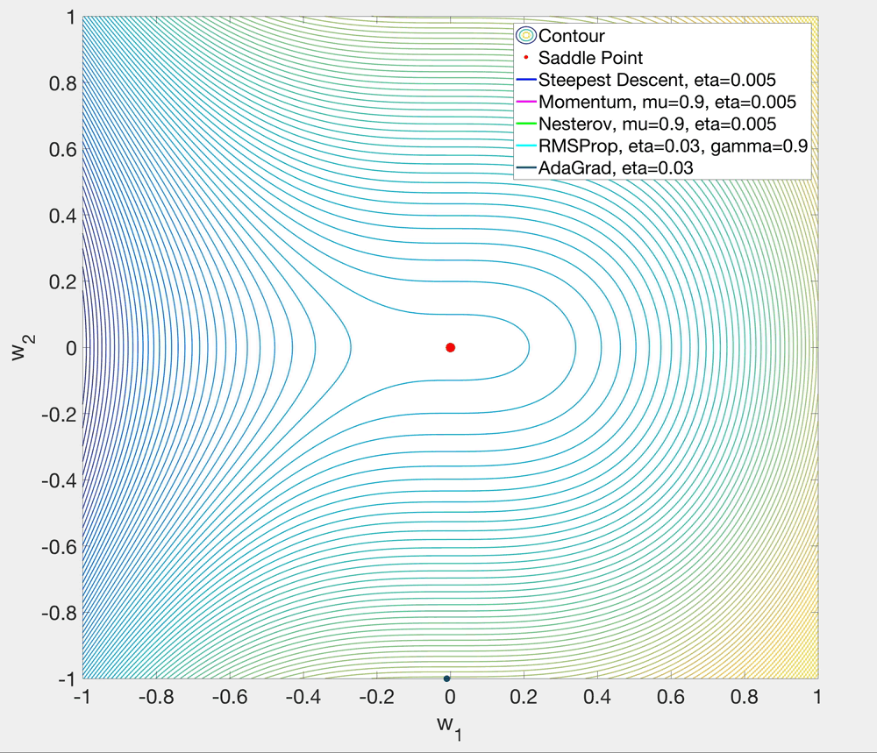

Slide 14
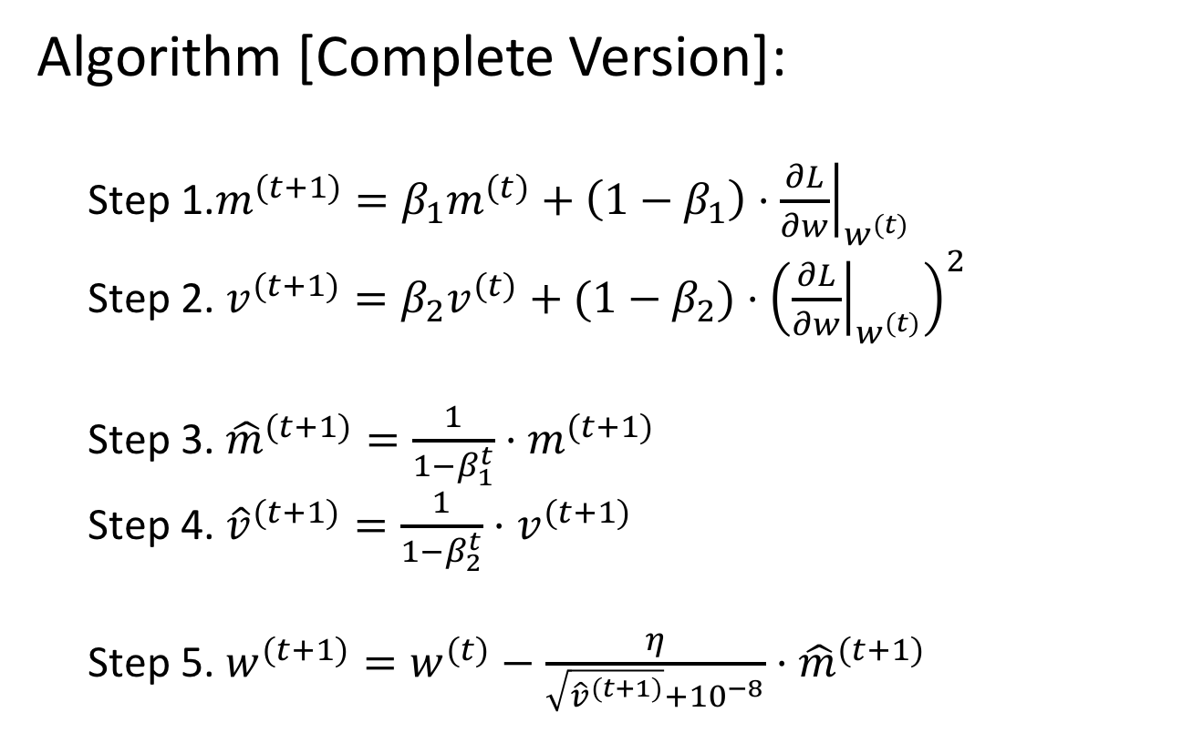
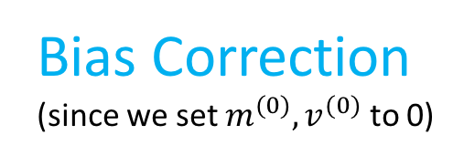
Adam (Adaptive Moment Estimation)
Algorithm [Complete Version]:
  Step 1.$m^{(t+1)}=β_{1}m^{(t)}+\left(1−β_{1}\right)⋅{\left.\frac{∂L}{∂w}\right|}_{w^{(t)}}$
  Step 2. $v^{(t+1)}=β_{2}v^{(t)}+(1−β_{2})$ $⋅{\left({\left.\frac{∂L}{∂w}\right|}_{w^{(t)}}\right)}^{2}$
  Step 3. ${\hat{m}}^{(t+1)}=\frac{1}{1−β_{1}^{t}}⋅m^{(t+1)}$
  Step 4. ${\hat{v}}^{(t+1)}=\frac{1}{1−β_{2}^{t}}⋅v^{(t+1)}$
  Step 5. $w^{(t+1)}=w^{(t)}−\frac{η}{\sqrt{{\hat{v}}^{(t+1)}}+{10}^{−8}}⋅{\hat{m}}^{(t+1)}$
Bias Correction (since we set $m^{(0)},v^{(0)}$ to 0)

Slide 15
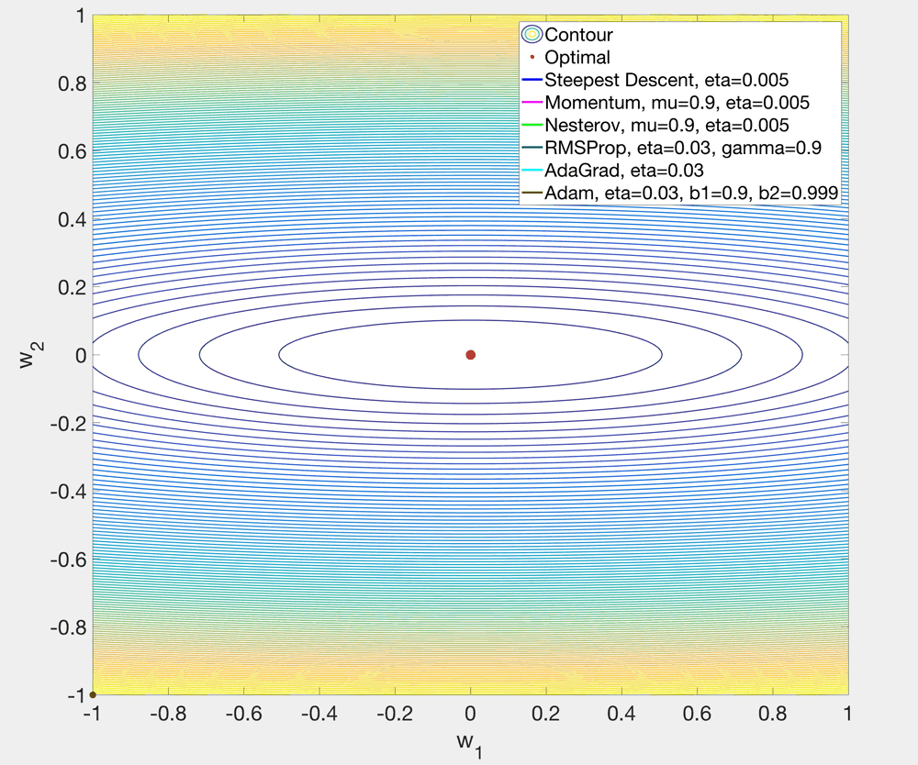

Slide 16
